Slide 1
SafeSign
Secure Digital Signature Scheme on Hardware Token Cluster
Yunzhou Yan, Riad Wahby

Slide 2
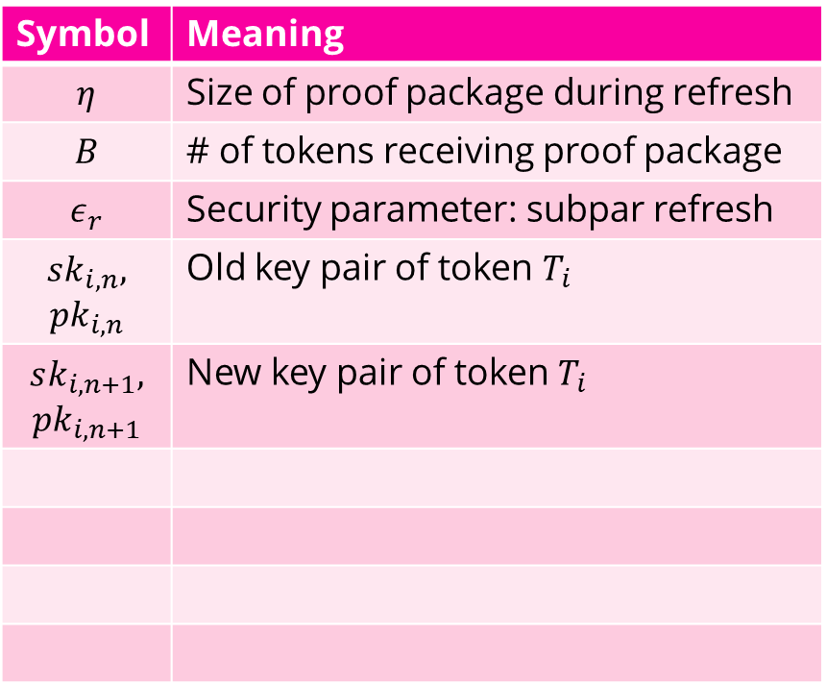
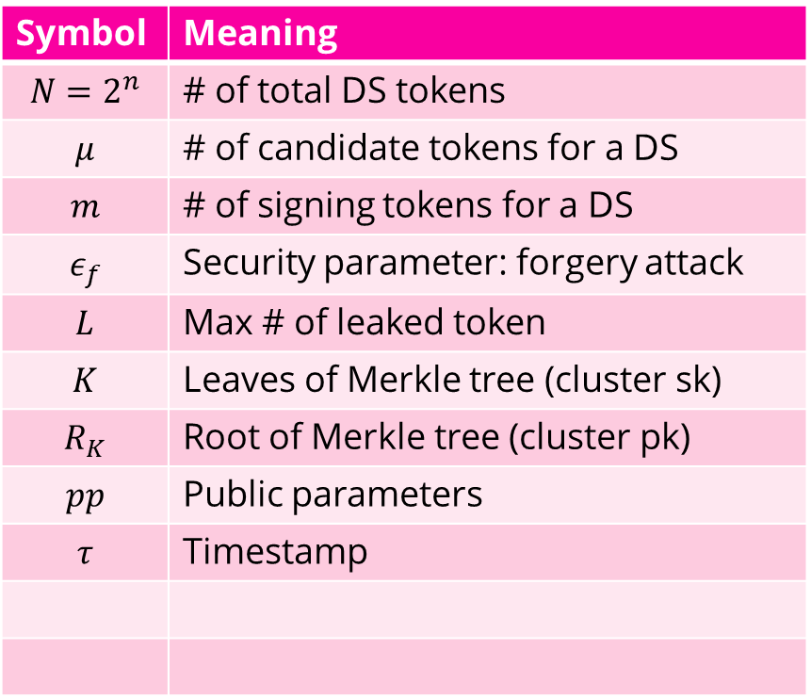
List of symbols
Symbol | Meaning
$$N=2^{n}$$ | # of total DS tokens
$$μ$$ | # of candidate tokens for a DS
$$m$$ | # of signing tokens for a DS
$$ε_{f}$$ | Security parameter: forgery attack
$$L$$ | Max # of leaked token
$$K$$ | Leaves of Merkle tree (cluster sk)
$$R_{K}$$ | Root of Merkle tree (cluster pk)
$$pp$$ | Public parameters
$$τ$$ | Timestamp
Symbol | Meaning
$$η$$ | Size of proof package during refresh
$$B$$ | # of tokens receiving proof package
$$ε_{r}$$ | Security parameter: subpar refresh
$$sk_{i,n},$$ $$pk_{i,n}$$ | Old key pair of token $T_{i}$
$$sk_{i,n+1},$$ $$pk_{i,n+1}$$ | New key pair of token $T_{i}$

Slide 3
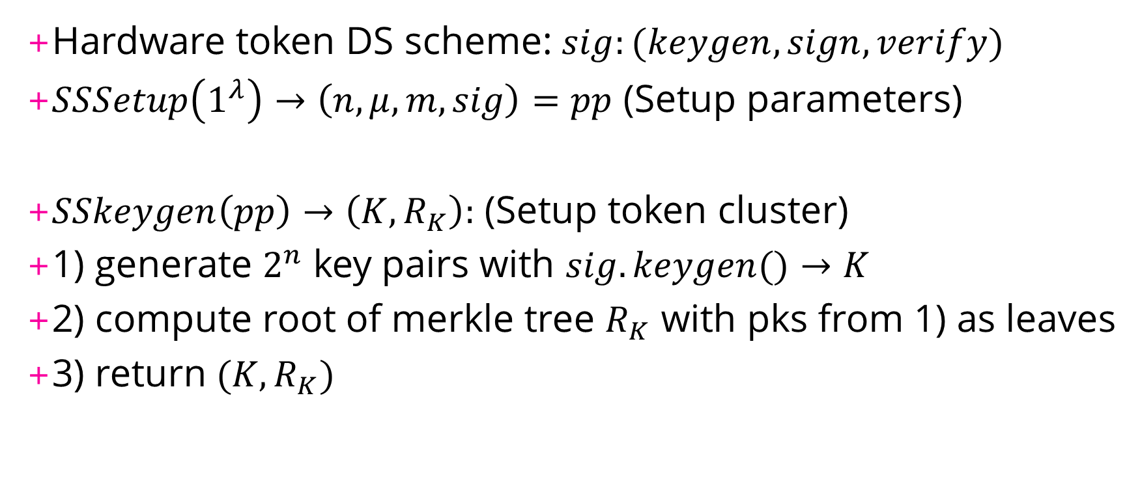
Protocol outline
Hardware token DS scheme: $sig:(keygen, sign, verify)$
$SSSetup\left(1^{λ}\right)→\left(n,μ,m,sig\right)=pp$ (Setup parameters)
$SSkeygen\left(pp\right)→\left(K,R_{K}\right):$ (Setup token cluster)
1) generate $2^{n}$ key pairs with $sig.keygen()→K$
2) compute root of merkle tree $R_{K}$ with pks from 1) as leaves
3) return $(K, R_{K})$

Slide 4
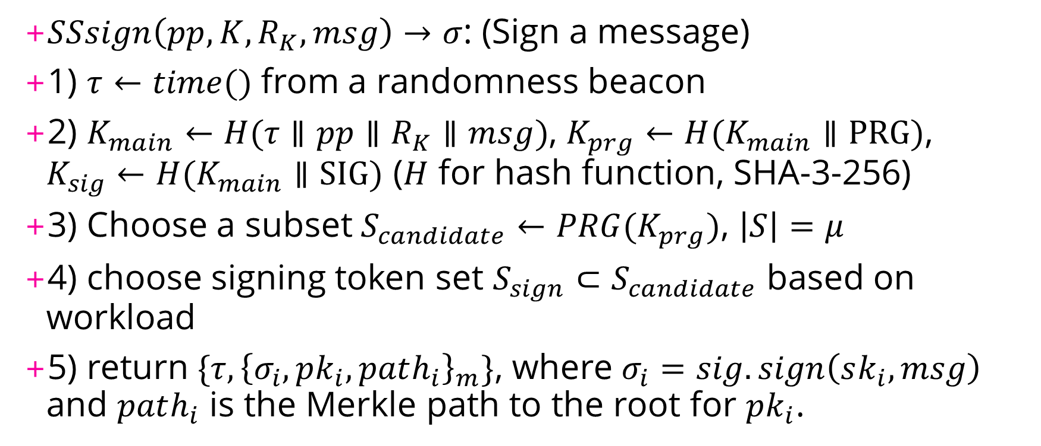
Protocol outline (cont.)
$SSsign\left(pp,K,R_{K},msg\right)→σ$: (Sign a message)
1) $τ←time()$ from a randomness beacon
2) $K_{main}←H(τ∥pp∥R_{K}∥msg)$, $K_{prg}←H(K_{main}∥\text{PRG})$, $K_{sig}←H(K_{main}∥\text{SIG})$ ($H$ for hash function, SHA-3-256)
3) Choose a subset $S_{candidate}←PRG(K_{prg})$, $\left|S\right|=μ$
4) choose signing token set $S_{sign}⊂S_{candidate}$ based on workload
5) return $\{τ,{\left\{σ_{i},pk_{i},path_{i}\right\}}_{m}\}$, where $σ_{i}=sig.sign\left(sk_{i}, msg\right)$ and $path_{i}$ is the Merkle path to the root for $pk_{i}$.

Slide 5
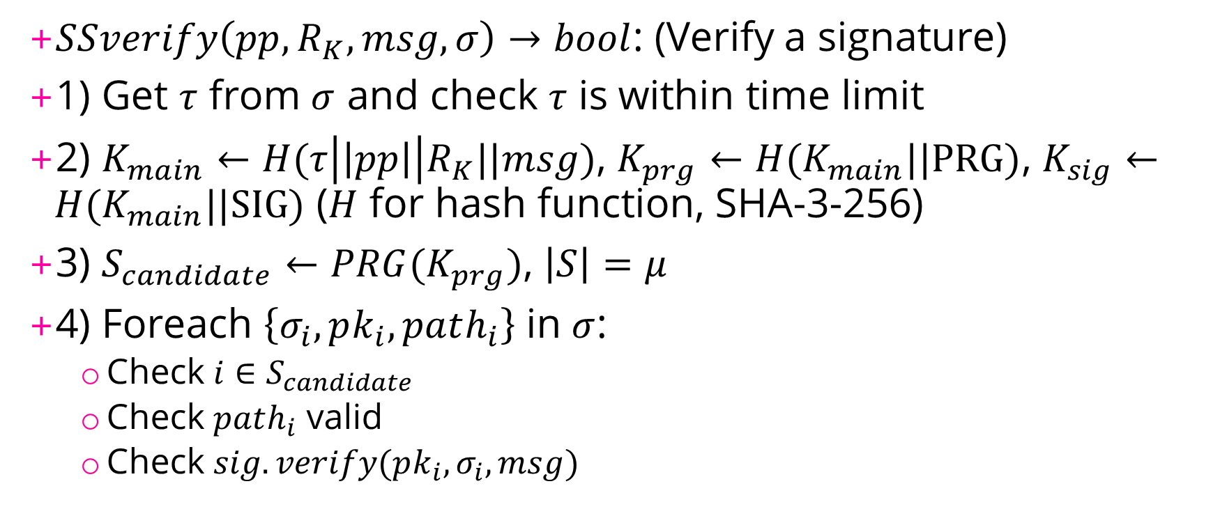
Protocol outline (cont.)
$SSverify\left(pp,R_{K},msg,σ\right)→bool$: (Verify a signature)
1) Get $τ$ from $σ$ and check $τ$ is within time limit
2) $K_{main}←H(τ\left|\left|pp\right|\right|R_{K}||msg)$, $K_{prg}←H(K_{main}||\text{PRG})$, $K_{sig}←H(K_{main}||\text{SIG})$ ($H$ for hash function, SHA-3-256)
3) $S_{candidate}←PRG(K_{prg})$, $\left|S\right|=μ$
4) Foreach $\left\{σ_{i},pk_{i},path_{i}\right\}$ in $σ$:
Check $i∈S_{candidate}$
Check $path_{i}$ valid
Check $sig.verify(pk_{i}, σ_{i}, msg)$

Slide 6
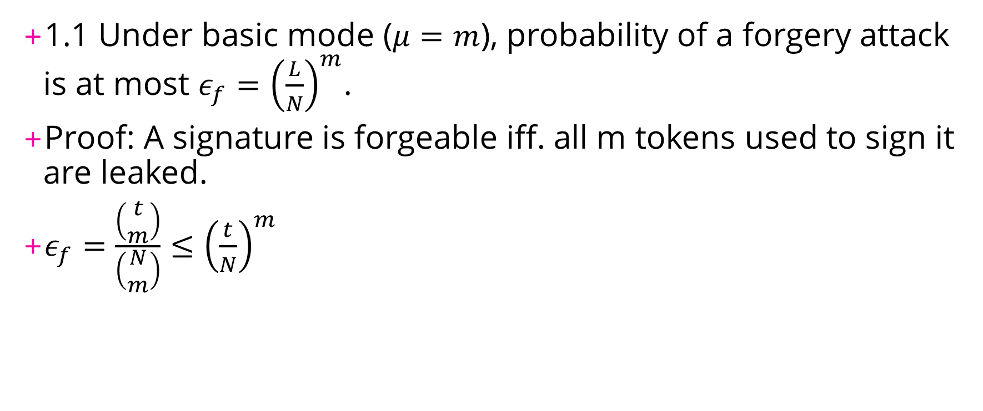
Security
1.1 Under basic mode ($μ=m$), probability of a forgery attack is at most $ε_{f}={\left(\frac{L}{N}\right)}^{m}$.
Proof: A signature is forgeable iff. all m tokens used to sign it are leaked.
$ε_{f}=\frac{\left(\begin{matrix}t \\ m\end{matrix}\right)}{\left(\begin{matrix}N \\ m\end{matrix}\right)}≤{\left(\frac{t}{N}\right)}^{m}$

Slide 7
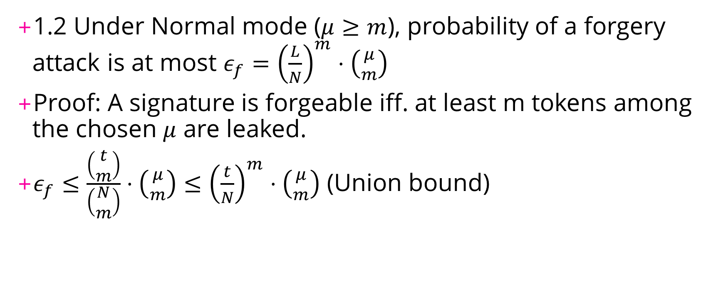
Security
1.2 Under Normal mode ($μ≥m$), probability of a forgery attack is at most $ε_{f}={\left(\frac{L}{N}\right)}^{m}⋅\left({μ \atop m}\right)$
Proof: A signature is forgeable iff. at least m tokens among the chosen $μ$ are leaked.
$ε_{f}≤\frac{\left(\begin{matrix}t \\ m\end{matrix}\right)}{\left(\begin{matrix}N \\ m\end{matrix}\right)}⋅\left({μ \atop m}\right)≤{\left(\frac{t}{N}\right)}^{m}⋅\left({μ \atop m}\right)$ (Union bound)

Slide 8
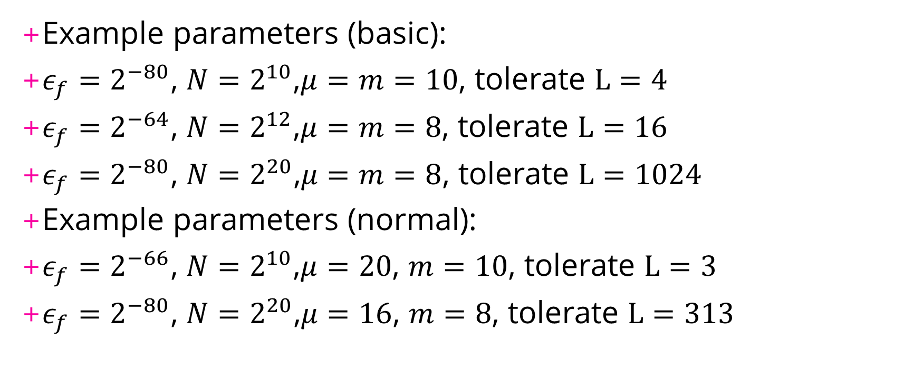
Parameters
Example parameters (basic):
$ε_{f}=2^{−80}$, $N=2^{10}$,$μ=m=10$, tolerate $L=4$
$ε_{f}=2^{−64}$, $N=2^{12}$,$μ=m=8$, tolerate $L=16$
$ε_{f}=2^{−80}$, $N=2^{20}$,$μ=m=8$, tolerate $L=1024$
Example parameters (normal):
$ε_{f}=2^{−66}$, $N=2^{10}$,$μ=20$, $m=10$, tolerate $L=3$
$ε_{f}=2^{−80}$, $N=2^{20}$,$μ=16$, $m=8$, tolerate $L=313$

Slide 9

Performance
2.1 Under basic mode ($μ=m$), w.h.p. max load on a single token under $s$ simultaneous signing request is $\frac{3ln\left(sm\right)}{ln(ln\left(sm\right))}$, when $s$ is relatively large.
Proof: ball and bins model.

Slide 10
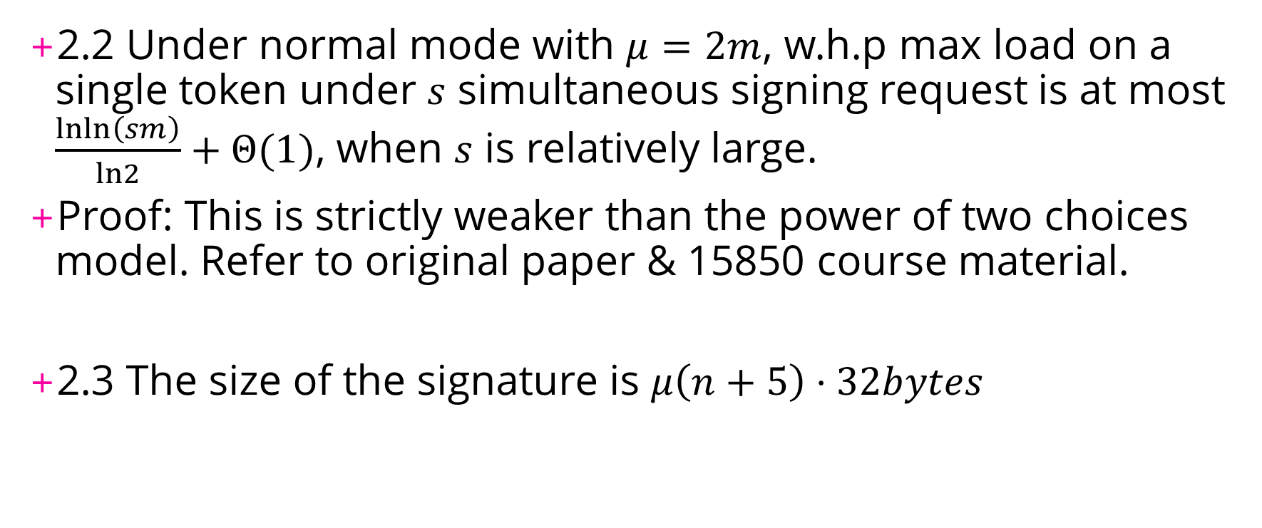
Performance
2.2 Under normal mode with $μ=2m$, w.h.p max load on a single token under $s$ simultaneous signing request is at most $\frac{lnln\left(sm\right)}{ln2}+Θ(1)$, when $s$ is relatively large.
Proof: This is strictly weaker than the power of two choices model. Refer to original paper & 15850 course material.
2.3 The size of the signature is $μ\left(n+5\right)⋅32bytes$

Slide 11
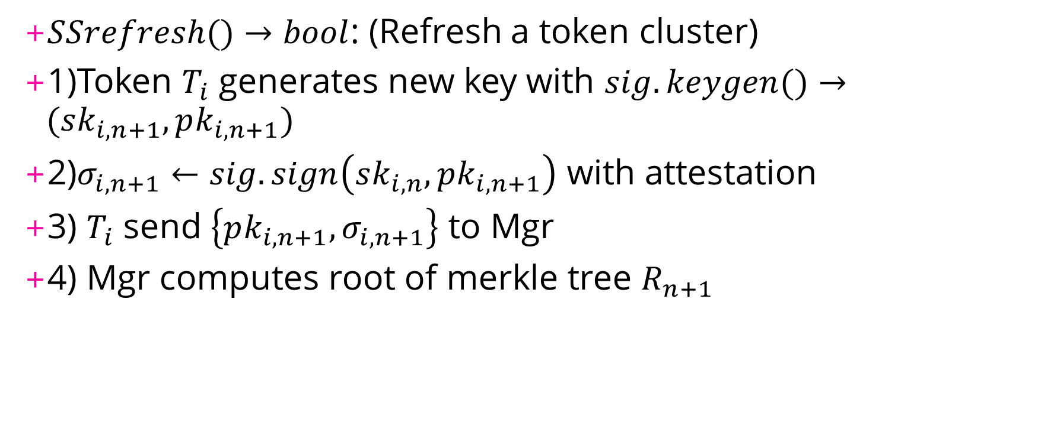
Refreshing tokens
$SSrefresh()→bool$: (Refresh a token cluster)
1)Token $T_{i}$ generates new key with $sig.keygen()→(sk_{i,n+1},pk_{i,n+1})$
2)$σ_{i,n+1}←sig.sign\left(sk_{i,n},pk_{i,n+1}\right)$ with attestation
3) $T_{i}$ send $\left\{pk_{i,n+1},σ_{i,n+1}\right\}$ to Mgr
4) Mgr computes root of merkle tree $R_{n+1}$

Slide 12
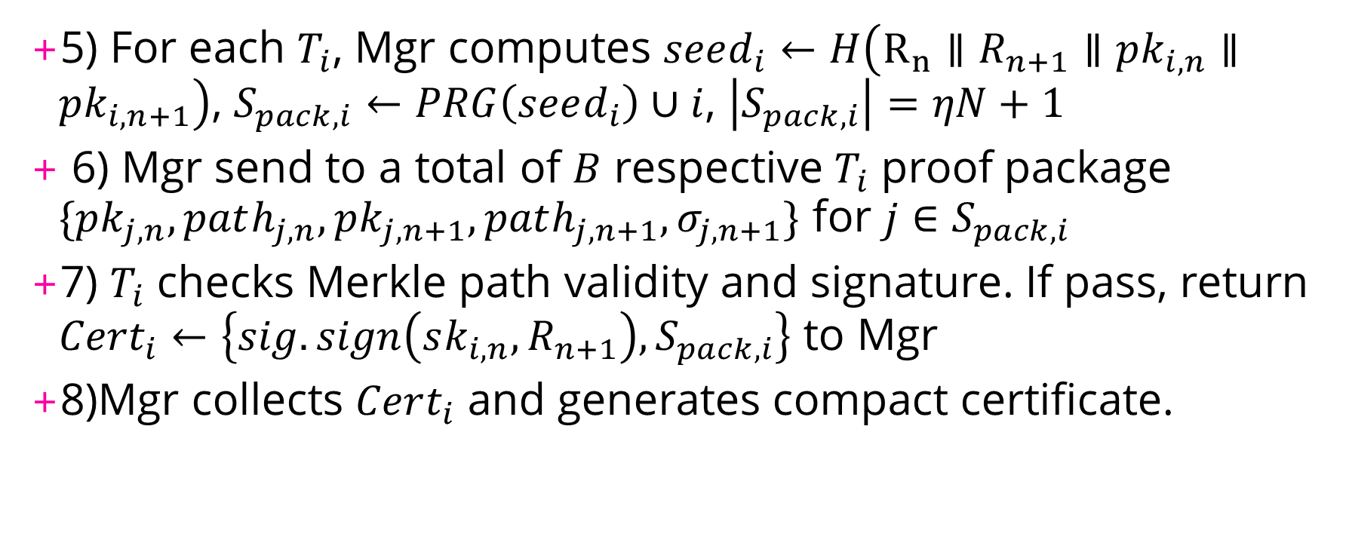
Refreshing tokens (cont.)
5) For each $T_{i}$, Mgr computes $seed_{i}←H\left(R_{n}∥R_{n+1}∥pk_{i,n}∥pk_{i,n+1}\right)$, $S_{pack,i}←PRG\left(seed_{i}\right)∪i$, $\left|S_{pack,i}\right|=ηN+1$
6) Mgr send to a total of $B$ respective $T_{i}$ proof package $\{pk_{j,n}, path_{j,n},pk_{j,n+1},path_{j,n+1},σ_{j,n+1}\}$ for $j∈S_{pack,i}$
7) $T_{i}$ checks Merkle path validity and signature. If pass, return $Cert_{i}←\left\{sig.sign\left(sk_{i,n},R_{n+1}\right),S_{pack,i}\right\}$ to Mgr
8)Mgr collects $Cert_{i}$ and generates compact certificate.

Slide 13
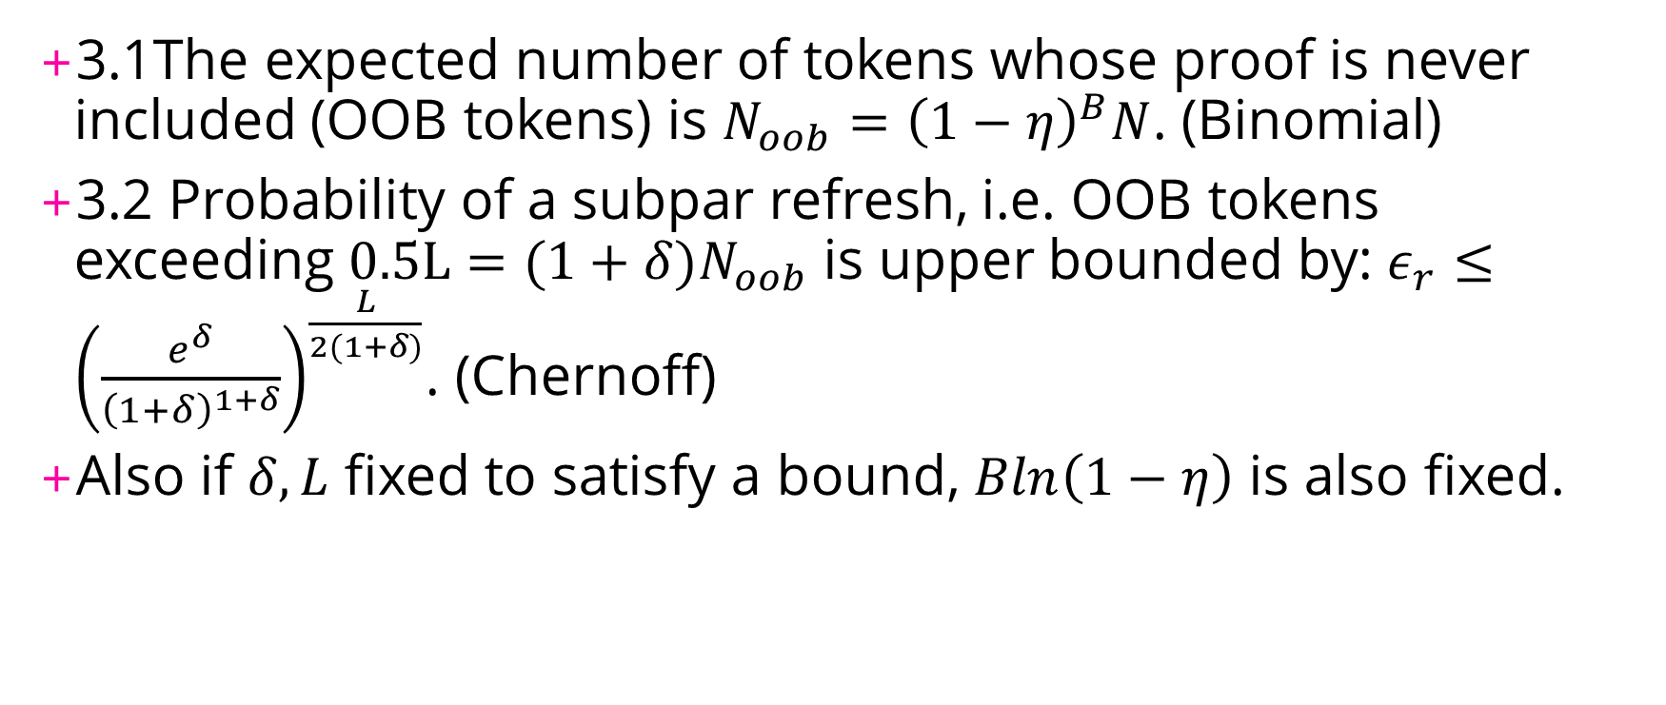
Security
3.1The expected number of tokens whose proof is never included (OOB tokens) is ${N_{oob}=\left(1−η\right)}^{B}N$. (Binomial)
3.2 Probability of a subpar refresh, i.e. OOB tokens exceeding $0.5L=(1+δ)N_{oob}$ is upper bounded by: $ε_{r}≤{\left(\frac{e^{δ}}{{\left(1+δ\right)}^{1+δ}}\right)}^{\frac{L}{2(1+δ)}}$. (Chernoff)
Also if $δ,L$ fixed to satisfy a bound, $Bln\left(1−η\right)$ is also fixed.

Slide 14
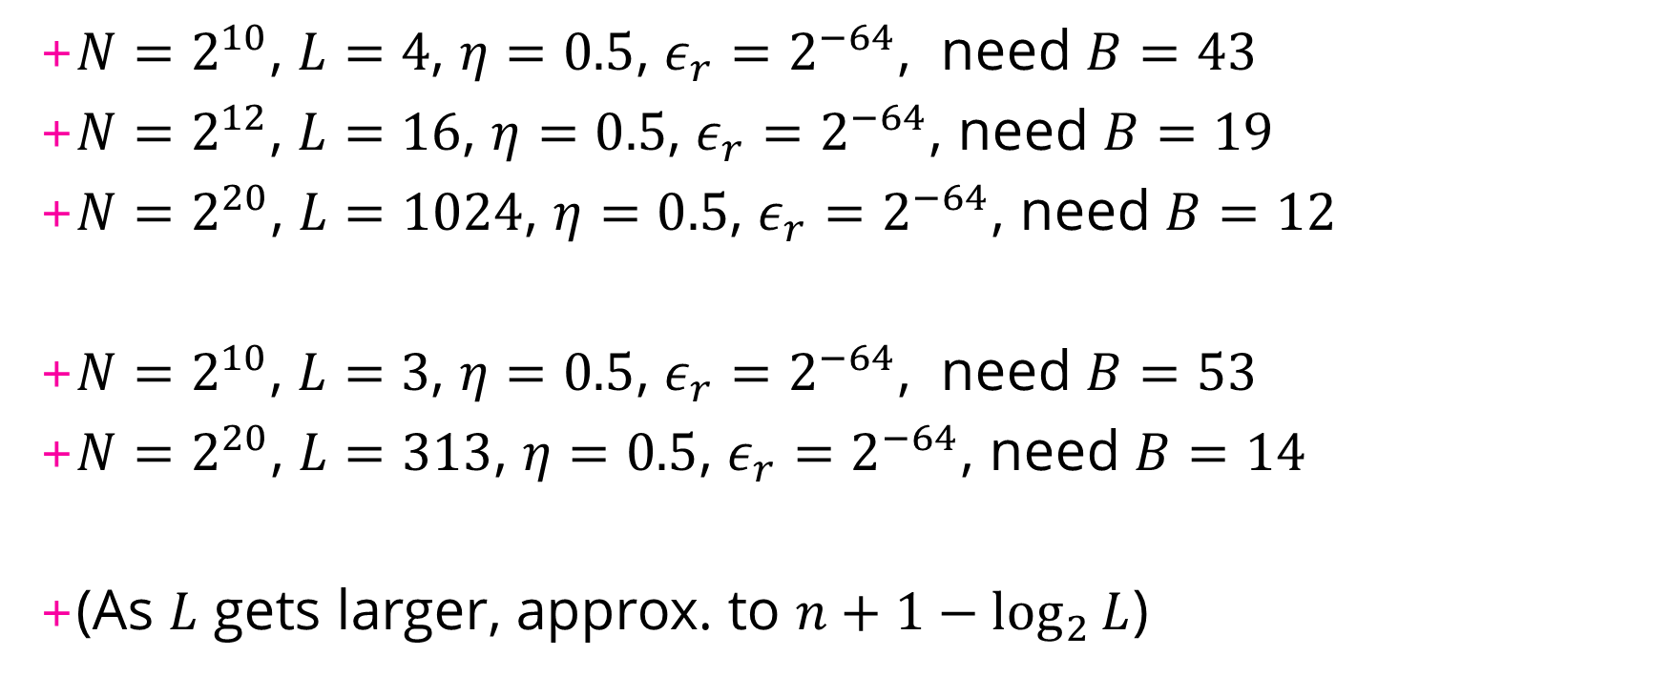
Parameter
$N=2^{10}$, $L=4$, $η=0.5$, $ε_{r}=2^{−64}$, need $B=43$
$N=2^{12}$, $L=16$, $η=0.5$, $ε_{r}=2^{−64}$, need $B=19$
$N=2^{20}$, $L=1024$, $η=0.5$, $ε_{r}=2^{−64}$, need $B=12$
$N=2^{10}$, $L=3$, $η=0.5$, $ε_{r}=2^{−64}$, need $B=53$
$N=2^{20}$, $L=313$, $η=0.5$, $ε_{r}=2^{−64}$, need $B=14$
(As $L$ gets larger, approx. to $n+1−\log_{2}{L}$)

Slide 15
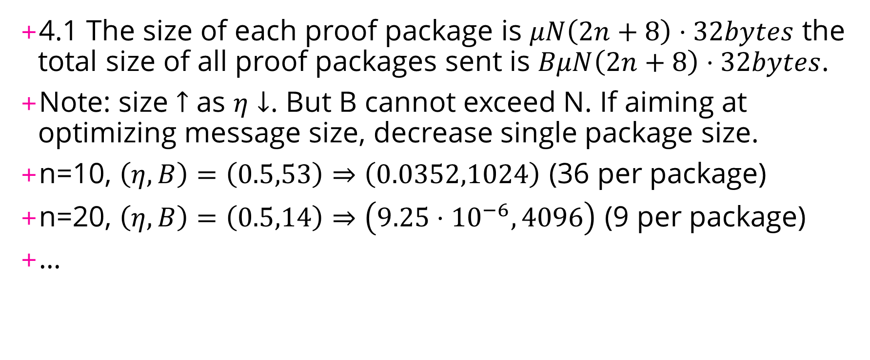
Performance
4.1 The size of each proof package is $μN\left(2n+8\right)⋅32bytes$ the total size of all proof packages sent is $BμN\left(2n+8\right)⋅32bytes$.
Note: size $↑$ as $η↓$. But B cannot exceed N. If aiming at optimizing message size, decrease single package size.
n=10, $\left(η,B\right)=\left(0.5,53\right)⇒\left(0.0352,1024\right)$ (36 per package)
n=20, $\left(η,B\right)=\left(0.5,14\right)⇒\left(9.25⋅{10}^{−6},4096\right)$ (9 per package)
…

Slide 16

Performance
4.2 The size of the compact certificate is $4B⋅32bytes$.
Note: If aiming at optimizing certificate size, increase single package size to reduce # of tokens returning signature.

Slide 17
Implementation
Python implementation of the cluster (sign+verify)
Alternate signature output for verifying on Ethereum
Solidity implementation of verification

Slide 18
To do…
Further inspection on the refresh part
Is there any way to detour the attestation?
Formal proof of the integrity of the refresh procedure?
Make sure the solidity contract is indeed correct
Especially ECDSA part, r+vs type of signature on python vs solidity
Maybe just find another python library for ECDSA
Run the whole thing
See how much it cost & how efficient it is

