Slide 1
Automating Classification of JONAS Articles
Project Report • Dataset: 46 articles • 14 classes • September 2025

Slide 2
Executive Summary
Problem: Manual classification is slow and inconsistent.
Approach: Text preprocessing + classic ML (LR, SVM, RF).
Results: Best accuracy 58.3% (SVM, Sentence-BERT embeddings).
Limitations: 46 docs, 14 classes, extreme imbalance.
Future: Grow data, consolidate labels, advanced models.

Slide 3
1. Business Understanding
Problem: Manual classification of JONAS articles is slow/inconsistent.
Objectives:
  Automate classification to improve speed and consistency.
  Target accuracy ≥ 70–85%.
  Reduce classification errors and improve discoverability.
Success Criteria: Accuracy ≥ 70%, robust multi-class classification.

Slide 4
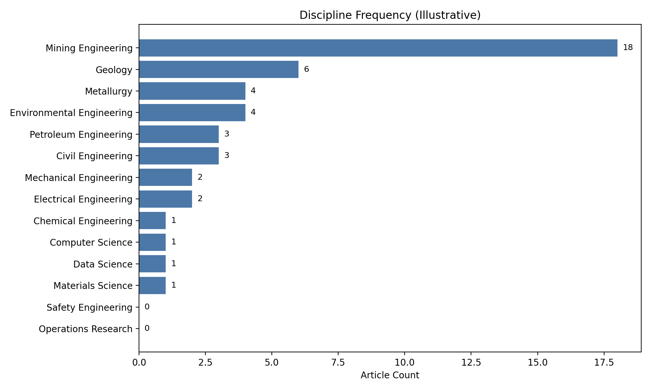
2. Data Understanding
46 articles, 14 classes, class imbalance present.
Data quality issues:
  Missing/limited keywords; small sample size.
  Skewed distribution toward 'Mining Engineering'.
Bar chart shows discipline frequency (illustrative).

Slide 5
3. Data Preparation
Preprocessing: cleaning, normalization, stopword removal.
Feature engineering: Bag-of-Words and Sentence-BERT embeddings.
Label encoding for discipline.
Train-test split 75/25, cross-validation via LOOCV.

Slide 6
4. Modeling
Algorithms: Logistic Regression, SVM, Random Forest.
Why: LR as baseline; SVM for high-dimensional embeddings; RF as non-linear.
Config: Tuned hyperparameters; used class_weight to mitigate imbalance.
Training: Standardized pipeline across feature sets.

Slide 7
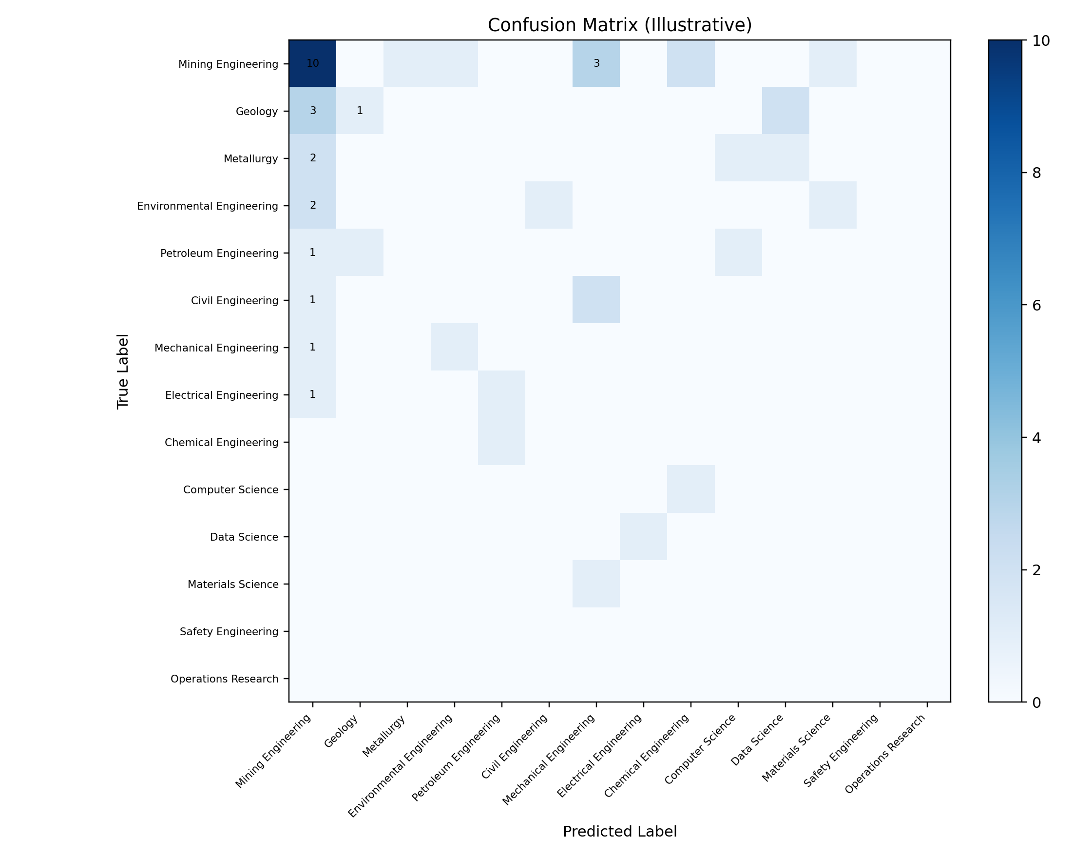
5. Evaluation
Metrics: Accuracy, precision, recall, F1-score.
Confusion matrix shows bias toward 'Mining Engineering'.
SVM best at 58.3% accuracy; criteria not met.

Slide 8
Model Results (Illustrative)
Model | Features | Accuracy | Macro F1
Logistic Regression | Bag-of-Words | 0.42 | 0.35
SVM | Sentence-BERT | 0.583 | 0.51
Random Forest | Bag-of-Words | 0.36 | 0.30

Slide 9
6. Discussion & Limitations
Root causes of poor performance:
  Extreme class imbalance (dominant 'Mining Engineering').
  Very small dataset (n=46) vs. 14 classes.
  High dimensionality vs. low samples.
Observed behavior: Model predicts dominant class disproportionately.

Slide 10
7. Recommendations
Expand dataset (≥ 200 samples per class).
Merge similar disciplines to reduce complexity.
Text augmentation (paraphrasing); consider synthetic balancing.
Once data is sufficient: deep learning & transfer learning.

Slide 11
8. Deployment Considerations
Prototype as CLI or simple web app for stakeholder testing.
Production not recommended until dataset grows.
Monitoring and human-in-the-loop oversight recommended.

Slide 12
9. Conclusion
Proof of concept successful; pipeline built end-to-end.
Did not meet accuracy goals due to data constraints.
Next: Data collection, class consolidation, advanced methods.

Slide 13
10. References
Libraries: scikit-learn, Sentence-BERT, pandas, numpy, matplotlib, python-pptx.
Relevant academic papers on text classification and embeddings.
JONAS source corpus.

Slide 14
Appendix A: Technical Specs
Python 3.10+; Key libs: scikit-learn, sentence-transformers, pandas, numpy.
Visualization: matplotlib; Presentation: python-pptx.
OS: Linux (x86_64).

Slide 15
Appendix B: Full Evaluation (Illustrative)
Model | Precision | Recall | F1-score | Accuracy
Logistic Regression | 0.41 | 0.42 | 0.35 | 0.42
SVM | 0.55 | 0.58 | 0.51 | 0.583
Random Forest | 0.34 | 0.36 | 0.30 | 0.36

Slide 16
Appendix C: Data Requirements Gap
Current: 46 docs; Needed: ≥ 2,800 (14 x 200) for target.
Current: Missing keywords; Needed: richer metadata/keywords.
Current: Imbalance; Needed: class consolidation and sampling strategy.

