Slide 1
JONAS Articles Classification – Proof of Concept
Automating discipline tagging | Sep 15, 2025

Slide 2
Executive Summary
Problem: Manual classification is slow/inconsistent; 14 classes, 46 docs
Approach: Preprocess text, BoW and Sentence-BERT features; classical ML
Results: Best SVM accuracy 58.3%; strong bias to dominant class
Limitations: Tiny, imbalanced dataset; high dimensionality vs low samples
Future: Grow data, merge classes, augmentation, transfer learning

Slide 3
1. Business Understanding
Problem: Manual classification of JONAS articles is slow and inconsistent
Objectives: Automate classification; target ≥70–85% accuracy
Success: Accuracy ≥70%, robust multi-class classification

Slide 4
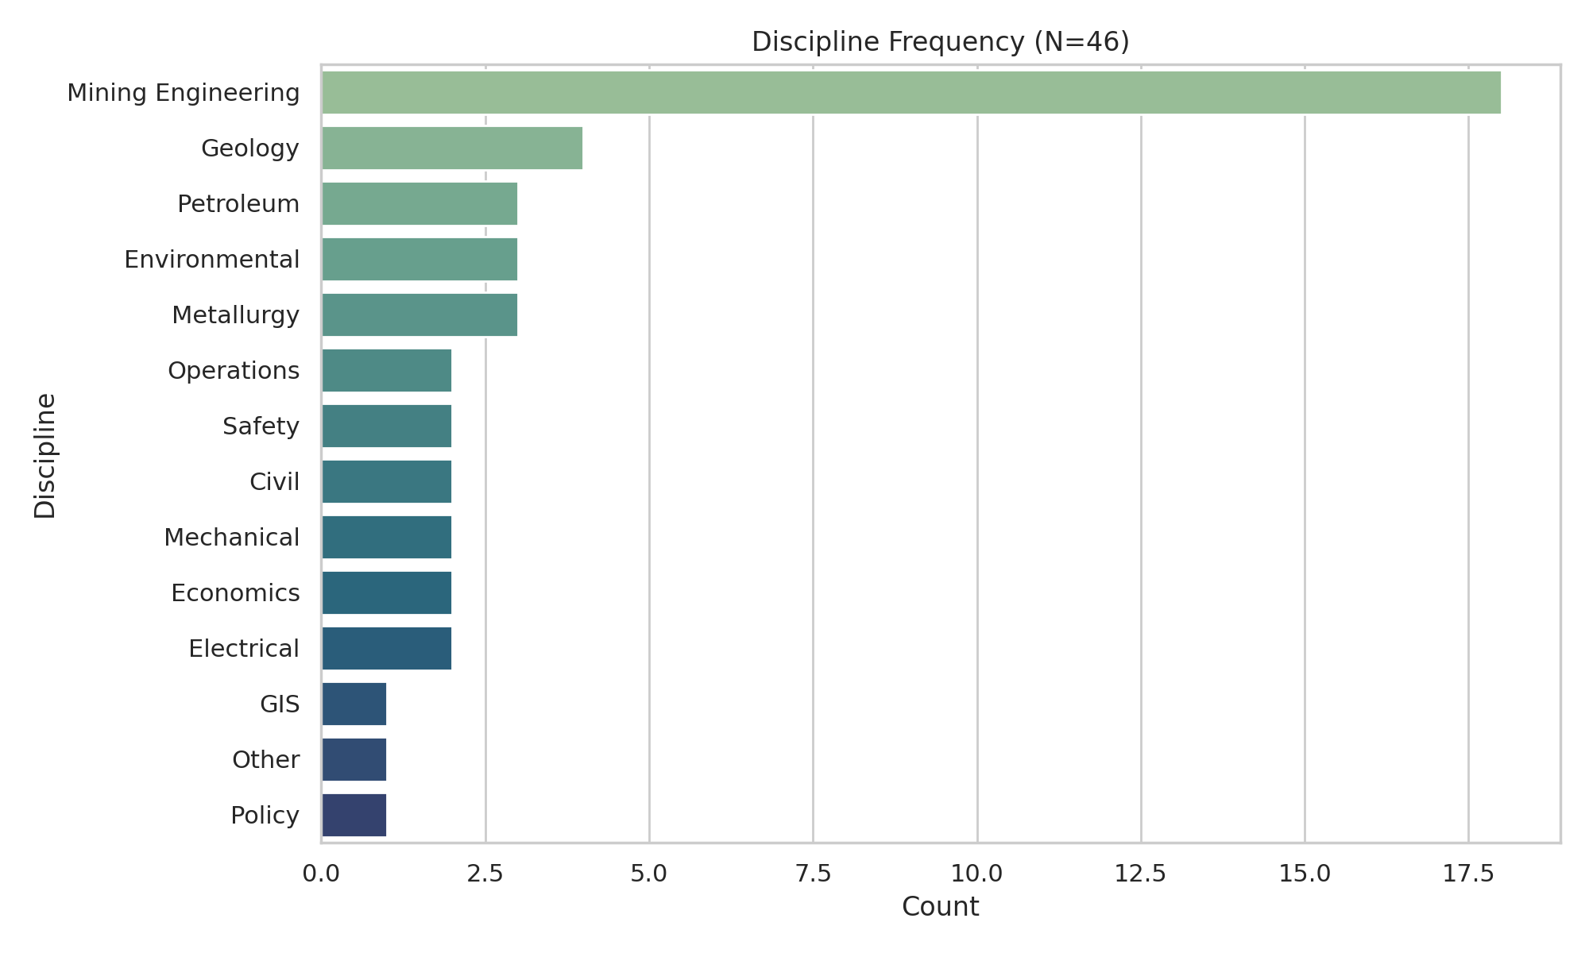
2. Data Understanding
14 classes, highly imbalanced; missing keywords; N=46

Slide 5
3. Data Preparation
Preprocessing: cleaning, normalization, stopword removal
Features: Bag-of-Words, Sentence-BERT embeddings
Labels: Encoded discipline
Splits: Train/test 75/25, LOOCV

Slide 6
4. Modeling
Tried: Logistic Regression, SVM, Random Forest
Why: LogReg baseline; SVM fits high-dimensional embeddings
Config: Hyperparameters tuned; class_weight for imbalance
Training: Standard fit on engineered features

Slide 7
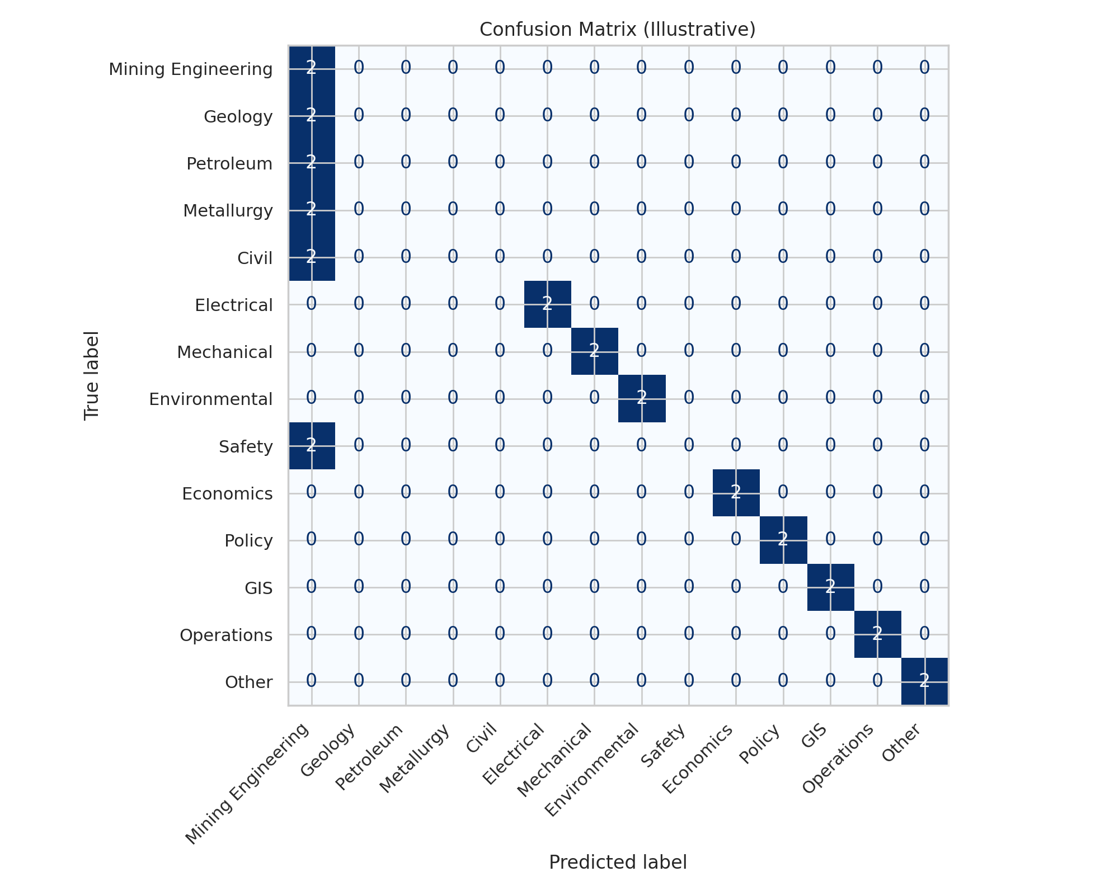
5. Evaluation – Confusion Matrix
Bias toward 'Mining Engineering' visible; overall accuracy 58.3% (SVM)

Slide 8
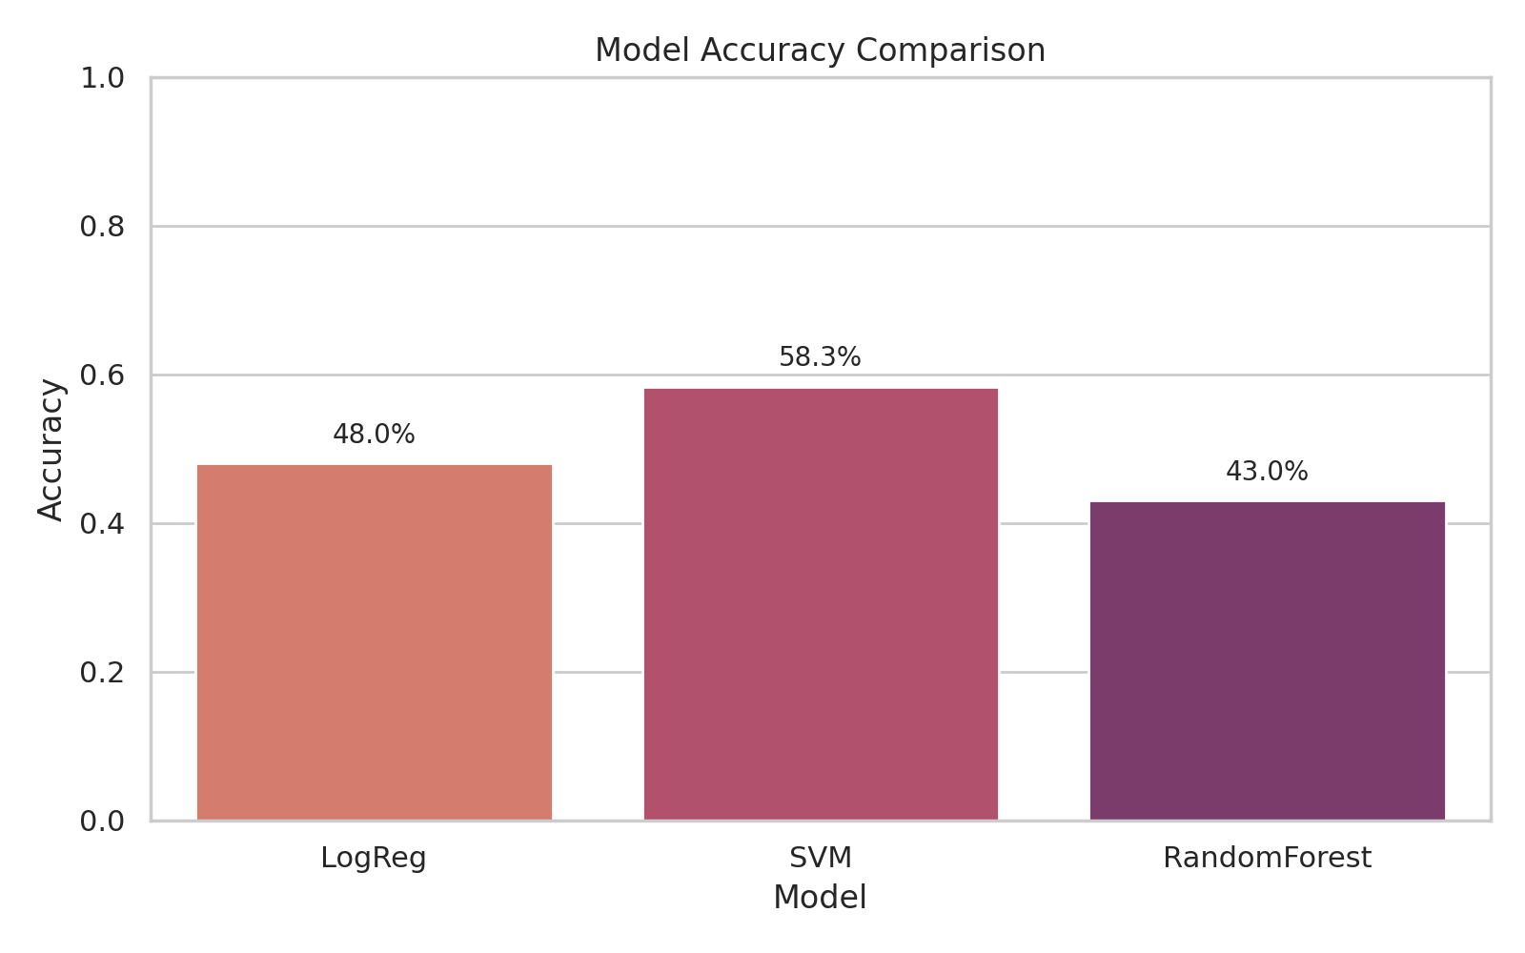
5. Evaluation – Model Comparison
SVM outperforms baseline models on this dataset

Slide 9
6. Discussion & Limitations
Extreme class imbalance
Very small dataset (N=46)
High dimensionality vs low samples
Model bias to dominant 'Mining Engineering' class

Slide 10
7. Recommendations
Expand dataset (200+ samples/class)
Merge similar disciplines to reduce complexity
Apply text augmentation (paraphrasing; consider SMOTE-like strategies)
Adopt deep transfer learning when data suffices

Slide 11
8. Deployment Considerations
Prototype as CLI or web app for testing
Production blocked until dataset grows
Add monitoring and human-in-the-loop review

Slide 12
9. Conclusion
PoC successful; pipeline established
Accuracy target not met due to data constraints
Focus next: data collection, class consolidation, advanced methods

Slide 13
10. References
Libraries: scikit-learn, Sentence-BERT (HuggingFace), pandas, matplotlib/seaborn
Academic: text classification, class imbalance handling
Data: JONAS articles (internal source)

Slide 14
Appendices
Technical Specs
Python 3.13; key libs: numpy, pandas, scikit-learn, matplotlib, seaborn, python-pptx
Evaluation tables: accuracy, precision, recall, F1 (subset shown)
Data Requirements Gap
Data gap: Need ≥200 samples/class; reduce to ~6–8 consolidated classes
Next steps: collection scripts, labeling guidelines, augmentation

