Slide 1

Categorizing Unscripted conversations
Matthew Hosking

Slide 2
VOICE Vienna Oxford International Corpus of English
151 Recorded and Transcribed Unscripted Conversations
Grouped into 10 different Speech Event Types:
Interview
Press conference
Service encounter
Seminar discussion
Working group discussion
Workshop discussion
Meeting
Panel
Question answer session
Conversation

Slide 3
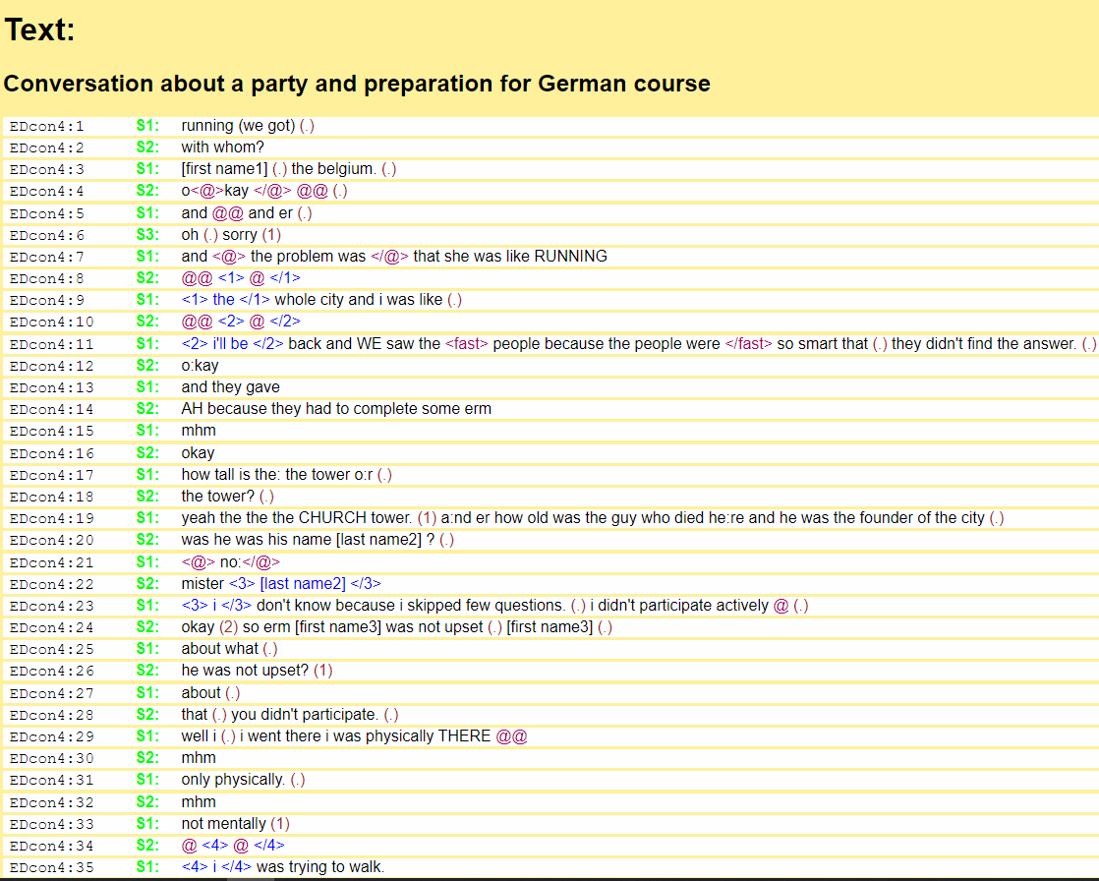
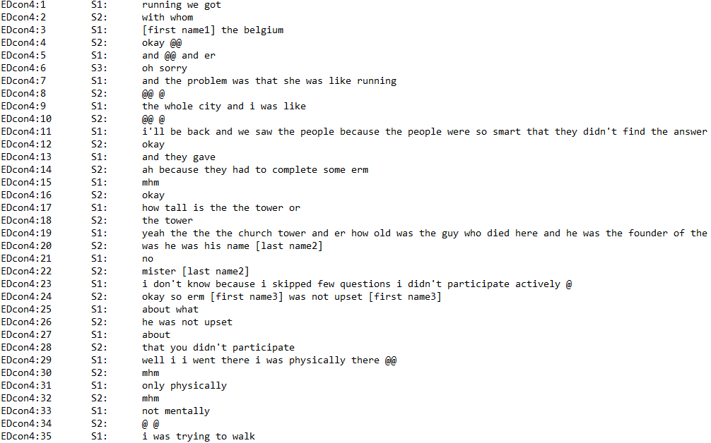
Tagged File Format
Txt File Format

Slide 4
Preprocessing
Procedure:
Deconstruct conversations into sections
Tokenize
Remove names and unintelligible words
Convert incomplete words to a common token
Remove stop words
Compile word counts for each token
Bag of Words
TF-IDF
Some Peculiarities of the Data
Presence of non-English Words
Prevalence of vocal artifacts such as “er,” “mhm,” or “um”
To Lemmatize or not to Lemmatize

Slide 5
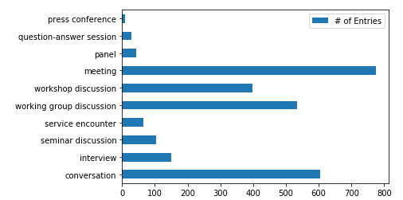
Category Breakdown
Clear imbalance in category distribution
Lots of conversations
Not many press conferences and question-answer sessions

Slide 6
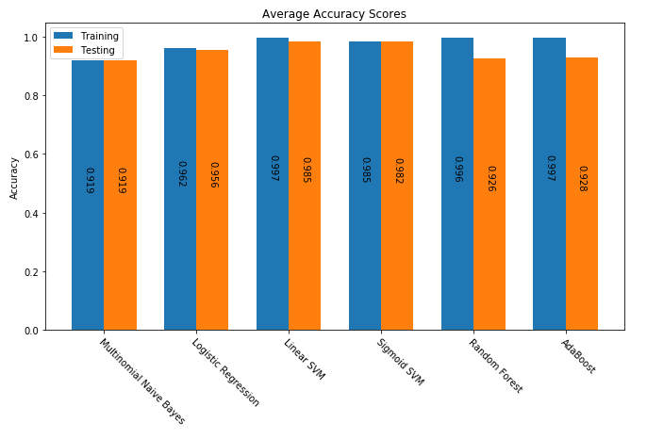
Algorithms
Multinomial Naïve Bayes
Logistic Regression
Linear SVM
Sigmoid SVM
Random Forest
AdaBoost

Slide 7
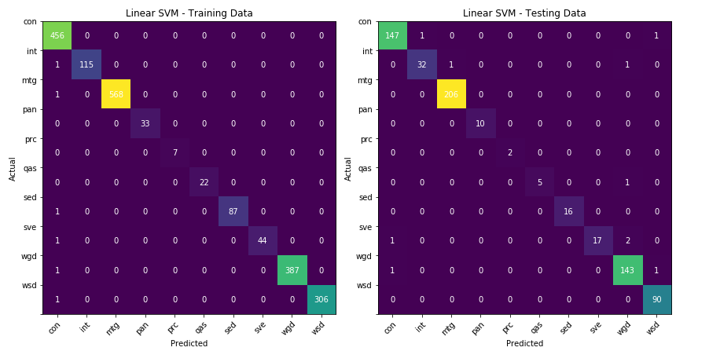
Linear SVM – Confusion Matrices

Slide 8
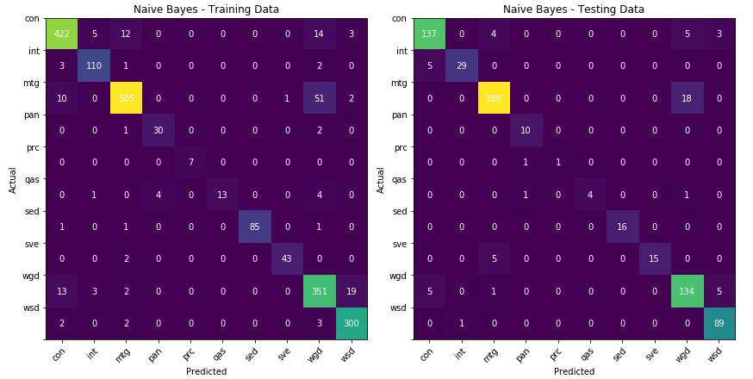
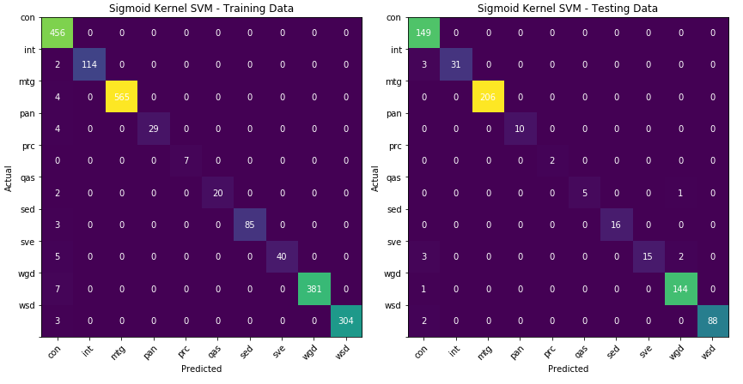
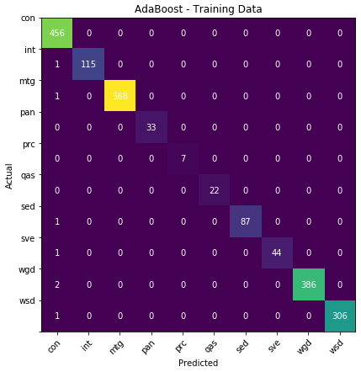


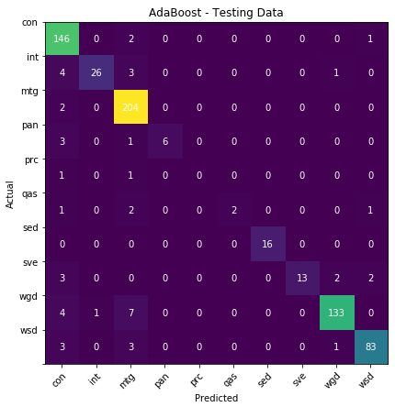
Other Confusion Matrices

Slide 9
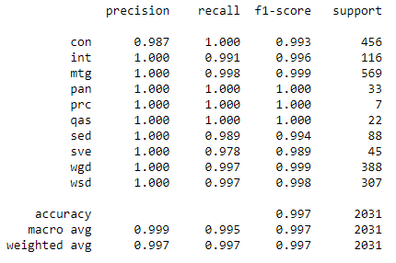
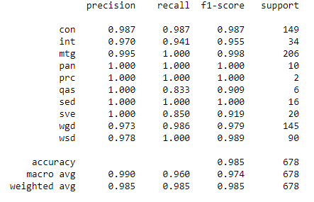
Linear SVM – Statistics
Training Data
Testing Data

Slide 10
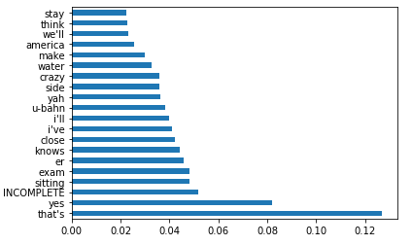
Most Important Features for Conversations

Slide 11
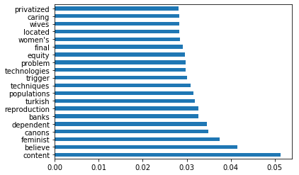
Most Important Features for Panels

Slide 12
Next Steps
Target Variable Imbalance
Compare ROC Curves for each class
Experiment with different sizes of conversation snippets
N-grams
Experiment with Neural Network
Future Work
Use XML tagged version
Dissect individual lines
Explore generative text model capabilities

Slide 13
Thank you

