Slide 1
Support of business processes with Artificial Intelligence at Osram OS
Von Stefan Lex
Betreuer Thomas Weißgerber
Professor Dr. Kosch

Slide 2
My Thesis in a nutshell
Email filtering
First step in a big tool chain
Evaluate if AI overkill

Slide 3
Structure
Motivation
Usecase explanation
Technical approach
Results and occured obstacles
Future Work
Discussion

Slide 4
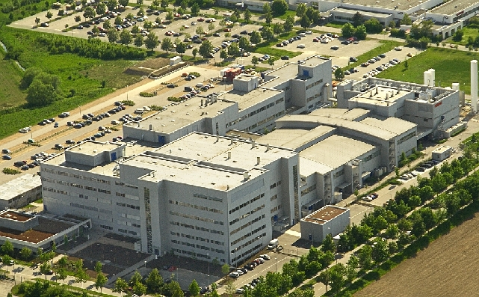
Motivation
Osram goes DIGITAL
Automatisation of workstreams

Slide 5
Usecase explanation
Quote = Order of Products/ Test Samples
Sales employee has to invest time in standart quote Mails
First step to the complete automatisation
This Thesis only covers the sorting process
Sorting Parsing compute Action PROFIT
Quote/no
Quote

Slide 6
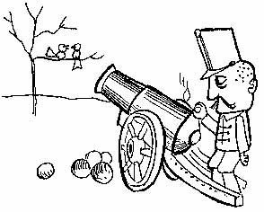
My approach
Use of company intern dataset
Which feature combination is the best choice?
Core question: Is it useful to use AI or are the results unsatisfying ?

Slide 7
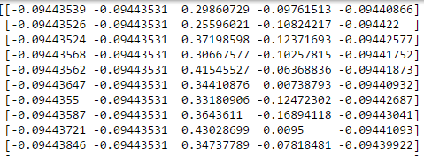
Technical Approach
Sklearn as base Libary
Extract main features with tfidf of content and subject
Add Features like send time or number of questions
Stored in a Feature Number x Mail Number
(example picture)

Slide 8
Technical Approach
Used Classifier: - K-Nearestneighbor (n=7)
- Neuronal Network (Multi-layer Perceptron (MLP))
- Support Vector Machine (Linear SVC)
- Naive Bayes (Gaussian and Bernoulli)
Train the Classifier with Dataset size of 300, 600, 900
600 and 900 in progress

Slide 9

Obstacles
Cross val with neuronal took very long
Tuning of Hyperparameters with Gridsearch
Feature space with only two main features low impact of smaller features
Emails have often answer tree strucutre, where start message is a Quote

Slide 10
Results
Classifier | Precision | Recall | Accuracy
SVM | +++ | ++ | ++
Gaussian NB | + | ++ | +
Bernoulli NB | ++ | ++ | ++
Neuronal | ++ | ++ | ++
KNN | -- | - | -
- Best Precision Score: SVM 88% (Content, Subject, Time, Attachment)
Best Recall Score: Bernoulli NB 94% (Subject)
- Best Accuracy Score: SVM 85% (Content, Subject, Time, Attachment)

Slide 11
Conclusion/Recommendation
SVM followed by Neuronal
Not every Classifier is useful (KNN)
More Features != higher Precision better use more specific
Verify benchmark to brute-force approach
Recall is more important than Precision
Like a spamfilter

Slide 12
Discussion

