Slide 1
Support of business processes with Artificial Intelligence at Osram OS
Von Stefan Lex
BetreuerThomas Weißgerber
Proffessor Dr. Kosch

Slide 2
My Thesis in a nutshell
Email filtering
First step in a big tool chain
Evaluate if AI overkill

Slide 3
Structure
Motivation
Usecase explanation
Technical approach
Results and occured obstacles
Future Work
Discussion

Slide 4
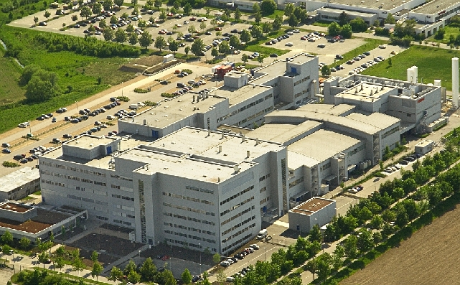
Motivation
Digitalisation process of the company
Automatisation of business processes

Slide 5
Usecase explanation
Quote = Order of Products/ Test Samples
Sales employee has to invest time in standart quote Mails
First step to the complete automatisation
Sorting Parsing compute Action PROFIT

Slide 6
Usecase and difference to other approaches
Use of company intern dataset
Which feature combination is the best choice?
Core question: Is it useful to use AI or are the results unsatisfying ?

Slide 7
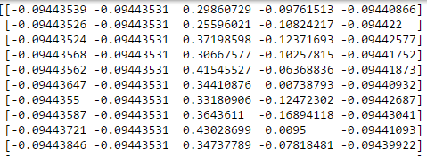
Technical Approach
Sklearn, Feature raum erstellen warum diese features, warum Word embedding nicht
Sklearn as base Libary
Extract main features with tfidf of content and subject
Add Features like send time or number of questions
Stored in a Feature Number x Mail Number
(example picture)

Slide 8
Technical Approach
Used Classifier: - K-Nearestneighbor (n=7
- Neuronal Network (Multi-layer Perceptron (MLP))
- Support Vector Machine (Linear SVC)
- Naive Bayes (Gaussian and Bernoulli)
Train the Classifier with Dataset size of 300, 600, 900

Slide 9

Obstacles
Cross val with neuronal was not working properly
Tuning of Hyperparameters with Gridsearch
Feature space with only two main features low impact of smaller features
Emails have often answer tree strucutre, where start message is a Quote

Slide 10
Results

Slide 11
Results
Not every Classifier is useful
More Features != higher Precision
Recall is more important than Precision

Slide 12
Discussion

