Slide 1
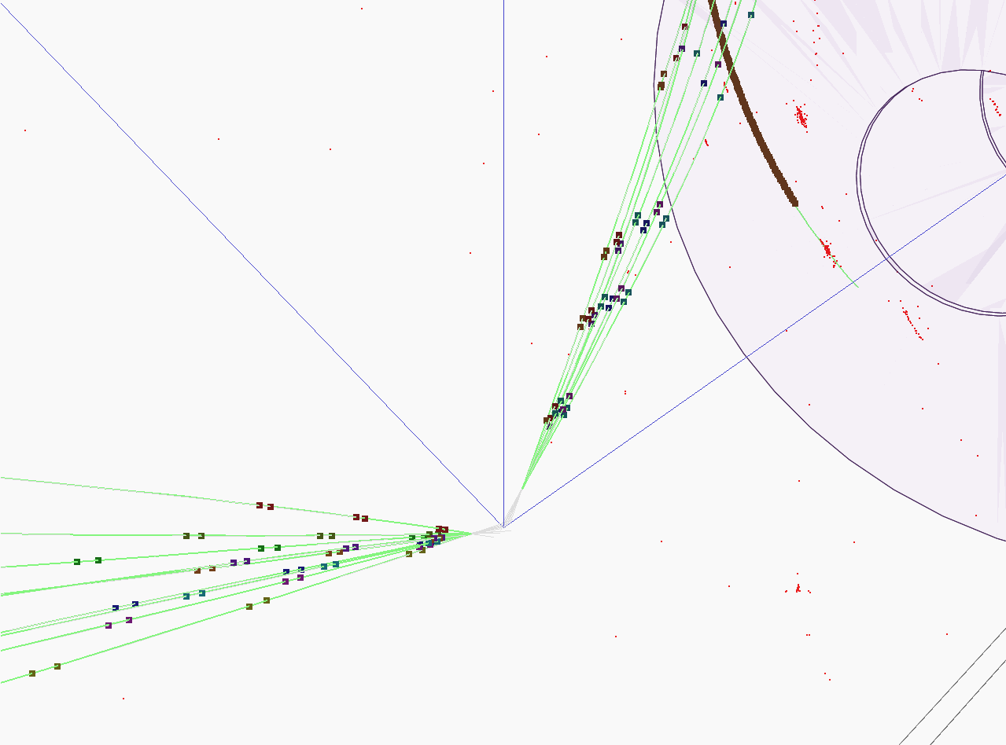




b charge reconstruction
Poeschl R., Richard F., Bilokin S.
LAL, Orsay
Top@LC 2017

Slide 2
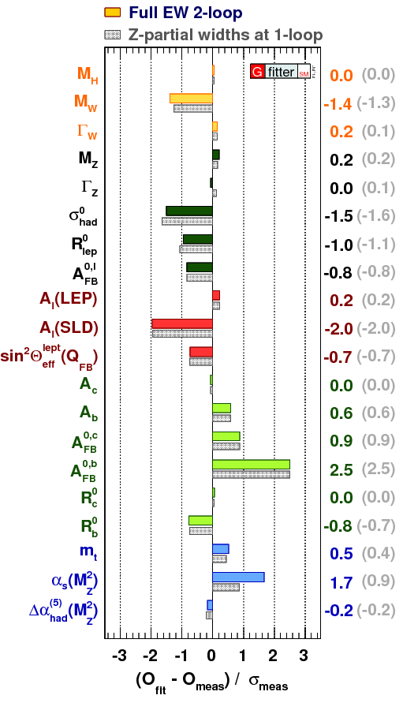
Motivation
Top quark is the heaviest elementary particle in the SM
Top quark is subject of many BSM theories,
  i.e. composite top or Randall-Sundrum models predict deviations for the EW couplings of the top quark
The top and bottom quarks belong to one doublet
Forward-backward asymmetry measurement at LEP has 2.5σ tension with the SM prediction
We need to measure the heavy quark EW couplings
  EW top couplings at ILC are discussed in Eur. Phys. J. C (2015) 75: 512.
arxiv: 1407.3792v1

Slide 3
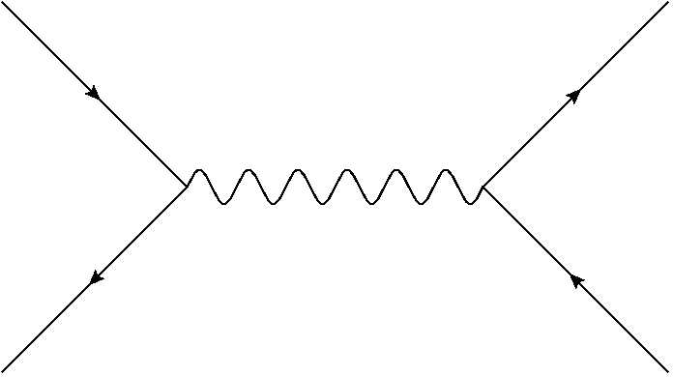
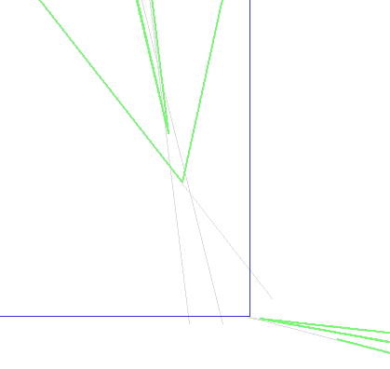
Objective
Main purpose of this work is to define the electroweak couplings of the bottom quark using the b-quark polar angle measurement of the process
Properties of decay products from the b-hadrons are used to determine the charge of initial b-quark
Charge of the b-quark is calculated as a sum of the charges of secondary and tertiary vertex particles
The charge of K-mesons from reconstructed vertices is directly connected to the initial quark charge
Y
Ternary
vertex
Secondary
vertex
X
Primary vertex

Slide 4
Research setup
We are using 250 GeV q qbar sample of 250 fb⁻¹ integrated luminosity with pair background v01-16-05 (DBD) for each polarization
To estimate the background we use ZZ HZ WW samples with the same version of ilcsoft
Modified version of VertexChargeRecovery from MarlinReco/Analysis (Recovery)

Slide 5
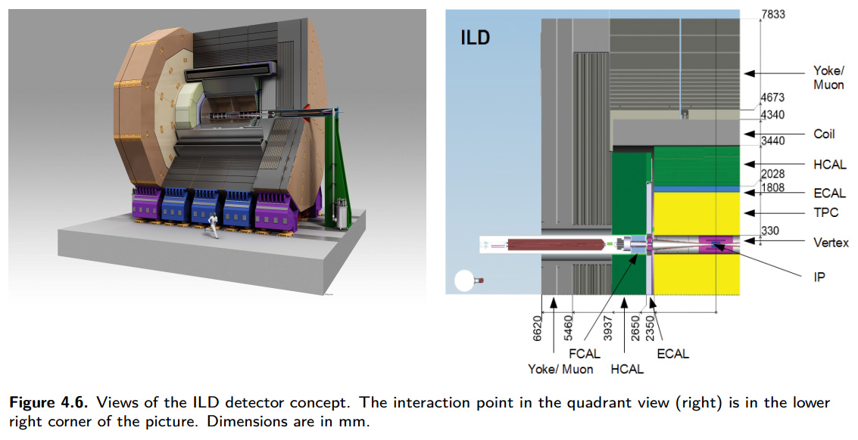
ILD project
Designed for Particle Flow algorithms that allow to reconstruct individual particles inside ILD
Tracking system:
  Vertex Detector composed of 3 double layers of silicon pixels
  Time Projection Chamber with particle identification capabilities
  Other devices
Calorimeters:
  High-granular silicon-tungsten Ecal (SiW Ecal)
  Hcal with iron absorber
3.5T Solenoid
Muon trackers
Full GEANT4 simulation

Slide 6
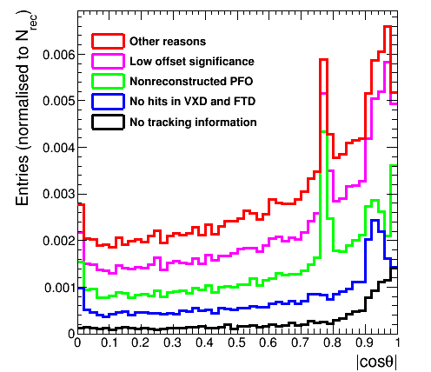
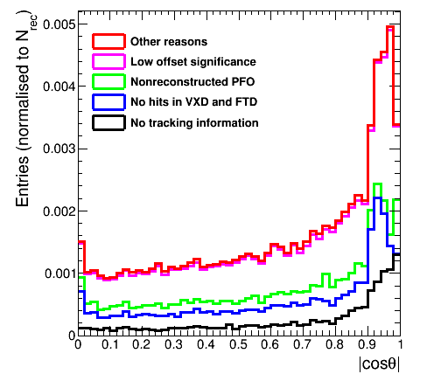
Elements of vertex charge measurement
The central problem of the vertex charge measurement is the missing particles from the reconstructed vertices
  We have identified the sources:
    No reconstructed tracks
    Particle has no hits in VXD
    No reconstructed PFO by Pandora
    Low offset\low momentum
  This study resulted in VertexChargeRecovery algorithm, which enhances the charge purity by adding the missing particles back
RECOVERY

Slide 7
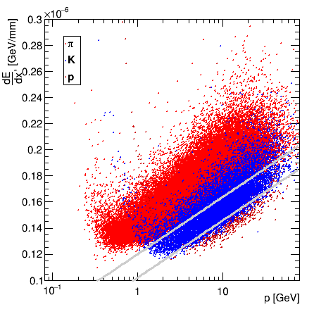
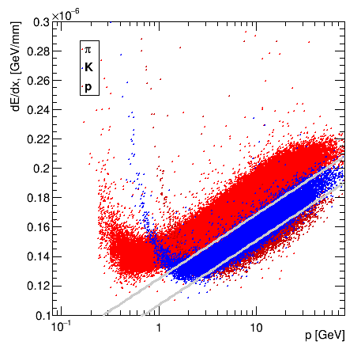
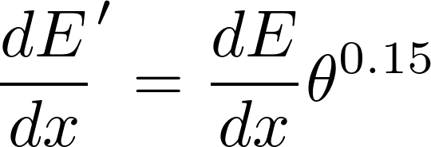
Elements of vertex charge measurement: Kaons
The kaons are identified by the dE/dx measurement of the TPC tracks
The main background particles for Kaons are
  Pions
  Protons
The developed angular correction compensates the increased dE/dx for longer TPC tracks, which increases purity and efficiency of the kaon selection
CORRECTION

Slide 8
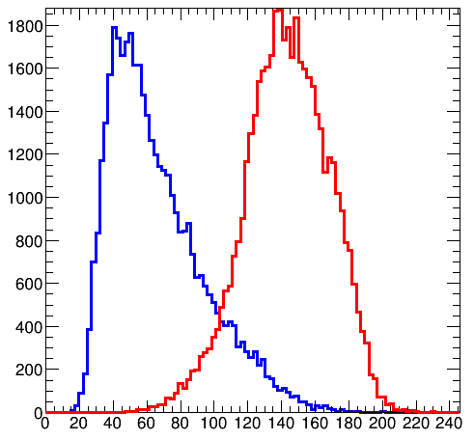
Event preselection for polar angle
Sort jets by b-tag
B-tag cuts: 0.8 for a high-tagged jet and 0.3 for a low-tagged jet
For Z return rejection:
  Invariant mass > 180 GeV and maximum photon energy < 40 GeV
For diboson background rejection
  Sum of jet masses < 120 GeV
Efficiency of the preselection is 55% for both polarizations

Slide 9
Event selection
We are using kaon charge and vertex charge combination to define a charge of a bjet
Kaons are identified using generator information on each particle in a reconstructed secondary or ternary vertex
  but we introduce ~94% purity and 88% efficiency, according to our previous PID studies
Kaon charge is a sum of all kaons charges found in jet vertices, zero sum is rejected
Vertex charge is the sum of all secondary and ternary track charges in a jet, zero sum is rejected
Only independent combinations are used to avoid charge correlations in the final result:
  Vertex charge from one jet, vertex charge from another jet
  Kaon charge from one jet, kaon charge from another jet
  Event is accepted if charges are opposite

Slide 10


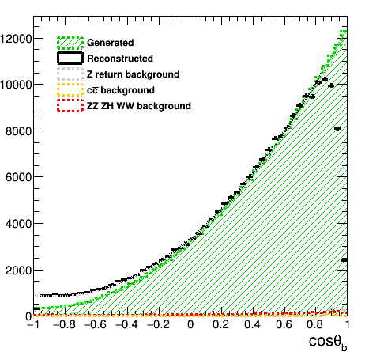
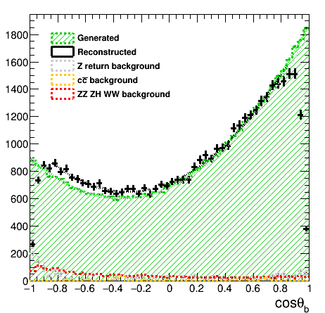
Polar angle reconstruction+bkg
The background is small due to the preselection cuts and the high signal cross section
Further plots for signal only

Slide 11
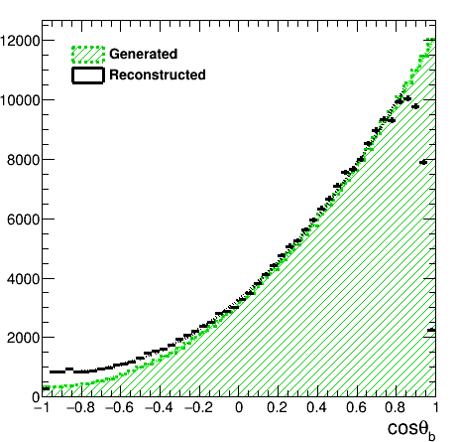
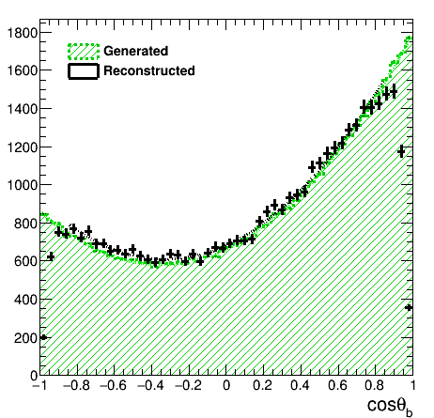

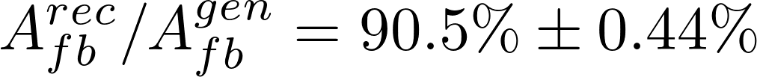
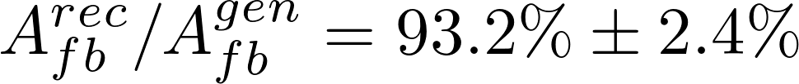
Bottom polar angle reconstruction
Forward region inefficiency is seen in both figures
The residual charge misreconstruction contaminates completely the backward region in the left-handed case

Slide 12


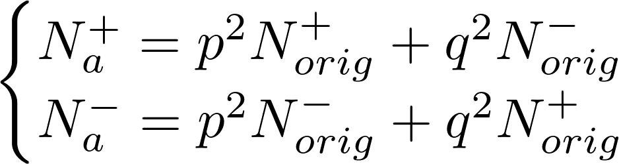
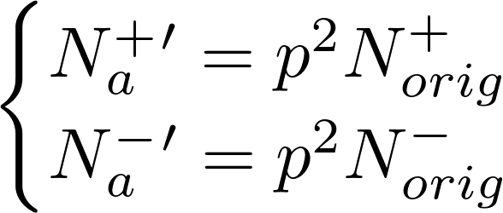
Charge purity and polar angle correction
We can use refused events with contradictory charges as a measure of our charge purity and calculate correction factors
Let p be a probability of a correct charge measurement of a jet
Then q = 1 – p is an incorrect charge probability
We can compute it from the following equations:
We define a number of original events:
Corrected values:
We do not use generator information for correction
# of refused events
# of accepted events
Original number of non-migrated
events in the forward/backward bins
Migration terms

Slide 13
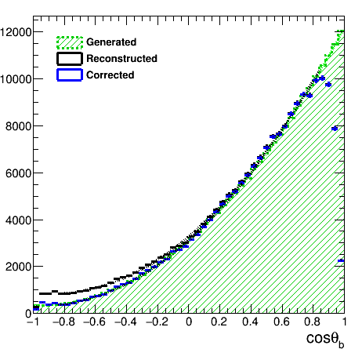
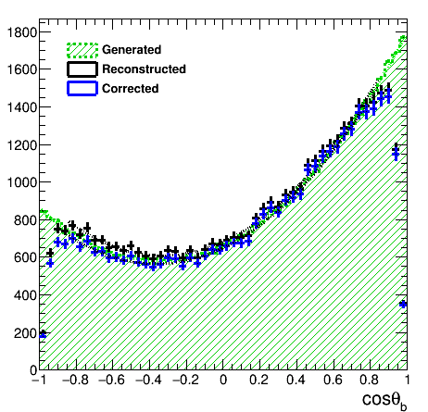
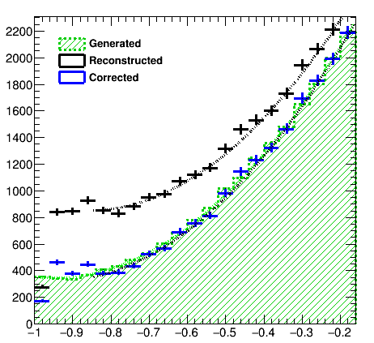
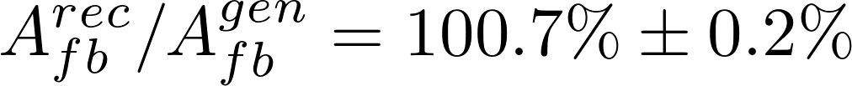
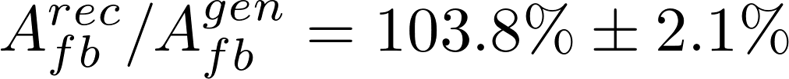
Polar angle reconstruction
The computed corrected distributions are much closer to the generated ones
After correction, one has a long lever arm for the extraction of relevant quantities

Slide 14
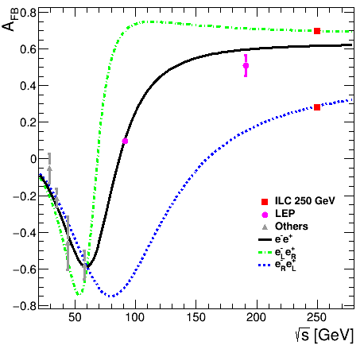
Overview of A_{FB} measurements
Forward-backward asymmetry in SM
arXiv:hep-ph/0610173v1
The A_{FB} value and the uncertainty is determined from the fit to the reconstructed curve
The measurements at Z pole are the most precise

Slide 15
Determination of the Form Factors
The top paper uses AFB and total cross section measurement approach
We are measuring the differential cross section
where the S A are
We have 4 observables and 4 electroweak form factors to estimate independently

Slide 16
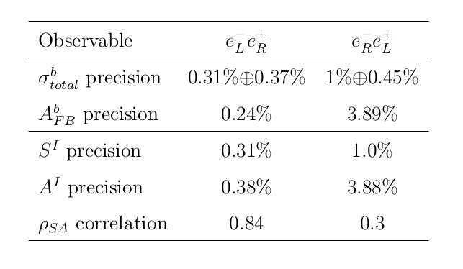
Reachable accuracies at the ILC
The accuracies reachable after the first run at 250 GeV:
The luminosity sharing between two beam polarizations prefers the e_{L}p_{R} case (67.5% vs 22.5%)
  Higher statistical uncertainties for e⁻_{R}e⁺_{L}
The statistical precision for the e⁻_{L}e⁺_{R} case is excellent:
  One needs to estimate the systematic effects

Slide 17
Conclusions
The b-quark polar angle is well reconstructed in the ILD environment, but there are two major problems
  The residual b charge impurity cause a tilt in the polar angle spectrum
    It was successfully corrected by the developed data-driven procedure
  There is a large inefficiency in the forward region of the ILD
    The ILD collaboration started to review the forward region layout (cables, FTD position)
The statistical uncertainties on the measured observables the <0.5% level for the e_{L}p_{R} case and at the level of 1-3%
See the talk by Francois Richard on 09/06 about the interpretation of these results!

Slide 18
Thank you!

Slide 19
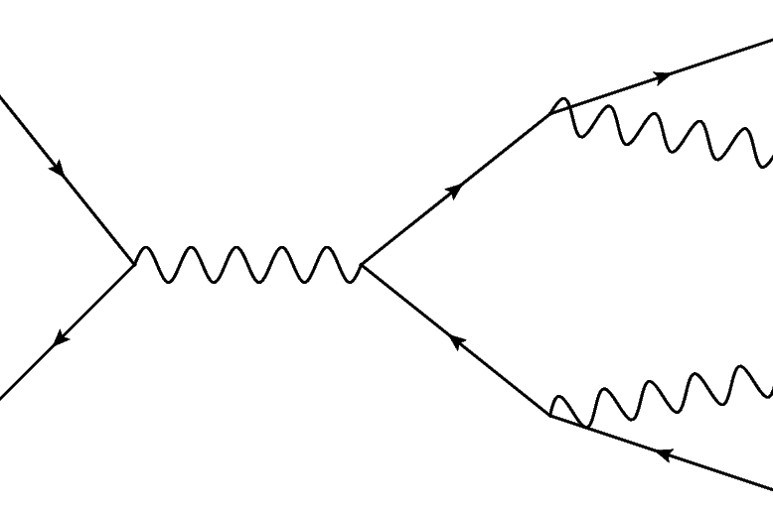
Heavy flavour at ILC
Measurement of the heavy flavour quarks at the electron-positron machines:
  Direct EW production
  No competing QCD production
Advantages of the ILC:
  Operating at increases the sensitivity to top axial form factors, minimizes the QCD uncertainties
  Polarized beams allow independent determination of the b-quark form factors
  Highly granular 4π detectors allow for precise final state reconstruction using PFA

Slide 20
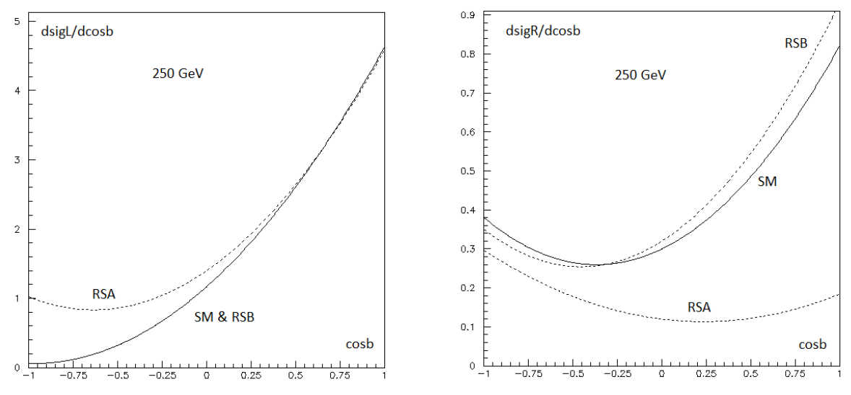
Motivation
F. Richard
F. Richard
Asymmetry is extremely strong for left-handed case
Different Randall-Sundrum scenarios can affect SM polar angle spectrum
arxiv:1105.3158

Slide 21
Event preselection for polar angle
Sort jets by b-tag
B-tag cuts: 0.8 for a high-tagged jet and 0.3 for a low-tagged jet
For Z return rejection:
  Invariant mass > 180 GeV and maximum photon energy < 40 GeV
For diboson background rejection
  Sum of jet masses < 120 GeV
Efficiency of the preselection is 55% for both polarizations
Final efficiency for the polar angle plots is 13%

Slide 22
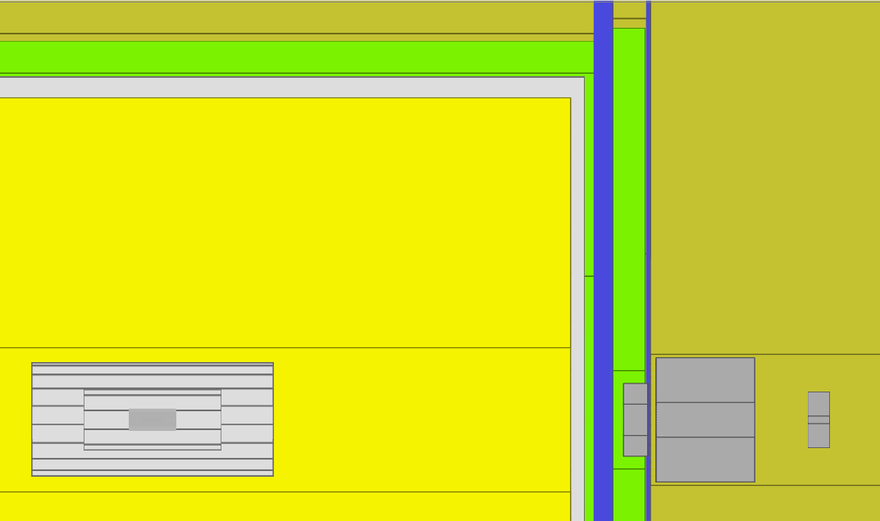
ECAL
Gap in TPC
Transition region
in calorimeters
TPC
ECAL
End of 6 layer barrel VXD
z
VXD

Slide 23
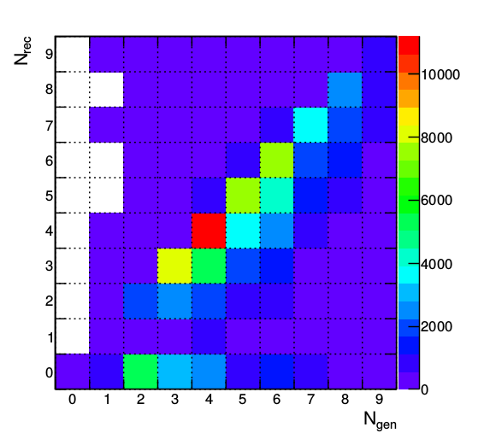
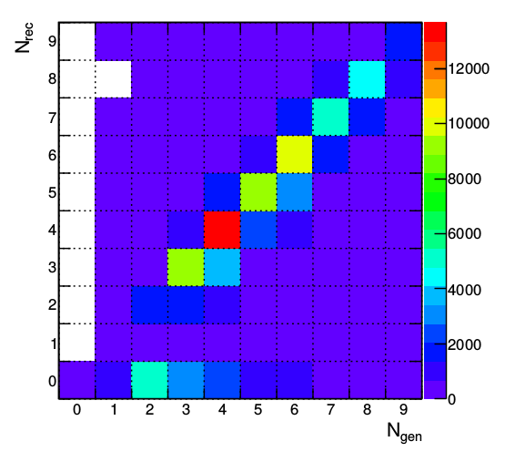
Vertex charge recovery improvement
49.0% on diagonal
62.0% on diagonal
The b-jet charge measurement requires very precise vertex reconstruction

Slide 24
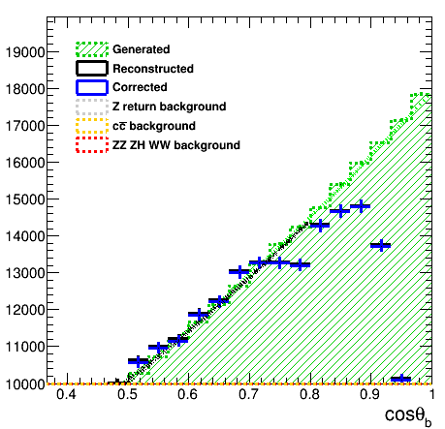
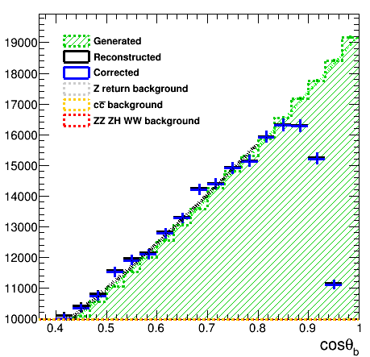
Recovery effects
Before charge recovery
After charge recovery
+7% of statistics
+4% of vertex purity
More kaons with the same purity
Constant charge purity in the barrel

Slide 25
Reducing angular dependence
Particle separation after reducing the dE/dx angular dependence
After correction dE/dx does have a better kaon separation properties
Selection cuts are optimized for dE/dx'

Slide 26
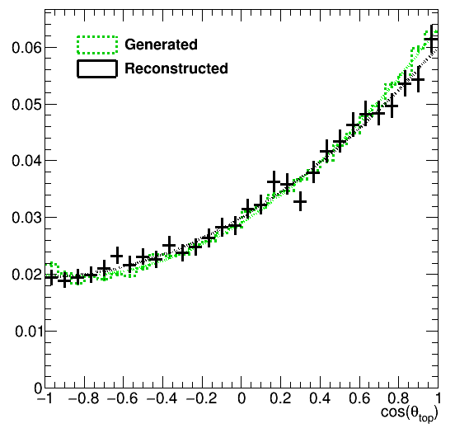
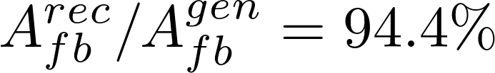
Top polar angle reconstruction
Vertex charge + kaons
94.4% precision
Top polar angle reconstruction using kaons and vertex charge combination. B-jet information only.

Slide 27
Vertex reconstruction quality
49.0% on diagonal
The b-jet charge measurement requires very precise vertex reconstruction.

Slide 28
Recovery effects
Before charge recovery
After charge recovery
+7% of statistics
+4% of vertex purity
More kaons with the same purity
Constant charge purity in the barrel

Slide 29
Recovery of vertices
x
z
IP – interaction point (primary vertex) , s – secondary vertex, t – point of closest approach of a track, p – reconstructed momentum, - offset of a track from primary vertex

