Slide 1
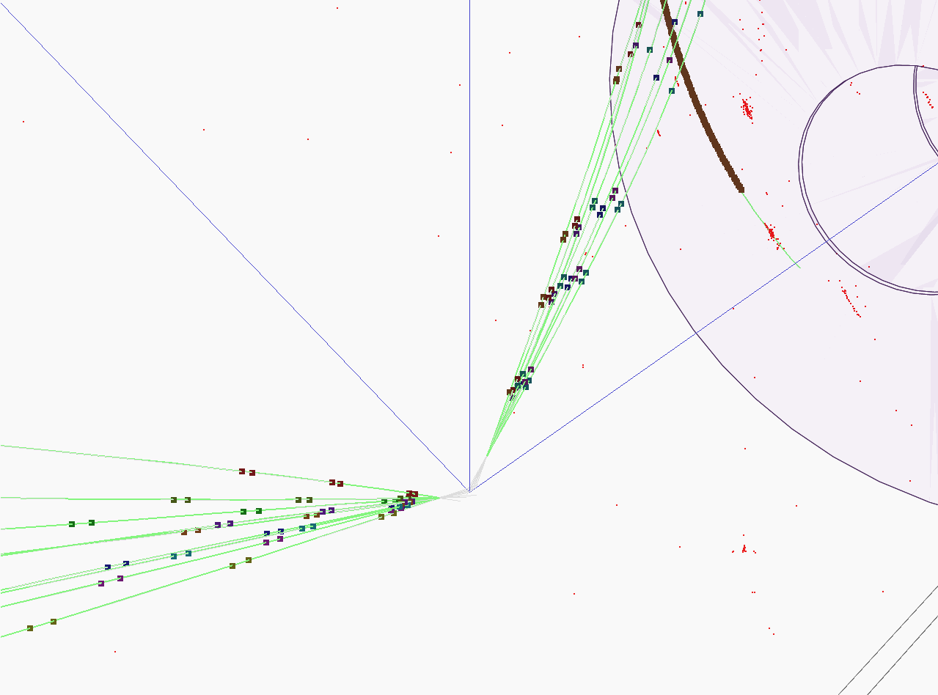


Hadronic showers in a highly granular silicon-tungsten calorimeter and
Production of bottom and top quark at the ILC
PhD candidate: BILOKIN Sviatoslav
Supervisor: PÖSCHL Roman
Orsay 2017

Slide 2
Content
Introduction
Hadronic showers in highly granular silicon-tungsten calorimeter
b-quark charge reconstruction
Top quark polar angle reconstruction
Bottom quark electroweak couplings measurement

Slide 3
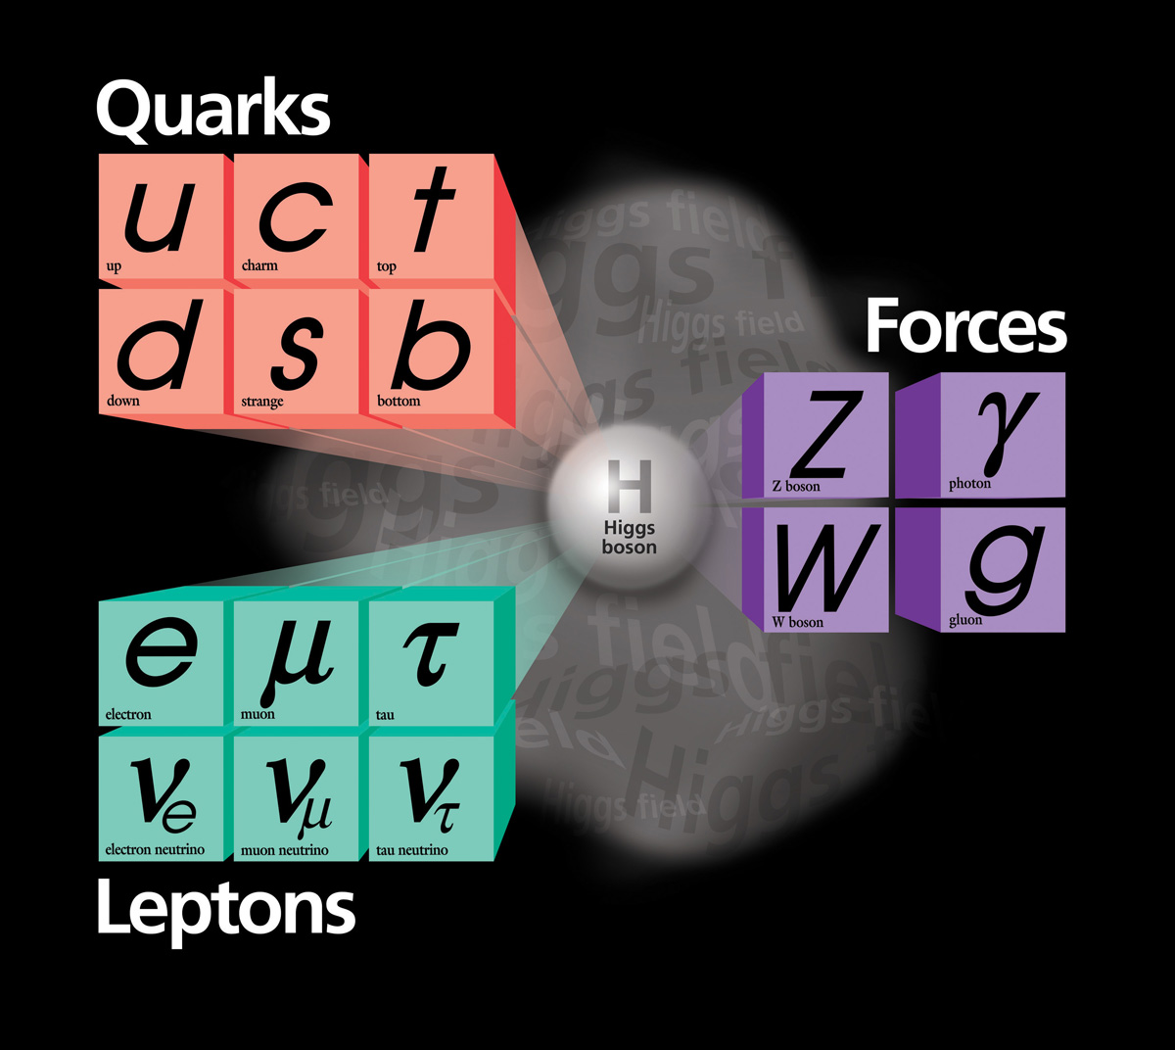
Standard Model of Particle physics
The Standard Model (SM) provides a consistent and precise theoretical description of known elementary particles and their interactions.
Theoretical framework was developed in 1960’s
Since then, the SM predicted many essential phenomena of Particle physics, like weak neutral currents and Higgs boson existence
It has been confirmed by a multitude of experiments

Slide 4
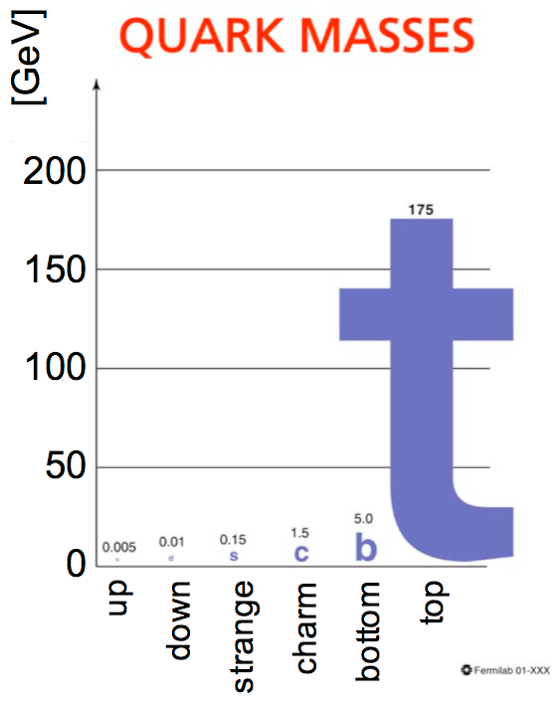
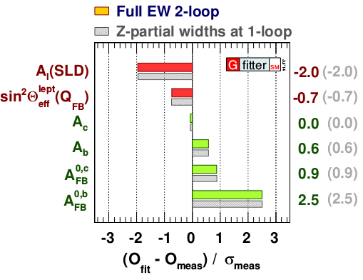
Motivation
The top and bottom quarks belong to one doublet
Top quark is the heaviest elementary particle in the SM
  heavy quarks carry an imprint of the Higgs mechanism
The top quark is a subject of many BSM theories,
  i.e. composite top or Randall-Sundrum models predict deviations for the EW couplings of the top quark
The b-quark forward-backward asymmetry A_{FB}^{b} measurement at LEP has 2.5σ deviation with the SM prediction
We need to measure precisely the bottom and the top quark EW couplings
arxiv: 1407.3792v1

Slide 5
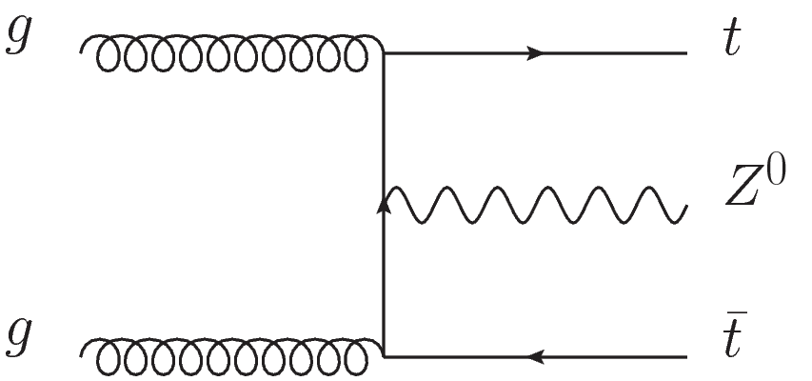
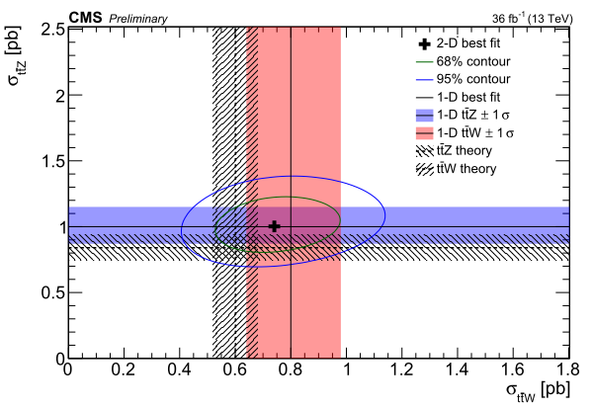
LHC results
The LHC has high production rates of the top and the bottom quarks
  Predominantly via QCD channels
The measurement of the and ttW couplings at the LHC requires studying the associated production
  Implies smaller cross sections
  The separation of the vector and axial-vector couplings is impossible at the LHC
A possible b-quark coupling measurements at the LHC cannot improve the LEP precision
The high precision measurements of the heavy doublet electroweak couplings are left for the future colliders
EPS-HEP 2017

Slide 6
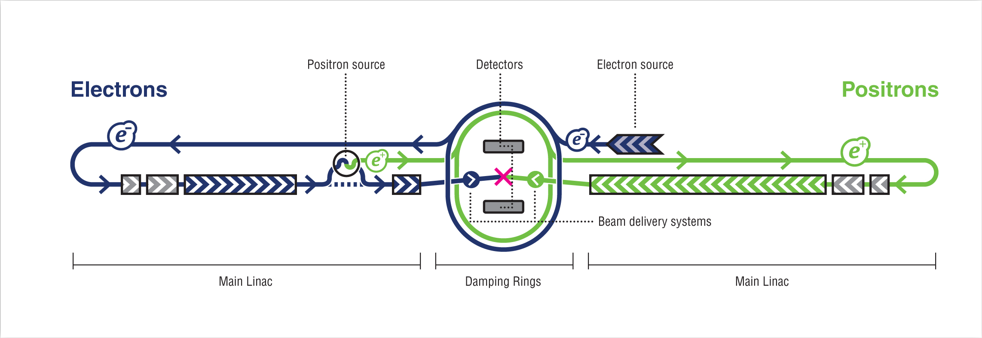
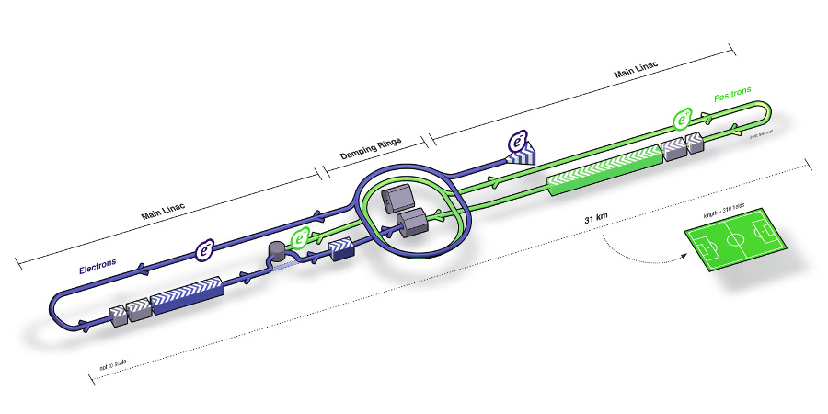
ILC project
Center-of-mass energy of 250 – 500 GeV with a 1000 GeV upgrade option
Polarized electron and positron beams
Two detectors, SiD and ILD
Well known state of initial particles, low machine background
Main goals:
  Precision measurement of Standard Model parameters
  Direct and indirect searches of Beyond Standard Model particles
The TDR has been released in 2013
arxiv:1306.6327

Slide 7
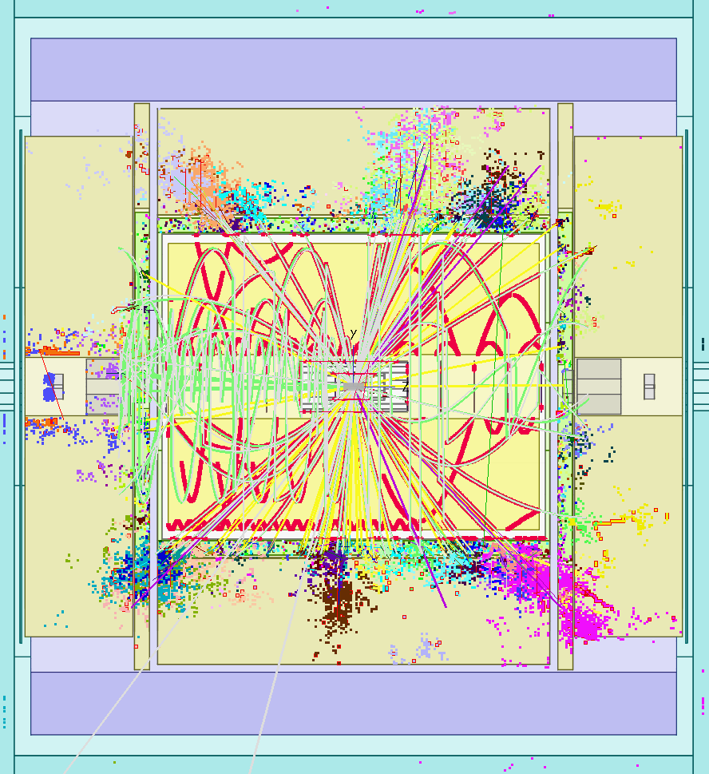
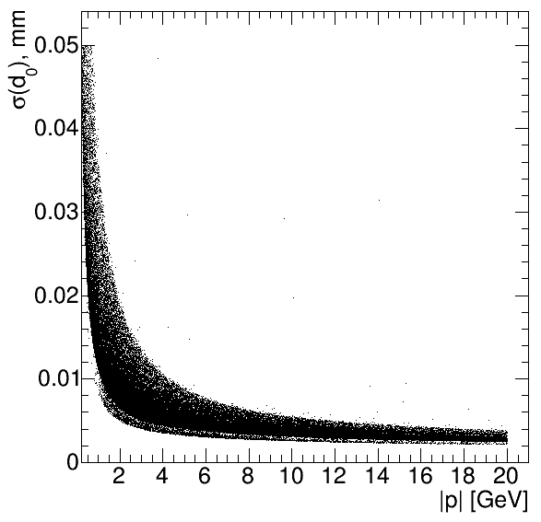
Detector requirements
The detector requirements are driven by the ILC physics program
Track momentum:
(1/10 x LEP)
Impact parameter:
(1/3 x SLD)
Jet energy resolution :
(1/2 x LEP)
Hermeticity :
Final state will comprise events with a large number of charged tracks and jets(6+)
  High granularity
  Excellent momentum measurement
  High separation power for particles

Slide 8
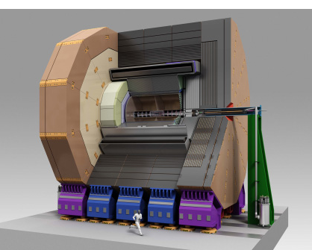
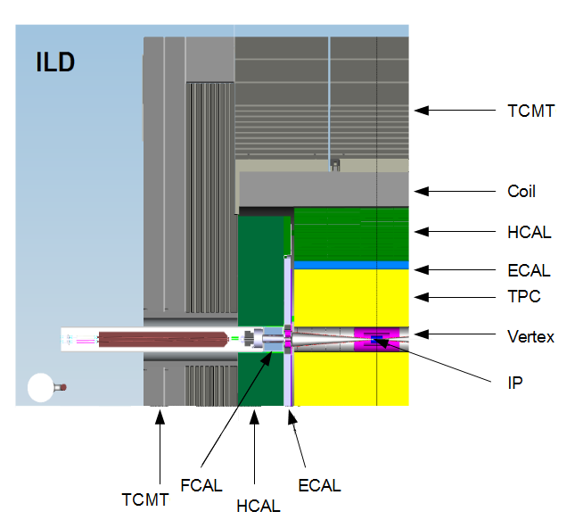
ILD project
Designed for Particle Flow algorithms
  Full GEANT4 simulation and event reconstruction
Hybrid tracking system: gas and silicon devices
  Vertex Detector (VXD) has 3 double layers of silicon pixels
  Forward Tracing Disks (FTD)
  Time Projection Chamber (TPC) with particle identification capabilities
  Other devices
Calorimeters:
  Highly granular silicon-tungsten Ecal (SiW Ecal)
  Highly granular iron Hcal
3.5T Solenoid
Muon trackers
7.8 m
VTX
FTD

Slide 9
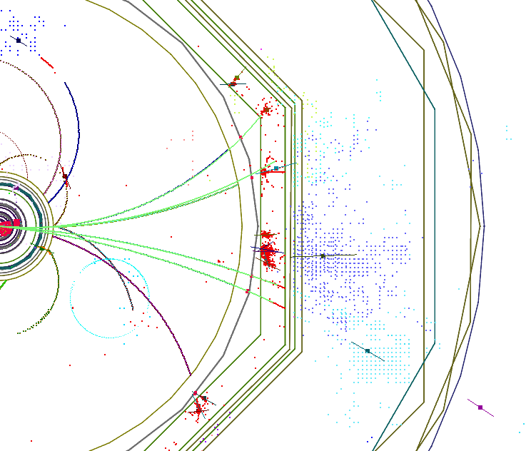
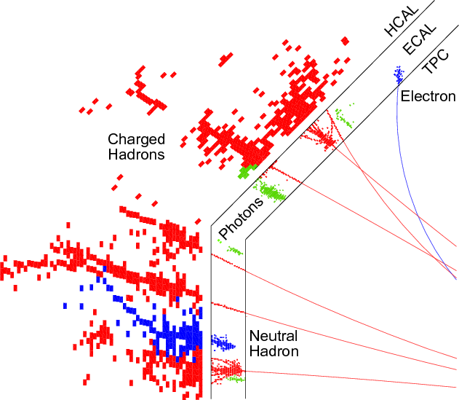
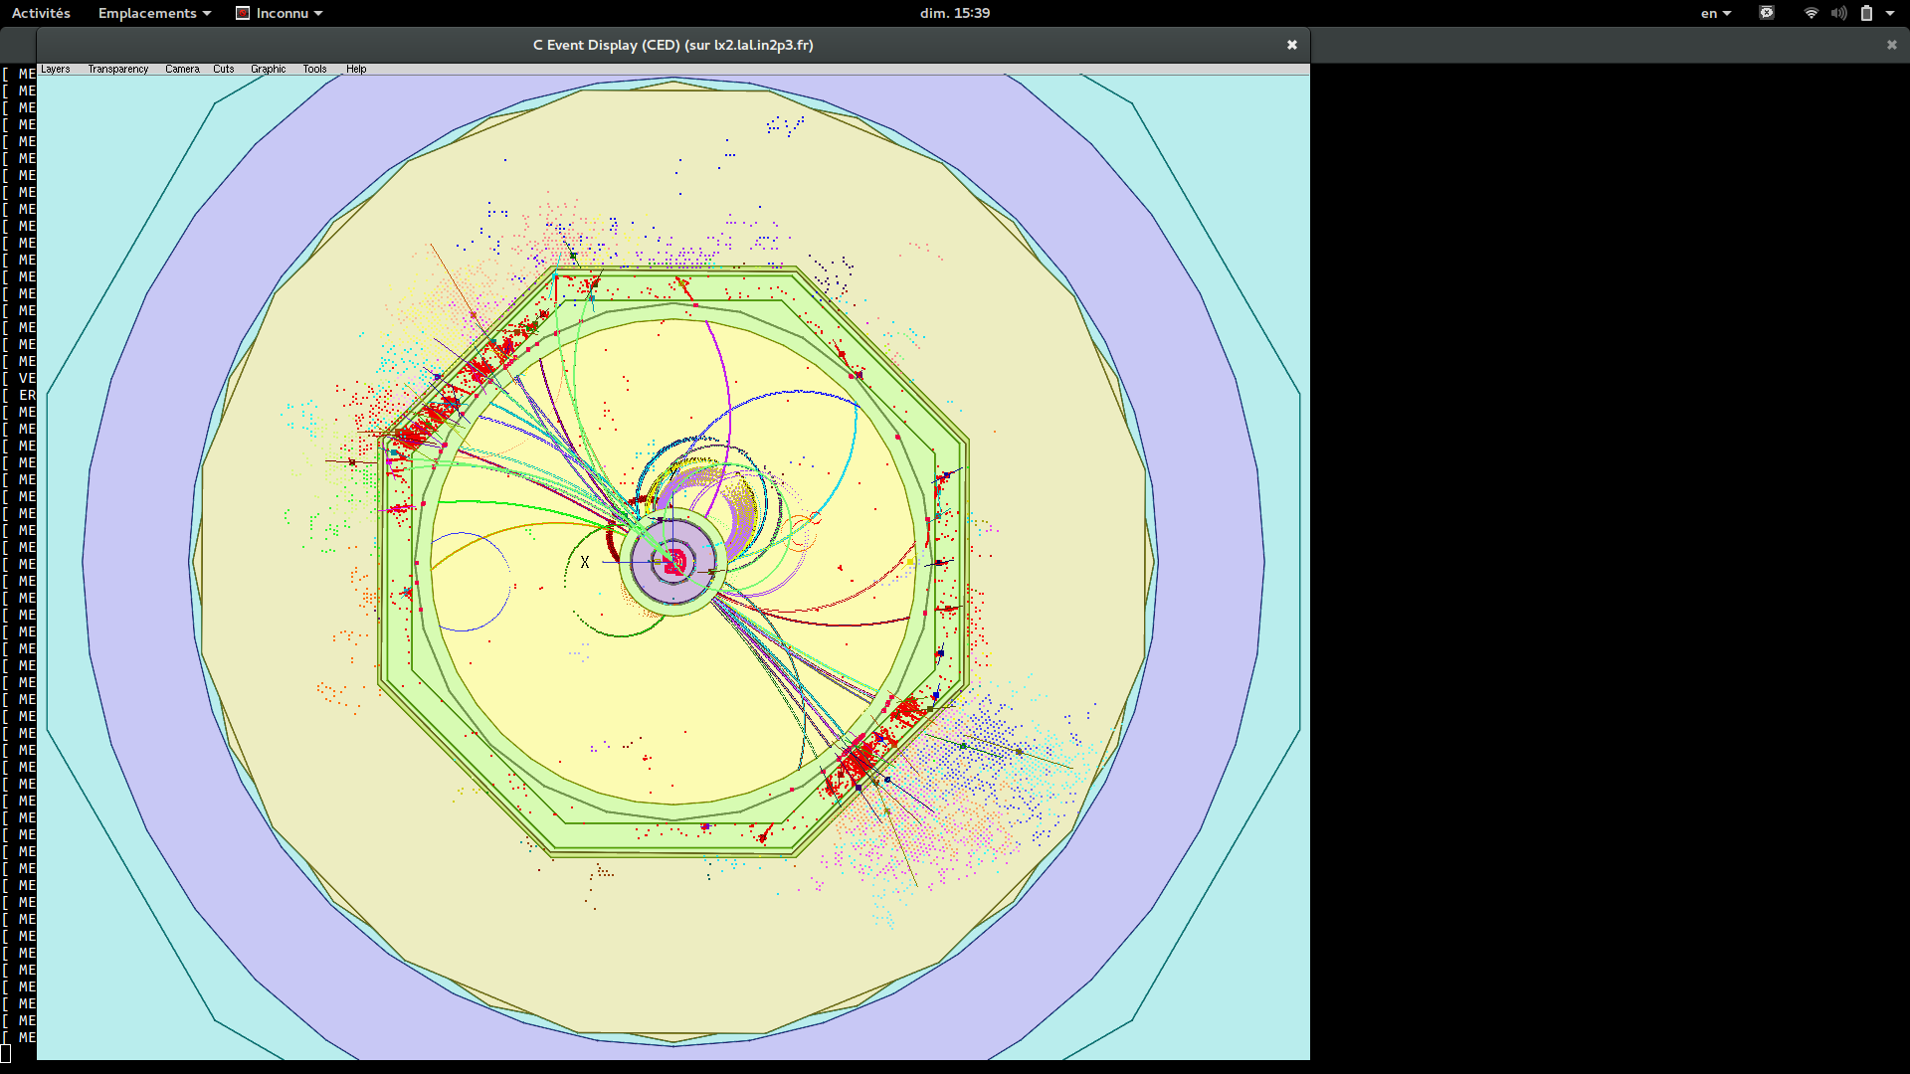
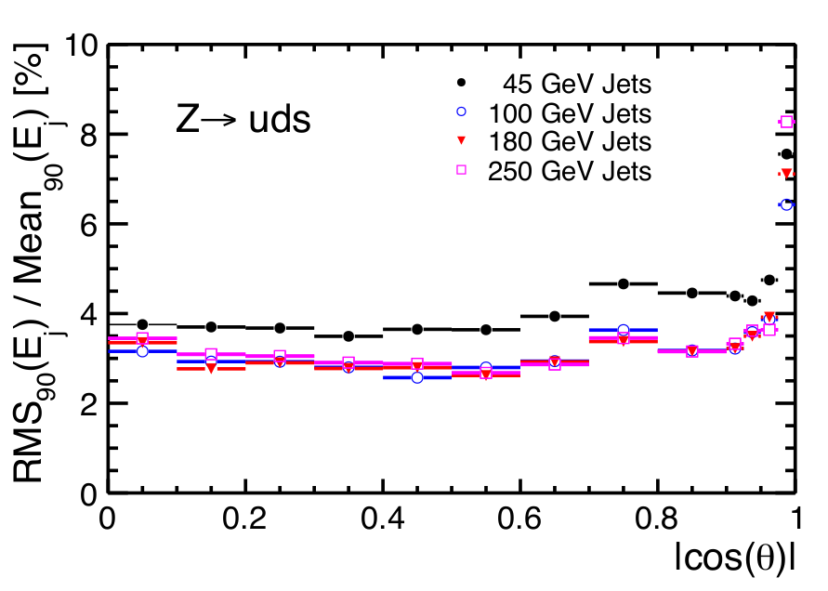
Particle Flow approach
Aimed at 3-4% jet energy resolution as required by the ILC physics program
The Particle Flow algorithms allow for reconstructing of individual particles inside the detector
Charged particle energy is measured by trackers, neutrals – in calorimeters
Implemented in PandoraPFA and ArborPFA
High granular calorimeters are essential for separation of the neutral from the charged particle clusters
ECAL
HCAL
TCMT
‘
TPC
TPC

Slide 10
Introduction
Hadronic showers in highly granular silicon-tungsten calorimeter
b-quark charge reconstruction
Top quark polar angle reconstruction
Bottom quark electroweak couplings measurement

Slide 11
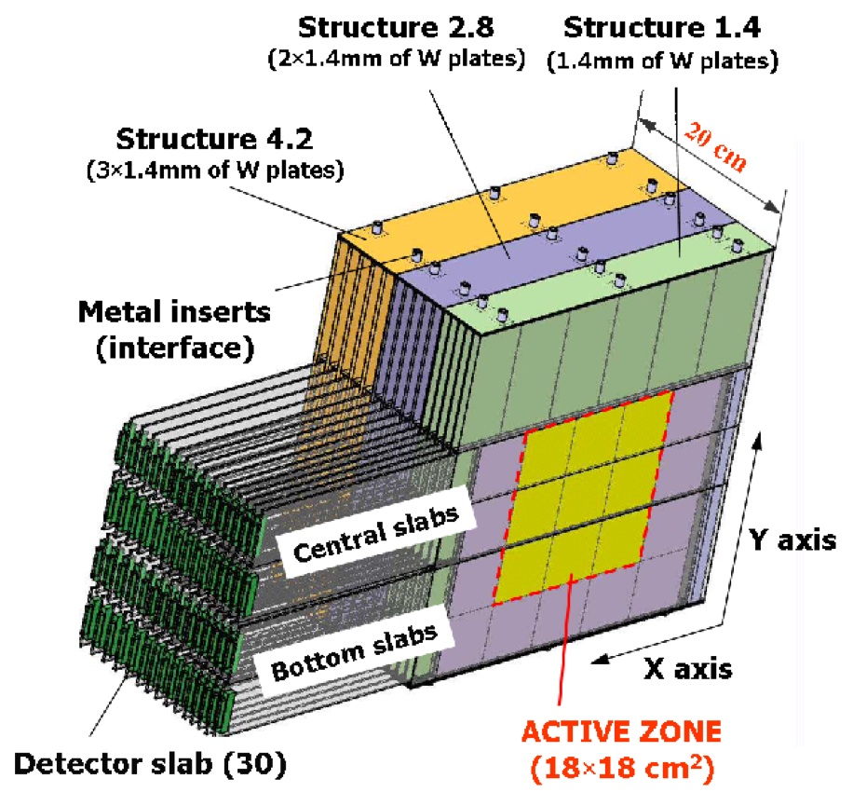
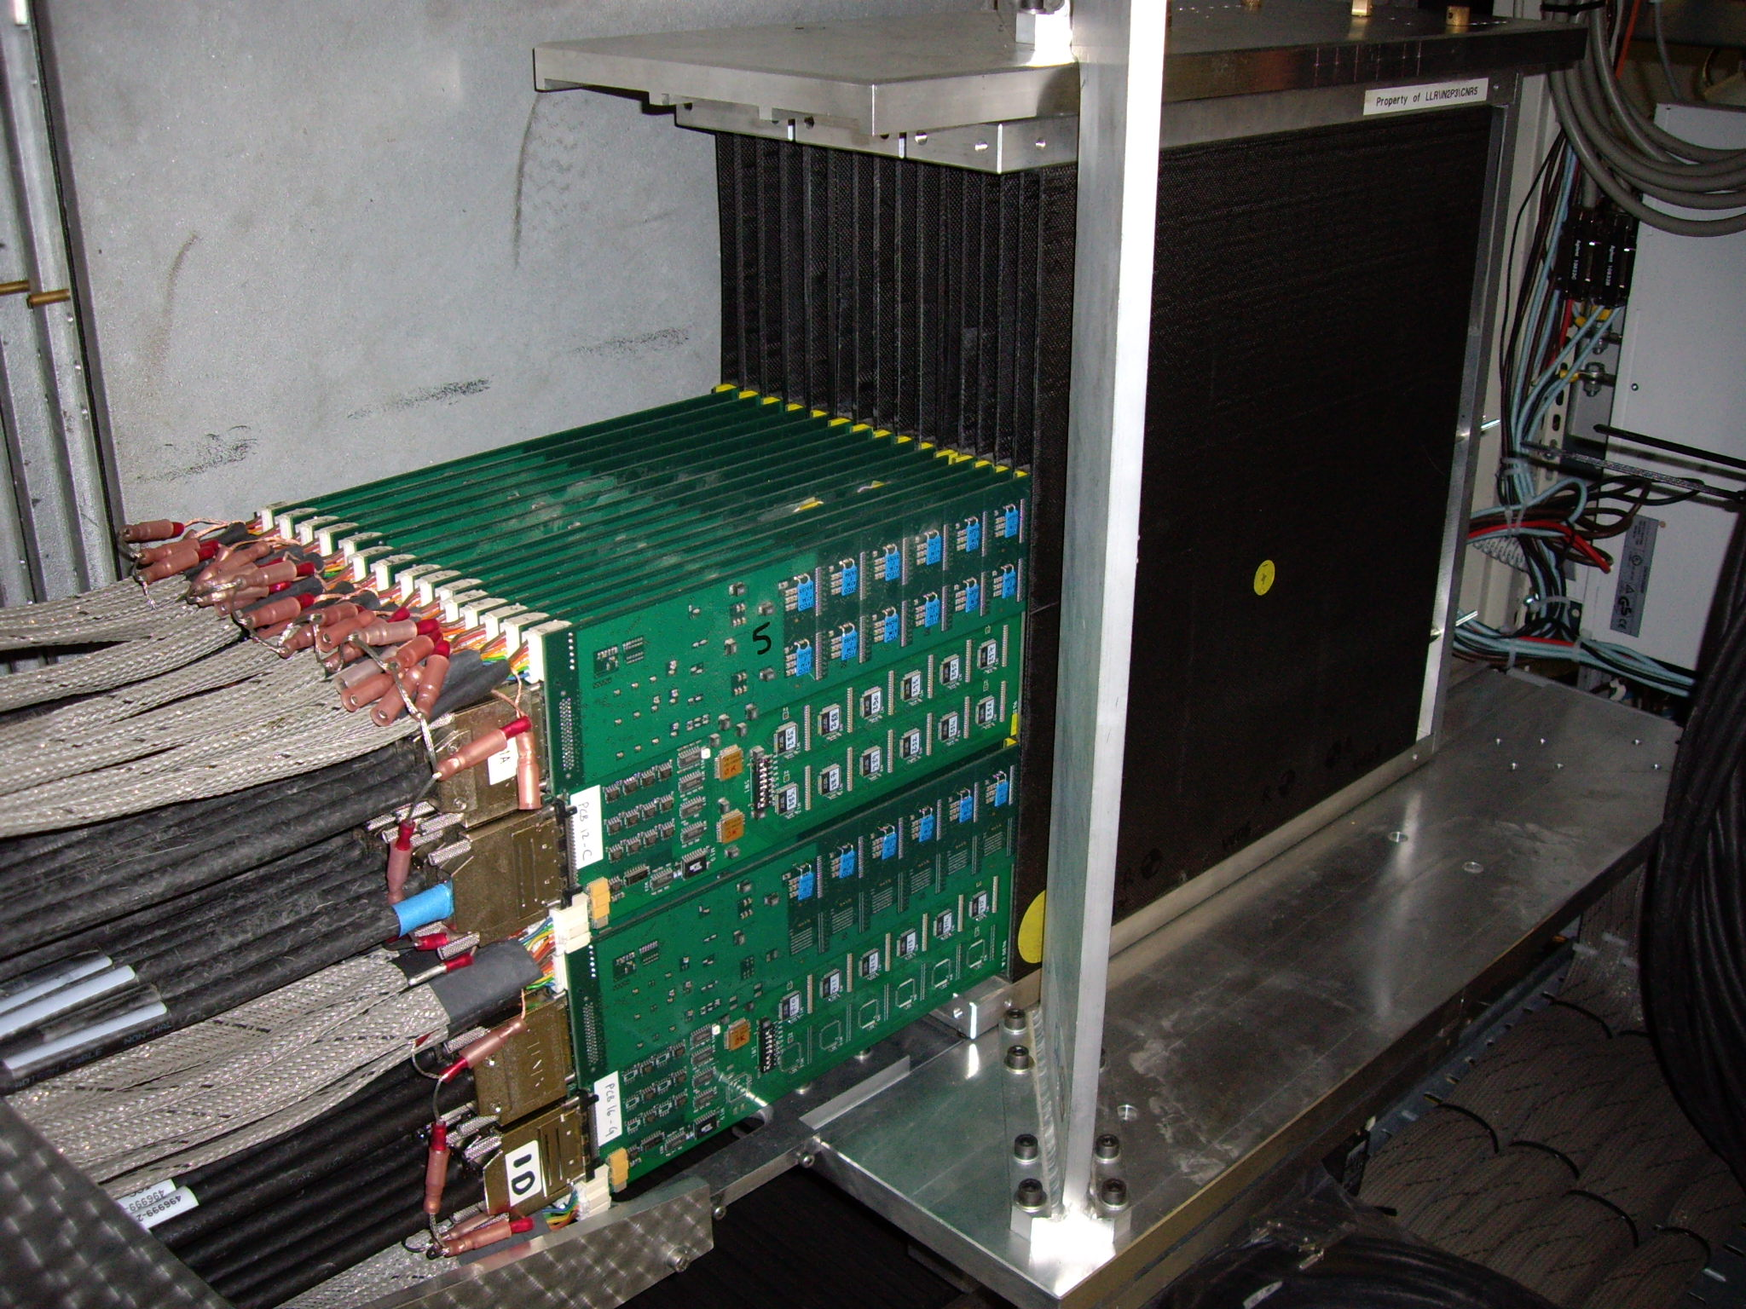
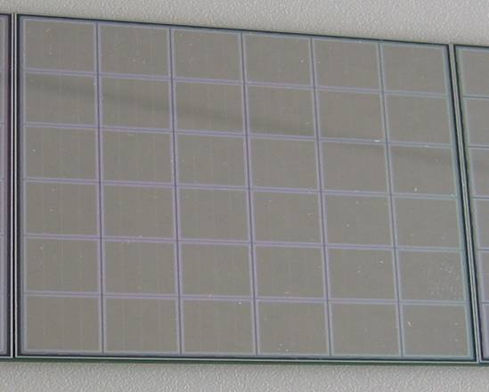
CALICE SiW ECAL physics prototype
Absorber: Tungsten
Active material: silicon P-I-N Diodes
Thickness 525 µm
Granularity: 10x10 mm²
Signal/Noise ~ 7.5
Three modules of 10 layers each
with increasing tungsten (W) thickness
Total depth:
Active Zone: 18x18 cm² in each layer
Total: 9720 Pixels/Channels

Slide 12
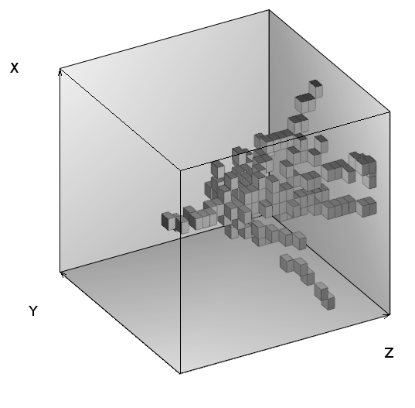
Introduction
High granularity of SiW Ecal allows for detailed investigation of first hadronic interaction
55% of the hadrons have first interaction in the Ecal
Test beam data recorded at FNAL in 2008 π⁻ between 2 GeV and 10 GeV
Analysis of global shower observables was published in NIM A794 (2015) 240
In this thesis, a tracking algorithm has been developed to separate hadronic showers in terms of primary particle, interaction region and outgoing secondary tracks
Compare various Monte Carlo models to the data using new set of differential observables from track finding algorithm
  Validation of existing simulation models
10 GeV pion in SiW ECAL prototype

Slide 13
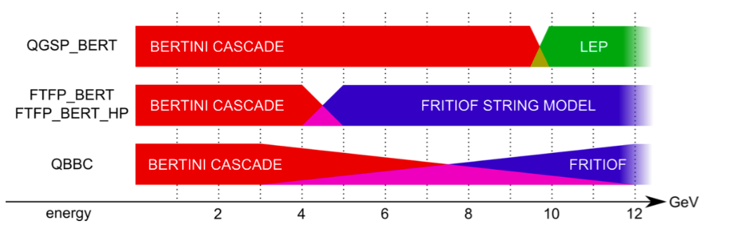
GEANT4 Physics lists
Presented study covers interesting energy range (2-10 GeV):
Energy range of majority of charged pions and other hadrons within high energy (LC) jets
GEANT 4 is lacking precise thin tungsten data input
Transition region for many physics lists
GEANT4 v.10 used:
  FTFP_BERT, QGSP_BERT and QBBC physics lists

Slide 14
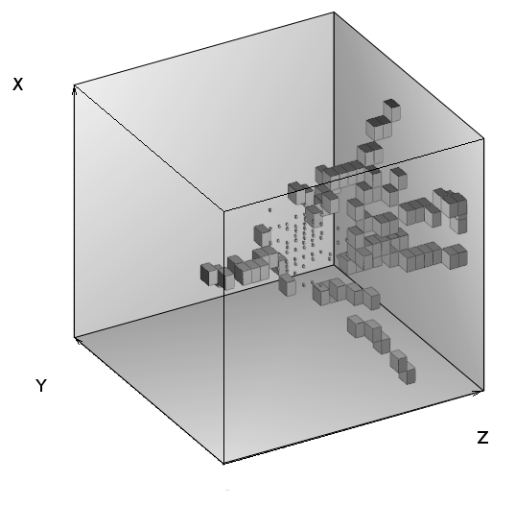
Hadronic shower analysis
An event after selection cuts

Slide 15
Hadronic shower analysis
Tracks from
secondary particles
MIP energy range,
Number, Polar angle, etc.
Track from
primary pion
MIP energy range
Interaction region
All hits with at least six
neighbouring pads with signal
Energy fraction, Radius

Slide 16
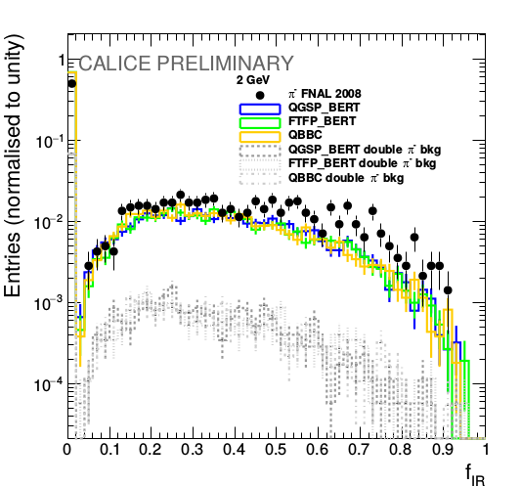
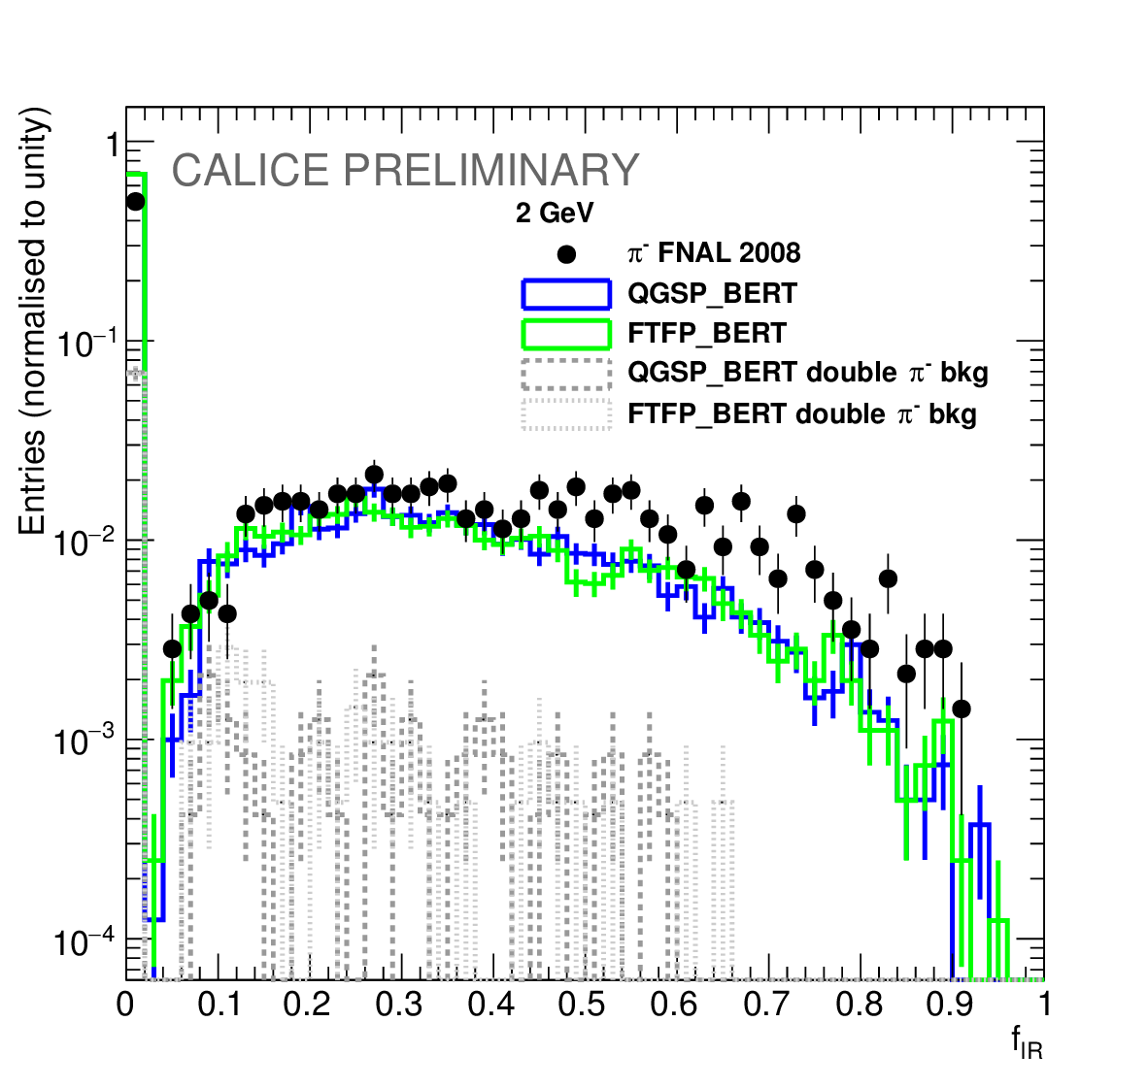
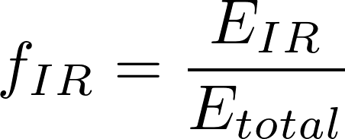
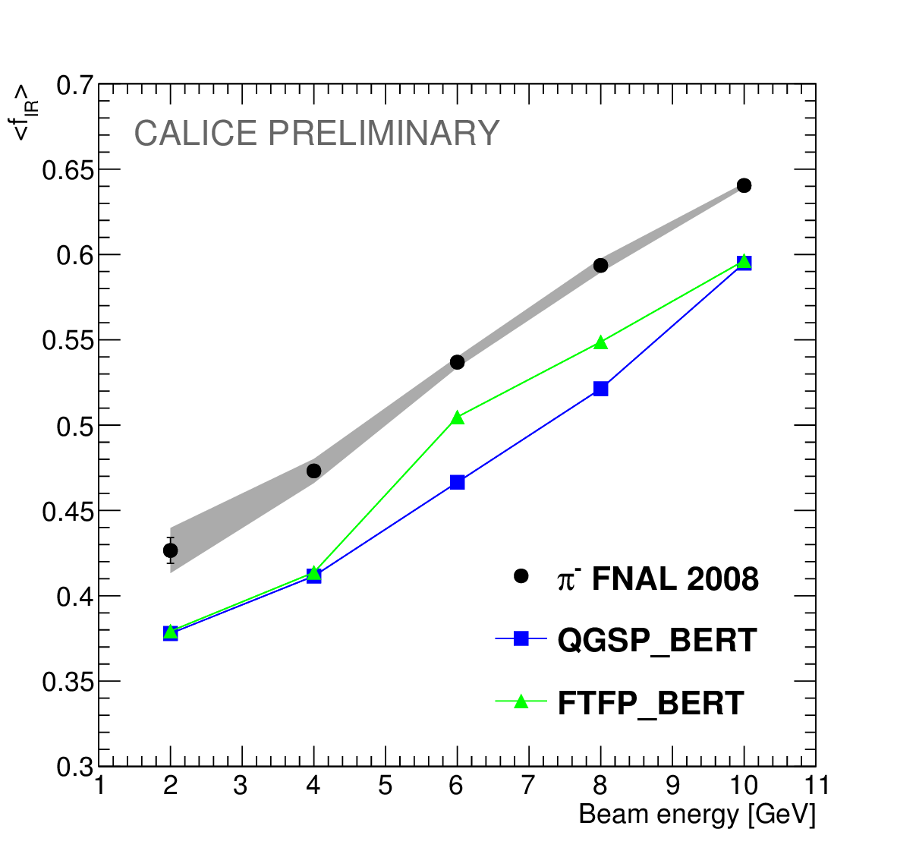
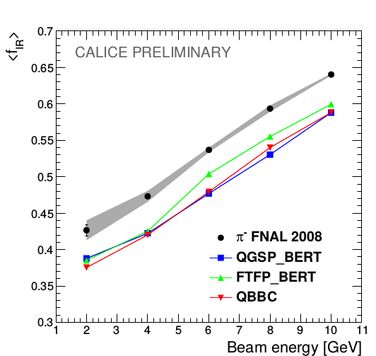
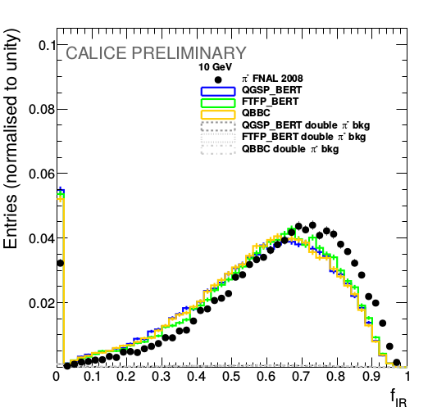
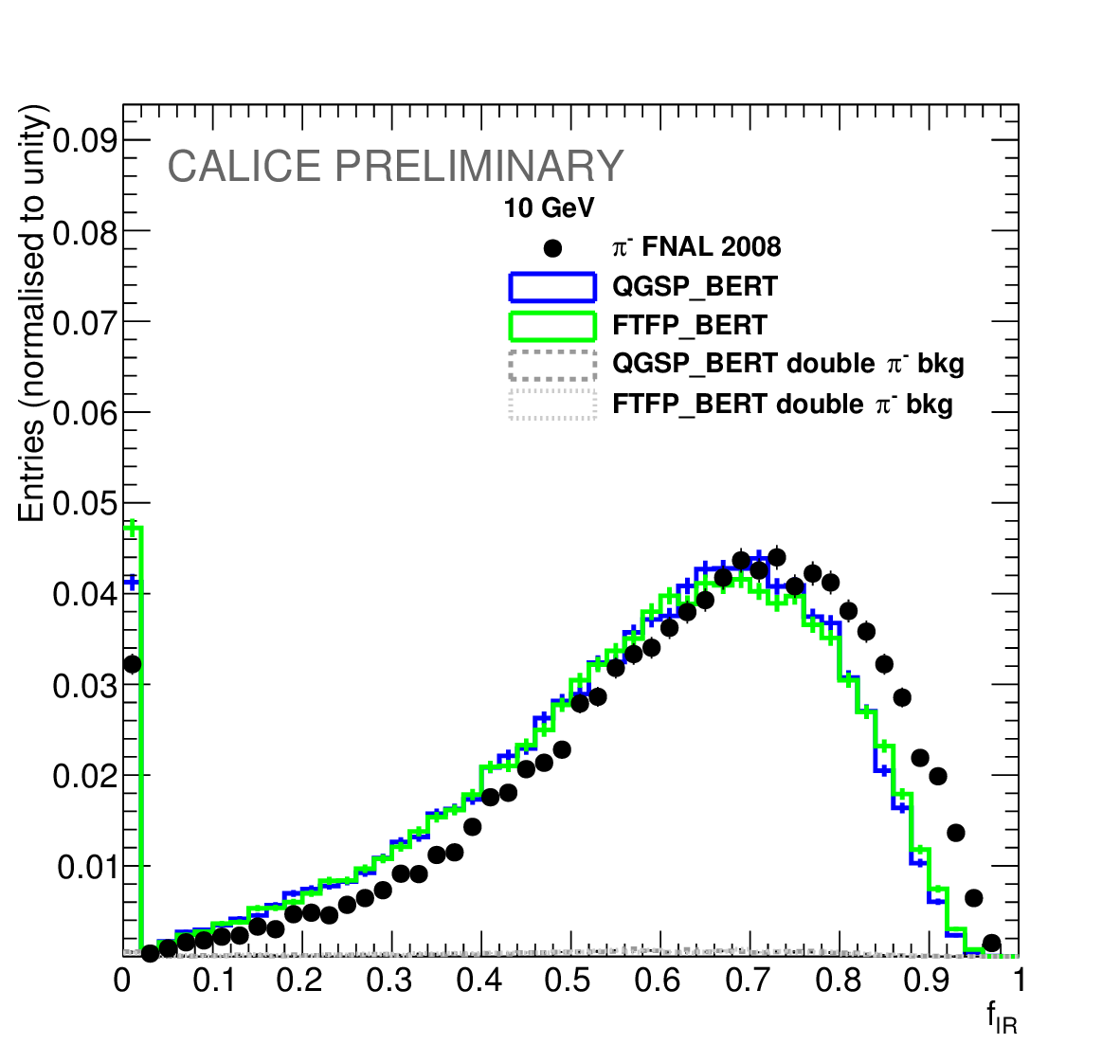
Energy fraction of the interaction region
2 GeV
10 GeV
The mean energy fraction is 8% - 15% higher in the data events compared with presented physics lists

Slide 17
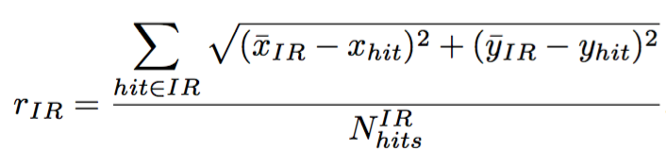
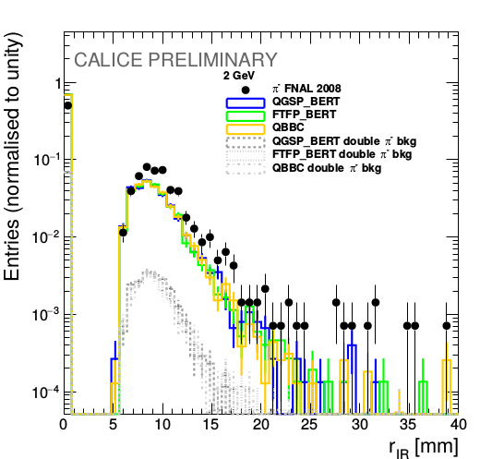
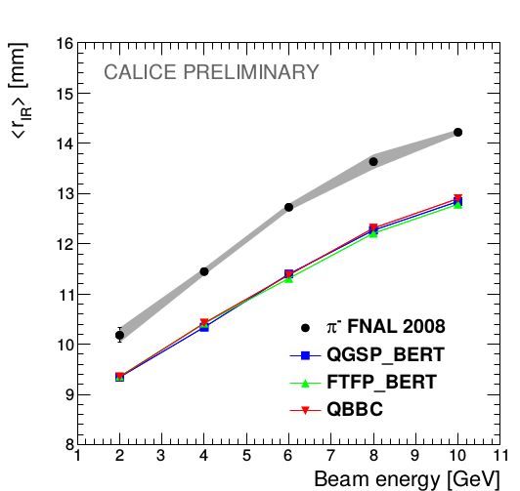
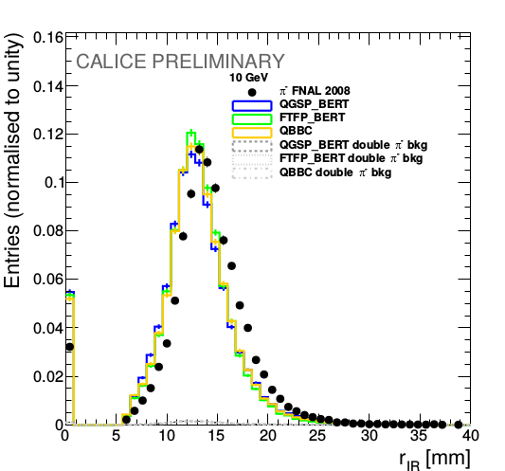
Lateral radius of the interaction region
2 GeV
10 GeV
Data has 9% wider interaction region than Monte Carlo for all beam energies.

Slide 18
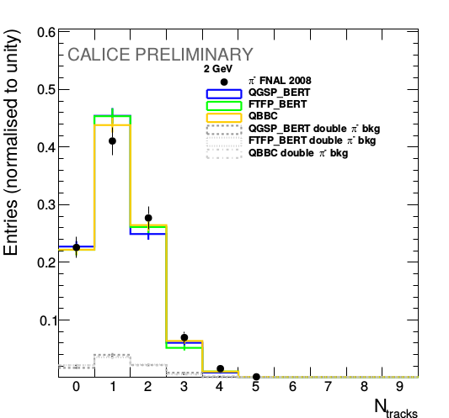
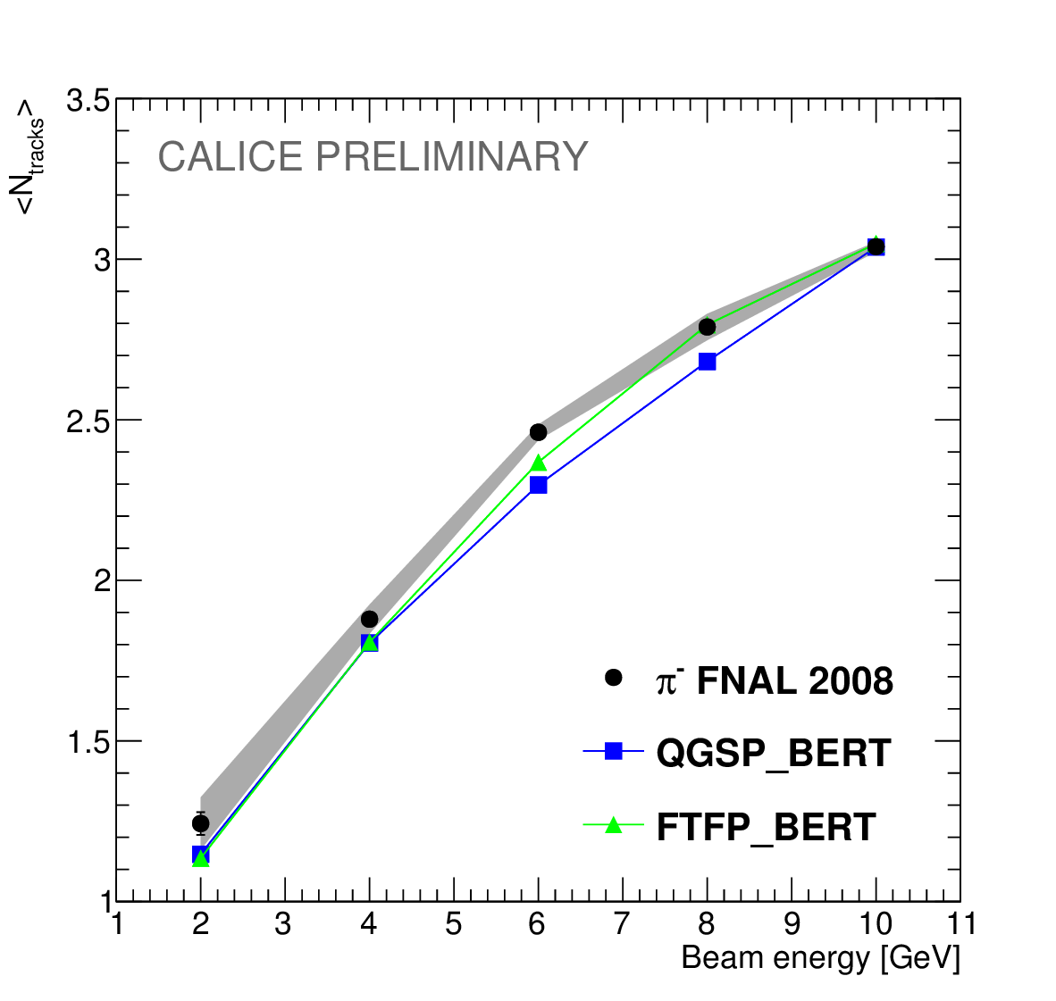
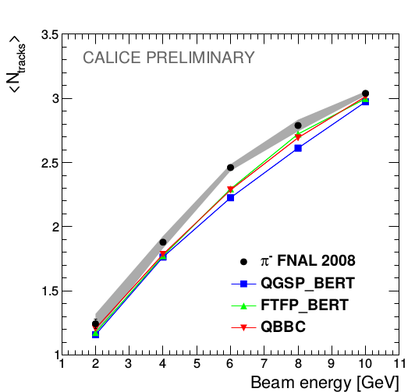
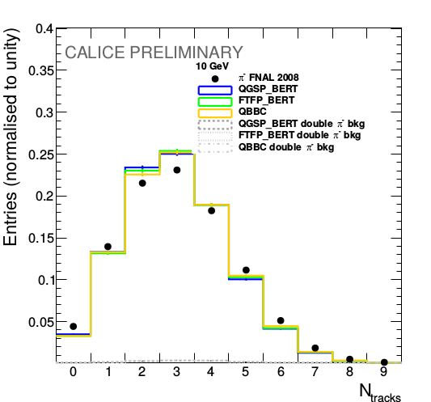
Number of secondary tracks
2 GeV
10 GeV
Well reproduced by MC
Both simulation models agree with the data within 5% of precision.

Slide 19
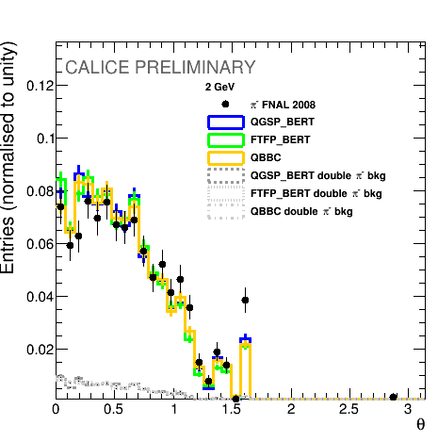
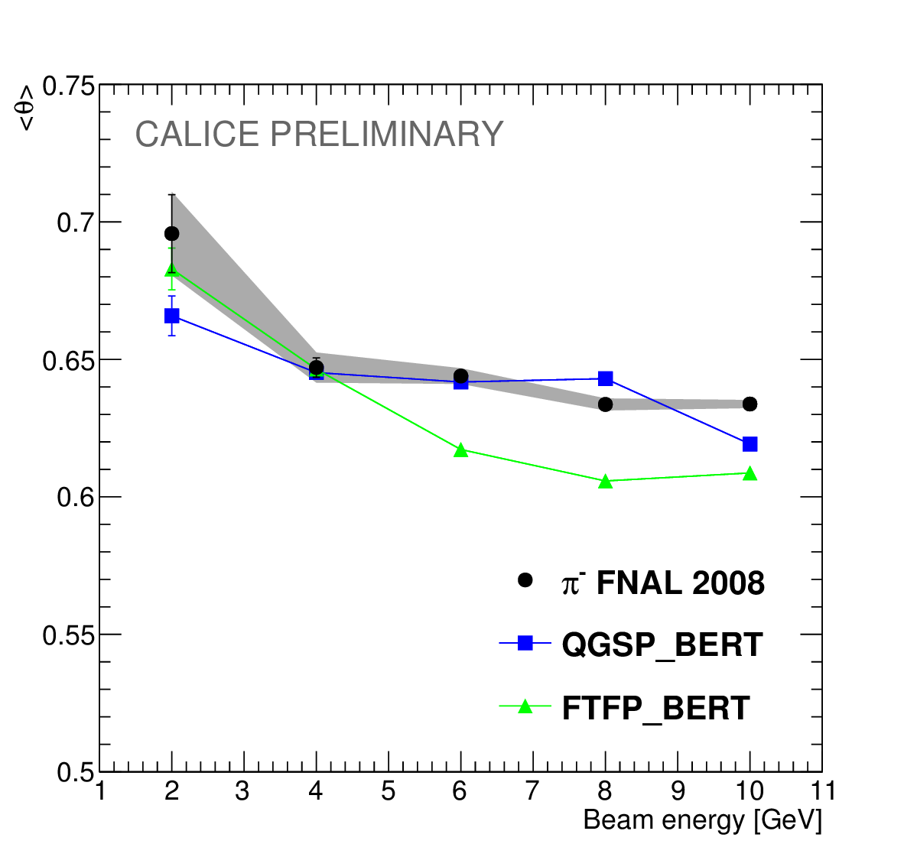
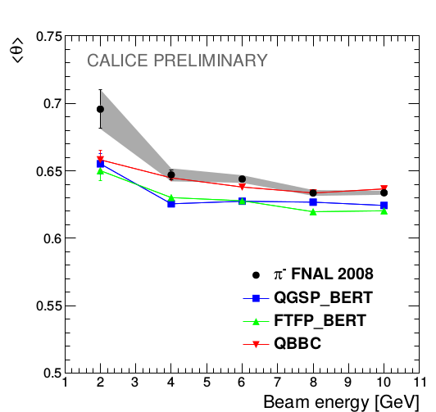
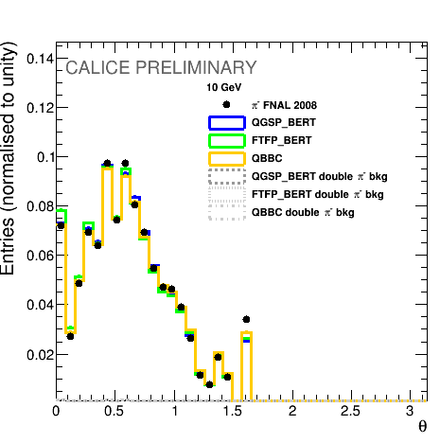
Polar angle distribution
Polar angle is defined w.r.t. the beam axis
2 GeV
10 GeV
Both simulation models agree with the data within 5% of precision.

Slide 20
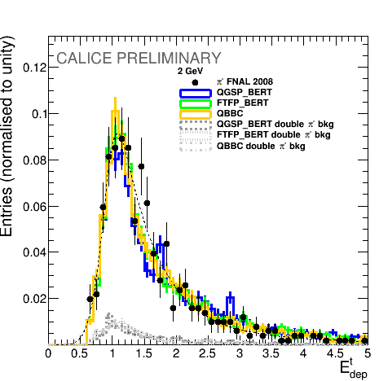
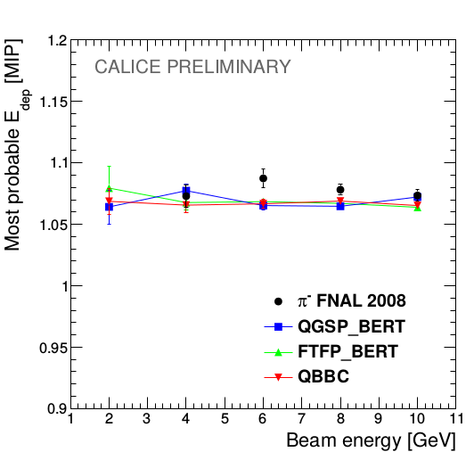
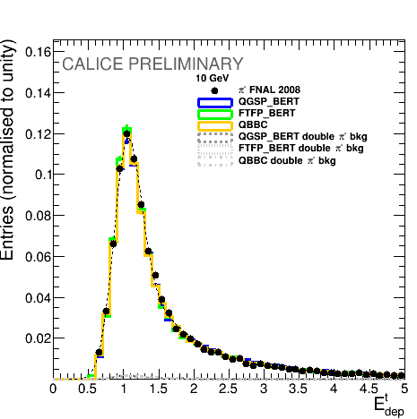
Energy deposition study
The produced particles act like MIPs, therefore, their energy depositions follow the Landau distribution
2 GeV
10 GeV
Both simulation models agree with the data within 2% of precision.
Can be used for in-situ monitoring and/or calibration

Slide 21
Conclusion of the study
A detailed investigation of the hadronic showers has been done using the developed track-finding algorithm
All three presented physics from GEANT4 v10 lists show a good performance in terms of new tracking observables
The largest discrepancy found in energy fraction and radius of the interaction region - up to 15% difference
The systematic effects of the algorithm and double pion background events are studied and taken into account
The developed track finding algorithm can be used for in-situ calibration and/or monitoring
  The algorithm can be used for a potential PFA improving by following the tracks to the Hcal
The GEANT4 v9.6 results are described in the CALICE note CAN-055 and were presented at
  IEEE/NSS MIC 2016
  VCI 2016
A paper publication with GEANT4 v10 is on going
GEANT4 team has acknowledged these studies

Slide 22
Introduction
Hadronic showers in highly granular silicon-tungsten calorimeter
b-quark charge reconstruction
Top quark polar angle reconstruction
Bottom quark electroweak couplings measurement

Slide 23
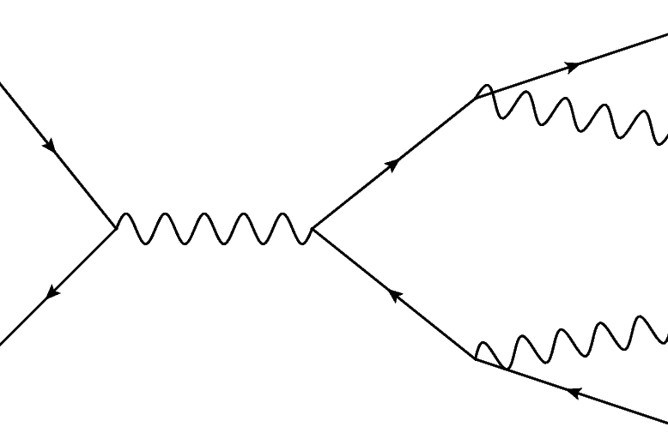
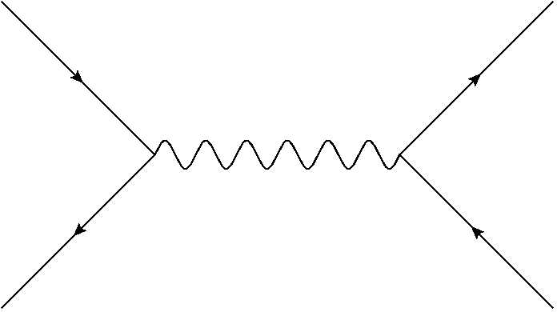
Heavy flavour at ILC
Measurement of the top and the bottom quarks at the electron-positron machines:
  Direct EW production
  No competing QCD production
Advantages of the ILC:
  Operating at minimizes the QCD uncertainties for top quark analysis
  Polarized beams allow independent determination of the b-quark EW couplings at
The analysis of these channels, particularly, the quark polar angle measurement require the b-quark charge reconstruction

Slide 24
Observables
The quark polar angle spectrum can be parametrized as
where S^{I} and A^{I} are fitted parameters, proportional to the ‘ideal’ observables:
  Total cross section
  Forward-backward asymmetry
The total cross section is computed as
The forward-backward asymmetry is defined as:

Slide 25
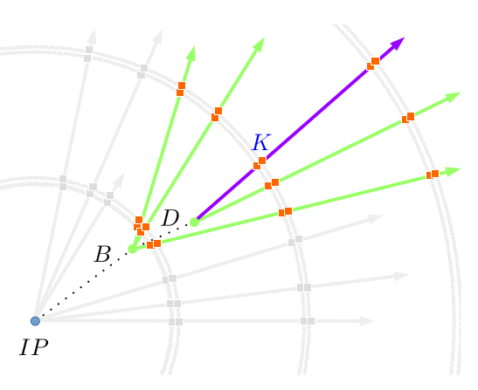
Objective
The b-quark charge purity was measured to be at the level of 60% in fully hadronic top pair decays
Properties of decay products from the b-hadrons are used to determine the charge of initial b-quark
Charge of the b-quark is calculated as a sum of the charges of secondary and tertiary vertex particles
The charge of K-mesons from reconstructed vertices is directly connected to the initial quark charge

Slide 26
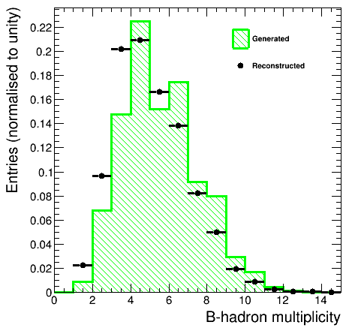
Generated vertices study
The generated vertices are selected by TruthVertexFinder algorithm
The average number of associated particles is about 5.5, which allows for a good vertex reconstruction
The reconstructed distribution has lower multiplicity than generated one

Slide 27
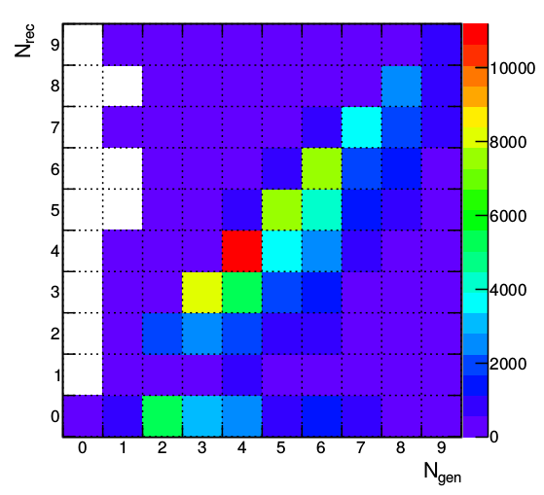
Standard reconstruction performance
Diagonal entries - 49%
Diagonal entries are ideally reconstructed
The reason behind the b-quark charge impurity is the missing prongs by the reconstruction algorithms

Slide 28
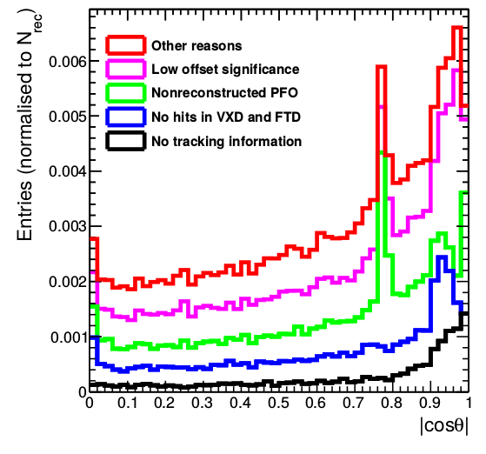
Missing particles
About 10% of the generated prongs are missing from the reconstructed b-hadron vertices
The reasons behind the missing prongs are:
  No corresponding reconstructed track – 0.93%
  Track has no associated hits in FTD or VXD – 2%
  Track has no reconstructed Particle Flow Object – 3.2%
  Low generated offset or momentum – 3.1%
  Other reasons – 1.7%
10.4% missing
One sees the peaks, which are explained on the next slide
One can develop a recovery algorithm which will add the missing prongs back and enhance the b-quark charge purity

Slide 29

ECAL
Cathode plates in TPC
Transition region
in calorimeters
TPC
ECAL
End of 6 layer barrel VXD
z
VXD

Slide 30

Vertex Charge Recovery algorithm
The developed VertexChargeRecovery uses two separation variables:
  Offset significance
  Angle between the vertex position and the track candidate direction
The defined cuts are:
x
z
Missing prongs
Background
Ratio

Slide 31




Recovery results
Standard
VertexChargeRecovery
The number of correctly reconstructed hadrons is increased
Decreased the number of missing prongs
The peak of missing prongs in the calorimeter transition region has been recovered
The increase of the background particles in the vertices is small – from 3% to 4%
49% on diagonal
62% on diagonal
10.4% missing
6.2% missing

Slide 32

Recovery results
The recovery algorithm improves purity significantly for low-multiplicity and moderate momentum events
As a result – nearly constant charge purity in the barrel of the ILD detector
Average purity is increased by 7%

Slide 33

Kaon charge: reconstruction
Charged kaons are part of the decay chain b→ c → s and carry an information about the initial b-quark charge
Charged kaons are identified in the TPC by the dE/dx information
There is a large dependence on the track polar angle in the initial distributions that needs to be corrected
  Has been observed at LEP I
This dependence is caused by an increased probability of δ-rays per sampling distance for forward tracks

Slide 34


Kaon charge: reconstruction
The angular correction is applied:
After the correction it is possible to identify charged kaons with up to 97% purity and 87% efficiency

Slide 35
Conclusion of the study
In this thesis, two basic b-quark charge signatures are used:
  Vertex charge, which is computed as a sum of the reconstructed secondary and tertiary particle charges;
  Kaon charge - the charge of a kaon from the reconstructed b-hadron vertices.
The impurity of the vertex charge is caused by missing particles – particles, that were not assigned to the corresponding reconstructed vertices.
A large inefficiency of the vertex reconstruction algorithm in forward region of ILD is observed.
The developed Vertex Charge Recovery algorithm assigns the missing particles to the reconstructed vertices using reconstructed observables.
  Average vertex charge purity is increased by 7% and the algorithm equalizes the vertex charge purity in the barrel region of the ILD detector.
The angular correction of the dE/dx values increases significantly the purity and efficiency of the kaon identification.

Slide 36
Introduction
Hadronic showers in highly granular silicon-tungsten calorimeter
b-quark charge reconstruction
Top quark polar angle reconstruction
Bottom quark electroweak couplings measurement

Slide 37

Motivation of top studies
Previous studies found a migration effect in the semileptonic events
Eur. Phys. J., C75(10):512, 2015
Because of the incorrect assignment of the W-jets to the b-jet from the leptonic top decay, the events “migrate” from forward to the backward region in e⁻_{L}e⁺ case, while other polarization is clean, because of the W kinematics;
Two solutions were found:
  Cut on the top reconstruction quality: ~28.5% efficiency
  Use a combination with the b-quark charge: ~30.8% efficiency
The goal of the top quark study: increase the efficiency in e⁻_{L}e⁺ case

Slide 38

Combination with the lepton charge
Using the combination of the b-quark charge signatures and the W lepton charge from leptonic top decay
An event is accepted if
  B-quark charges are compatible
  W lepton has opposite charge to the b-quark charge from the same top quark and like sign to the b-quark from hadronic top quark
  W lepton charge is used solely if an event passes cuts
  ~25% efficiency improvement w.r.t. the published result
38.6% efficiency
Good agreement between reconstructed and generated distributions

Slide 39
Introduction
Hadronic showers in highly granular silicon-tungsten calorimeter
b-quark charge reconstruction
Top quark polar angle reconstruction
Bottom quark electroweak couplings measurement

Slide 40
Structure of the EW vertex
Main purpose of this work is to define the ILC precision on the electroweak couplings and form factors of the bottom quark using the b-quark polar angle measurement
In tree level SM the form factors are proportional to the weak and electric charges
- electroweak form factors, in which we are interested
- electroweak couplings

Slide 41
Research setup
We are using 250 GeV sample of 250 fb⁻¹ integrated luminosity with pair background for each polarization
To estimate the background we use ZZ HZ WW samples
Modified version of VertexChargeRecovery from MarlinReco/Analysis (Recovery)

Slide 42

Event preselection for polar angle
Sort jets by b-tag
B-tag cuts: 0.8 for a high-tagged jet and 0.3 for a low-tagged jet
For Z return rejection:
  Invariant mass > 180 GeV and maximum photon energy < 40 GeV
For diboson background rejection
  Sum of jet masses < 120 GeV
Efficiency of the preselection is 51% for both polarizations
Signal
Background

Slide 43
Event selection
We are using kaon charge and vertex charge combination to define a charge of a bjet
Kaons are identified using generator information on each particle in a reconstructed secondary or tertiary vertex
  but we introduce ~97% purity and 87% efficiency, according to our previous PID studies
Kaon charge is a sum of all kaons charges found in jet vertices, zero sum is rejected
Vertex charge is the sum of all secondary and ternary track charges in a jet, zero sum is rejected
Only independent combinations are used to avoid charge correlations in the final result:
  Vertex charge from one jet, vertex charge from another jet
  Kaon charge from one jet, kaon charge from another jet
  Event is accepted if charges are opposite and rejected if the charges are the same

Slide 44




Polar angle reconstruction+bkg
The reconstruction of the polar angle in e_{L}p case is challenging
The background is small due to the preselection cuts and the high signal cross section
Further plots for signal only

Slide 45





Bottom polar angle reconstruction
Fit region
Forward region inefficiency is seen in both figures, both distributions are fitted in the region of
The residual charge misreconstruction contaminates completely the backward region in the left-handed case

Slide 46



Polar angle reconstruction
The distributions are corrected using rejected event rates – events with the same sign of vertex or kaon charges
  This in-situ correction procedure uses only the reconstructed information

Slide 47
Determination of the Form Factors
The published top analysis uses A_{FB} and total cross section measurement approach
We are measuring the differential cross section
where the S A are
We have 4 observables and 4 electroweak form factors to estimate independently
  Initial state polarization is essential for the b-quark studies, as one have no spin information after the b-quark hadronization

Slide 48

Reachable accuracies at the ILC
The accuracies reachable after the first stage at 250 GeV:
The luminosity sharing between two beam polarizations prefers the e_{L}p_{R} case (67.5% vs 22.5%)
  Higher statistical uncertainties for e⁻_{R}e⁺_{L}
The statistical precision for the e⁻_{L}e⁺_{R} case is excellent

Slide 49


Interpretation
The accuracies on the couplings after the first run at 250 GeV:
The sign of the coupling is not fixed by LEP and SLC
The relative precision on is about 5 times better than at LEP
The ILC is able to resolve LEP anomaly in clear and unambiguous way

Slide 50
Conclusions of the study
The b-quark polar angle is well reconstructed in the ILD environment
The residual b charge impurity cause a tilt in the polar angle spectrum was successfully corrected by the developed in-situ procedure
The ILD collaboration started to review the forward region layout (cables, FTD position) to reduce the vertexing inefficiency in the forward region
The statistical uncertainties on the measured observables the <0.5% level for the e_{L}p_{R} case and at the level of 1-3% in the e_{R}p_{L} case
The precision on the right handed coupling is ~5 times better than at LEP
  LEP deviation will be unambiguously resolved at the ILC
Studies were presented at EPS-HEP 2017
A paper publication is on-going

Slide 51
General summary
Very detailed ILD analysis: from hits in subdetectors to a precision on the electroweak coupling constants
The b-quark analysis relies on all ILD subdetectors, which makes it a viable detector performance benchmark
  The only analysis which depends on TPC dE/dx information
The ILC heavy quark physics program can start at 250 GeV stage
The calorimeter study will improve existing G4 physics list and can be used for the validation of existing PFA
  Tracks can be followed to the Hcal providing better particle energy resolution
Three conference publications, two paper publications are on-going

Slide 52
Thank you!

Slide 53

Beam contamination

Slide 54







Track finding algorithm in the ECal
Select events by interaction layer number from 6 to 15
Separate out and analyze the interaction region (IR)
Run clusterization algorithm on non-IR hits
Classify each cluster as track like or not track like
  Criteria:
“Neighborhood cube”
Considered pad
vector of a cluster
Noise correction
(free parameter)

Slide 55



Number of hits
2 GeV
10 GeV
Both simulation models agree with the data within 5% of precision.

Slide 56

Generated particles
Correlation between number of generated particles and number of reconstructed tracks by the algorithm.

Slide 57

Motivation for the classification choice
Correlation between Nhits − 1 and cluster length l at the example of simulated pions with an energy of 10 GeV using the QGSP_BERT physics list.

Slide 58
Observables
In this thesis, the differential cross section is measured:
The “traditional” observables are the total cross section and the forward-backward asymmetry

Slide 59

Hadronization and decays of the b-quark
In general, one expects two vertices in a b-jet
The TruthVertexFinder algorithm is developed to find the generated vertices and associated charged particles (prongs) from the b-hadron decays

Slide 60
Conclusion of the study
In this study, three basic b-quark charge signatures have been used:
  Vertex and Kaon charges from b-hadron vertices and W lepton charge signature, which is specific for semileptonic top pair decays
The top quark polar angle spectrum was sucessfully reconstructed using combinations of vertex and kaon charge signatures only
  This result can be extended on the fully hadronic top pair decays and the b-quark channel
  The Vertex Charge Recovery increases statistics by 7% and increases the reconstruction quality by 4%
Combining all three charge signatures leads to a good agreement with the generated spectrum and to the 25% efficiency increase

Slide 61

Lost vertices
The large inefficiency of the vertexing algorithms in the forward region is observed
The 1-prong vertices are lost mainly because no other vertices were reconstructed in a jet

Slide 62

Overview of A_{FB} measurements
Forward-backward asymmetry in SM
arXiv:hep-ph/0610173v1
The A_{FB} value and the uncertainty is determined from the fit to the reconstructed curve
The measurements at Z pole are the most precise

Slide 63

Top reconstruction
This work reuses the top reconstruction approach from the previous studies
The event signature is two b-jets, two light jets from hadronic W, an isolated lepton and a neutrino
The isolated lepton is found using the LAL Lepton Finder algorithm
The b-jets are selected using b-tag information
The light jets from W boson are combined with one of the b-jets to form a hadronic top minimizing the following expression:
The reconstruction cuts and the cuts against the background lead to the ~54% efficiency and 91% purity
One uses charge information to build the top polar angle distribution

Slide 64

Charge signatures
The top polar angle is reconstructed using the hadronic top decay
This work uses three charge signatures:
All signatures demonstrate a discrepancy between the generated and the reconstructed curves
One needs to use charge combinations to reduce the migration effect

Slide 65

B-quark charge combination
Using only the combination of the b-quark charge signatures, the vertex and the kaon charges
An event is accepted if
  Two vertex or kaons charges from different b-jets are opposite
  The vertex charge and the kaon charge have the same sign within one b-jet
  The vertex charge and the kaon charges are opposite for different b-jets
Only b-quark charge is used
The Vertex Charge Recovery increases statistics by 7% and increases the reconstruction quality by 4%
16% efficiency
Good agreement between reconstructed and generated distributions

Slide 66

New physics modifications
Different Randall-Sundrum scenarios can affect SM polar angle spectrum at the ILC
  RSa scenario flips the right-handed coupling sign
  The ILC will have enough accuracy to detect both scenario
arxiv:1105.3158

Slide 67


LEP measurements
Allowed regions for the b-quark couplings after LEP
The LEP and SLC experiments were not sensitive to the sign of the couplings, because of operation at the Z pole
The precise R_{b} measurements resulted in the small errors on the left-handed coupling

Slide 68

Motivation
There is a top-bottom complementarity in the EFT framework
The ILC measurement of the b-quark EW couplings can narrow down the confidence regions for the Wilson coefficients, proportional to the top quark couplings
arxiv:1704.01782

Slide 69

Forward region revisited

Slide 70

Forward region revisited

Slide 71




Charge purity and polar angle correction
We can use refused events with contradictory charges as a measure of our charge purity and calculate correction factors
Let p be a probability of a correct charge measurement of a jet
Then q = 1 – p is an incorrect charge probability
We can compute it from the following equations:
We define a number of original events:
Corrected values:
We do not use generator information for correction
# of refused events
# of accepted events
Original number of non-migrated
events in the forward/backward bins
Migration terms

Slide 72


Recovery effects
Before charge recovery
After charge recovery
+7% of statistics
+4% of vertex purity
More kaons with the same purity
Constant charge purity in the barrel

Slide 73

Interpretation
The accuracies on the couplings after the first run at 250 GeV:
The sign of the coupling is not fixed by LEP and SLC
The relative precision on is about 5 times better than at LEP
The ILC is able to resolve LEP anomaly in clear and unambiguous way

