Slide 1
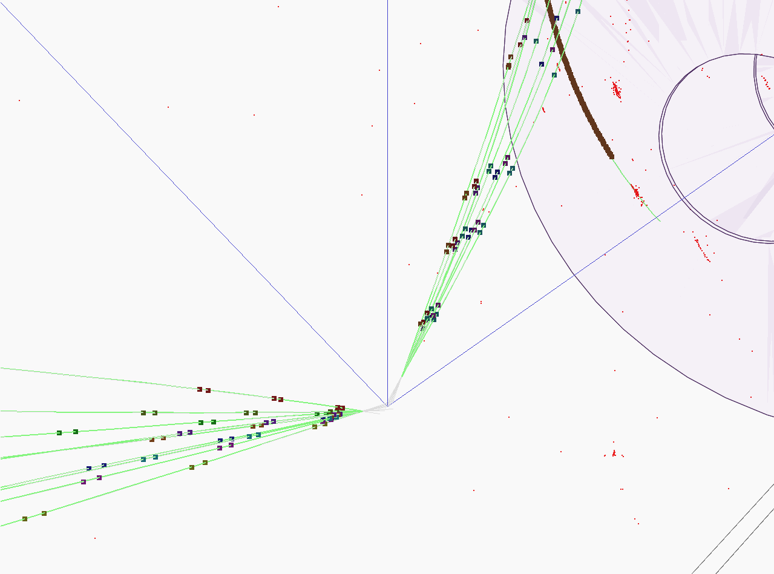


b charge measurement
Poeschl R., Richard F., Bilokin S.
LAL, Orsay
ILD Software and Analysis meeting

Slide 2
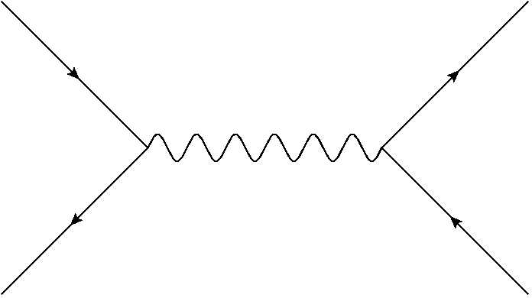
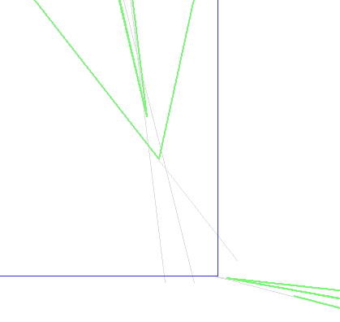
Objective
Main purpose of this work is to define the electroweak couplings of the bottom quark using the b-quark polar angle measurement of the process
Properties of decay products from the b-hadrons are used to determine the charge of initial b-quark
Charge of the b-quark is calculated as a sum of the charges of secondary and ternary vertex particles
The charge of K-mesons from reconstructed vertices is directly connected to the initial quark charge
Y
Ternary
vertex
Secondary
vertex
X
Primary vertex

Slide 3
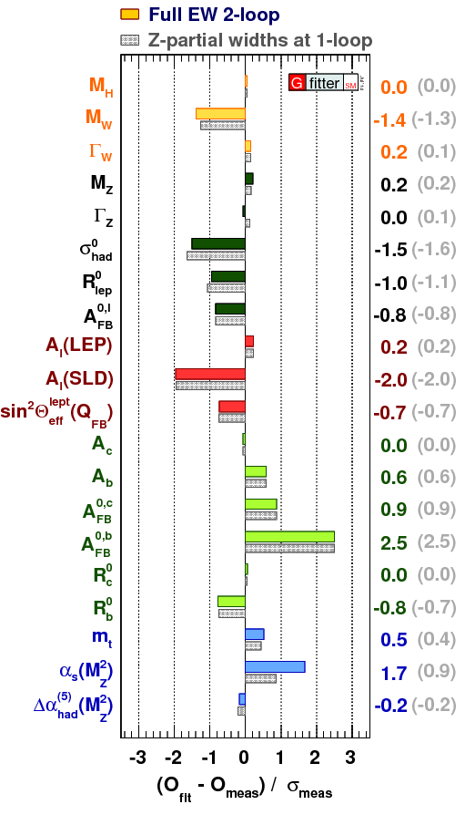
Motivation
The measured value of Afb for b-quarks has the highest tension with Standard Model expectation

Slide 4
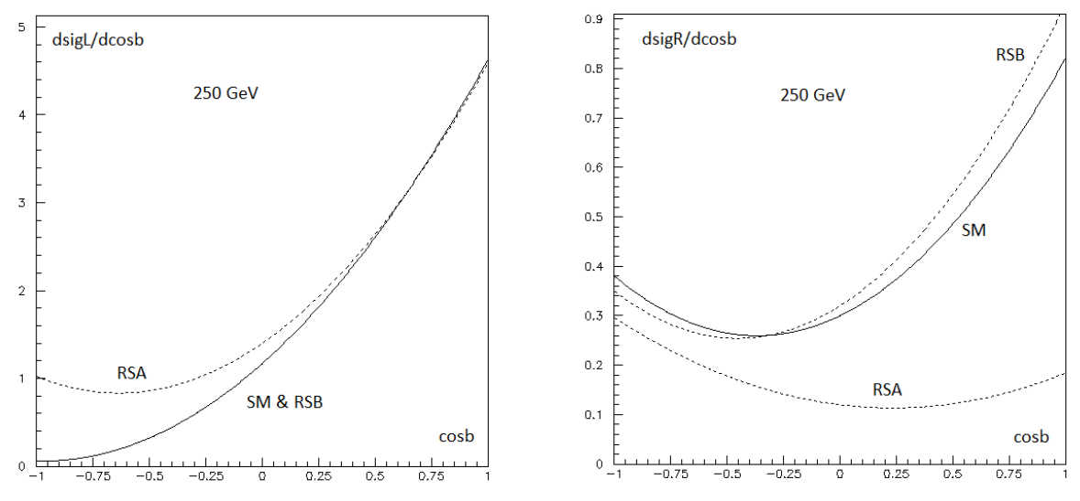
Motivation
F. Richard
F. Richard
Asymmetry is extremely strong for left-handed case
Different Randall-Sundrum scenarios can affect SM polar angle spectrum
Polarization of initial state is important

Slide 5
Research setup
We are using 250 GeV q qbar sample with pair background v01-16-05 (DBD) of 250 fb-1 for each polarization
To estimate the background we use hadronic ZZ HZ WW samples with the same version of ilcsoft
Modified version of VertexChargeRecovery from MarlinReco/Analysis (Recovery)

Slide 6
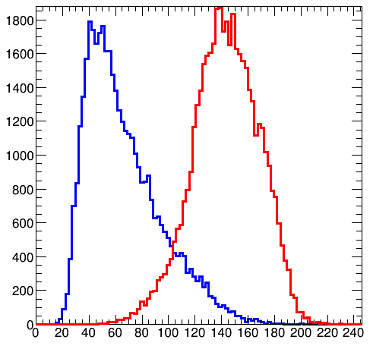
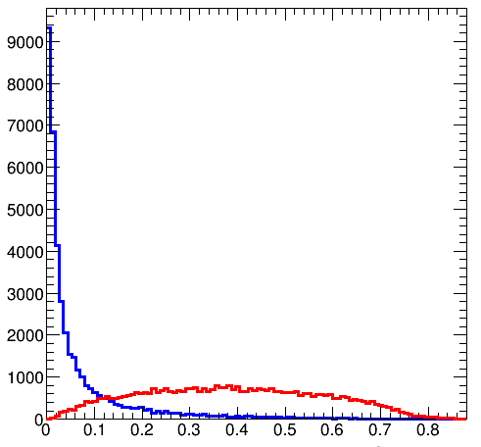
Event preselection
Sort jets by b-tag
B-tag cuts: 0.8 for a high-tagged jet and 0.3 for a low-tagged jet
For Z return rejection:
  Invariant mass > 180 GeV and maximum photon energy < 40 GeV
For diboson background rejection
  Sum of jet masses < 120 GeV and event sphericity < 0.2
Efficiency of the preselection is ~55% for both polarizations
Signal
ZZ

Slide 7
Event selection
We are using kaon charge and vertex charge combination to define a charge of a bjet
Kaons are identified using generator information on each particle in a reconstructed secondary or ternary vertex
  but we introduce ~94% purity and 88% efficiency, according to our previous PID studies
Kaon charge is a sum of charges of all kaons found in jet vertices, zero sum is rejected
Vertex charge is the sum of all secondary and ternary track charges in a jet, zero sum is rejected
Only independent combinations are used to avoid charge correlations in the final result:
  Vertex charge from one jet, vertex charge from another jet
  Kaon charge from one jet, kaon charge from another jet
  Event is accepted if charges are opposite

Slide 8


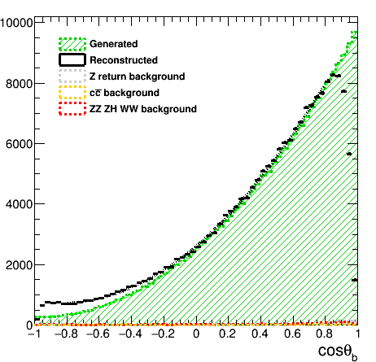
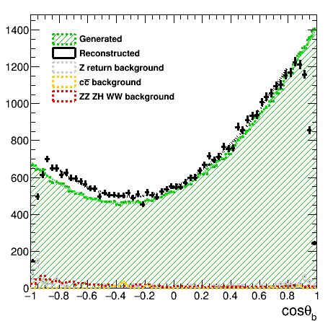
Polar angle reconstruction+bkg
The background is small due to the preselection cuts and the high signal cross section
Further plots for signal only

Slide 9
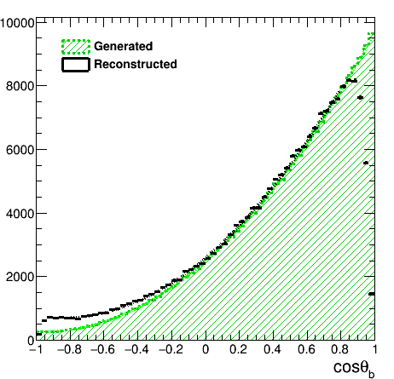
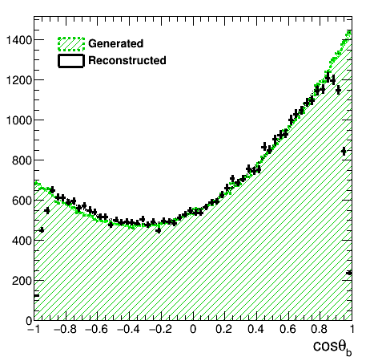
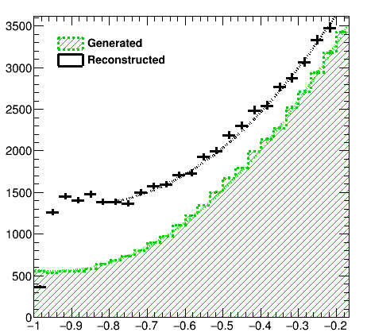
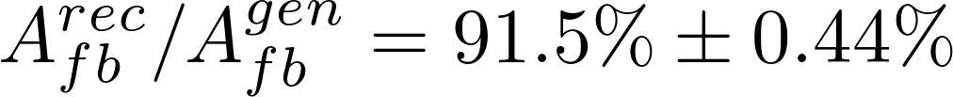
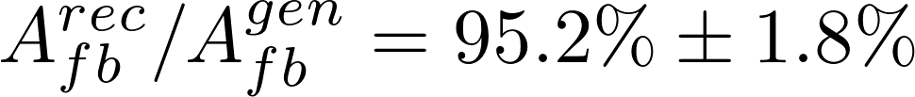
Bottom polar angle reconstruction
Forward region inefficiency is seen in both figures
The residual charge misreconstruction contaminates completely the backward region in the left-handed case

Slide 10


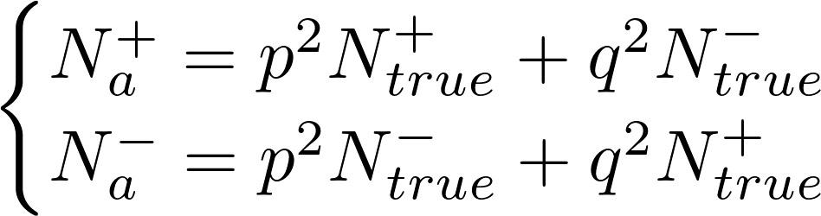
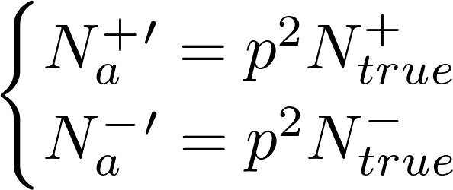
Charge purity and polar angle correction
We can use refused events with contradictory charges as a measure of our charge purity and calculate correction factors
Let q be a probability of an incorrect charge measurement of a jet
Then p = 1 – q is a correct charge probability
We can compute it from the following equations:
We define a number of true events:
Corrected values:
We do not use generator information for correction
# of refused events
# of accepted events
Migration terms

Slide 11
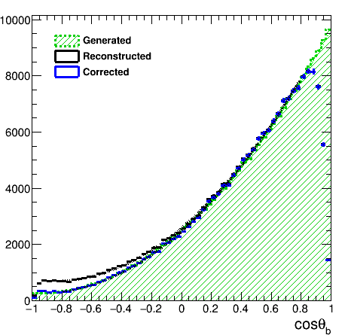
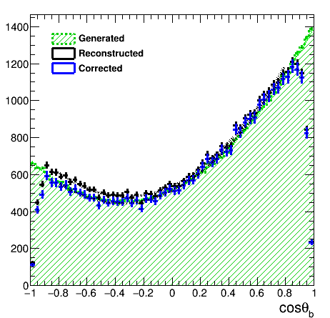
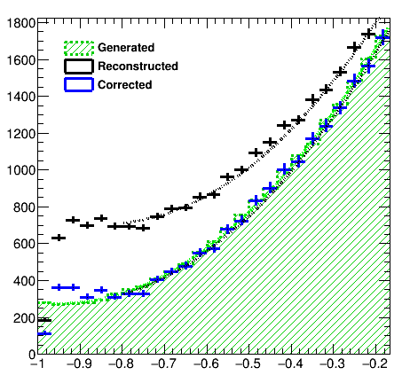
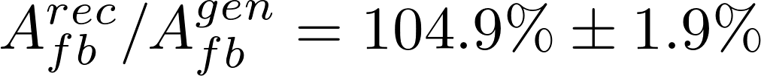
Polar angle reconstruction
The computed corrected distributions are much closer to the generated ones

Slide 12
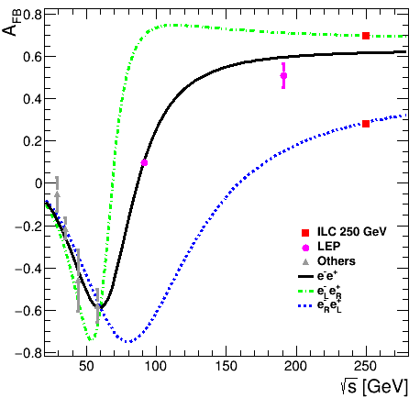
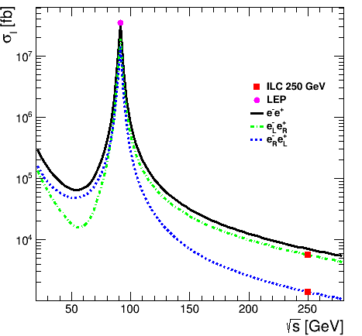
Asymmetry and cross section
PRELIMINARY | WORK IN PROGRESS
Forward-backward asymmetry
Cross section
The ILC can resolve the LEP Afb anomaly
The precision on the ILC cross section measurement to be determined

Slide 13
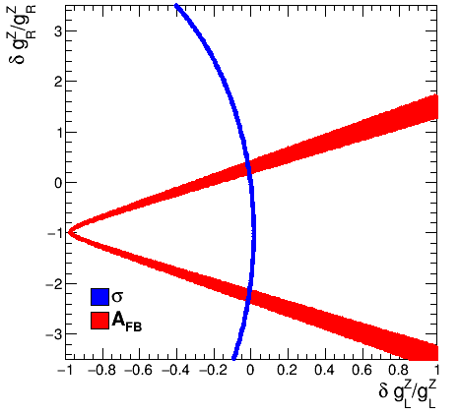
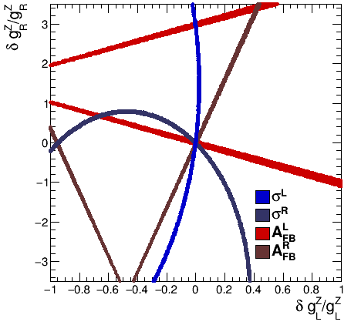
Precision on b-quark couplings
PRELIMINARY | WORK IN PROGRESS
Allowed 1σ regions for the tree level predictions
LEP
ILC
gL is well defined
gR sign flip is possible
Allows for 20% gR variation
Only one precise solution
Assume only the Zbb coupling varies

Slide 14
Precision on the Form Factors
We are measuring the differential cross section
where the A B C are
We have 6 observables and 6 form factors to estimate
Therefore, we can independently extract the form factors directly from the polar angle histograms
One can extract A B C factors from the fit, or directly from the histogram by integration with an orthogonal polynomial

Slide 15
Precision on the Form Factors
PRELIMINARY | WORK IN PROGRESS
Reconstructed
Generated
Results depend on the number of events used – to be fixed
There are 1-2% percent difference between the reconstructed and generated A and B values
We get small C value as compared to A and B values as expected
A and C values are correlated
Results and conclusions are similar for the right-handed polarization
Factor | Value | Error
A | 2514 | 15.18
B | 4730.6 | 19.29
C | -34.84 | 20.48
Factor | Value | Error
A | 2486.32 | 2.04
B | 4689.86 | 3.43
C | 12.88 | 3.00

Slide 16
Conclusions
The b-quark polar angle is well reconstructed in ILD environment
The ILC will provide precise and unambiguous solution to the LEP tension
At the ILC it will be possible to extract the b-quark form factors independently using the differential cross section
Future work:
  Rescale to 1st 250 GeV run and the beam polarization
  Define the final uncertainties
  Define the final precision on the LEP tension
We would like to thank Hiroaki Ono and the generator group for providing the high statistics sample

Slide 17
Thank you!

Slide 18
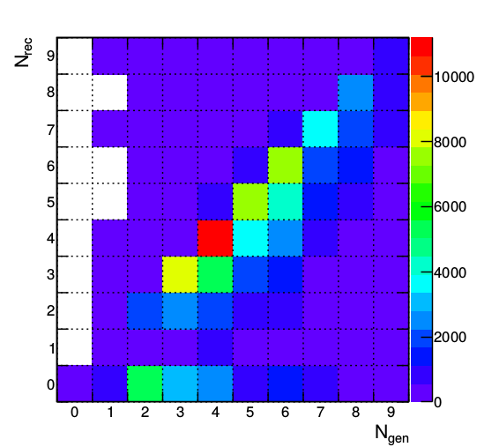
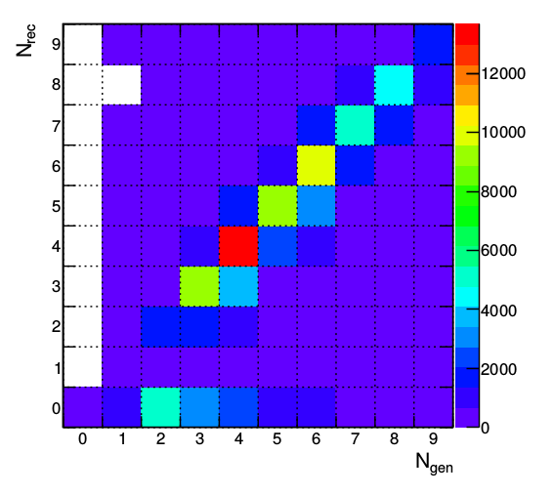
Vertex charge recovery improvement
49.0% on diagonal
62.0% on diagonal
The b-jet charge measurement requires very precise vertex reconstruction

Slide 19
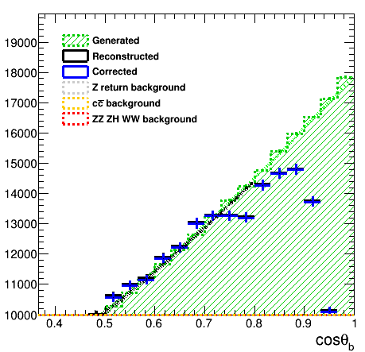
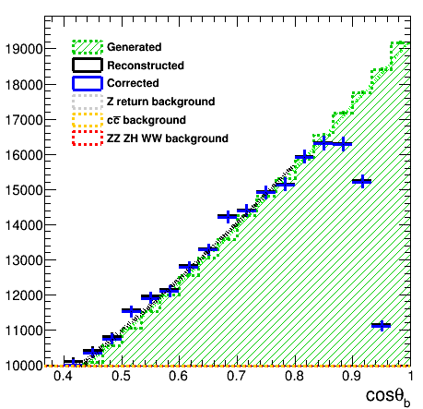
Recovery effects
Before charge recovery
After charge recovery
+7% of statistics
+4% of vertex purity
More kaons with the same purity
Constant charge purity in the barrel

Slide 20
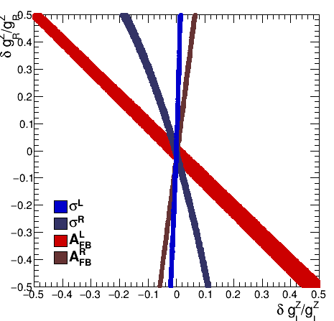
Precision on bottom couplings
PRELIMINARY | WORK IN PROGRESS
LEP
ILC
The ILC can resolve the LEP Afb anomaly

Slide 21
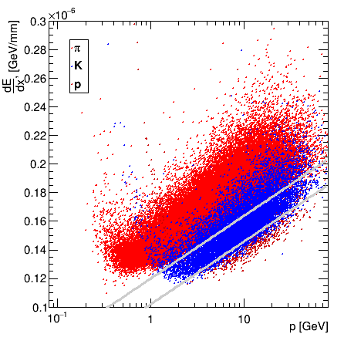
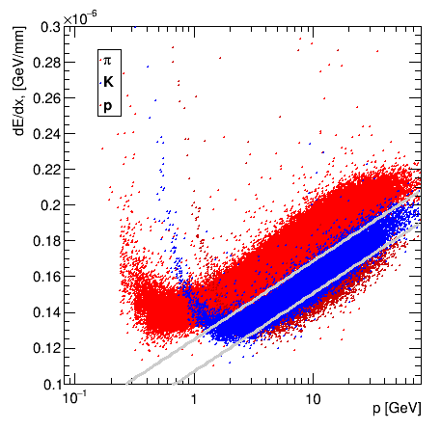
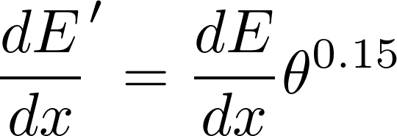
Reducing angular dependence
Particle separation after reducing the dE/dx angular dependence
After correction dE/dx does have a better kaon separation properties
Selection cuts are optimized for dE/dx'

Slide 22
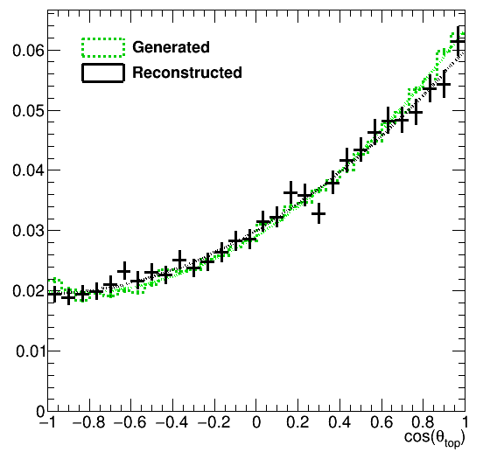
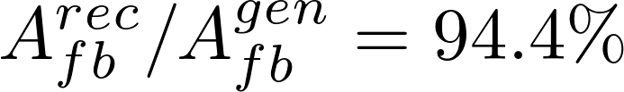
Top polar angle reconstruction
Vertex charge + kaons
94.4% precision
Top polar angle reconstruction using kaons and vertex charge combination. B-jet information only.

Slide 23
Vertex reconstruction quality
49.0% on diagonal
The b-jet charge measurement requires very precise vertex reconstruction.

Slide 24
Recovery effects
Before charge recovery
After charge recovery
+7% of statistics
+4% of vertex purity
More kaons with the same purity
Constant charge purity in the barrel

Slide 25
Recovery of vertices
x
z
IP – interaction point (primary vertex) , s – secondary vertex, t – point of closest approach of a track, p – reconstructed momentum, - offset of a track from primary vertex

Slide 26
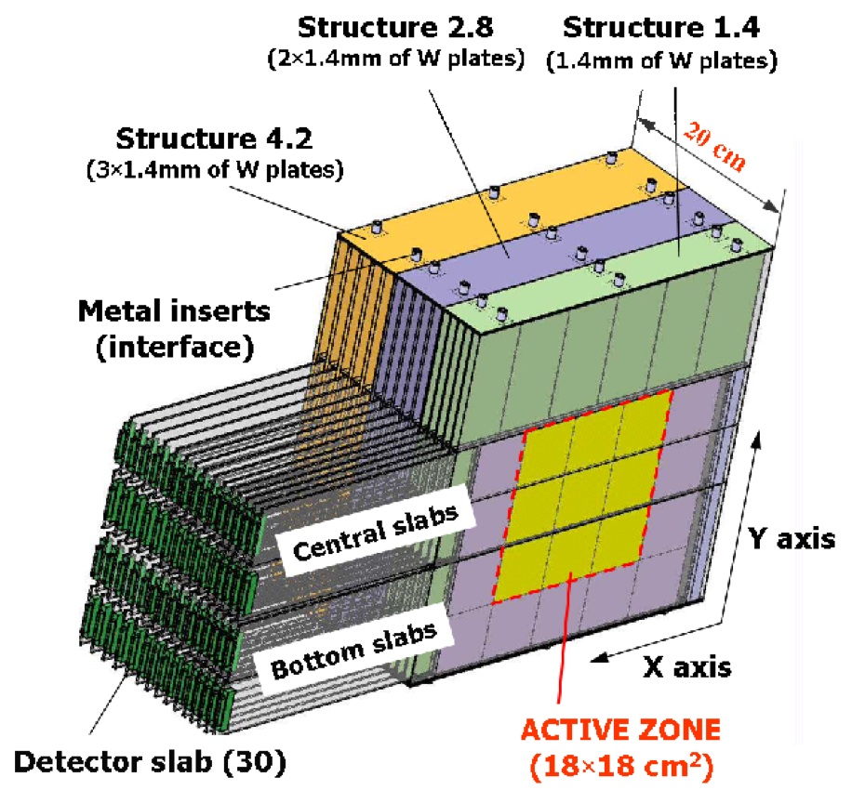
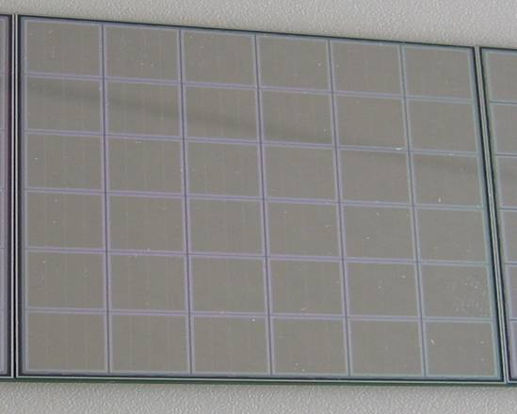
SiW ECAL prototype
Three modules of 10 layers each
with increasing tungsten (W) thickness
Total depth:
Active Zone: 18x18 cm2 in each layer
Granularity: 10x10mm2
Total: 9720 Pixels/Channels

Slide 27
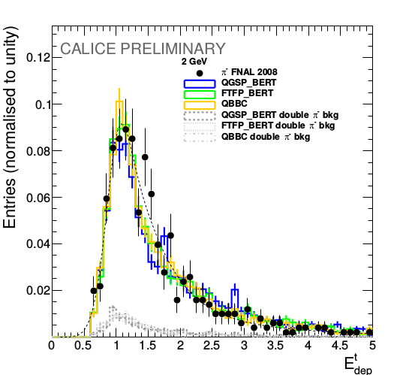
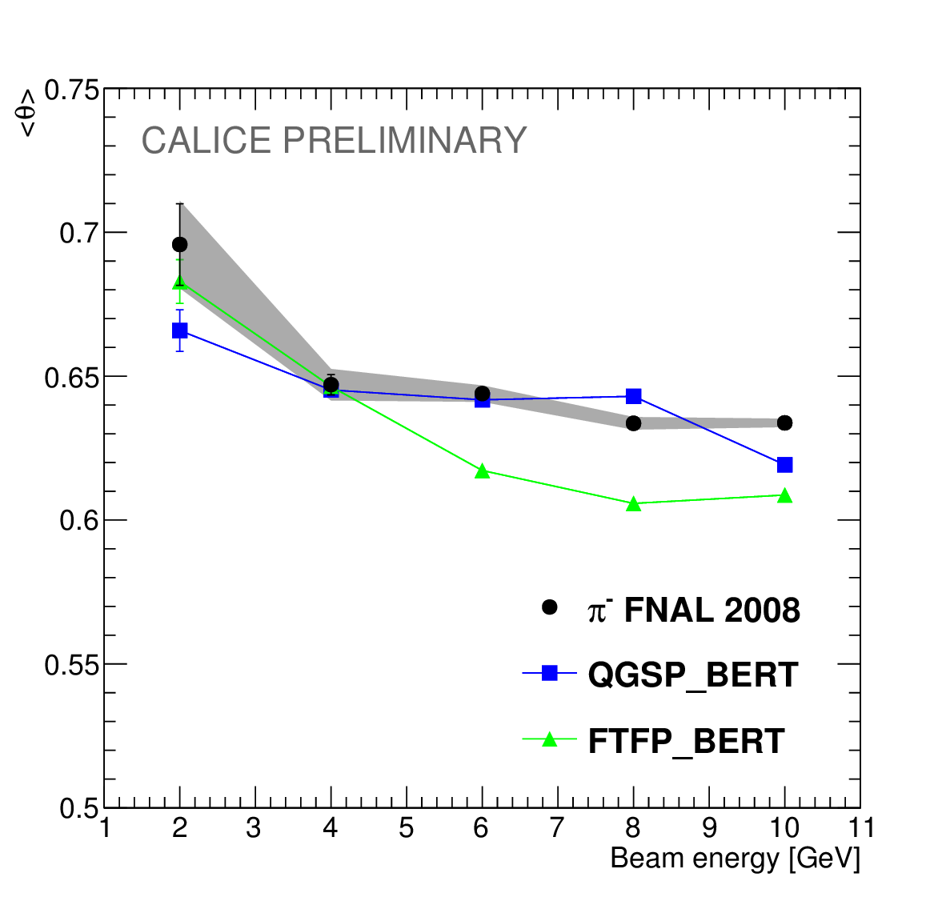
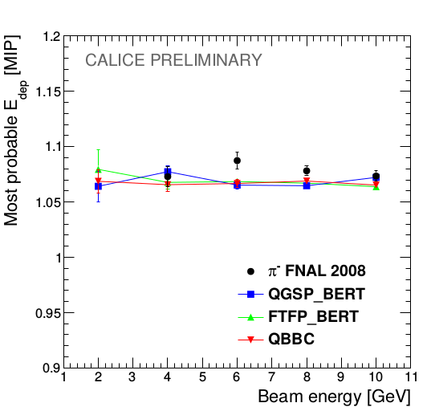
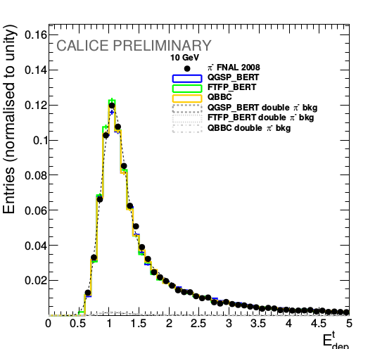
Energy deposition of track hits
The secondary particles should act as MIPs, the distributions of the energy depositions should have Landau shape
2 GeV
10 GeV
Both simulation models agree with the data within 2% of precision.

