Slide 1
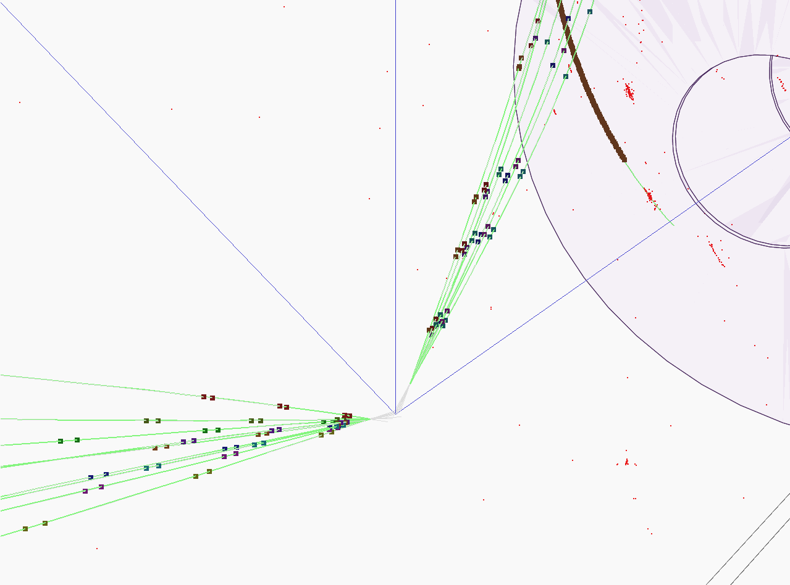

Heavy flavor physics at ILC
S. Bilokin, E. Kou, F. Le Diberder, Y. Sato, F. Richard, R. Pöschl
Joint workshop FKPPL TYL/FJPPL 2017

Slide 2
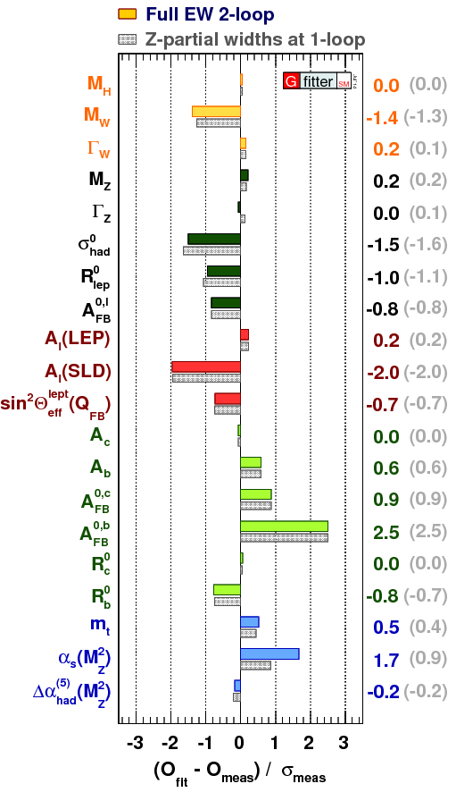
Motivation
Top quark is the heaviest elementary particle in the SM
Top quark is subject of many BSM theories,
  i.e. composite top or Randall-Sundrum models predict deviations for the EW couplings of the top quark
The top and bottom quarks belong to one doublet
Forward-backward asymmetry measurement at LEP has 2.5σ tension with the SM prediction
We need to measure the heavy quark EW couplings
We need to compute the theoretical predictions for the top quark production
arxiv: 1407.3792v1

Slide 3
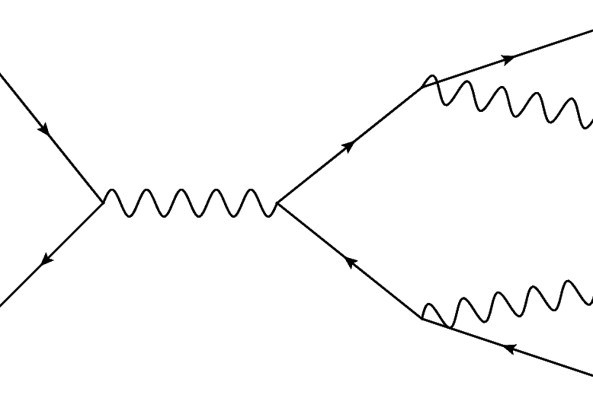
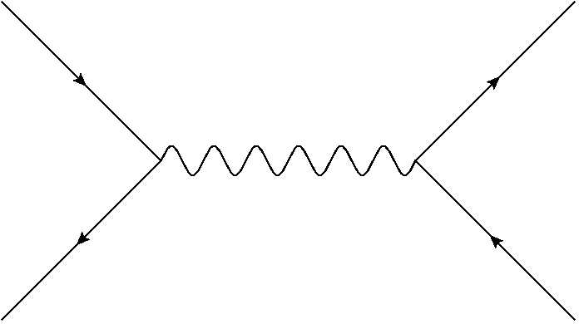
Heavy flavour at ILC
Measurement of the heavy flavour quarks at the electron-positron machines:
  Direct EW production
  No competing QCD production
Advantages of the ILC:
  Operating at increases the sensitivity to top axial form factors, minimizes the QCD uncertainties
  Polarized beams allow independent determination of the b-quark form factors
  Highly granular 4π detectors allow for precise final state reconstruction using PFA

Slide 4
Content
process
Matrix element method for
NLO computation for

Slide 5
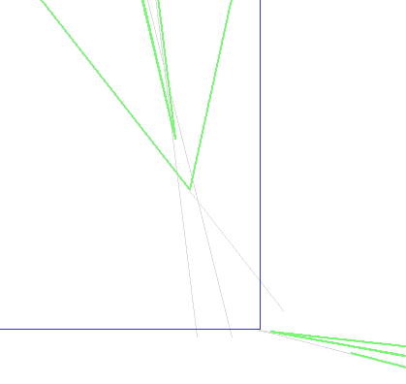
Richard F., Pöschl R., Bilokin S.
Main purpose of this work is to define the electroweak couplings of the bottom quark using the b-quark polar angle measurement of the process
Properties of decay products from the b-hadrons are used to determine the charge of initial b-quark
Charge of the b-quark is calculated as a sum of the charges of secondary and ternary vertex particles
The charge of K-mesons from reconstructed vertices is directly connected to the initial quark charge
Y
Ternary
vertex
Secondary
vertex
X
Primary vertex

Slide 6


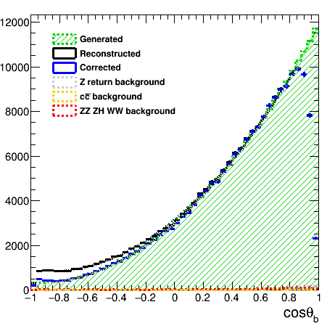
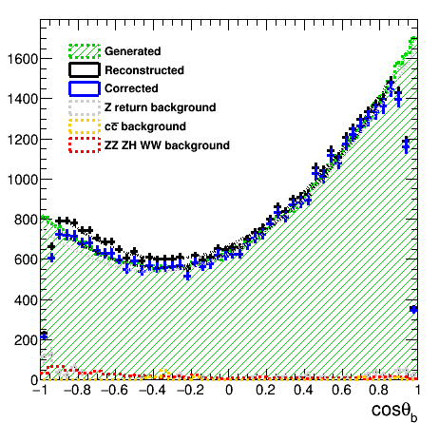
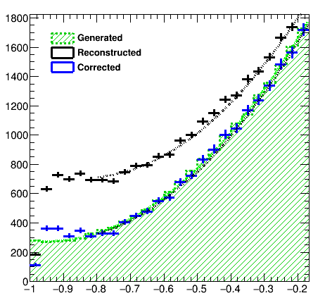
Bottom quark polar angle reconstruction
Richard F., Pöschl R., Bilokin S.
The residual charge impurity cause a migration effect, which leads to discrepancy between the reconstructed and generated curves
The developed correction procedure allows to measure the charge purity and correct for migrations using reconstructed events only

Slide 7
Determination of the Form Factors
Richard F., Pöschl R., Bilokin S.
We are measuring the differential cross section
where the A B C are
One has 6 observables and 6 form factors to estimate
Therefore, we can independently extract the form factors directly from the polar angle histograms
PRELIMINARY: The expected precision on the form factors is ~0.5% for the left-handed polarization and ~1-2% for the right-handed polarization using two parameter fit

Slide 8
Conclusions
The b-quark polar angle was successfully reconstructed in the ILD environment
The ILC will provide precise solution to the LEP tension
At the ILC it will be possible to extract the b-quark form factors independently using the differential cross section
FJPPL student exchange program was done in 2016
The Matrix Element Method was successfully applied on full ILD simulation
  ISR, FSR, hadronization effects are incorporated
Method was checked with NLO events
Next step → check with the background processes
The box diagram causes the difference between left-handed and right-handed cross section
The spin correlation analysis is now available in GRACE generator

Slide 9
Thank you!

Slide 10
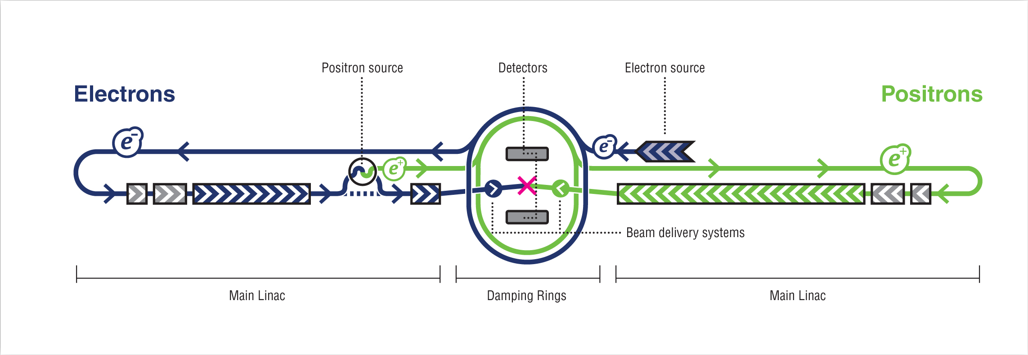
ILC project
Polarized electron and positron beams
Center-of-mass energy of 250 – 500 GeV with a 1000 GeV upgrade option
Two detectors, SiD and ILD
Well known state of initial particles, low machine background
Main goals:
  Precision measurement of Standard Model parameters
  Direct and indirect searches of Beyond Standard Model particles

Slide 11
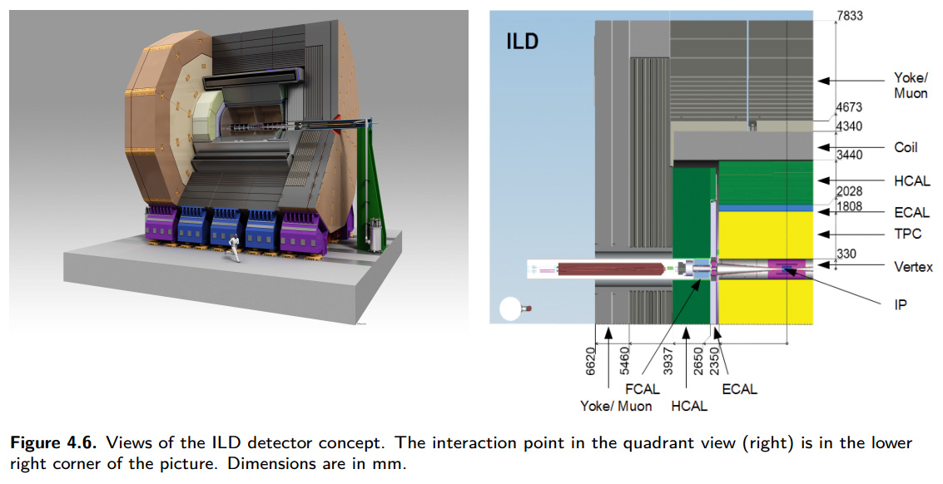
ILD project
Designed for Particle Flow algorithms that allow to reconstruct individual particles inside ILD
Tracking system:
  Vertex Detector composed of 3 double layers of silicon pixels
  Time Projection Chamber with particle identification capabilities
  Other devices
Calorimeters:
  High-granular silicon-tungsten Ecal (SiW Ecal)
  Hcal with iron absorber
3.5T Solenoid
Muon trackers
Full GEANT4 simulation

Slide 12
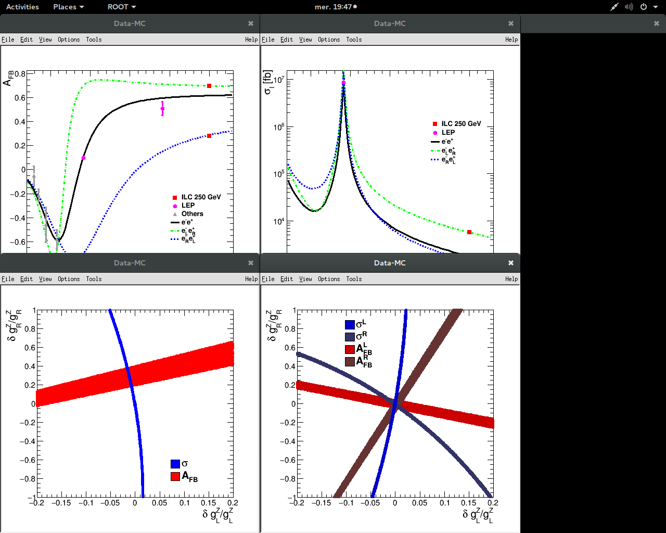
Precision on b-quark couplings
Richard F., Pöschl R., Bilokin S.
PRELIMINARY | WORK IN PROGRESS
Allowed 1σ regions for the tree level predictions
LEP
ILC
gL is well defined
gL sign flip is possible
Allows for 20% gR variation
Only one precise solution
Better resolution on the gR value
Assume only the Zbb coupling varies

Slide 13
Determination of the Form Factors
PRELIMINARY | WORK IN PROGRESS
Reconstructed
Generated
Results depend on the number of events used – to be fixed
There are 1-2% percent difference between the reconstructed and generated A and B values
We get small C value as compared to A and B values as expected
Errors on the A and C values are correlated
Results and conclusions are similar for the right-handed polarization
Factor | Value | Error
A | 3127.92 | 16.61
B | 5933.01 | 22.7
C | 9.74 | 22.61
Factor | Value | Error
A | 3058.95 | 2.52
B | 5770.09 | 4.22
C | 16.11 | 3.7

Slide 14
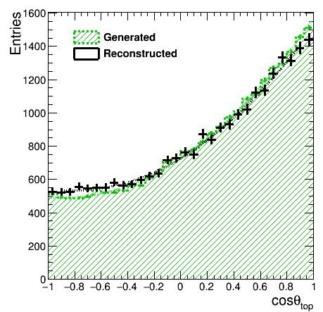
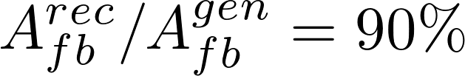
Top polar angle reconstruction
Vertex charge + kaons
94.4% precision
Top polar angle reconstruction using kaons and vertex charge combination. B-jet information only.

