Slide 1
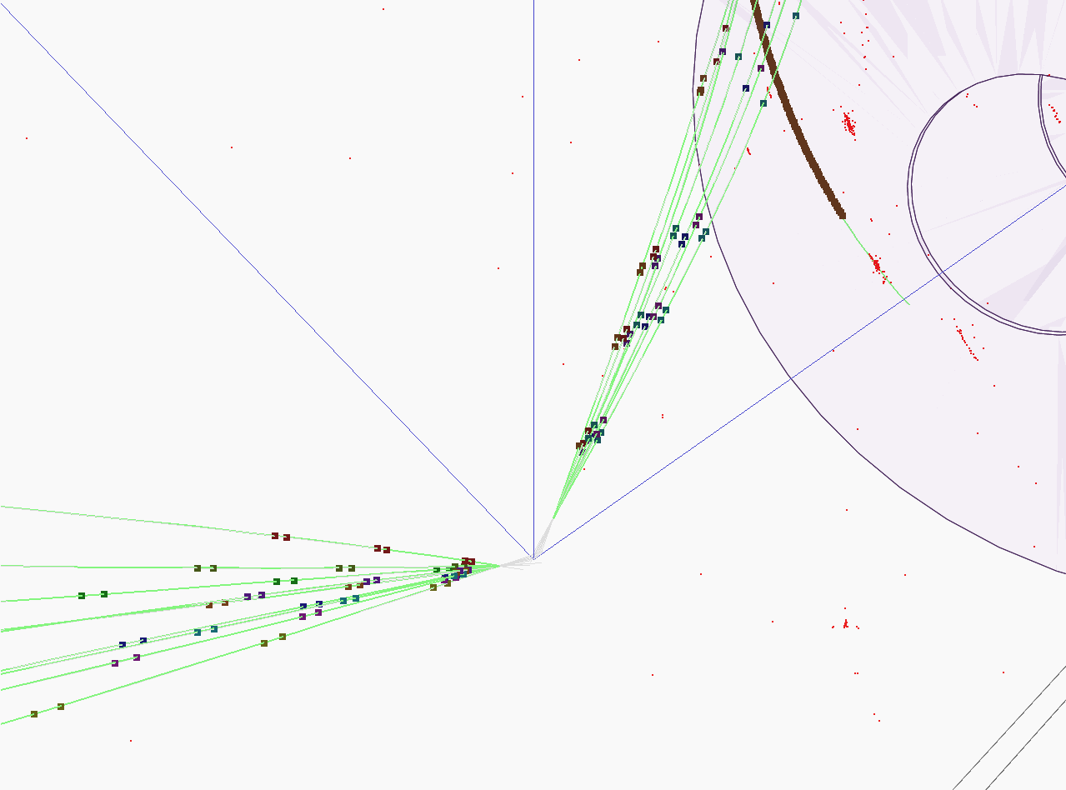


Hadronic showers in a highly granular silicon-tungsten calorimeter and
Production of bottom and top quark at the ILC
PhD candidate: BILOKIN Sviatoslav
Supervisor: PÖSCHL Roman
Orsay 2017

Slide 2
Content
Introduction
Hadronic showers in highly granular silicon-tungsten calorimeter
b-quark charge reconstruction
Top quark polar angle reconstruction
Bottom quark electroweak couplings measurement

Slide 3
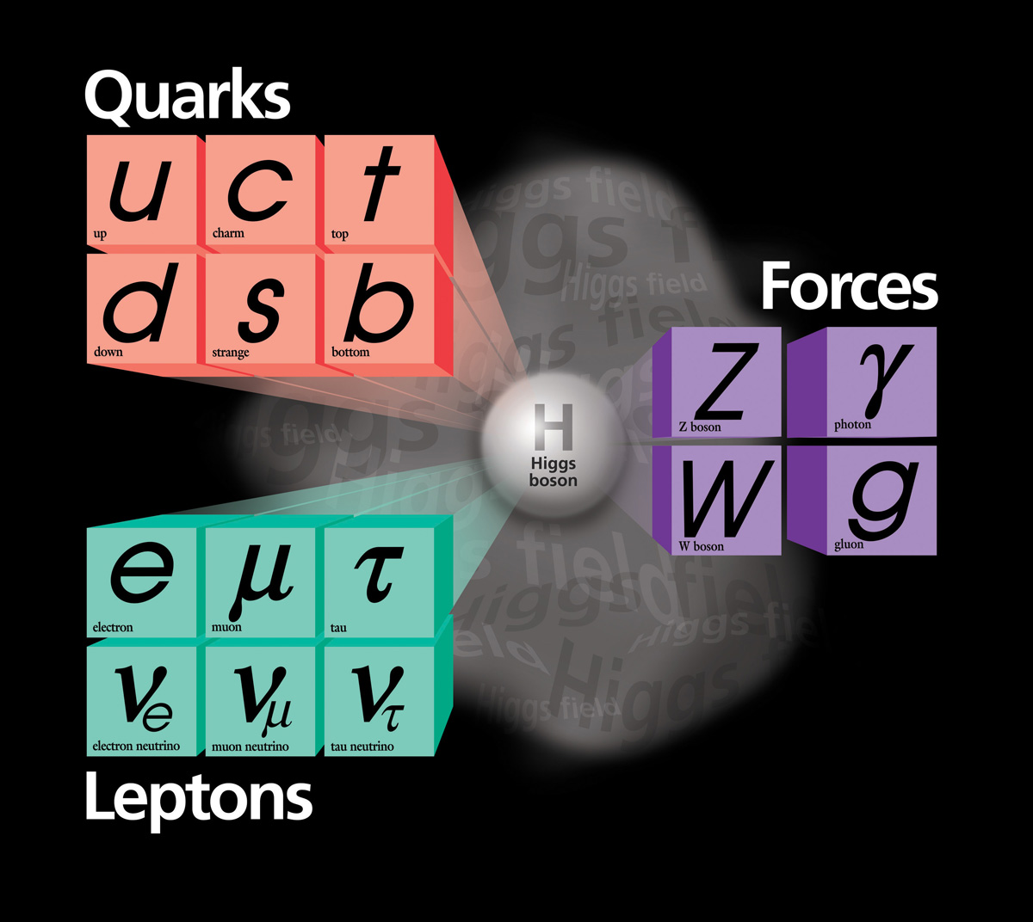
Standard Model of Particle physics
The Standard Model (SM) provides a consistent and precise theoretical description of known elementary particles and their interactions.
Theoretical framework was developed in 1960’s
Since then, the SM predicted many essential phenomena of Particle physics, like weak neutral currents and Higgs boson existence
It has been confirmed by a vast majority of experiments

Slide 4
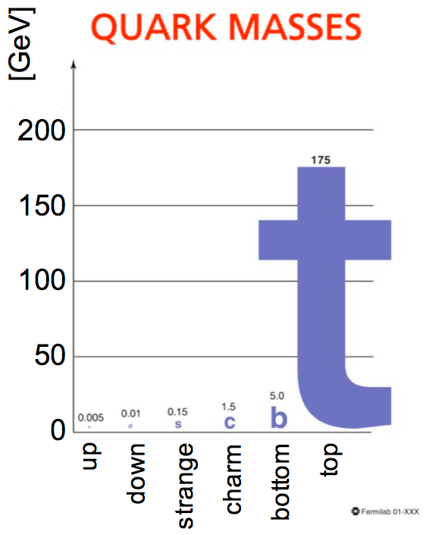
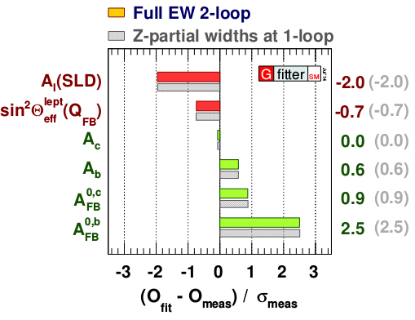
Motivation
Top quark is the heaviest elementary particle in the SM, and it is a subject of many BSM theories,
  i.e. composite top or Randall-Sundrum models predict deviations for the EW couplings of the top quark
The top and bottom quarks belong to one doublet
Forward-backward asymmetry measurement at LEP has 2.5σ tension with the SM prediction
We need to measure precisely the bottom and the top quark EW couplings
arxiv: 1407.3792v1

Slide 5
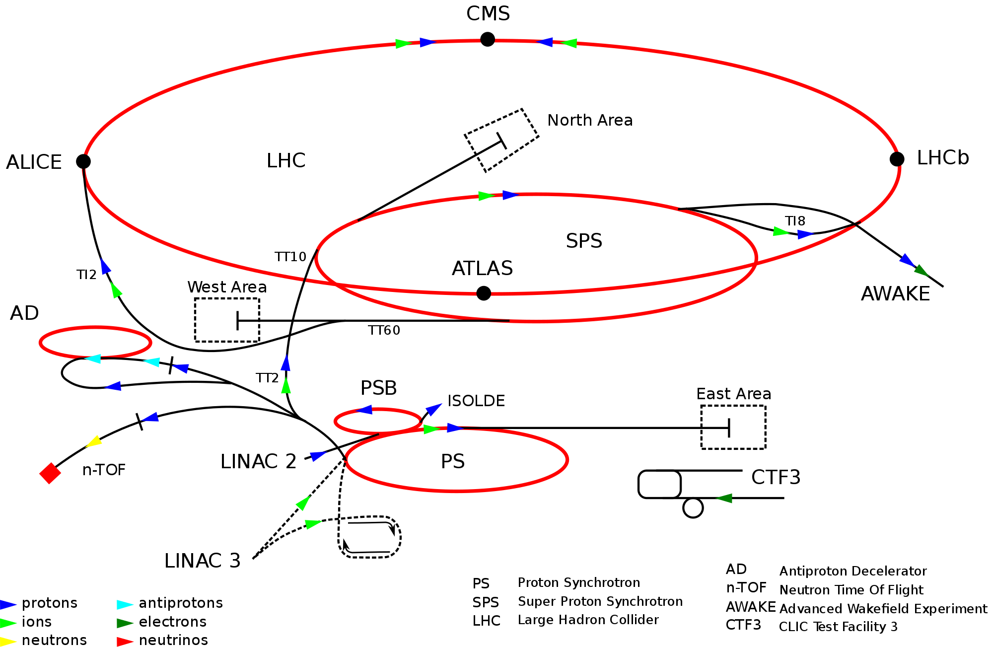
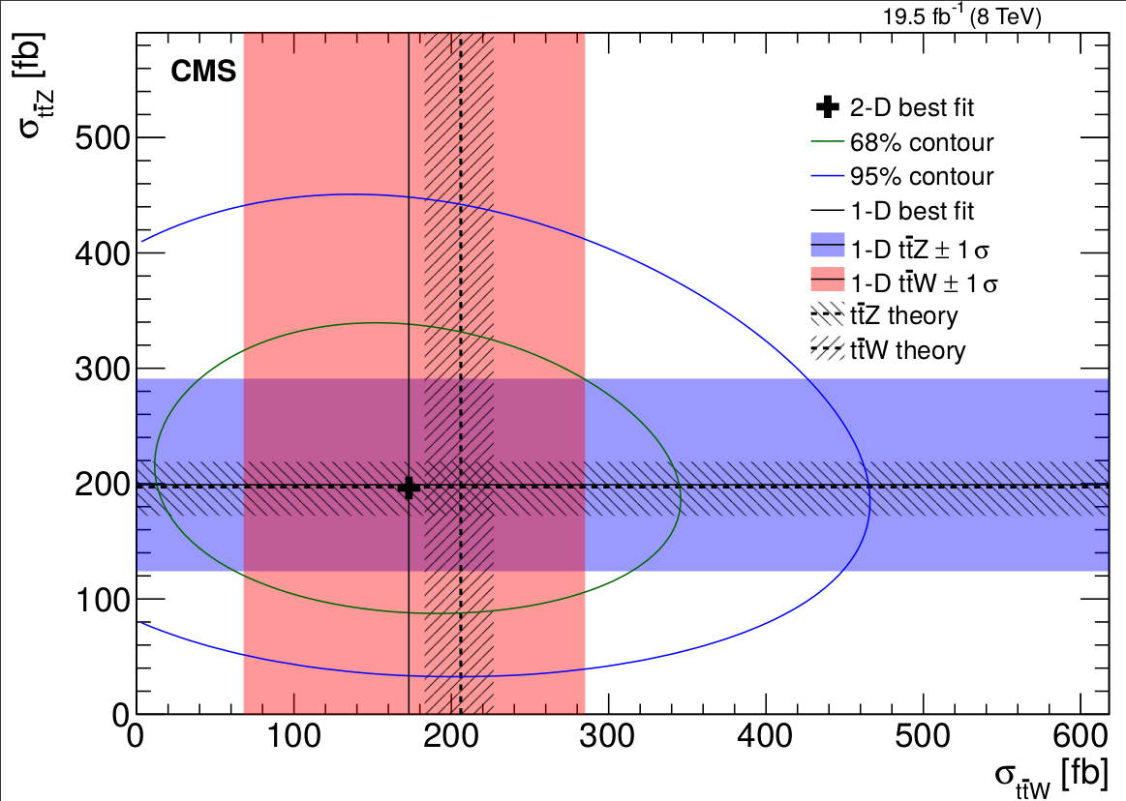
LHC results
The LHC high production rates of the top and the bottom quarks
  Predominantly via QCD channels
The measurement of the couplings at the LHC requires studying the associated decays
  Implies smaller cross sections
  The independent measurement of the vector and axial-vector couplings is impossible at the LHC
The b-quark couplings study at the LHC cannot improve the LEP measurements
The high precision measurements of the heavy doublet electroweak couplings are left for the future colliders
arxiv: 1406.7830

Slide 6
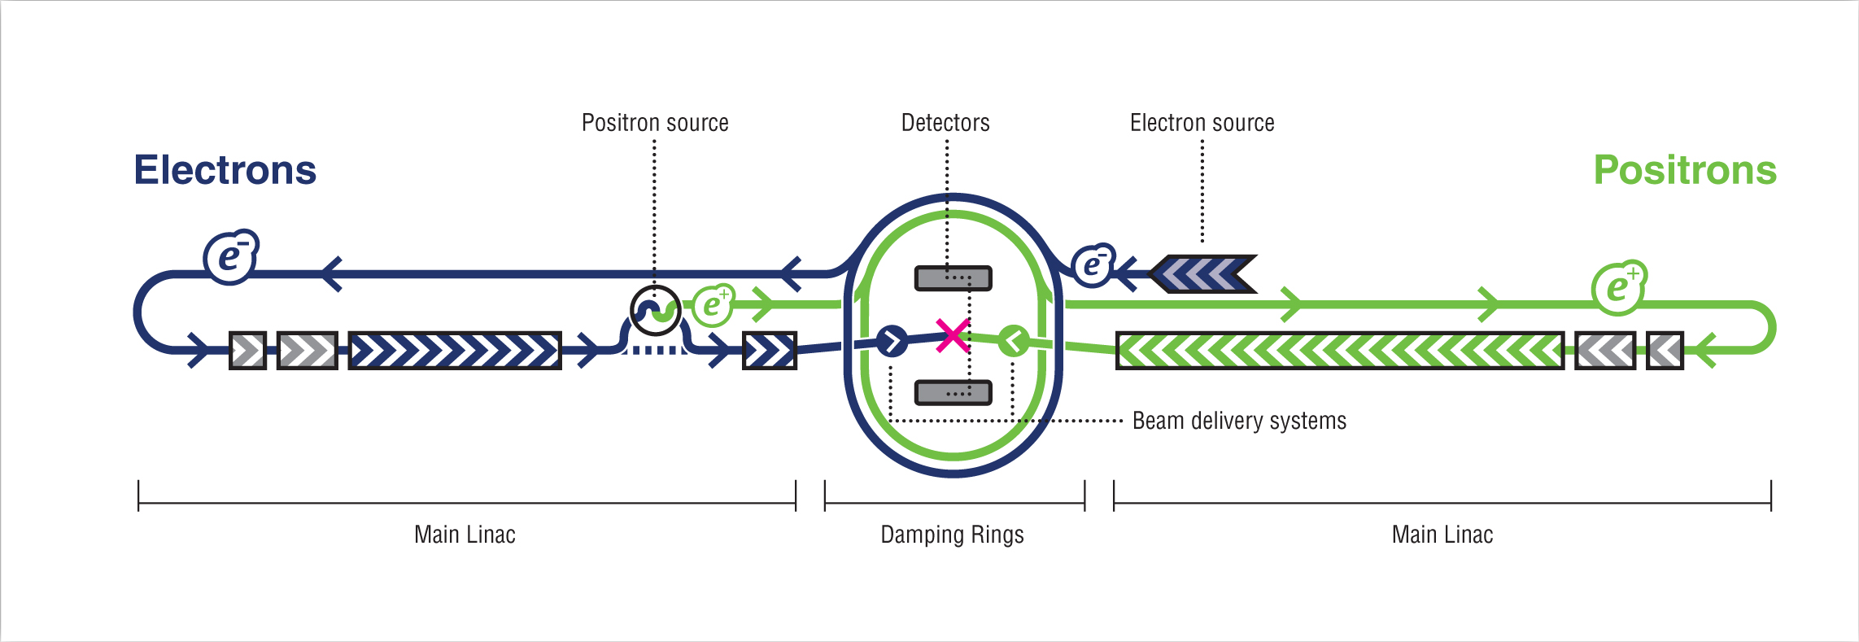
ILC project
Polarized electron and positron beams
Center-of-mass energy of 250 – 500 GeV with a 1000 GeV upgrade option
Two detectors, SiD and ILD
Well known state of initial particles, low machine background
Main goals:
  Precision measurement of Standard Model parameters
  Direct and indirect searches of Beyond Standard Model particles

Slide 7
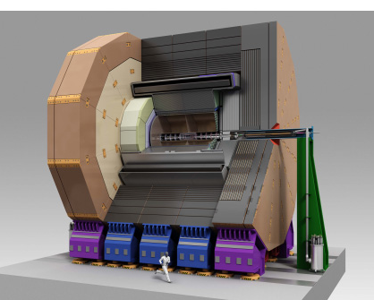
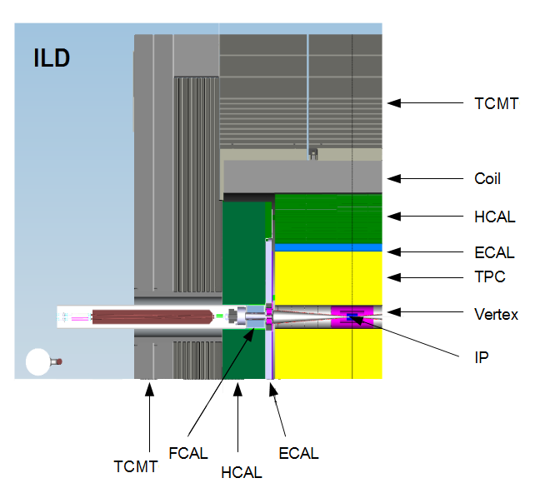
ILD project
Designed for Particle Flow algorithms
  Full GEANT4 simulation
Hybrid: gas and silicon devices
Tracking system:
  Vertex Detector (VXD) has 3 double layers of silicon pixels
  Forward Tracing Disks (FTD)
  Time Projection Chamber (TPC) with particle identification capabilities
  Other devices
Calorimeters:
  Highly granular silicon-tungsten Ecal (SiW Ecal)
  Highly granular iron Hcal
3.5T Solenoid
Muon trackers
VTX
FTD

Slide 8
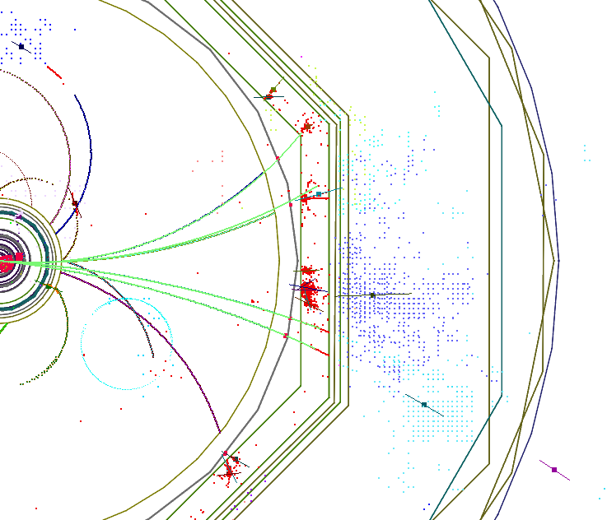
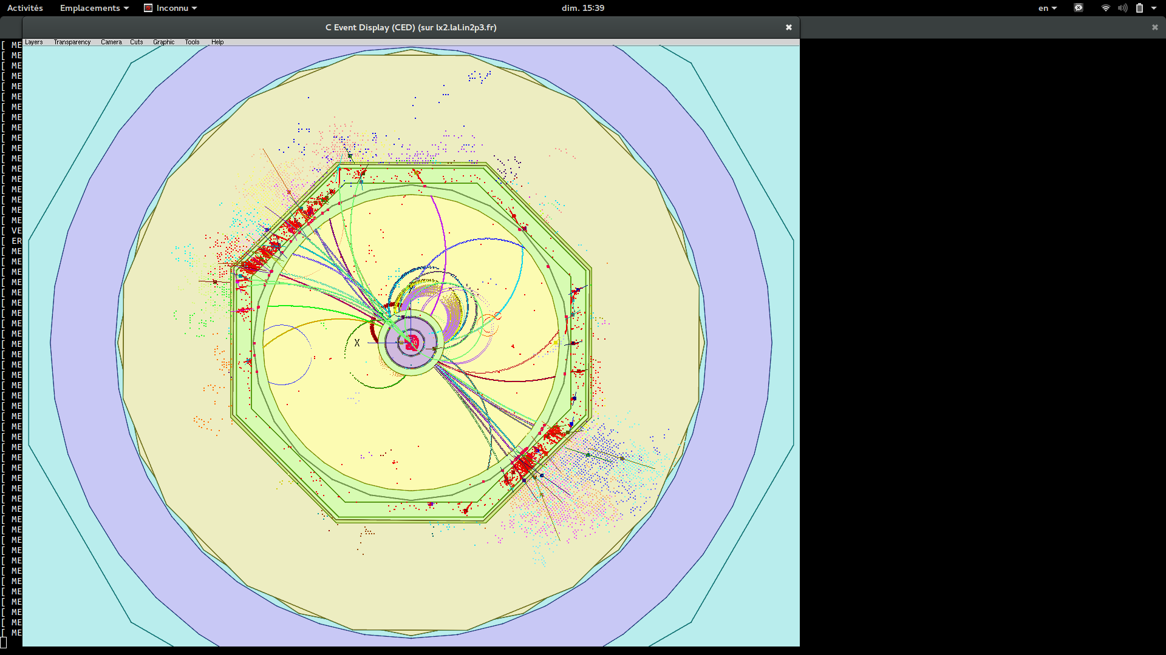
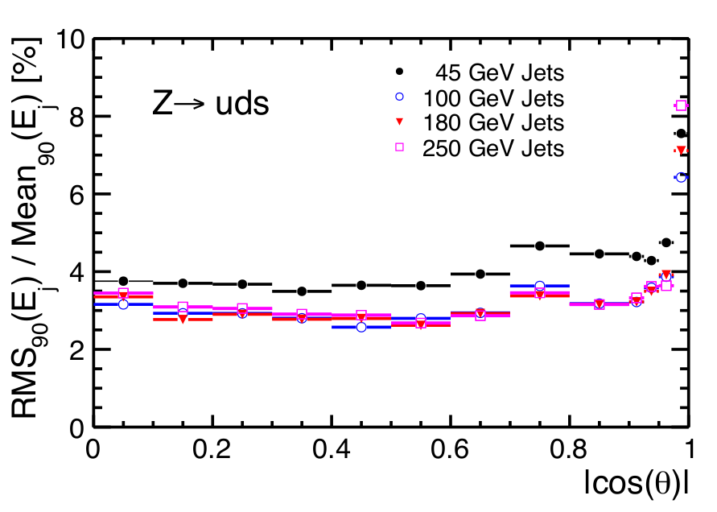
Particle Flow approach
The Particle Flow algorithms that allow to reconstruct individual particles inside the detector
Particle Flow Object (PFO) types:
  Photons
  Electrons
  Muons
  Charged and neutral hadrons
Charged particle energy is measured by trackers, neutrals – in calorimeters
Aimed at 3-4% jet energy resolution as required by the ILC physics program
High granular calorimeters are essential for separation of the neutral from the charged particle clusters
ECAL
HCAL
TCMT
‘
TPC
TPC

Slide 9
Introduction
Hadronic showers in highly granular silicon-tungsten calorimeter
b-quark charge reconstruction
Top quark polar angle reconstruction
Bottom quark electroweak couplings measurement

Slide 10
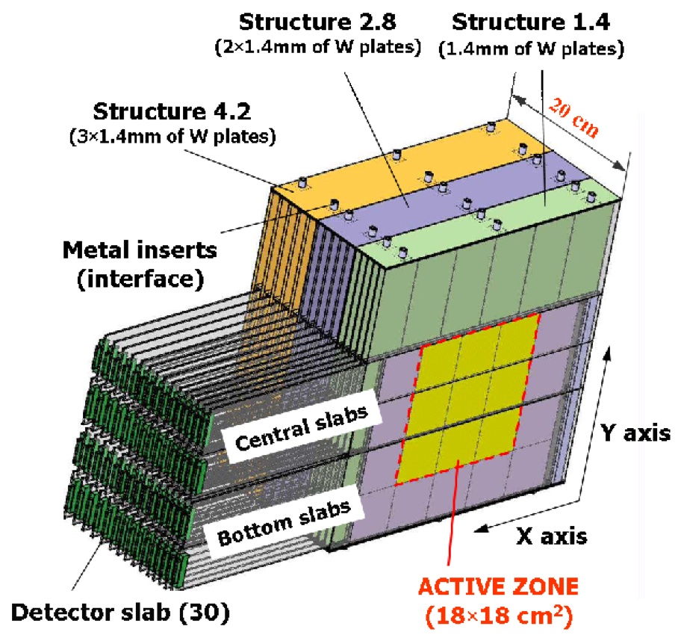
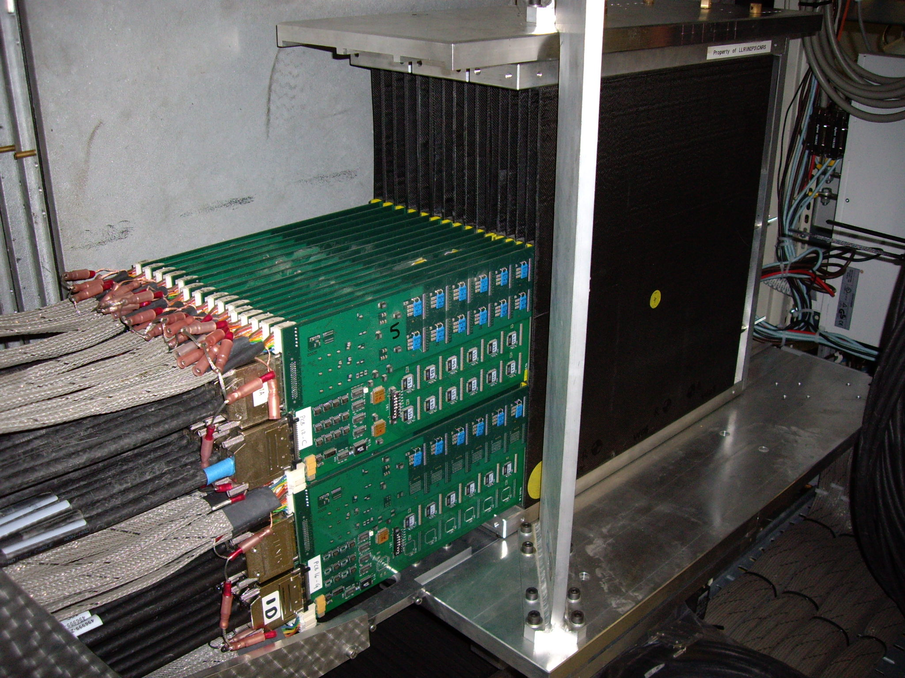
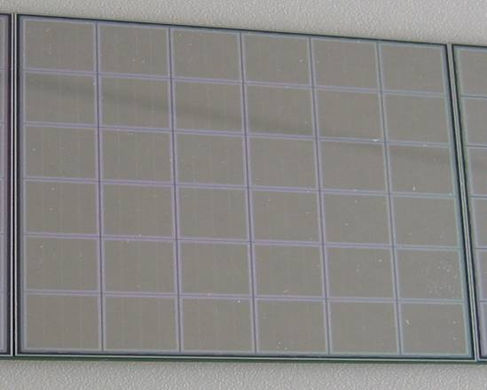
CALICE SiW ECAL physics prototype
Absorber: Tungsten plates 1.4-4.2 mm:
Active material: silicon P-I-N Diodes
Thickness 525 µm
Granularity: 10x10 mm²
Signal/Noise ~ 7.5
Three modules of 10 layers each
with increasing tungsten (W) thickness
Total depth:
Active Zone: 18x18 cm² in each layer
Total: 9720 Pixels/Channels

Slide 11
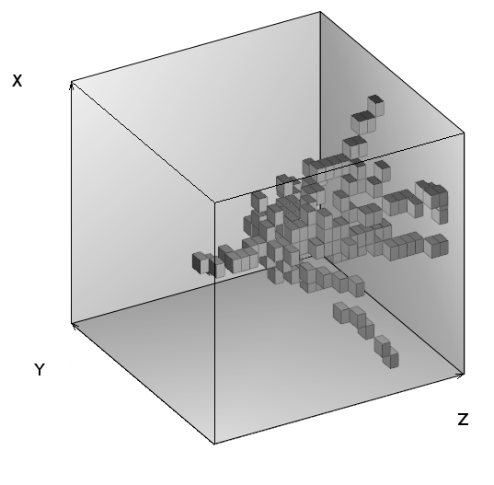
Introduction
Compare various Monte Carlo models to the data using new set of differential observables from track finding algorithm
  Validation of existing simulation models
Test beam data recorded at FNAL in 2008 π⁻ between 2 GeV and 10 GeV
GEANT 4 is lacking precise thin tungsten data input
Study of interactions in terms of global observables: radial and longitudinal shower profiles: NIM A794 (2015) 240
New: Study of GEANT4 v10 performance within this energy range
10 GeV pion in SiW ECAL prototype

Slide 12
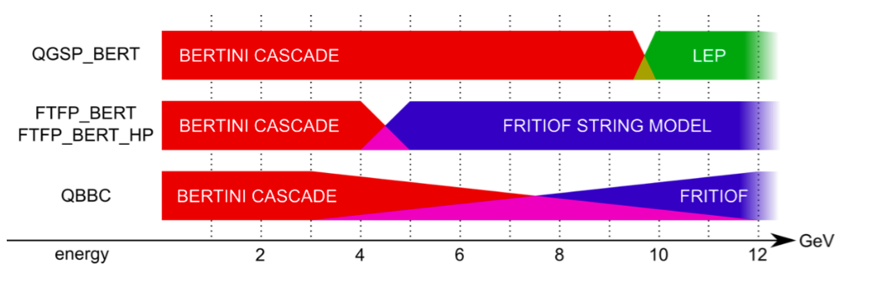
GEANT4 Physics lists
Presented study covers interesting energy range (2-10 GeV):
Energy range of majority of charged pions and other hadrons within high energy (LC) jets
Transition region for many physics lists
55% of the hadrons have first interaction in the Ecal
GEANT4 v.10 used:
  FTFP_BERT, QGSP_BERT and QBBC physics lists

Slide 13
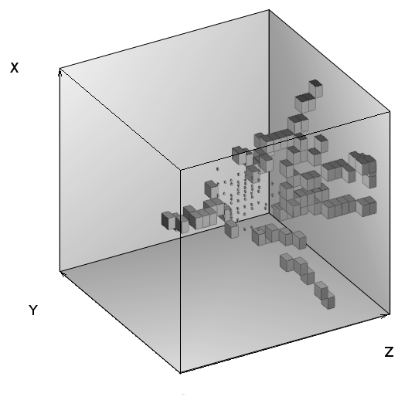
Hadronic shower analysis
An event after selection cuts

Slide 14
Hadronic shower analysis
Tracks from
secondary particles
MIP energy range,
Number, Polar angle, etc.
Track from
primary pion
MIP energy range
Interaction region
All hits with at least six
neighbouring pads with signal
Energy fraction, Radius

Slide 15
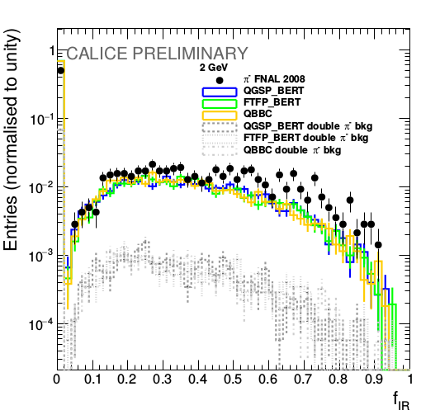
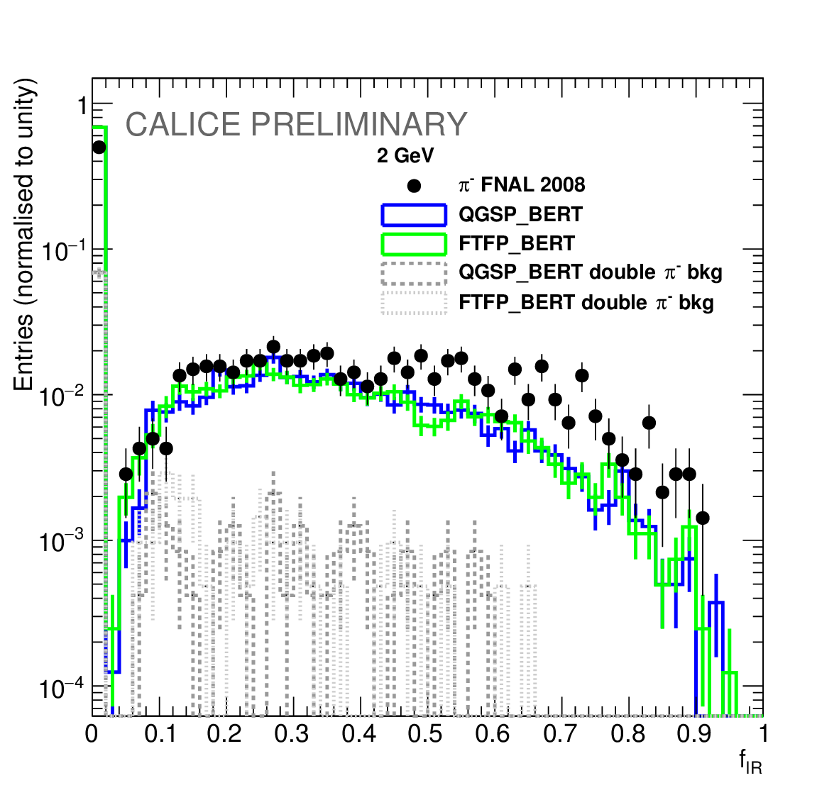
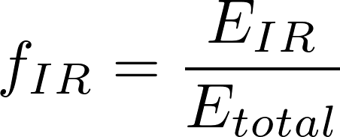
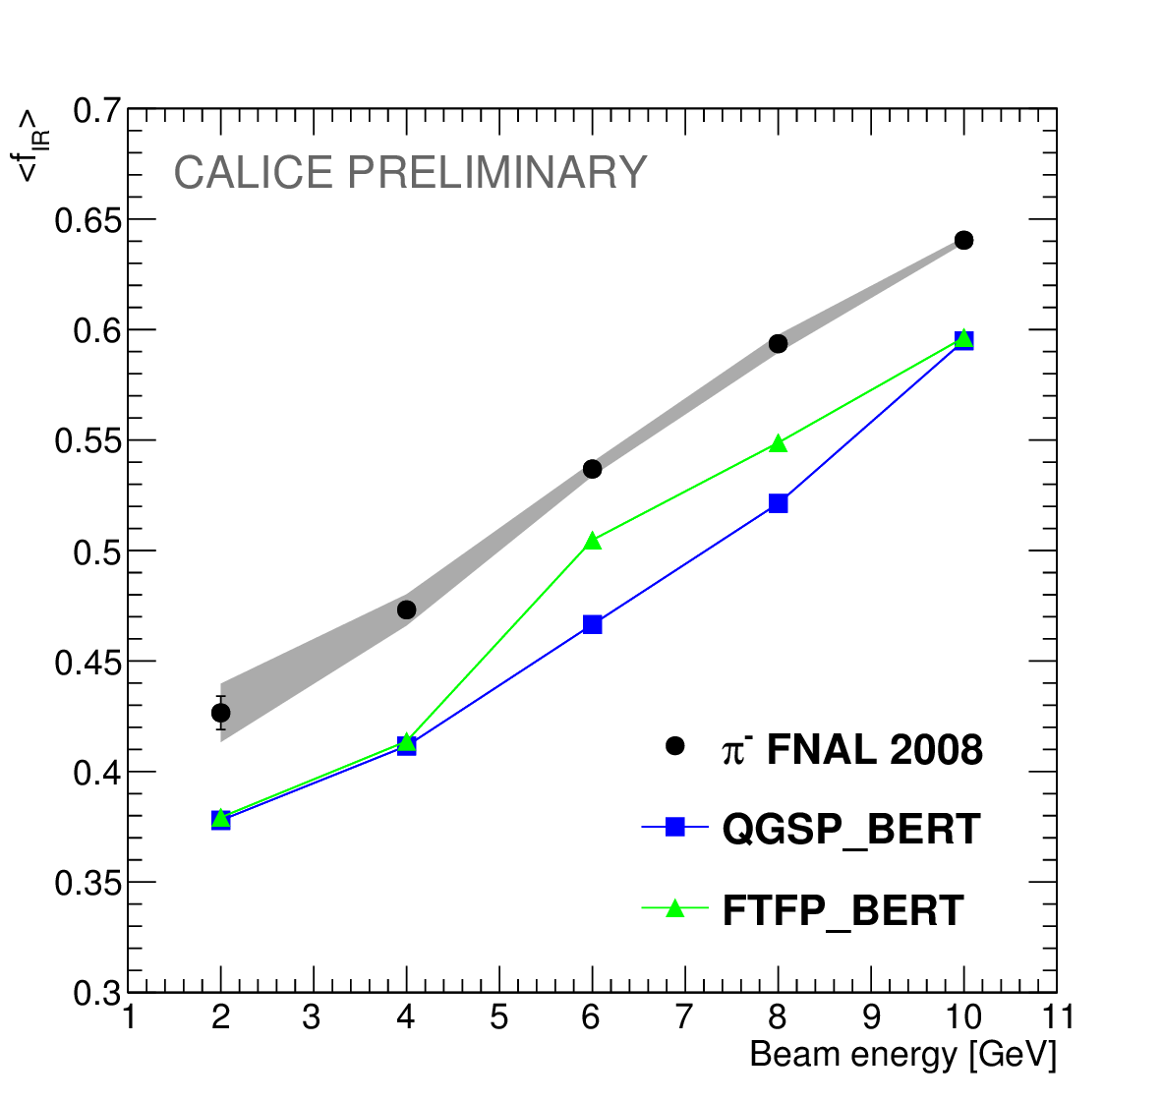
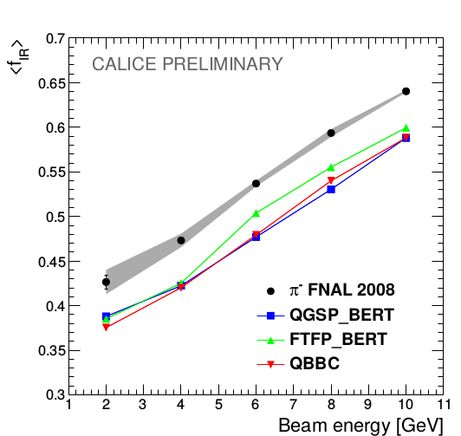
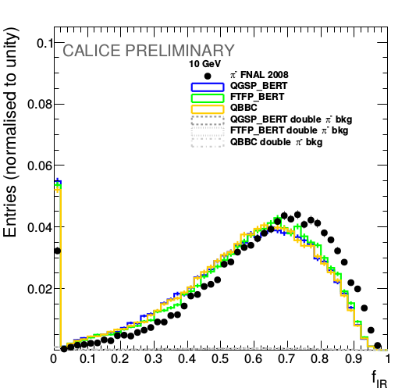
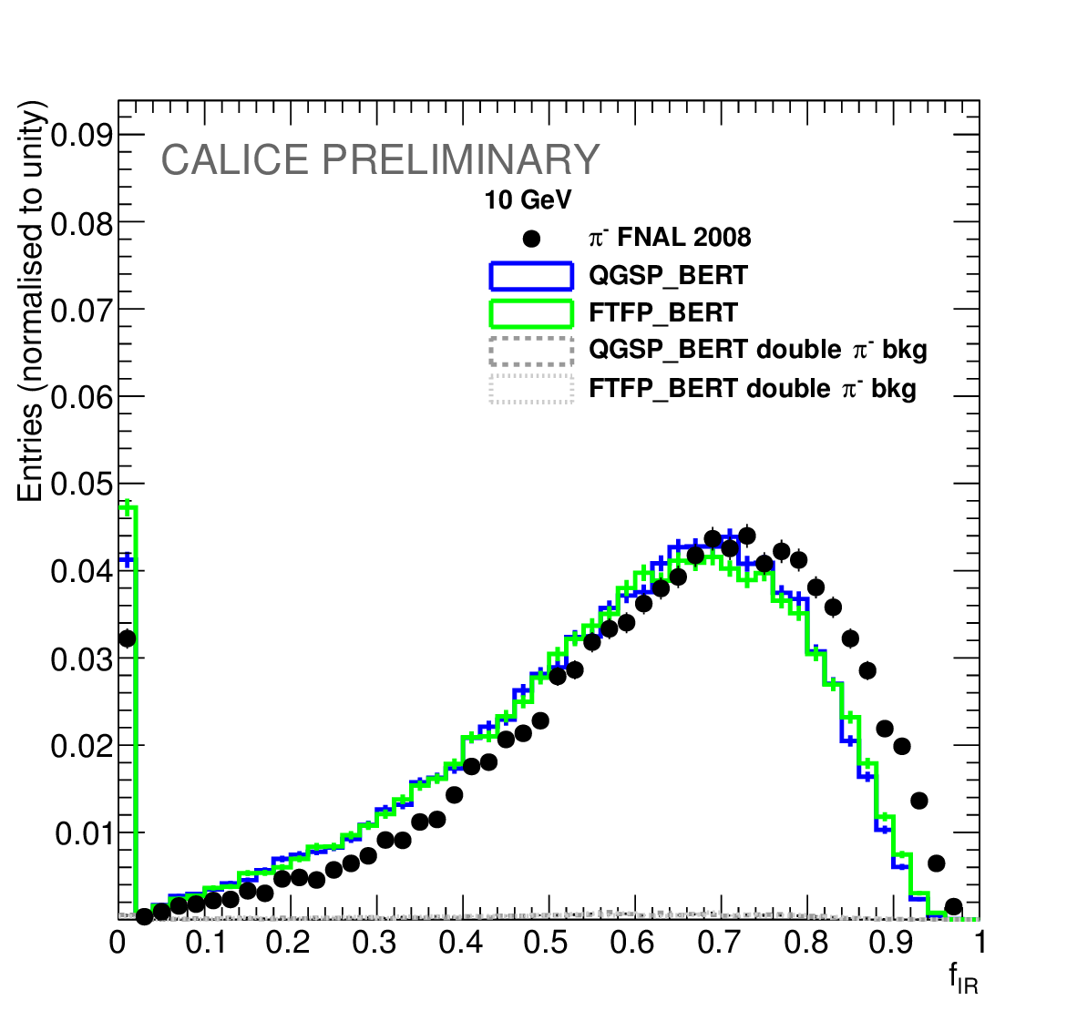
Energy fraction of the interaction region
2 GeV
10 GeV
The mean energy fraction is 8% - 11% higher in the data events compared with presented physics lists

Slide 16
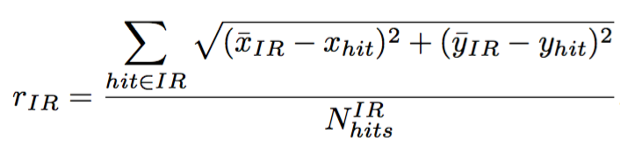
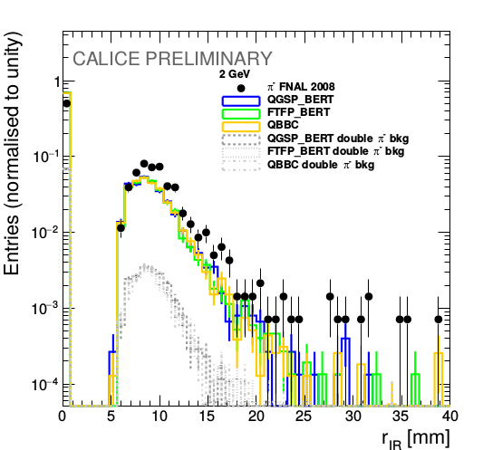
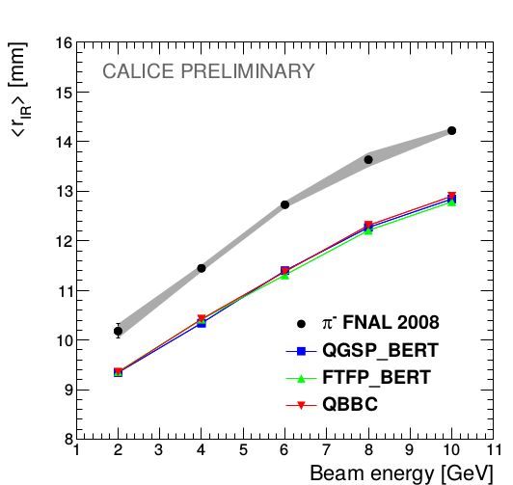
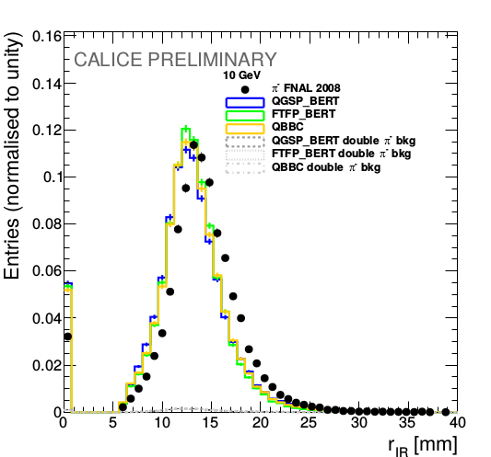
Lateral radius of the interaction region
2 GeV
10 GeV
Data has 9% wider interaction region than Monte Carlo for all beam energies.

Slide 17
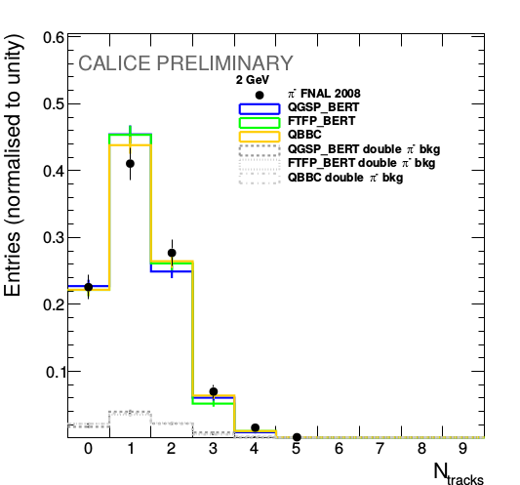
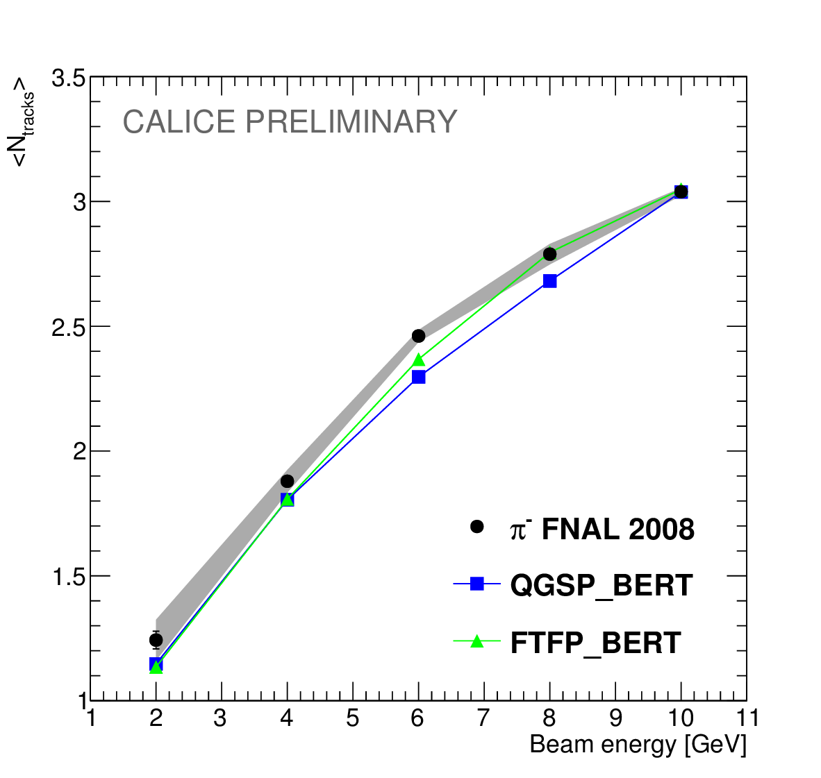
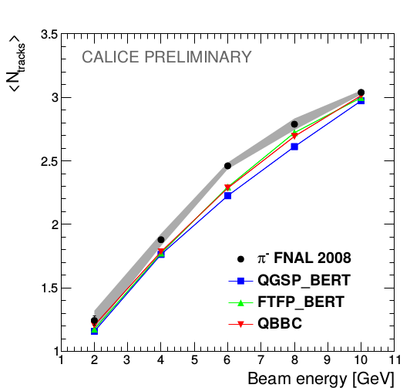
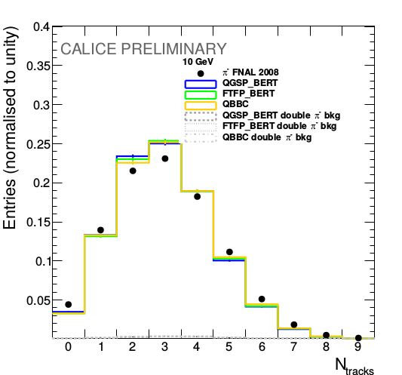
Number of secondary tracks
2 GeV
10 GeV
Well reproduced by MC
Both simulation models agree with the data within 5% of precision.

Slide 18
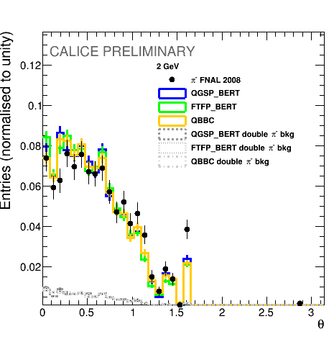
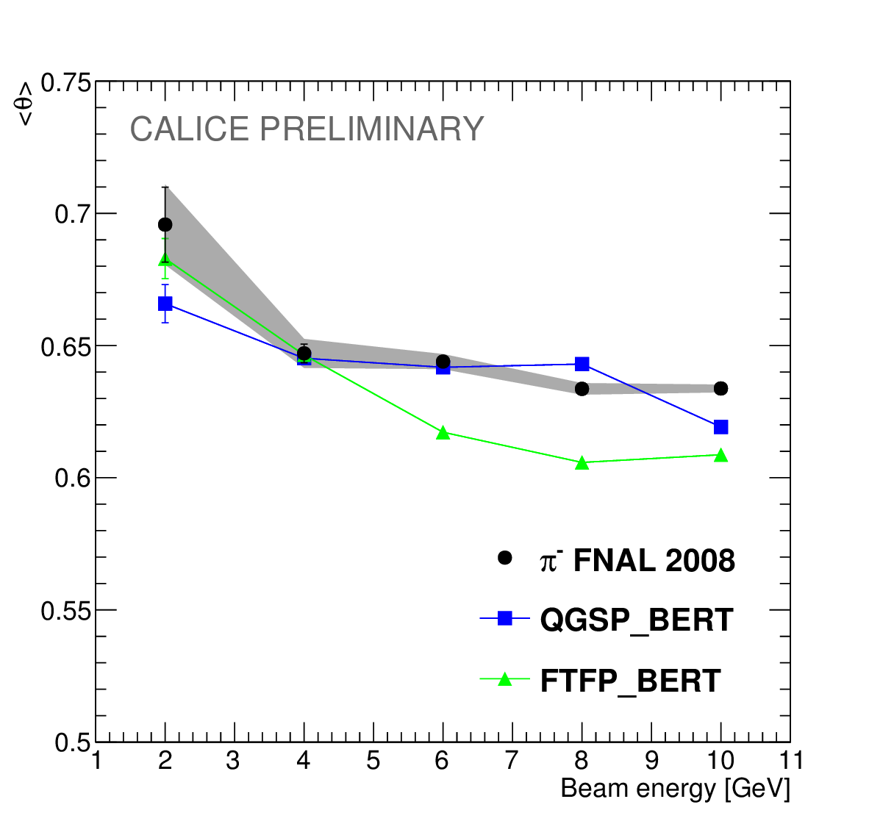
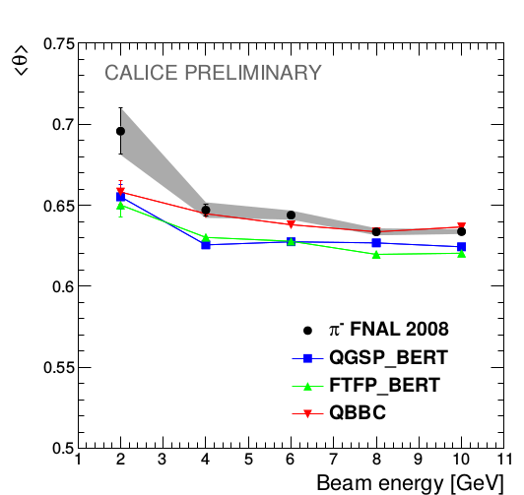
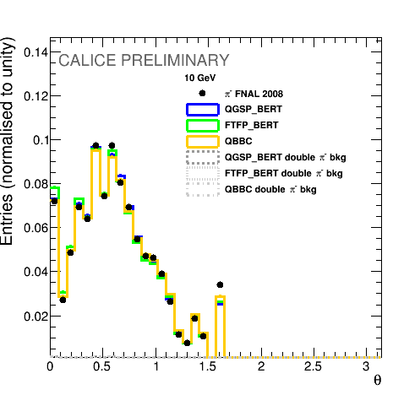
Polar angle distribution
Polar angle is defined w.r.t. the beam axis
2 GeV
10 GeV
Both simulation models agree with the data within 5% of precision.

Slide 19
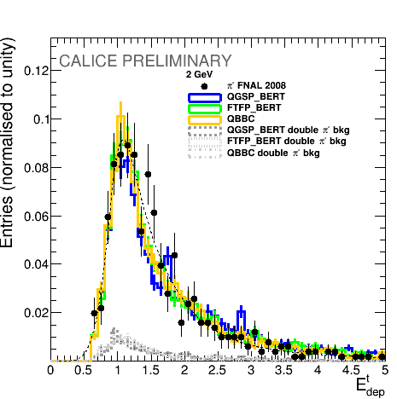
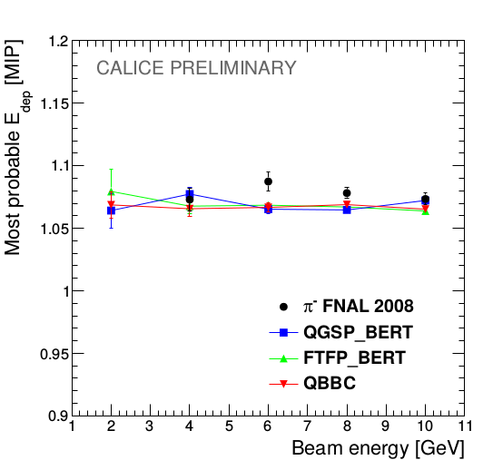
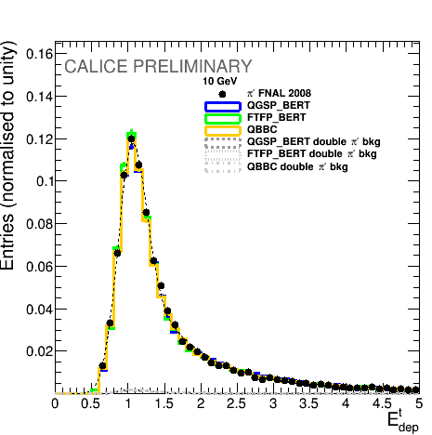
Energy deposition study
The produced particles act like MIPs, therefore, their energy depositions follow the Landau distribution
2 GeV
10 GeV
Both simulation models agree with the data within 5% of precision.

Slide 20
Conclusion of the study
All three presented physics from GEANT4 v10 lists show a good performance in terms of new tracking observables
The largest discrepancy found in energy fraction and radius of the interaction region - up to 15% difference
The systematic effects of the algorithm and double pion background events are studied and taken into account
The developed track finding algorithm can be used for in-situ calibration and/or monitoring
The GEANT4 v9.6 results are described in the CALICE note CAN-055 and were presented at
  IEEE/NSS MIC 2016
  VCI 2016
A paper publication with GEANT4 v10 is on going
GEANT4 team has shown high interest in this kind studies

Slide 21
Introduction
Hadronic showers in highly granular silicon-tungsten calorimeter
b-quark charge reconstruction
Top quark polar angle reconstruction
Bottom quark electroweak couplings measurement

Slide 22
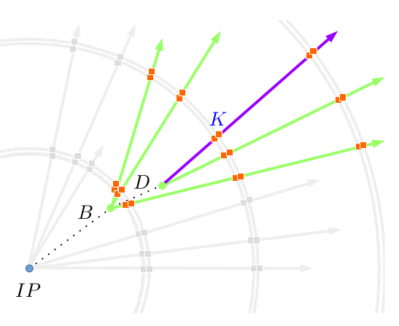
Objective
Main purpose of this work is to reconstruct the b-quark charge
The b-quark charge purity was measured to be at the level of 60% in fully hadronic ttbar decays
Properties of decay products from the b-hadrons are used to determine the charge of initial b-quark
Charge of the b-quark is calculated as a sum of the charges of secondary and tertiary vertex particles
The charge of K-mesons from reconstructed vertices is directly connected to the initial quark charge

Slide 23
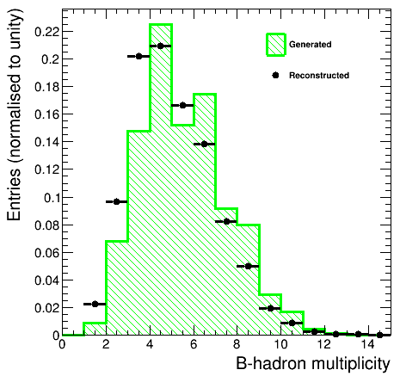
Generated vertices study
The generated vertices are selected by TruthVertexFinder algorithm
The average number of associated particles is about 5.5, which allows for a good vertex reconstruction
The reconstructed distribution has lower multiplicity than generated one

Slide 24
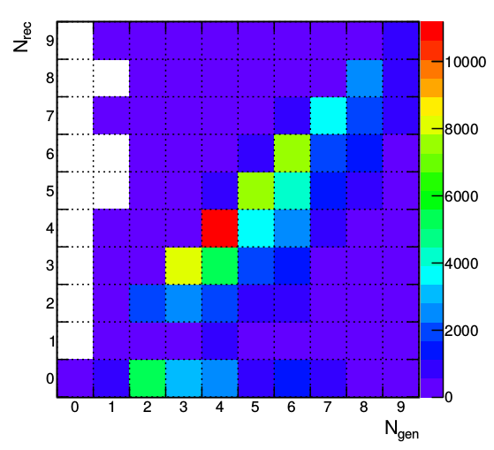
Standard reconstruction performance
Diagonal entries - 49%
The reason behind the b-quark charge impurity is the missing prongs by the reconstruction algorithms
Diagonal entries are almost ideally reconstructed - ~97% purity

Slide 25
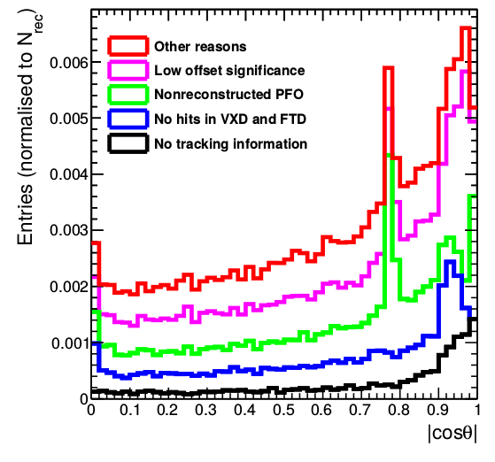
Missing particles
About 10% of the generated prongs are missing from the reconstructed b-hadron vertices
The reasons behind the missing prongs are:
  No corresponding reconstructed track – 0.93%
  Track has no associated hits in FTD or VXD – 2%
  Track has no reconstructed Particle Flow Object – 3.2%
  Low generated offset or momentum – 3.1%
  Other reasons – 1.7%
10.4% missing
One sees the peaks, which are explained on the next slide
One can develop a recovery algorithm which will add the missing prongs back and enhance the b-quark charge purity

Slide 26
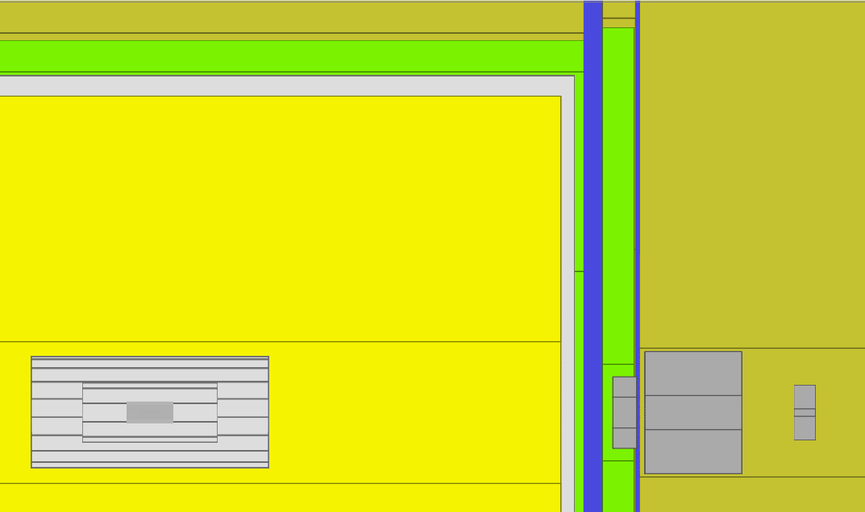
ECAL
Gap in TPC
Transition region
in calorimeters
TPC
ECAL
End of 6 layer barrel VXD
z
VXD

Slide 27
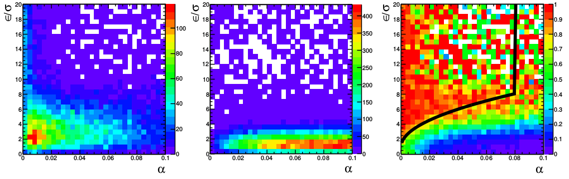
Vertex Charge Recovery algorithm
The developed VertexChargeRecovery uses two separation variables:
  Offset significance
  Angle between the vertex position and the track candidate direction
The defined cuts are:
x
z
Missing prongs
Background
Purity

Slide 28
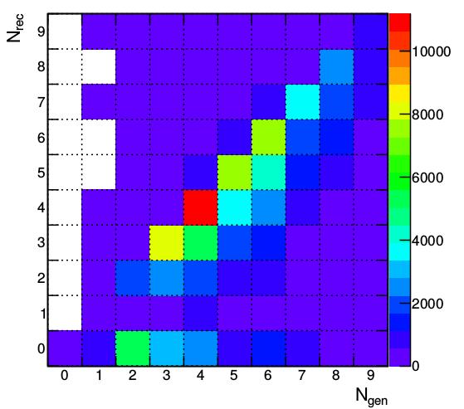
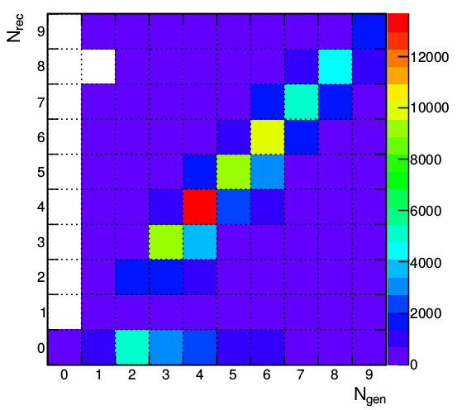
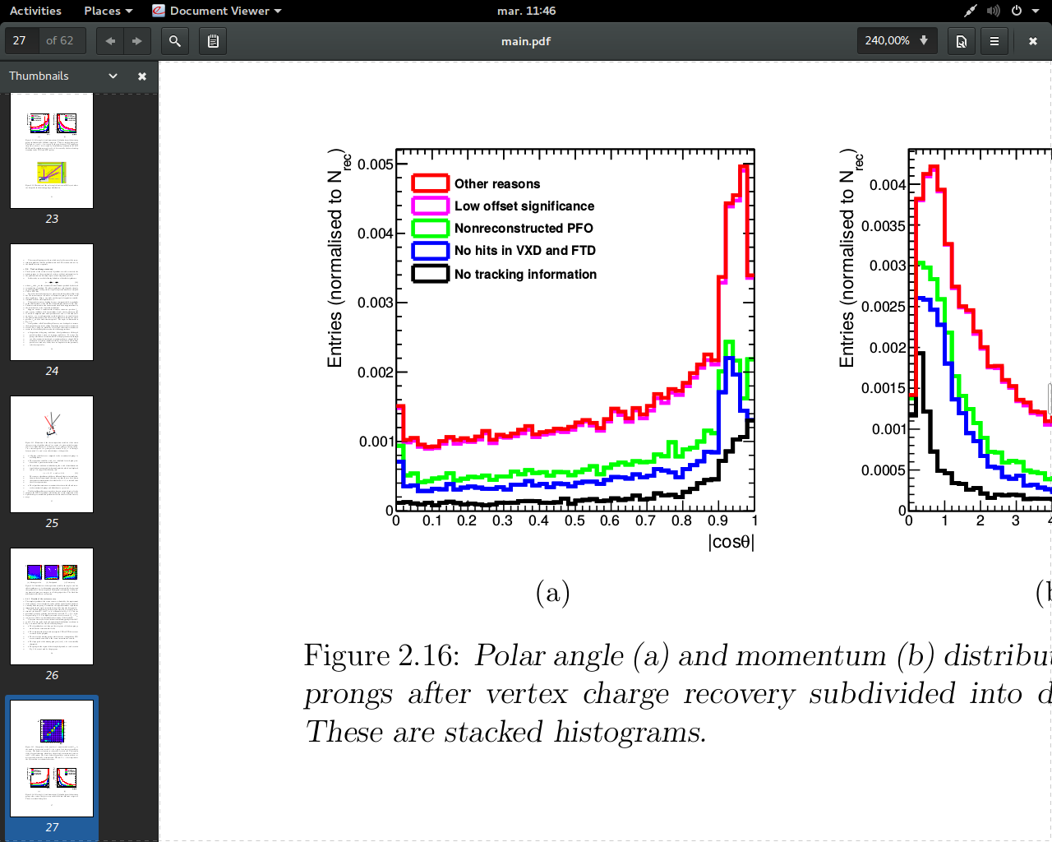
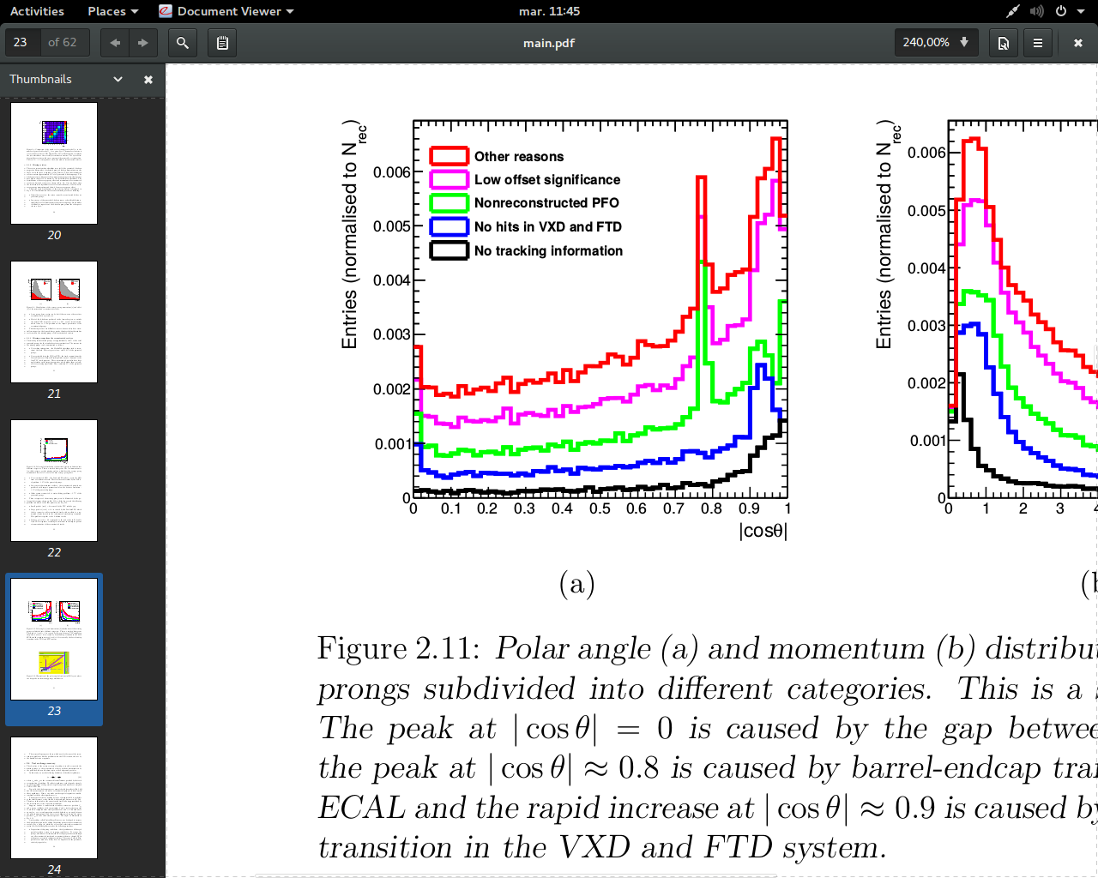
Recovery results
Standard
VertexChargeRecovery
The number of correctly reconstructed hadrons is increased
Decreased the number of missing prongs
The peak of missing prongs in the calorimeter transition region is recovered
The increase of the background particles in the vertices is small – from 3% to 4%
49% on diagonal
62% on diagonal
10.4% missing
6.2% missing

Slide 29

Recovery results
Recovery algorithm improves purity significantly for low-multiplicity and moderate momentum events
As a result – nearly constant charge purity in the barrel of the ILD detector
Average purity is increased up to 73%

Slide 30

Kaon charge: reconstruction
Charged kaons are part of the decay chain b→ c → s and carry an information about the initial b-quark charge
Charged kaons are identified in the TPC by the dE/dx information
There is a large dependence on the track polar angle in the initial distributions that needs to be corrected
  Has been observed at LEP I
This dependence is caused by an increased probability of δ-rays per sampling distance for forward tracks

Slide 31


Kaon charge: reconstruction
The angular correction is applied:
After the correction it is possible to identify kaons with up to 97% purity and 87% efficiency

Slide 32
Conclusion of the study
In this thesis, two basic b-quark charge signatures are used:
  Vertex charge, which is computed as a sum of the reconstructed secondary and tertiary particle charges;
  Kaon charge - the charge of a kaon from the reconstructed b-hadron vertices.
The impurity of the vertex charge is caused by missing particles – particles, that were not assigned to the corresponding reconstructed vertices.
A large inefficiency of the vertex reconstruction algorithm in forward region of ILD is observed.
The developed Vertex Charge Recovery algorithm assigns the missing particles to the reconstructed vertices using reconstructed observables.
  Average vertex charge purity is increased by 7% and the algorithm equalizes the vertex charge purity in the barrel region of the ILD detector.
The angular correction of the dE/dx values increases significantly the purity and efficiency of the kaon identification.

Slide 33
Introduction
Hadronic showers in highly granular silicon-tungsten calorimeter
b-quark charge reconstruction
Top quark polar angle reconstruction
Bottom quark electroweak couplings measurement

Slide 34


Heavy flavour at ILC
Measurement of the top quarks at the electron-positron machines:
  Direct EW production
  No competing QCD production
Advantages of the ILC:
  Operating at increases the sensitivity to top axial form factors, minimizes the QCD uncertainties
  Polarized beams allow independent determination of the b-quark EW couplings
  High luminosity
  Highly granular 4π detectors allow for precise final state reconstruction using PFA

Slide 35

B-quark charge combination
Using only the combination of the b-quark charge signatures, the vertex and the kaon charges
An event is accepted if
  Two vertex or kaons charges from different b-jets are opposite
  The vertex charge and the kaon charge have the same sign within one b-jet
  The vertex charge and the kaon charges are opposite for different b-jets
Only b-quark charge is used
The Vertex Charge Recovery increases statistics by 7% and increases the reconstruction quality by 4%
16% efficiency
Good agreement between reconstructed and generated distributions

Slide 36

Combination with the lepton charge
Using only the combination of the b-quark charge signatures, the vertex and the kaon charges
An event is accepted if
  B-quark charges are compatible (as on the previous slide)
  W lepton has opposite charge to the b-quark charge from the same top quark and like sign to the b-quark from hadronic top quark
  W lepton charge is used solely if an event passes cuts
  ~25% improvement w.r.t. the published result
38.6% efficiency
Good agreement between reconstructed and generated distributions

Slide 37
Introduction
Hadronic showers in highly granular silicon-tungsten calorimeter
b-quark charge reconstruction
Top quark polar angle reconstruction
Bottom quark electroweak couplings measurement

Slide 38
Objective
Main purpose of this work is to define the electroweak couplings and form factors of the bottom quark using the b-quark polar angle measurement of the process
Properties of decay products from the b-hadrons are used to determine the charge of initial b-quark
Charge of the b-quark is calculated as a sum of the charges of secondary and tertiary vertex particles
The charge of K-mesons from the reconstructed vertices is directly connected to the initial quark charge
- electroweak form factors, in which we are interested
- electroweak couplings

Slide 39
Research setup
We are using 250 GeV sample of 250 fb⁻¹ integrated luminosity with pair background v01-16-05 (DBD) for each polarization
To estimate the background we use ZZ HZ WW samples with the same version of ilcsoft
Modified version of VertexChargeRecovery from MarlinReco/Analysis (Recovery)

Slide 40

Event preselection for polar angle
Sort jets by b-tag
B-tag cuts: 0.8 for a high-tagged jet and 0.3 for a low-tagged jet
For Z return rejection:
  Invariant mass > 180 GeV and maximum photon energy < 40 GeV
For diboson background rejection
  Sum of jet masses < 120 GeV
Efficiency of the preselection is 51% for both polarizations

Slide 41
Event selection
We are using kaon charge and vertex charge combination to define a charge of a bjet
Kaons are identified using generator information on each particle in a reconstructed secondary or ternary vertex
  but we introduce ~97% purity and 87% efficiency, according to our previous PID studies
Kaon charge is a sum of all kaons charges found in jet vertices, zero sum is rejected
Vertex charge is the sum of all secondary and ternary track charges in a jet, zero sum is rejected
Only independent combinations are used to avoid charge correlations in the final result:
  Vertex charge from one jet, vertex charge from another jet
  Kaon charge from one jet, kaon charge from another jet
  Event is accepted if charges are opposite and rejected if the charges are the same

Slide 42




Polar angle reconstruction+bkg
The background is small due to the preselection cuts and the high signal cross section
Further plots for signal only

Slide 43





Bottom polar angle reconstruction
Fit region
Forward region inefficiency is seen in both figures, both distributions are fitted in the region of
The residual charge misreconstruction contaminates completely the backward region in the left-handed case

Slide 44





Polar angle reconstruction
The distributions are corrected using rejected event rates – events with the same sign of vertex or kaon charges
  The correction procedure uses only reconstructed events

Slide 45
Determination of the Form Factors
The published top analysis uses A_{FB} and total cross section measurement approach
We are measuring the differential cross section
where the S A are
We have 4 observables and 4 electroweak form factors to estimate independently
  Initial state polarization is essential for the b-quark studies, as one have no spin information after b-quark hadronization

Slide 46

Reachable accuracies at the ILC
The accuracies reachable after the first run at 250 GeV:
The luminosity sharing between two beam polarizations prefers the e_{L}p_{R} case (67.5% vs 22.5%)
  Higher statistical uncertainties for e⁻_{R}e⁺_{L}
The statistical precision for the e⁻_{L}e⁺_{R} case is excellent:
  One needs to estimate carefully the systematic effects

Slide 47


Interpretation
The accuracies on the couplings after the first run at 250 GeV:
The sign of the coupling is not fixed by LEP and SLC
The ILC is able to resolve LEP anomaly in clear and unambiguous way
  The relative precision on is about 5 times better than at LEP
A reach of within EFT framework is achievable for indirect New Physics searches

Slide 48
Conclusions
The b-quark polar angle is well reconstructed in the ILD environment, but there are two major problems
  The residual b charge impurity cause a tilt in the polar angle spectrum
    It was successfully corrected by the developed data-driven procedure
  There is a large inefficiency in the forward region of the ILD
    The ILD collaboration started to review the forward region layout (cables, FTD position)
The statistical uncertainties on the measured observables the <0.5% level for the e_{L}p_{R} case and at the level of 1-3%
The precision on the right handed coupling is ~5 times better than at LEP
  LEP deviation will be unambiguously resolved at the ILC
Studies were presented on EPS-HEP 2017
The paper publication is on-going

Slide 49
General summary
Very detailed ILD analysis: from hits in subdetectors to a precision on electroweak coupling constants
The b-quark analysis can be used as a benchmark of the detector performance
For the moment, the only analysis in ILD which makes use of dE/dx from TPC
The main purpose of the ILD simulations study, which is improving the detector hardware, was archived
  Can replace the top physics program for the 250 GeV ILC stage
  Indirect New Physics searches exceed the LHC energy reach
The calorimeter study can be used as an input for regulation of the GEANT4 parameters
  Tracks can be followed to the Hcal providing better particle energy resolution
Three conference publications, two paper publications are on-going

Slide 50
Thank you!

Slide 51







Track finding algorithm in the ECal
Select events by interaction layer number from 6 to 15
Separate out and analyze the interaction region (IR)
Run clusterization algorithm on non-IR hits
Classify each cluster as track like or not track like
  Criteria:
“Neighborhood cube”
Considered pad
vector of a cluster
Noise correction
(free parameter)

Slide 52



Number of hits
2 GeV
10 GeV
Both simulation models agree with the data within 5% of precision.

Slide 53

Hadronization and decays of the b-quark
In general, one expects two vertices in a b-jet
The TruthVertexFinder algorithm is developed to find the generated vertices and associated charged particles (prongs) from the b-hadron decays

Slide 54
Conclusion of the study
In this study, three basic b-quark charge signatures have been used:
  Vertex and Kaon charges from b-hadron vertices and W lepton charge signature, which is specific for semileptonic top pair decays
The top quark polar angle spectrum was sucessfully reconstructed using combinations of vertex and kaon charge signatures only
  This result can be extended on the fully hadronic top pair decays and the b-quark channel
  The Vertex Charge Recovery increases statistics by 7% and increases the reconstruction quality by 4%
Combining all three charge signatures leads to a good agreement with the generated spectrum and to the 25% efficiency increase

Slide 55

Overview of A_{FB} measurements
Forward-backward asymmetry in SM
arXiv:hep-ph/0610173v1
The A_{FB} value and the uncertainty is determined from the fit to the reconstructed curve
The measurements at Z pole are the most precise

Slide 56

Motivation
Previous studies found a migration effect in the semileptonic events
Eur. Phys. J., C75(10):512, 2015
Eur. Phys. J., C75(10):512, 2015
Because of the incorrect assignment of the W-jets to the b-jet from the leptonic top decay, the events “migrate” from forward to the backward region in e⁻_{L}e⁺_{R}, while other polarization is clean, because of the W kinematics;
Two solutions were found:
  Cut on the top reconstruction quality: ~28.5% efficiency
  Use a combination with the b-quark charge: ~30.8% efficiency
Main purpose of the present study: increase the efficiency in e⁻_{L}e⁺_{R}

Slide 57

Top reconstruction
This work reuses the top reconstruction approach from the previous studies
The event signature is two b-jets, two light jets from hadronic W, an isolated lepton and a neutrino
The isolated lepton is found using the LAL Lepton Finder algorithm
The b-jets are selected using b-tag information
The light jets from W boson are combined with one of the b-jets to form a hadronic top minimizing the following expression:
The reconstruction cuts and the cuts against the background lead to the ~54% efficiency and 91% purity
One uses charge information to build the top polar angle distribution

Slide 58

Charge signatures
The top polar angle is reconstructed using the hadronic top decay
This work uses three charge signatures:
All signatures demonstrate a discrepancy between the generated and the reconstructed curves
One needs to use charge combinations to reduce the migration effect

Slide 59

New physics modifications
Different Randall-Sundrum scenarios can affect SM polar angle spectrum at the ILC
  RSa scenario flips the right-handed coupling sign
  The ILC will have enough accuracy to detect both scenario
arxiv:1105.3158

Slide 60


LEP measurements
Allowed regions for the b-quark couplings after LEP
The LEP and SLC experiments were not sensitive to the sign of the couplings, because of operation at the Z pole
The precise R_{b} measurements resulted in the small errors on the left-handed coupling

Slide 61

Motivation
There is a top-bottom complementarity in the EFT framework
The ILC measurement of the b-quark EW couplings can narrow down the confidence regions for the Wilson coefficients, proportional to the top quark couplings
arxiv:1704.01782

Slide 62

Forward region revisited

Slide 63

Forward region revisited

Slide 64




Charge purity and polar angle correction
We can use refused events with contradictory charges as a measure of our charge purity and calculate correction factors
Let p be a probability of a correct charge measurement of a jet
Then q = 1 – p is an incorrect charge probability
We can compute it from the following equations:
We define a number of original events:
Corrected values:
We do not use generator information for correction
# of refused events
# of accepted events
Original number of non-migrated
events in the forward/backward bins
Migration terms

Slide 65


Recovery effects
Before charge recovery
After charge recovery
+7% of statistics
+4% of vertex purity
More kaons with the same purity
Constant charge purity in the barrel

