Slide 1
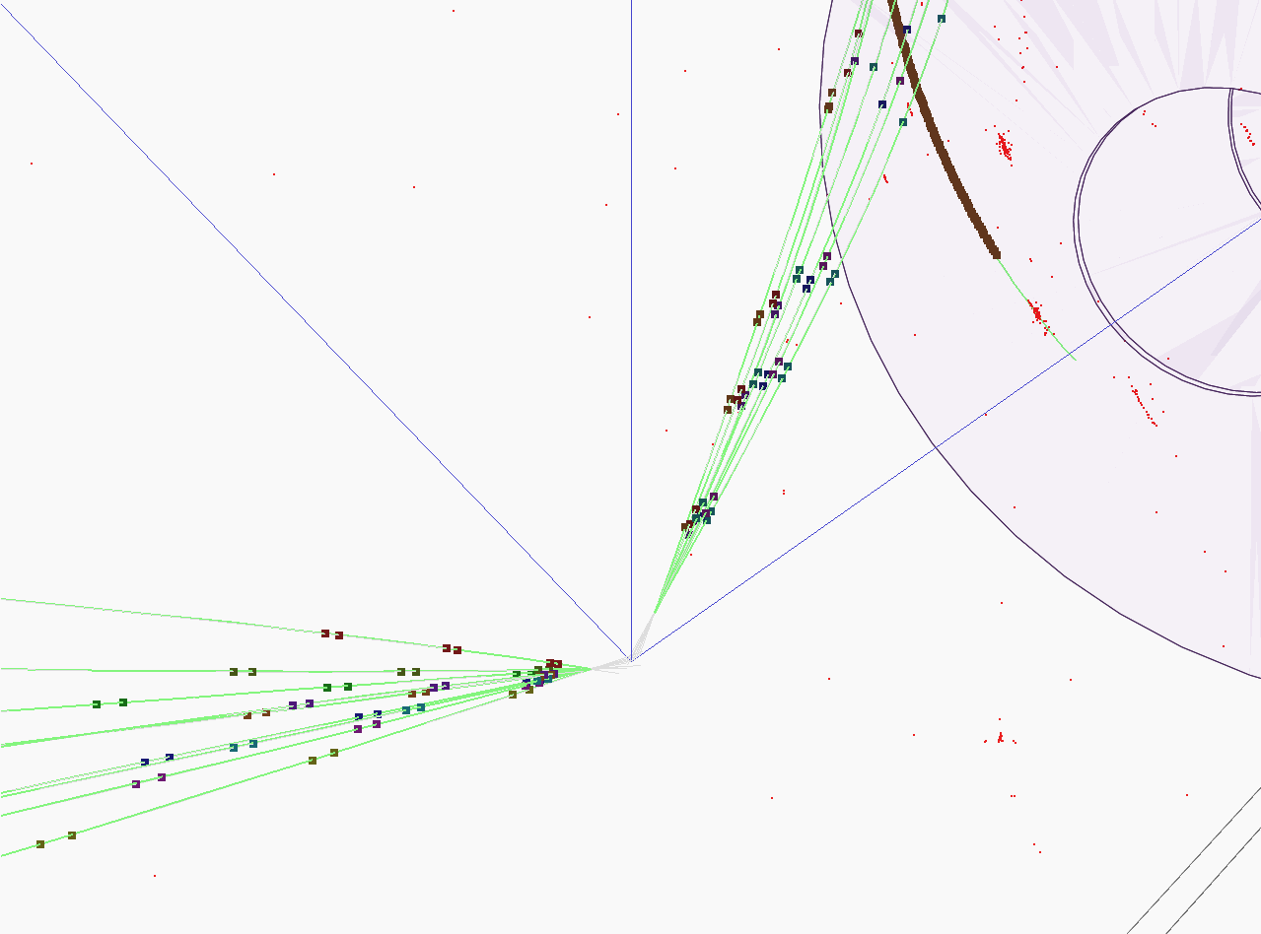


Hadronic showers in a highly granular silicon-tungsten calorimeter and
Production of bottom and top quark at the ILC
PhD candidate: BILOKIN Sviatoslav
Supervisor: PÖSCHL Roman
Orsay 2017

Slide 2
Content
Introduction
Hadronic showers in highly granular silicon-tungsten calorimeter
B-quark charge reconstruction
Top quark production
Bottom quark production

Slide 3
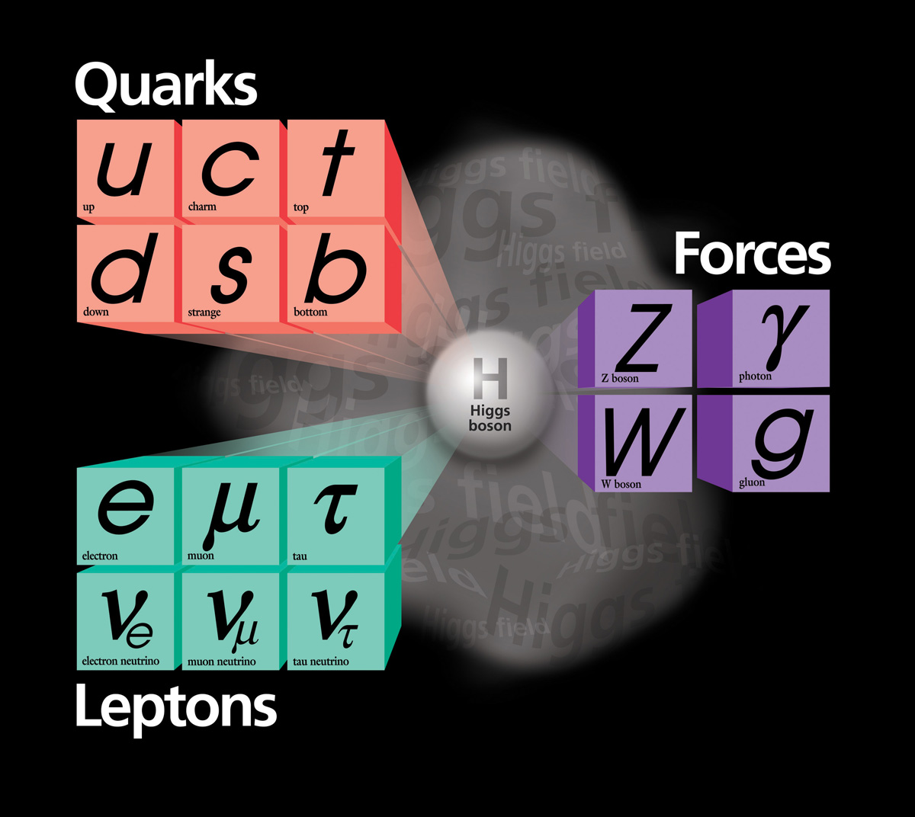
Standard Model of Particle physics
The Standard Model (SM) provides a consistent and precise theoretical description of known elementary particles and their interactions.
Theoretical framework was developed in 1960’s
Since then, the SM predicted many essential phenomena of Particle physics, like weak neutral currents, or Higgs boson existence
It has been confirmed by a vast majority of experiments

Slide 4
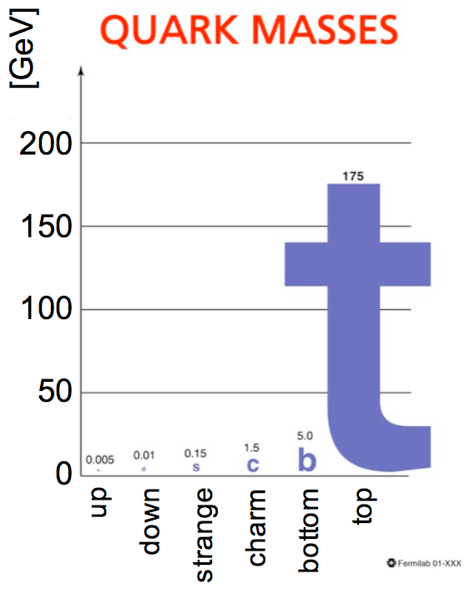
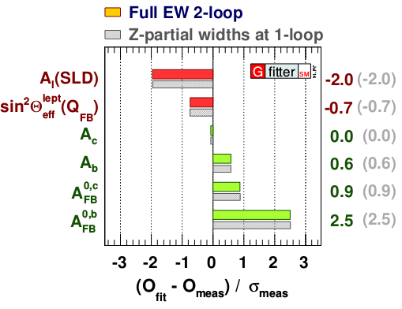
Motivation
The large problem of the SM is the fermion mass hierarchy
Top quark is the heaviest elementary particle in the SM, and it is a subject of many BSM theories,
  i.e. composite top or Randall-Sundrum models predict deviations for the EW couplings of the top quark
The top and bottom quarks belong to one doublet
Forward-backward asymmetry measurement at LEP has 2.5σ tension with the SM prediction
We need to measure the bottom and top quark EW couplings
arxiv: 1407.3792v1

Slide 5
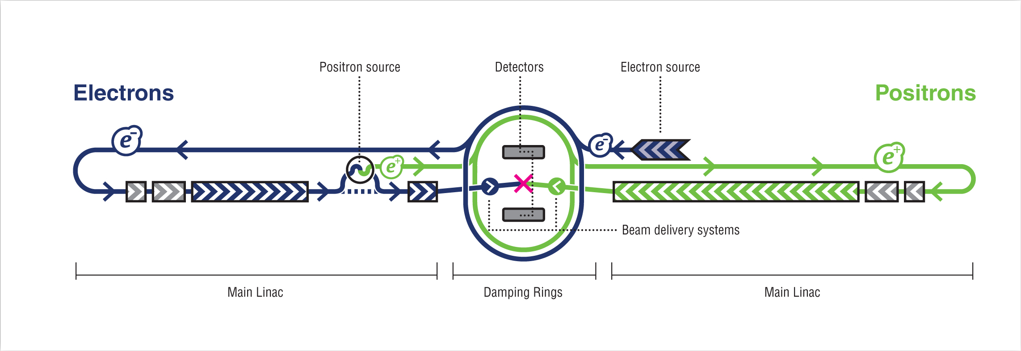
ILC project
Polarized electron and positron beams
Center-of-mass energy of 250 – 500 GeV with a 1000 GeV upgrade option
Two detectors, SiD and ILD
Well known state of initial particles, low machine background
Main goals:
  Precision measurement of Standard Model parameters
  Direct and indirect searches of Beyond Standard Model particles

Slide 6
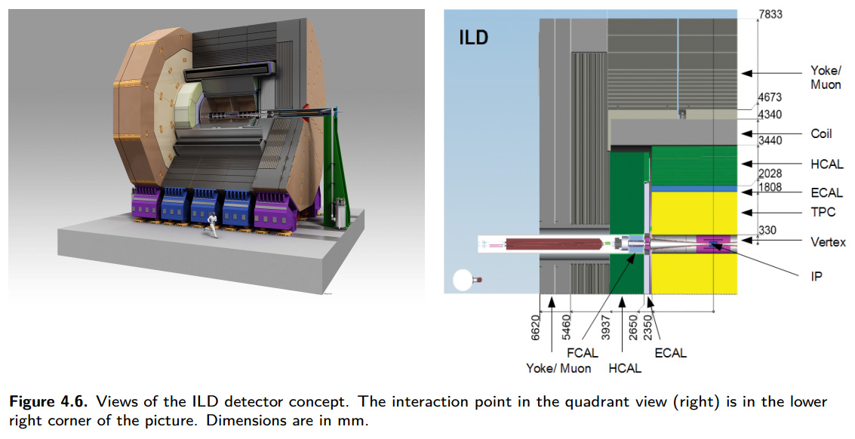
ILD project
Designed for Particle Flow algorithms that allow to reconstruct individual particles inside ILD. Full GEANT4 simulation
Tracking system:
  Vertex Detector (VXD) has 3 double layers of silicon pixels
  Time Projection Chamber (TPC) with particle identification capabilities
  Forward Tracing Disks (FTD)
  Other devices
Calorimeters:
  Highly granular silicon-tungsten Ecal (SiW Ecal)
  Highly granular iron Hcal
3.5T Solenoid
Muon trackers

Slide 7
Introduction
Hadronic showers in highly granular silicon-tungsten calorimeter
B-quark charge reconstruction
Top quark production
Bottom quark production

Slide 8
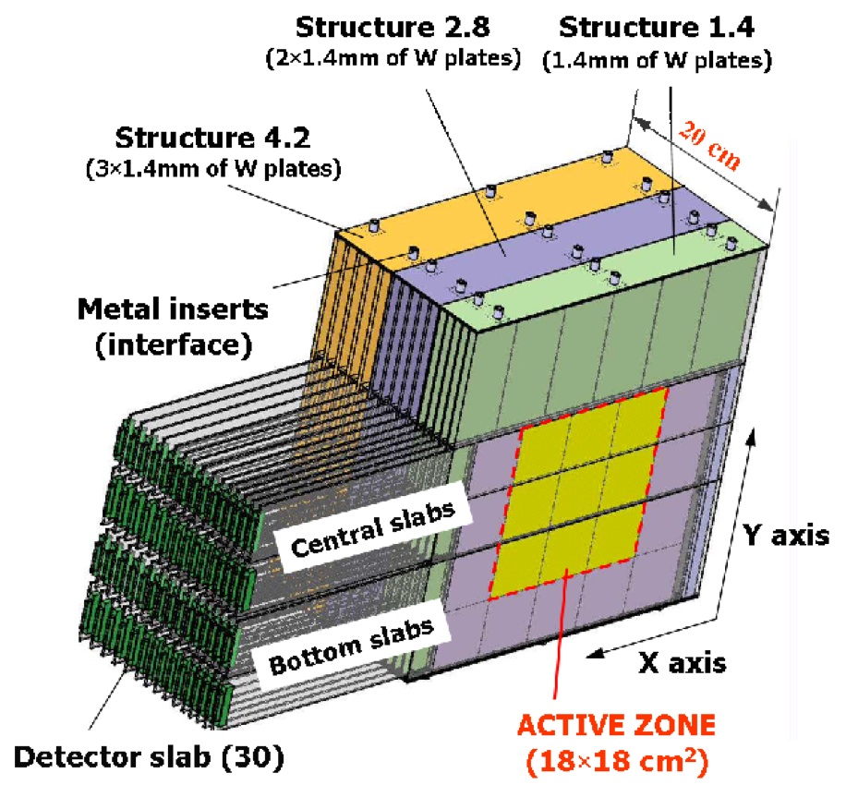
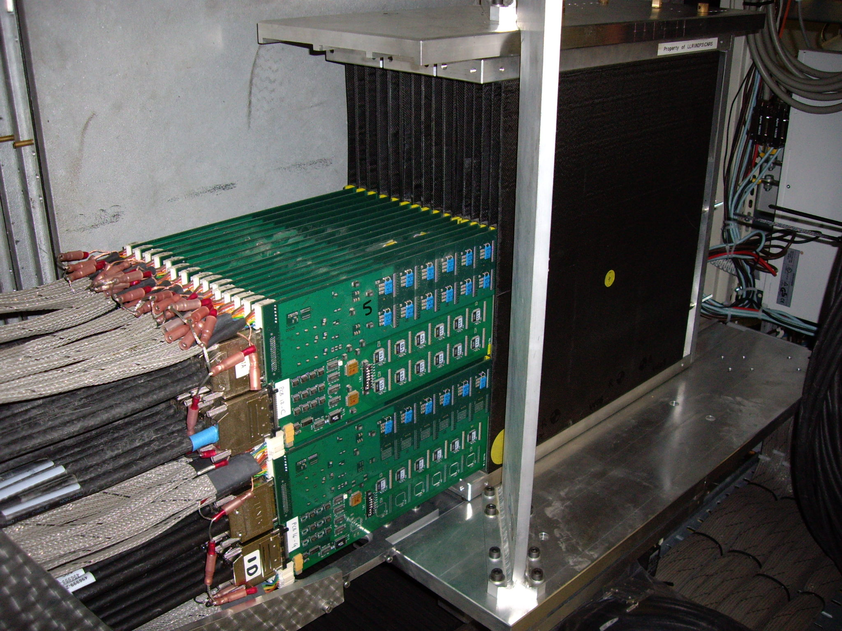
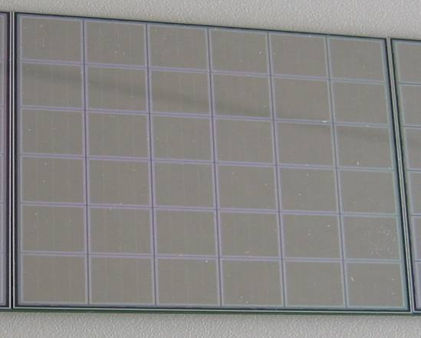
CALICE SiW ECAL physics prototype
Absorber: Tungsten plates 1.4-4.2 mm:
Active material: silicon P-I-N Diodes
Thickness 525 µm
Granularity: 10x10 mm²
Three modules of 10 layers each
with increasing tungsten (W) thickness
Total depth:
Active Zone: 18x18 cm² in each layer
Total: 9720 Pixels/Channels

Slide 9
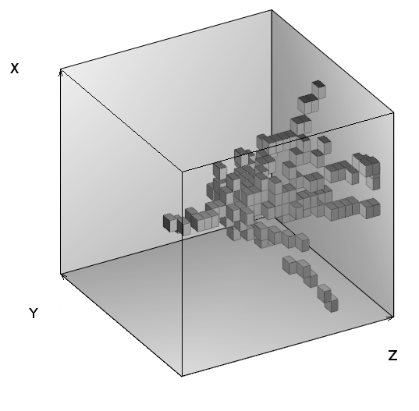
Introduction
Compare various Monte Carlo models to the data using new set of differential observables from track finding algorithm
Test beam data recorded at FNAL in 2008 π⁻ between 2 GeV and 10 GeV
Study of interactions in terms of global observables: radial and longitudinal shower profiles: NIM A794 (2015) 240
New: Study of GEANT4 v10 performance within this energy range
10 GeV pion in SiW ECAL prototype

Slide 10
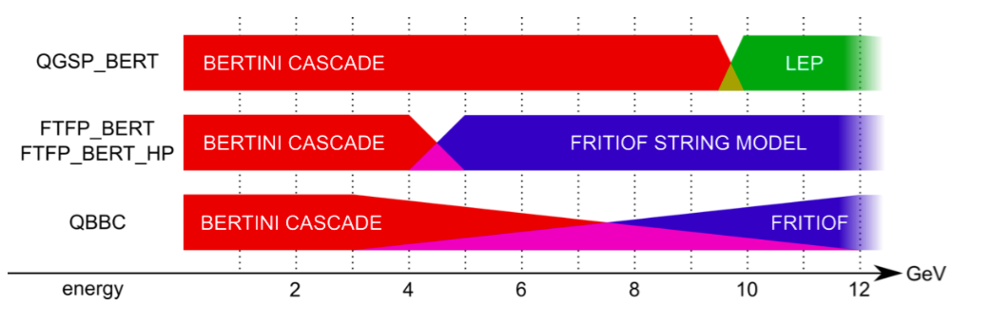
GEANT4 Physics lists
Presented study covers interesting energy range (2-10 GeV):
Energy range of majority of charged pions and other hadrons within
high energy (LC) jets
Transition region for many physics lists
GEANT4 v.10 used:
  FTFP_BERT, QGSP_BERT and QBBC physics lists

Slide 11
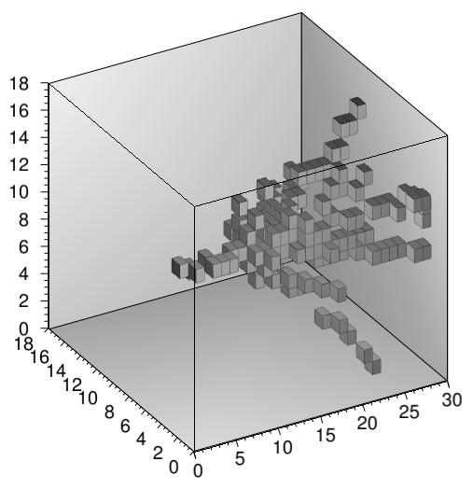
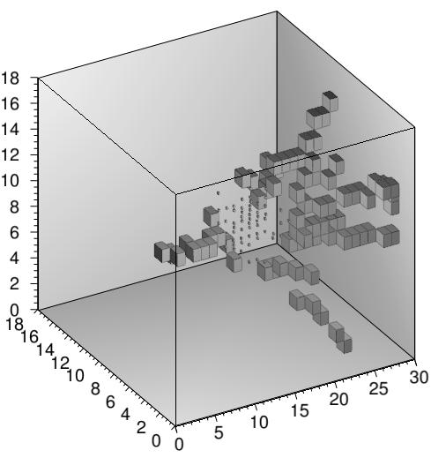
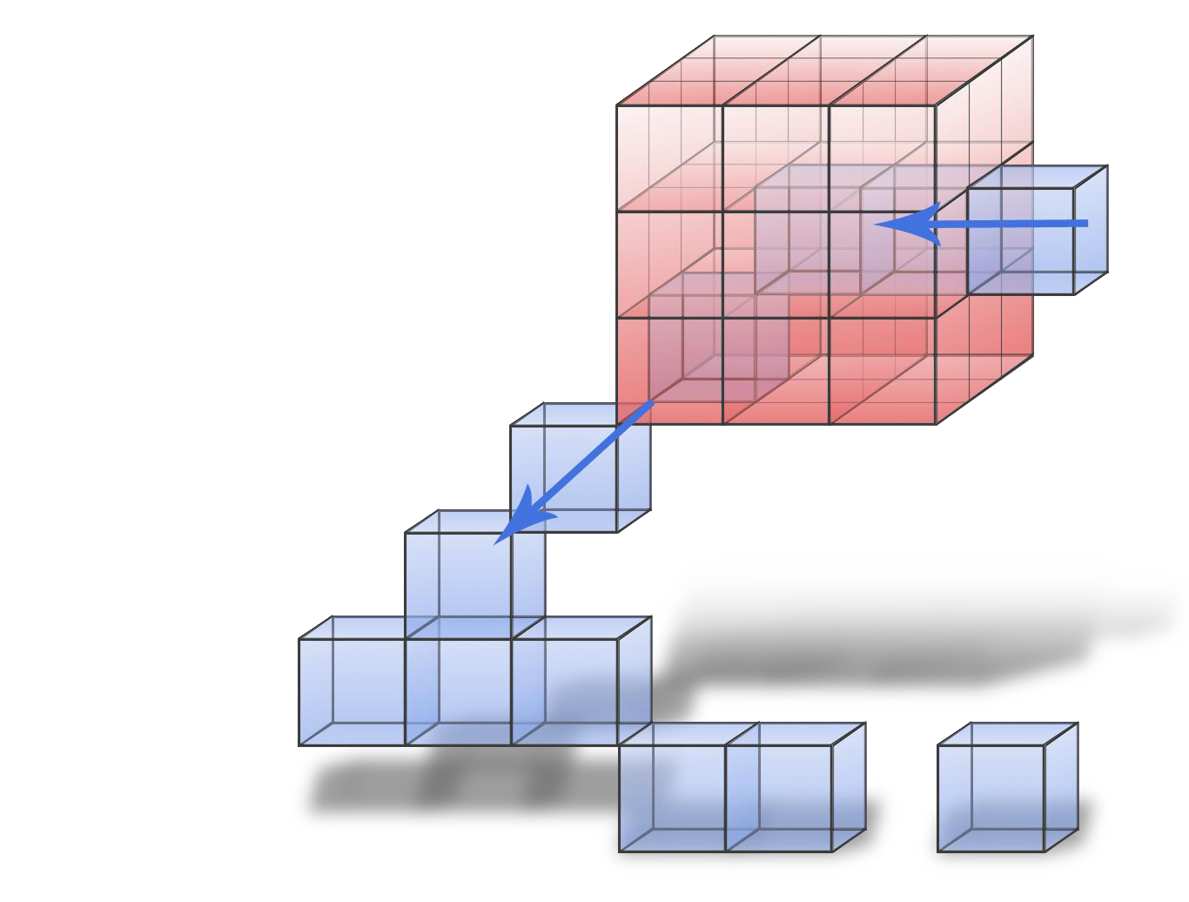
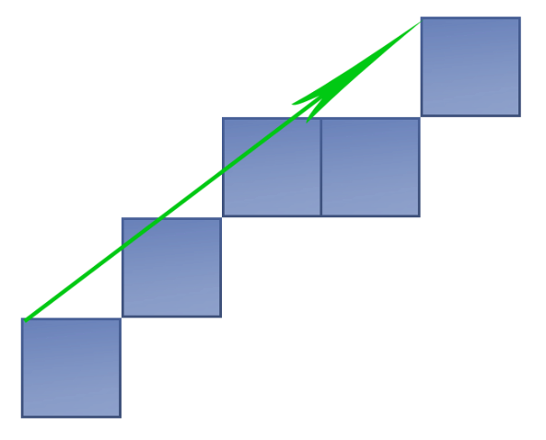

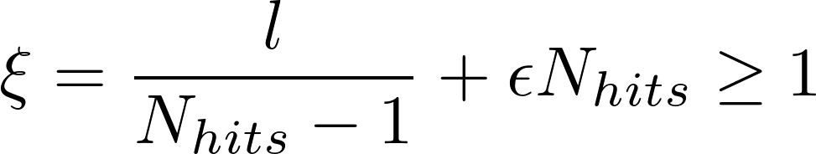

Track finding algorithm in the ECal
Select events by interaction layer number from 6 to 15
Separate out and analyze the interaction region (IR)
Run clusterization algorithm on non-IR hits
Classify each cluster as track like or not track like
  Criteria:
“Neighborhood cube”
Considered pad
vector of a cluster
Noise correction
(free parameter)

Slide 12
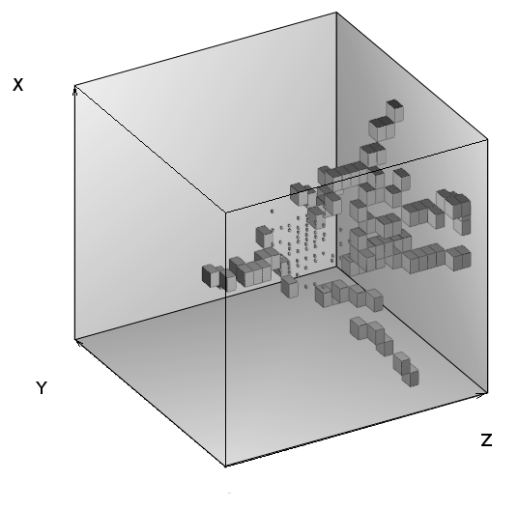
Hadronic shower analysis
An event display of hadronic interaction in SiW ECAL prototype, after noise cut at 0.6 MIP

Slide 13
Hadronic shower analysis
Tracks from
secondary particles
MIP energy range,
Number, Polar angle, etc.
Track from
primary pion
MIP energy range
Interaction region
All hits with at least six
neighbouring pads with signal
Energy fraction, Radius

Slide 14
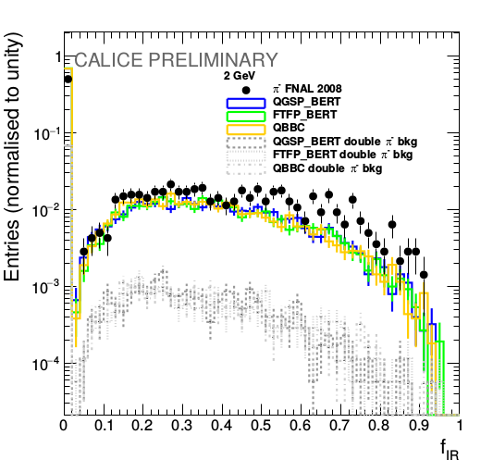
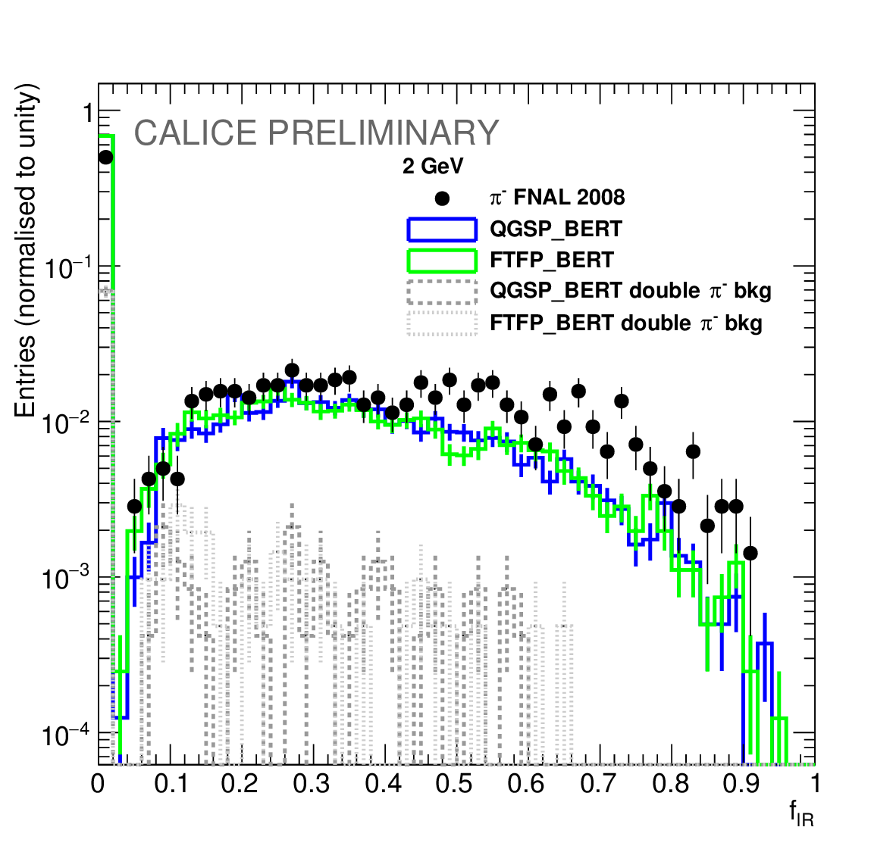
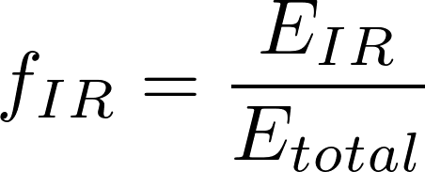
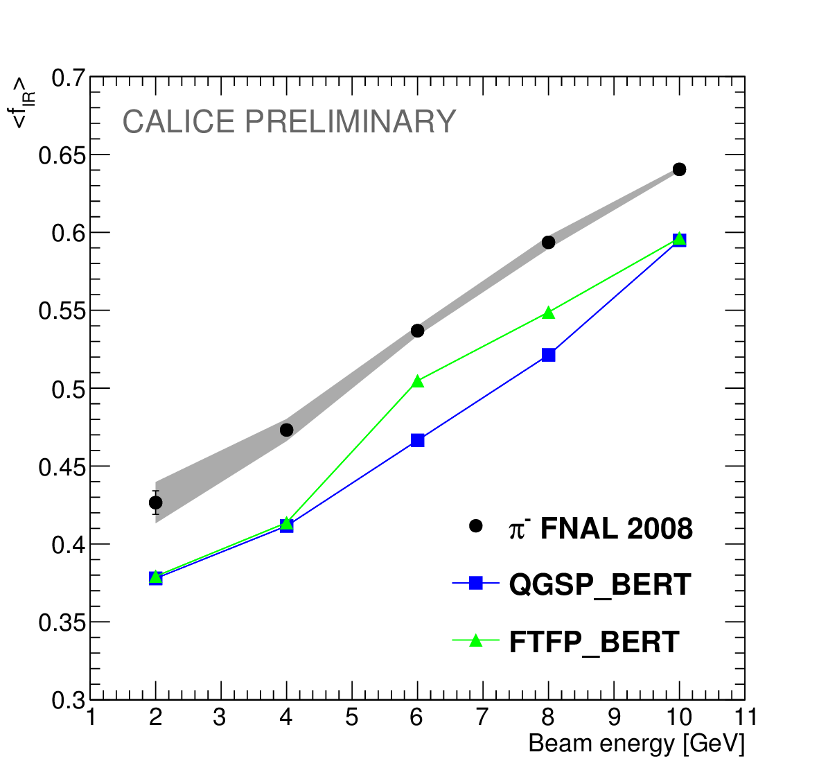
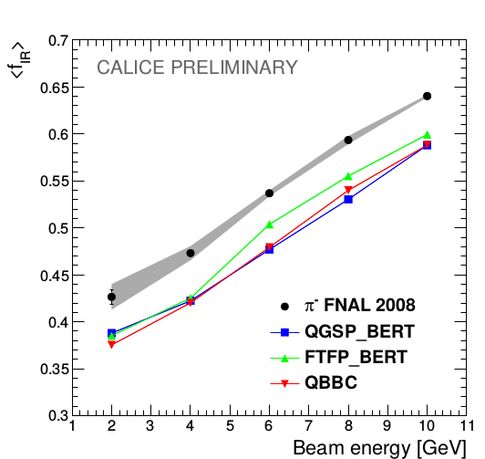
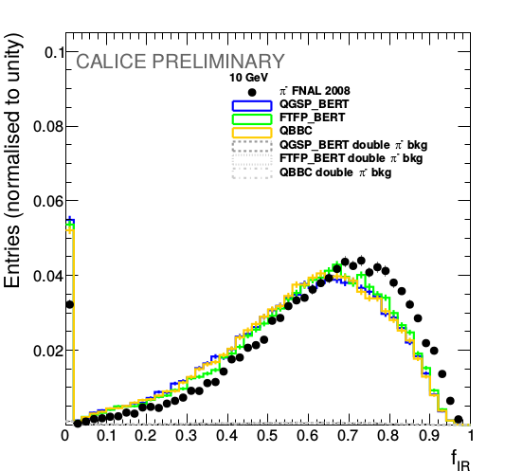
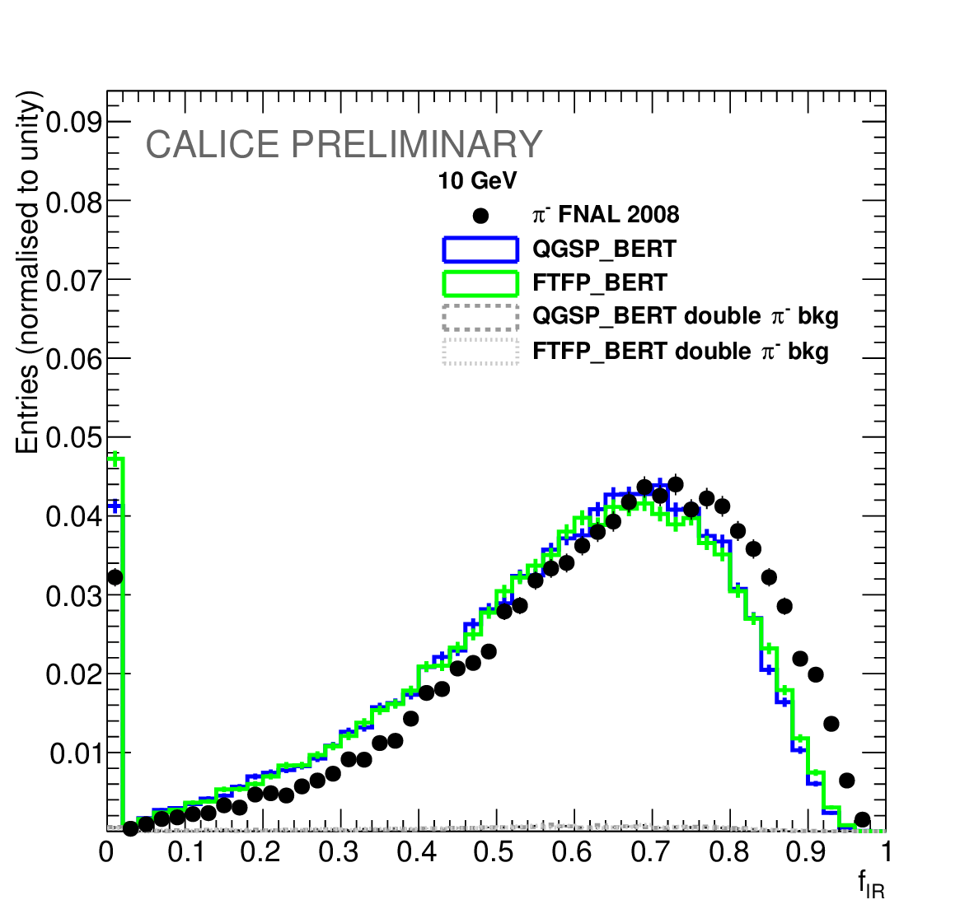
Energy fraction of the interaction region
2 GeV
10 GeV
The mean energy fraction is 8% - 11% higher in the data events compared with presented physics lists

Slide 15
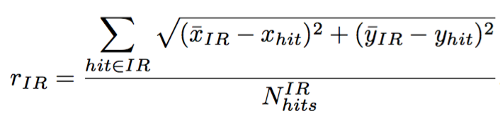
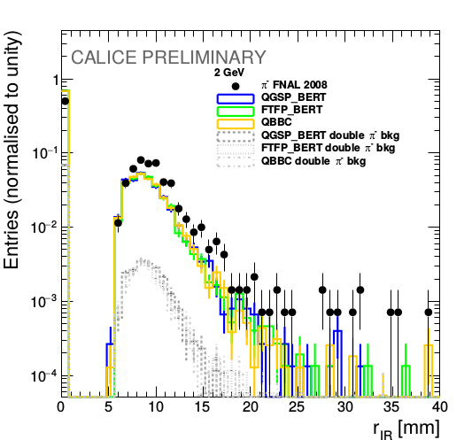
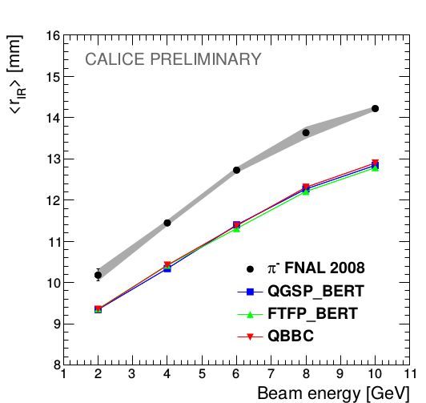
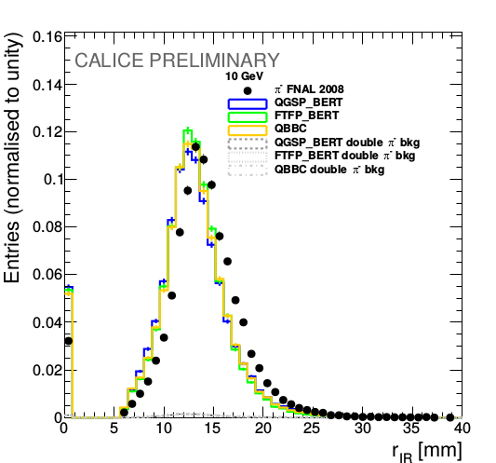
Lateral radius of the interaction region
2 GeV
10 GeV
Data has 9% wider interaction region than Monte Carlo for all beam energies.

Slide 16
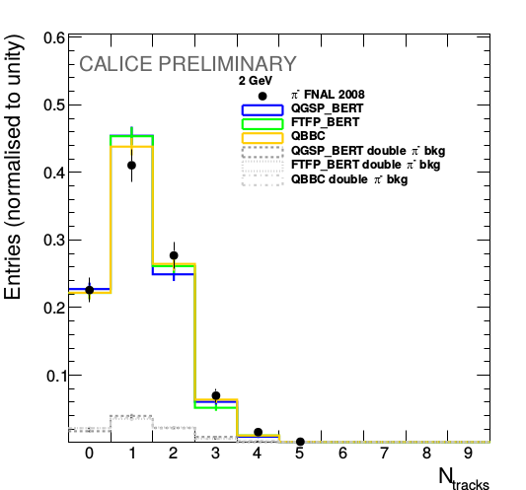
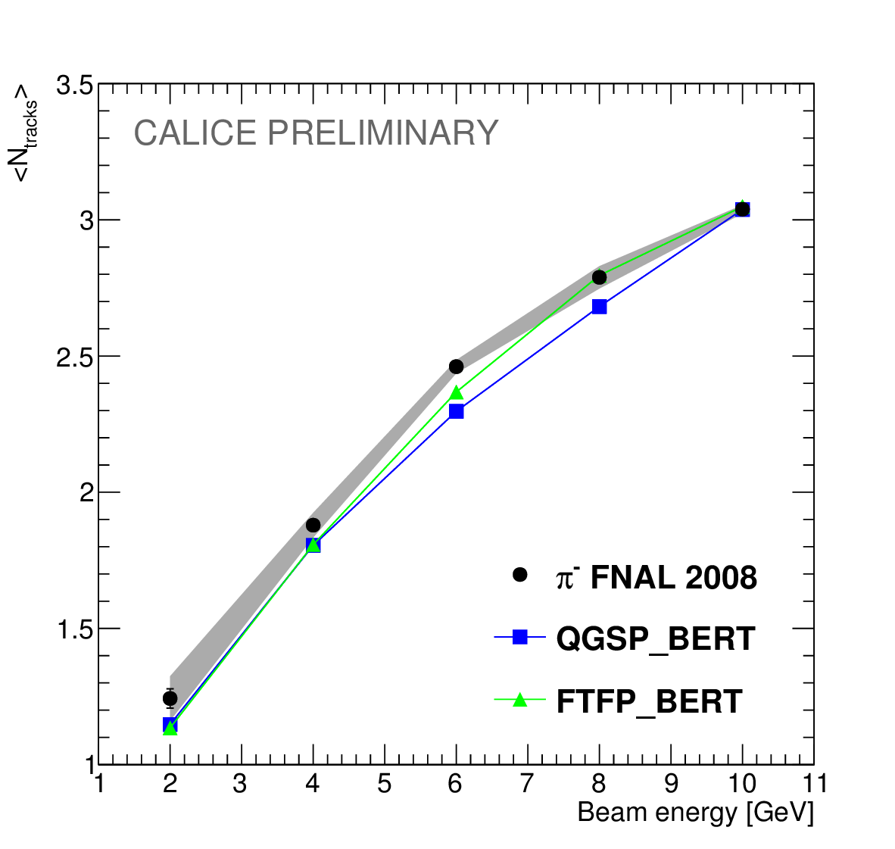
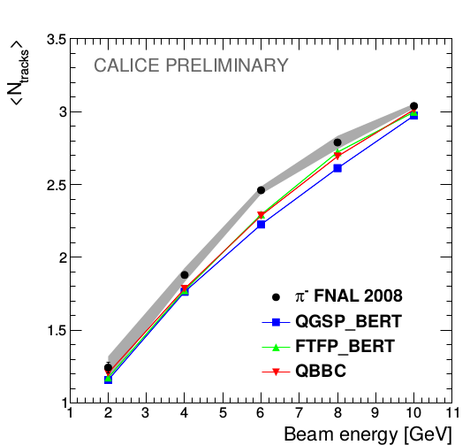
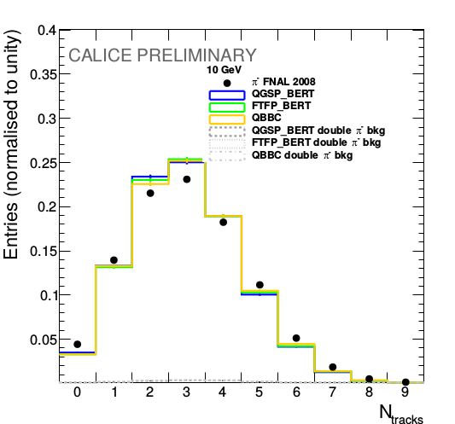
Number of secondary tracks
2 GeV
10 GeV
Well reproduced by MC
Both simulation models agree with the data within 5% of precision.

Slide 17
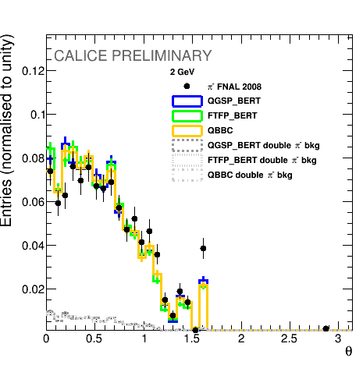
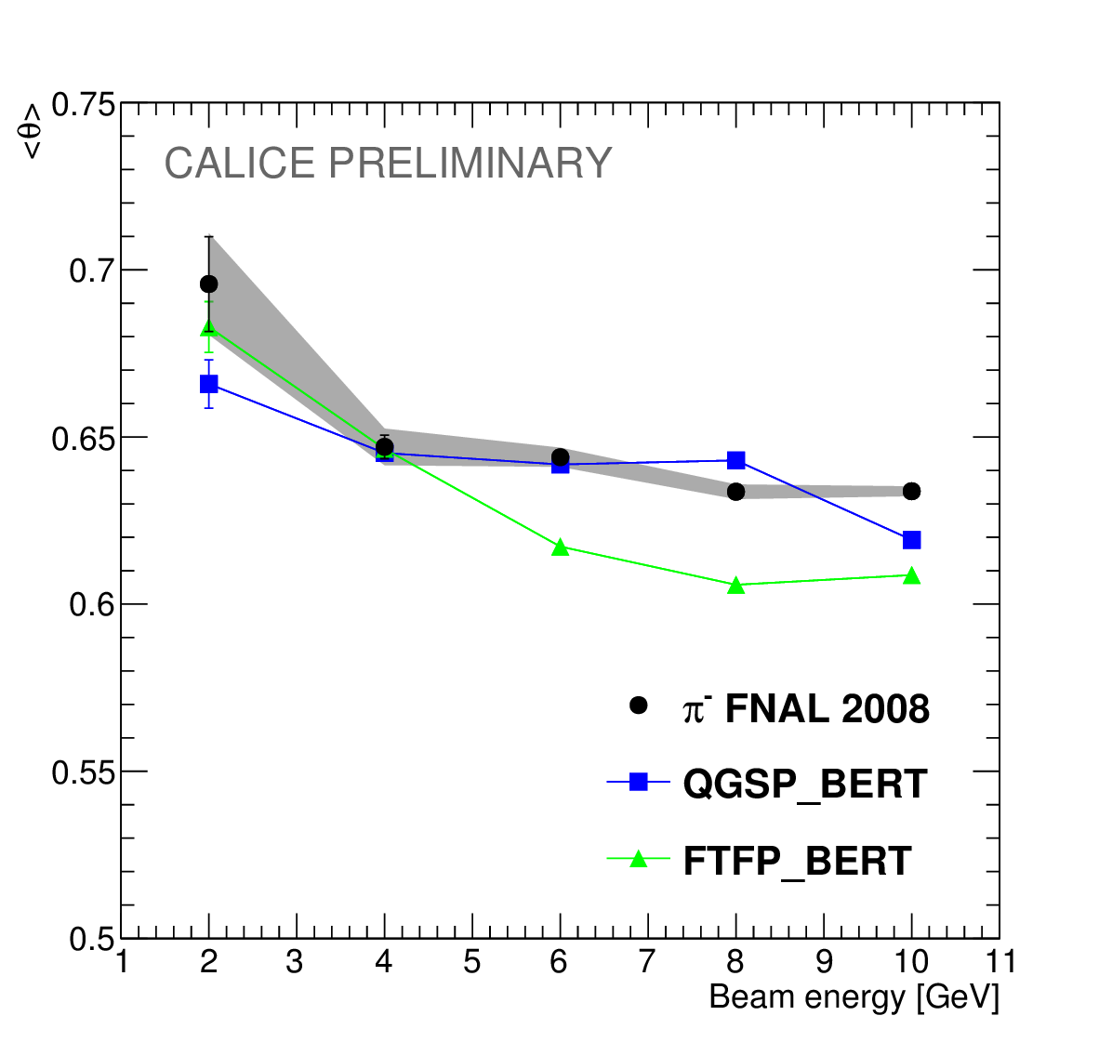
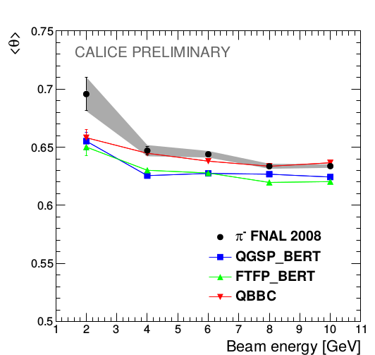
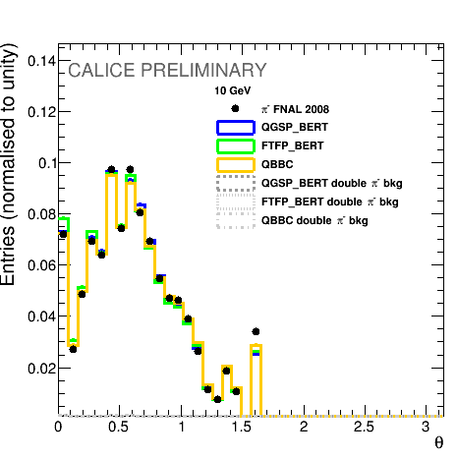
Polar angle distribution
Polar angle is defined w.r.t. the beam axis
2 GeV
10 GeV
Both simulation models agree with the data within 5% of precision.

Slide 18
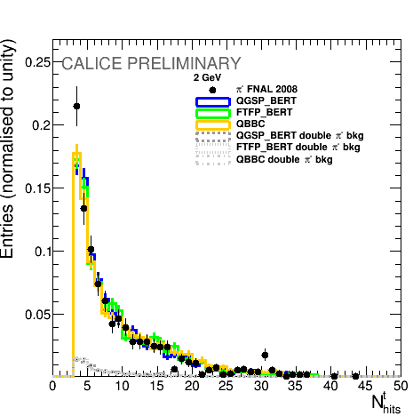
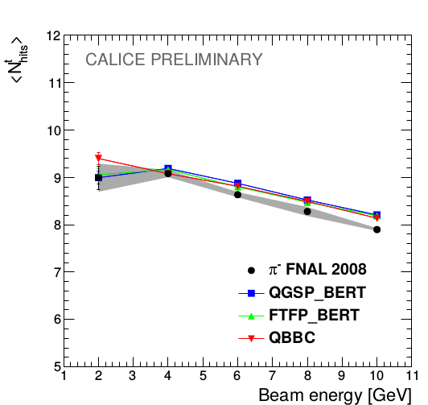
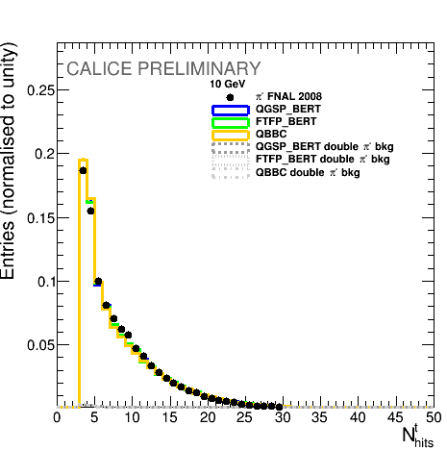
Number of hits
2 GeV
10 GeV
Both simulation models agree with the data within 5% of precision.

Slide 19
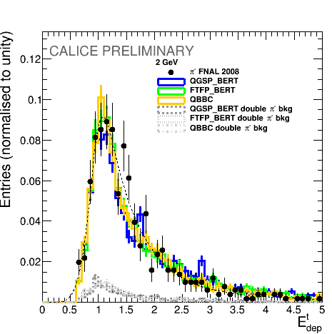
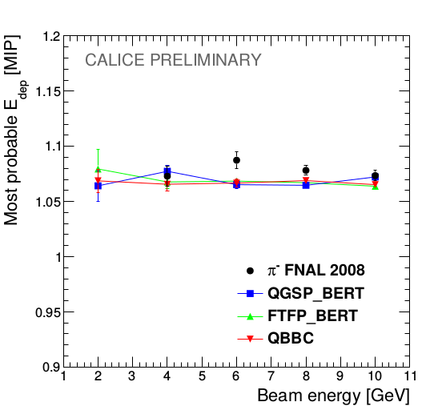
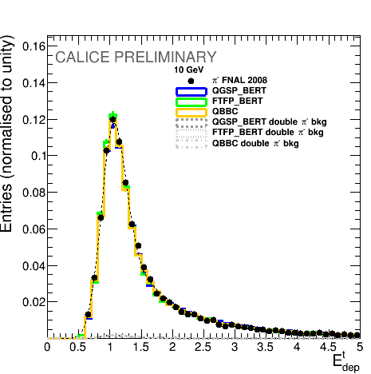
Calibration
The produced particles act like MIPs, therefore, their energy depositions follow the Landau distribution
2 GeV
10 GeV
Both simulation models agree with the data within 5% of precision.

Slide 20
Conclusion of the study
All three presented physics from GEANT4 v10 lists show a good performance in terms of new tracking observables
The largest discrepancy found in energy fraction and radius of the interaction region - up to 15% difference
The systematic effects of the algorithm and double pion background events are studied and taken into account
The developed track finding algorithm can be used for in-situ calibration and/or monitoring
The GEANT4 v9.6 results are described in the CALICE note CAN-055 and were presented at
  IEEE/NSS MIC 2016
  VCI 2016
Future studies:
  A paper publication with the G4 v10 is on going
  Follow tracks into HCAL physics prototype
  Possible application for PFA

Slide 21
Introduction
Hadronic showers in highly granular silicon-tungsten calorimeter
B-quark charge reconstruction
Top quark production
Bottom quark production

Slide 22
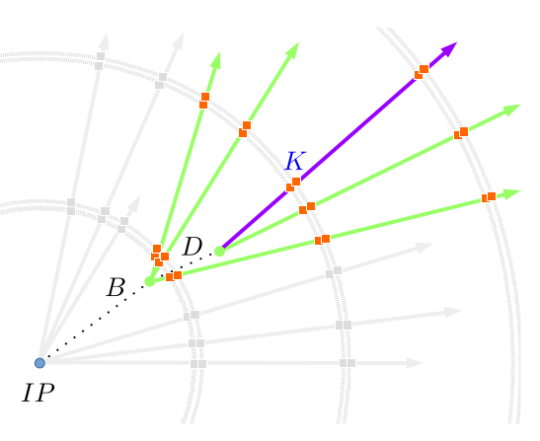
Objective
Main purpose of this work is to reconstruct the b-quark charge
The b-quark charge purity was measured to be at the level of 60% in a fully hadronic ttbar decays
Properties of decay products from the b-hadrons are used to determine the charge of initial b-quark
Charge of the b-quark is calculated as a sum of the charges of secondary and tertiary vertex particles
The charge of K-mesons from reconstructed vertices is directly connected to the initial quark charge

Slide 23
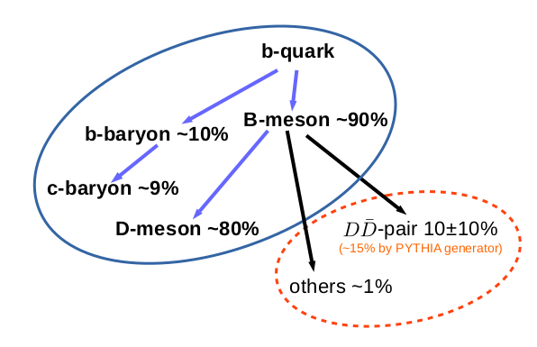
Hadronization and decays of the b-quark
In general, one expects two vertices in a b-jet
The TruthVertexFinder algorithm is developed to find the generated vertices and associated charged particles (prongs) from the b-hadron decays

Slide 24
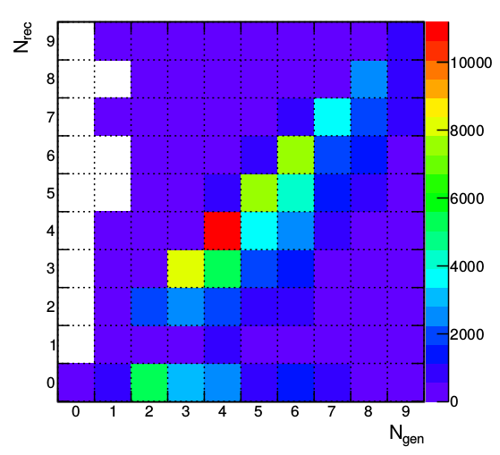
Standard reconstruction performance
Diagonal entries - 49%
The reason behind the b-quark charge impurity is the missing prongs by the reconstruction algorithms
Diagonal entries are almost ideally reconstructed - ~97% purity

Slide 25
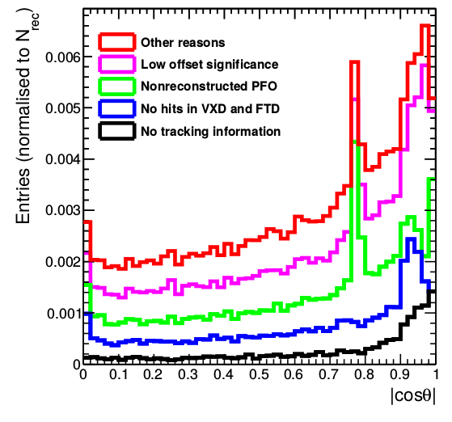
Missing particles
The reasons behind the missing prongs are:
  No corresponding reconstructed track – 0.93%
  Track has no associated hits in FTD or VXD – 2%
  Track has no reconstructed Particle Flow Object – 3.2%
  Low generated offset or momentum – 3.1%
  Other reasons – 1.7%
One sees the peaks, which are explained on the next slide
One can develop a recovery algorithm which will add the missing prongs back and enhance the b-quark charge purity

Slide 26
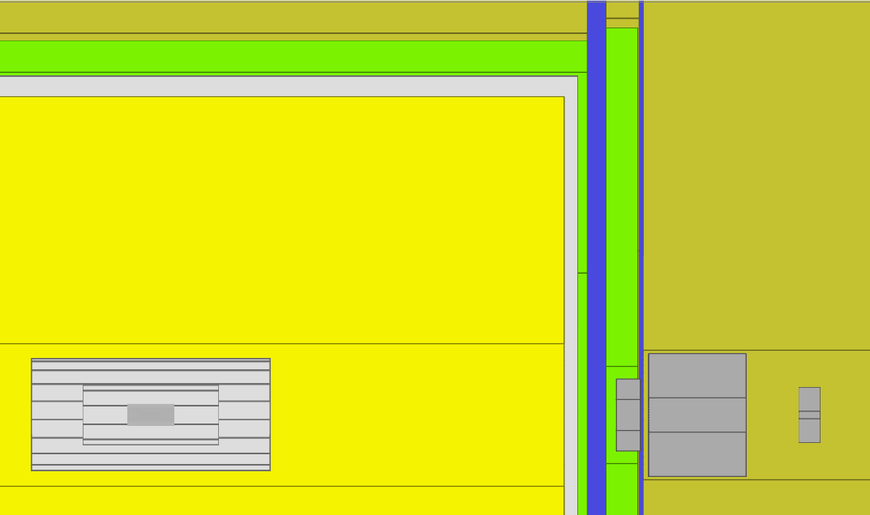
ECAL
Gap in TPC
Transition region
in calorimeters
TPC
ECAL
End of 6 layer barrel VXD
z
VXD

Slide 27
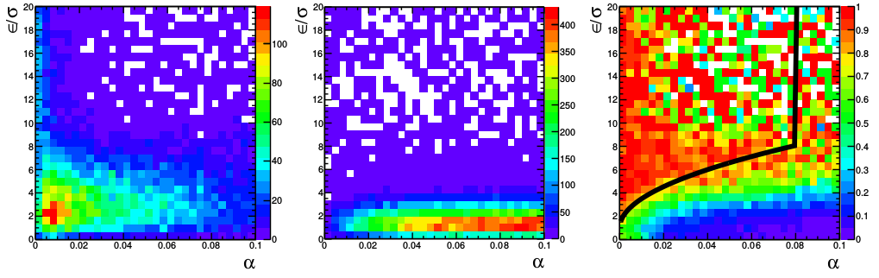
Vertex Charge Recovery algorithm
The developed VertexChargeRecovery uses two separation variables:
  Offset significance
  Angle between the vertex position and the track candidate
The defined cuts are:
x
z
Missing prongs
Background
Purity

Slide 28
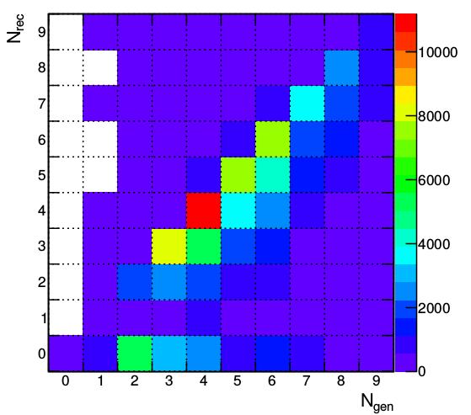
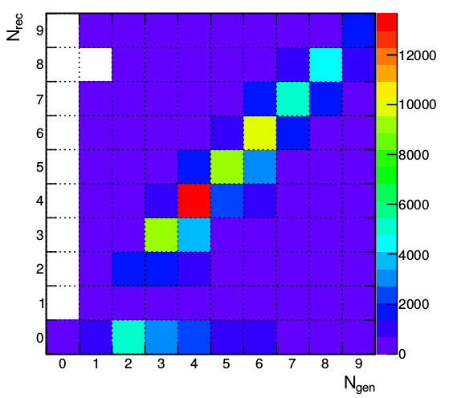


Recovery results
Standard
VertexChargeRecovery
The number of correctly reconstructed hadrons is increased
Decreased the number of missing prongs
The peak of missing prongs in the calorimeter transition region is recovered
Average purity is increased up to 73%
49% on diagonal
62% on diagonal
10.4% missing
6.2% missing

Slide 29

Kaon charge: reconstruction
Charged kaons are part of the decay chain b→ c → s and carry information about initial b-quark charge
Charged kaons are identified in the TPC by the dE/dx information
There is a large dependence on the track angle in the initial distributions that needs to be corrected

Slide 30

Kaon charge: reconstruction
The angular correction is applied:
After the correction it is possible to identify kaons with up to 97% purity and 87% efficiency

Slide 31
Conclusion of the study
In this thesis, two basic b-quark charge signatures are used:
  Vertex charge, which is computed as a sum of the reconstructed secondary and tertiary particle charges;
  Kaon charge - the charge of a kaon from the reconstructed b-hadron vertices.
The impurity of the vertex charge is caused by missing particles – particles, that were not assigned to the corresponding reconstructed vertices.
A large inefficiency of the vertex reconstruction algorithm in forward region of ILD is observed.
The developed Vertex Charge Recovery algorithm assigns the missing particles to the reconstructed vertices using reconstructed observables.
  Average vertex charge purity is increased by 7% and the algorithm equalizes the vertex charge purity in the barrel region of the ILD detector.
The angular correction of the dE/dx values increases significantly the purity and efficiency of the kaon identification.

Slide 32
Introduction
Hadronic showers in highly granular silicon-tungsten calorimeter
B-quark charge reconstruction
Top quark production
Bottom quark production

Slide 33

Heavy flavour at ILC
Measurement of the heavy flavour quarks at the electron-positron machines:
  Direct EW production
  No competing QCD production
Advantages of the ILC:
  Operating at increases the sensitivity to top axial form factors, minimizes the QCD uncertainties
  High luminosity
  Highly granular 4π detectors allow for precise final state reconstruction using PFA

Slide 34

Motivation
Previous studies found a migration effect in the semileptonic events
Because of the incorrect assignment of the W-jets to the b-jet from the leptonic top decay, the events “migrate” from forward to the backward region in e⁻_{L}e⁺_{R}, while other polarization is clean, because of the W kinematics;
Two solutions were found:
  Cut on the top reconstruction quality: ~28.5% efficiency
  Use a combination with the b-quark charge: ~30.8% efficiency
Main purpose of the present study: increase the efficiency in e⁻_{L}e⁺_{R}

Slide 35

Top reconstruction
This work reuses the top reconstruction approach from the previous studies
The event signature is two b-jets, two light jets from hadronic W, an isolated lepton and the neutrino
The isolated lepton is found using the LAL Lepton Finder algorithm
The b-jets are selected using b-tag information
The light jets from W boson are combined with one of the b-jets to form a hadronic top minimizing the following expression:
The reconstruction cuts and the cuts against the background lead to the ~54% efficiency and 91% purity
One uses charge information to build the top polar angle distribution

Slide 36

Charge signatures
The top polar angle is reconstructed using the hadronic top decay
This work uses three charge signatures:
All signatures demonstrate a discrepancy between the generated and the reconstructed
One needs to use charge combinations to reduce the migration effect

Slide 37

B-quark charge combination
Using only the combination of the b-quark charge signatures, the vertex and the kaon charges
An event is accepted if
  Two vertex or kaons charges from different b-jets are opposite
  The vertex charge and the kaon charge have the same sign within one b-jet
  The vertex charge and the kaon charges are opposite for different b-jets
No W lepton charge is used
An additional cut against the non-boosted ttbar events are applied:
16% efficiency

Slide 38

Combination with the lepton charge
Using only the combination of the b-quark charge signatures, the vertex and the kaon charges
An event is accepted if
  Two vertex or kaons charges from different b-jets are opposite
  The vertex charge and the kaon charge have the same sign within one b-jet
  The vertex charge and the kaon charges are opposite for different b-jets
No W lepton charge is used
An additional cut against the non-boosted ttbar events are applied:
38.6% efficiency

Slide 39
Conclusion of the study
In this thesis, two basic b-quark charge signatures are used:
  Vertex charge, which is computed as a sum of the reconstructed secondary and tertiary particle charges;
  Kaon charge - the charge of a kaon from the reconstructed b-hadron vertices.
The impurity of the vertex charge is caused by missing particles – particles, that were not assigned to the corresponding reconstructed vertices.
A large inefficiency of the vertex reconstruction algorithm in forward region of ILD is observed.
The developed Vertex Charge Recovery algorithm assigns the missing particles to the reconstructed vertices using reconstructed observables.
  Average vertex charge purity is increased by 7% and the algorithm equalizes the vertex charge purity in the barrel region of the ILD detector.
The angular correction of the dE/dx values increases significantly the purity and efficiency of the kaon identification.

Slide 40
Introduction
Hadronic showers in highly granular silicon-tungsten calorimeter
B-quark charge reconstruction
Top quark production
Bottom quark production

Slide 41


Objective
Main purpose of this work is to define the electroweak couplings of the bottom quark using the b-quark polar angle measurement of the process
Properties of decay products from the b-hadrons are used to determine the charge of initial b-quark
Charge of the b-quark is calculated as a sum of the charges of secondary and tertiary vertex particles
The charge of K-mesons from reconstructed vertices is directly connected to the initial quark charge
Y
Ternary
vertex
Secondary
vertex
X
Primary vertex

Slide 42
Research setup
We are using 250 GeV q qbar sample of 250 fb⁻¹ integrated luminosity with pair background v01-16-05 (DBD) for each polarization
To estimate the background we use ZZ HZ WW samples with the same version of ilcsoft
Modified version of VertexChargeRecovery from MarlinReco/Analysis (Recovery)

Slide 43

Event preselection for polar angle
Sort jets by b-tag
B-tag cuts: 0.8 for a high-tagged jet and 0.3 for a low-tagged jet
For Z return rejection:
  Invariant mass > 180 GeV and maximum photon energy < 40 GeV
For diboson background rejection
  Sum of jet masses < 120 GeV
Efficiency of the preselection is 51% for both polarizations

Slide 44
Event selection
We are using kaon charge and vertex charge combination to define a charge of a bjet
Kaons are identified using generator information on each particle in a reconstructed secondary or ternary vertex
  but we introduce ~94% purity and 88% efficiency, according to our previous PID studies
Kaon charge is a sum of all kaons charges found in jet vertices, zero sum is rejected
Vertex charge is the sum of all secondary and ternary track charges in a jet, zero sum is rejected
Only independent combinations are used to avoid charge correlations in the final result:
  Vertex charge from one jet, vertex charge from another jet
  Kaon charge from one jet, kaon charge from another jet
  Event is accepted if charges are opposite and rejected if the charges are the same

Slide 45




Polar angle reconstruction+bkg
The background is small due to the preselection cuts and the high signal cross section
Further plots for signal only

Slide 46





Bottom polar angle reconstruction
Forward region inefficiency is seen in both figures
The residual charge misreconstruction contaminates completely the backward region in the left-handed case

Slide 47




Charge purity and polar angle correction
We can use refused events with contradictory charges as a measure of our charge purity and calculate correction factors
Let p be a probability of a correct charge measurement of a jet
Then q = 1 – p is an incorrect charge probability
We can compute it from the following equations:
We define a number of original events:
Corrected values:
We do not use generator information for correction
# of refused events
# of accepted events
Original number of non-migrated
events in the forward/backward bins
Migration terms

Slide 48





Polar angle reconstruction
The computed corrected distributions are much closer to the generated ones
After correction, one has a long lever arm for the extraction of relevant quantities

Slide 49

Overview of A_{FB} measurements
Forward-backward asymmetry in SM
arXiv:hep-ph/0610173v1
The A_{FB} value and the uncertainty is determined from the fit to the reconstructed curve
The measurements at Z pole are the most precise

Slide 50
Determination of the Form Factors
The top paper uses AFB and total cross section measurement approach
We are measuring the differential cross section
where the S A are
We have 4 observables and 4 electroweak form factors to estimate independently

Slide 51

Reachable accuracies at the ILC
The accuracies reachable after the first run at 250 GeV:
The luminosity sharing between two beam polarizations prefers the e_{L}p_{R} case (67.5% vs 22.5%)
  Higher statistical uncertainties for e⁻_{R}e⁺_{L}
The statistical precision for the e⁻_{L}e⁺_{R} case is excellent:
  One needs to estimate carefully the systematic effects

Slide 52


Interpretation
The accuracies on the couplings after the first run at 250 GeV:
The ILC is able to resolve LEP anomaly in clear and unambiguous way
  The relative precision on is about 5 times better than at LEP
The statistical precision for the e⁻_{L}e⁺_{R} case is excellent:
  One needs to estimate carefully the systematic effects

Slide 53
Conclusions
The b-quark polar angle is well reconstructed in the ILD environment, but there are two major problems
  The residual b charge impurity cause a tilt in the polar angle spectrum
    It was successfully corrected by the developed data-driven procedure
  There is a large inefficiency in the forward region of the ILD
    The ILD collaboration started to review the forward region layout (cables, FTD position)
The statistical uncertainties on the measured observables the <0.5% level for the e_{L}p_{R} case and at the level of 1-3%
See the talk by Francois Richard on 09/06 about the interpretation of these results!

Slide 54
Thank you!

Slide 55


Generated vertices study
The generated vertices are selected by TruthVertexFinder algorithm
The distributions of the offsets, number of associated charged particles (prongs) and their momenta are compatible with the detector resolution
The distributions of the c-vertex multiplicities are realistic
B meson oscillations are enabled in the generator

Slide 56

Motivation
F. Richard
F. Richard
Asymmetry is extremely strong for left-handed case
Different Randall-Sundrum scenarios can affect SM polar angle spectrum
arxiv:1105.3158

Slide 57


Vertex charge recovery improvement
49.0% on diagonal
62.0% on diagonal
The b-jet charge measurement requires very precise vertex reconstruction

Slide 58


Recovery effects
Before charge recovery
After charge recovery
+7% of statistics
+4% of vertex purity
More kaons with the same purity
Constant charge purity in the barrel

Slide 59



Reducing angular dependence
Particle separation after reducing the dE/dx angular dependence
After correction dE/dx does have a better kaon separation properties
Selection cuts are optimized for dE/dx'

Slide 60


Top polar angle reconstruction
Vertex charge + kaons
94.4% precision
Top polar angle reconstruction using kaons and vertex charge combination. B-jet information only.

Slide 61
Vertex reconstruction quality
49.0% on diagonal
The b-jet charge measurement requires very precise vertex reconstruction.

Slide 62
Recovery effects
Before charge recovery
After charge recovery
+7% of statistics
+4% of vertex purity
More kaons with the same purity
Constant charge purity in the barrel

Slide 63
Recovery of vertices
x
z
IP – interaction point (primary vertex) , s – secondary vertex, t – point of closest approach of a track, p – reconstructed momentum, - offset of a track from primary vertex

