Slide 1


Insights into the SoA in Graph Theory & Algorithms
Vasileios Papastergios
Academic ID: 3651
Course: Graph Theory & Algorithms
Instructor: Charalampos Kouzinopoulos

Slide 2
Studied papers
Ahmad Biniaz. “Euclidean Bottleneck Bounded-Degree Spanning Tree Ratios”. In: arXiv e-prints, arXiv:1911.08529 (Nov. 2019) [cs.CG].
Haitao Wang and Yiming Zhao. “Computing the Minimum Bottleneck Moving Spanning Tree”. In: 47th International Symposium on Mathematical Foundations of Computer Science (MFCS 2022). Leibniz International Proceedings in Informatics (LIPIcs). Dagstuhl, Germany, 2022.
Hugo A. Akitaya et al. “The Minimum Moving Spanning Tree Problem”. In: Journal of Graph Algorithms and Applications 27.1 (2021), pp. 1–18.
David Eppstein. “A Stronger Lower Bound on Parametric Minimum Spanning Trees”. In: Algorithms and Data Structures. Springer International Publishing, 2021.

Slide 3
Introduction
In this presentation, we provide insights into SoA work and results published within 2018 – 2023 related to spanning tree problems. We investigate different variations of:
the Minimum Bottleneck Spanning Tree (MBST) problem
the Minimum Spanning Tree (MST) problem

Slide 4


The Minimum Bottleneck Spanning Tree Problem
A tree that connects all vertices of the given graph
Minimizes the maximum weight of an edge in the graph (bottleneck)
Alteration 1: Degree-bounded MBSTs in ℝ² under the Euclidean distance metric
Alteration 2: MBSTs of moving points in ℝ^{dim} under any convex distance metric

Slide 5
Paper 1
Euclidean Bottleneck Bounded-degree Spanning Tree Ratios

Slide 6
The degree-bounded MBST ratios [1]
Based on previously published results, we know that all finite point sets in the Euclidean plane have an MBST of degree at most 5. The paper investigates the supremum ratios β_{k} (the largest edge-length of the degree-K BST to the largest edge-length of the BST for the same set V of vertices) for K ∊ {2, 3, 4}.
Known bounds before publication:
2 ≤ β₂ ≤ 3, √2 ≤ β₃ ≤ 2, 1.175 ≤ β₄ ≤ √3
Improved bounds after publication:
√7 ≤ β₂ ≤ 3, √2 ≤ β₃ ≤ √3, 1.175 ≤ β₄ ≤ √2

Slide 7
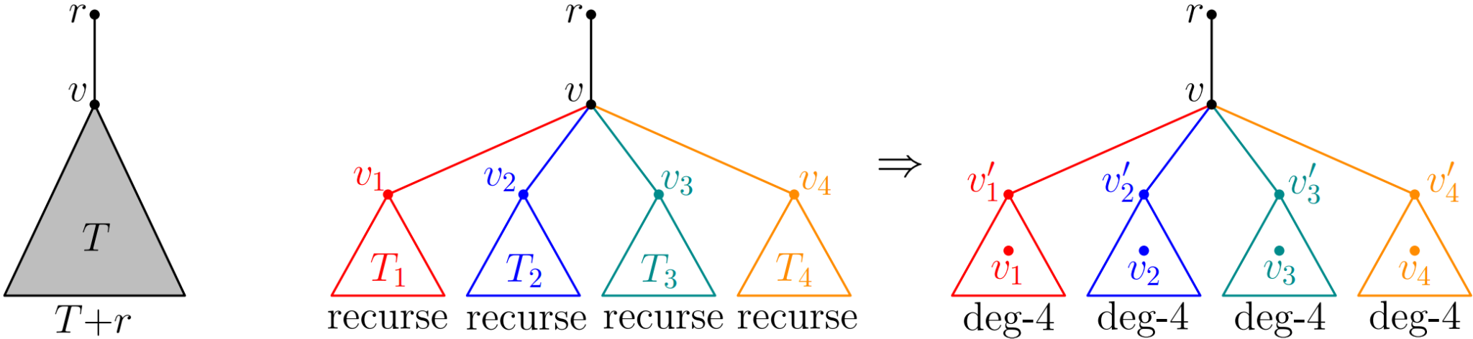
The degree-bounded MBST algorithm [1]
In order to prove the upper bounds, the authors of [1] propose a new algorithm that belongs to the dynamic programming algorithm family. The algorithm recursively visits the sub-trees of the given currently examined node, making transformations (edge removals and additions).

Slide 8
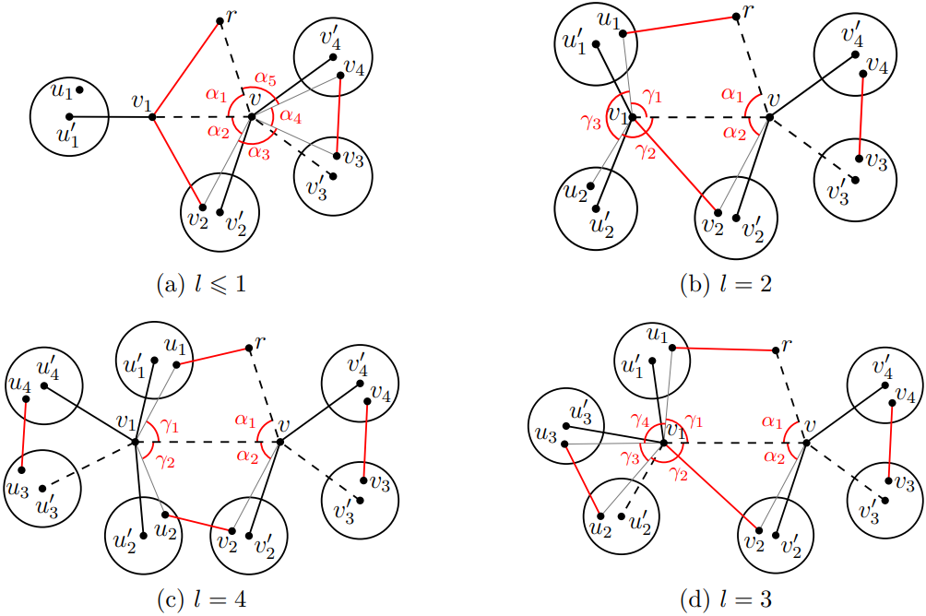
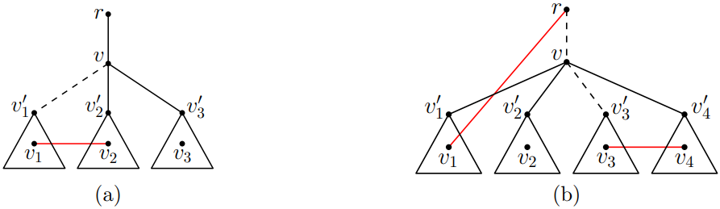
The degree-bounded MBST algorithm [1]
In every recursion step, the algorithm differentiates its behavior, based on the number of children of the currently examined vertex. In all versions of the algorithm (for the different values of the degree bound K), the algorithm re-examines the subtrees that consists of the parent + child. The end condition of the recursion asks for the visited node to have degree at most K, which meets the K-degree BST requirement.

Slide 14
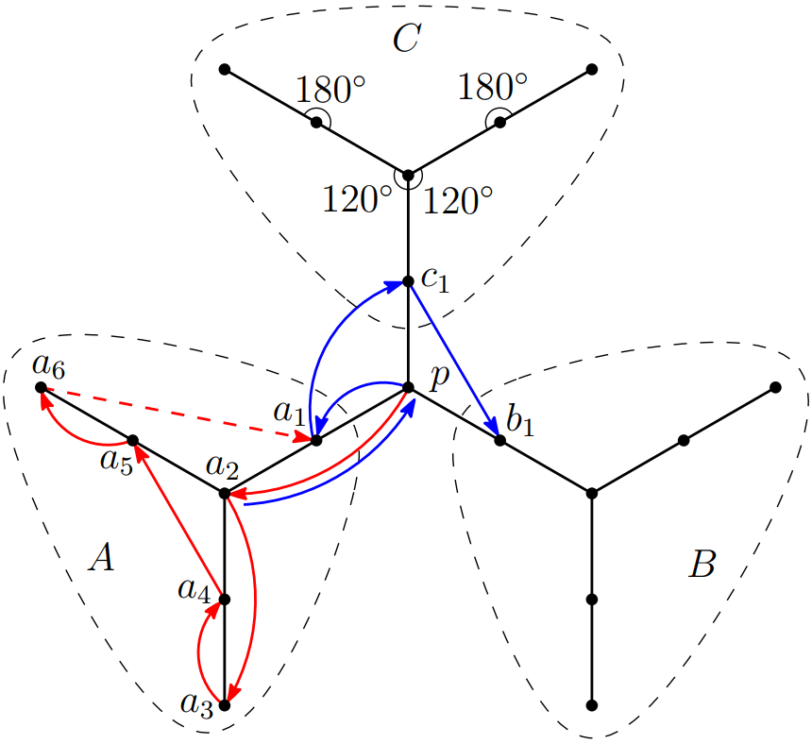
The improved lower bound for β₂ [1]
Except for the upper bounds, the authors of [1] improve the lower bound for β₂, i.e., the supremum ratio of the 2-degree BST bottleneck to the BST bottleneck for the same vertex set. In order to do so, they present a specific point set, whose Hamiltonian path bottleneck is at least √7 times larger than the no degree-bounded BST.

Slide 15
In a word … [1]
Computing the Minimum Bottleneck Moving Spanning Tree
Paper 2
Known bounds before publication:
2 ≤ β₂ ≤ 3, √2 ≤ β₃ ≤ 2, 1.175 ≤ β₄ ≤ √3
Improved bounds after paper publication:
√7 ≤ β₂ ≤ 3, √2 ≤ β₃ ≤ √3, 1.175 ≤ β₄ ≤ √2
Important improvements for approximation algorithms that compute degree-bounded BSTs as an intermediate step!

Slide 16
Paper 2
Computing the Minimum Bottleneck Moving Spanning Tree

Slide 17
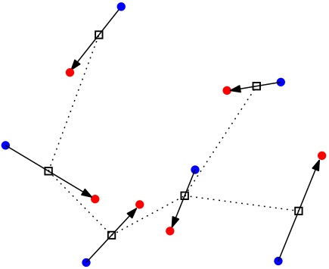
The Euclidean MBST of moving points [2]
Paper 2
Computing the Minimum Bottleneck Moving Spanning Tree
We remain in the Euclidean plane, but, this time, we let the vertices be linearly moving points in ℝ². Our goal is to compute a single minimum BST that connects the points throughout the motion.
Important: We want to compute a single tree that does not change topologically during the time frame (real-world application: spatial data visualizations, mobile network stability, etc.

Slide 18
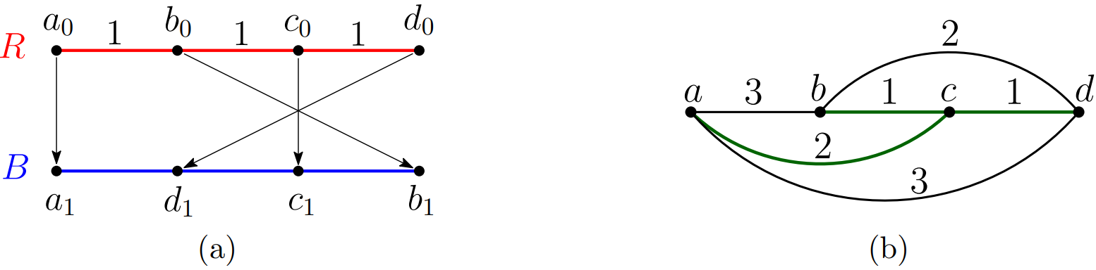
Key Observations [2]
The distance between two points moving linearly under constant velocity is maximized either at the start or at the end of the time interval.
Problem: The Minimum Bottleneck Moving Spanning Tree, however, is not necessarily attained at time t=0 or t=1. Counter-example:

Slide 20
bottleneck(R) = 3
bottleneck(B) = 3

Slide 21
bottleneck = 2

Slide 23
Key Observations [2]
The distance between two points moving linearly under constant velocity is maximized either at the start or at the end of the time interval.
Problem: The Minimum Bottleneck Moving Spanning Tree, however, is not necessarily attained at time t=0 or t=1. Counter-example:
Suggestion: Divide the problem into a decision and an optimization one!

Slide 24
The decision problem [2]
Definition: Given any λ > 0, the decision problem is to decide whether for the bottleneck b(T*) of the EMBST T* holds b(T*) ≤ λ. A key-notion in the suggested algorithm is the unit-disk graph.

Slide 25
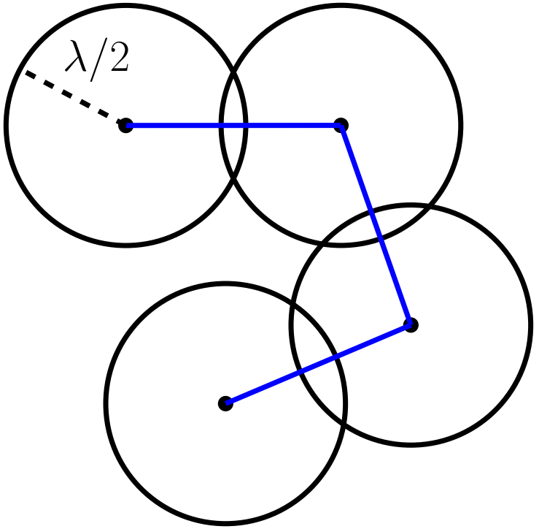
The decision problem [2]
Definition: The unit-disk graph G_{λ}(𝑄) for a set 𝑄 of points in the plane with respect to a parameter λ is an undirected graph whose vertex set is 𝑄 such that an edge connects two points p, q ∊ 𝑄 if |pq| ≤ λ. In other words, the unit-disk graph G_{λ}(𝑄) can be viewed as the intersection graph of the set of congruous disks centered at the points of 𝑄 with radius λ/2. Two vertices are connected if and only if their disks intersect.

Slide 26
The decision problem algorithm [2]
The authors of [2] use two unit-disk graphs in the algorithm that solves the decision problem. The first is G_{λ}(0) that corresponds to the position of the points at time t = 0 and G_{λ}(1) that corresponds to their position at t = 1.
The basic idea of the algorithm is to investigate whether the intersection of the two graphs is a tree that connects all vertices, i.e., G_{λ}(0) and G_{λ}(1) have a common spanning tree.
Implementation keys: BFS for connectivity check, batched range searching technique and Unit-Disk Range Emptiness (UDRE) queries on a special data structure for avoiding explicit computation of the two unit-disk graphs (avoiding O(n²)).
Time complexity: O(n^{4/3}log²n)

Slide 27
The optimization problem [2]
Definition: Using the algorithm presented for the decision problem, find the minimal value of λ, for which the decision problem answers positively.
In other words, find the bottleneck of the moving EMBST and construct it, using as “black-box” the decision problem algorithm.

Slide 28
The optimization problem algorithm [2]
Basic idea: Perform binary search in the search frontier containing all possible values of λ used in the decision problem algorithm.
Algorithmic steps
Initialize an interval (a₀, b₀] to (0, ∞].
Set as pivot the edge with the k-th (median) smaller length, where initial k = ^{n(n-1)}/₄
Perform a decision problem algorithm execution with λ = pivot.
if answer is “yes”, update the interval to (a₀, pivot]
if answer is “no”, update the interval to (pivot, b₀]
set as new pivot the median of the new interval
Repeat until the minimal value of λ is found.

Slide 29
The optimization problem algorithm [2]
Total time complexity:
O(logn) operations for the binary search (optimization problem)
O(n^{4/3}log²n) at each iteration to decide if b(T*) ≤ λ (decision problem)
In total: O(logn) x O(n^{4/3}log²n) = O(n^{4/3}log³n)

Slide 30
In a word … [2]
Paper 3
The Minimum Moving Spanning Tree Problem
If
Vertices are linearly moving points in ℝ²
Edges are the Euclidean distances between the points
then, we can compute a single Minimum Bottleneck Moving Spanning tree in O(n^{4/3}log³n) time.

Slide 31
Paper 3
The Minimum Moving Spanning Tree Problem

Slide 32
Context of presented work [3]
Paper 3
The Minimum Moving Spanning Tree Problem
Till now:
Vertices are linearly moving points in ℝ²
Edges are the Euclidean distances between the points
In this paper:
Vertices are linearly moving points in ℝ^{dim}, for any constant dim
Edges are the distances between the points, under any convex distance metric.
The goal is, again, to compute a single Minimum Bottleneck Moving Spanning Tree for the whole time interval.

Slide 33
Key observations + algorithm [3]
The distance between two linearly moving points is maximized either at the start or at the end of their motion.
Problem: That does not necessarily mean the MBMST is acquired at time t=0 or t=1.
Solution: Construct an upper bound graph:
fully connected graph with vertex set the same as the initial graph
edge between all pairs p, q, with |pq| = max{|p(0)q(0)|, |p(1)q(1)|}
Algorithm: Compute an MBST on the upper bound graph using a known algorithm with O(size) complexity. The upper bound graph has ^{n(n-1)}/₂ edges, thus O(n²) time complexity in total.

Slide 34



Examined Problem

Slide 35
Examined Problem

Slide 36
The Minimum Spanning Tree Problem
A tree that connects all vertices of the given graph
Minimizes the total weight of the graph (not only the bottleneck)
Alteration 1: Compute a single MST for the whole motion, for a set of linearly moving points in ℝ^{dim}
Alteration 2: Compute the different MSTs during the motion

Slide 37
Computing the Minimum Moving Spanning Tree [3]
Up to that end, we examined the MBMST problem, where we only opt for minimizing the maximum edge-weight. However, there exist problems where such an approach is not enough. Instead, we need to minimize the total weight of the spanning tree. The problem gets even more challenging, if we keep the same environment of execution as we did before:
Vertex set is points linearly moving in ℝ^{dim} under constant velocity
Edges are distances between the points under any convex distance metric

Slide 38

The Partition problem [3]
The authors of [3] show that finding the Minimum Moving Spanning Tree under this context is NP-Hard. They do so, by reducing an alteration of the partition problem, which is known to be NP-Hard.
Definition: In one formulation of the Partition problem, a set of n positive integers a₀, … , a_{i} is given and the goal is to decide whether there is a subset S $⊆\{0, …, n−1\}$ such that
$$\sum_{i∈S}{a_{i}}=\frac{1}{2}\sum_{i=0}^{n−1}{a_{i}}$$

Slide 39
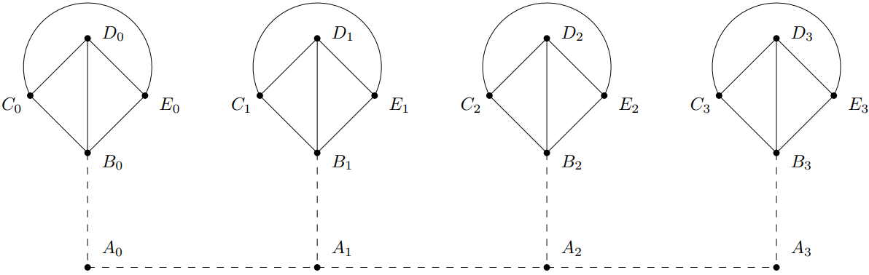
The Partition problem [3]
In order to prove the NP-Hardness of the MMST problem, the authors of [3] construct an instance of the problem and show that is equivalent with the partition problem. The proof is made by exhaustive case analysis.

Slide 40
Workaround #1: Use the upper bound graph [3]
The upper bound graph was the one to provide an exact solution, back in the MBMST problem. However, that is not exactly the case in the MMST. The authors of [3] show that, when used for the MMST problem, finding an MST of the upper bound graph gives an approximation of the optimal solution.
Algorithm: | Construct the upper bound graph and compute an MST on it, using Prim’s algorithm and Fibonacci heap
Time complexity: | O(n²) (due to the |E| of the upper bound graph)
Result: | 2-approximation MMST (can be at most twice worse than the optimal one)

Slide 41

Workaround #2: Custom distance metric [3]
The second proposed approximation algorithm is based on the notions of the L∞ norm and its behavior, the doubling dimension and the fatness of a convex set. The algorithm maps all points to a new space (ℝ^{2*dim})
$$P^{′}=\left(p\left(0\right),p\left(1\right)\right)$$
Time complexity: | O(nlogn) (expected)
Result: | (2 + ε)-approximation MMST

Slide 42
In a word … [3]
Paper 4
A Stronger Lower Bound on Parametric Minimum Spanning Trees
If
Vertices are linearly moving points in ℝ^{dim}
Edges are any convex distance function between the points
We can:
Construct an upper bound graph with the maximum weights to compute
an MBMST of the initial graph in O(n²) time
an MMST 2-approximation in O(n²) time using Prim + Fibonacci heaps
Compute an MMST (2+ε)-approximation in O(nlogn)

Slide 43
Paper 4
A Stronger Lower Bound on Parametric Minimum Spanning Trees

Slide 44
Parametric Minimum Spanning Tree
A tree that connects all vertices of the given graph, whose edge-weights vary
The edges are linear functions of a parameter λ
For any value of λ ∈ ℝ, a spanning tree T_{λ} can be obtained as the MST of the weight functions, evaluated at λ
A discreet sequence of trees is produced as λ varies from −∞ to ∞
Applications: bicriteria optimization, etc.

Slide 45
Bounds for Parametric Minimum Spanning Trees [4]
Before the publication of the paper, the know bounds for the number of trees in a graph with n vertices and m edges were Ω(mα(n)), where α(n) is the inverse Ackermann function and is always O(m n^{1/3}).
The paper focuses on improving the lower bound Ω(mα(n)) to Ω(mlogn).

Slide 46
Parametric Minimum Spanning Trees and line crossings [4]
The basic idea of the algorithm suggested by the authors of [4] is the fact that the number of different spanning trees for the different values of the parameter λ ∈ R is closely related to the number of crossings between these lines in the (λ, weight) plane.
Recall that the known MST computation algorithms (Prim, Kruskal, etc.) are based on the sorted ordering of the edge weights, rather than their actual value. Thus, the MST can only change when λ passes through one of these crossing points, as its varies from −∞ to ∞.

Slide 47
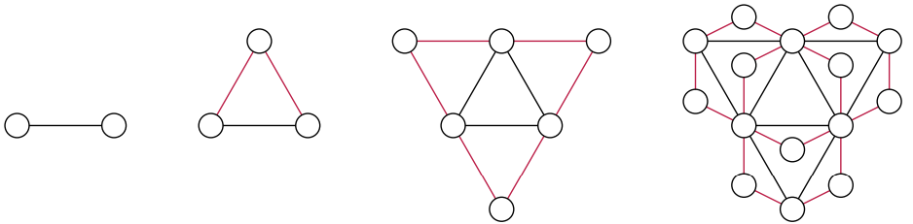
The notion of 2-trees [4]
Definition: The proposed algorithm by the authors of [4] is based on 2-trees. A 2-tree is a graph that can be produced starting from the K₂ by repeatedly adding new degree-two vertices, adjacent to pairs vertices that were previously adjacent. During each repetitive step, we simultaneously replace all the edges of the initial graph G with triangles, producing the new 2-tree graph G+

Slide 49
The notion of 2-trees [4]
Definition: The proposed algorithm by the authors of [4] is based on 2-trees. A 2-tree is a graph that can be produced starting from the K₂ by repeatedly adding new degree-two vertices, adjacent to pairs vertices that were previously adjacent. During each repetitive step, we simultaneously replace all the edges of the initial graph G with triangles, producing the new 2-tree graph G+

Slide 50
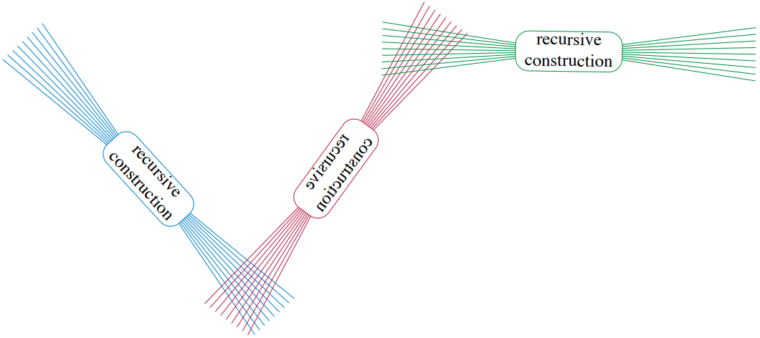
The algorithm
The basic idea of the function is that the line (parameter) functions are transformed and scaled, in order to get placed in a monochromatic neighborhood. The advantage of such a result, is the fact that, when transformed in strictly defined color neighborhoods, the lines can be fully monitored concerning their crossings with specific edges, belonging to monitored edge sets.

Slide 51
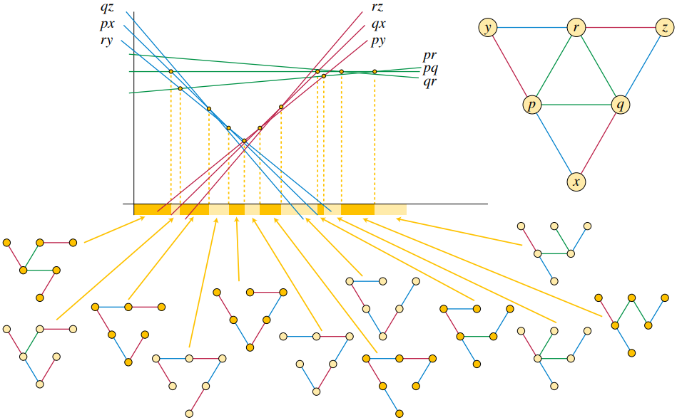

The stronger lower bound [4]
Based on this arrangement, the authors of [4] present and prove the argument that the number of parametric spanning trees for T_{i} is at least as large as
$$N\left(ⅈ\right)=\frac{{ⅈ3}^{i}}{2}+\frac{3^{ⅈ}+3}{4}$$
which leads in at least Ω(n log n) different spanning trees.

Slide 52
In an image … [4]

Slide 53
Thank
Any questions?
Feel free to ask !
you
Vasileios Papastergios
Academic ID: 3651
Course: Graph Theory & Algorithms
Instructor: Charalampos Kouzinopoulos

