Slide 1
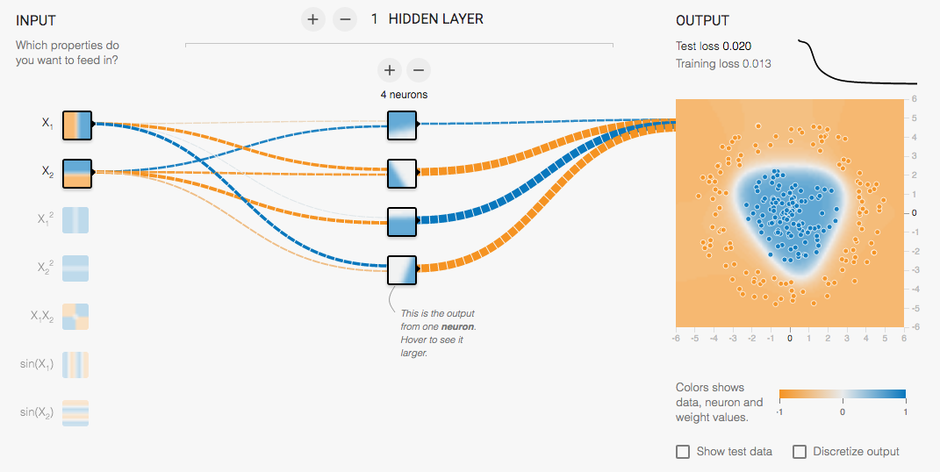
Introduction to Neural Networks
http://playground.tensorflow.org/

Slide 2
Outline
Perceptrons
Perceptron update rule
Multi-layer neural networks
Training method
Best practices for training classifiers
After that: convolutional neural networks

Slide 3
Recall: “Shallow” recognition pipeline
Feature representation
Trainable classifier
Image
Pixels
Class label
Hand-crafted feature representation
Off-the-shelf trainable classifier

Slide 4
“Deep” recognition pipeline
Image pixels
Layer 1
Layer 2
Layer 3
Simple Classifier
Learn a feature hierarchy from pixels to classifier
Each layer extracts features from the output of previous layer
Train all layers jointly
Notes:
Make clear that classic methods, e.g. convnets are purely supervised.

Slide 5
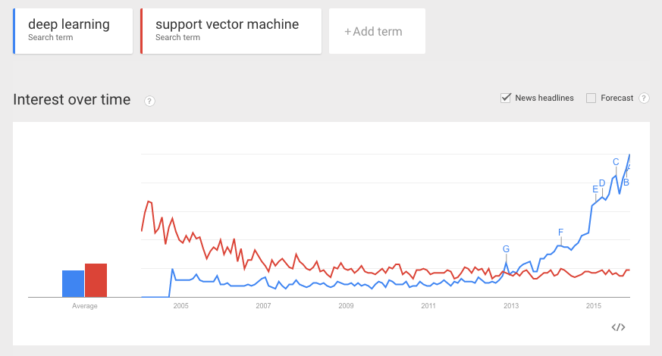

Neural networks vs. SVMs (a.k.a. “deep” vs. “shallow” learning)

Slide 6
Linear classifiers revisited: Perceptron
Input
Weights
x₁
w₁
x₂
w₂
Output: sgn(w⋅x + b)
x₃
w₃
.
.
.
w_{D}
Can incorporate bias as component of the weight vector by always including a feature with value set to 1
x_{D}

Slide 7
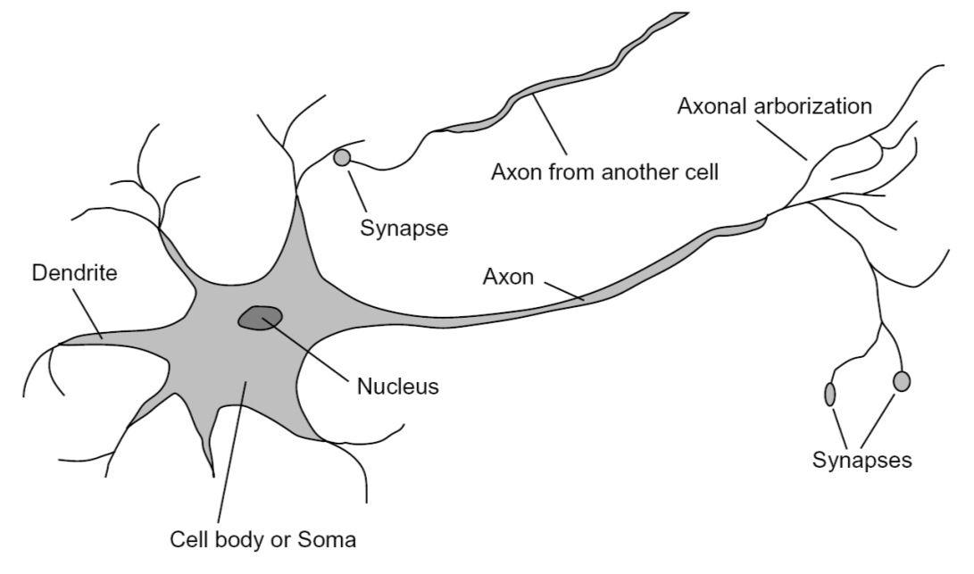
Loose inspiration: Human neurons
Notes:
From Wikipedia: At the majority of synapses, signals are sent from the axon of one neuron to a dendrite of another... All neurons are electrically excitable, maintaining voltage gradients across their membranes… If the voltage changes by a large enough amount, an all-or-none electrochemical pulse called an action potential is generated, which travels rapidly along the cell's axon, and activates synaptic connections with other cells when it arrives.

Slide 8
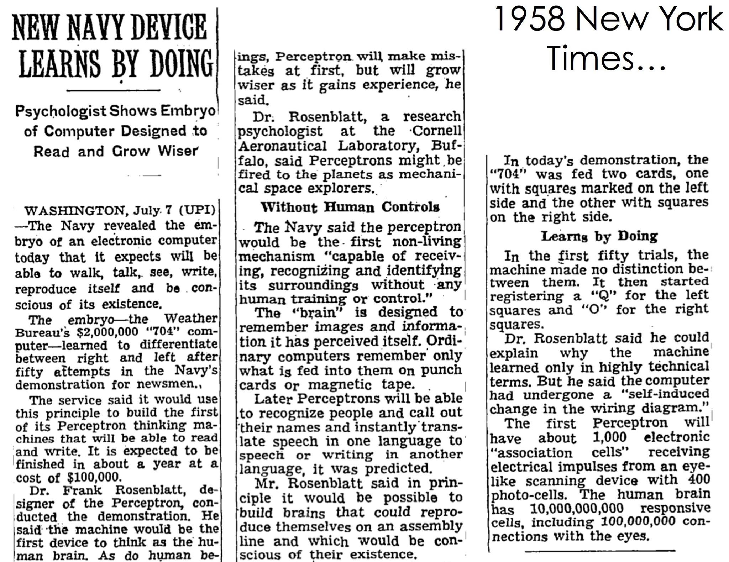

Slide 9
Perceptron training algorithm
Initialize weights w randomly
Cycle through training examples in multiple passes (epochs)
For each training example x with label y:
Classify with current weights:
If classified incorrectly, update weights: (α is a positive learning rate that decays over time)

Slide 10
Perceptron update rule
The raw response of the classifier changes to
If y = 1 and y’ = -1, the response is initially negative and will be increased
If y = -1 and y’ = 1, the response is initially positive and will be decreased

Slide 11
Convergence of perceptron update rule
Linearly separable data: converges to a perfect solution
Non-separable data: converges to a minimum-error solution assuming examples are presented in random sequence and learning rate decays as O(1/t) where t is the number of epochs

Slide 12
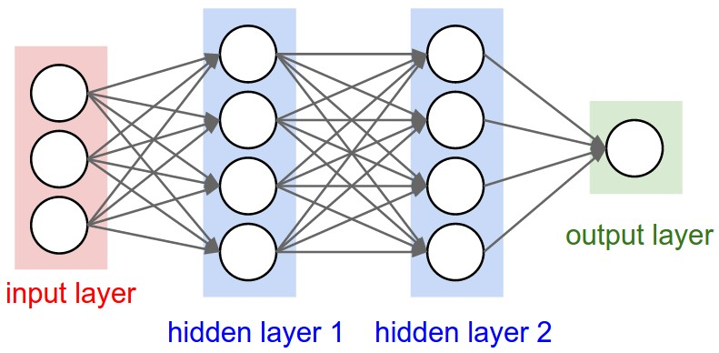
Multi-layer perceptrons
To make nonlinear classifiers out of perceptrons, build a multi-layer neural network!
This requires each perceptron to have a nonlinearity

Slide 13
Multi-layer perceptrons
To make nonlinear classifiers out of perceptrons, build a multi-layer neural network!
This requires each perceptron to have a nonlinearity
To be trainable, the nonlinearity should be differentiable
Sigmoid:
Rectified linear unit (ReLU): g(t) = max(0,t)

Slide 14
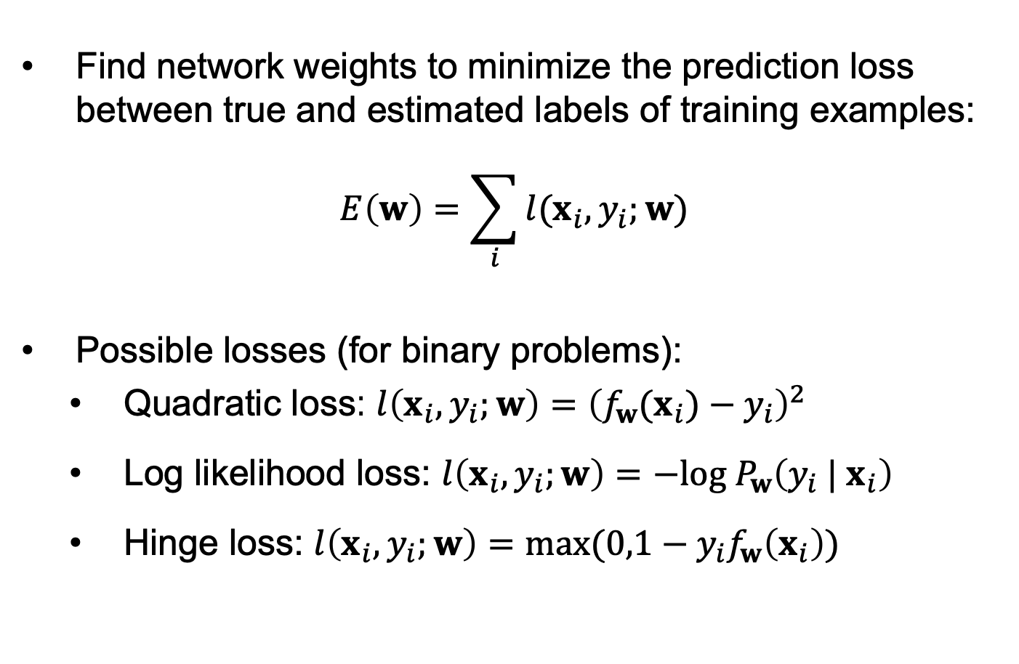
Training of multi-layer networks
Find network weights to minimize the prediction loss between true and estimated labels of training examples:
$$E\left(w\right)=\sum_{i}{l(x_{i},y_{i};w)}$$
Possible losses (for binary problems):
Quadratic loss: $l\left(x_{i},y_{i};w\right)={\left(f_{w}(x_{i})−y_{i}\right)}^{2}$
Log likelihood loss: $l\left(x_{i},y_{i};w\right)=−log⁡{ P}_{w}\left({y_{i} | x}_{i}\right)$
Hinge loss: $l\left(x_{i},y_{i};w\right)=max⁡(0,1−y_{i}f_{w}\left(x_{i}\right))$

Slide 15
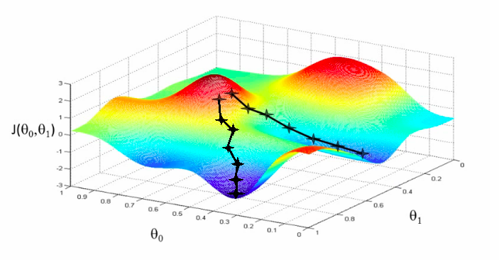
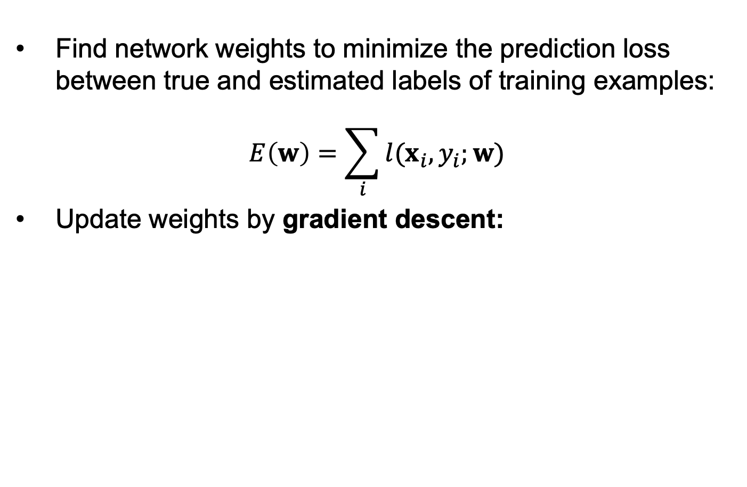
Training of multi-layer networks
Find network weights to minimize the prediction loss between true and estimated labels of training examples:
$$E\left(w\right)=\sum_{i}{l(x_{i},y_{i};w)}$$
Update weights by gradient descent:
w₂
w₁

Slide 16
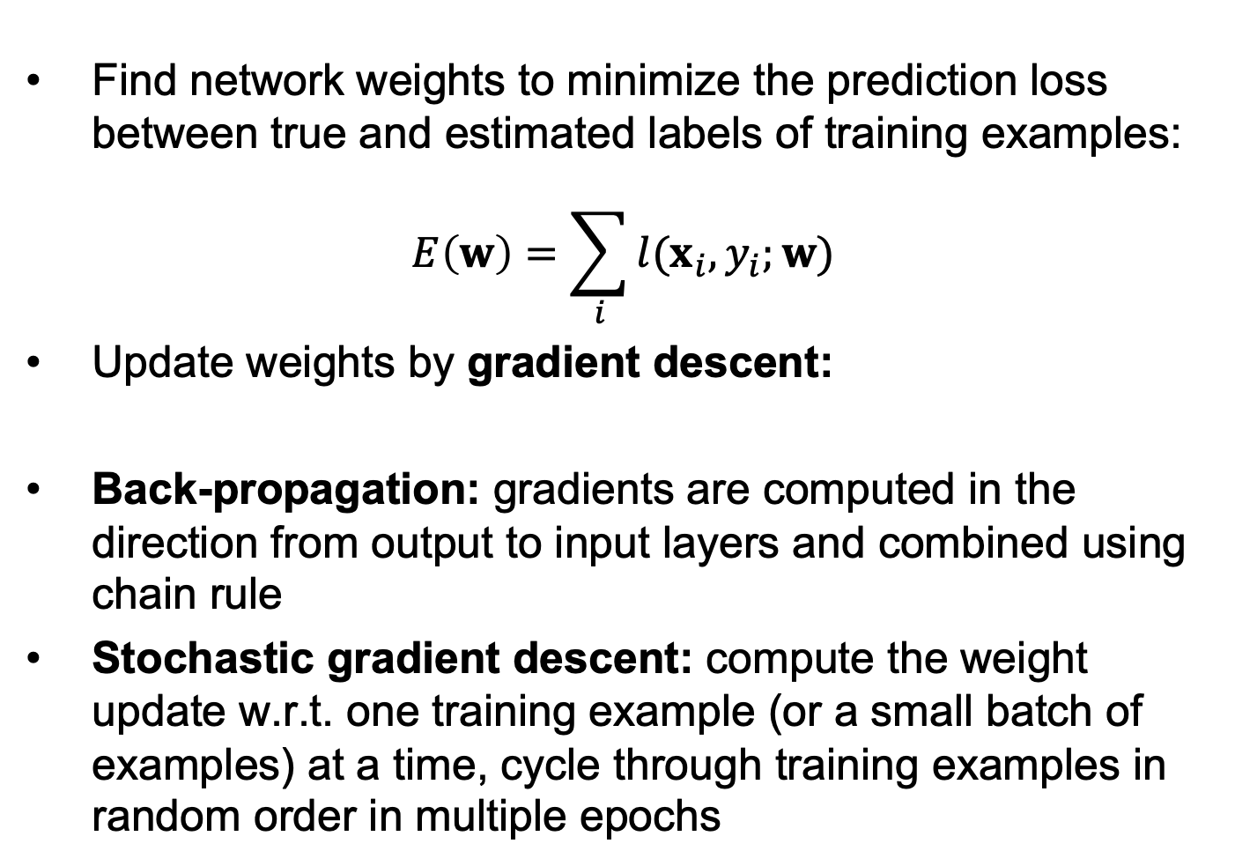
Training of multi-layer networks
Find network weights to minimize the prediction loss between true and estimated labels of training examples:
$$E\left(w\right)=\sum_{i}{l(x_{i},y_{i};w)}$$
Update weights by gradient descent:
Back-propagation: gradients are computed in the direction from output to input layers and combined using chain rule
Stochastic gradient descent: compute the weight update w.r.t. one training example (or a small batch of examples) at a time, cycle through training examples in random order in multiple epochs

Slide 17
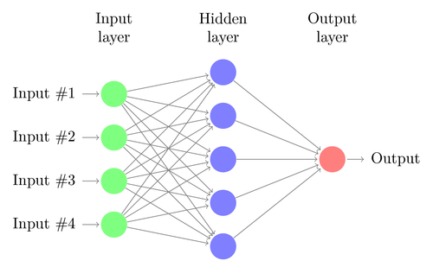
Network with a single hidden layer
Neural networks with at least one hidden layer are universal function approximators

Slide 18
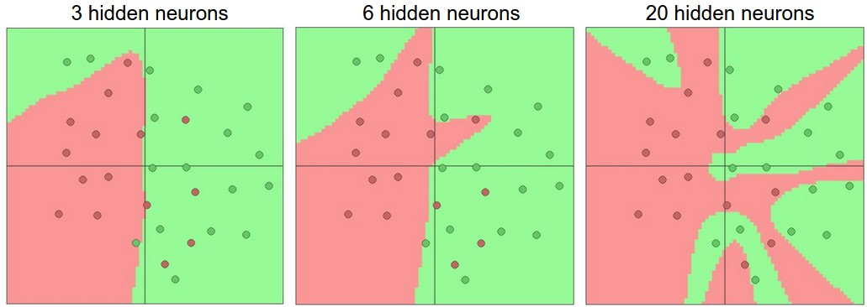
Network with a single hidden layer
Hidden layer size and network capacity:
Source: http://cs231n.github.io/neural-networks-1/

Slide 19
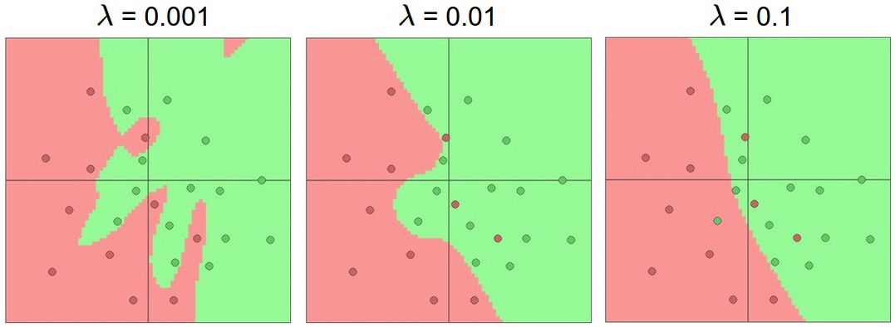
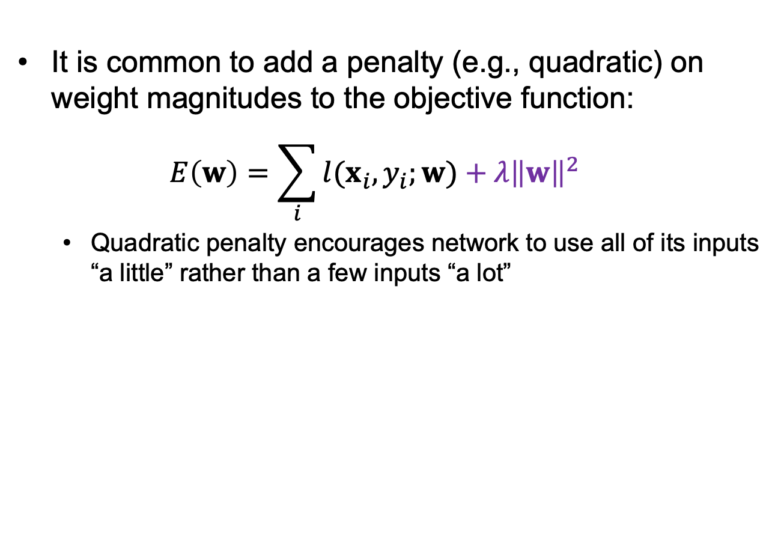
Regularization
It is common to add a penalty (e.g., quadratic) on weight magnitudes to the objective function:
$$E\left(w\right)=\sum_{i}{l(x_{i},y_{i};w)}+λ{\left\|w\right\|}^{2}$$
Quadratic penalty encourages network to use all of its inputs “a little” rather than a few inputs “a lot”
Source: http://cs231n.github.io/neural-networks-1/

Slide 20
Multi-Layer Network Demo
http://playground.tensorflow.org/

Slide 21
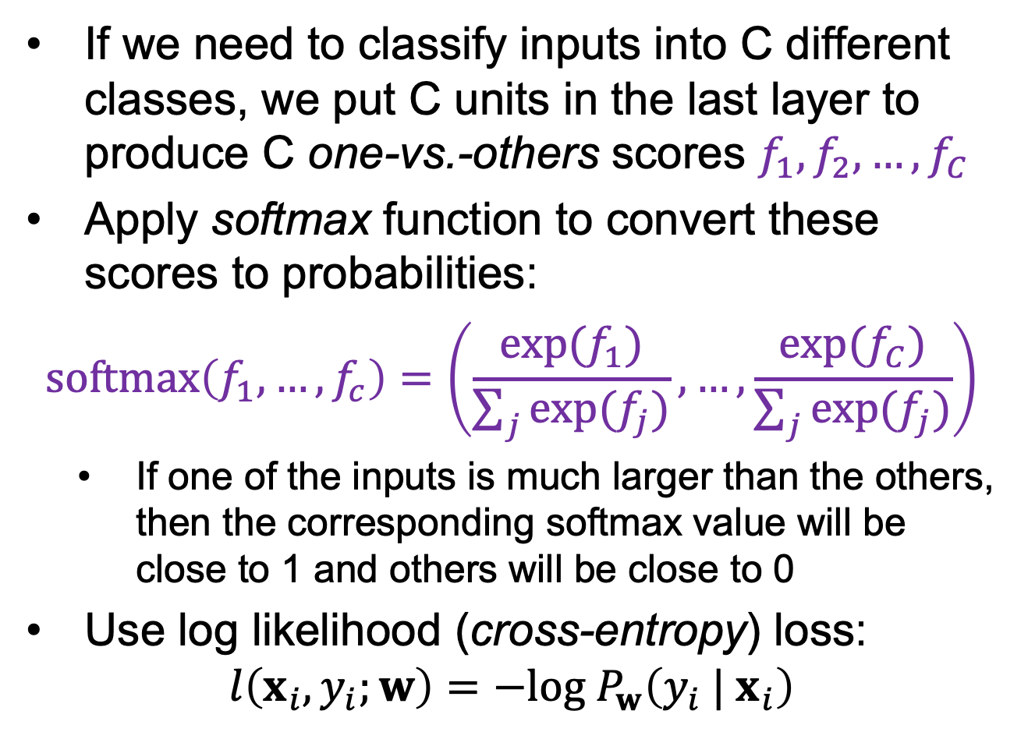
Dealing with multiple classes
If we need to classify inputs into C different classes, we put C units in the last layer to produce C one-vs.-others scores $f_{1}, f_{2},…,f_{C}$
Apply softmax function to convert these scores to probabilities:
$$softmax\left(f_{1},…,f_{c}\right)=\left(\frac{exp⁡(f_{1})}{\sum_{j}{exp⁡(f_{j})}},…,\frac{exp⁡(f_{C})}{\sum_{j}{exp⁡(f_{j})}}\right)$$
If one of the inputs is much larger than the others, then the corresponding softmax value will be close to 1 and others will be close to 0
Use log likelihood (cross-entropy) loss:
$$l\left(x_{i},y_{i};w\right)=−log⁡{ P}_{w}\left({y_{i} | x}_{i}\right)$$

Slide 22
Neural networks: Pros and cons
Pros
Flexible and general function approximation framework
Can build extremely powerful models by adding more layers
Cons
Hard to analyze theoretically (e.g., training is prone to local optima)
Huge amount of training data, computing power may be required to get good performance
The space of implementation choices is huge (network architectures, parameters)

Slide 23
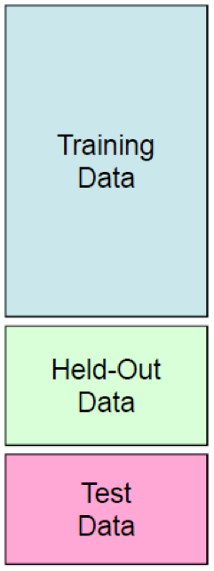
Best practices for training classifiers
Goal: obtain a classifier with good generalization or performance on never before seen data
Learn parameters on the training set
Tune hyperparameters (implementation choices) on the held out validation set
Evaluate performance on the test set
Crucial: do not peek at the test set when iterating steps 1 and 2!

Slide 24


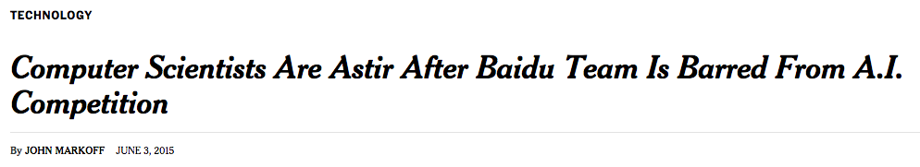



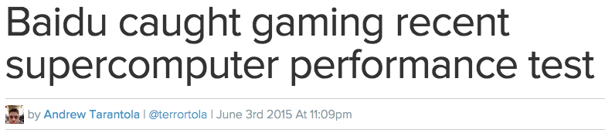
What’s the big deal?

Slide 25
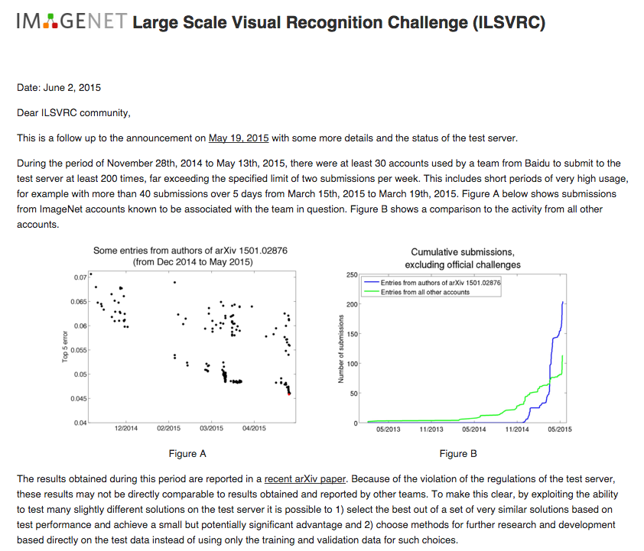
http://www.image-net.org/challenges/LSVRC/announcement-June-2-2015

Slide 26
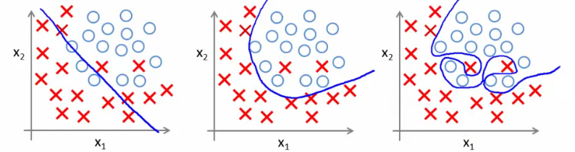
Bias-variance tradeoff
Prediction error of learning algorithms has two main components:
Bias: error due to simplifying model assumptions
Variance: error due to randomness of training set
Bias-variance tradeoff can be controlled by turning “knobs” that determine model complexity
High bias, low variance
Low bias, high variance
Figure source

Slide 27
Underfitting and overfitting
Underfitting: training and test error are both high
Model does an equally poor job on the training and the test set
The model is too “simple” to represent the data or the model is not trained well
Overfitting: Training error is low but test error is high
Model fits irrelevant characteristics (noise) in the training data
Model is too complex or amount of training data is insufficient
Underfitting
Good tradeoff
Overfitting
Figure source

