Slide 1
IOT BASED HOME AUTOMATION SOLUTION
Submitted by:
Bimal Kumar Behera
Rajeev Lochan Panda
College: National Institute of Science and Technology, Berhampur
EMERTXE IoT Internship Home automation

Slide 2
CONTENTS
C Programming
IoT (Internet Of Things)
Embedded Systems
Microcontroller
Home Automation Control Project
Arduino
PicSimlab
Blynk IoT Configuration
Arduino Requirements
Simulation Image
Blynk App Image
Conclusion

Slide 3
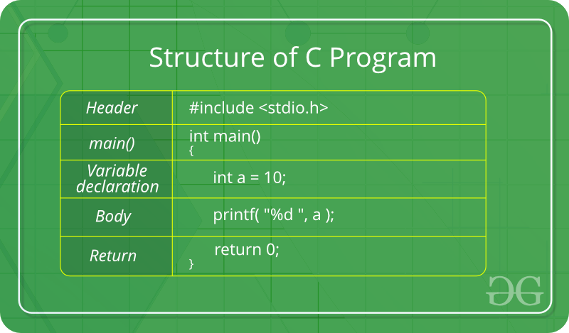
C Programming
C Programming is considered as the base for other programming languages, that is why it is known as mother language.

Slide 4
Topics learnt in C
Data Types (int, char, float, double, Boolean)
Modifiers and Qualifiers
Conditionals and Loops
Operators
Arrays and Pointers
Strings
Function
Storage Classes
Pre-Processors

Slide 5
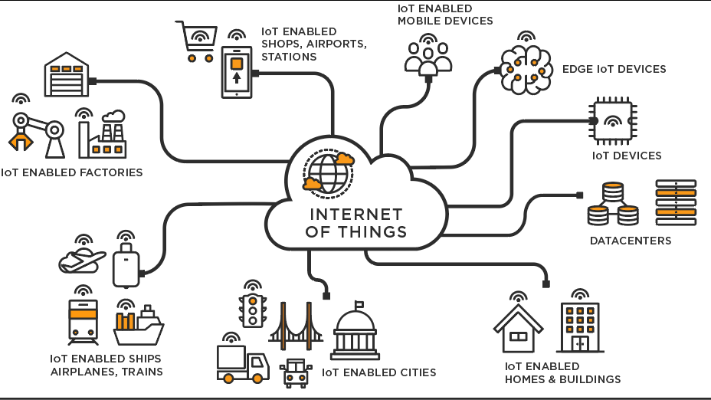
Internet of Things (IoT)
Dynamic & Self-Adapting
Self-Configuring
Interoperable Communication Protocols
Unique Identity
Integrated into Information Network

Slide 6
Internet of Things (IoT)
Applications of IoT:
Home Automation
Activity Trackers
Industrial Security and Safety
Motion Detection
Health Monitor

Slide 7
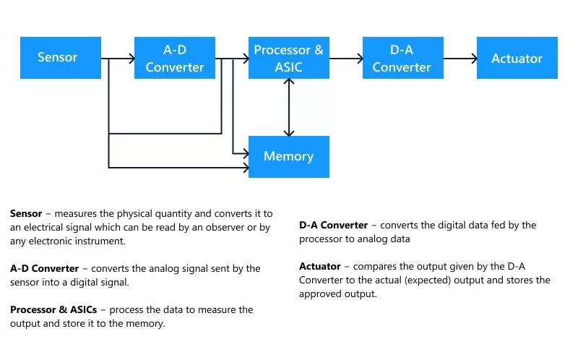
Embedded System
Embedded System is the combination of computer hardware and software for a specific design.

Slide 8
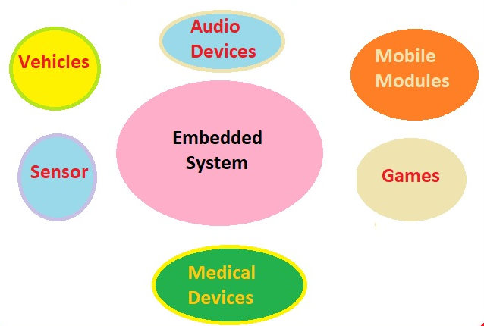
Embedded System
Applications:

Slide 9
Microcontroller
ADC block and DAC block
Timers and Counters
PWM
Processors, Memory and I/O ports
RAM, ROM and its types.

Slide 10
Home Automation Control Project
Overview:
This project provides an IoT based home automation solution using Arduino UNO board in picsimlab simulator.
Blynk IoT mobile application is used to control the devices remotely.
In this project we can control the LED lights, temperature of the home and inflow and outflow of water in the water tank.
Connect the home appliances to the Arduino and integrate it with Blynk IoT app using Blynk cloud.
Control lights, temperature of home along with the level of water tank using mobile app and obtain the notifications on the mobile phone.

Slide 11
Home Automation Control Project
Why we need Home Automation:
Generally, people always don’t stay at home, this brings the problem of home appliances not being monitored.
The solution for this problem comes out to be home automation.
Home automation enables people to control most of the devices remotely, such as garden lights, temperature of home, volume of water in the water tank.

Slide 12
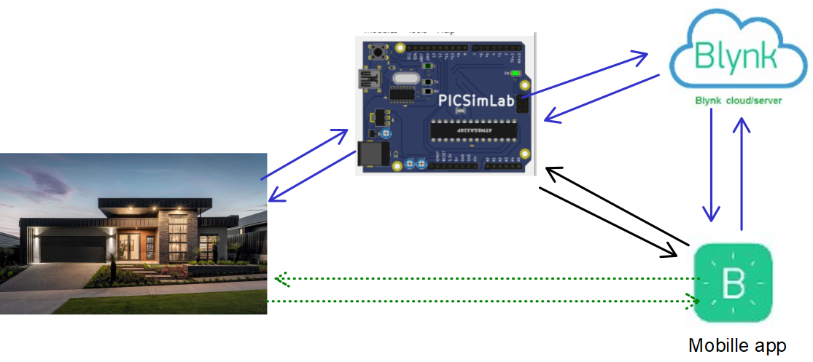
Home Automation Control Project

Slide 13
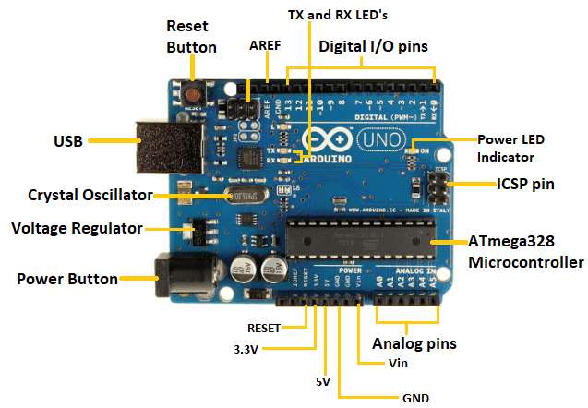
Arduino
Arduino UNO is based on ATmega328P microcontroller.
The Arduino UNO includes 6 analog pin inputs, 14 digital pins, a USB connector, a power jack, and an ICSP (In-Circuit Serial Programming) header.
It is programmed based on IDE, which stands for Integrated Development Environment.
It can run on both online and offline platforms.

Slide 14
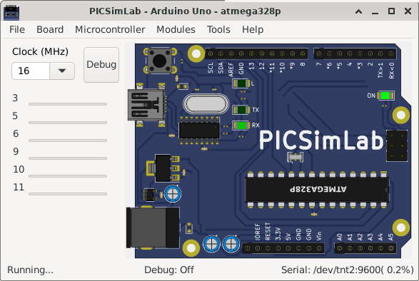
PicSimLab
PicSimLab is a real-time emulator of development boards with MPLABX/avr-gdb debugger integration.
PicSimLab supports several devices (spare parts) that can be connected to the boards for simulation.

Slide 15
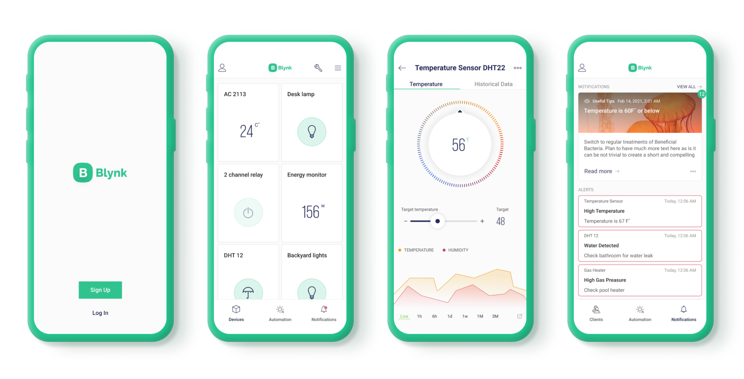
Blynk IoT App Configuration
How to create new template
How to add device
How to select and add data stream
How to create icons
How to include Blynk library

Slide 16
Arduino Requirements
LED
LDR
Temperature Control System
Serial tank(Serial communication)
Ethernet Shield
Blynk IoT app

Slide 17
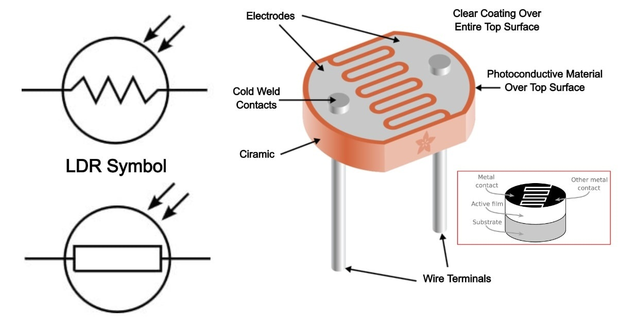
LDR (Light Dependent Register)
LDR (Light Dependent Resistor) as the name states is a special type of resistor that works on the photoconductivity principle means that resistance changes according to the intensity of light.
Its resistance decreases with an increase in the intensity of light.
It is also called a Light Sensor.

Slide 18
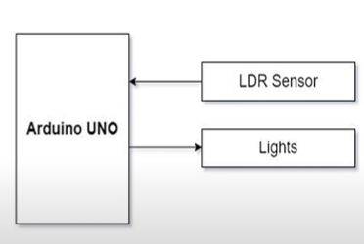
Garden Light Control
The properties of LDR sensor is applied to accomplish the controlling of garden lights.
During that day, the outdoor light is maximum, so the LDR sensor detects the light and the garden light is turned off.
Where is at night the outdoor light is very low, so the LDR sensor detects the light and light is turned on.

Slide 19
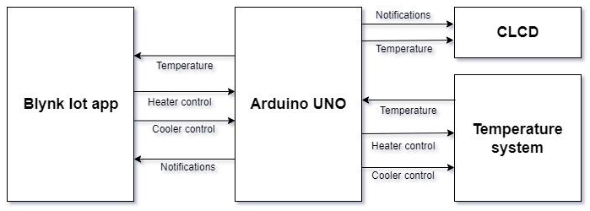
Temperature Control System
Temperature is recorded using LM35 sensor.
It consists of heating resistor, LM35 sensor, and a cooler.
Analog value of temperature is obtained from LM35 sensor and then it is converted into digital value which is displayed on the CLCD.
Temperature System i.e. heater and cooler can controlled using the Blynk Mobile App.

Slide 20
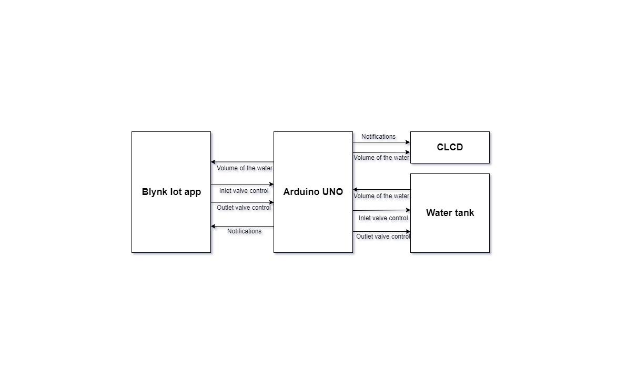
Water Tank Control
Read the volume of the water in the tank through Serial Communication and display it on the CLCD.
Control the volume of the water in the tank by controlling the inlet and outlet valve, by sending commands through serial communication and display the volume of water in the tank on the CLCD.

Slide 21
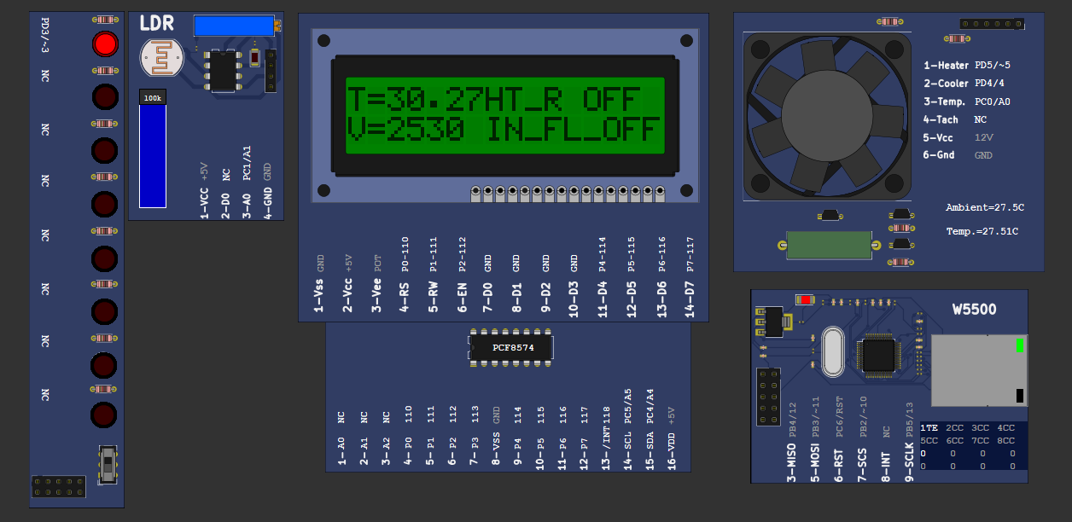
Simulation Image

Slide 22
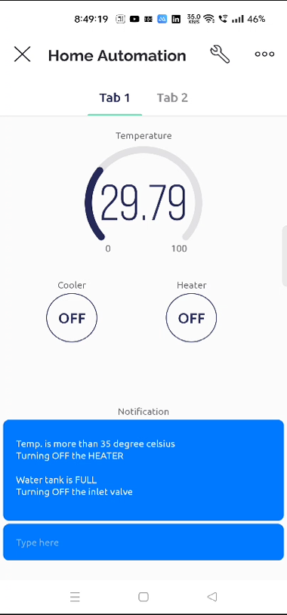
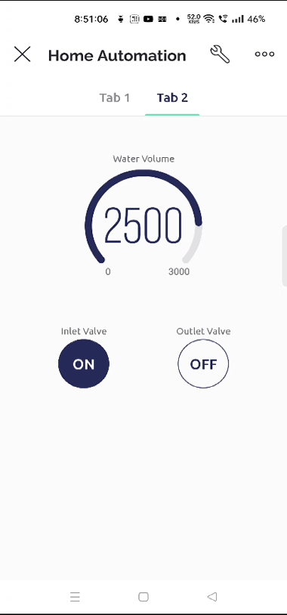
Blynk App Image

Slide 23
Conclusion
In this project we have built the home automation system with the help of PicSimLab Simulator and Blynk IoT App.
Using BLYNK IoT App and PicSimLab Simulator, simulated home automation, where LED, temperature system, Serial tank resembles Light, Heater, Cooler and Water tank in real time.
User can easily use the Blynk IoT and control the home automation from the mobile phone.

Slide 24
THANK YOU

