Slide 1
ContractLens From Manual Review To Automatic Comparison

Slide 2
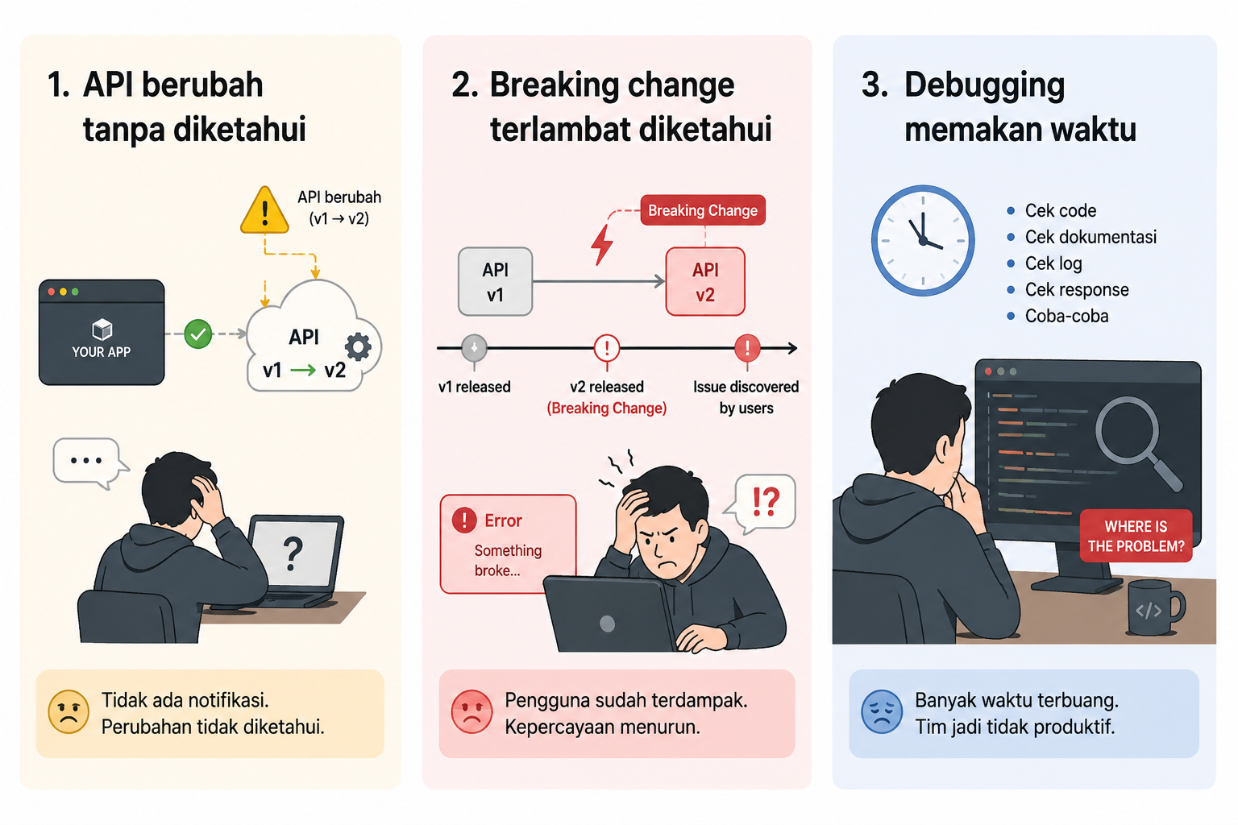
Problem

Slide 3
Solution
ContractLens sebagai API Gateway + Analyzer • Capture Request • Compare Contract

Slide 4
Architecture
Client → Gateway → Target Service ↓ RabbitMQ ↓ Analyzer ↓ Compare & Store

Slide 5
Hands on
Hands On

Slide 6
Core Components
• Spring Boot, JDK 21, GraalVm • RabbitMQ • PostgreSQL • MongoDB (History) • Redis (Cache)

Slide 7
Need Enhancement
UI For More Interactive User.
AI For More Natural Interaction.
Alert/Notif User For Change Comparison.
Request Header and Request Body Comparison.

Slide 8
Closing
Goal: Give developers confidence when deploying APIs.

