Slide 1
Bengali Handwritten Character Recognition: A Comparative Study of CNN Variants and Lightweight Pretrained Models on Small Size Dataset
Presented By: Bimal Gayali (21MA25018)
Supervisor: Prof. Debjani Chakraborty

Slide 2
INTRODUCTION
Handwritten Character Recognition (HCR):
Digitizes handwritten scripts for OCR systems, education, and document preservation.
Bengali script poses unique challenges due to intricate shapes, overlapping characters, and handwriting variability.
Previous Work:
Focused on large-scale datasets to train deep learning models.
Problem Statement:
Large datasets are often unavailable for regional scripts like Bengali.
A gap exists in exploring advanced architectures for small datasets

Slide 3
MOTIVATION
Why Small Datasets?
Real-world scenarios often lack large-scale labeled datasets for regional languages.
Addressing this gap can make HCR solutions more practical and scalable.
Challenges in Bengali HCR:
Dependence on large datasets in previous work limits applicability.
Focus of This Work
Explore advanced architectures like Dilated Residual CNNs and SE Blocks.
Optimize models to perform effectively on small datasets.

Slide 4
OBJECTIVE
Primary Goal:
Achieve high recognition accuracy for Bengali handwritten characters using a small dataset.
Key Objectives:
Adapt advanced architectures (e.g., Residual CNNs, Dilated CNNs) for small datasets.
Integrate attention mechanisms (e.g., SE Blocks) to improve feature extraction.
Compare the performance of custom architectures with pretrained models.
Provide insights for optimizing small dataset performance.

Slide 5
DATASET
Dataset Features:
Classes: 50 distinct Bengali characters, including vowels and consonants.
Image Details: Grayscale, resized to 32×32 pixels.
Diversity: Variations in handwriting styles, stroke thickness, and orientation.
Data Splits:
Training: 12,000 images.
Testing: 3,000 images.

Slide 6
Methodology Overview
custom models
standard optimized CNN
Residual Neural Networks.
Dilated Residual Neural Networks.
CNN with SE Blocks
Pretrained Models
MobileNetV2: Lightweight and efficient architecture for small datasets.
VGG16: Deep architecture suitable for extracting complex features
ResNet50: Uses residual blocks to mitigate vanishing gradient issues.

Slide 7
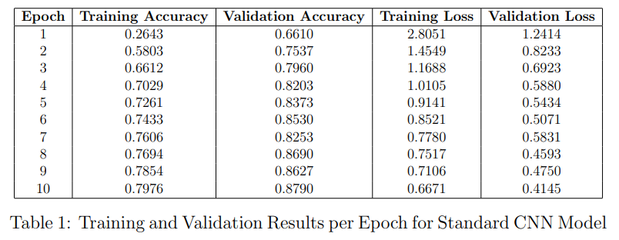
Standard Optimized CNN
Layers:
Convolutional: extract low-level features.
Max pooling: dimensionality reduction.
Fully connected: high-level feature extraction.
Softmax: classification into 50 classes

Slide 8
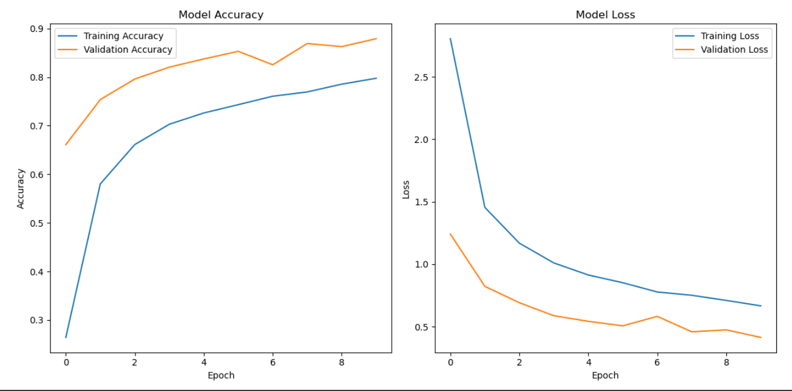
Achieved validation accuracy: 87.9%.

Slide 9
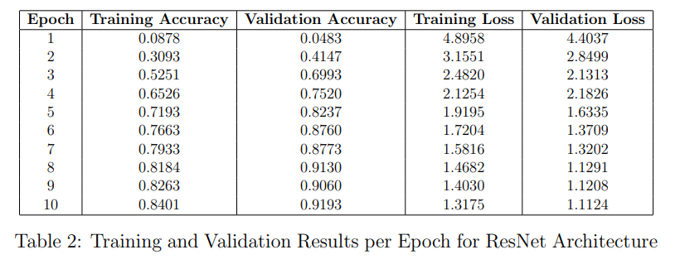
Residual Neural Network (ResNet)
Method:
Introduces residual connections that bypass one or more layers, allowing for better gradient flow.
Uses multiple layers of convolutions and batch normalization to enhance learning.

Slide 10
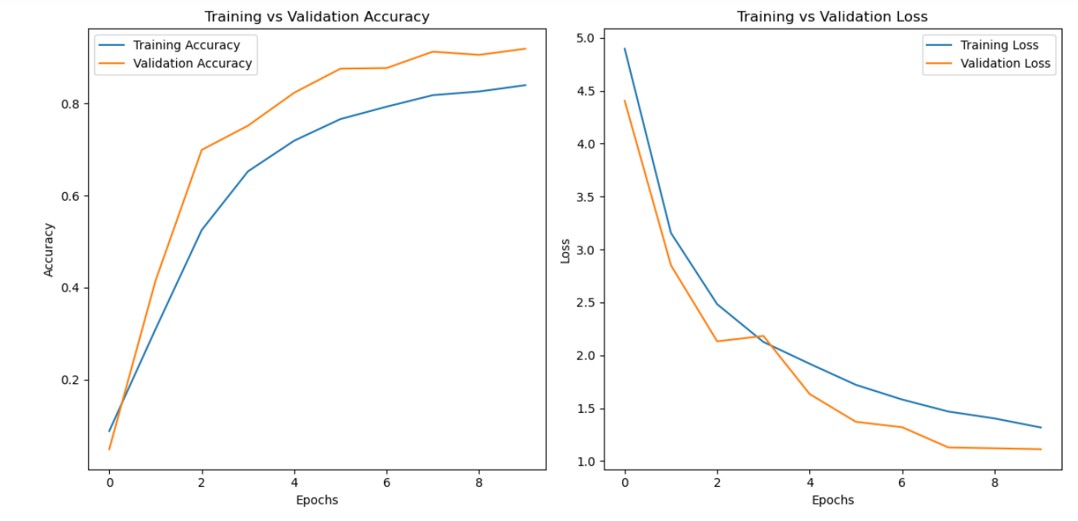
Achieved validation accuracy: 91.93%.

Slide 11
Dilated Residual CNN
Rate = 1
Method:
Combines dilated convolutions to increase the receptive field without increasing computational cost.
Residual connections are used to combat the vanishing gradient problem.
Helps the model capture broader context in the image.
Rate = 2​

Slide 12
Dilation Rate | Train Accuracy | Validation Accuracy | Train Loss | Validation Loss
rate=1 | 0.8392 | 0.9160 | 1.3891 | 1.2303
rate=2 | 0.8491 | 0.9250 | 1.3872 | 1.1070
rate=3 | 0.8152 | 0.8960 | 1.3864 | 1.2260
Best validation accuracy: 92.5% (dilation rate = 2)

Slide 13
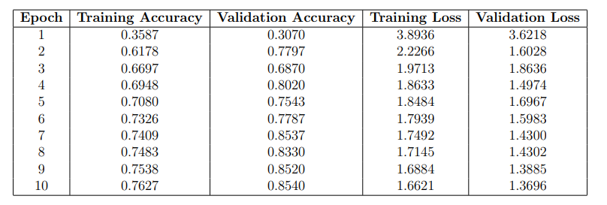
Squeeze-and-Excitation Block (SE-Block)
Method:
Uses attention mechanisms to recalibrate the channel-wise feature responses by learning the importance of each channel.
Applied to each convolutional layer for feature enhancement.
The SE-block adjusts the feature maps based on the "squeezed" global information.

Slide 14
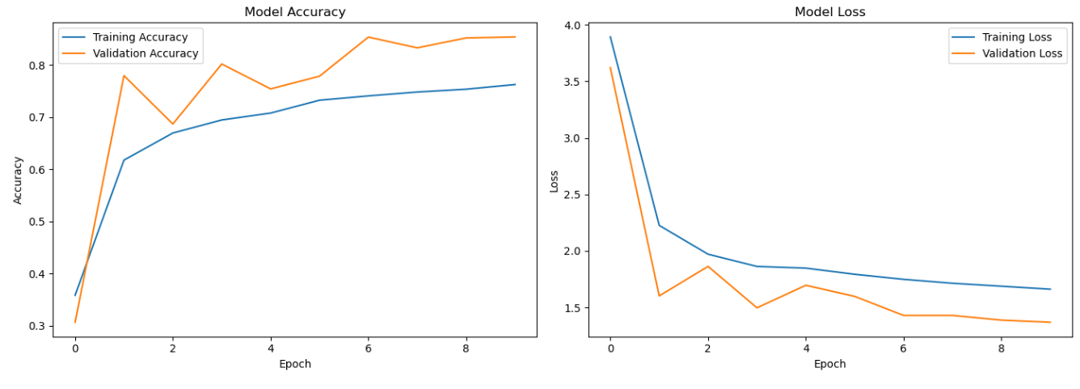
Achieved validation accuracy: 85.4%.

Slide 15
Performance Comparison of Custom Models​
Model | Train Accuracy | Validation Accuracy | Train Loss | Validation Loss
Standard CNN | 0.7976 | 0.8790 | 0.6671 | 0.4145
Residual CNN | 0.8401 | 0.9193 | 1.3175 | 1.1124
Dilated Residual CNN (Rate 1) | 0.8392 | 0.9160 | 1.3891 | 1.2303
Dilated Residual CNN (Rate 2) | 0.8491 | 0.9250 | 1.3872 | 1.1070
Dilated Residual CNN (Rate 3) | 0.8152 | 0.8960 | 1.3864 | 1.2260
SE Block CNN | 0.7627 | 0.8540 | 1.6621 | 1.3696

Slide 16
Performance Comparison of Pretrained Models
Objective:
To evaluate the performance of lightweight pretrained models on the Bengali handwritten character recognition task. The models analyzed include:
MobileNetV2
VGG16
ResNet50
Model | Train Accuracy(%) | Validation Accuracy(%) | Train Loss | Validation Loss
MobileNetV2 | 73.8 | 63.9 | 0.8680 | 1.2938
DenseNet121 | 40.0 | 56.4 | 2.0693 | 1.5371
VGG16 | 40.08 | 63.4 | 1.7427 | 1.3023

Slide 17
Key Observations and Result Analysis for Developed Models
Custom Architectures: Outperformed pretrained models, demonstrating superior adaptability to the dataset.
Standard CNN: Established a baseline validation accuracy of 87.9%.
Residual CNN: Improved over the standard CNN with 91.93% validation accuracy, leveraging skip connections for enhanced gradient flow and deeper feature learning.
Dilated Residual CNN (Rate 2): Achieved the highest validation accuracy (92.5%), excelling in capturing broader spatial context and making it the most effective model.
Dilated Residual CNN (Rates 1 to 3): Showed consistent improvements in accuracy and reduced loss, highlighting the importance of tuning receptive field size through increasing dilation rates.
SE Block CNN: Show 85.4% validation accuracy, emphasizing critical features but underperforming compared to dilated models.
Pretrained Models (e.g., MobileNetV2): Effective for limited datasets but underperformed compared to custom architectures, with MobileNetV2 achieving a maximum validation accuracy of 63.9%

Slide 18
Conclusion
Achievements:
Enhanced recognition accuracy with ResNet variants.
Demonstrated the efficacy of SE blocks for Bengali character recognition.
Highlighted the limitations of pretrained models for small datasets.
Best Performing Model: Dilated ResNet with dilation rate = 2

Slide 19
Future Scope
Explore hybrid models (CNN + Transformers).
Implement advanced attention mechanisms like CBAM.
Extend to larger Bengali script datasets or similar regional languages.

Slide 20
Applications​
Digitization of Bengali text .
Enhanced OCR for regional languages.
Potential use in education and assistive technologies.

Slide 21
Thank You

