Slide 1

Guardians Management Solutions (Pvt) Ltd
“We connect suppliers to constructors at the right time and you will not miss a single item in costing through our robust estimation and quotation management"
www.guardians.lk

Slide 2
The Problem
1. Poor Estimation
(Project Failures, Loosing Tenders)
2. Manage Quotations
(Time Consuming, Human Errors)

Slide 3
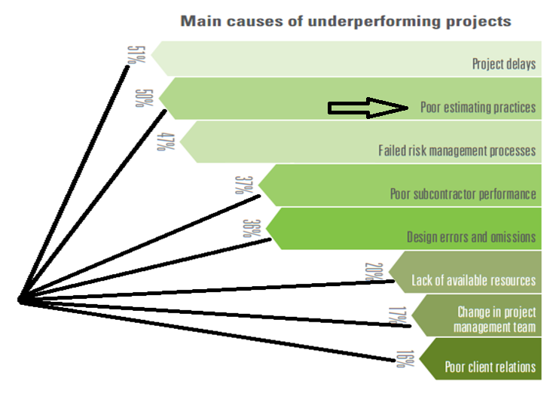
Source: KPMG International Research

Slide 4
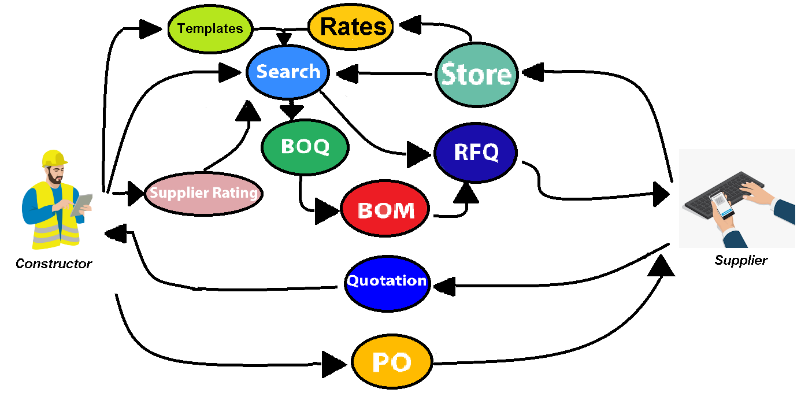
Work Flow
BOQ – Bill of Quantity RFQ – Request for Quotation
BOM – Bill of Materials PO – Purchase Order

Slide 5
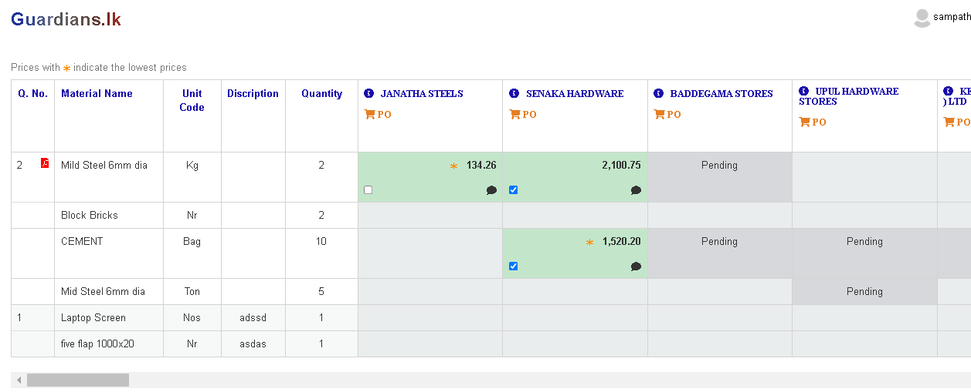
Supplier – Quotation Evaluation

Slide 6


Hodabass.lk (1,833)
Redcube.lk (774)
Rainbowpages.lk (3,789)
Ikman.lk (459)
wedabima.lk (208)
1. BOQ Templates – 841
2. Search Algorithms
3. Known Suppliers – 1,400
4. Materials – 6,500

Slide 7
Why Fund needs
Mobile and API Development
SEO, Email, FB, SMS Campaign
Help desk and promotional calls
Online Meetings knowledge sharing
Templates creation
Video and Brochure design
Keyword mapping from search history

Slide 8
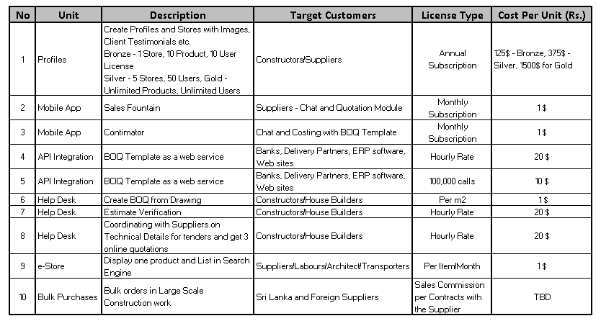
Revenue Model

Slide 9
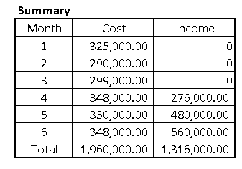
Cost Revenue - 6 months

Slide 10
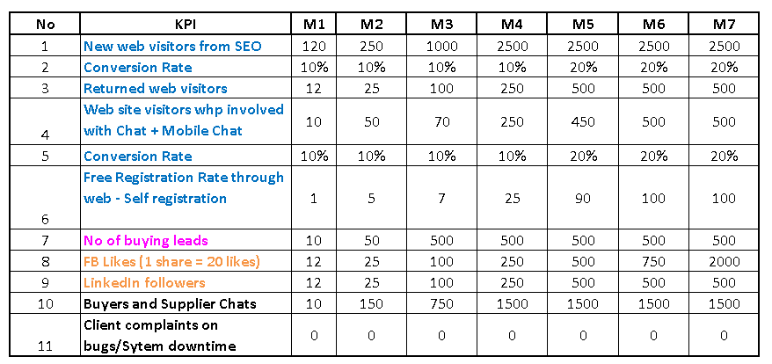
Other KPIs

Slide 11
SWOT Analysis
Strength
Combination of Civil and IT founders
15 year experience in construction works with 51 Bn projects
841 BOQ Templates
Already known suppliers – 1400
Weakness
Marketing Arm
Opportunity
8 Billion awarded projects
Low acquisition cost of customers
Robust Promotion among suppliers to reach higher quality rating
Treats
Covid will continue, Resistance from QS

Slide 12
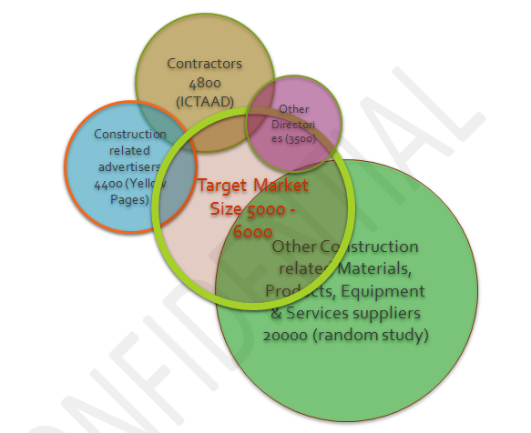
Market Share – 40% by End of 2022

Slide 13
Why they need Spiralation
Helping hand in marketing
Network with stake holders
Lead Generation guide
Improve PR

Slide 14
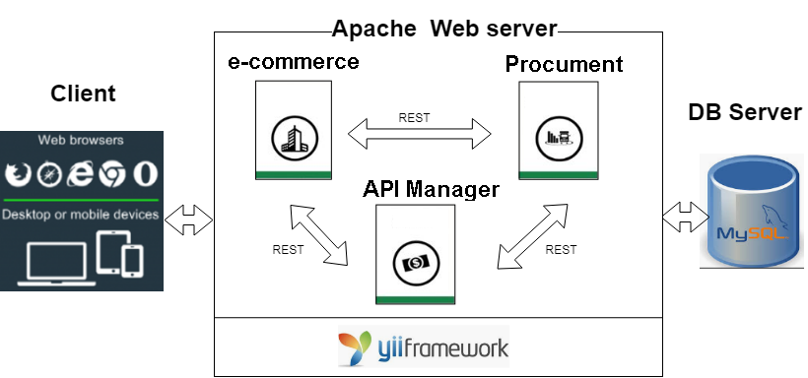
Deployment Architecture

Slide 15
Technology Stack
Interface Layer : Bootstrap, Mobile Responsive Layout, JQuery and Java Script, CSS
Business Layer : Yii – PHP Framework, Regexp
Data Layer: MySql
Integration: Rest API
Mobil: Flutter
Hosting platform : Upcloud
Backup : Every hour, Day, Week, Month
Data Protection - Role based Access Permission, Password Encryption, DB Backup, User Activity Logs

Slide 16
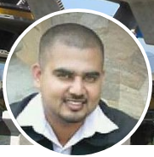
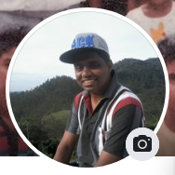
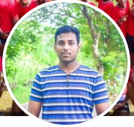
Our Team
Sanjaya Kumar, CEO, Bsc.Hons.(SE), BTech(Civil), MCSE, ACSE, PMP (Part Time)
M. K. Thushara Sampath, CTO, BSc. PMP (Full Time)
Bimalka Yashodana, Tech Lead/Software Engineer, Reading for BSc (Full Time)

Slide 17
Product Demo

Slide 18
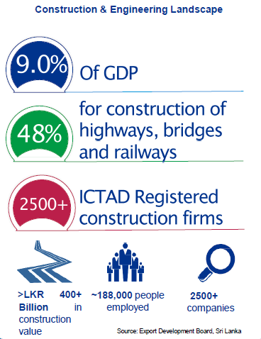

Slide 19
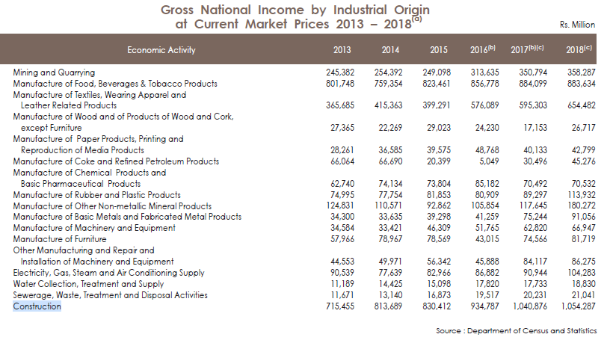
Market Size in Sri Lanka

Slide 20

