Slide 1
Airbnb Data Engineering Assignment
Data Engineer Intern Assignment | A.B.T. Perera
CITY
LISTINGS
VALID PRICES
TOOLS
Amsterdam
10,480
5,874
Python + SQL
Single-city scope
Raw listing records
For price analysis
PostgreSQL model
1

Slide 2
Project Objective & Scope
Build a repeatable ETL workflow from raw Inside Airbnb files to analysis-ready outputs.
Profile, clean, standardize, enrich, and model Amsterdam Airbnb data in PostgreSQL.
Produce EDA, statistical findings, a baseline price prediction experiment, and business recommendations.
Scope intentionally excludes cloud deployment, Docker, dbt, dashboarding, and advanced AI/LLM work.
RAW FILES
CALENDAR ROWS
4
3.8M
listings, calendar, reviews,
neighbourhoods
Daily availability records
REVIEWS
NEIGHBOURHOODS
501K
22
Guest review records
Amsterdam areas
2

Slide 3
Dataset Overview
File | Rows | Purpose
listings.csv.gz | 10,480 | Listing, host, price and review score fields
calendar.csv.gz | 3,825,200 | Daily listing availability records
reviews.csv.gz | 501,084 | Guest review records linked to listings
neighbourhoods.csv | 22 | Neighbourhood reference data
Main join key: listings.id -> calendar.listing_id and reviews.listing_id.
Important limitation: calendar price and adjusted_price fields were missing.
Calendar unavailable dates were treated as occupancy estimates, not confirmed bookings.
3

Slide 4
ETL Pipeline Design
1. Raw CSV files
2. File checks & profiling
3. Extract useful columns
4. Quality checks
5. Cleaning & standardization
6. Enrichment & joining
7. PostgreSQL model
8. EDA, stats, ML, innovation
run_pipeline.py automates the main ETL steps and writes reports/pipeline_run_log.csv.
Outputs are stored in reports/, figures/, exports/, and PostgreSQL analytics tables.
4

Slide 5
Cleaning, Enrichment & Data Model
Cleaned price values by removing currency symbols and commas, then cast to numeric.
Parsed date fields and standardized text/category fields such as room type and neighbourhood.
Created validation flags for missing/invalid values instead of deleting records too early.
Joined listings with calendar summaries and review summaries to create listing_master.csv.
Loaded a PostgreSQL model with dim_host, dim_listing, dim_neighbourhood, and fact_listing_performance.
5

Slide 6
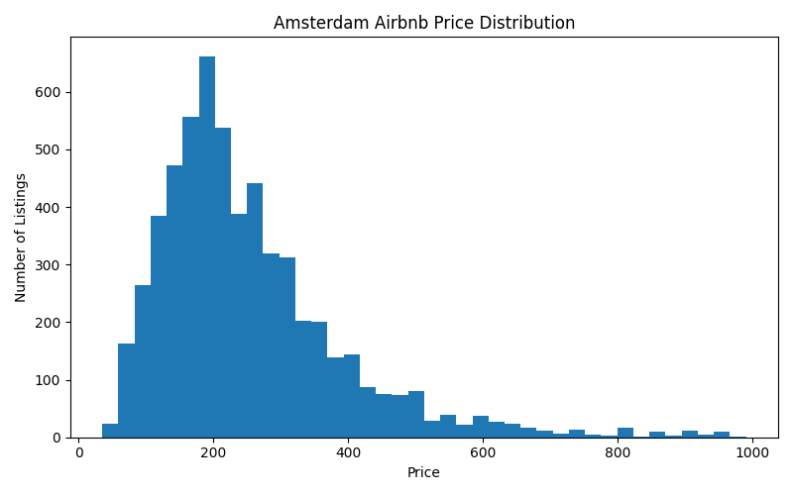
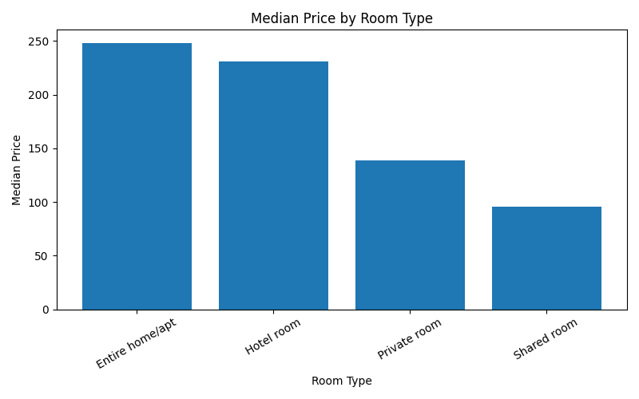
EDA Findings: Prices & Room Types
MEDIAN PRICE
AVG PRICE
EDA OUTLIERS
222.00
336.79
59
Typical listing price
Affected by high values
Above 99th percentile
6

Slide 7
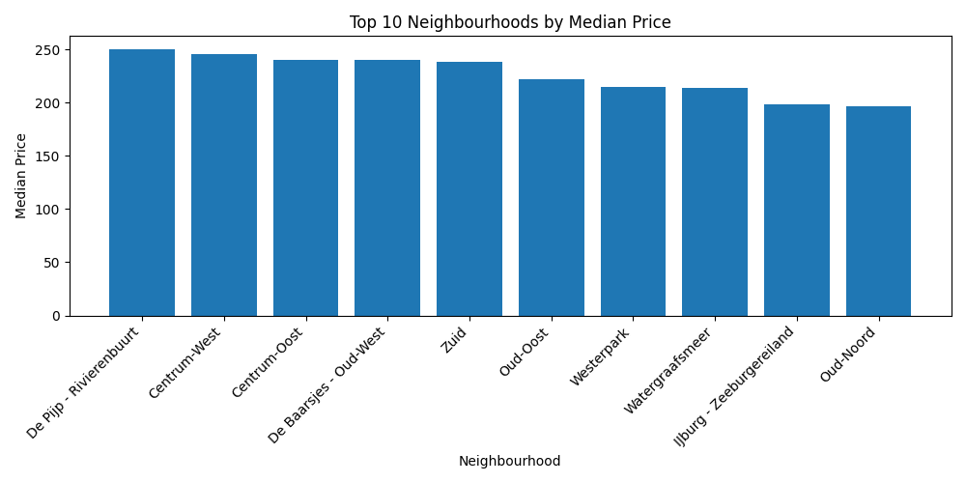
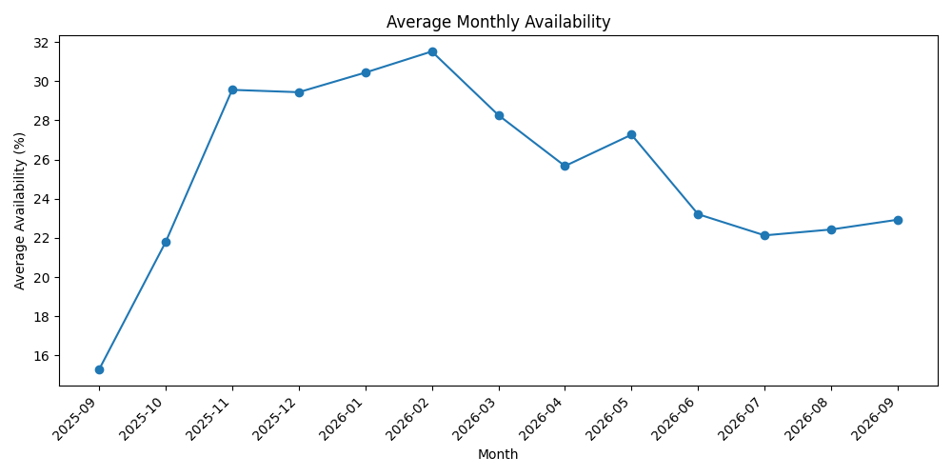
EDA Findings: Location, Availability & Hosts
Neighbourhoods show different median price levels, so location is a key pricing factor.
Availability supports estimated occupancy, but unavailable dates are not confirmed bookings.
The market includes both individual hosts and hosts managing multiple listings.
7

Slide 8
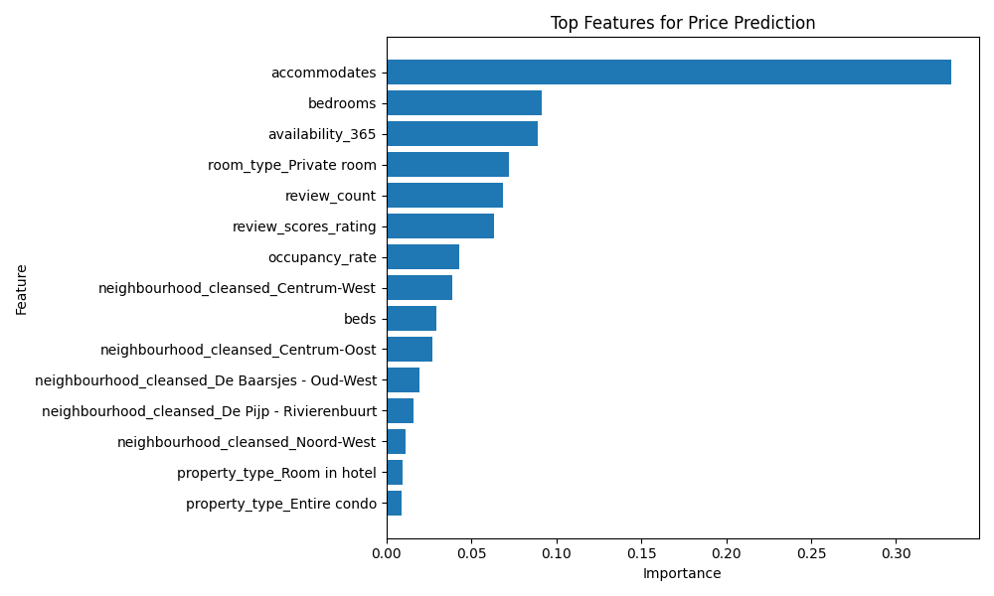
Statistical & Price Prediction Results
Test | Result | Business meaning
Entire home vs private room | Significant | Room type affects price
Superhost vs non-superhost | Significant, small practical gap | Superhost label alone is not enough
>10 reviews vs <=10 reviews | Significant | Reviews are a demand proxy
Neighbourhood price differences | Significant | Location affects price
Random Forest performed slightly better, but the model remains exploratory, not production-ready.
Model | Test MAE | R2
Linear Regression | 67.77 | 0.5179
Random Forest | 66.79 | 0.5237
8

Slide 9
Open Innovation & Business Recommendations
VALUE AREAS
Market Opportunity Finder identifies value neighbourhoods, premium areas, high-occupancy areas, improvement opportunities, and top estimated revenue listings.
Use median price by room type and neighbourhood as the main benchmark.
Treat occupancy and revenue as estimates because calendar availability does not confirm bookings.
Use price prediction as a support tool, not as an automatic pricing system.
Improve listings with many reviews but lower ratings.
6
Exported neighbourhood list
PREMIUM AREAS
10
Highest price areas
HIGH OCCUPANCY
10
Estimated occupancy list
9

Slide 10
Limitations, Future Work & Submission
Limitations: Amsterdam only, missing calendar prices, occupancy is estimated, and review count is only a demand proxy.
Future work: multi-city pipeline, confirmed booking data, daily pricing analysis, stronger model features, dashboard, and automated testing.
Submission includes source code, README, SQL, notebooks, reports, figures, exports, assumptions and decision logs, and AI usage disclosure.
10

