Slide 1

Bidirectional Transformation of NL requirements to and from UML class model for MDD
Master Thesis
Markus Bimassl - 01026122

Slide 2




Content
Thesis Inspiration and Goals
Systematic Literature Review
Search Strategy and General Findings
Transformation Approaches
Tools Used
Transformed UML Elements
Prototype
Moving Forward

Slide 3

Thesis Inspiration and Goals

Slide 4
Thesis Inspiration
One goal of RE: reduce the risk of misinterpretation.
Restricting syntax reduces the risk of misinterpretation -> Models
Problems with Models:
Time-intensive
Knowledge required
Keeping Models and NL consistent is challenging

Slide 5


Thesis Goals
G1
Get an overview over the existing state of the research field.
SLR
G1.1
Compare existing approaches.
G2
Create a working software tool that enables fully-automatic bidirectional transformation between requirements in NL and a UML class model.
Proto

Slide 6
Systematic Literature Review
Research Questions and general Findings

Slide 7
Research Questions
RQ.1
How many fully automatic solutions for the transformation of requirements in NL/UML to UML/NL were developed?
RQ.2
Which techniques were used in the fully automatic solutions?
RQ.3
Which other tools were integrated in the solutions?
RQ.4
Which elements of a UML class model were transformed in the solutions?

Slide 8
General Findings
41 papers included
1140 papers checked

Slide 9
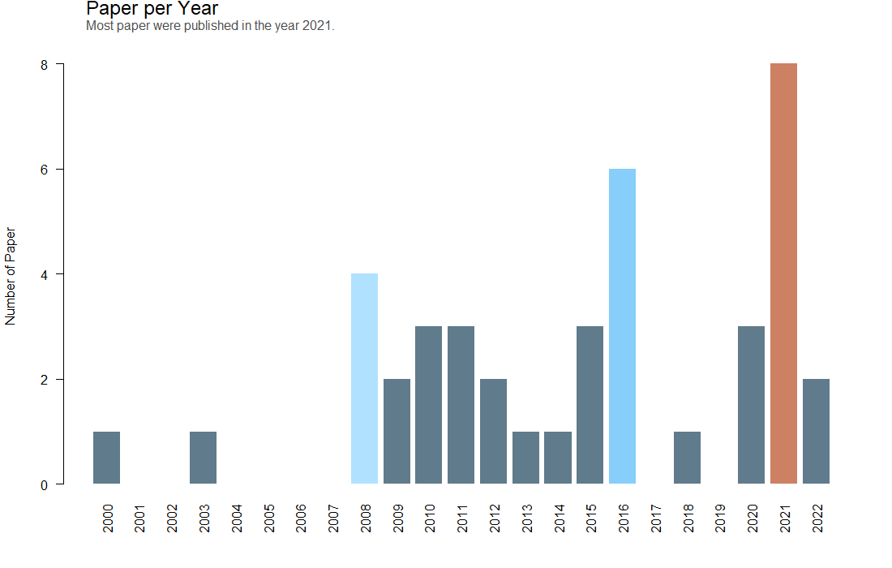

Slide 10
Systematic Literature Review
Transformation Approaches

Slide 11


Transformation Approaches
Text-to-Model (T2M)
Model-to-Text (M2T)
No included study focused on both directions.

Slide 12
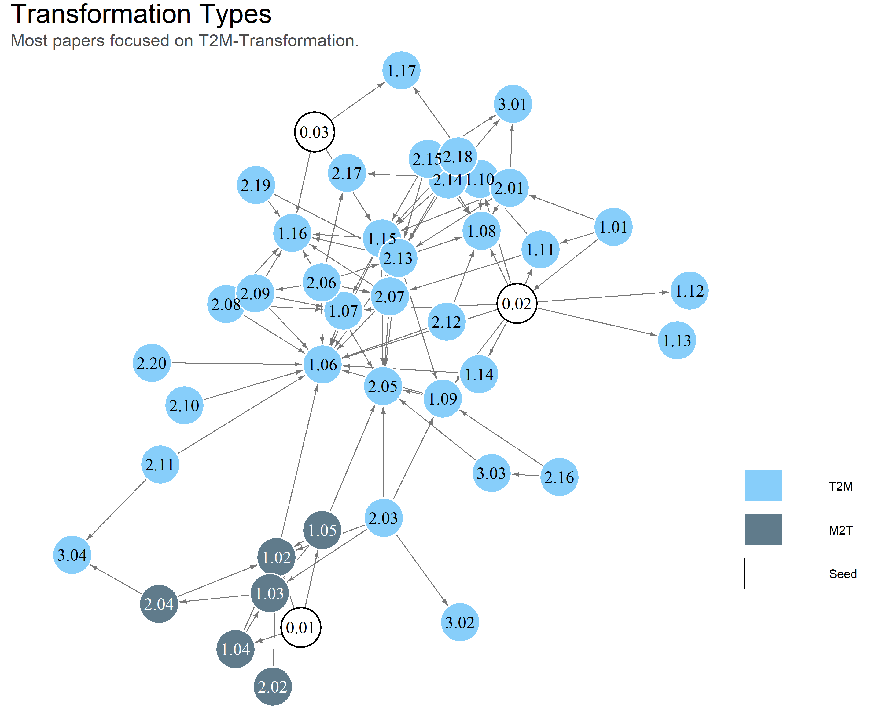

Slide 13
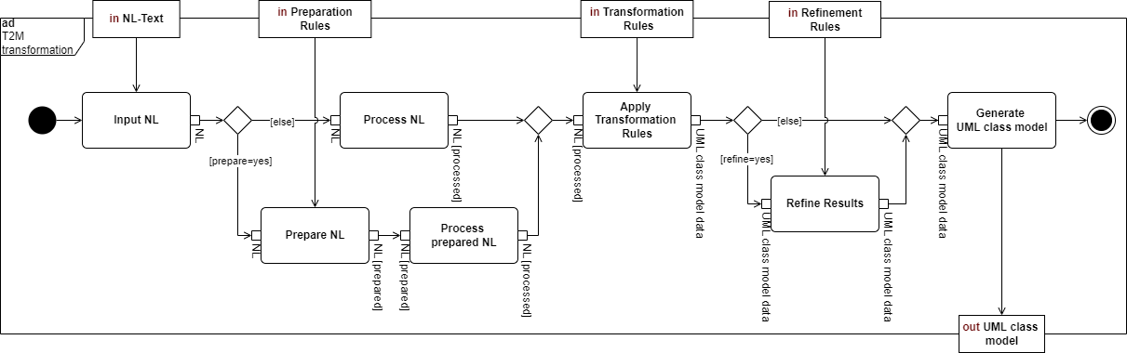
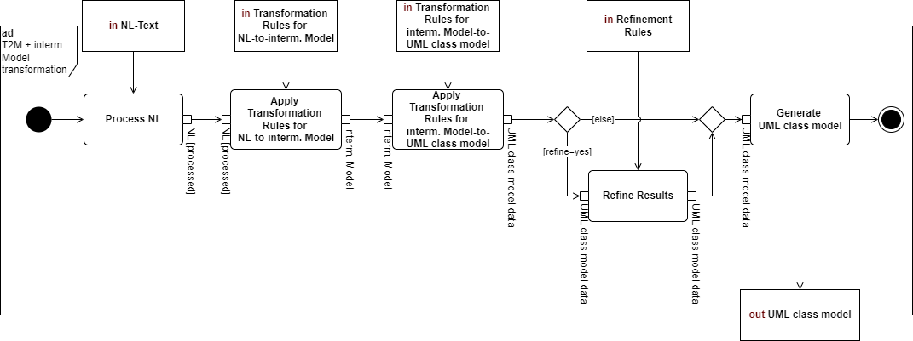
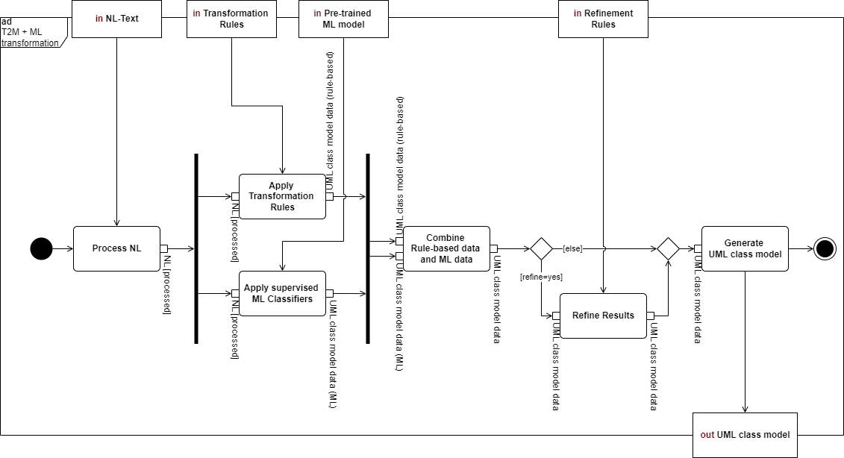
Text-to-Model Approaches
Basic
With Intermediate Model
With Machine Learning

Slide 14
T2M - Basic

Slide 15
T2M - Basic

Slide 16
T2M - Basic

Slide 17
T2M - Basic

Slide 18
T2M - Basic

Slide 19
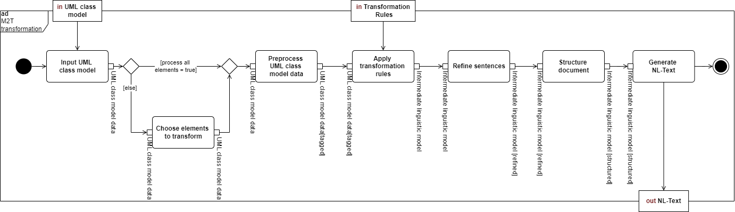
Model-to-Text Approach

Slide 20
Model-to-Text Approach

Slide 21
Model-to-Text Approach

Slide 22
Model-to-Text Approach

Slide 23
Model-to-Text Approach

Slide 24
Model-to-Text Approach

Slide 25
Systematic Literature Review
Tools used

Slide 26

Tools used
NLP
Natural Language Processing – Tools
For text tokenization, POS tagging, dependency parsing, lemmatization,…
Modeling
Mainly for visualizing the UML class model
Other
Frameworks and additional Machine Learning libraries.

Slide 27
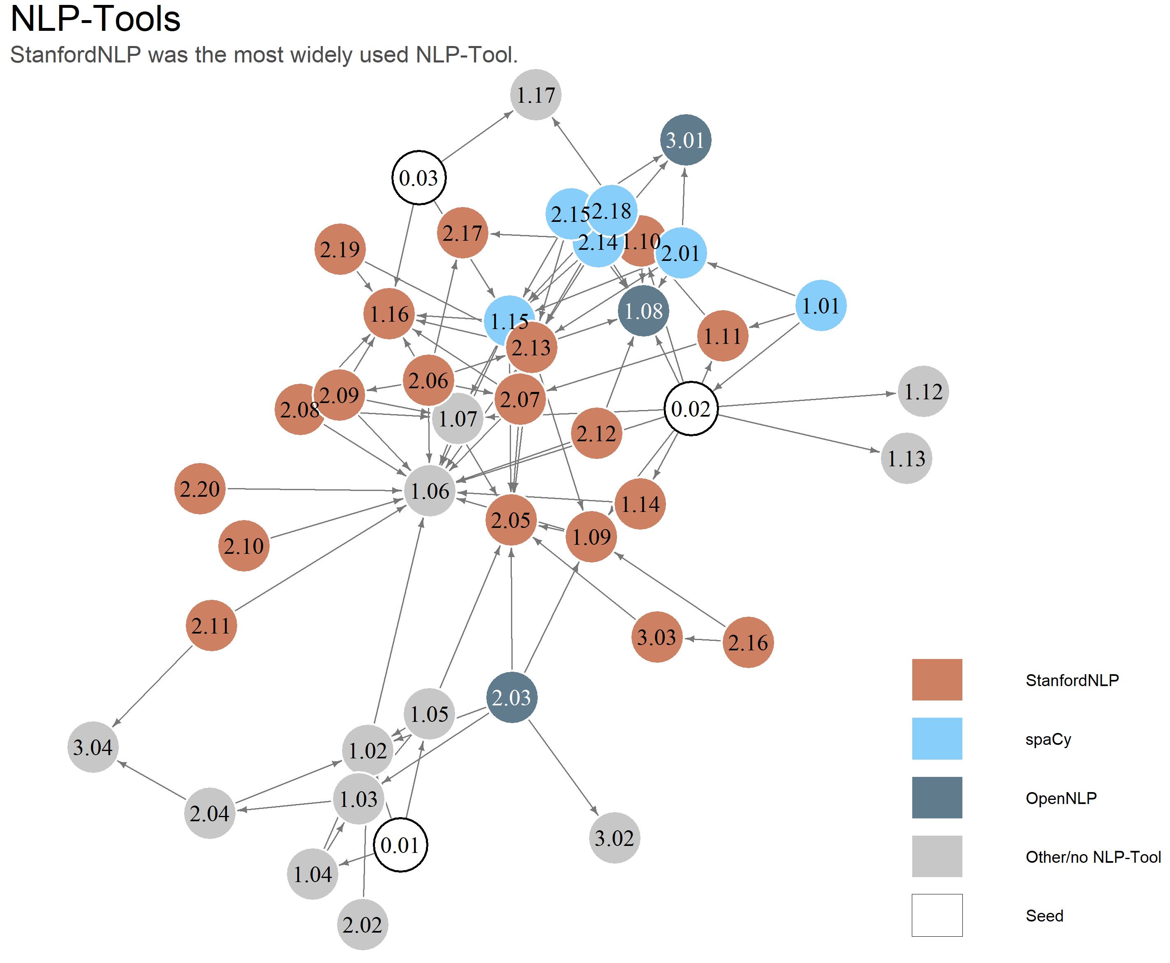

Slide 28
Systematic Literature Review
Transformed UML Elements

Slide 29
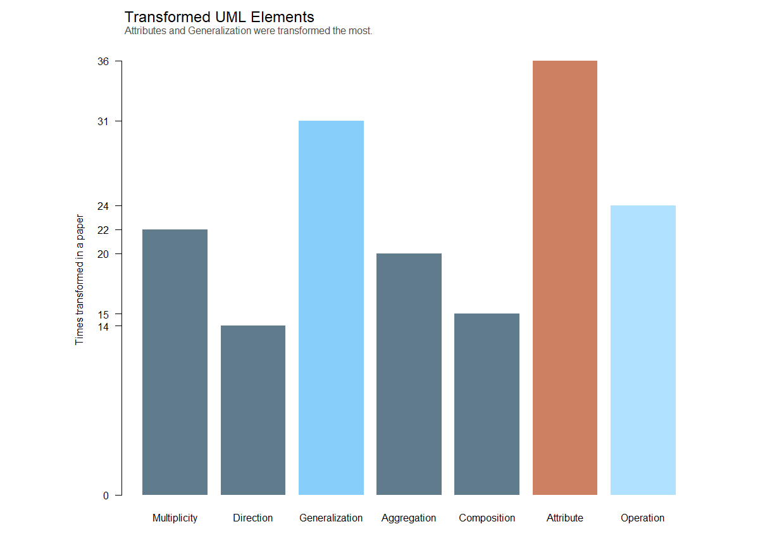

Slide 30
Prototype
Bidirectional Transformation of Requirements in Natural language and UML class models
BiT-ReNU

Slide 31
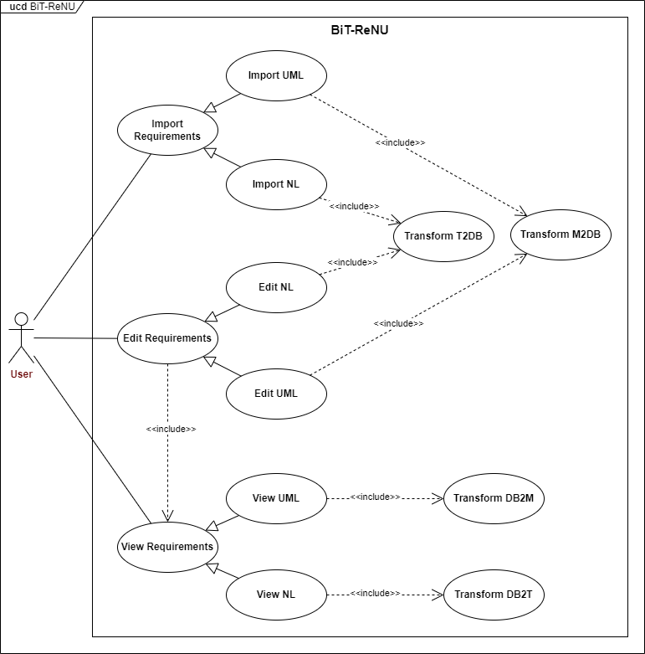
BiT-ReNU

Slide 32

Moving Forward

Slide 33
Moving Forward
BiT-ReNU
Finish Writing
Design
Implement
Evaluate

Slide 34
Thank You for listening

Slide 35
Appendix I
Literature Search

Slide 36
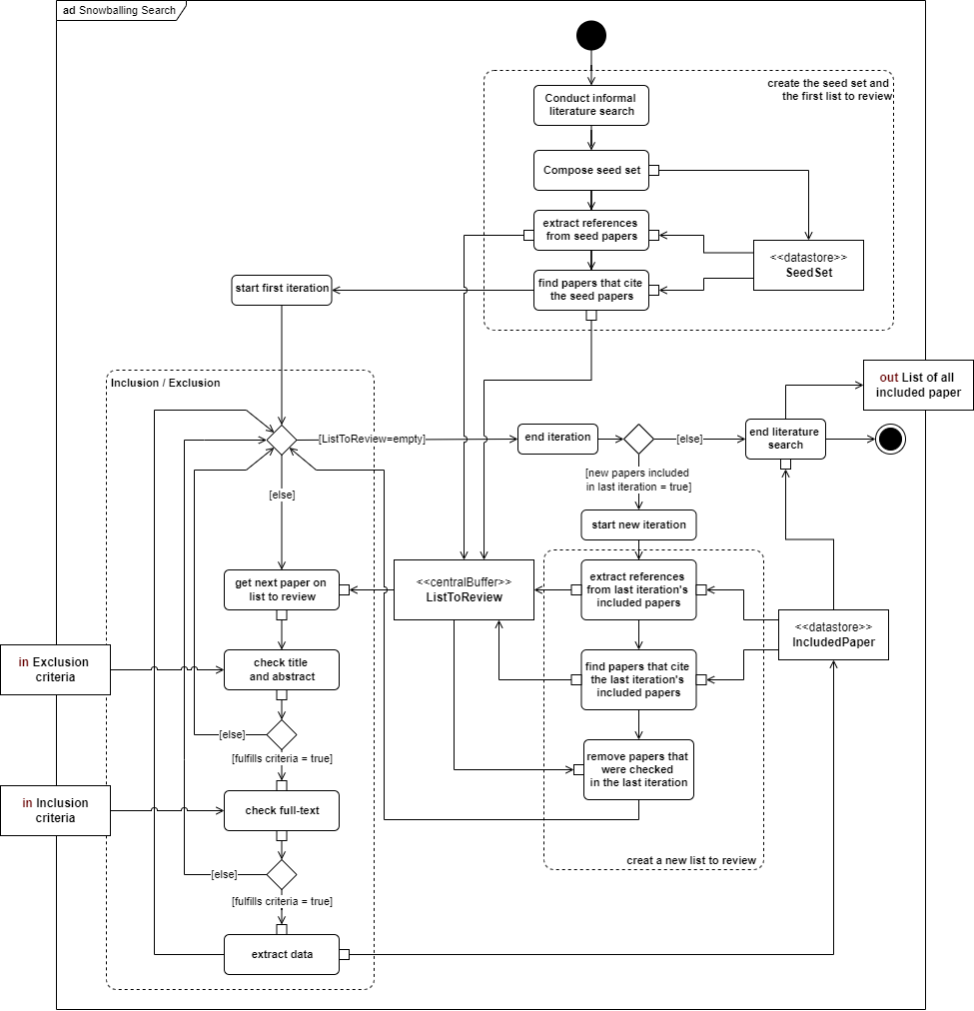
Search Process

Slide 37
Search Criteria
ID | Criteria
E.1 | Exclude tables of contents, editorials, commentaries, extended abstracts, communications, books, SLRs and tutorials.
E.2 | Exclude papers that were already checked in a previous iteration.
E.3 | Exclude papers that are not written in English.
E.4 | Exclude papers where the natural language used for the transformation was not English.
I.1 | Include papers that investigate at least one of the following topics: Fully automatic transformations from only natural language into a UML class model. Fully automatic transformations from a single UML class model into natural language.
I.2 | Include papers that describe the implementation of the tool.
I.3 | Include papers that evaluated their transformation tool.

Slide 38
Appendix II
SLR Findings

Slide 39
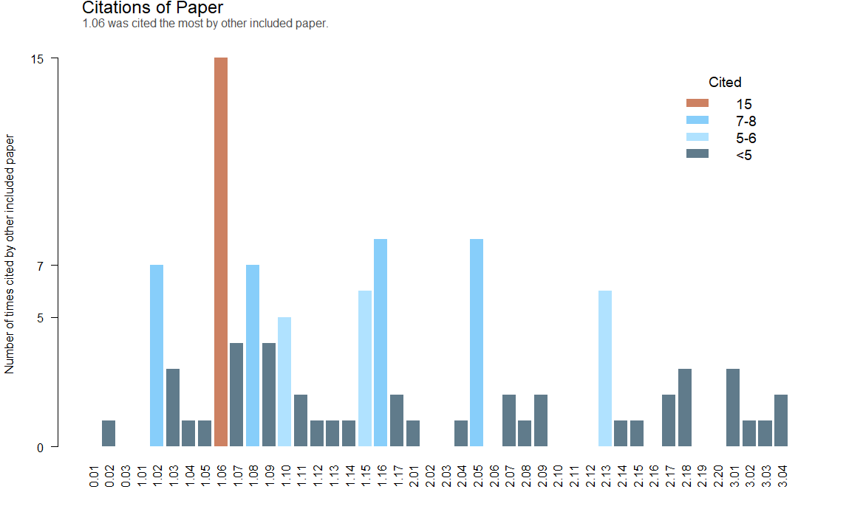
Citations per Paper

Slide 40
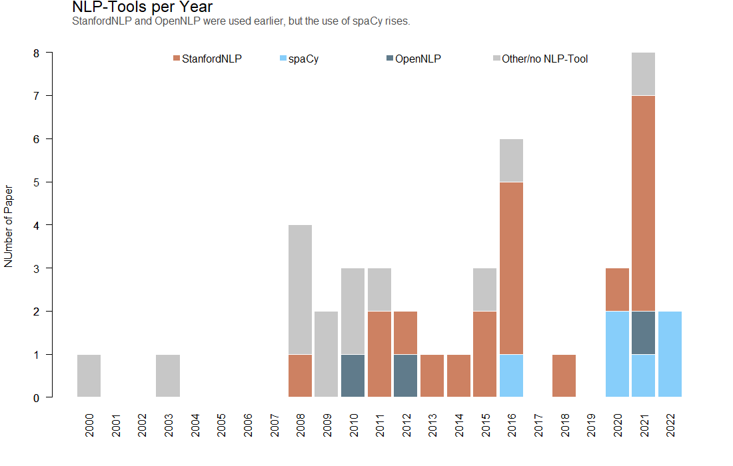
NLP Tools per year

Slide 41
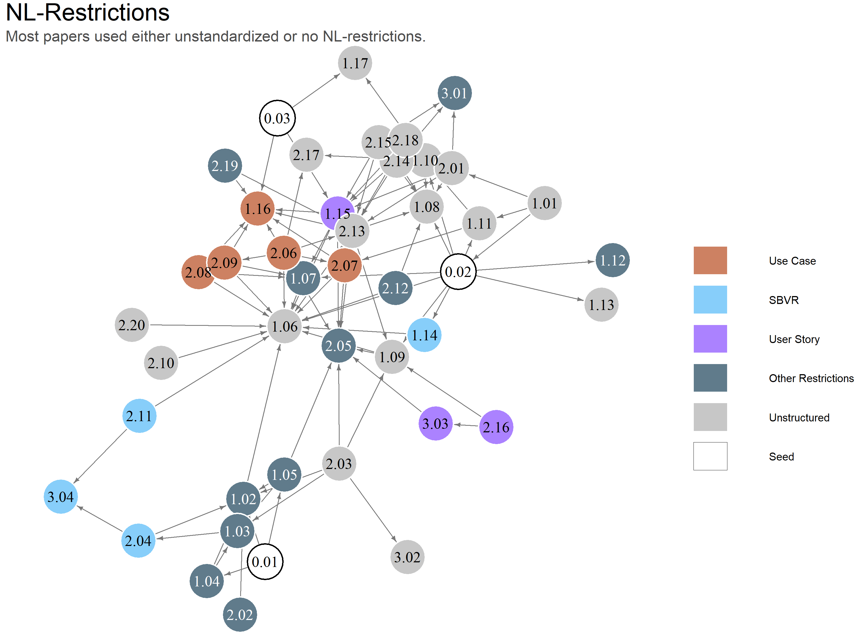
NL Restrictions

Slide 42
T2M - Intermediate

Slide 43
T2M – Machine Learning

Slide 44
Appendix III
BiT-ReNU Design

Slide 45
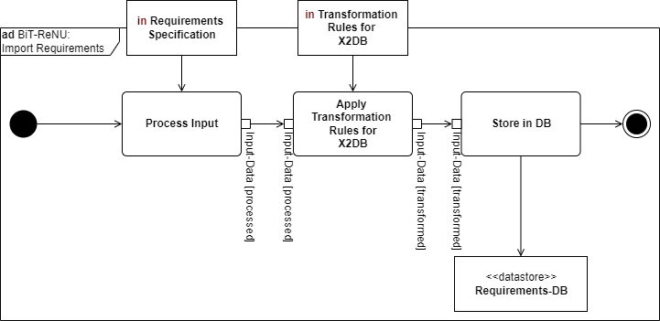
Import Requirements

Slide 46
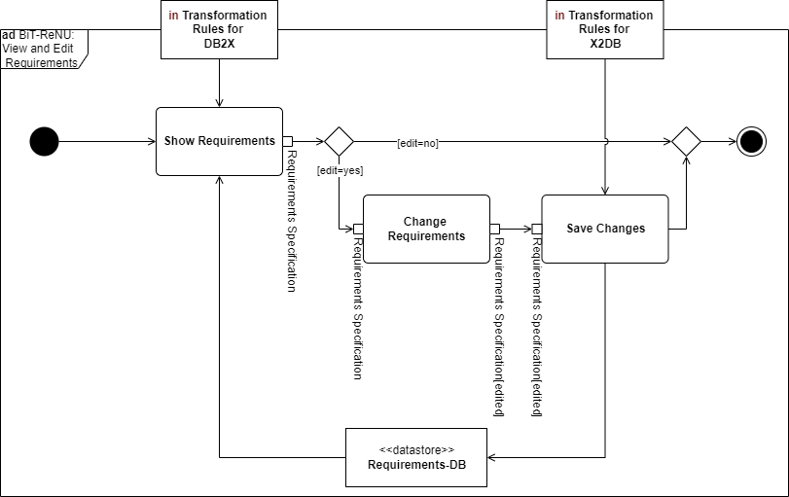
View and Edit Requirements

Slide 47
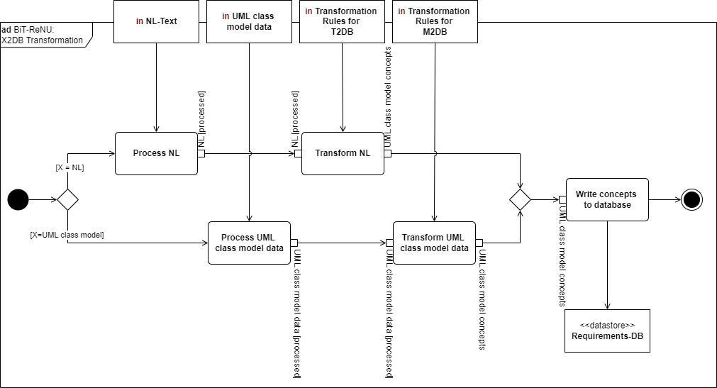
Transform X-to-DB

Slide 48


T.1 Active Association
<Subject> CAN | MUST <Action> <Object>
CAN
MUST

Slide 49


T.2 Passive Association
<Subject> CAN | MUST <Passive Action> <Object>
CAN
MUST

Slide 50

T.3 Attributes
<Subject> HAS <Object>

Slide 51

T.4 Generalization
<Subject> IS <Object>

Slide 52

T.5 Composition
<Subject> IS PART OF <Object>

Slide 53
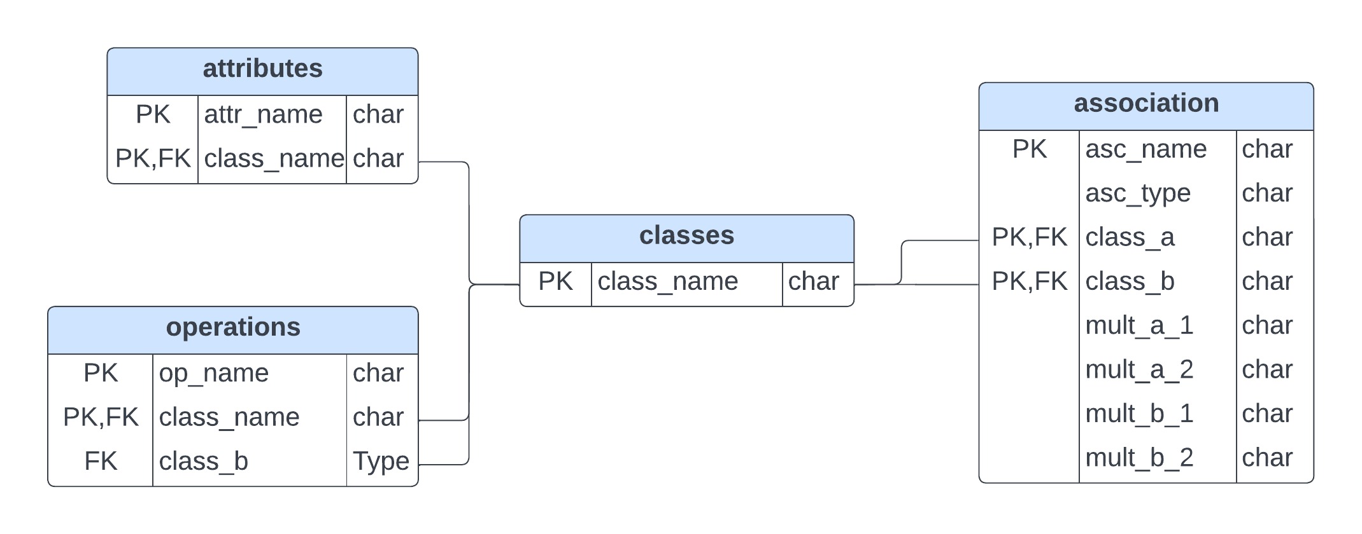
Database Schema

Slide 54
Appendix IV
Example Requirements

Slide 55
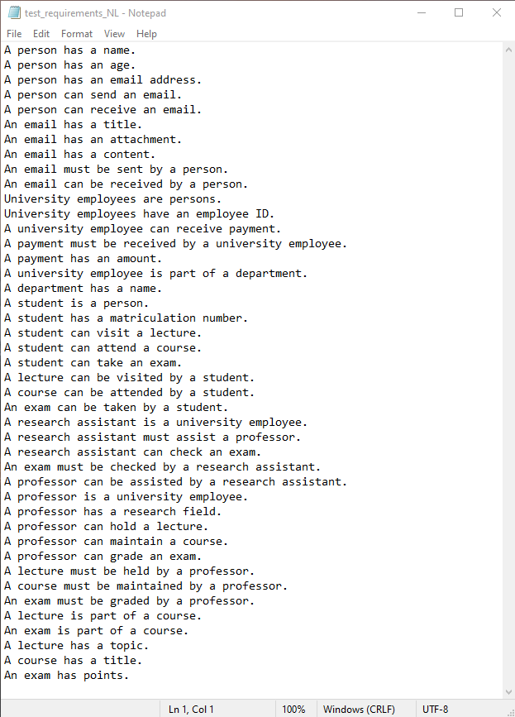

Slide 56
