Slide 1
Bidirectional transformation of natural-language requirements to and from UML class models for Model-Driven Development
Master Thesis by Markus Bimassl

Slide 2
CONTENT
Quick Overview
SLR Retrospective
Prototype
Goals
Design
Implementation
Validation
Lessons Learnt

Slide 3
QUICK OVERVIEW

Slide 4
QUICK OVERVIEW
Topic
Transforming Requirements to/from Natural Language (NL) to/from a UML class model.
SLR
Investigate the field of Text-to-Model (T2M) and Model-to-Text (M2T), with focus on the topic.
Prototype Development
Develop a prototype based on the findings of the SLR

Slide 5
SLR RETROSPECTIVE

Slide 6
SLR RETROSPECTIVE
Relevant Findings for Prototype-Design:
Transformation approach via an intermediate structure
NL input mostly structured
No included paper covered a bidirectional approach (Text <-> Model)
Many approaches use similar “keywords” to transform the same concepts
E.g. “X is a Y” -> often used for Generalization

Slide 7
PROTOTYPE GOALS

Slide 8
PROTOTYPE GOALS
Similar to other included approaches:
Goal 1: Transform requirements in NL into a UML class model without losing information
Goal 2: Transform requirements in a UML class model into NL without losing information
Gap in the included literature:
Goal 3: Enable transformation of requirements from NL into a UML class model and back, without causing unintended alterations
Subgoals for adding/editing/deleting elements in UML before transforming back into NL
Goal 4: Enable transformation of requirements from a UML class model into NL and back, without causing unintended alterations
Subgoals for adding/editing/deleting sentences in NL before transforming back into UML

Slide 9
PROTOTYPE DESIGN

Slide 10
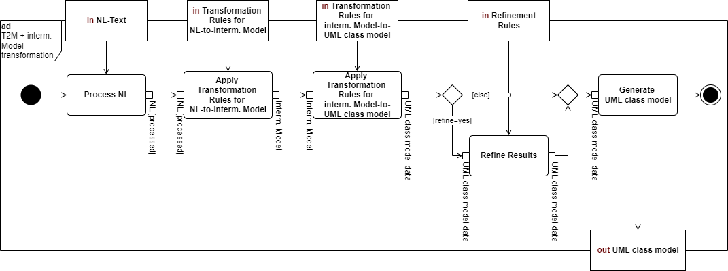
PROTOTYPE DESIGN: TRANSFORMATION APPROACH
X-to-DB
DB-to-X

Slide 11
PROTOTYPE DESIGN: SENTENCE TEMPLATES
T.1: <Subject> CAN|MUST <Action><Object>
T.2: <Subject> CAN|MUST <PassiveAction><Object>
T.3: <Subject> HAS <Object>
T.4: <Subject> IS <Object>
T.5: <Subject> IS PART OF <Object>
T.6: <Subject> CAN|MUST HAVE <Object>

Slide 12
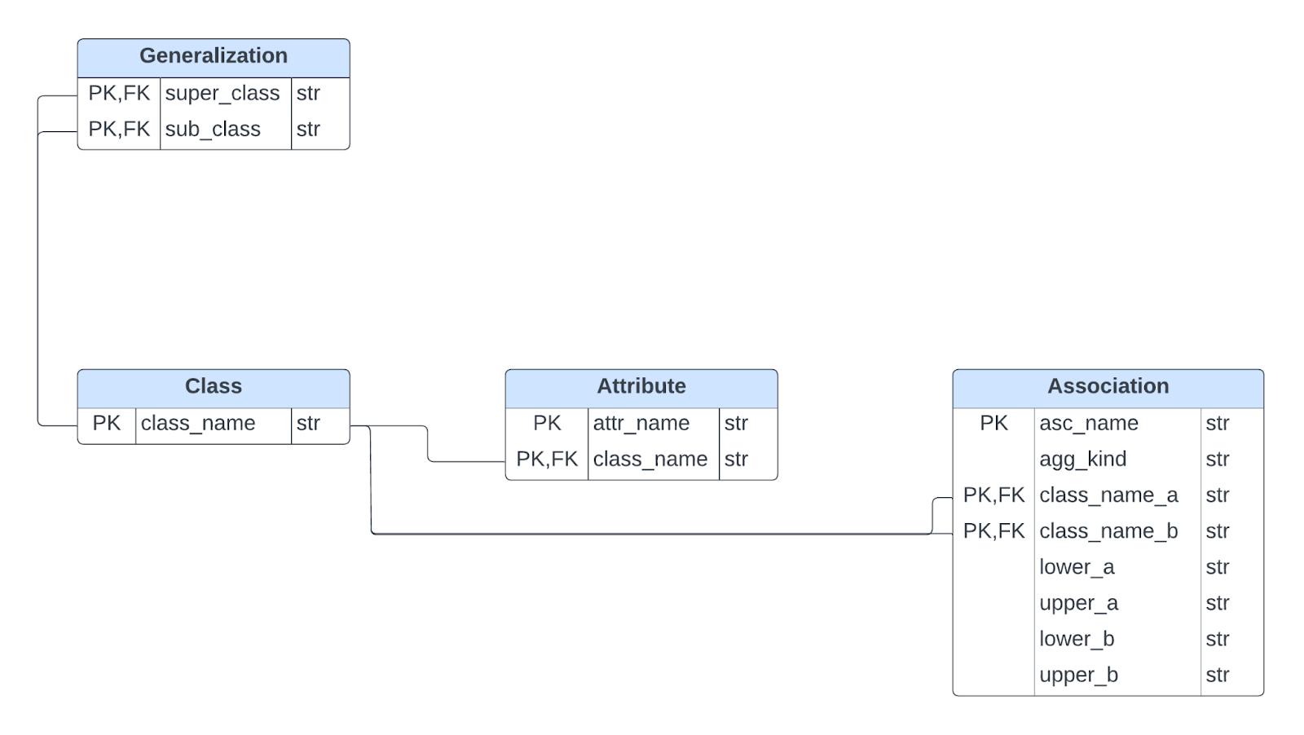
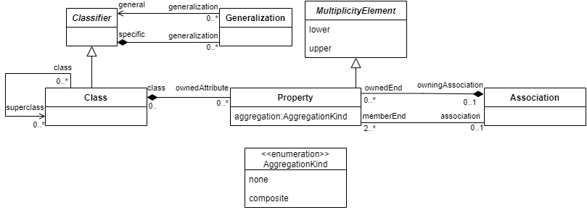
PROTOTYPE DESIGN: DB-SCHEMA

Slide 13
PROTOTYPE DESIGN: DB-SCHEMA – ORM Example
Map.4: Mapping the Generalization concept
Many-to-many relation between classes
No additional information stored for generalization relations
“Association Table Mapping Pattern” is used
-> Create a new table only for the generalization with PK from two FKs referencing the two classes stored in another table.
Alternatives:
Embedded Value Pattern
One-to-one -> For example for attributes (aggregation_kind)
Save one as a column in another table
Dependent Mapping Pattern
One-to-many -> Used to map compositions between classes
Use a foreign key in the first table to reference another table

Slide 14
PROTOTYPE IMPLEMENTATION

Slide 15
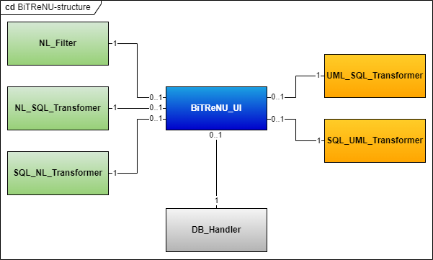
PROTOTYPE IMPLEMENTATION: STRUCTURE

Slide 16
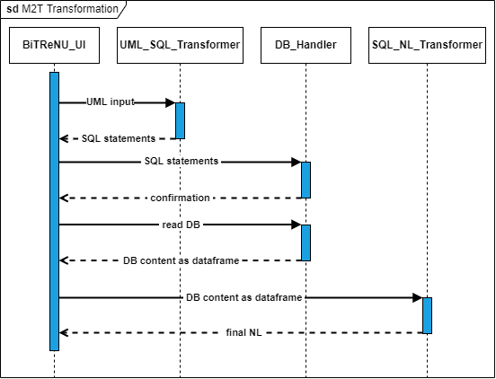
PROTOTYPE IMPLEMENTATION: M2T - Sequence
X-to-DB
Intermediate Structure
DB-to-X

Slide 17
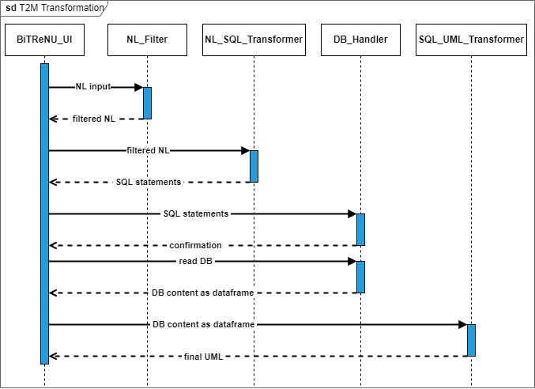
PROTOTYPE IMPLEMENTATION: T2M - Sequence
X-to-DB
Intermediate Structure
DB-to-X

Slide 18
PROTOTYPE VALIDATION

Slide 19
PROTOTYPE VALIDATION: TEST SUITE AND GOALS
Bidirectional Transformation Tests (2 Tests)
Goal 1: Transform requirements in NL into a UML class model without losing information.
Goal 2: Transform requirements in a UML class model into NL without losing information.
Alterations in UML Tests (20 Tests)
Goal 3: Enable transformation of requirements from NL into a UML class model and back, without causing unintended alterations.
Alterations in NL Tests (40 Tests)
Goal 4: Enable transformation of requirements from a UML class model into NL and back, without causing unintended alterations.
Performance Tests (6 Tests)

Slide 20
PROTOTYPE VALIDATION: PERFORMANCE TESTS
Tested Functionality:
Text-to-Model Transformation
Model-to-Text Transformation
Measurements
Execution Time (seconds)
Memory Usage (Mebibytes)
Variable:
Input size (original, original * 2, original * 3)

Slide 21
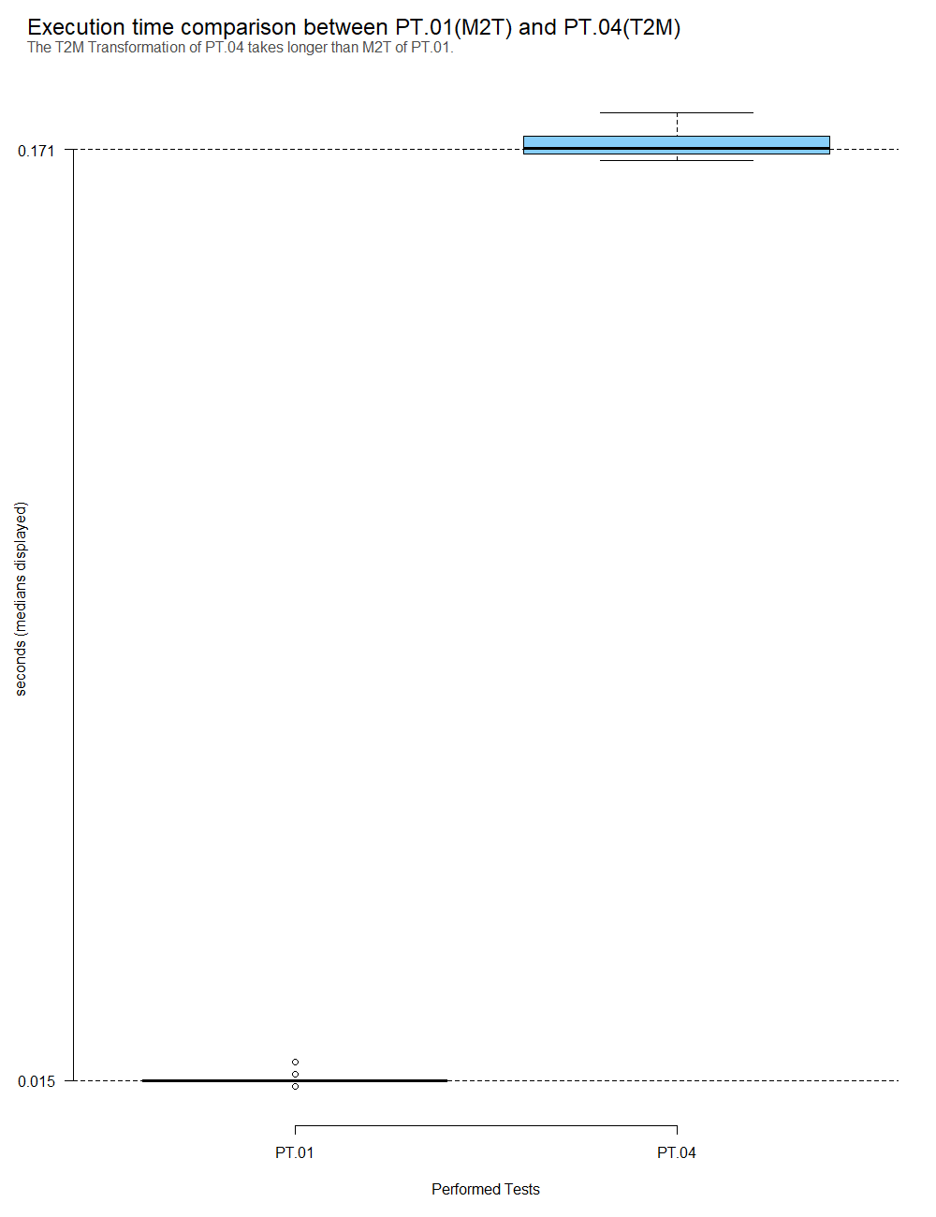
PROTOTYPE VALIDATION: PERFORMANCE TESTS – EXECUTION TIMES

Slide 22
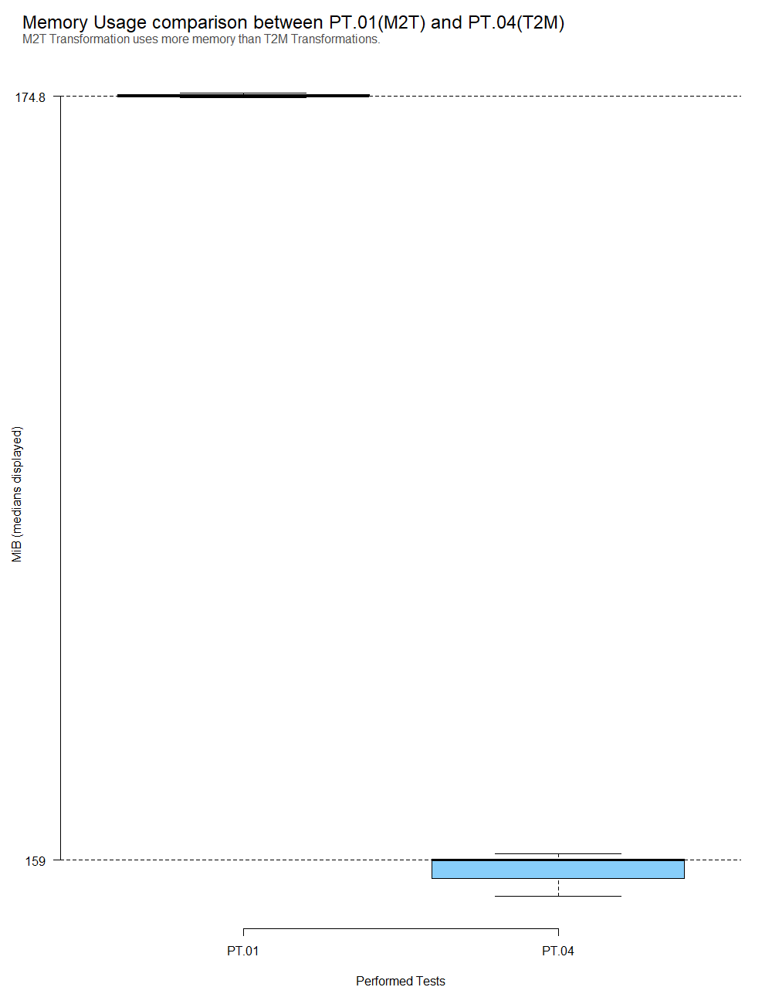
PROTOTYPE VALIDATION: PERFORMANCE TESTS – MEMORY USAGE

Slide 23
PROTOTYPE VALIDATION: PERFORMANCE TESTS – OTHER APPROACHES
Studies focused mostly on showing that their approach does transform NL/UML into UML/NL
4 studies measured time of tests
The fastest measurement of UML class model extraction was 0,6minutes of “Rijul Saini, Gunter Mussbacher, Jin LC Guo, and Jörg Kienzle. Automated, interactive, and traceable domain modelling empowered by artificial intelligence. Software and Systems Modeling, pages 1–31, 2022” to generate models with a median of 35 elements
Prototype: execution time of 0,506 seconds for 180 requirements and a resulting UML class model of 249 elements.

Slide 24
LESSONS LEARNT

Slide 25
LESSONS LEARNT: TOPIC RELATED
Included Studies focused on one-way transformations
For T2M:
Typically, the NL input is structured in some form. If it is not structured initially, it will be structured by the tool before it is transformed into UML.
Most defining tool was the used NLP-Tool
For M2T:
The input (a UML class model) is already structured, therefore no additional structuring had to be done.

Slide 26
LESSONS LEARNT: GENERAL
SLR
Good Preparation helps!
Especially in SB, mistakes/reworks during the search can have a big impact!
Prototype
Finding Patterns before implementation helps!
Tests should be written in a way that they can be executed even if prototype or the input changes!

Slide 27
THANK YOU FOR YOUR ATTENTION

Slide 28
APPENDIX

Slide 29
SLR RETROSPECTIVE
Search Strategy
Informal search for seed papers
Then forward and backward snowballing search
Reviewed paper: 1140
Included paper: 41
(Publication range from 2000 – 2022)

Slide 30
PROTOTYPE GOALS: Goal 3 - Subgoals
Goal 3: Enable transformation of requirements from NL into a UML class model and back, without causing unintended alterations
Goal 3.1: Enable Goal 3, while editing an element in the UML class model before the transformation back to NL
Goal 3.2: Enable Goal 3, while adding an element in the UML class model before the transformation back to NL
Goal 3.3: Enable Goal 3, while deleting an element in the UML class model before the transformation back to NL

Slide 31
PROTOTYPE GOALS: Goal 4 - Subgoals
Goal 4: Enable transformation of requirements from a UML class model into NL and back, without causing unintended alterations
Goal 4.1: Enable Goal 4, while editing a requirement in the NL representation before the transformation back into a UML class mode
Goal 4.2: Enable Goal 4, while adding a requirement in the NL representation before the transformation back into a UML class model
Goal 4.3: Enable Goal 4, while deleting a requirement in the NL representation before the transformation back into a UML class model

Slide 32
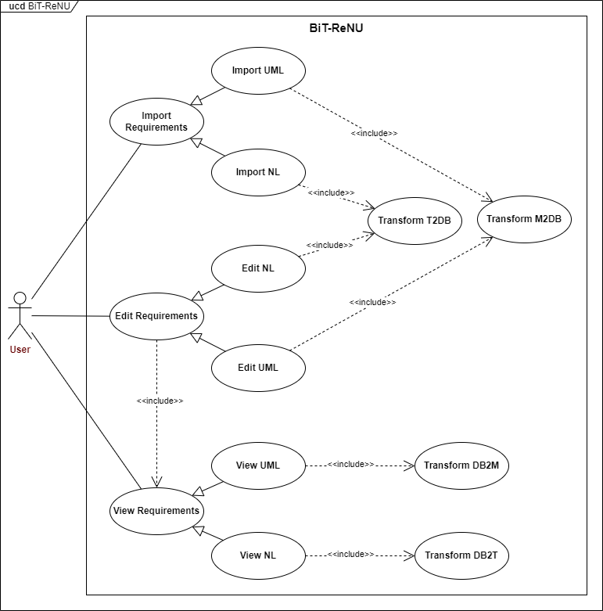
PROTOTYPE DESIGN: USE CASES

Slide 33
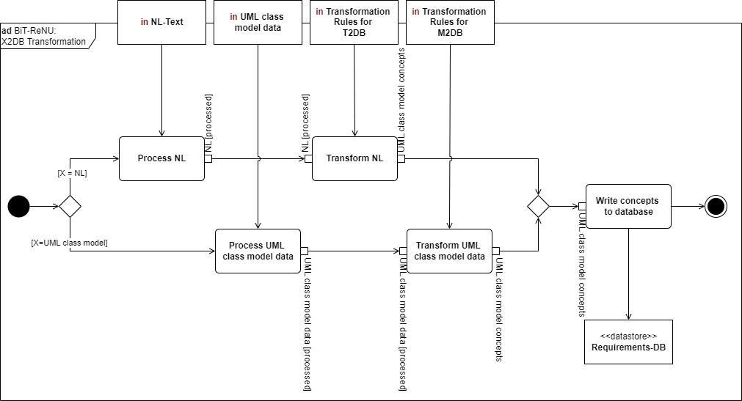
PROTOTYPE DESIGN: TRANSFORMATION APPROACH

Slide 34
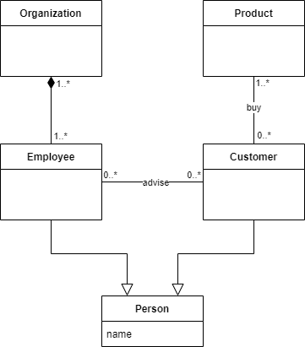
PROTOTYPE DESIGN: SENTENCE TEMPLATES
Illustration example:

Slide 35
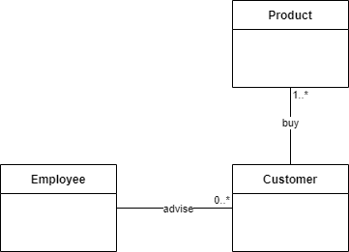
PROTOTYPE DESIGN: SENTENCE TEMPLATES
T.1: < Subject > CAN|M U ST < Action >< Object >
“An employee can advise a customer.”
“A customer must buy a product.”

Slide 36
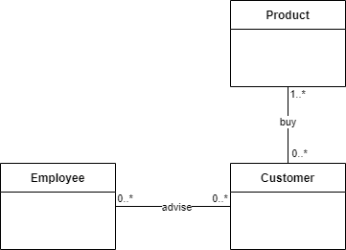
PROTOTYPE DESIGN: SENTENCE TEMPLATES
T.2 < Subject > CAN |M U ST < PassiveAction >< Object >
A Customer can be advised by an Employee.
A Product can be bought by a Customer

Slide 37
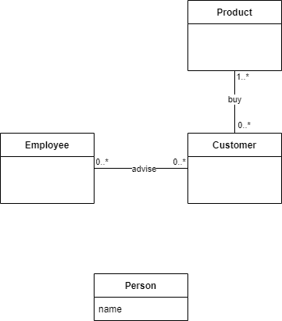
PROTOTYPE DESIGN: SENTENCE TEMPLATES
T.3 < Subject > HAS < Object >
“A person has a name.”

Slide 38
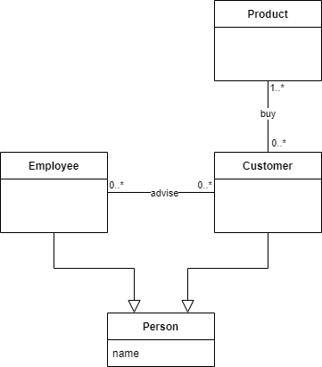
PROTOTYPE DESIGN: SENTENCE TEMPLATES
T.4 < Subject > IS < Object >
An Employee is a Person.
A Customer is a Person.

Slide 39
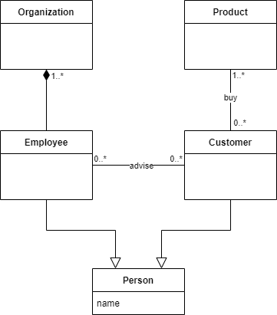
PROTOTYPE DESIGN: SENTENCE TEMPLATES
T.5 < Subject > IS PART OF < Object >
An Employee is part of an Organization.

Slide 40
PROTOTYPE DESIGN: SENTENCE TEMPLATES
T.6 < Subject > CAN|M U ST HAV E < Object >
An Organization must have an Employee

Slide 41
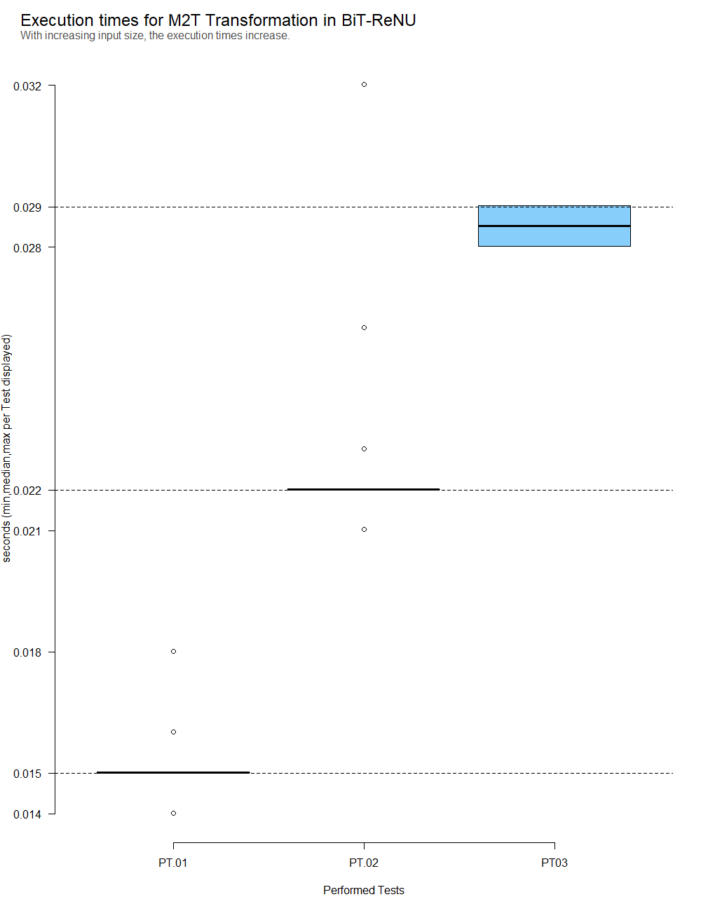
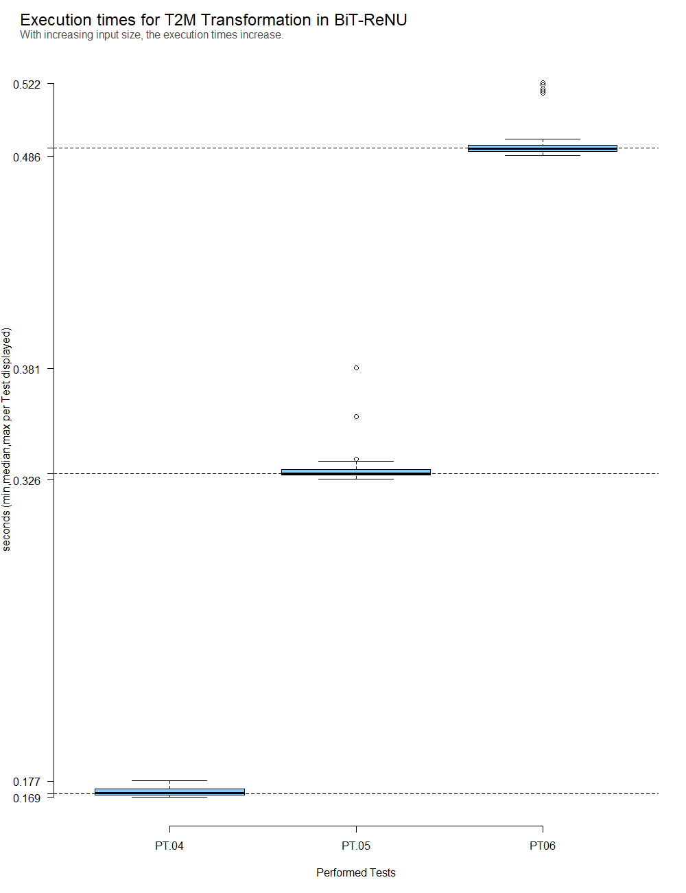
PROTOTYPE VALIDATION: PERFORMANCE TESTS – EXECUTION TIMES

Slide 42
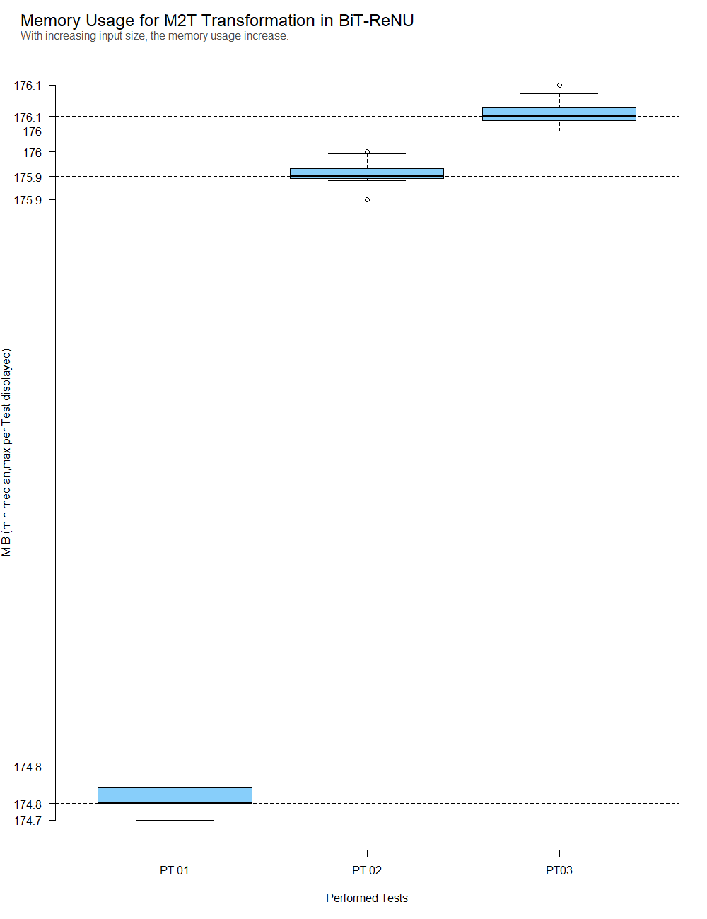
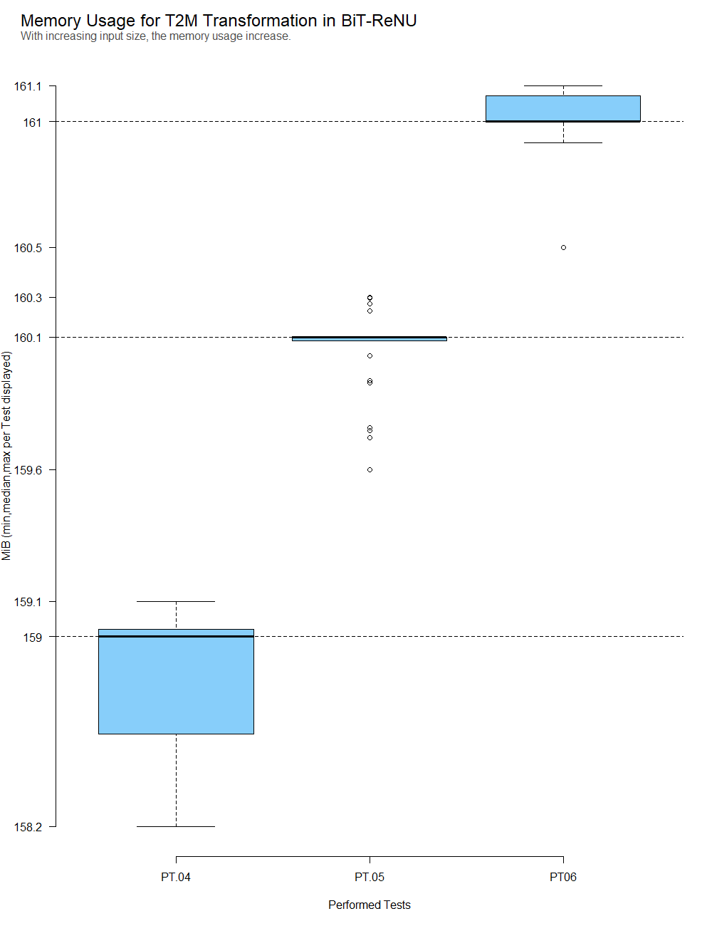
PROTOTYPE VALIDATION: PERFORMANCE TESTS – MEMORY USAGE

Slide 43
CAREER TAKE-AWAY
My field: BA/RE/EA
Every statement should have justification and a foundation
Find and use Patterns (do not reinvent the wheel every time)
If a search has to be done and documented systematically
Invest time beforehand to set up a structured search approach
Test the search/documentation/analysis on a small set before you start with the complete search
If something has to be tested or data has to be analysed:
Use well defined reproduction packages

