Slide 1
Bidirectional transformation of natural-language requirements to and from UML class models for Model-Driven Development
Master Thesis by Markus Bimassl

Slide 2
CONTENT
Quick Overview
SLR - Findings
Prototype
Goals
Design
Implementation
Validation
Lessons Learnt

Slide 3
QUICK OVERVIEW

Slide 4
QUICK OVERVIEW
Topic
Transforming Requirements to/from Natural Language (NL) to/from a UML class model.
Systematic Literature Review
Investigate a part of the field of “Text-to-Model (T2M)” and “Model-to-Text (M2T)” transformations.
Prototype Development
Develop a prototype based on the findings of the SLR

Slide 5
SLR RETROSPECTIVE

Slide 6
SLR Findings
Relevant Findings for Prototype-Design
Transformation approach via an intermediate structure
NL input mostly structured
No included paper covered a bidirectional approach
Many approaches use similar “keywords” to transform the same concepts
E.g. “X is a Y” → often used for Generalization

Slide 7
PROTOTYPE GOALS

Slide 8
PROTOTYPE GOALS
Similar to other included approaches:
Goal 1: Transform requirements in NL into a UML class model without losing information.
Goal 2: Transform requirements in a UML class model into NL without losing information.

Slide 9
PROTOTYPE GOALS
Gap in the included literature:
Goal 3: Enable transformation of requirements from NL into a UML class model and back, without causing unintended alterations.
Subgoals for adding/editing/deleting elements in UML before transforming back into NL.
Goal 4: Enable transformation of requirements from a UML class model into NL and back, without causing unintended alterations.
Subgoals for adding/editing/deleting sentences in NL before transforming back into UML.

Slide 10
PROTOTYPE DESIGN

Slide 11
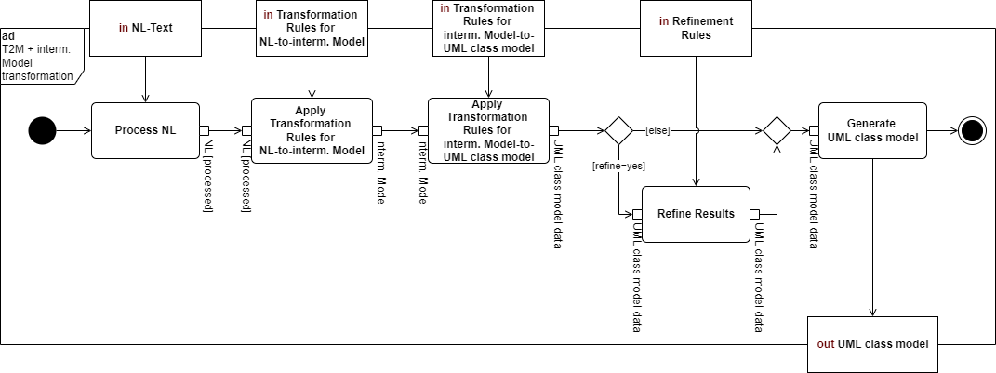
PROTOTYPE DESIGN: TRANSFORMATION APPROACH
Einleitung?

Slide 12
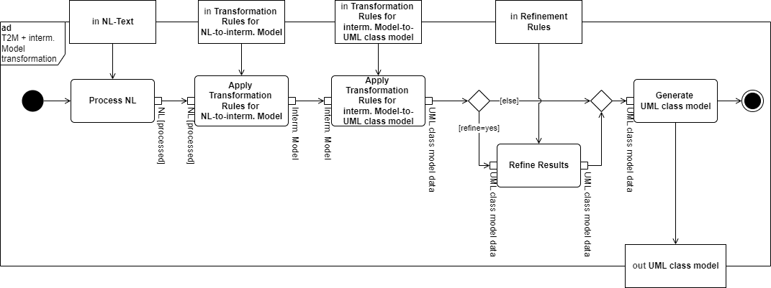
PROTOTYPE DESIGN: TRANSFORMATION APPROACH
Text-to-Intermediate

Slide 13
PROTOTYPE DESIGN: TRANSFORMATION APPROACH
Intermediate-to-Model

Slide 14
PROTOTYPE DESIGN: TRANSFORMATION APPROACH
Intermediate structure

Slide 15
PROTOTYPE DESIGN: SENTENCE TEMPLATES
Associations
T.1: <Subject> CAN|MUST <Action><Object>
T.2: <Subject> CAN|MUST <PassiveAction><Object>
Attributes
T.3: <Subject> HAS <Object>
Generalizations
T.4: <Subject> IS <Object>
Compositions
T.5: <Subject> IS PART OF <Object>
T.6: <Subject> CAN|MUST HAVE <Object>

Slide 16
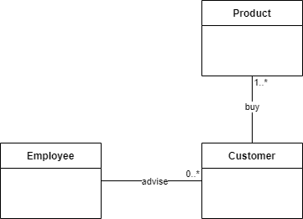
PROTOTYPE DESIGN: SENTENCE TEMPLATES
Associations
T.1: <Subject> CAN|MUST <Action><Object>
T.2: <Subject> CAN|MUST <PassiveAction><Object>
“An employee can advise a customer.”
“A customer must buy a product.”

Slide 17
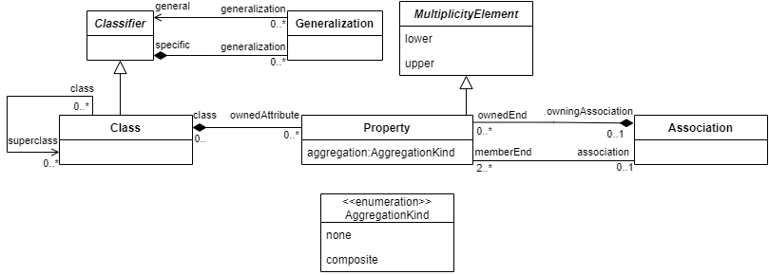
PROTOTYPE DESIGN: DB-SCHEMA
Part of EMOF Metamodel

Slide 18
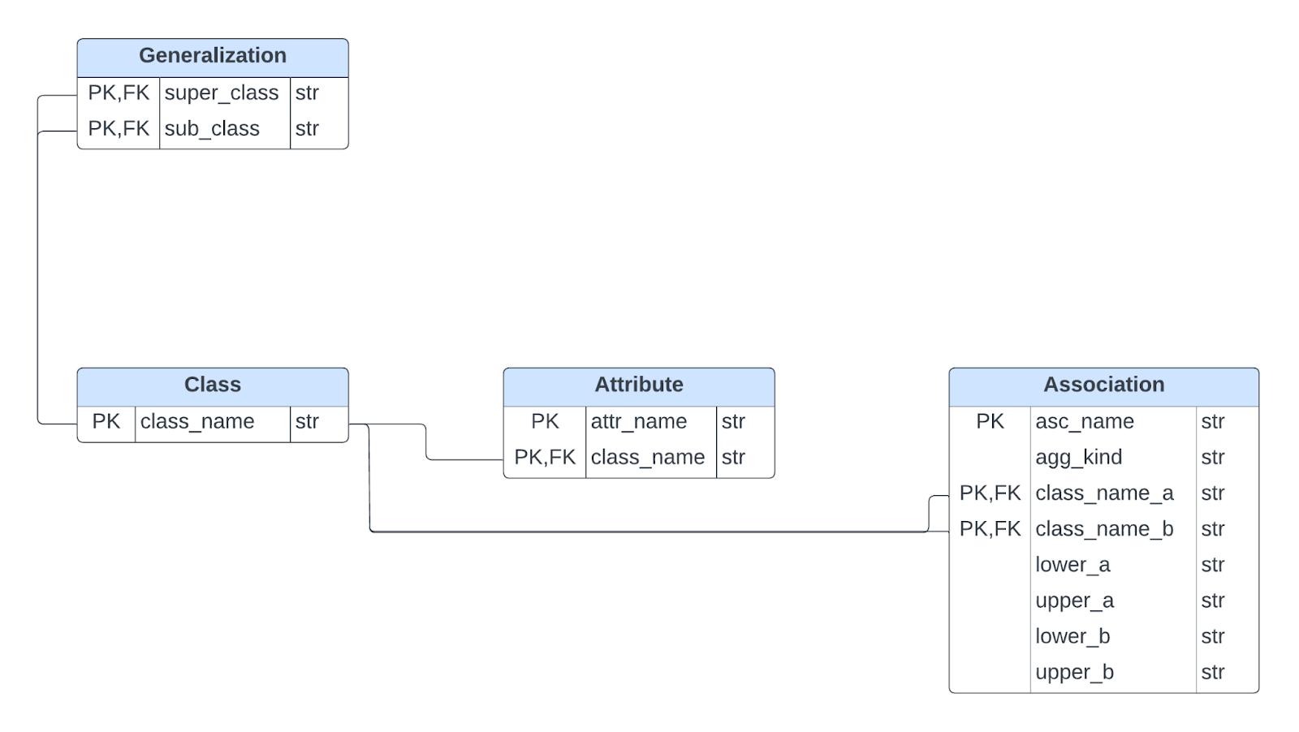
PROTOTYPE DESIGN: DB-SCHEMA
Rel. DB Schema

Slide 19
PROTOTYPE DESIGN: DB-SCHEMA – ORM Examples
Example: Mapping the Generalization Concept
Used Pattern: “Association Table Mapping Pattern”
Pattern is used for:
Many-to-many relations
Result:
Create a new table only for the generalization with PK from two FKs referencing the two classes stored in the Class table.

Slide 20
PROTOTYPE IMPLEMENTATION

Slide 21
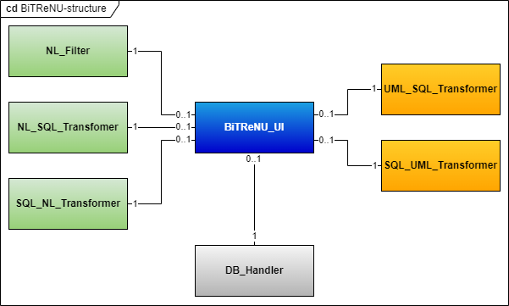
PROTOTYPE IMPLEMENTATION: STRUCTURE

Slide 22
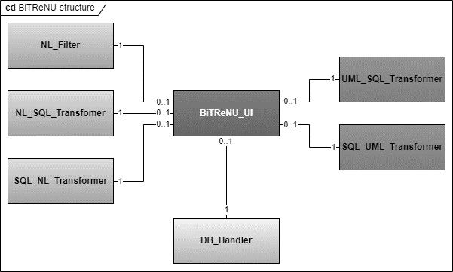

PROTOTYPE IMPLEMENTATION: STRUCTURE
NL-Module
Sort NL into sentence templates
Transform from NL into SQL
Transform from DB into NL

Slide 23
PROTOTYPE IMPLEMENTATION: STRUCTURE
UML-Module
Transform UML into SQL
Transform from DB into UML

Slide 24
PROTOTYPE IMPLEMENTATION: STRUCTURE
DB-Module
Manages all interactions with DB
No transformations do happen here

Slide 25
PROTOTYPE IMPLEMENTATION: STRUCTURE
Main Interface to access the two main functions:
Transformation from NL into UML
Transformation from UML into NL
Can also be used to access more specific functions of the modules

Slide 26
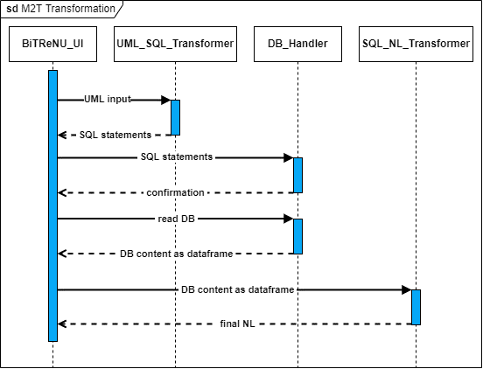
PROTOTYPE IMPLEMENTATION: M2T - Sequence

Slide 27
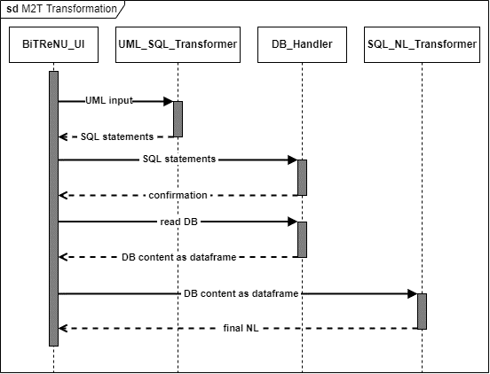

PROTOTYPE IMPLEMENTATION: M2T - Sequence
UML-to-DB

Slide 28
PROTOTYPE IMPLEMENTATION: M2T - Sequence
DB-to-NL

Slide 29
PROTOTYPE IMPLEMENTATION: M2T - Sequence
Intermediate structure

Slide 30
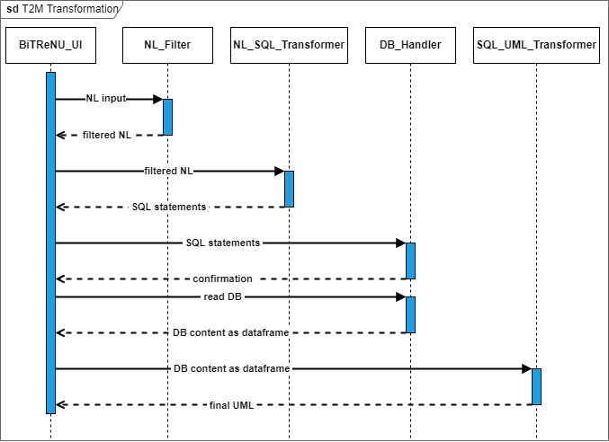
PROTOTYPE IMPLEMENTATION: T2M - Sequence

Slide 31
PROTOTYPE IMPLEMENTATION: T2M - Sequence
NL-to-DB

Slide 32
PROTOTYPE IMPLEMENTATION: T2M - Sequence
DB-to-UML

Slide 33
PROTOTYPE IMPLEMENTATION: T2M - Sequence
Intermediate structure

Slide 34
PROTOTYPE IMPLEMENTATION: T2M - Sequence
UML-to-DB
DB-to-UML
NL-to-DB
DB-to-NL

Slide 35
Static DEMO
Screenshot-wise “DEMO”

Slide 36
PROTOTYPE VALIDATION

Slide 37
PROTOTYPE VALIDATION: TEST SUITE AND GOALS
Bidirectional Transformation Tests (2 Tests)
Goal 1: Transform requirements in NL into a UML class model without losing information.
Goal 2: Transform requirements in a UML class model into NL without losing information.
Goal 3: Enable transformation of requirements from NL into a UML class model and back, without causing unintended alterations.
Goal 4: Enable transformation of requirements from a UML class model into NL and back, without causing unintended alterations.
Alterations in UML Tests (20 Tests)
Goal 3.1: Enable Goal 3, while editing an element in the UML class model before the transformation back to NL.
Goal 3.2: Enable Goal 3, while adding an element in the UML class model before the transformation back to NL.
Goal 3.3: Enable Goal 3, while deleting an element in the UML class model before the transformation back to NL.
Alterations in NL Tests (40 Tests)
Goal 4.1: Enable Goal 4, while editing a requirement in the NL representation before the transformation back into a UML class model.
Goal 4.2: Enable Goal 4, while adding a requirement in the NL representation before the transformation back into a UML class model.
Goal 4.3: Enable Goal 4, while deleting a requirement in the NL representation before the transformation back into a UML class model.
Performance Tests (6 Tests)

Slide 38
PROTOTYPE VALIDATION: PERFORMANCE TESTS
Tested Functionality:
Text-to-Model Transformation
Model-to-Text Transformation
Measurements
Execution Time (seconds)
Memory Usage (Mebibytes)
Variable:
Input size (original, original * 2, original * 3)

Slide 39
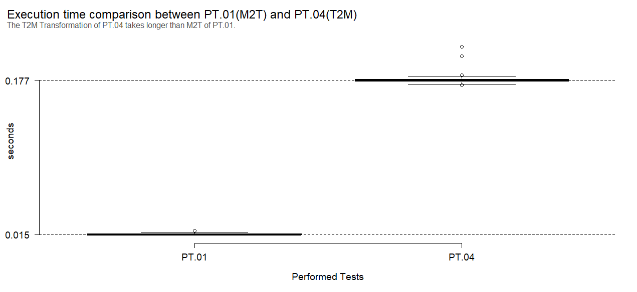
PROTOTYPE VALIDATION: PERFORMANCE TESTS – EXECUTION TIMES

Slide 40
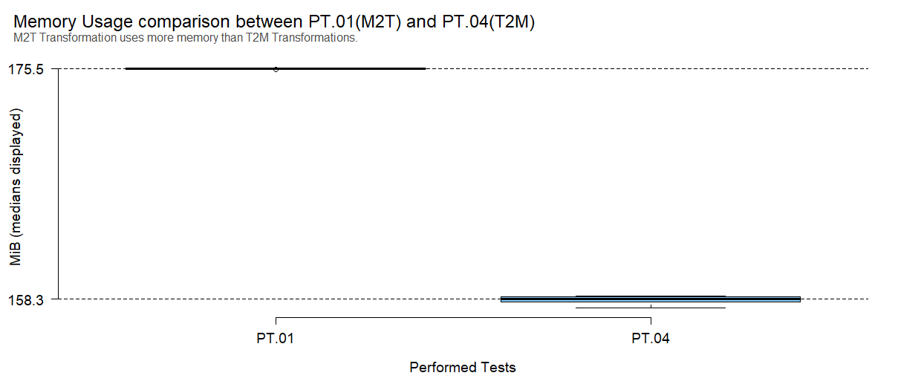
PROTOTYPE VALIDATION: PERFORMANCE TESTS – MEMORY USAGE

Slide 41
PROTOTYPE VALIDATION: PERFORMANCE TESTS – OTHER APPROACHES
Studies focused mostly on showing that their approach does transform NL/UML into UML/NL
4 studies measured time of tests
The fastest measurement of UML class model extraction was 0,6minutes of “Rijul Saini, Gunter Mussbacher, Jin LC Guo, and Jörg Kienzle. Automated, interactive, and traceable domain modelling empowered by artificial intelligence. Software and Systems Modeling, pages 1–31, 2022” to generate models with a median of 35 elements
Prototype: execution time of 0,506 seconds for 180 requirements and a resulting UML class model of 249 elements.

Slide 42
LESSONS LEARNT

Slide 43
LESSONS LEARNT: TOPIC RELATED
Included Studies focused on one-way transformations
For T2M:
Typically, the NL input is structured in some form. If it is not structured initially, it will be structured by the tool before it is transformed into UML.
Most defining tool was the used NLP-Tool
For M2T:
The input (a UML class model) is already structured, therefore no additional structuring had to be done.

Slide 44
LESSONS LEARNT: GENERAL
SLR
Good Preparation helps!
Especially in SB, mistakes/reworks during the search can have a big impact!
Prototype
Finding Patterns before implementation helps!
Tests should be written in a way that they can be executed even if prototype or the input changes!

Slide 45
THANK YOU FOR YOUR ATTENTION

Slide 46
Appendix

Slide 47
SLR RETROSPECTIVE
Search Strategy
Informal search for seed papers
Then forward and backward snowballing search
Reviewed paper: 1140
Included paper: 41
(Publication range from 2000 – 2022)

Slide 48
PROTOTYPE GOALS: Goal 3 - Subgoals
Goal 3: Enable transformation of requirements from NL into a UML class model and back, without causing unintended alterations
Goal 3.1: Enable Goal 3, while editing an element in the UML class model before the transformation back to NL
Goal 3.2: Enable Goal 3, while adding an element in the UML class model before the transformation back to NL
Goal 3.3: Enable Goal 3, while deleting an element in the UML class model before the transformation back to NL

Slide 49
PROTOTYPE GOALS: Goal 4 - Subgoals
Goal 4: Enable transformation of requirements from a UML class model into NL and back, without causing unintended alterations
Goal 4.1: Enable Goal 4, while editing a requirement in the NL representation before the transformation back into a UML class mode
Goal 4.2: Enable Goal 4, while adding a requirement in the NL representation before the transformation back into a UML class model
Goal 4.3: Enable Goal 4, while deleting a requirement in the NL representation before the transformation back into a UML class model

Slide 50
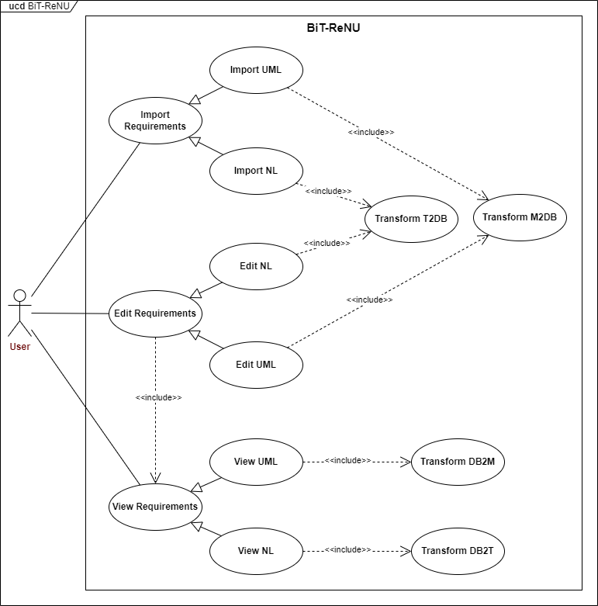
PROTOTYPE DESIGN: USE CASES

Slide 51
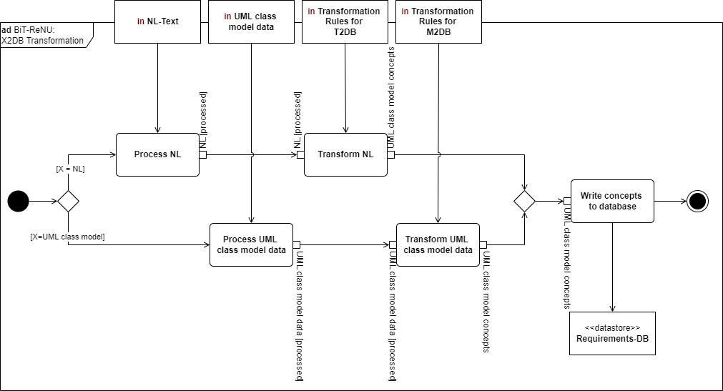
PROTOTYPE DESIGN: TRANSFORMATION APPROACH

Slide 52
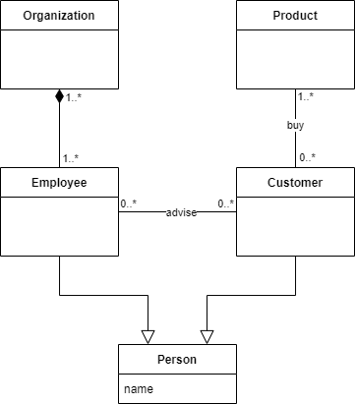
PROTOTYPE DESIGN: SENTENCE TEMPLATES
Illustration example:

Slide 53
PROTOTYPE DESIGN: SENTENCE TEMPLATES
T.1: < Subject > CAN|M U ST < Action >< Object >
“An employee can advise a customer.”
“A customer must buy a product.”

Slide 54
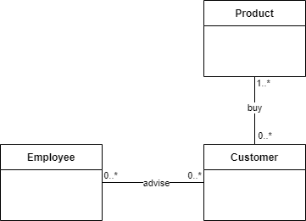
PROTOTYPE DESIGN: SENTENCE TEMPLATES
T.2 < Subject > CAN |M U ST < PassiveAction >< Object >
A Customer can be advised by an Employee.
A Product can be bought by a Customer

Slide 55
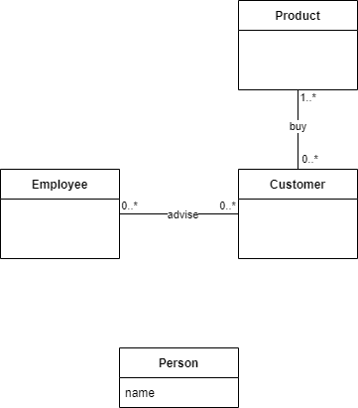
PROTOTYPE DESIGN: SENTENCE TEMPLATES
T.3 < Subject > HAS < Object >
“A person has a name.”

Slide 56
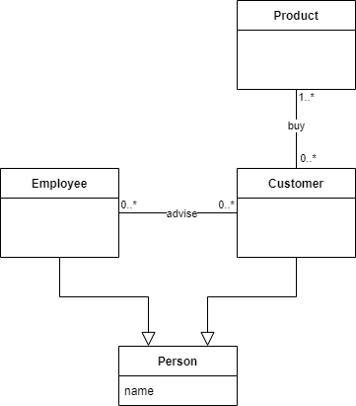
PROTOTYPE DESIGN: SENTENCE TEMPLATES
T.4 < Subject > IS < Object >
An Employee is a Person.
A Customer is a Person.

Slide 57
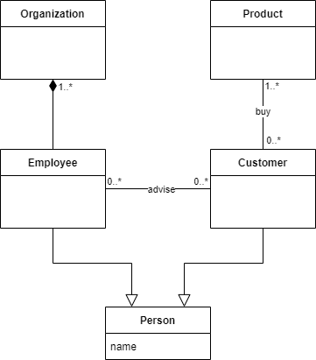
PROTOTYPE DESIGN: SENTENCE TEMPLATES
T.5 < Subject > IS PART OF < Object >
An Employee is part of an Organization.

Slide 58
PROTOTYPE DESIGN: SENTENCE TEMPLATES
T.6 < Subject > CAN|M U ST HAV E < Object >
An Organization must have an Employee

Slide 59
PROTOTYPE DESIGN: DB-SCHEMA

Slide 60
PROTOTYPE DESIGN: DB-SCHEMA – ORM Example
Embedded Value Pattern
One-to-one -> For example for attributes (aggregation_kind)
Save one as a column in another table
Dependent Mapping Pattern
One-to-many -> Used to map compositions between classes
Use a foreign key in the first table to reference another table

Slide 61
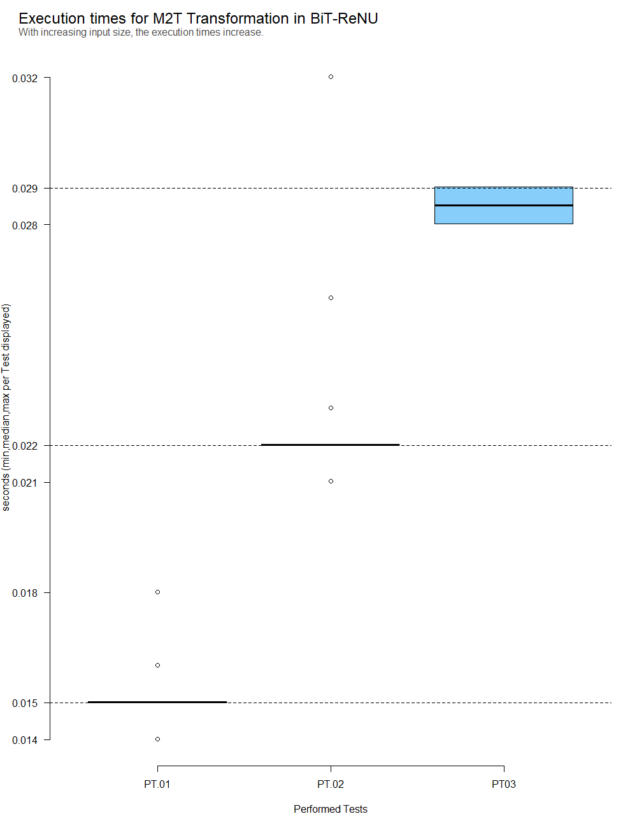
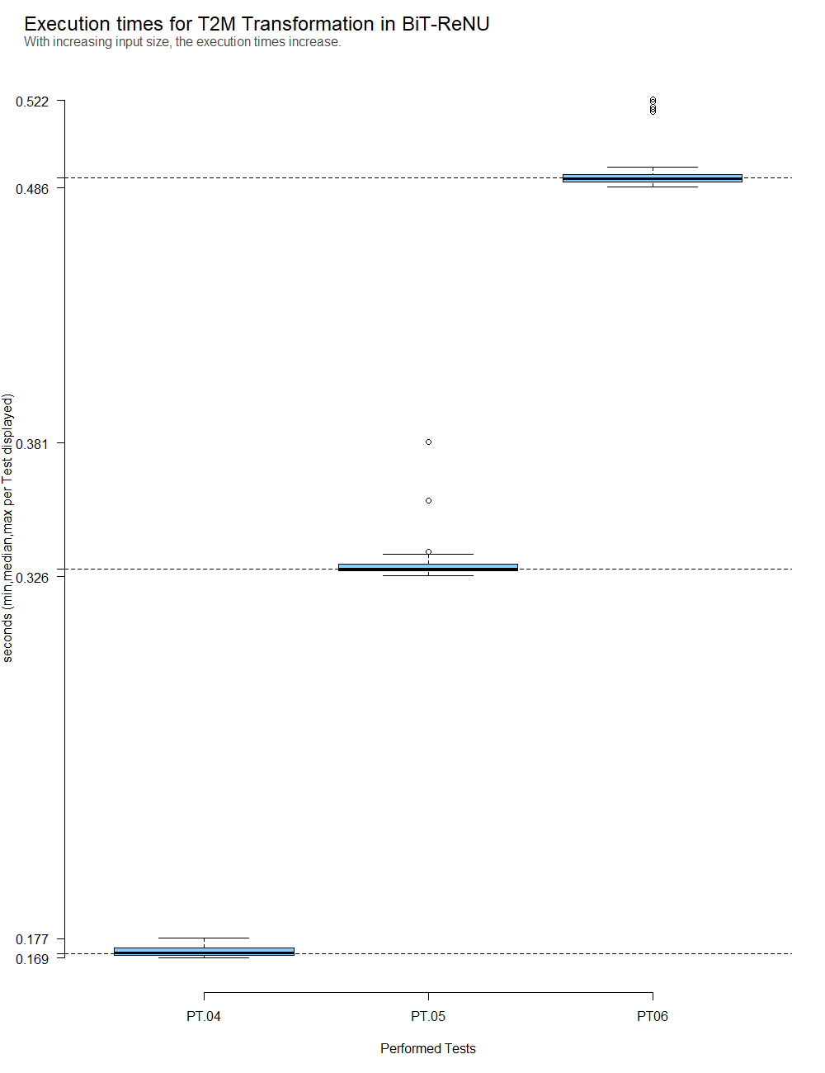
PROTOTYPE VALIDATION: PERFORMANCE TESTS – EXECUTION TIMES

Slide 62
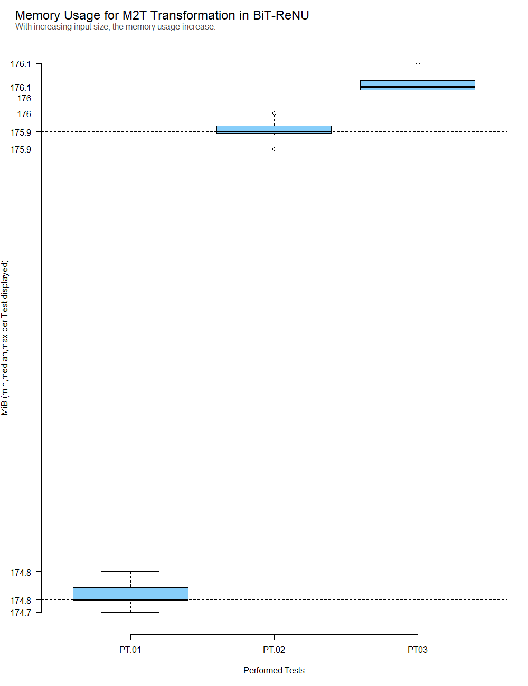
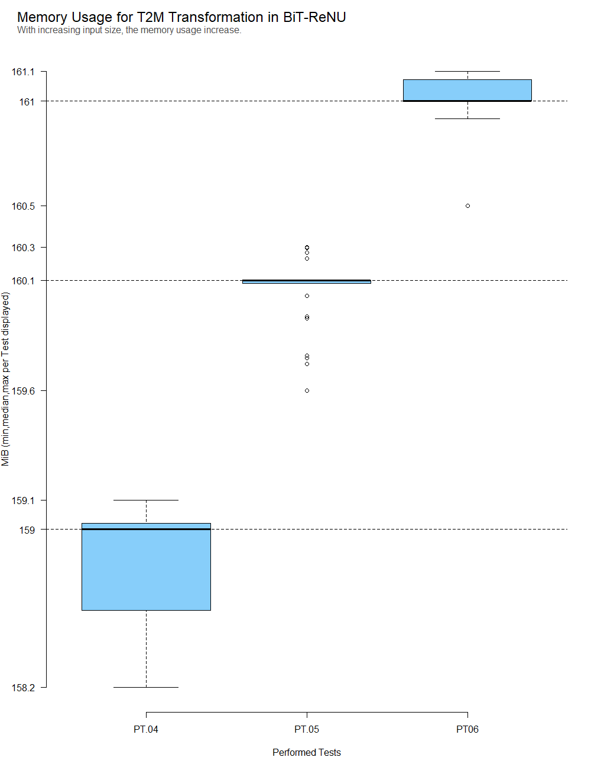
PROTOTYPE VALIDATION: PERFORMANCE TESTS – MEMORY USAGE

Slide 63
CAREER TAKE-AWAY
My field: BA/RE/EA
Every statement should have justification and a foundation
Find and use Patterns (do not reinvent the wheel every time)
If a search has to be done and documented systematically
Invest time beforehand to set up a structured search approach
Test the search/documentation/analysis on a small set before you start with the complete search
If something has to be tested or data has to be analysed:
Use well defined reproduction packages

