Slide 2





e-Conductor

Slide 3

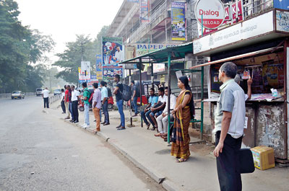

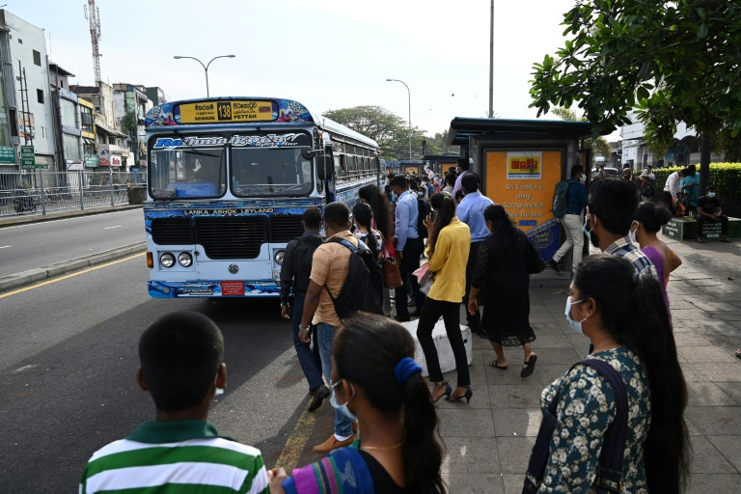
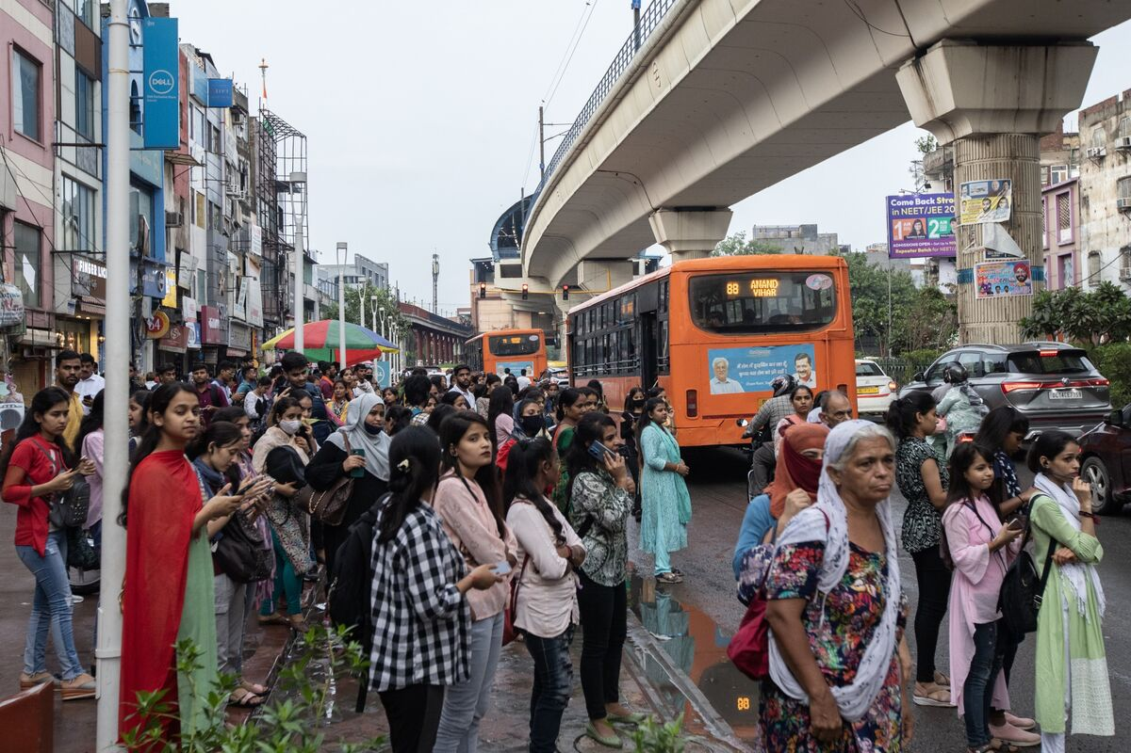

SAMPLE TEXT
POINT 1
POINT 2
POINT 3
POINT 4
POINT 5

Slide 4





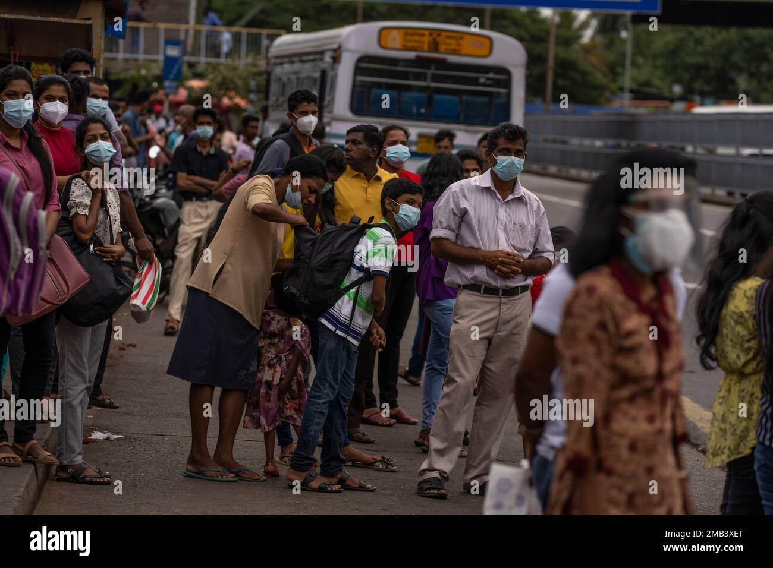
SAMPLE TEXT
POINT 1
POINT 2
POINT 3
POINT 4
POINT 5

Slide 5
SAMPLE TEXT
POINT 1
POINT 2
POINT 3
POINT 4
POINT 5

Slide 6
e-Conductor

Slide 7
e-Conductor

Slide 8
e-Conductor

Slide 9
e-Conductor

Slide 10
e-Conductor

Slide 11
END

