Slide 1
The Internet And
Relationships

Slide 2
Part 01 - Vocabulary
Part 02 - Article Comprehension
Part 03 - Related Topics

Slide 3
Part 01 -
Vocabulary

Slide 4
prospective
unscrupulous
/prəˈspektɪv/ adj. 潜在的；可能的；预期的；有望的；即将发生的；行将来临的
例：
prospective friends 潜在的朋友
相关:
prospect：n. 前景；展望；希望；前途；可能性
/ʌnˈskruːpjələs/ adj.肆无忌惮的；不道德的
例：
unscrupulous people
相关:
scrupulous：adj.一丝不苟的；仔细的；细致的；审慎正直的；恪守道德规范的

Slide 5
alienation
anonymous
/ˌeɪliəˈneɪʃn/ n.
1.疏远；（common）
2.精神疯狂的状态；（here）
3.异化；（ philosophical term）
相关:
alienist：n. 研究精神病的医生
/əˈnɒnɪməs/ adj.匿名的
例：The anonymous nature of Internet communication does make it easy for dishonest individuals to take advantage of others.
相关:
onymous：（rare）adj.（文章等）署了名的
anonymity：匿名性

Slide 6
intimacy
liaison
/ˈɪntɪməsi/ n.亲密；密切；
例：Sometimes this experience can provide a false sense of intimacy, which can create uncomfortable feelings.
相关:
intimate：adj. 亲密的
/liˈeɪzn/ adj.联络；私通；
例：Millions being lured into dangerous liaisons by unscrupulous people.
相关:
liaise：vi. (与某人)联络，联系（with）；做联系人；担当联络员（between）

Slide 7
proximity
self-disclosure
/prɒkˈsɪməti/ n.接近；邻近；靠近；
例：For example, good looks and close physical proximity are powerful factors in initial attraction in the real world.
相关:
proximal：adj. 近端的；近身体中心的（ medical term ）
/self dɪsˈkləʊʒə/ n.自我披露；自我揭露；
例：Self-disclosure is another relationship issue affected by the differences in the two types of communication.
相关:
disclosure ：n. 披露

Slide 8
assume
shroud
/əˈsjuːm / v.
文中是“承担”的意思
例：The Internet has also assumed tremendous importance.
/ʃraʊd/
vi.覆盖
n.覆盖物；寿衣
例：Internet is shrouded in the cloak of anonymity.
相关:
disclosure ：n. 披露

Slide 9
Part 02 -
Article Comprehension

Slide 10
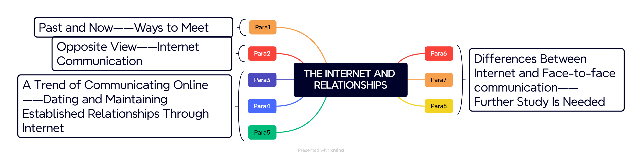
Structure

Slide 11
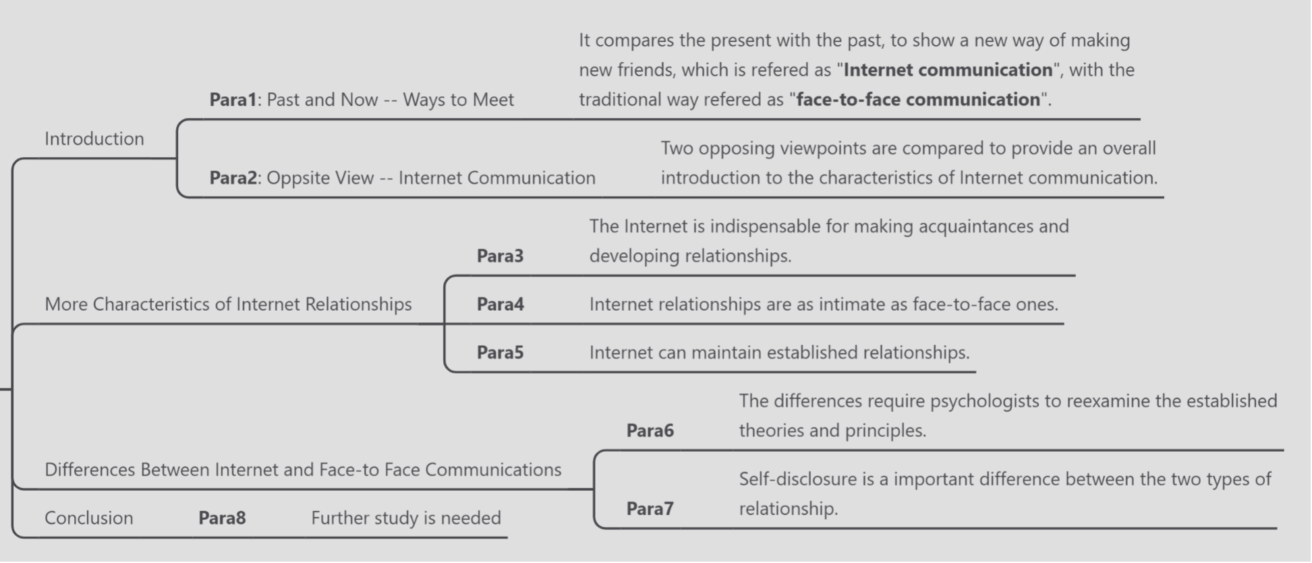
Structure

Slide 12
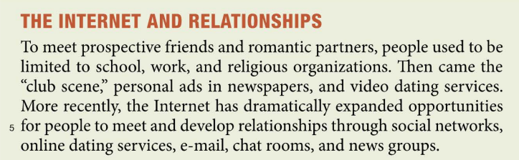
Introduction-Paragraph1
Past and Now——Ways to Meet
Phase 1: In the past, people were limited to friends and lovers they met at school, workplaces, or religious organizations.
Phase 2: Later, they met through club scenes, self-advertisements published in newspapers, and video dating services.
Phase 3 (Now): In recent years, the internet has greatly expanded the ways people meet friends and lovers, such as online dating services, email, online chat rooms, and newsgroups.

Slide 13
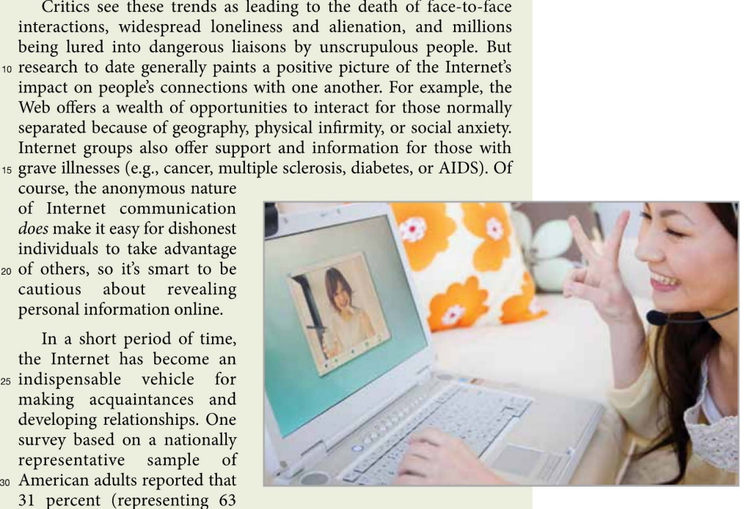
Introduction-Paragraph2
Views On Internet Communication
Opposite views
Critics argue that the promotion of online communication has led to the death of face-to-face communication, accelerated feelings of alienation between people, and made it easy for unfriendly strangers to harass.
Positive views
However, studies show that online communication is positive, breaking down geographical barriers between people and providing more information and communication opportunities for those with physical disabilities and social anxiety. To protect personal information is the solution to previous problem.

Slide 14
Three features - Paragraph3: indispensable.
The Internet is indispensable for making acquaintances and developing relationships. One survey reported:

Slide 15
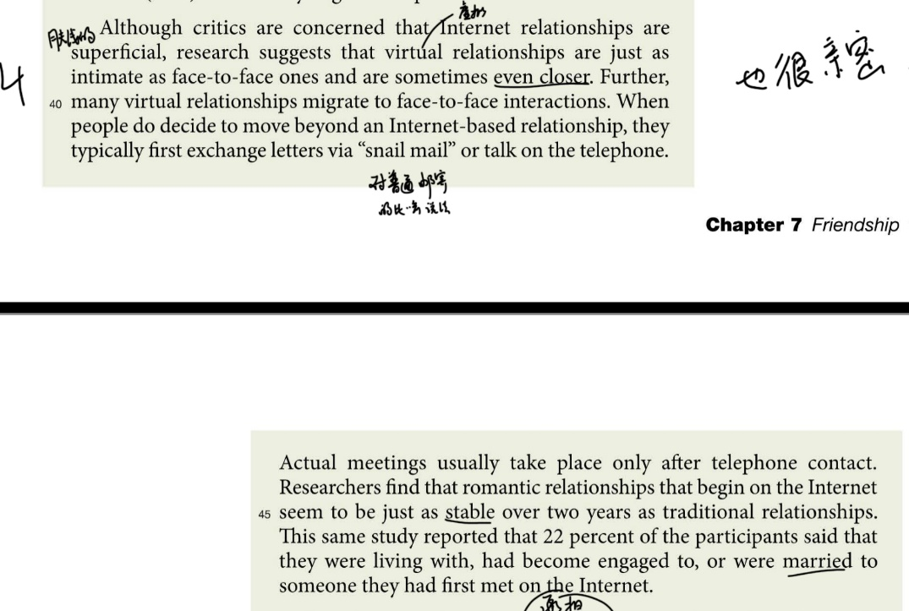
Three features – Paragraph4: intimate.
Intimate
Internet relationships are as intimate as face-to-face ones, and are sometimes even closer.
Convert
Many online relationships convert to face-to-face ones.
Romantic Relationships
Online romantic relationships seem to be more stable than traditional ones. And marriages because of online romantic relationships are not rare.

Slide 16
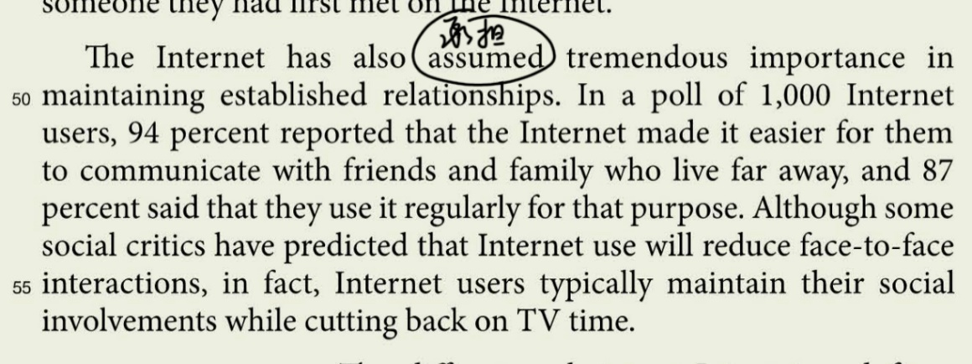
Three features – Paragraph5: maintain.
Internet has also assumed tremendous importance in maintaining established relationships.
For example, a poll shows that most people reported the Internet made it easier to communicate with friends and family who live far away.

Slide 17
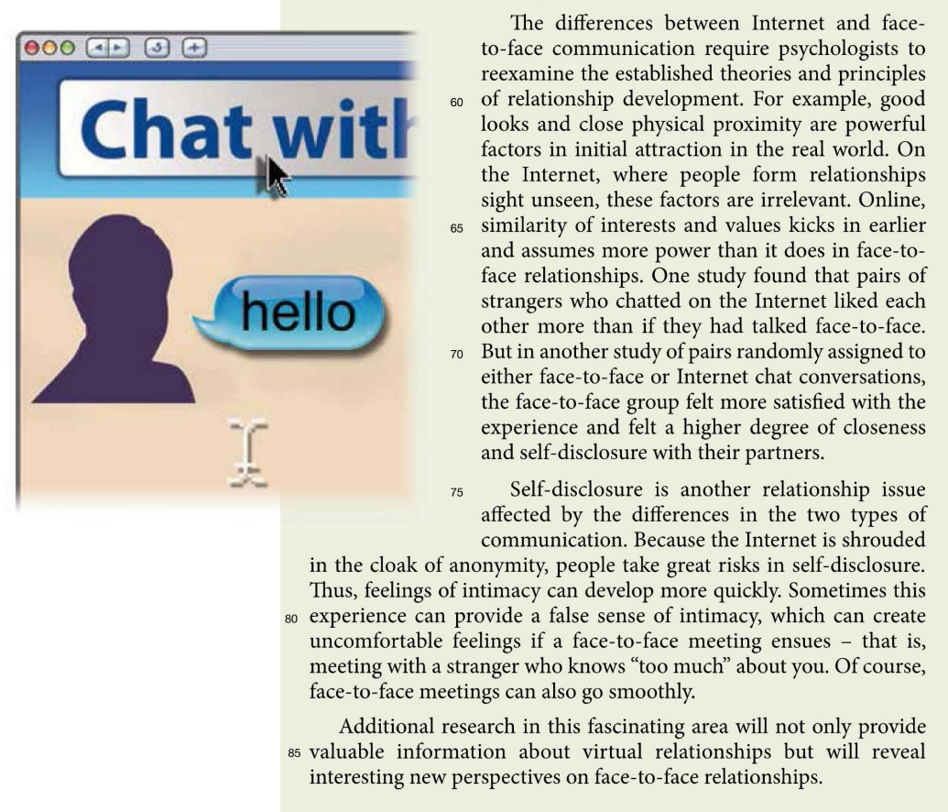
Differences Between Internet and Face-to-face Communications
The differences challenge the old relationship theories.
In face-to-face communications, physical appearance and proximity are crucial in attraction, while online relationships prioritize shared interests and value. Research shows mixed results: while Internet communications are as real as face-to-face ones, face-to-face communications often lead to greater satisfaction.
About self-closure.
On the internet, because of anonymity, people tend to take risks in self-closure. Sometimes this provides a false sense of intimacy. If a face-to-face one ensues, bad feelings may occur. Face-to-face communications do not have that problem.
Para8:
Additional research in this area will give many beneficial results.

Slide 18
Abstract
This article explores the impact of the internet on interpersonal relationships.
The article introduces the topic by comparing the traditional communication methods in the past ,and the opposing views on Internet communication. The article points out that the rapid development of Internet communication is an indispensable communication method. Different from general cognition, it is as close as face-to-face communication. It also points out that Internet communication can well maintain established relationships.
The difference between the two communications prompts scholars to further research. Future exploration in this field will give more beneficial results.

Slide 19
Part 03 -
Related Topics

Slide 20
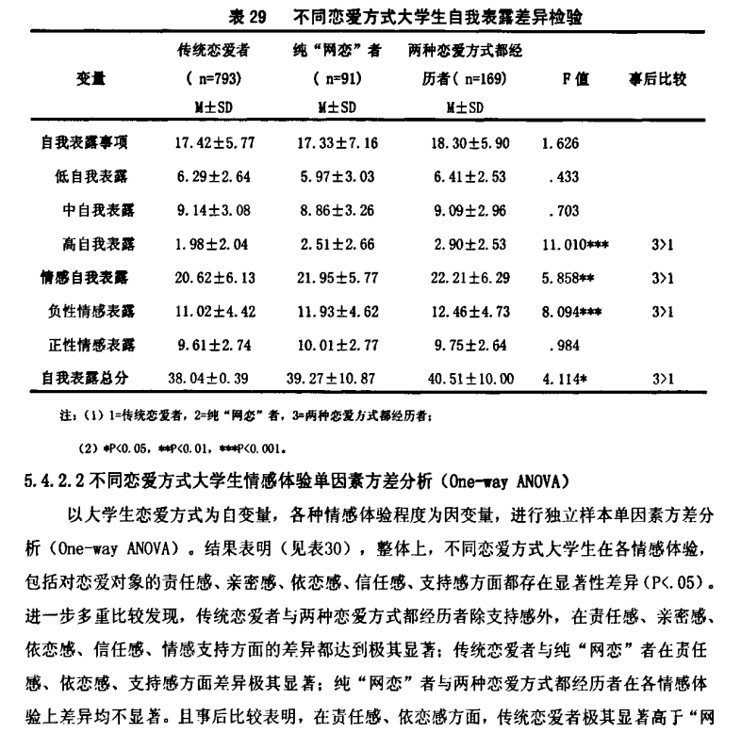
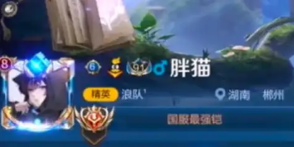
In China, compared to traditional romantic relationship,
is online romantic relationship reliable?
Special cases & Common ideas……
Academic perspectives……

Slide 21
In China, compared to traditional romantic relationship,
is online romantic relationship reliable?
In terms of sense of responsibility and attachment, traditional lovers are significantly higher than those who have experienced "online dating". In terms of intimacy, trust, and emotional support, traditional lovers are significantly higher than those who have experienced both types of dating; In terms of support, traditional lovers are significantly higher than those who engage in pure online dating.
Academic perspectives……

Slide 22
In China, compared to traditional romantic relationship,
is online romantic relationship reliable?
The answer seems to be No.
This contradicts the viewpoint in the text. But as mentioned in the article, there are indeed many opposing views in this field, which indicates that research on Internet social relationships is still a promising field.

Slide 23
Thank you

