Slide 1

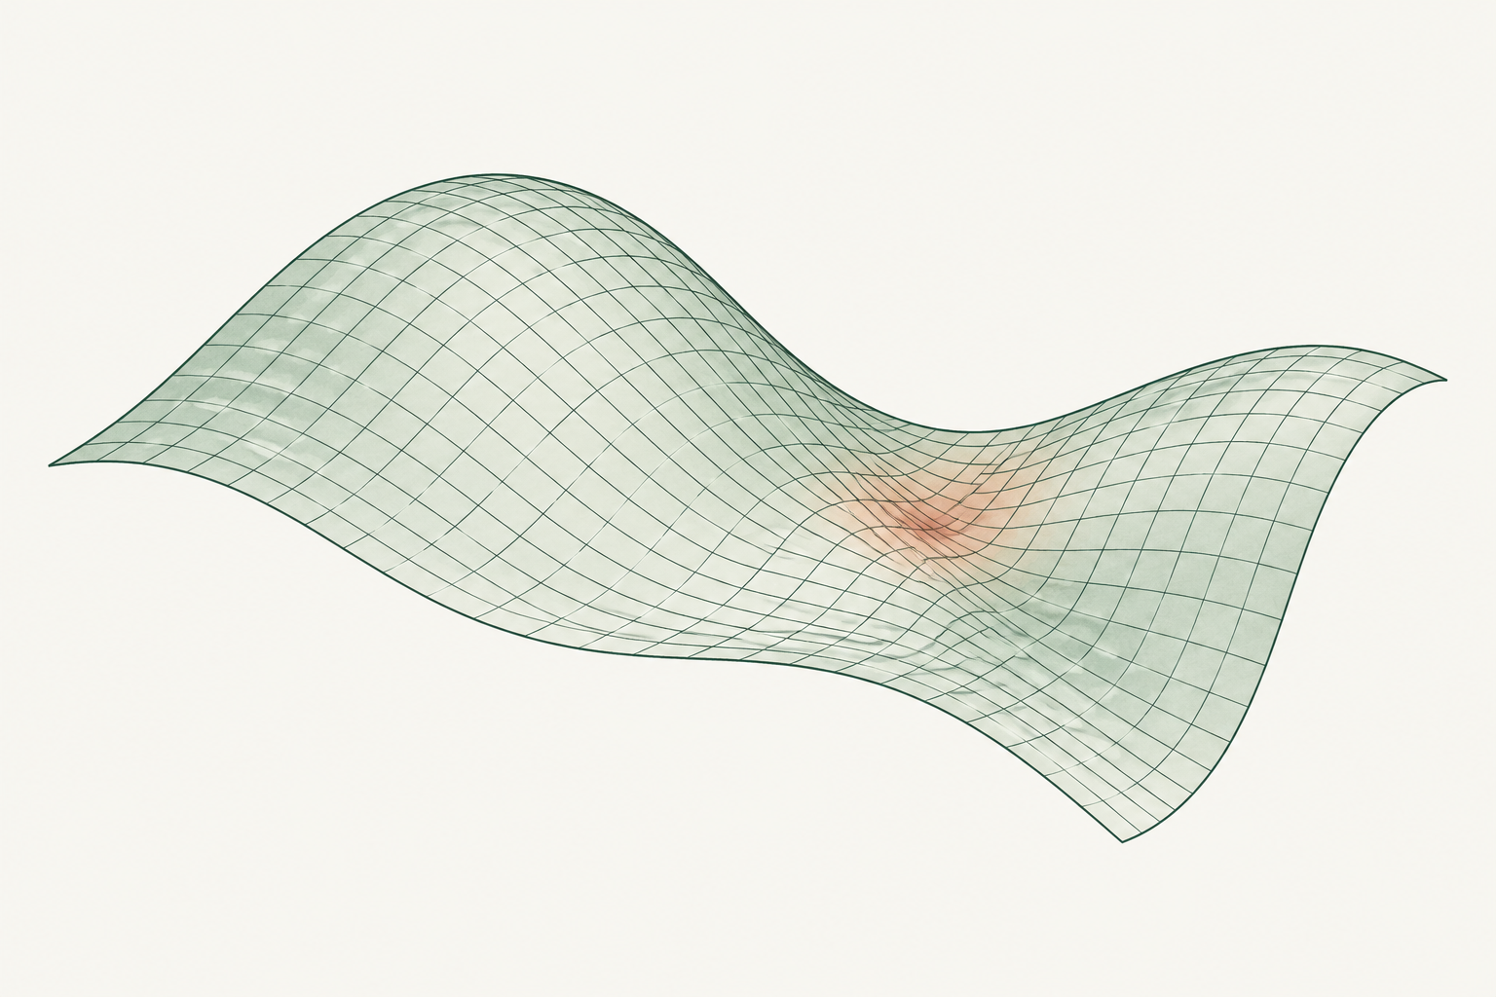
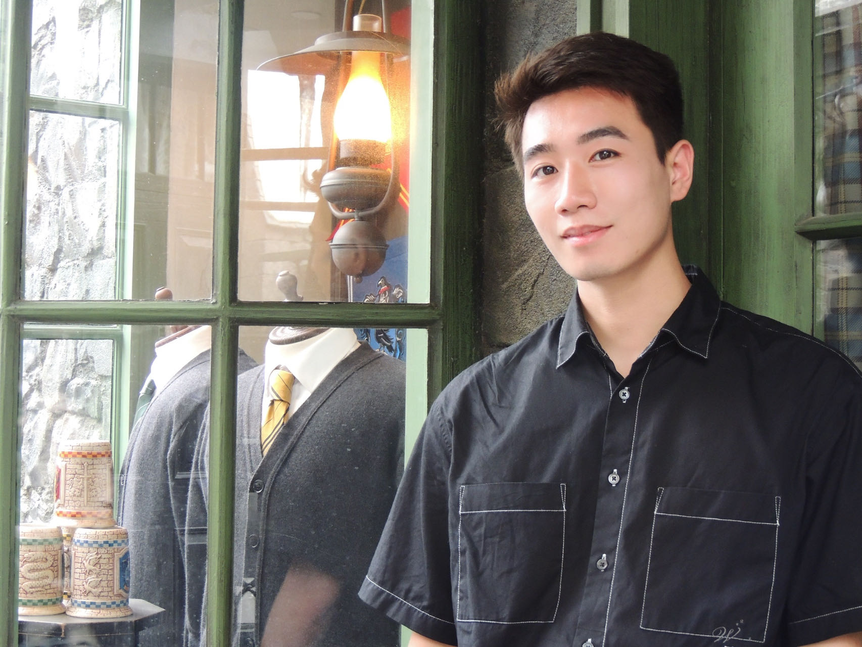
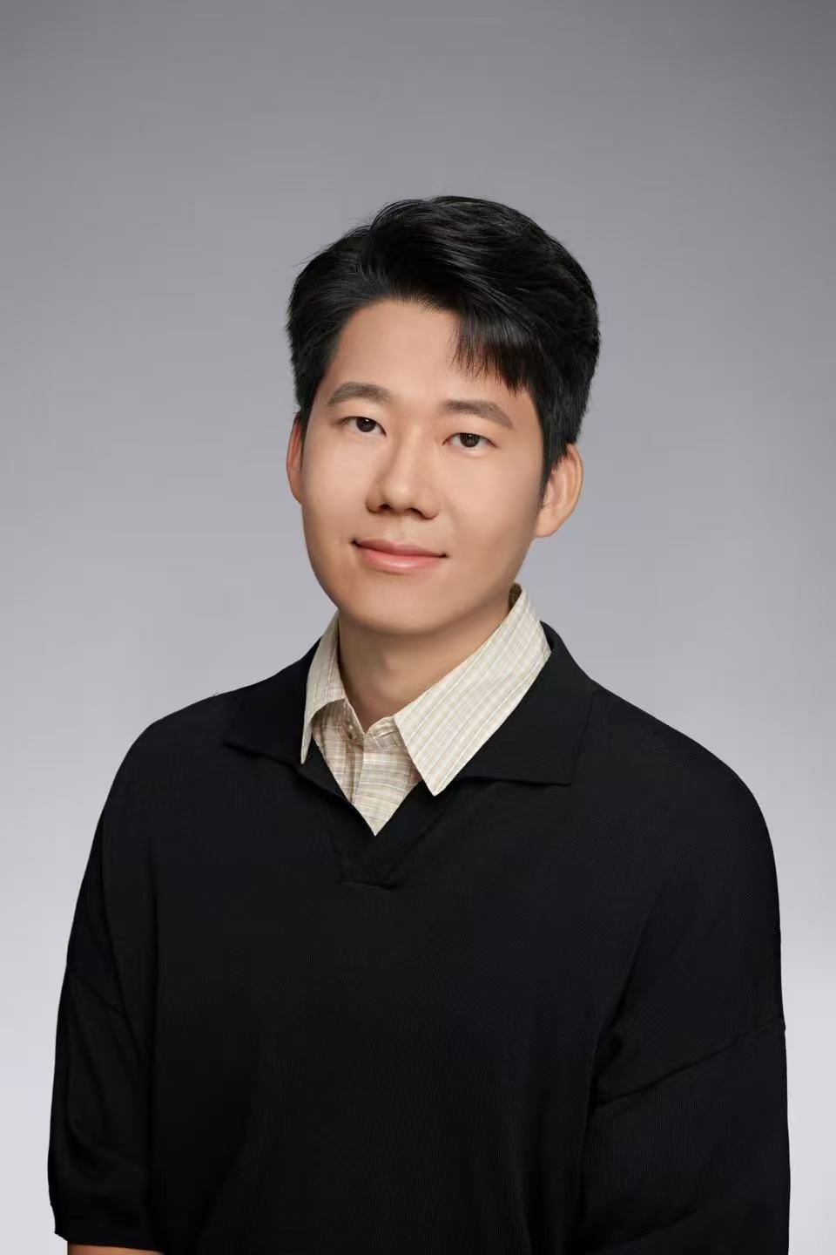
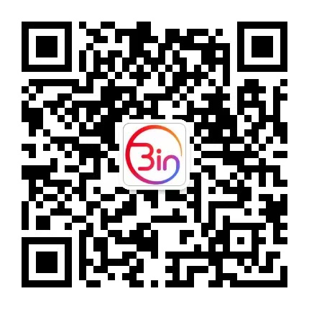
UNPACKED SEMINAR
24 OCT 2026
An AI for Science forum for young researchers
15:00 Beijing (UTC+8) / Talk in Chinese
SESSION 001
AI for PDEs in
Computational Mechanics
Real tech. Real experience.
SPEAKER
INVITER / HOST
Yizheng Wang
Bin Cao
PhD Student, Tsinghua University
Huawei Noah’s Ark Lab, London
Stay connected
SciMindBin
METHODS
Physics-driven, data-driven and hybrid approaches
Scan with WeChat
APPLICATIONS
Forward and inverse problems in solid mechanics
ai4s.hk.cn
We’ll begin shortly
Live discussion only
Please keep your microphone muted.
No recordings. No replays.
Notes:
Source: repository README.md and site/dist/content.js, session 001. Confirmed session: 24 October 2026, 15:00 Beijing UTC+8, Chinese. Speaker: Yizheng Wang, PhD student at Tsinghua University. Host: Bin Cao, Huawei Noah’s Ark Lab, London. QR code and emblem are embedded unchanged from cover/unpacked-seminar-waiting-en.pptx. The mesh is conceptual artwork generated with the built-in imagegen tool, not simulation data. Prompt saved at cover/assets-v2/illustration-prompt.txt. All text is editable. Original cover is preserved.

