Slide 1


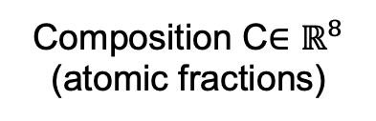






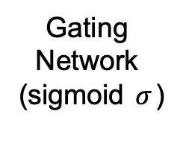


TRAJECTORY
Experimental Trajectory $𝒯_{c}$：
$$E_{1}≤E_{2}≤⋯≤E_{n}$$
Trajectory State
$$S_{t}$$
MLP
(state)
$$h_{state}$$
Self-Consistent Iterative Inference
Categorical
P_{cont}
FEATURE FUSION
& PREDICTION
Processing
P
Embedding
MLP
(proc)
$$⋯$$
$$h_{proc}$$
Continuous
Gating
Network
(sigmoid $σ$)
P_{cont}
Residual
Adaptor
MLP
(strength head)
$$\hat{UTS}$$
INPUTS
Composition C$∈ℝ^{8}$
(atomic fractions)
MLP
(comp)
$$h_{comp}$$
Gated Features
MLP
(shared
fusion)
Weighted Multi-Task Loss
+
$$h_{fused}$$
MLP
(elongation head)
MLP
(test)
•
Testing Conditions T
(strain rate, temp)
$$h_{test}$$
$$\hat{ELG}$$
During training
ADAPTIVE GATING

