Slide 1


广州市材料信息学重点实验室
Guangzhou Municipal Key Laboratory of Materials Informatics
X-Ray photoelectron Spectrograph
WPEM fitting
Bin CAO
Guangzhou Municipal Key Laboratory of Materials Informatics
The Hong Kong University of Science and Technology (GZ)
Feb. 21-th, 2024
https://github.com/Bin-Cao (binjacobcao@gmail.com )

Slide 2

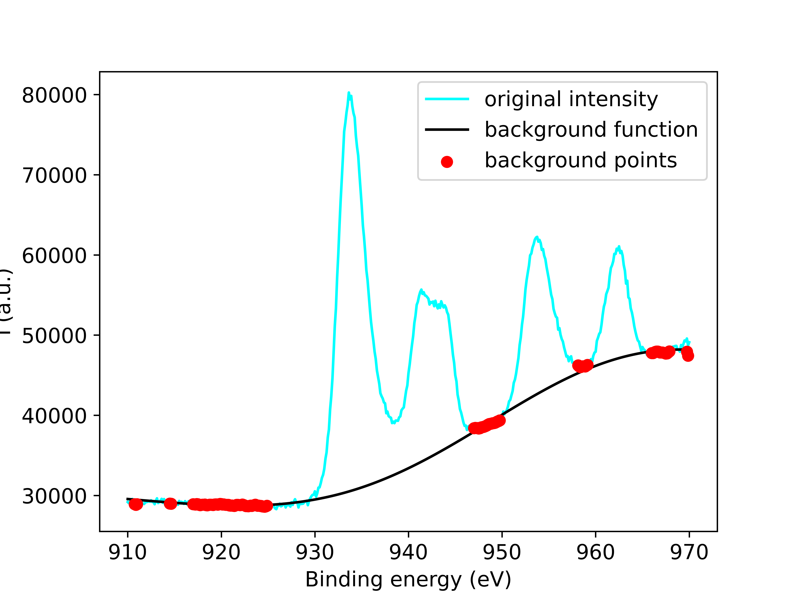
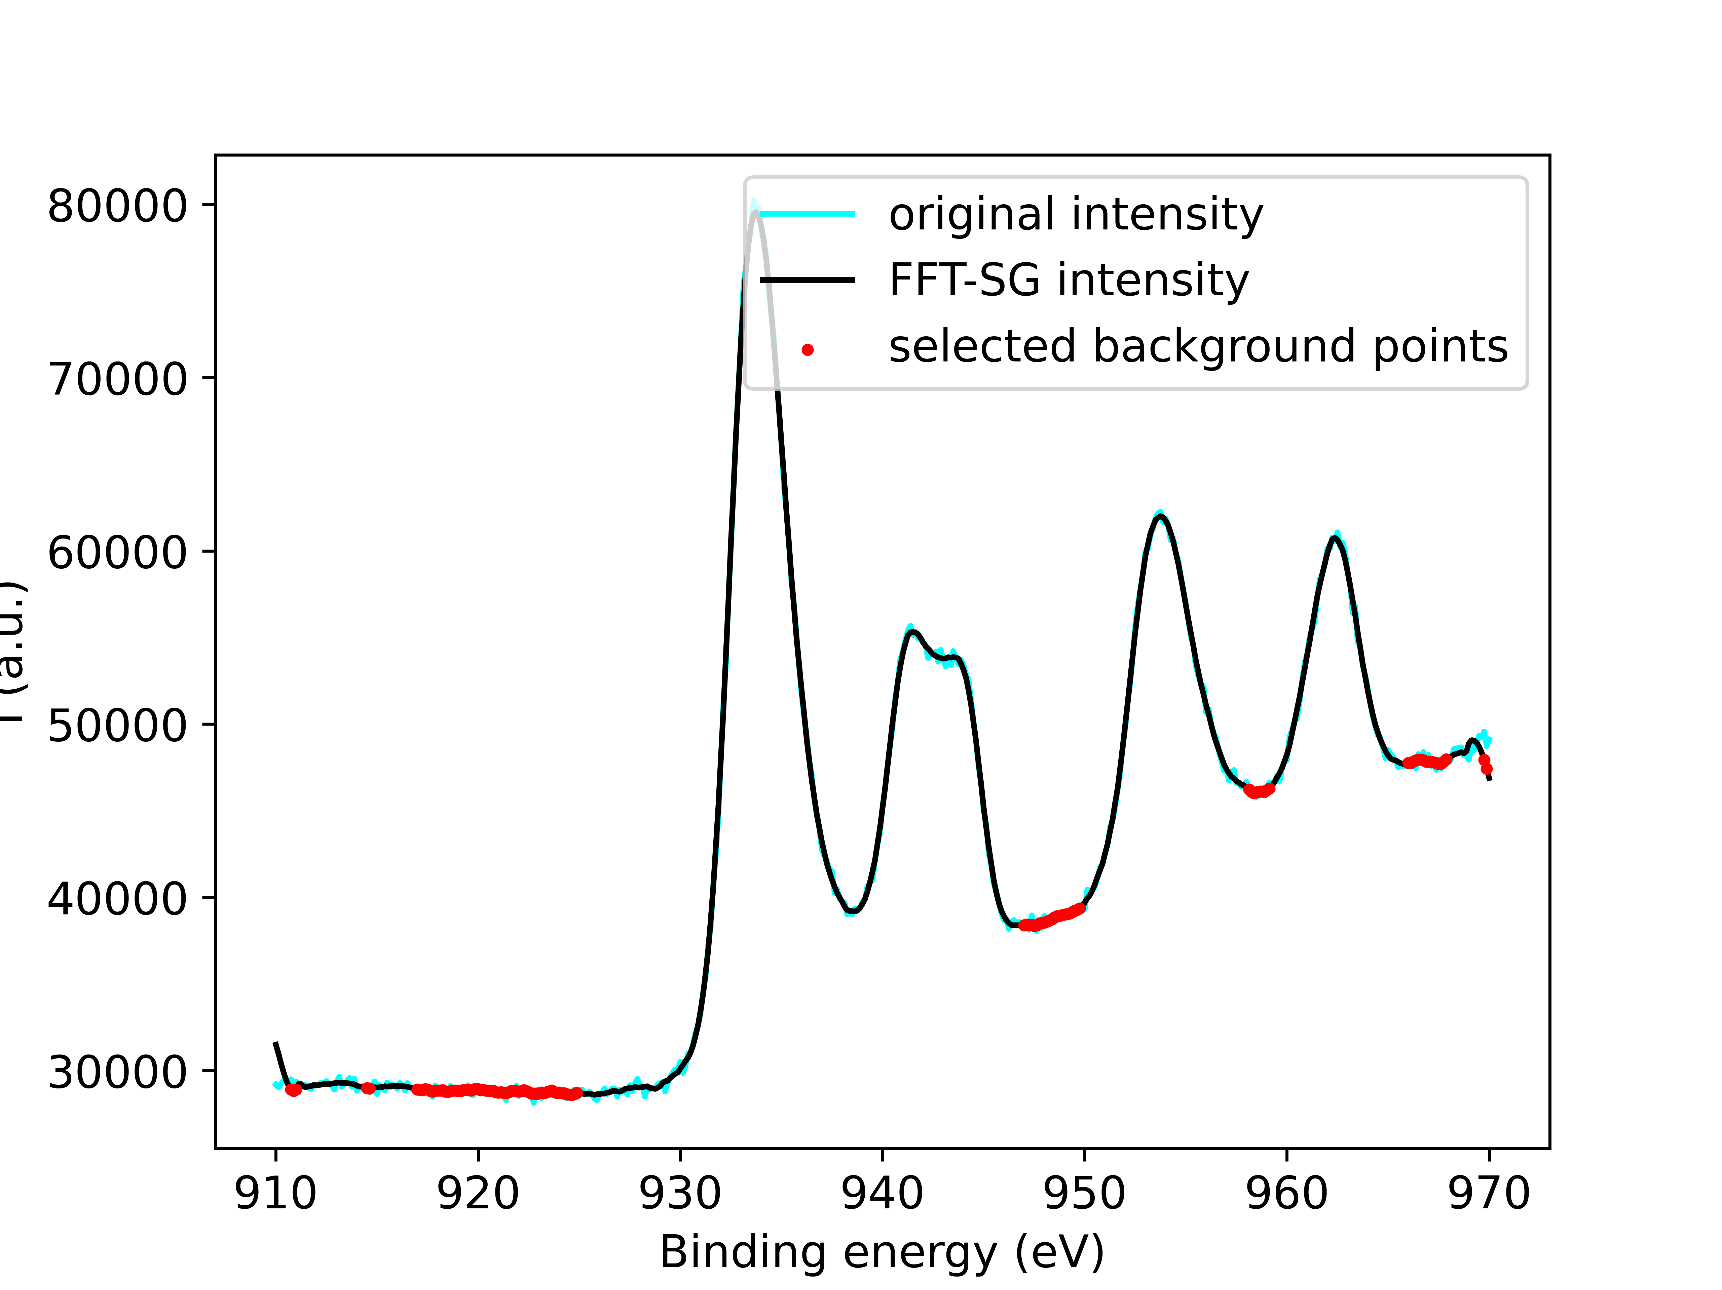
Satellites
Cu (I) : no satellites
Cu (II) : one / two satellites
BIOINORGANIC CHEMISTRY 6, 45-59 (1976)
Experimental data
Background fitting by GPR

Slide 3
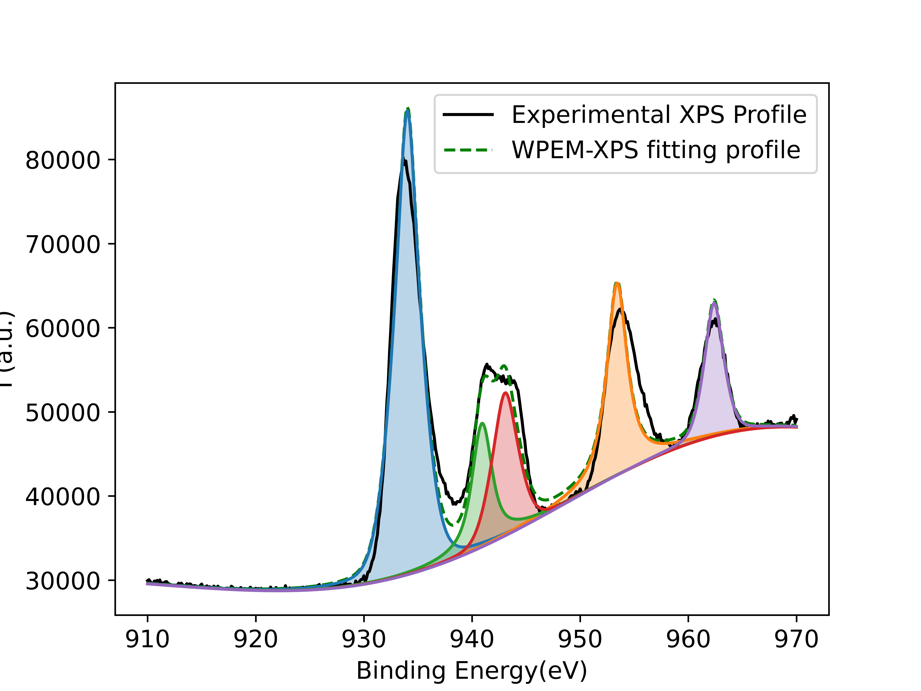
Peak decomposition
2p3/2
Integral area （P2+P3）/ Integral area （P1） = Integral area （P5）/ Integral area （P4）
Intensity P1 : P4 = 2 : 1
Energy gap follws central field approximation Zeff = 25.576
2p1/2
P5
P4
P3
satellite of 2p1/2
P1
P2
satellites of 2p3/2

Slide 4
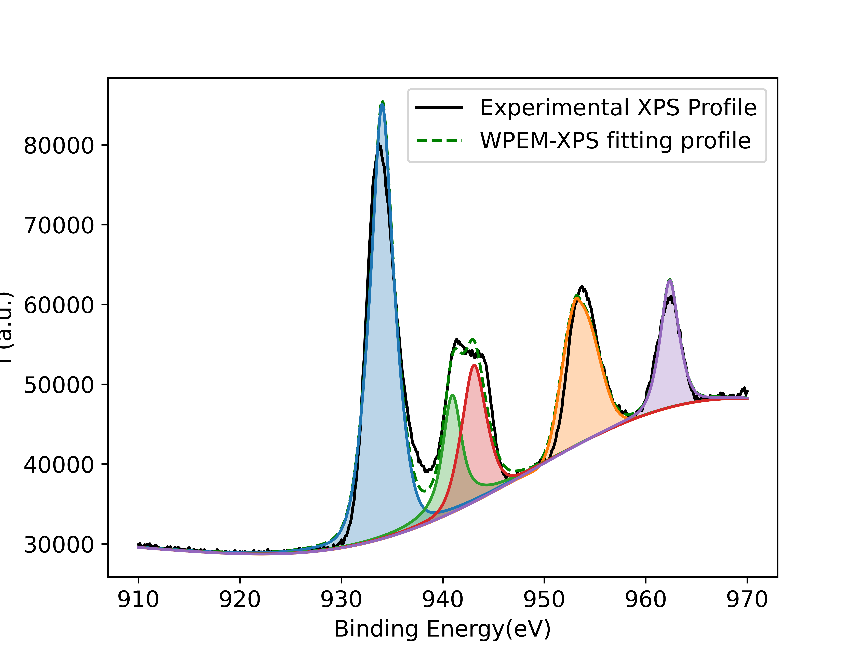

Asymetary peak shap
Asymetary factor = w * ($∆x)$

Slide 5
Thank you!
If you use the PPT, please quote it as follows :
Bin CAO. (2024). Bgolearn: A Bayesian global optimization package. Retrieved from https://github.com/Bin-Cao/Bgolearn

Slide 6
x

