Slide 1

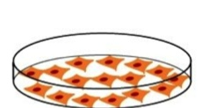
?
>20, 000 proteins
Drug
Disease
Notes:
Incomplete info
Context dependent

Slide 2
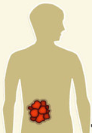

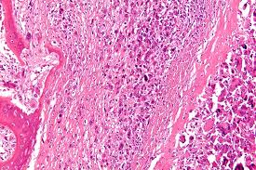
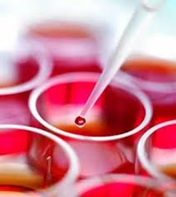
Big Data
Notes:
You will see that mmany of my decision is driven by the data

Slide 3

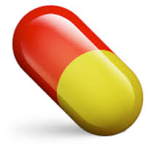
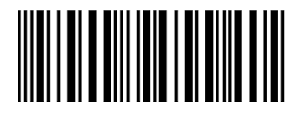
transcriptome
proteome
metabolome
Notes:
drug discovery in my opinion is just to match disease and drug based on their molecular profiles. If the patients have high glucose level, we find a drug to reverse the glucose to the normal stage.. If the patients have HER2 over expressed, we find one drug to reverse it expression to the normal stage. However, in most cases, what we get is a list of dysregulated genes, instead of one single feature. So our strategy is to reverse the disease molecular features in a systematic manner. We are now using transcriptome data but will be expanding to other features.

