Slide 1
Data-driven ballast layer evaluation and prediction based on machine learning models
Bin Feng

Slide 2
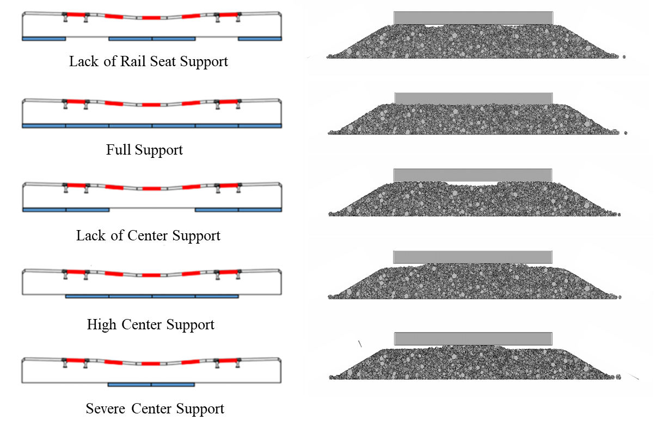
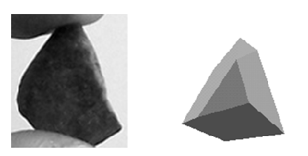
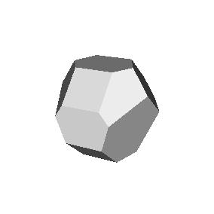

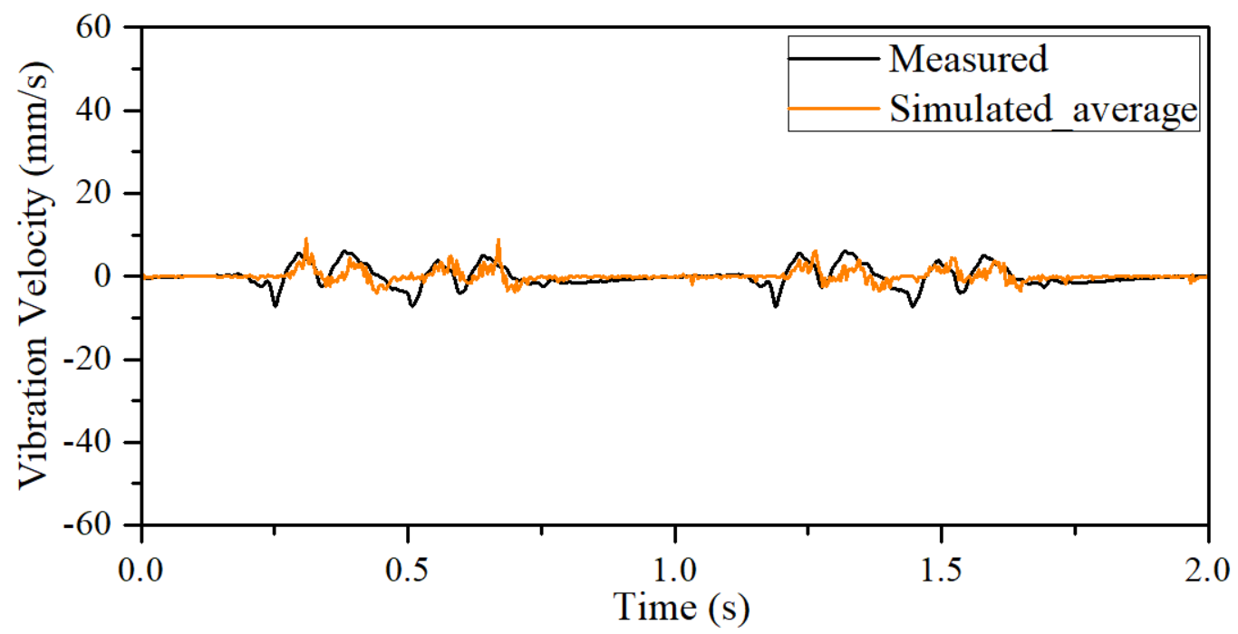
INTRODUCTION
Ballast Layer
Ballast Particle
GBs of data:
location
movement
velocity
force
…

Slide 3
OBJECTIVE (I)
TOP BALLAST
Empirical
SHLDR.
BOTTOM BALLAST
SHLDR.
Data-driven
Un/Semi-supervised Learning
Hierarchical clustering
K-means/K-medoids clustering
Mixture model based clustering
…

Slide 4
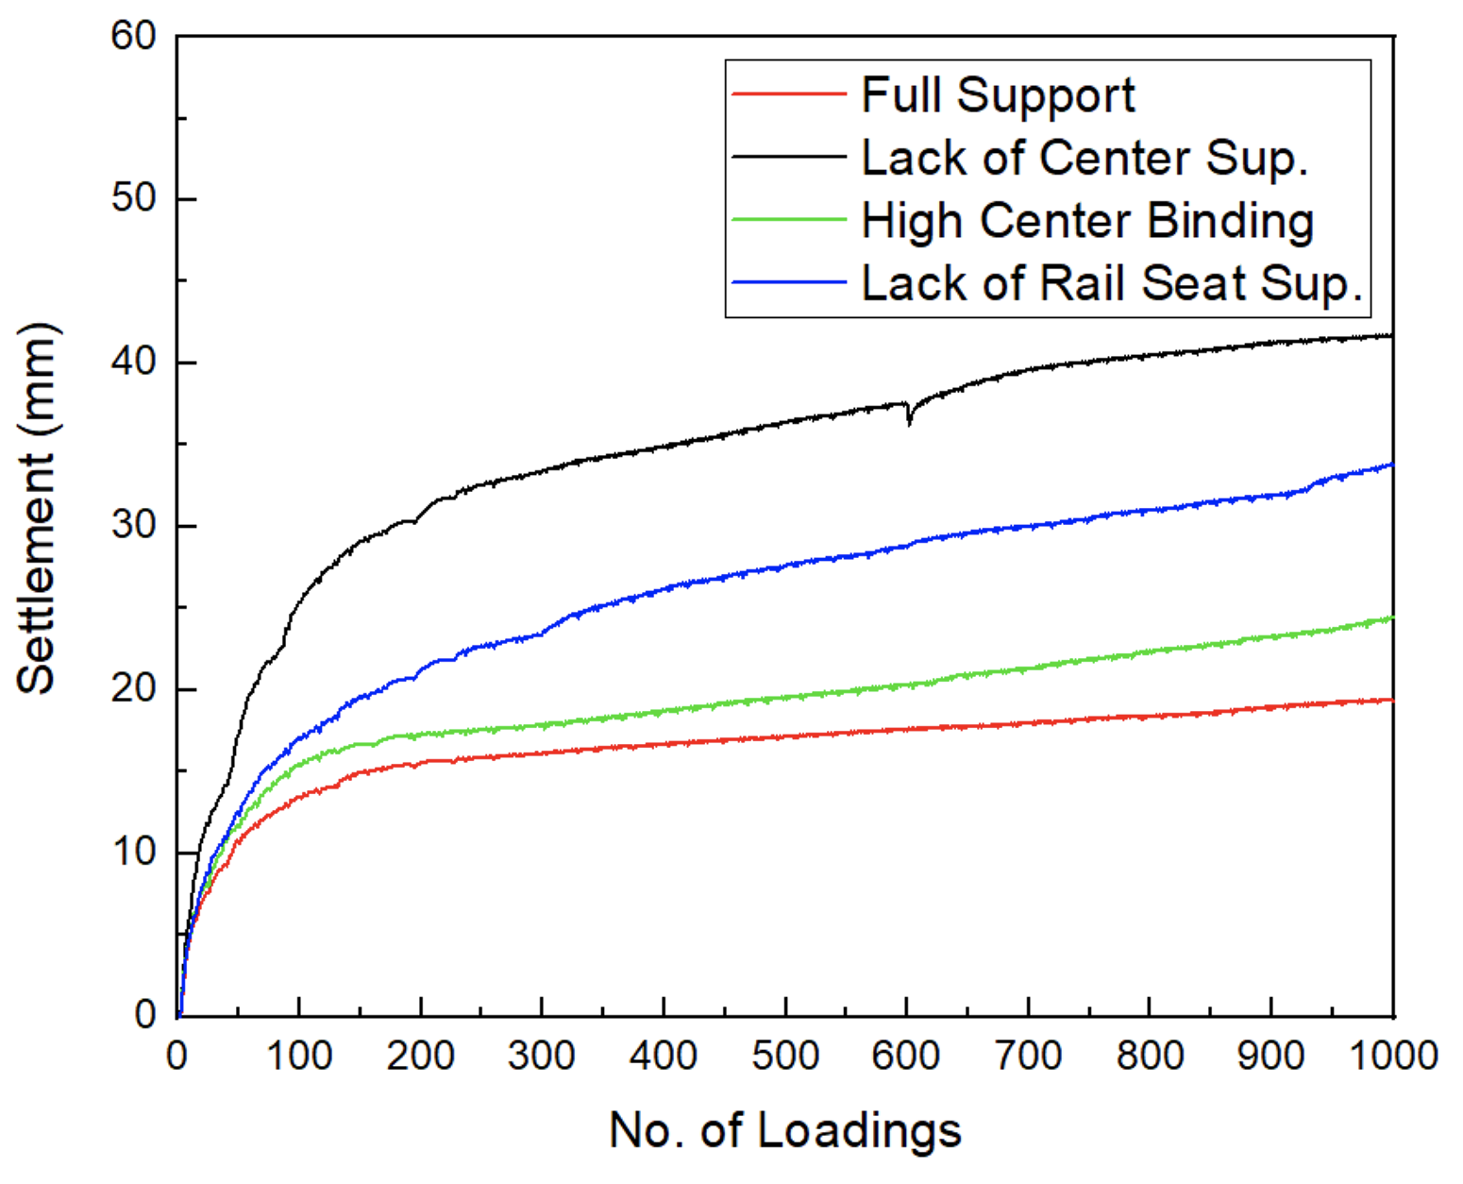
OBJECTIVE (II)
Clustering Model
Prediction Model
ARMA
LSTM
…

Slide 5
OBJECTIVE (III)
Clustering Model
Classification Model
?
SVM
Logistic
Classification Tree
…

Slide 6
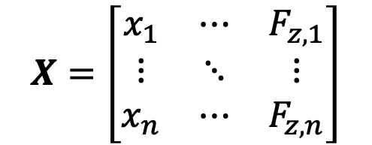
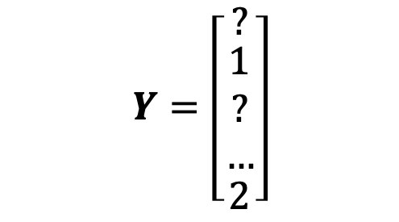

METHODOLOGY
Unsupervised Learning
Semi-supervised Learning
$$X=\left[\begin{matrix}x_{1} & ⋯ & F_{z,1} \\ ⋮ & ⋱ & ⋮ \\ x_{n} & ⋯ & F_{z,n}\end{matrix}\right]$$
Row: particle ID (~10000+)
CHALLENGE #1
Column: particle properties
$$Y=\left[\begin{matrix}? \\ \begin{matrix}1 \\ ? \\ …\end{matrix} \\ 2\end{matrix}\right]$$
$$Y=\left[?\right]$$
Row: particle belongs to which cluster (~10000+)

Slide 7
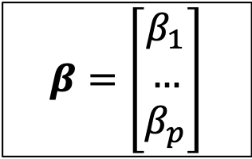
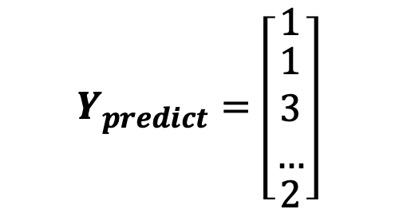
METHODOLOGY
Unsupervised Learning
Semi-supervised Learning
$$X=\left[\begin{matrix}x_{1} & ⋯ & F_{z,1} \\ ⋮ & ⋱ & ⋮ \\ x_{n} & ⋯ & F_{z,n}\end{matrix}\right]$$
Row: particle ID (~10000+)
CHALLENGE #1
Column: particle properties
$$β=\left[\begin{matrix}β_{1} \\ … \\ β_{p}\end{matrix}\right]$$
Cluster Analysis
Hierarchical clustering
K-means/K-medoids clustering
Mixture model based clustering
…
$$Y_{predict}=\left[\begin{matrix}1 \\ \begin{matrix}1 \\ 3 \\ …\end{matrix} \\ 2\end{matrix}\right]$$
CHALLENGE #2

