Slide 1
Errors, Error Handling and Unittests

Slide 2
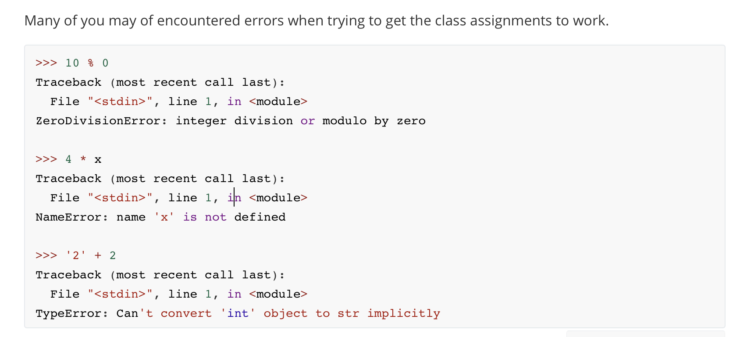
Errors

Slide 3
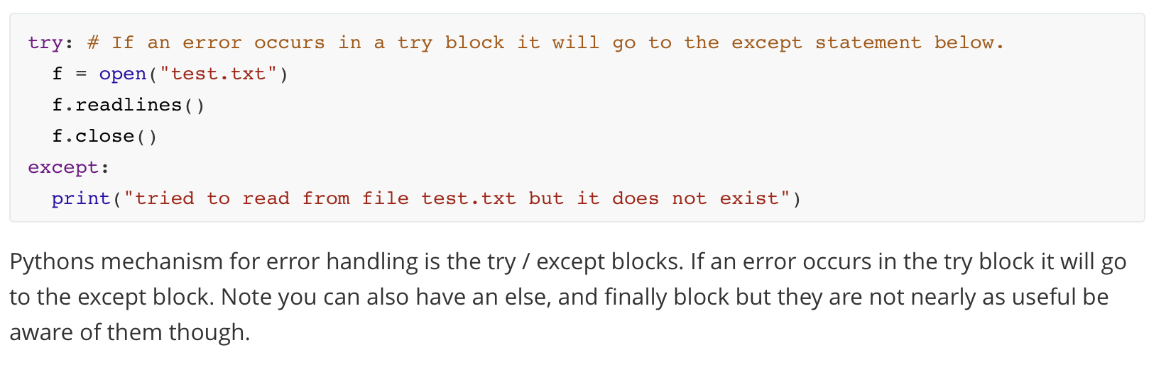
Error Handling

Slide 4
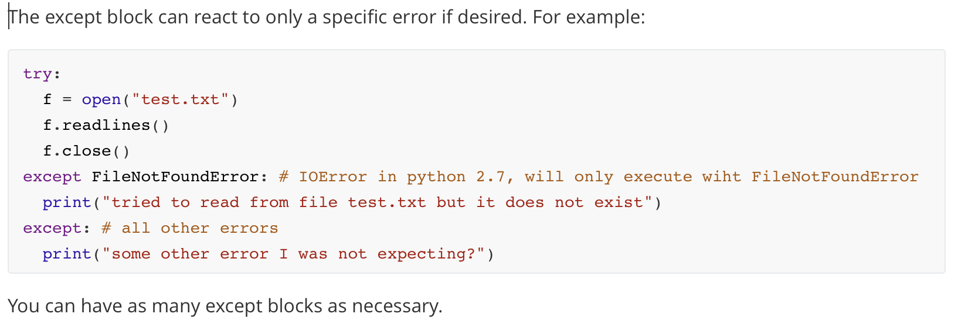
Error Handling

Slide 5
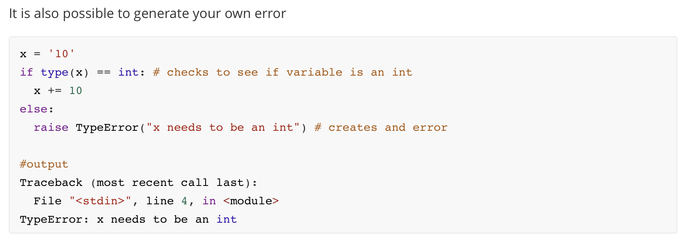
Raising your own errors

Slide 6
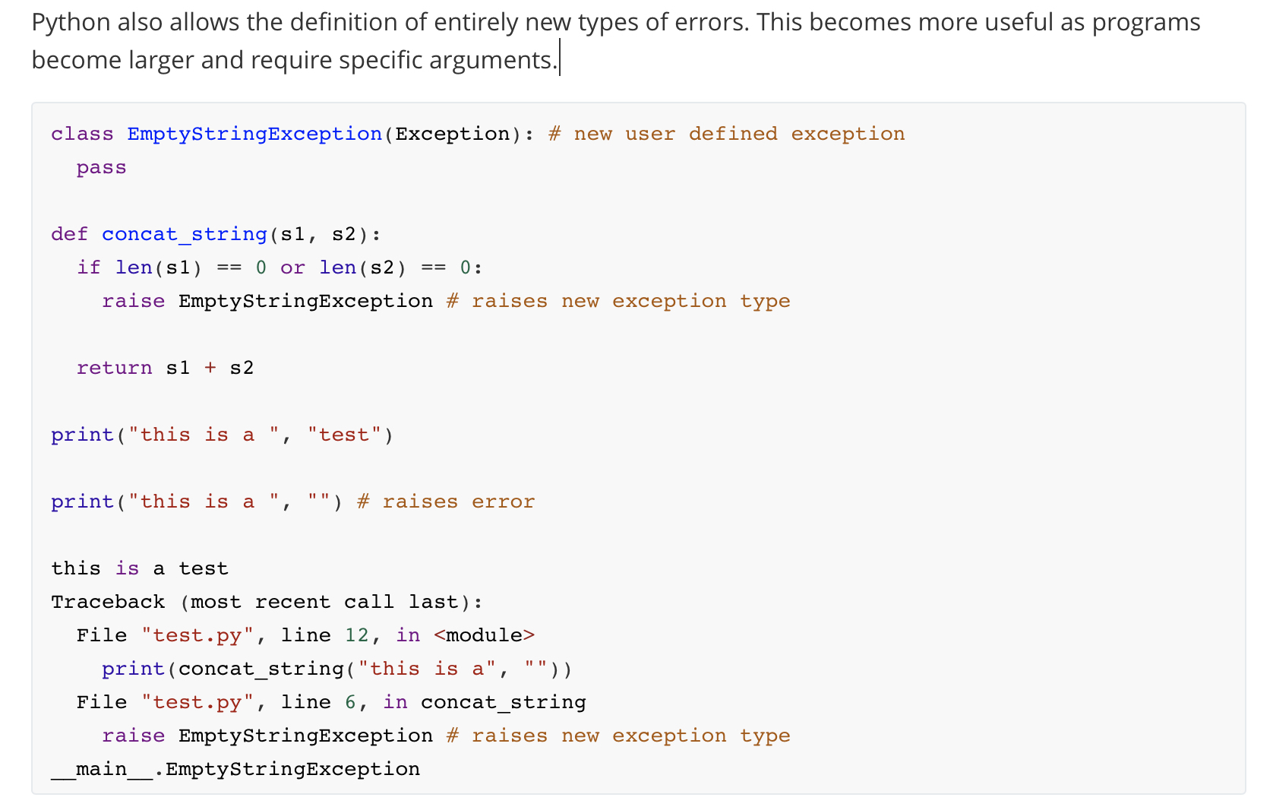
Defining new exceptions

Slide 7
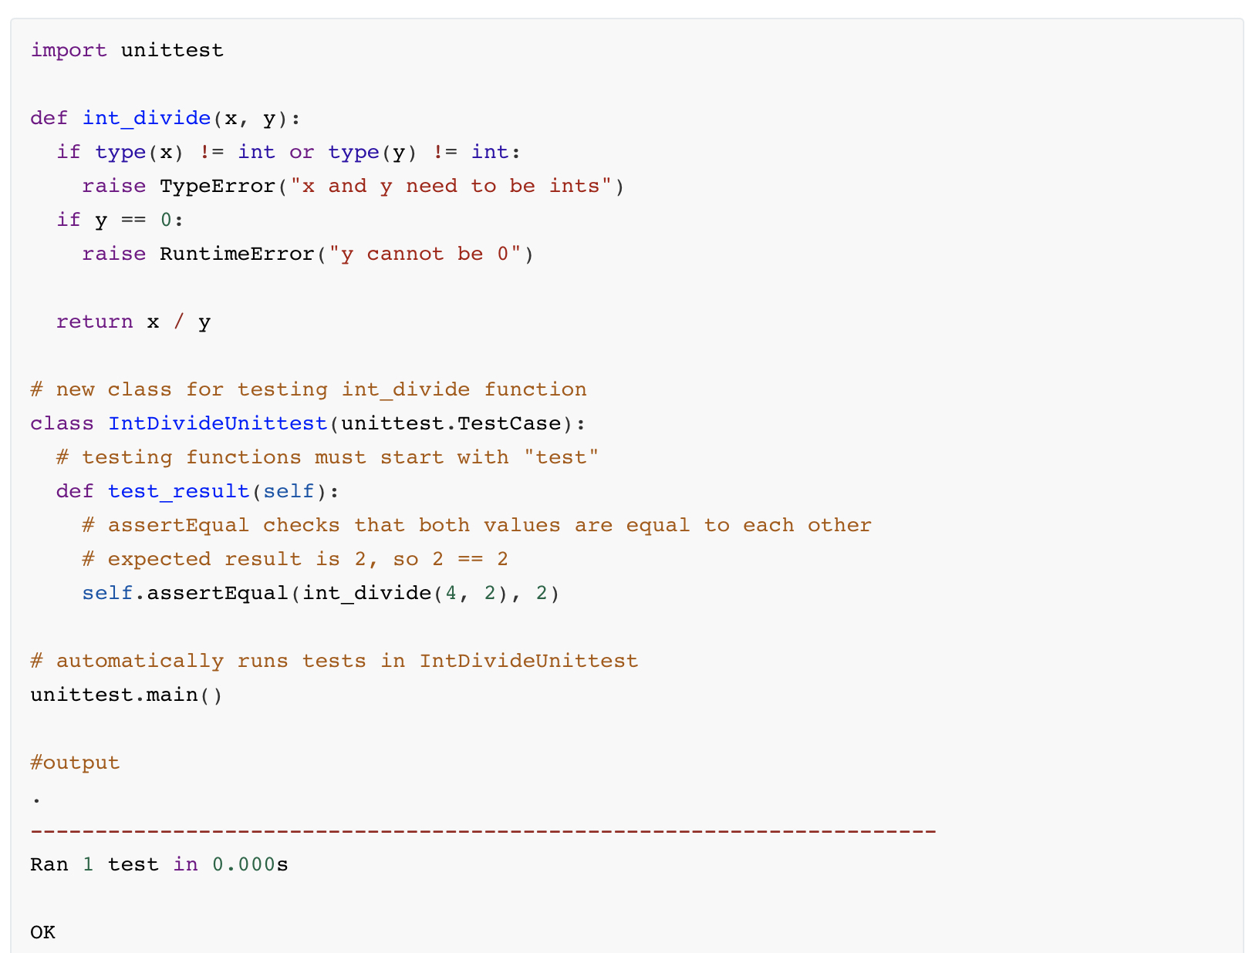
Unittesting

Slide 8
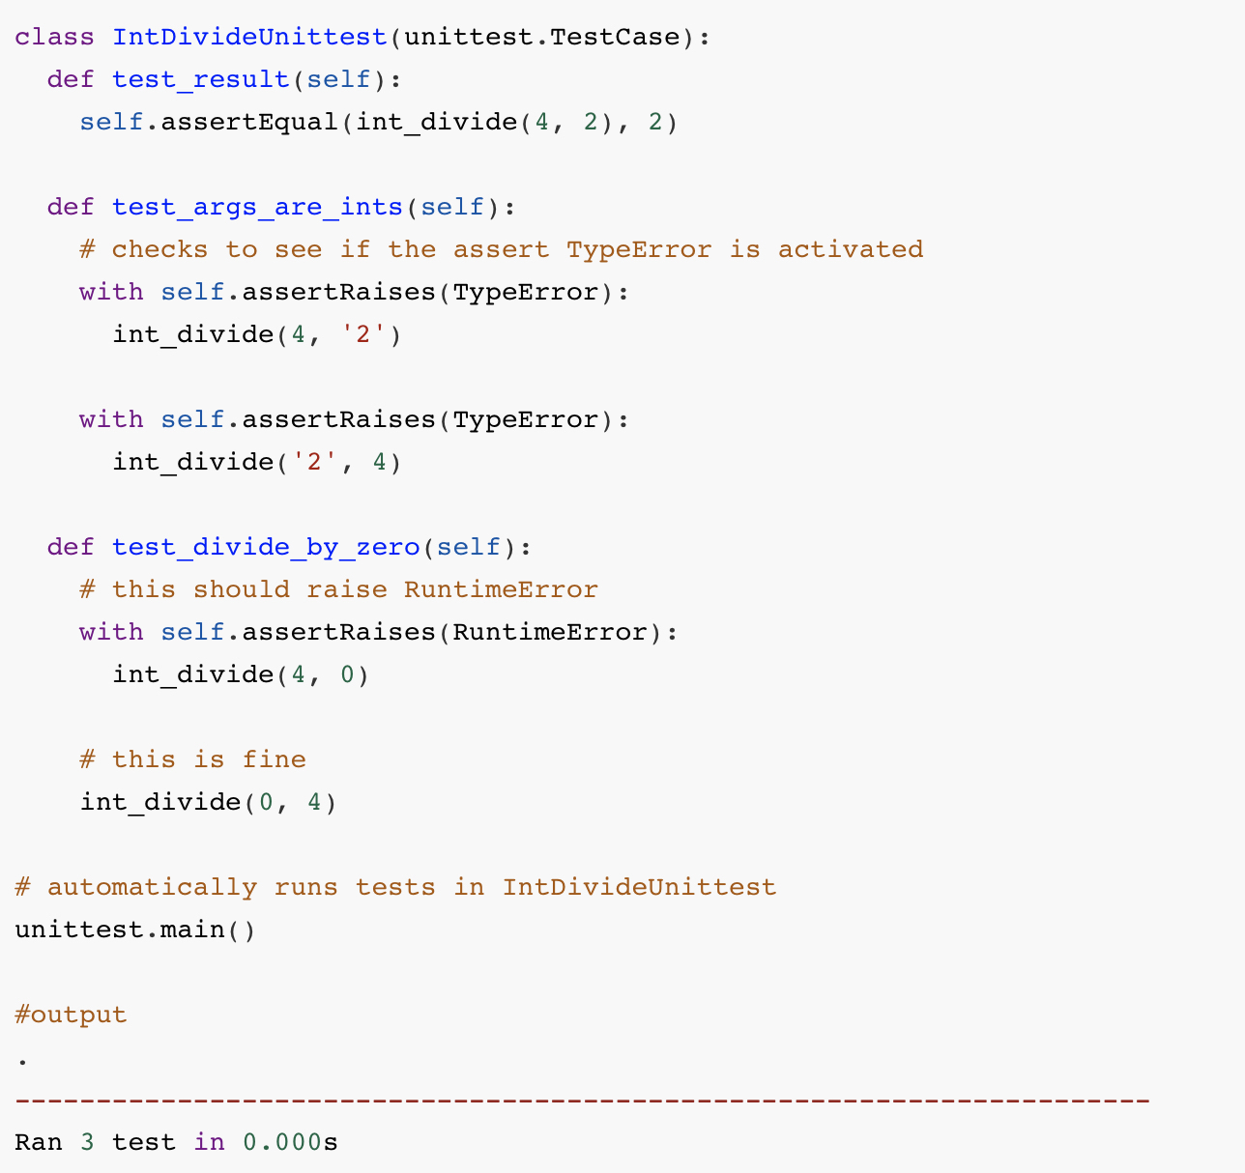
Unittesting

