Slide 1
Molecular Dynamics

Slide 2
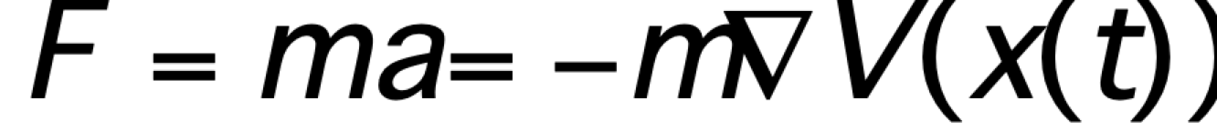
What is Molecular Dynamics?
Molecular Dynamics is the application of classical physics to atomic systems
Above is a simple example on how taking simple concepts as F=ma can be used to calculate the force of one atom on another given we know their positions at a give time!
The critical concept to understand is the use of basic concepts such as the equation above can be used to treat atomic systems to balls and springs

Slide 3
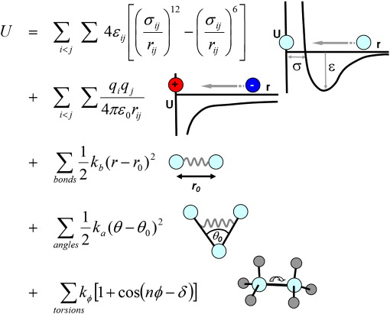
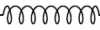
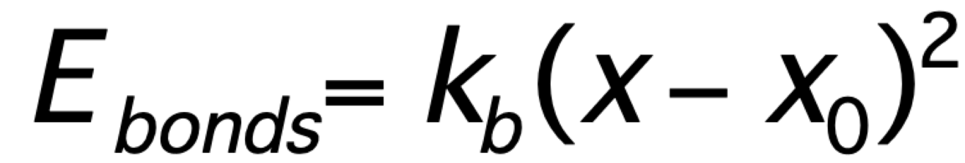
Molecular Mechanics Energy Terms Example
Why Does Ball and Spring Model Work for Covalent Bonds?
If the two atoms get closer together than the equilibrium interatomic distance, they repel each other.
If the two atoms get farther apart than the equilibrium interatomic distance, they attract each other
The magnitude of the force one atom exerts on another is proportional to the stretch or compression of the bond between them.
Energy (kcal/mol)
Distance Between Atoms (pm)

Slide 4
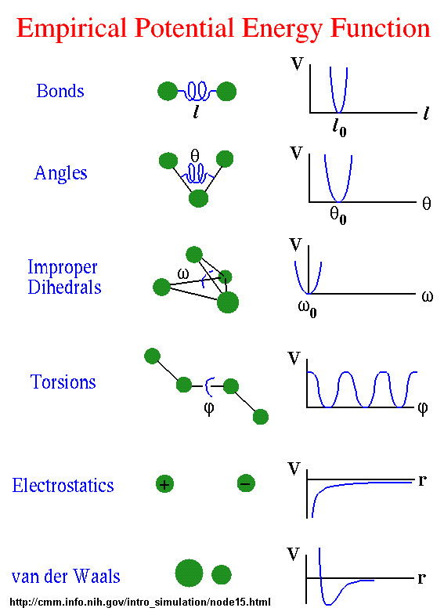
Molecular Mechanics Force Field Parameters
Notes:
A force field is constructed of 6 basic parameters. 4 intramolecular parameters: Bonds and Angles: which can be thought of simple strings around optimal distances and angles. Improper Dihedrals which can be used to perserve planarity of rings. Torsions which describe rotations about bonds and are modeled with a series of cosines. And finally intermolecule parameters electrostatics which is dependent on atomic charges and are modeled using colombs law and van der waals governed by a 12-6 lennard jones potential. These parameters are grouped together into what are known as atomtypes which a parameters that describe a specific chemical space
There are currently 6 CHARMM forcefields each for simulating a specific part of chemical space. They are the protein force field which comprises the amino acids and modifications, the nucleic acid force field, the lipid, carbohydrate, ether and the new small molecule also know as the charmm general force field.

Slide 5
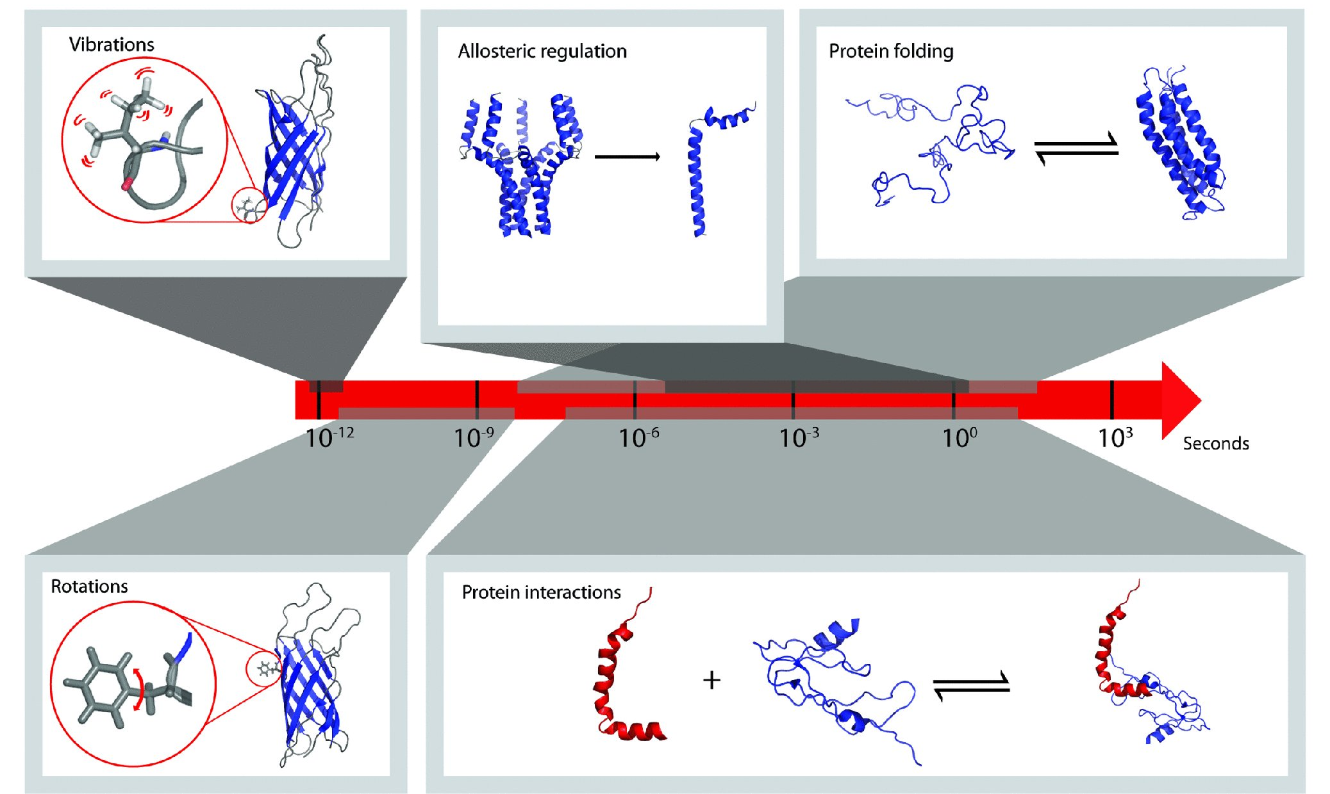
Timescales (what is the minimum time step?)
To accurately capture the motion of biomolecules such proteins molecule dynamics must operate on the fastest varying force (bond vibrations) This has led most MD programs to use a time step of 1 femtosecond (10⁻¹² seconds)
Heike I. Rosner¹ and Birthe B. Kragelund*¹ Compr Physiol 2011. DOI: 10.1002/ cphy. c110036 Copyright © 2011 American Physiological Society

Slide 6
MD Integrator Algorithm Example
Using accelerations of the current time step, compute the velocities at half-time step:
v
t-Δt/2
t
t+Δt/2
t+Δt
t+3Δt/2
t+2Δt

Slide 7
MD Integrator Algorithm Example
Now that velocity for the next half step is determined the next position can also be updated:
v
x
t-Δt/2
t
t+Δt/2
t+Δt
t+3Δt/2
t+2Δt

Slide 8
MD Integrator Algorithm Example
This cycle will continue endlessly until the molecular dynamics simulation so over. It should be noted that both equations being used are simple Newtonian equations of motion!
Velocity Update
Position Update
v
x
v
t-Δt/2
t
t+Δt/2
t+Δt
t+3Δt/2
t+2Δt

Slide 9
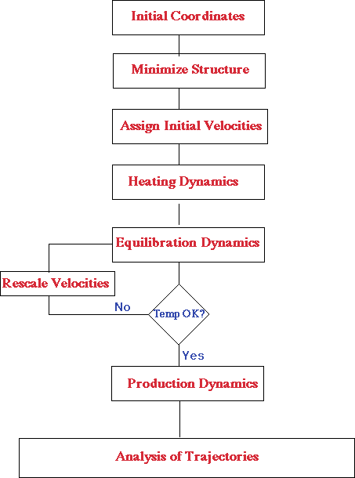
Typical Molecular Dynamics Run

Slide 10
When to use Molecular Dynamics?
Advantages
Disadvantages
Atomic Resolution
Not Limited by Experimental Limitations
No size limitations
Slow, timescale is not capable of answering every question
Experimental validation is still necessary
Force fields are models not reality
Requires accurate 3D structure from Xray/NMR
Good for Molecular Dynamics to solve:
System is well defined, has a solved crystal structure or NMR structure with RDCs
Specific property of system is known and can be easily measure from simulation (etc. % alpha helix)
Timescale of interest is short, tens of microseconds is by far the longest with few exceptions

