Slide 1
Python basics V: Advanced class topics

Slide 2
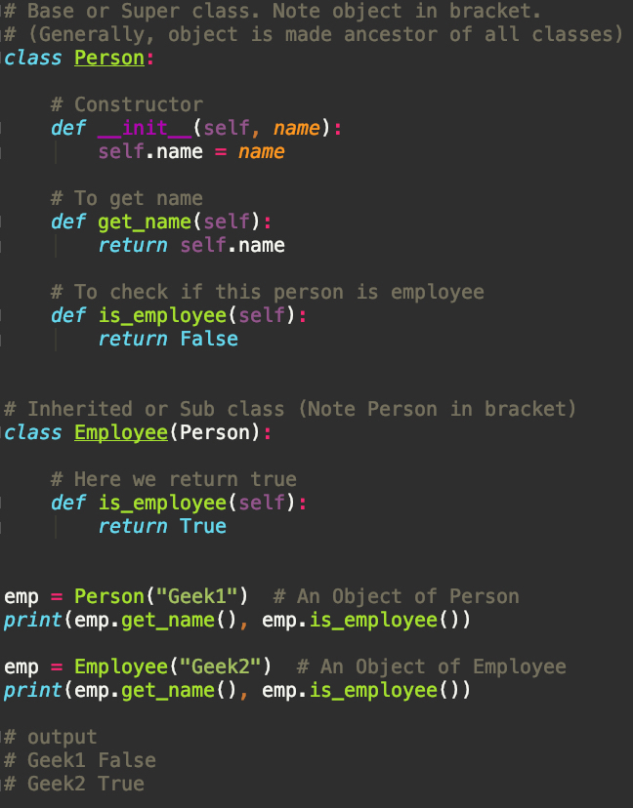
Class Inheritance
Inheritance is the capability of one class to derive or inherit the properties from some another class.

Slide 3
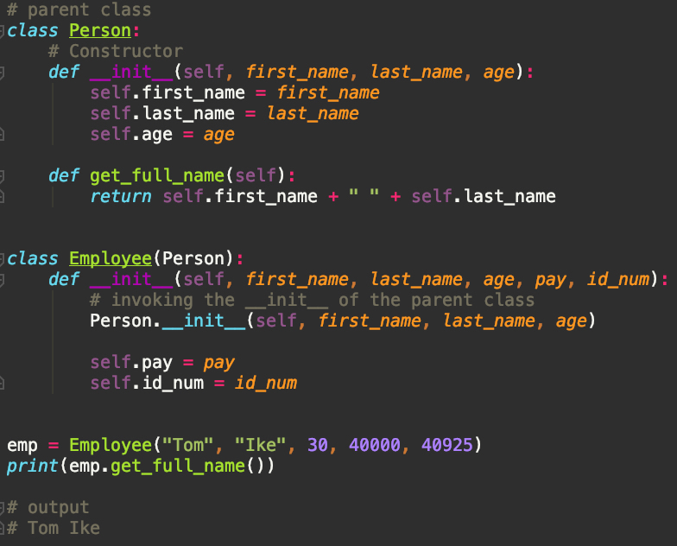
Class Inheritance
Calling the super or parent class constructor from the child class

Slide 4
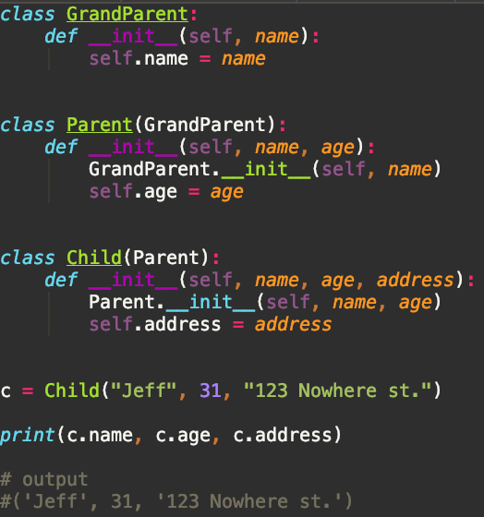
Chaining Inheritance

Slide 5
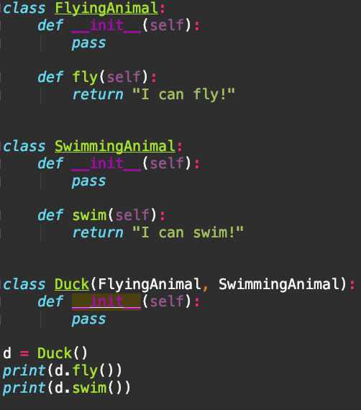
Multiple Inheritance

Slide 6
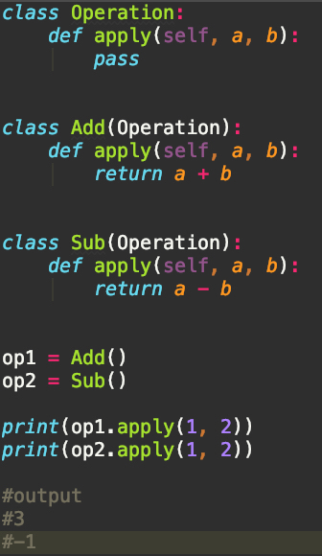
Polymorphism
Polymorphism means same function name (but different signatures) being uses for different types.

