Slide 1

BinPy – PyCon 2014
About BinPy :
BinPy is a digital electronics simulation library ...
Aimed at students
Initiated by students of BITS Pilani – Goa
Started a few months ago ...
http://tinyurl.com/binpycon14

Slide 2
What to expect from this talk
Learn the basics of Digital electronics using BinPy
Learn about Gates, FlipFlops, Registers, Counters, Multivibrators and their implimentation in BinPy
Play with ICs ( 7400 / 4000 Series )
Work with a basic ASCII oscilloscope ...
Learn about logic minimization using QM algorithm
Some boolean expressions and stuff
Multipliers – Booth's multiplier / Robertson's / Karatsuba's
( If time permits ) Analog Converters / Buffers
Signal Generators using BinPy ..

Slide 3
What NOT to expect ... / Known bugs
Plain and simple, BinPy is not PSpice / OrCad ( There are plenty of tools out there )
We are “trying” hard to be an easy alternative to verilog ...
Actually we are inspired by myHDL which is 4 year old library and an excellent verilog like library in python and PyEDA, which is a 2 year old awesome digital design library ...
No GUI “YET”, sorry for that !
Delay models / K-Map / Advanced expression parsing is WIP
Currently we are planning a migration to Pseudo real time to improve efficiency / robustness ... Everything is kind of ... concurrent right now ! So there are quite a few timing related bugs out there :/

Slide 4
So lets get started !
Installing BinPy
Via Source :
Get the latest development version of BinPy from GitHub :
git clone https://www.github.com/BinPy/BinPy.git
Move to BinPy directory and then run setup ...
python setup.py install
That should be pretty much fine ...
Via PIP / .exe file / tar ball install :
Refer : https://github.com/BinPy/BinPy/wiki/Download-Installation

Slide 5
Gates
BinPy has modules for all basic gates like AND, OR, XOR, AND, NOR and NOT
Instantiate a Gate class with inputs ( similar to verilog )
gate1 = AND(1,0,0,0)
gate1.output()

Slide 6
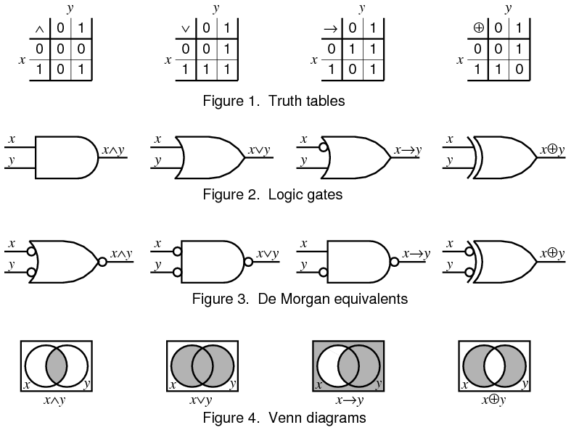
Basic Gates and their Venn Diagrams
– Courtesy Wikibooks

Slide 7
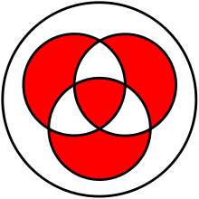
XOR ( Exclusive disjunction operation )
Input with a uniform distribution in { 1 , 0 }^{n} when XOR-ed with another input with a uniform distribution in { 1, 0 }^{n} outputs a n – bit sequence which is again uniform in { 1 , 0 }^{n}
{ 1, 0 }^{n} ==> n-bit sequence of 1s and 0s
Uniform distribution ==> Probability of 1 = Probability of 0
This has enormous use in Crypto – Frequency analysis of the output sequence made harder using the above fact.
Arithmatically equivalent to mod 2 addition of two bits.
Ex 1 exor 1 = 0 ( 1 exor 1 = ( 1 + 1 ) % 2 = 0 )

Slide 8
Concept of Connectors and Bus-es in BinPy
Connector can be used to :
To logically connect two ports ( input / output ) of any 2 gates / IC / components
To store a logic state ( like reg / inout in verilog)
Instantiating a Connector -
B_0 = Connector(0)
B_1 = Connector(1)
B_x = Connector(None)
B_ouput = Connector()

Slide 9
Bus is a more versatile class :
[ Similar to declaring a multibit vector inout / reg ]
These are a few features of Bus class :
They can store n-bit digital or n port analog input / output value
Can connect to another n-bit / n port device
Can use batch updation, using set_logic_all or the set_voltage_all methods
Can iterate over individual ports / bits
Can do list like slice operations.
Can copy values from / to another Bus object
Perform circular rotation of bits using << or >> operators

Slide 10
The Linker Module
The linker module in BinPy stores links between ports of Connectors or Busses in a Graph data structure
( AutoUpdater._graph )
The AutoUpdater thread runs in the background to update all links of the graph “synchronously”.
While this is convenient to run simulations, this is expected to be replaced by a pseudo real time updater module to make BinPy robust.
Example – In IPython notebook

Slide 11
The BinPyBits Module
Binary string manipulation module.
Derived from bitsttring.BitArray
Bitstring is a very versatile library with robust efficient routines to convert to from bin, hex, int, uint etc ...
Various bit fiddling operations can be easily done using slice / del / direct member assignment operations of the BinPyBits class ( Thanks to library )
( obj.bin = “1111” )
Bitwise Multiplication / Negation / Xor / Shift / rotation and a wide variety of functions ...

Slide 12
Binary Operations
Using the operations module :
# Initialize the operation class object
op = Operations()
# Binary Addition
print (op.ADD('0', '1'), op.ADD('00', '10'),
op.ADD('010', '100'))
1 10 110
# Binary Multiplication
print (op.MUL('0', '1'), op.MUL('00', '10'),
op.MUL('010', '100'))

Slide 13
# Binary Complement
print (
op.COMP(
'0', '1'), op.COMP(
'00', '1'), op.COMP(
'00', '2'), op.COMP(
'010', '1'))
1 11 100 101
bittools has pretty much everything this Operations module has.

Slide 14
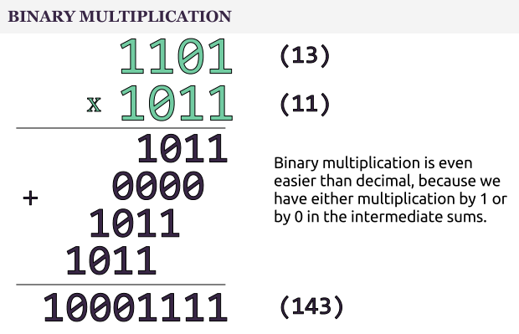
Multiplication - Naiive
Time complexity is O(n²)
n numbers of n bit multiplication

Slide 15
Multiplication algorithms in BinPy
Robertson's multiplication algorithm.
Product of 2 numbers calculated as a series of shift and add methods :
Pi = Pi + Xi * Y
Pi+1 = Pi * 2-1
Where Pi is the partial product.
Can multiply negative ( signed ) binary numbers too.
Using robertsons_multiply method of MultiplicationAlgos
Example : See IPython noteboo`k ...

Slide 16
Booth's Multiplication algorithm
A slight modification to Robertson's algorithm
Examins the multiplier in pairs of 2.
Essentially it examines adjacent bits of the N-Bit multiplier and based on it reduces complex operations to much simpler addition / subtraction operations.
It takes advantage of the fact that groups of 1s can be represented by simpler arithmatic.
Ex. 1111 = 10000 – 00001
Similar to simplification while multiplying with long strings of decimal numbers as :
5 * 77,77,777 = 5 * ( 8,00,00,000 – 1 )
Hence essentially the worst case complexity ( when multiplying 1010101010 kind of numbers ) remains the same.
However the average case complexity is improved over Robertson's method.
Refer http://en.wikipedia.org/wiki/Booth's_multiplication_algorithm

Slide 17
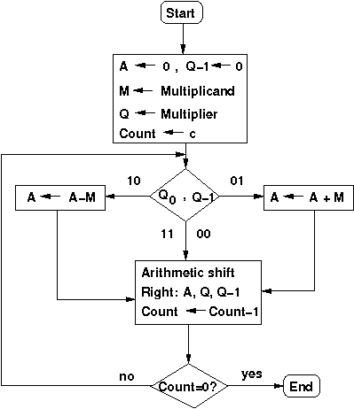

Slide 18
Karatsuba's fast multiplication algorithm
Consider two n bit ( assume even ) binary numbers X ( Multiplicand ) and Y ( Multiplier ).
These can be written as ( in Base 2 ) :
X = X₁ * 2^{n/2} + X₀
Y = Y₁ * 2^{n/2} + Y₀
Now the multiplication of X and Y can be carried out as :
X * Y = ( X₁ * 2^{n/2} + X₀ ) * ( Y₁ * 2^{n/2} + Y₀ )
= X₁*Y₁ * 2^{n} + ( X₀Y₁ + X₁Y₀ ) * 2^{n/2} + X₀*Y₀
The primary optimization in Karatsuba's algorithm is done here :
X₀Y₁ + X₁Y₀ = ( X₀ + X₁ ) * ( Y₀ +Y₁ ) - X₁*Y₁ - X₀*Y₀

Slide 19
Integrated Circuits
BinPy has ic modules with around 100 IC's from 7400 and 4000 Series.
Examples :
74181 – 4 Bit ALU with 4 Bit function Select Lines
4008 – 4 Bit Carry Look ahead adders

Slide 20
Digital Structures in BinPy
Combinational Circuits
Circuits whose output depends only on the current inputs.
Adders, Subtractors, MUX, DEMUX, Encoder, Decoder etc ..
Sequential Circuits
Circuits whose output depends not only on the current input but also on the history of inputs.
FlipFlops, Counters, Registers etc ...
Tools like Multivibrators, Oscilloscope

Slide 21
Analog Structures
Analog Buffer Blocks ( with attenuation / gain support )
Analog D2A and A2D Converters
8-Bit / 16-Bit / IEEE754 Single / Double precision format ...
Analog Signal Generators ( Sine, Square, Ramp, TTL ) with AM modulation support.

Slide 22
Expression Module With TT
Basic expression module with Truth Table output
QM Logic minimization

Slide 23
Thank You :)

