Slide 1
Feature-rich Deep Ensemble Model -- SENTENCE SIMILARITY
Bin Qian
jie Su
Riuqiu Miao
Xinyu Hu
25/04/2018

Slide 2
OUTLINE
Introduction
Solution
Pre-processing
Feature-Engineering
Deep Model
Ensemble
Results
Analysis

Slide 3
INTRODUCTION - DATASET
Dataset Overview
ID | Question 1 | Question 2 | Is_duplicate
0 | How much is 30 kV in HP? | Where can I find a conversion chart for CC to horsepower? | 0
1 | How do I read and find my YouTube comments? | How can I see all my Youtube comments? | 1
Dataset Statistics
Data Source | Question Pairs | Duplicate vs not_duplicate
Training Data | 404,290 | 1: 2.79
Test Data | 2,345,796 | /

Slide 4
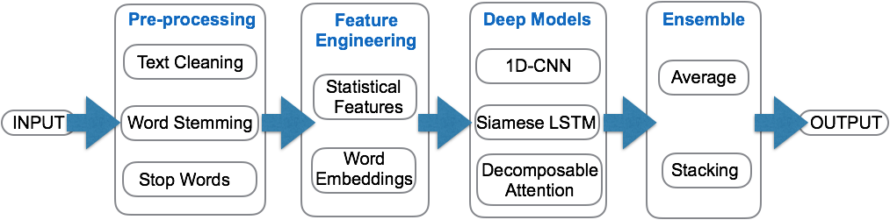
INTRODUCTION - ARCHITECTURE

Slide 5
SOLUTION – PREPROCESSING & FEATURE ENGINEERING
PREPROCESSING
Feature Engineering
Lower case
Word stemming
Stop words removal
Text cleaning
Statistical
TFIDF cosine similarity
Question 1 frequency
Question 2 frequency
Intersection of Question 1 & 2
NLP
Word Embeddings

Slide 6
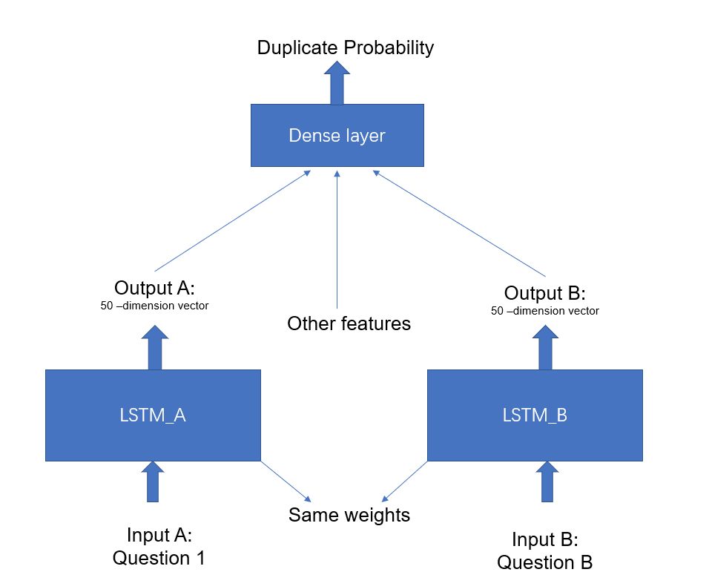
SOLUTION – DEEP MODELS – Siamese LSTM
Jonas and Thyagarajan（2016）

Slide 7
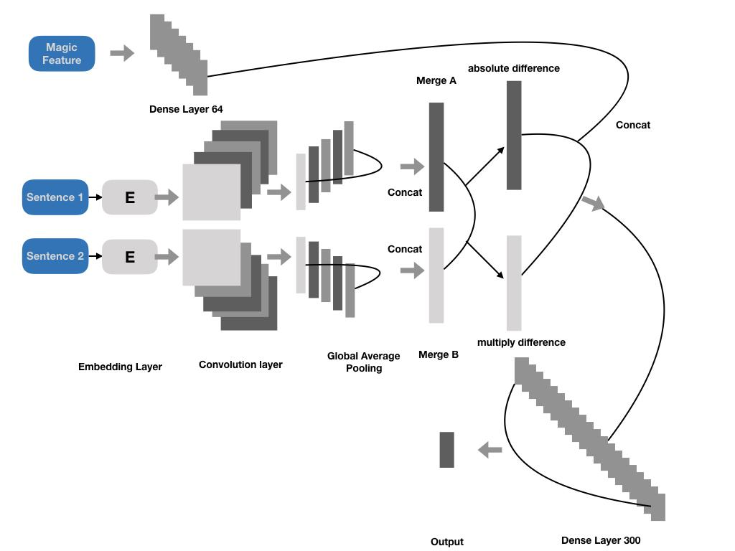
SOLUTION – DEEP MODELS -- CNN

Slide 8
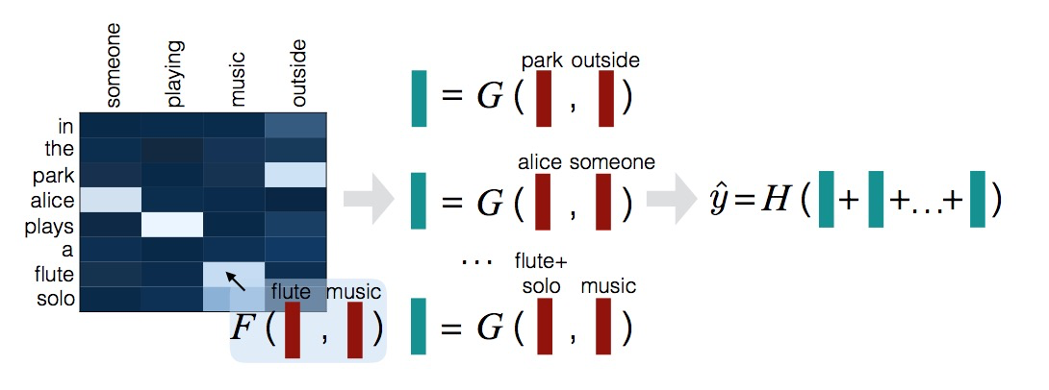
SOLUTION – DEEP MODELS -- ATTENTION MODEL
Parikh et.al, 2016

Slide 9
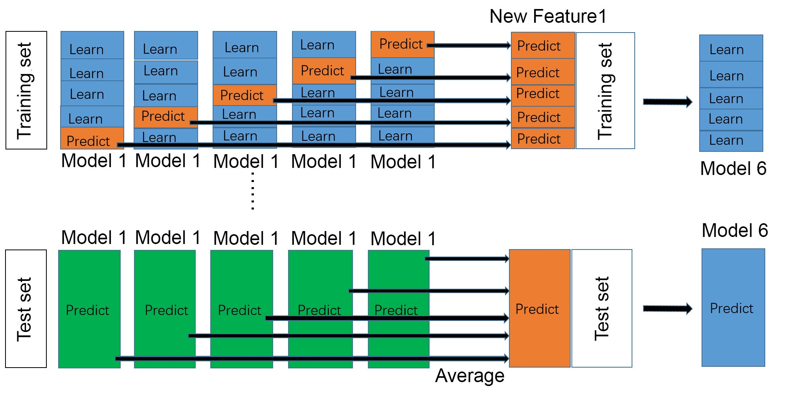
SOLUTION – ENSEMBLE
bagging
average
Stacking
nn
Logistic Regression

Slide 10
RESULTS
Model | Results
\ | Pure Word Embedding | Word Embedding + More Feature
1DCNN | 0.31210 | 0.17684
Siamese LSTM | 0.33166 | 0.17009
Decomposable Attention | 0.31590 | 0.17297
Average over 3 base models | 0.16551
NN Stacking | 0.16876
logistic regression Stacking | 0.16818
… | …

Slide 11
Analysis
Incorporating rich feature into deep model increases performance
Stacking does not improve performance dramatically when incorporating similar models
Attention, alignment relationship
CNN, most similar sub-phrases
LSTM, relationship of the words in the whole sentence

Slide 12
REFERENCE
Parikh, A.P., Täckström, O., Das, D. and Uszkoreit, J., 2016. A decomposable attention model for natural language inference. arXiv preprint arXiv:1606.01933.
Mueller, Jonas, and Aditya Thyagarajan. "Siamese Recurrent Architectures for Learning Sentence Similarity." AAAI. 2016.

Slide 13
THANK YOU!

