Slide 1
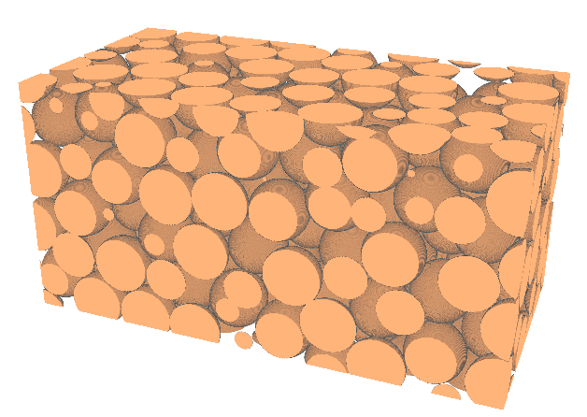
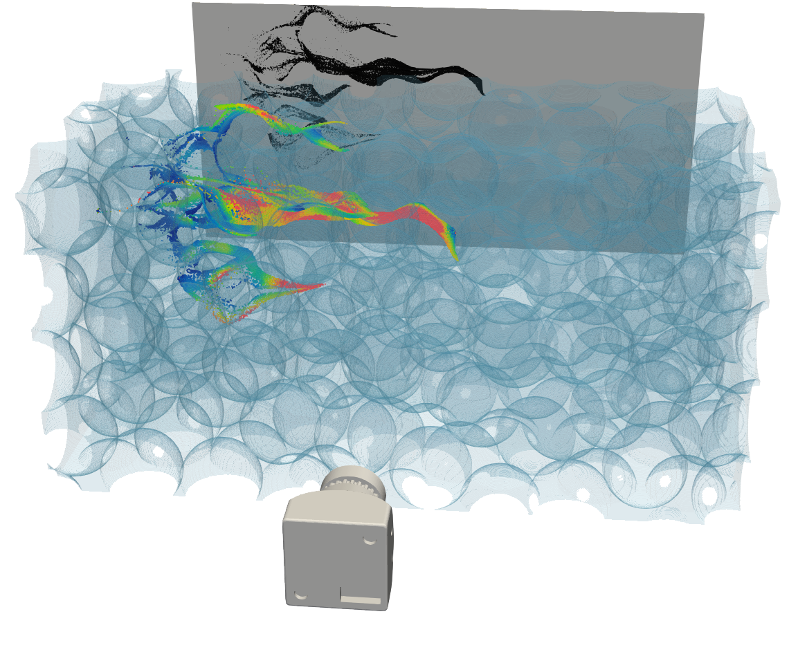
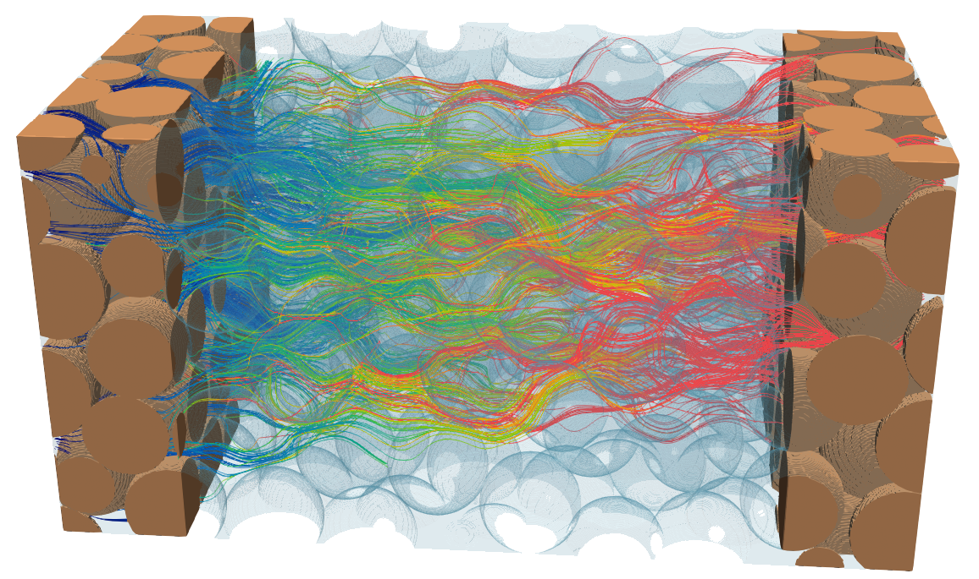
Digital rock physics visualization (ParaviewTM)
Experimental 3D Velocity Field in Random Sphere Packing
Bin Wang
Craft & Hawkins Department of Petroleum Engineering
Louisiana State University
Dataset from Mathieu Souzy (University of Twente)
doi: 10.17612/HDP8-0149

