Slide 1
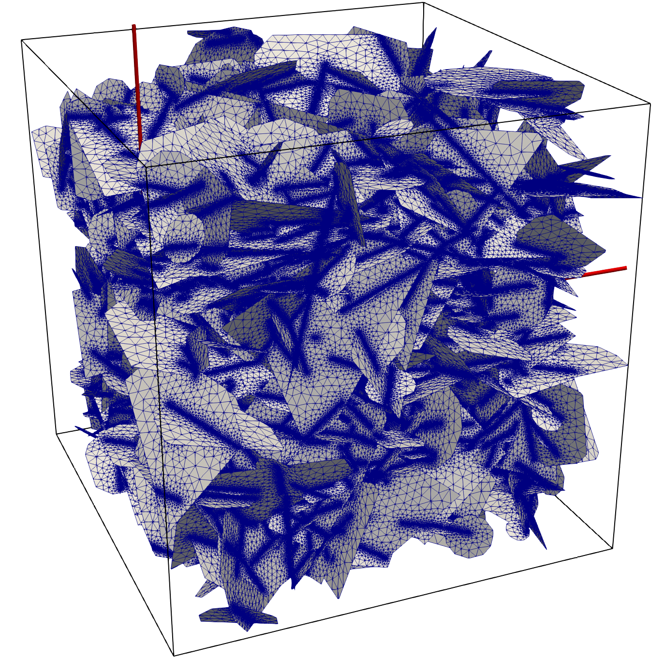
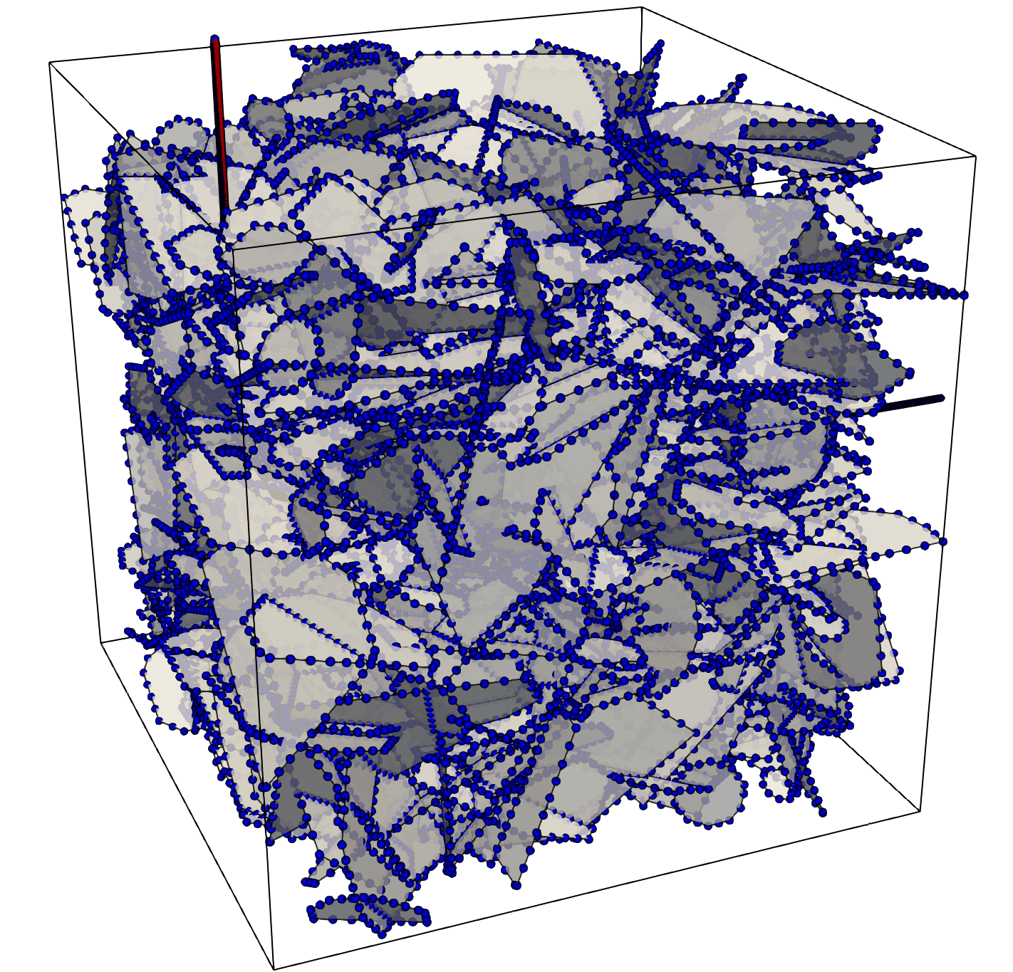
FEM/FVM Mesh with 12.54 million 2D elements and 5.45 million nodes
BEM Mesh with 0.13 million 1D elements and 0.11 million nodes

