Slide 1
Information extraction with Transfer Learning and Unsupervised Pre-training
Lizhen Qu

Slide 2
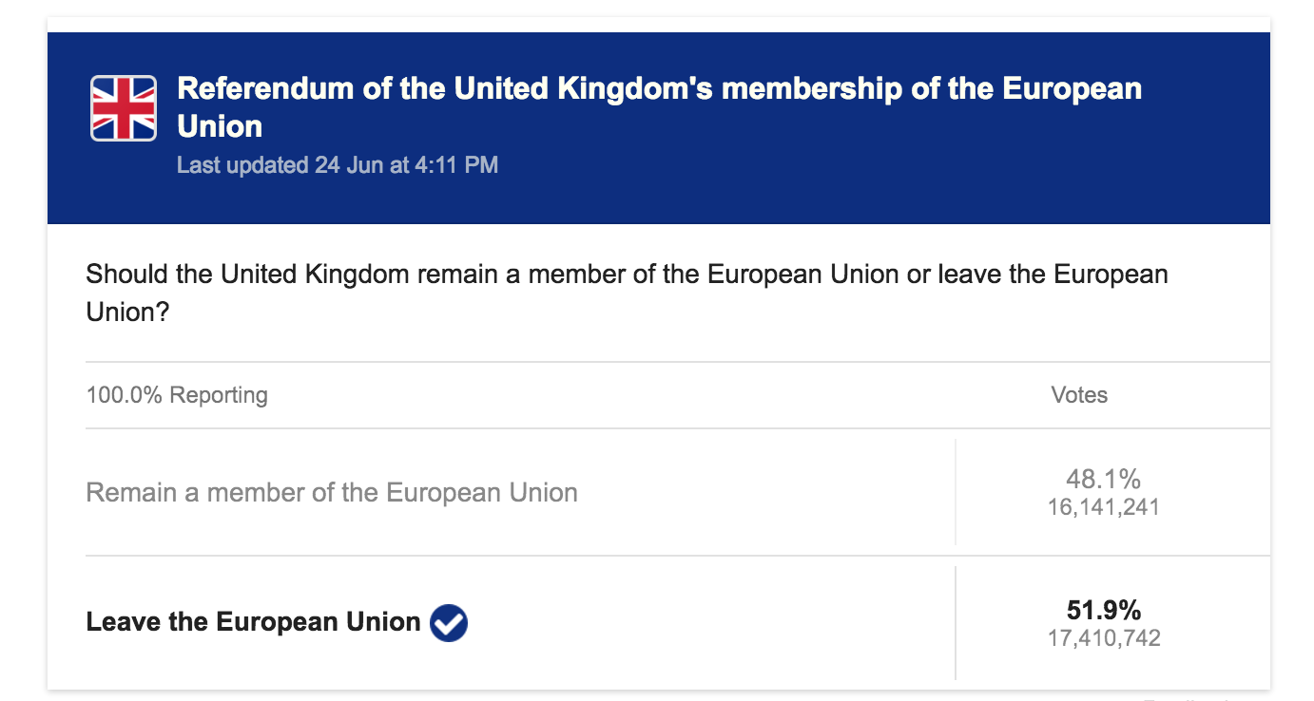
Information Extraction for Brexit?
Voters have voted in favor of Brexit: British exit from the European Union .
Brexit: Shocked European Union tells Britain to leave quickly amid 'chain reaction' fears.
Researchers reeling as UK votes to leave EU.
Millions sign petition for second referendum

Slide 3
Transfer Learning for NER
PER
LOC
Donald Trump sees Australia as
'special relationship’.
transfer
Voters have voted in favor of Brexit:
UK will leave the European Union .
COUNTRY
POLITICO-ECONOMIC UNION

Slide 4
Linear-Chain CRF
Focus of Transfer
“of” “brexit” “will” “leave”

Slide 5
Simplify CRF to Logistic Regression
reduced to

Slide 6
TransMultiTypeInit

Slide 7
Learn Type Correlation
LOC
ORG
PER
MISC

Slide 8
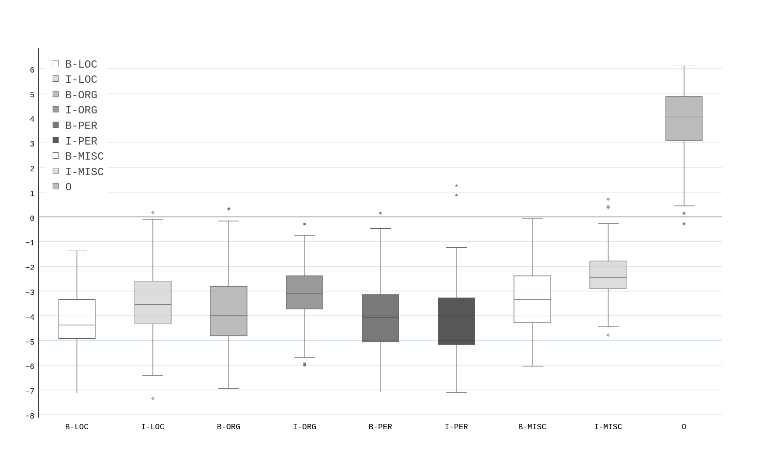
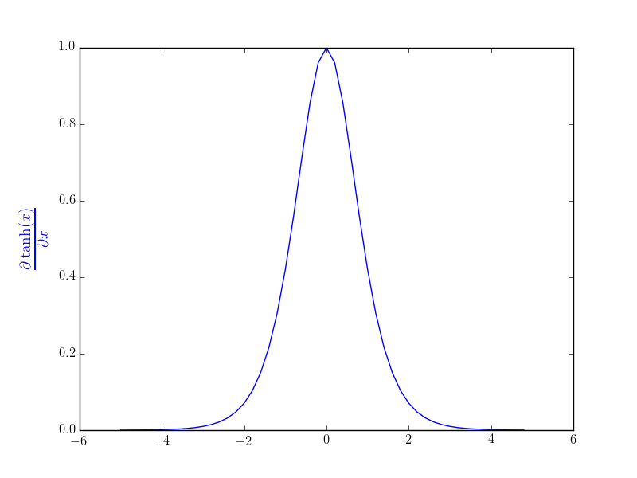
Why not to Add Non-Linear Layer?

Slide 9
Initialize CRF for Target Types
LOC
ORG
PER
MISC

Slide 10
Initialize CRF for Target Types
Initialize

Slide 11
Datasets

Slide 12
Results on I2B2

Slide 13
Results on CADEC

