Slide 1
In Defense of Fully Connected Layers in Visual Representation Transfer
Chen-Lin Zhang, Jian-Hao Luo, Xiu-Shen Wei, Jianxin Wu
Reporter：Keji Han
Tutor: Yun Li

Slide 2
Contents
INTRODUCTION
Models
Datasets
Decline of FC
Why in defense of FC
VISUALIZATION & OBSERVATION
DISCUSSIONS& CONCLUSIONS

Slide 3
Contents
INTRODUCTION
Models
Datasets
Decline of FC
Why in defense of FC
VISUALIZATION & OBSERVATION
DISCUSSIONS& CONCLUSIONS

Slide 4
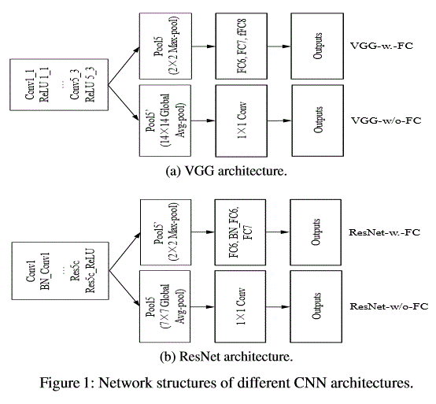
models

Slide 5
Contents
INTRODUCTION
Models
Datasets
Decline of FC
Why in defense of FC
VISUALIZATION & OBSERVATION
DISCUSSIONS& CONCLUSIONS

Slide 6
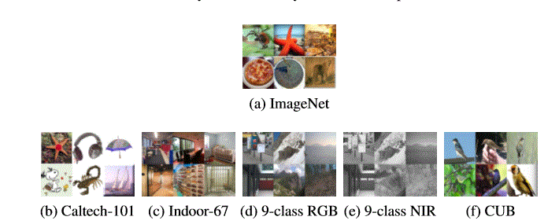
datasets
– Caltech-101. It has 101 categories of objects. This dataset is the most similar one to ImageNet, because the categories in Caltech-101 are mostly included in the categories in ImageNet.
– MITIndoor-67. It has 67 indoor scene categories. This dataset is less similar to the source ImageNet dataset than Caltech-101.
– 9-class RGB-NIR scene. This scene recognition dataset is proposed in . It includes nine scene categories in the RGB-NIR image. The RGB images in this dataset is getting more distant to ImageNet, because the outdoor scenes in this dataset is different from those in ImageNet. The NIR part of this dataset is taken by different sensors than the ImageNet (NIR vs. RGB). Due to this difference in imaging sensor, the NIR images are dissimilar to the ImageNet images.
– CUB200-2011. contains 11788 images of 200 ﬁne-grained bird species. We perform both classiﬁcation and unsupervised localization/retrieval tasks on CUB200-2011.

Slide 7
Contents
INTRODUCTION
Models
Datasets
Decline of FC
Why in defense of FC
VISUALIZATION & OBSERVATION
DISCUSSIONS& CONCLUSIONS

Slide 8
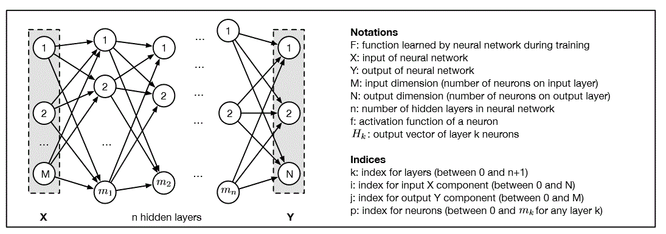
Decline of FC
FC and Softmax is a dream ticket
Figure2. Architecture of Forward-feed Network

Slide 9
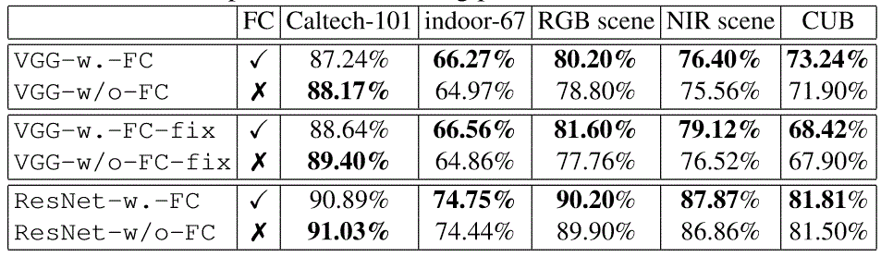
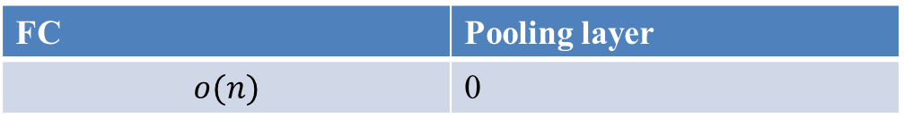
Decline of FC
In recent CNNs, FC is replaced by pooling layer
fewer parameters
Higer accuracy
Reference:
[1]He, K., Zhang, X., Ren, S., Sun, J.: Deep residual learning for image recognition. In: CVPR. pp. 770–778 (2016).
[2]Lin, M., Chen, Q., Yan, S.: Network in network. ICLR (2014)
[3] Szegedy, C., Liu, W., Jia, Y., Sermanet, P., Reed, S., Anguelov, D., Erhan, D., Vanhoucke, V., Rabinovich, A.: Going deeper with convolutions. In: CVPR. pp. 1–9 (2015) .
FC | Pooling layer
 | 0

Slide 10
Contents
INTRODUCTION
Models
Datasets
Decline of FC
Why in defense of FC
VISUALIZATION & OBSERVATION
DISCUSSIONS& CONCLUSIONS

Slide 11
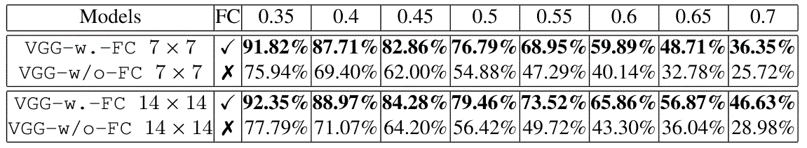
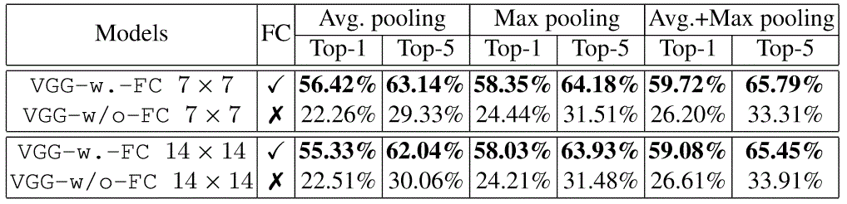
Why in defense of FC?
In some cases, FC is necessary
Table 1: Comparison of different outputs’ SCDA object localization accuracy on CUB200-2011 with different IoU.
Table 2: Comparison of different outputs’ SCDA image retrieval accuracy on CUB2002011.

Slide 12
Contents
INTRODUCTION
Models
Datasets
Decline of FC
Why in defense of FC
VISUALIZATION & OBSERVATION
DISCUSSIONS& CONCLUSIONS

Slide 13
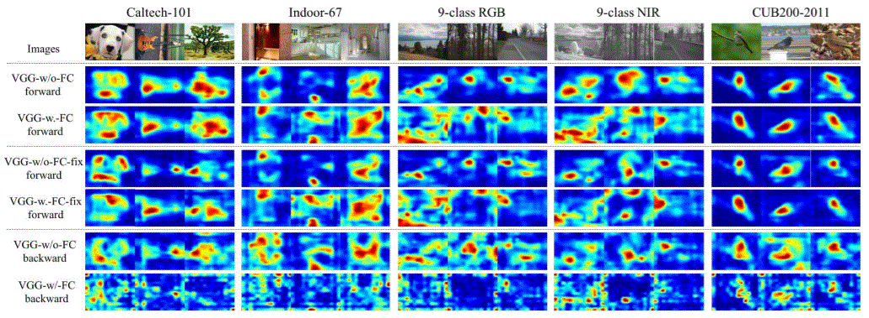
Visualization and observation
Figure3. Visualization of the activations for the four baseline models on four classiﬁcation datasets；the red regions mean larger values and blue regions refer to smaller values.

Slide 14
Contents
INTRODUCTION
Models
Datasets
Decline of FC
Why in defense of FC
VISUALIZATION & OBSERVATION
DISCUSSIONS& CONCLUSIONS

Slide 15
Discussion and Conclusion
Without FC, the activations is too concentrated around the object. While, those models with FC layers show a different property.
Target domain is not far away from the source domain, fully connected layers can be replaced by global average pooling for better efﬁciency and accuracy.

Slide 16
Future work
Maintain CNN models with global average pooling and make it suitable for visual representation transfer to distant target domains.

