Slide 1
STRICT: Information Retrieval Based Search Term Identification for Concept Location
24th IEEE International Conference on Software Analysis, Evolution and Reengineering (SANER)
CCF B in field of Software Engineering / System Software / Programming Languages
Reporter：leo.liu
Tutor:XiaoLong Xu

Slide 2

PageRank

Slide 3
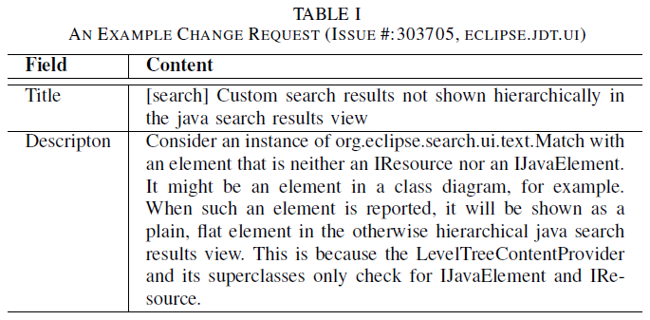
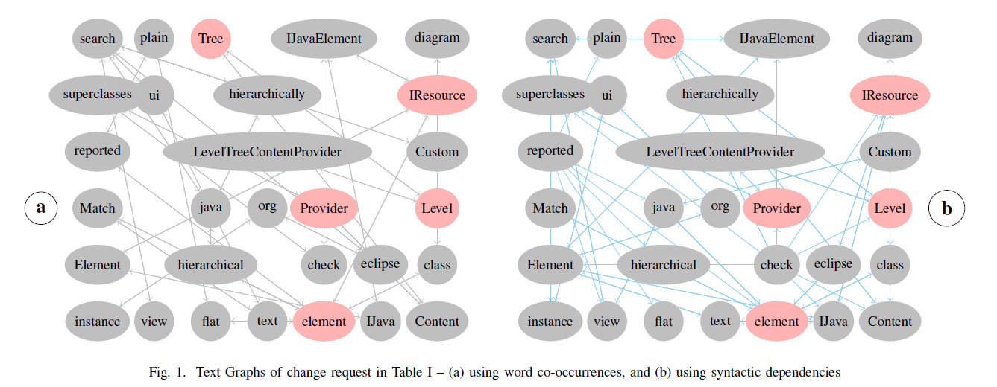
TextRank and POSRank
TextRank: Co-occurrence
POSRank: Modification

Slide 4
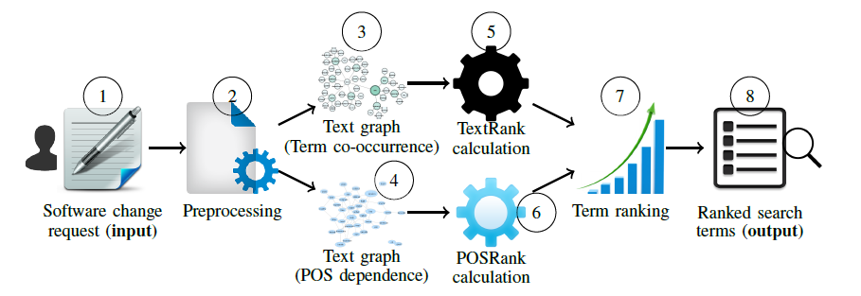
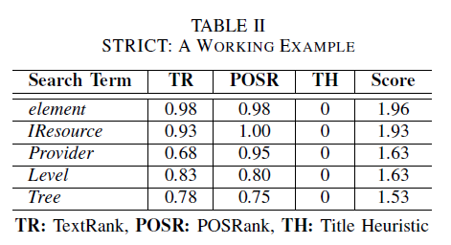
STRICT
STRICT = TextRank + POSRank + title-based heuristic

Slide 5
Application:
1. A search term identification technique
Identifies good quality search terms from a change request
2. A search query reformulation technique
Reformulates the baseline queries by discarding low quality search terms
Four research questions:
RQ1: Better than the baseline search or not(STRICT)?
RQ2: How does it perform?
RQ3: How effective are(TextRank and POSRank)?
RQ4: Can the STRICT outperform the state-of-the-art techniques(Kevic and Fritz [24], Rocchio’s Method [18, 39])?

Slide 6
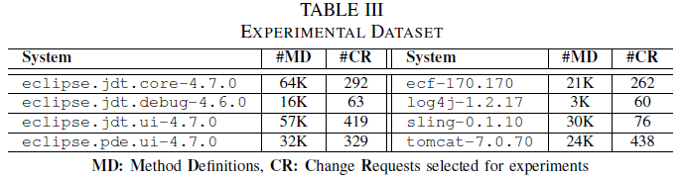
Dataset:
1,939 software change requests from eight Java-based subject systems (i.e., five Eclipse systems and three Apache systems).
Four performance metrics for evaluation and validation :
Effectiveness (E): the rank of the first occurred in the search result list.
Mean Reciprocal Rank@K (MRR@K): average reciprocal of the rank of the first correctly returned within the Top-K results.
Mean Average Precision@K (MAP@K): mean of average precision at the occurrence of every single relevant result in the ranked list.
Top-K Accuracy: percentage of the change requests for which at least one changed file is correctly returned within the Top-K results by the search queries

Slide 7
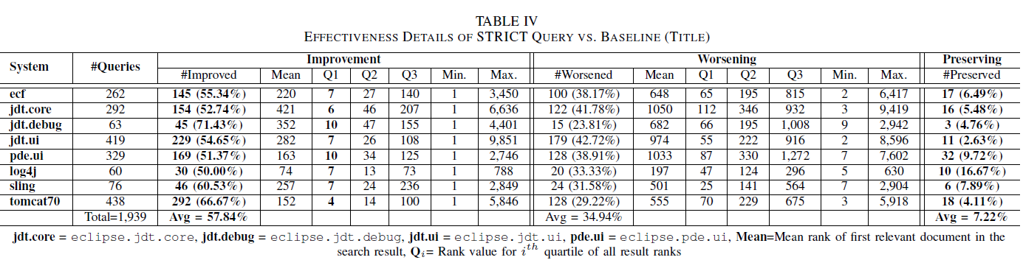
RQ1：

Slide 8
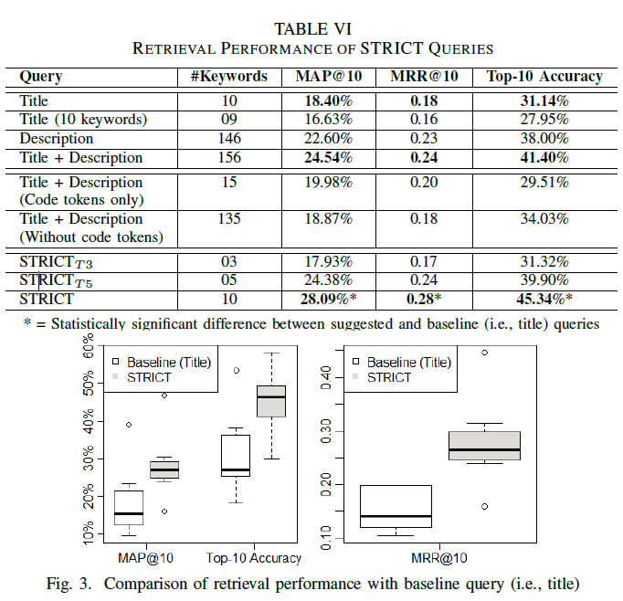
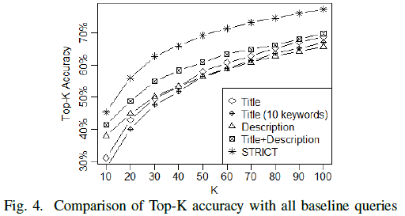
RQ2：

Slide 9
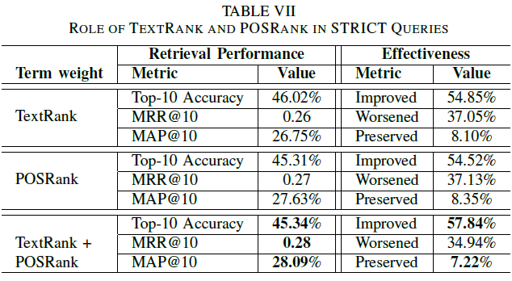
RQ3：

Slide 10
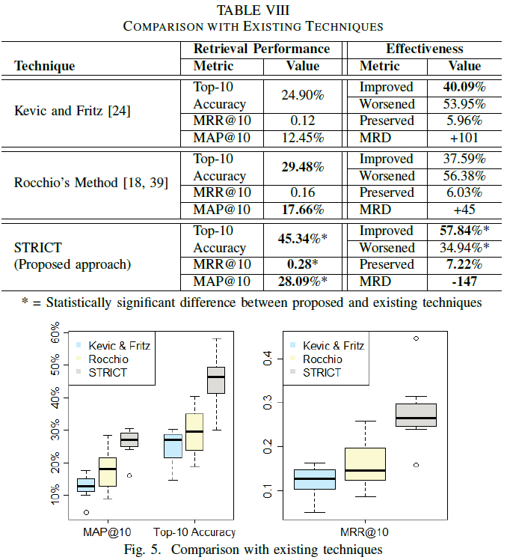
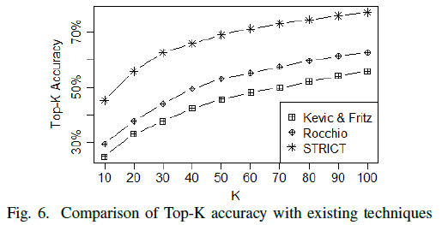
RQ4：

Slide 11
CONCLUSION:
We make the following contributions:
A novel and promising search term identification technique–STRICT–that identifies good quality search terms for a change task from its change request.
Comprehensive evaluation of the technique using 1,939 change requests from eight subject systems and four state-of-the-art performance metrics.
Comprehensive validation of the technique using comparisons with two state-of-the-art techniques.

Slide 12
Expandation:
We can consider as this paper for a specific implementation of keyword extraction in the field of debug/program developing. So can “TextRank + POSRank + title-based heuristic” be used more widely to other fields such as Scenario dialogue?
Four quantitative indicators are promoted to evaluate and validate the performance of the proposed technique. How to apply them to other NLP task?
Putting together the value of TextRank, POSRank and title-based heuristic are too roughly? Or we can give more exquisitely resolution?
Can we combine a DNN with the graph model of a text to improve the performance of specific NLP task? Such as below:

Slide 13
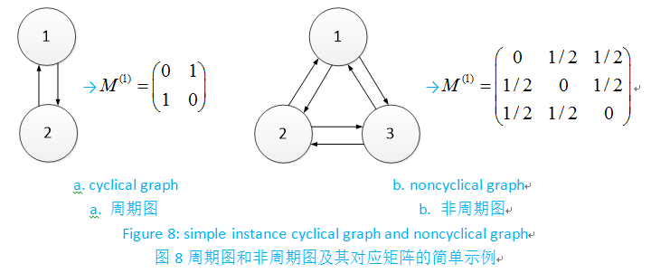

Slide 14


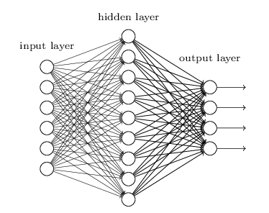
Feature of a text set(inductive bias)
Feature of a single text
DNN to learn the value of Wii to improve the accuracy.
Application ?
?
Wii + M
Backward Propagation ?
Indicators ?

Slide 15
Thanks all.

