Slide 1



STRICT: Information Retrieval Based Search Term Identification for Concept Location
International Conference on Software Analysis, Evolution and Reengineering (SANER 2017), Klagenfurt, Austria
Mohammad Masudur Rahman, Chanchal K. Roy
Department of Computer Science
University of Saskatchewan, Canada
Notes:
Introduce yourself and the affiliation.
Today I am going to talk about query suggestion for Concept location where we used Information Retrieval methods.

Slide 2
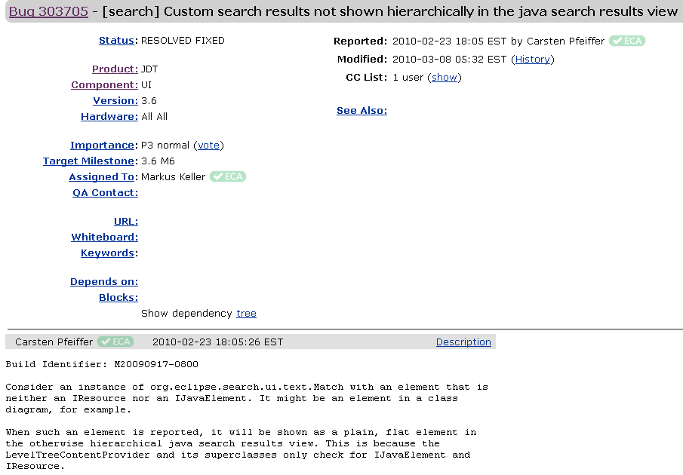
Software Change Task
Task Summary
Other Information
Task Description
Notes:
This is a software change request.
It has different sections like title, description and others.
Now a developer’s task is to identify the most important terms and then use them for finding the source code to change.

Slide 3

Software Change Task: Domain Concept--Artifact Mapping
Domain concepts
Tree
Provider
IResource
Level
element
Our contribution: Identifying such concepts
Project artifacts
(e.g., classes, methods)
Notes:
To model the problem formally, this is a mapping problem.
And the mapping is between concepts in the change request and the relevant source artifacts from the codebase.
Our job is to identify the appropriate terms from the change request for the successful mapping.

Slide 4
Existing Works
Query reformulation & expansion
Haiduc et al, ICSE 2013
Gay et al, ICSM 2009
Shepherd et al, ASOD 2007
Query quality analysis
Haiduc et al, ASE 2011
Haiduc et al, ICPC 2011
Haiduc et al, ICSE 2012
Software artifact mining
Howard et al, MSR 2013
Kevic & Fritz, MSR 2014
Heuristics
Kevic & Fritz, ICSE 2014
Most studies expect the developer to provide an initial query
Developers succeed only in 12.2% of cases (Kevic & Fritz, ICSE 2014)
Initial search query for a change task.
Notes:
There have been some studies on similar problem.
However, most of these studies reformulate a given query.
That means, the developer needs to provide an initial query first.
But studies show that choosing that initial query itself is challenging.
A study reported that only 12% of developers chosen search terms from the change request were useful.
So, our focus is to choose the initial query from a change request rather than reformulation.
The closely related work used a set of heuristics.

Slide 5
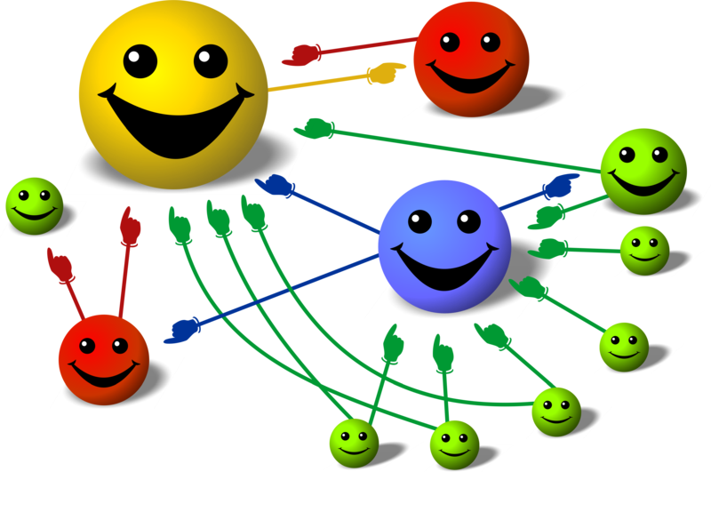
PageRank Algorithm: Web Link Analysis
Most important face in this crowd
Size of a face ∞ Size of the faces pointing to it
Notes:
While the earlier work used heuristics for the same problem,
we used Google’s PageRank algorithm for choosing the important terms from a body of texts.
Here, the most important face in the crowd is the face everybody is looking at, right?
This also goes true for world wide web.
A page is reputed is it is referred by other reputed pages from the web.
So, we adapt our search term identification after this model.

Slide 6
Search Term Identification using TextRank & POSRank
Notes:
We identify search terms using two variants of PageRank---
They are called TextRank and POSRank in the information retrieval domain.

Slide 7
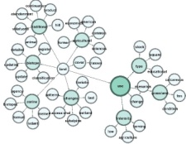







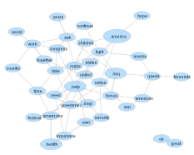

Schematic Diagram: Proposed Approach
TextRank calculation
Change request
Preprocessing
Ranking
Search terms
POSRank calculation
Focus of this talk
Notes:
So, these are the pretty straight-forward steps of our approach.
We take a change request, and perform standard NLP (stop word removal and splitting). We avoided stemming.
Then from the pre-processed texts, we develop two types of graphs – text graph and POS graph.
Then we derive importance score for each of the terms from those two graphs.
Then we a do linear combination, perform ranking and choose the top words as the search terms based on their scores.
Now, we will zoom in this sections more.

Slide 8
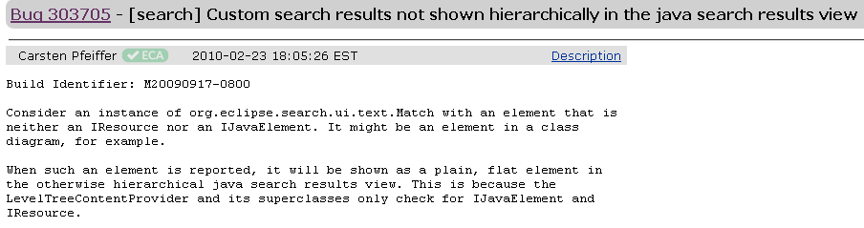
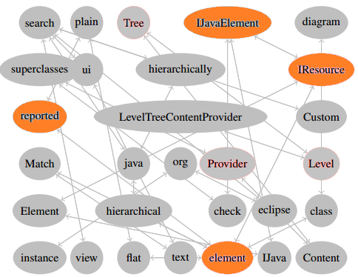
TextRank: Term Importance using Co-occurrence (Mihalcea et al, EMNLP 2004)
IResource-------IJavaElement, element-----reported
Node = Distinct word
Edge = Two words co-occurring in the same context
Notes:
The idea behind this text graph is word co-occurrence.
For example, these two terms—IResource and IJavaElement-- occur in the same context across multiple sentences.
These are another two terms– element and reported—occur in the same context.
Here we define context as a window size of two words within a sentence.
We encode their co-occurrence into an edge in this text graph.
This way, the whole change request can be converted into a text graph.

Slide 9
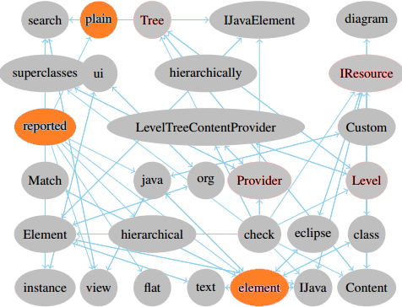
POSRank: Term Importance using Syntactic Dependence (Blanco & Lioma, Inf. Retr. 2012)
Jespersen’s Rank Theory
Verb-------Noun, Verb---Adjective
Verb
Adjective
Noun
Edge = Syntactic dependence between various parts of speech in the sentence
Notes:
Similarly, we develop the second graph based on syntactic dependence among various parts of speech of sentence.
We apply Jespersen’s Rank Theory of 3 ranks. More details on the paper.
That is, some POS depends on others POS for their complete meaning.
For example, verb modifies noun and adjectives from within the same sentence.
We encode such dependencies into the connecting edge, and develop another text graph.
Thus, some terms are more connected than others.

Slide 10
Term Importance (Adapted from PageRank)
V_{i} – node of interest
V_{j} – node connected to V_{i} through incoming links
 – damping factor (i.e., probability of choosing a node in the network)
In(V_{i}) – incoming nodes to V_{i}
Out(V_{j}) – outgoing nodes from V_{j}
Notes:
Now, we have two graphs developed from the change request based on two different dimensions
--Word co-occurrence and syntactic dependence.
Now, we apply the above algorithms adapted from PageRank for scoring.
That is, a term’s importance will be determined by the importance of the surrounding terms, not just the connectivity.
This is how Google beats the SCAM pages.
We apply that in the case of concept location as well.
This is the first time done in the concept location task, and this is our novelty.

Slide 11
Term Importance (Explained)
V_{j6}
V_{j5}
V_{i}
V_{j4}
V_{j3}
V_{j1}
V_{j2}
Term Score (V_{i}) = TextRank (V_{i}) + POSRank (V_{i})
Notes:
So, this is how the score of a term is determined, based on the scores of the surrounding terms.
That means, the score of V_{i} is determined based on the scores of Vj1 to Vj5.
We collect scores for the terms from both graphs which we call TextRank and POSRank.
We combine them, rank them and collect the top ones as the search terms.

Slide 12






Experimental Dataset
8 Projects (Apache + Eclipse)
1,939 change tasks
BugZilla + JIRA issues
GitHub commits &
Change set
Notes:
For experiments, we select 8 subject systems from Apache and Eclipse.
We collect 1939 change requests/bug reports from BugZilla and JIRA,
and prepare the gold set by consulting the commit history of those projects from GitHub.
For selecting bug fixing commits, we adopted the widely accepted approach.
That is, we identify the Bug ID in the commit title, and then extract corresponding change set.

Slide 13







Experimental Setup
Query Effectiveness
Mean Avearge Precision
Mean Recall
Top-K Accuracy
Our ranks
Suggested
query
Code search
Compare
Change
request
Baseline
query
Baseline
ranks
Notes:
For experiments,
We collect our queries and the baseline queries (e.g., title or description from the change request), and feed them to a code search engine.
Then we collect their results/ranks and compare.
For evaluation/validation, we used these four performance metrics.

Slide 14
Experimental Results (Query Effectiveness)
Query Pairs | Improved | Worsened | P-value | Preserved | MRD
STRICT vs. Title | 57.84% | 34.94% | <0.001* | 7.22% | -147
STRICT vs. Title (10 keywords) | 62.49% | 32.26% | <0.001* | 5.25% | -201
STRICT vs. Description | 53.84% | 38.21% | <0.001* | 7.95% | -329
STRICT vs. (Title + Desc.) | 52.36% | 39.94% | <0.001* | 7.70% | -265
*= Significant Difference, MRD = Mean Rank Difference
Notes:
Results show that our method can improve 52%--62% of the baseline queries, which is promising according to relevant literature.
We consider various combinations as the baseline queries, and got similar performance.
Our improvement and worsening ratios are significantly different according to statistical tests.
The mean rank difference also shows that our mean ranks are closer to the top than the baseline.

Slide 15
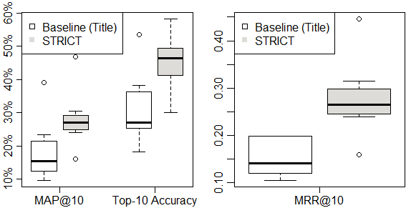
Experimental Results (Retrieval Performance)
*Our performance is significantly higher for each metric
Notes:
In terms retrieval performance, precision and recall are not too high.
Precision is close to 30% and the accuracy is close to 45% when Top-10 results are considered.
But I guess, that has been the status quo for the last 15 years. So, nothing very dramatic.
However, they are quite higher than the baseline performance actually.

Slide 16
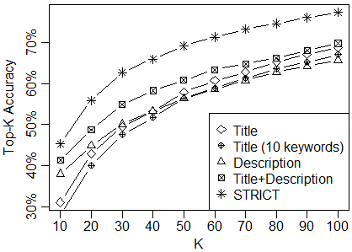
Experimental Results (Retrieval Performance)
Our Top-K accuracy is clearly higher for various K-values
Notes:
When we extend the K-values, we found the accuracy is growing significantly.
But, still, our performance remained higher than all the baselines.
This shows the potential of our method.

Slide 17
Comparison with Existing Methods (Query Effectiveness)
Technique | Improved | Worsened | Preserved | MRD
Kevic & Fritz, ICSE 2014 | 40.09% | 53.95% | 5.96% | +101
Rocchio’s Method, ICSE 2013 | 37.59% | 56.38% | 6.03% | +45
STRICT | 57.84%* | 34.94%* | 7.22% | -147
*= Significant Difference, MRD = Mean Rank Difference
Notes:
We compared with two parallel methods– Kevic & Fritz used heuristics and the second is a classic query reformulation technique.
While they were promising, but still our method beat them in all aspects, and the performance is significantly higher as you see.

Slide 18
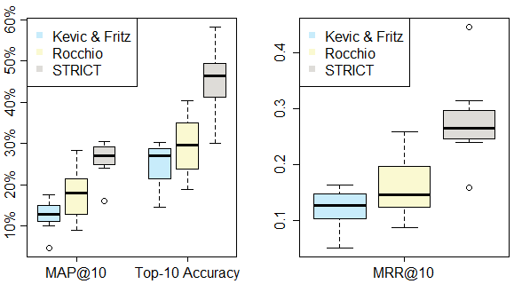
Comparison with Existing Methods (Retrieval Performance)
*Our performance is significantly higher for each metric
than the state-of-the-art
Notes:
If we see at box plots, we can see that our median metrics are significantly higher.
While they relied to a set of heuristics and term weighting, our PageRank-based model seems to perform better.

Slide 19
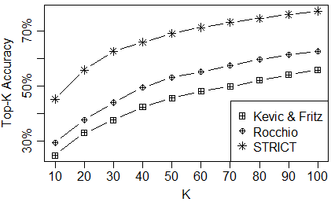
Comparison with Existing Methods (Retrieval Performance)
Our Top-K accuracy is clearly higher for various K-values
than the state-of-the-art
Notes:
When we consider various Top-K accuracy, we got similar findings.
Our method located concepts correctly for 80% of the change requests whereas they did for 60% of them at best.
This shows the potential of our technique.

Slide 20
Take-Home Messages
Identifying initial search terms is challenging.
Only 12.20% of developer’s search terms are relevant.
PageRank Algorithm adapted for term importance.
We combined TextRank and POSRank for identifying important terms.
Experiments with 1,939 change tasks from 8 systems of Apache & Eclipse.
57.84% of queries improved by STRICT.
Comparison with state-of-the-art approach validates our approach.
Notes:
You can simply read out the texts I guess.

Slide 21

Thank You !!! Questions?
More details on STRICT:
http://homepage.usask.ca/~masud.rahman/strict/
Contact: masud.rahman@usask.ca
Notes:
Thanks for your time and attention.
I am ready to have a few questions.

Slide 22
Provocative Statement
We need better algorithms to overcome “vocabulary mismatch issue”. Where to start from? Which source/repository is more appropriate beside project source code?
Notes:
We tried with source code and Stack Overflow to look for semantically similar words.
What’s next?

Slide 23
Probable Questions
Did you do stemming?
No we didn’t since many recent studies reported negative performance. Especially does not help when the texts contain structured items like camel case tokens.
Which one is better TextRank and POSRank?
The performed quite similarly. But we combined them since they convey two distinct aspects of connectivity.
Which settings did you apply for the ranking algorithm?
Details in the paper. But these PR-based algorithms have a tendency of converging scores despite their initial settings unlike simple VSM based models.
Can this be used for query reformulation?
Could be yes, if you can convert the artifact into the text graph. We are basically working with that using source code.

Slide 24
Probable Questions
Recent studies show that IR-based methods are not effective if the bug report is not rich.
Yup, that’s true. We need more techniques to better write the bug reports. Plus, we need better methods to address vocabulary mismatch issue.
Why didn’t you consider any stuff from the source code?
We are suggesting the initial query. Yes, the source will be used for query-reformulation. We also showed that our initial query is better than the baselines as used by the developers frequently.
How is the cost? How long it take?
It is pretty much real time. We are planning to develop an IDE plug-in recently.

