Slide 1

Machine Learning Autoencoder Applied to Communication Channels
Eduardo Dadalto Camara Gomes
Prof. Meryem Benammar, Ph.D
Department of Electronics, Optronics and Signal Processing (DEOS)

Slide 2
Summary
Introduction
Point to point communication system
Binary symmetric channel
Channel decoding: Maximum A Posteriori Decoder (MAP)
Problem Statement
Related Work
Future Work

Slide 3
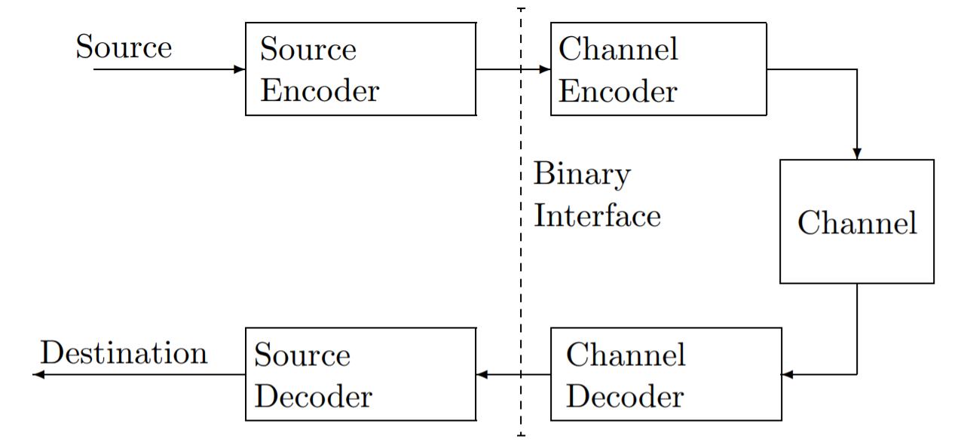
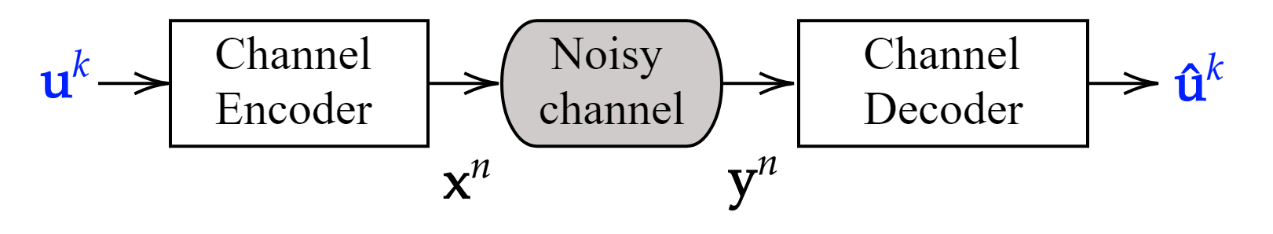
Introduction
Point to point communication system

Slide 4
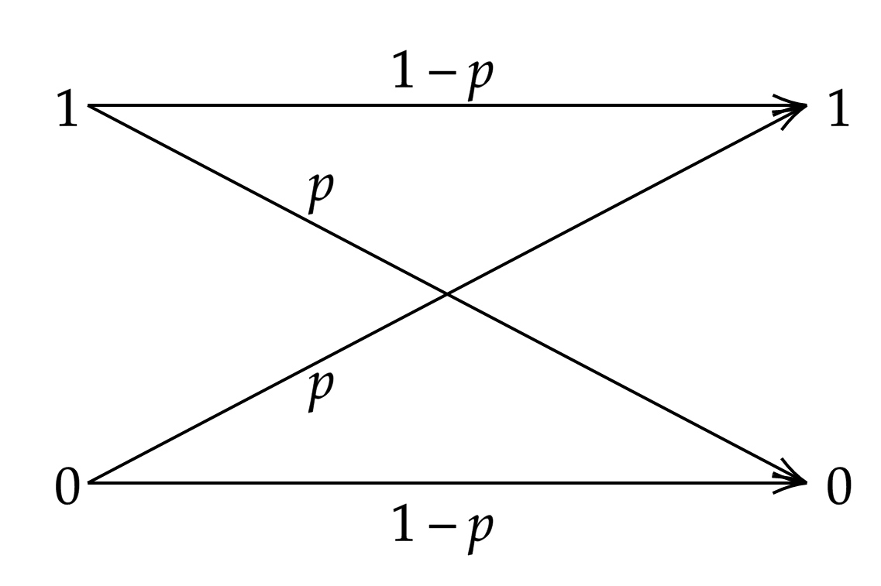

Introduction
Binary symmetric channel
Cross over probability $0≤p≤1/2$
Result in corrupted information

Slide 5
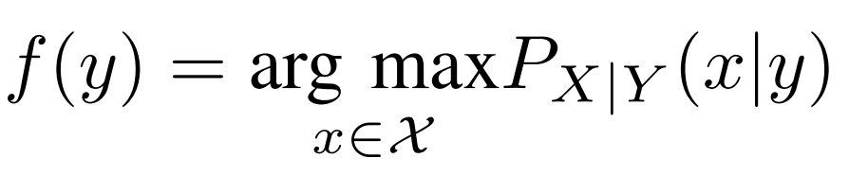
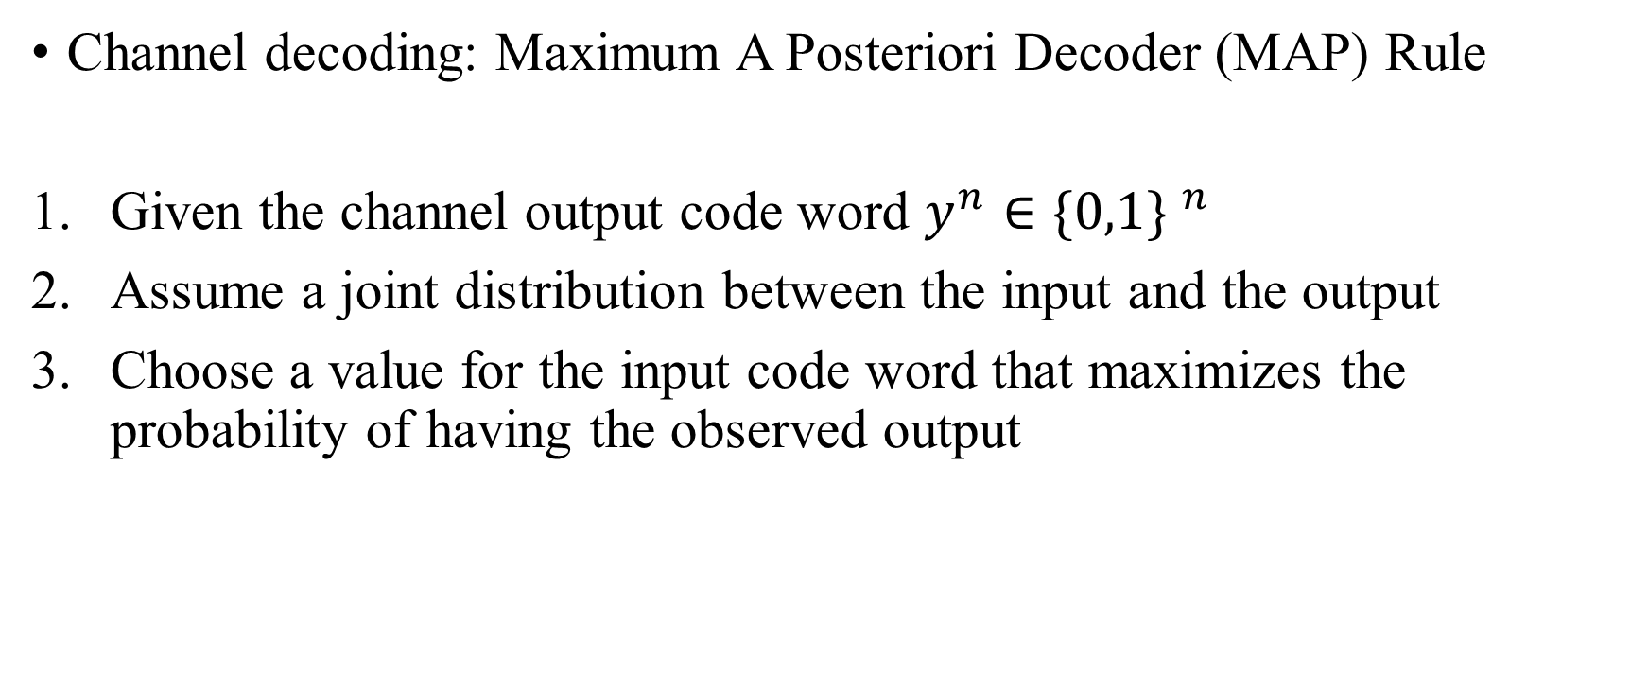
Introduction
Channel decoding: Maximum A Posteriori Decoder (MAP) Rule
Given the channel output code word $y^{n}∈{\{0,1\} }^{n}$
Assume a joint distribution between the input and the output
Choose a value for the input code word that maximizes the probability of having the observed output

Slide 6
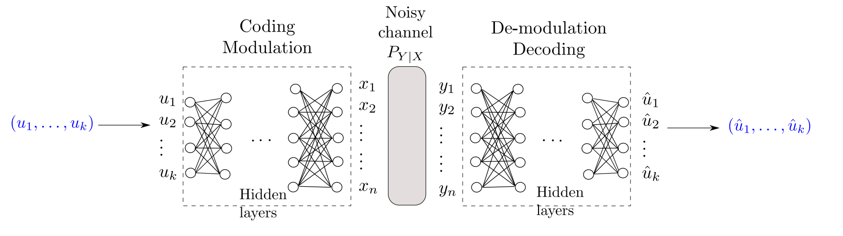
Problem Statement
Proposed solution: Deep Neural Network (DNN) based Autoencoder

Slide 7
Related Work
O’Shea et al. develop a fundamental new way to think about communications system design as an end-to-end reconstruction optimization task that seeks to jointly optimize transmitter and receiver components in a single process, by interpreting a communications system as an autoencoder. ¹
T. Gruber et al. proved that a deep learning-based channel decoder could actually learn a decoding algorithm rather than just being a simple classifier. ²
¹ O’Shea, Tim & Hoydis, Jakob, “An Introduction to Machine Learning Communications Systems”
² T. Gruber, S. Cammerer, J. Hoydis, and S. ten Brink, “On deep learning based channel decoding,”

Slide 8
Future Work
Machine Learning
DNN basics ✓
TensorFlow library familiarization -
DNN channel decoder X
DNN channel autoencoder X
Communication System
Hamming source code ✓
MAP channel decoder ✓
BER x SNR graphics X
Results X
Analysis X
Conclusions X

