Slide 1



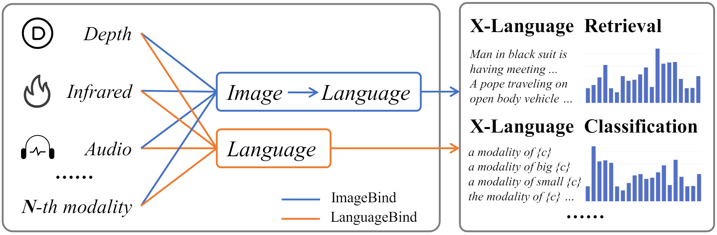
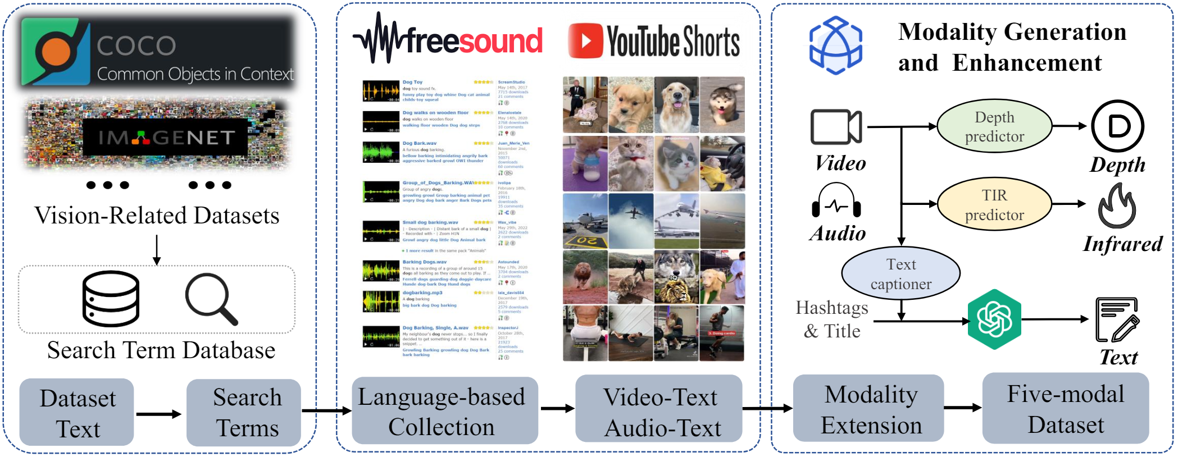
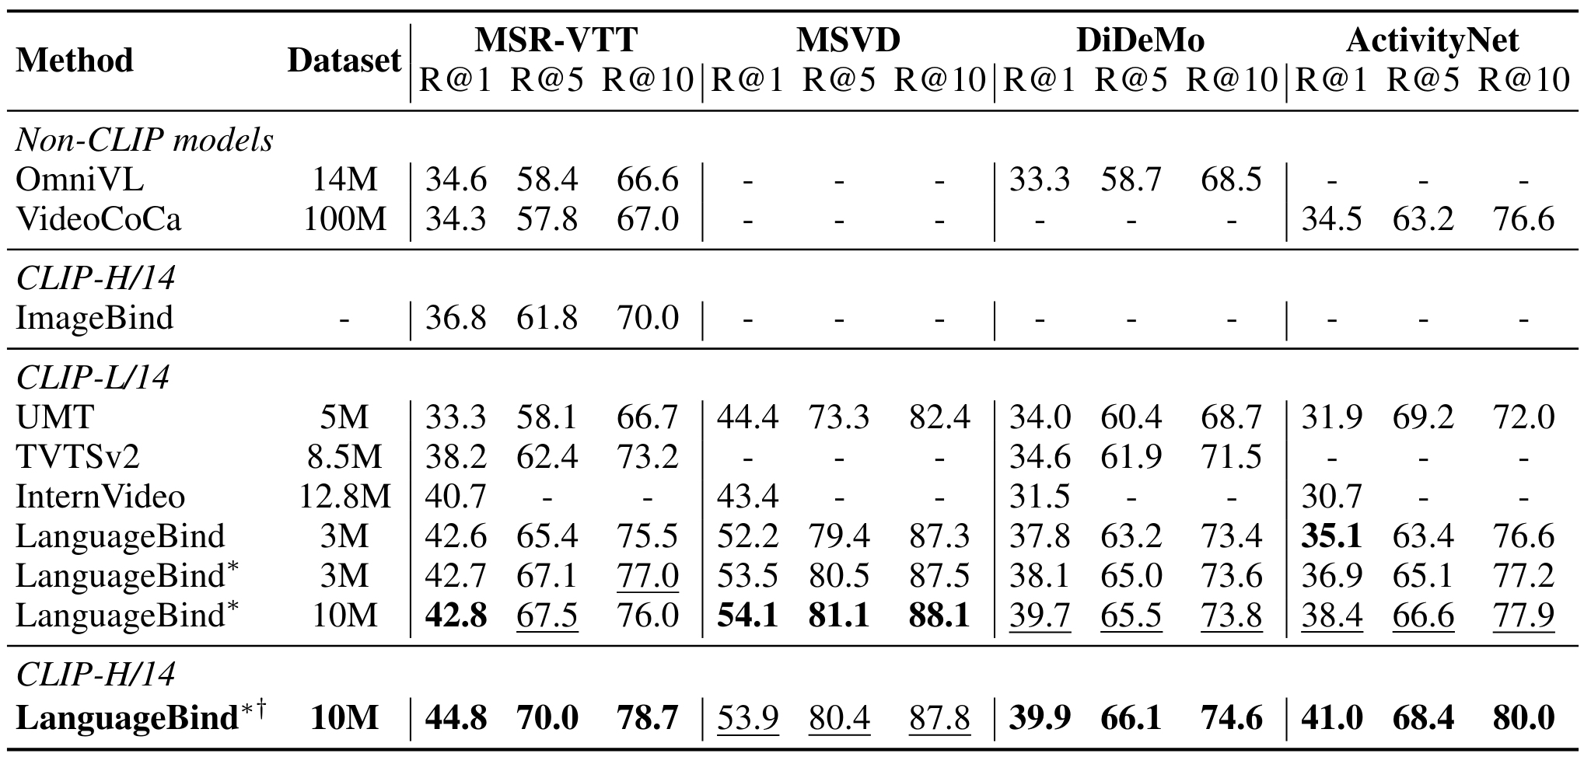
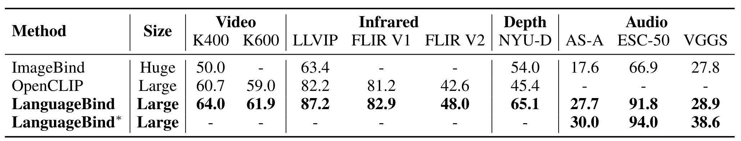
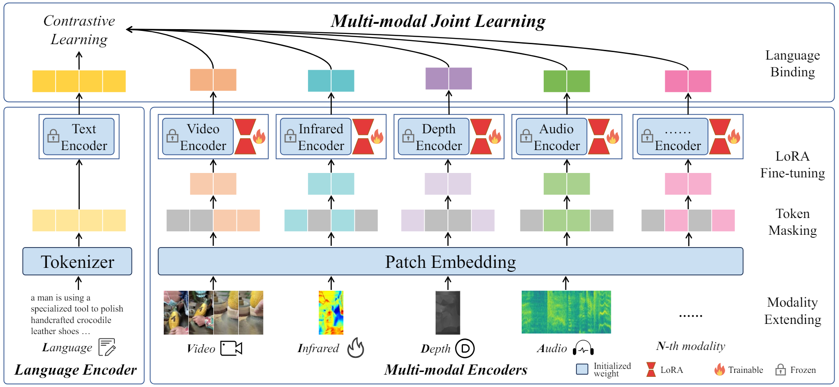
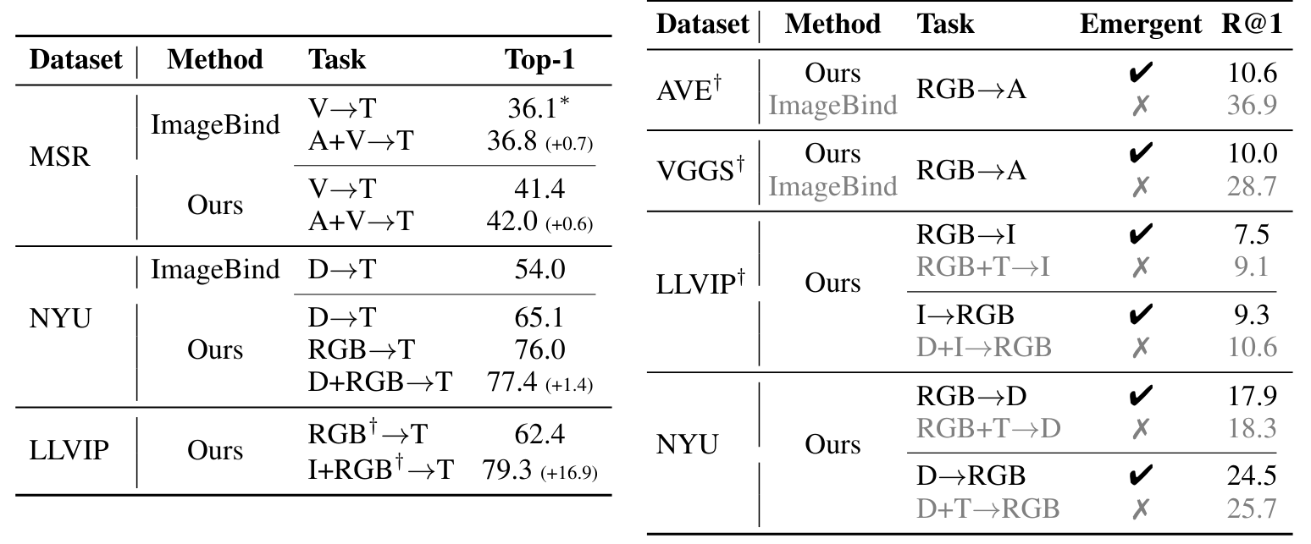
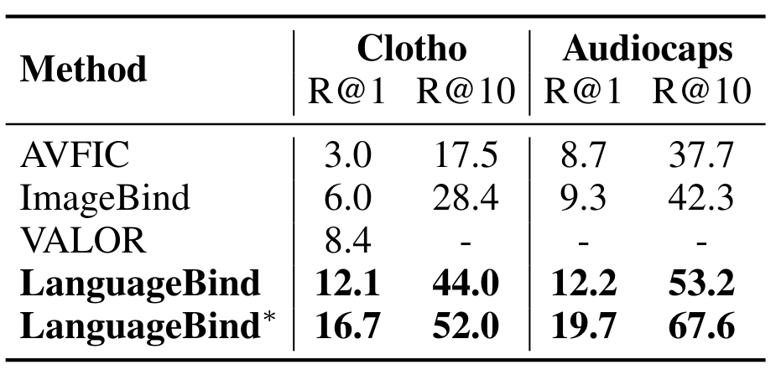
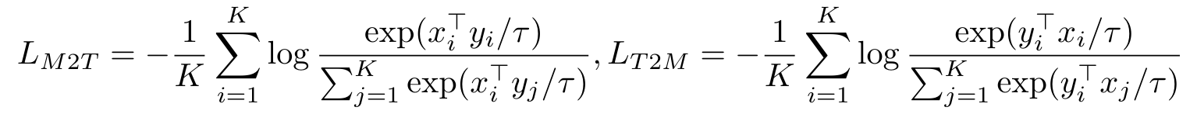
LanguageBind: Extending Video-Language Pretraining to N-modality by Language-based Semantic Alignment
Bin Zhu, Bin Lin, Munan Ning, Yang Yan, Jiaxi Cui, HongFa Wang, Yatian Pang, Wenhao Jiang, Junwu Zhang, Zongwei Li, Wancai Zhang, Zhifeng Li, Wei Liu, Li Yuan
Peking University, Tencent Data Platform, National University of Singapore, Pengcheng Lab
Github
Paper
ICLR 2024
Core Challenge
Dataset
Search term database collection
Video and audio collection and filtering
Modality generation and enhancemnet
VIDAL-10M construction. (a) Firstly, a search term database is generated by leveraging visually related datasets. (b) Subsequently, relevant videos and audios are collected from the internet and undergo a series of filtering processes. (c) Lastly, we perform infrared and depth modality generation, as well as multi-view text generation and enhancement.
Current VL pretraining frameworks are often limited to vision and language modalities. ImageBind
(Girdhar et al., 2023) introduces an indirect alignment method for multi-modal pretraining. It aligns
other modalities to images.
In practical tasks such as retrieval and classification, the alignment with language modality is predominantly required for various modalities.
Experiments
Zero-shot Video-Text retrieval
Zero-shot X-Language classification
Framework
By employing contrastive learning between language and other modalities, LanguageBind successfully achieved multimodal joint learning, thereby fostering semantic alignment across different modalities.
Emergent zero-shot retrieval
Zero-shot Audio-Language retrieval

