Slide 1
Planetary Level systems using Blockchain Technology
B. RAMAMURTHY
©2022, ALL RIGHTS RESERVED
BINA@BUFFALO.EDU
HTTP://WW.CSE.BUFFALO.EDU/FACULTY/BINA
DIRECTOR, BLOCKCHAIN THINKLAB
COMPUTER SCIENCE AND ENGINEERING
PROGRAM DIRECTOR, DATA-INTENSIVE COMPUTING PROGRAM
COURSERA INSTRUCTOR
MANNING AUTHOR: BLOCKCHAIN IN ACTION
Ethereum Wallet address: bina.eth

Slide 2





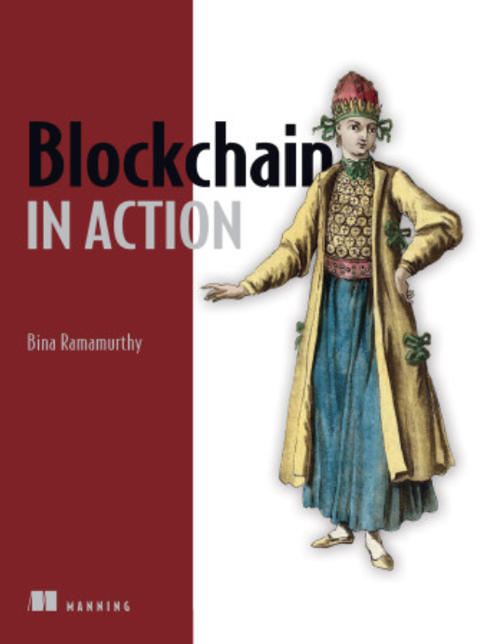

Introducing myself..
bina@buffalo.edu
Ph.D. in Computer Engineering: Fault tolerance in distributed systems
Faculty at CSE and University at Buffalo (UB) for the past 3 decades
2008 - 2023: NSF grants: Data-intensive computing EHR(3), DBI, HDR
2010 -2018: SUNY-supported blockchain grants
2018 - present: 4-course certification on blockchain on Coursera MOOC
-- More than 220,000 learners and 600,000 visitors from all over the world
2019 SUNY chancellor’s award for excellence in teaching
2020 - Published a technical book: Blockchain in Action (Manning.com)
2018 – Three Blockchain Courses – Currently teaching one
2020 - Decentralized Finance (DeFi) Series Production (Coursera)

Slide 3
Background: Blockchain
The innovation

Slide 4
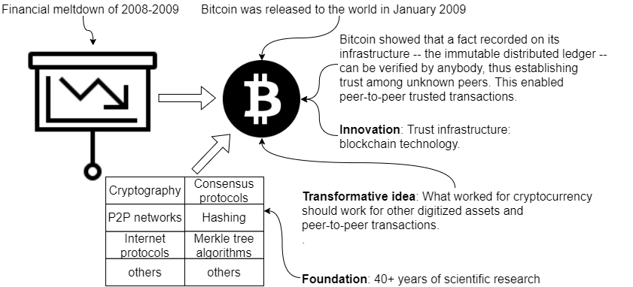
Bitcoin and Blockchain: the innovation
The birth of blockchain technology [1]

Slide 5
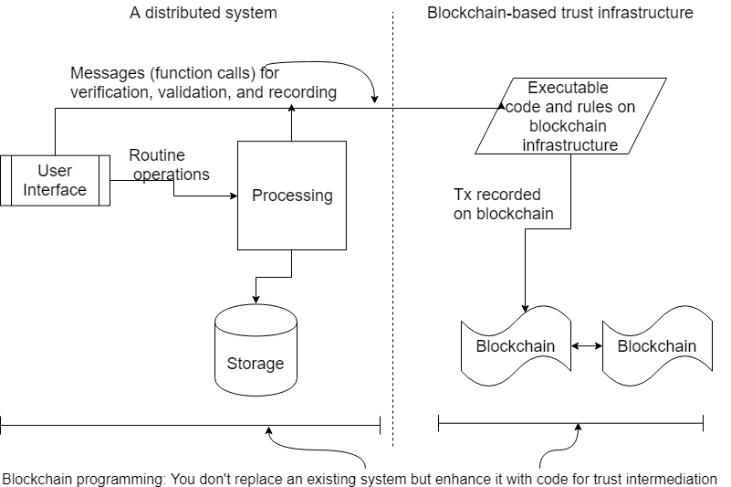
Blockchain coexists with your system!
Implementing trust by
verification,
validation and
recording with consensus

Slide 6


Expected Outcome of this presentation?
Cryptocurrency, coins, FT, NFT, multi-Token NFT, DeFi, ……
Focus on:
Planetary level systems,
applications, and problem solving
using blockchain technology

Slide 7
More on this presentation
A proof of concept prototype for blockchain-based
micropayments to enable planetary level systems is available on github:
Codebase. + instructions + installation of required tools
https://github.com/BinaRam/topcoder
Details are available in Chapter 7 and 8 of Blockchain in Action book.
https://www.manning.com/books/blockchain-in-action

Slide 8
Planetary Level Systems and applications
The real impact!

Slide 9
Planetary Level Systems
Blockchain is not intended to replace existing applications, but to address issues that are not solvable with traditional approaches.
Don’t think of replacing your current system with a blockchain system or porting an existing
application in one language (such as Java or Python) to Solidity simply to use the
capabilities of blockchain technology.
You have to be thinking about newer and never before seen application models for blockchain.
One of the areas that is wide open (no pun intended) are the large scale global problem that cannot be effectively solved by any centralized authority. Examples areas: global plastics cleanup, global climate issues, global hunger management, in general ESG (environmental, social, and governance) at the global level involving all the people and entities.
The solutions for such global problems lie in the participation of diverse people (stakeholders, beneficiaries) in an ecosystem emerging from blockchain technology.

Slide 10
Representative Application
PROBLEM STATEMENT Assume that a United Nations-like nongovernmental organization wants to pay individuals certain incentive payments (micropayments) for every bin of recyclable plastics collected from the environment and deposited at a designated location for recycling and proper disposal. You are required to design and develop a decentralized solution to facilitate this process.
Massive Planetary Level (Plastics) Cleaning (MPC)

Slide 11
Use case visualization
Observe on-chain
and off-chain operations!

Slide 12
On-chain and off-chain operations
Micropayment channel opened. A single-use micropayment channel between sender (organizer) and receiver (worker) is created by deploying a smart contract.
Plastics collected. In off-line (and off-chain) operations, people or robots (workers) collect plastics garbage in bins.
Collections verified. Off-chain verification is done by appropriate automatic instrumentation, with sender-organizer being informed of how many bins were collected and by whom (using worker identities).
Micropayments paid. Organizer sends off-chain signed micropayment messages to the worker for bins verified in step 3.
Payment claimed. Using a single on-chain transaction executed on the smart contract, the worker is paid from escrow deposited by the organizer.
Channel closed. After the payment, the channel is closed by the destruction of the smart contract.

Slide 14
Micropayment channel concept

Slide 15
Code and Demo
Structure of your application
MPC-Dapp
MPC-contract
MPC-app
We’ll compile and deploy the smart contract for MPC on Ganache local blockchain.
Download and Quick Start the Ganache
Navigate to MPC-contract folder and deploy the MPC smart contract on Ganache
truffle migrate –reset
Navigate to MPC-app folder and deploy the MPC-app web application and User interface on node.js
npm install
npm start
Here is a demo of the interaction: This simulates both the participant (plastics collector) and also organizer
who sends micropayments. The participant-worker claims payment.
The application needs to be extended to multiple participants and long-running smart contract.

Slide 16
Need more information?
MPC is a template for Planetary Level Systems and Applications using blockchain Technology.
What is a standard structure for a Dapp?
MPC-contract, MPC-app folders of the MPC-Dapp
What is the toolchain?
Truffle, Ganache and Ropsten test nets of Ethereum
Node.js server, web UI framework (or mobile UI framework)
More details: See Chapter 7, 8 of Blockchain in Action, Manning Publishers.
Codebase for MPC-dapp and instructions are also available on github.

