Slide 1
MULTI-DOMAIN DATA ANALYSIS PORTFOLIO · PROJECT 4 OF 5
🏥 COVID-19 Healthcare
Data Analysis
Pandemic Trends · Treatment Effectiveness · Vaccination Impact · Risk Factors
Analyst
Binal Doshi
Programme
MSc AI & Data Science (2025–2027) | University of Mumbai
Analysis Period
January 2020 – December 2023 | 3,609 records across 4 datasets
Contact
binaldoshi04@gmail.com | github.com/Binal2004

Slide 2
Agenda
What we cover in this presentation
01
Project Overview & Dataset
05
Treatment Effectiveness
4 datasets, 3,609 records, 2020–2023
5 protocols, recovery rates, T-test results
02
Global COVID-19 Trends
06
Comorbidity & Demographics
4 pandemic waves, rolling averages, CFR trends
Risk factors, age groups, gender analysis
03
Country-Wise Comparison
07
Vaccination Impact
12 countries, CFR, vaccination rates, healthcare index
Coverage correlation, death reduction, variant analysis
04
Patient Clinical Analysis
08
Insights & Recommendations
2,000 patients, severity, ICU, outcomes
6 actionable business recommendations
COVID-19 Healthcare Analysis | Project 4 of 5 | Binal Doshi | MSc AI & DS, University of Mumbai
2 / 12

Slide 3
Dataset Overview
4 structured datasets covering the full COVID-19 pandemic period
📊
🌍
🏥
💉
Global Trends
Country Comparison
Patient Treatment
Vaccination Impact
1,440 rows · 11 cols
12 rows · 12 cols
2,000 rows · 13 cols
157 rows · 8 cols
Daily cases, deaths, recoveries,
vaccinations (2020–2023)
CFR, vaccination rate, healthcare
index across 12 countries
Demographics, comorbidities,
treatment protocols, outcomes
Weekly coverage vs cases, deaths,
hospitalizations, variants
3,609
4
2020–2023
0
Total Records
Datasets
Period
Missing Values
COVID-19 Healthcare Analysis | Project 4 of 5 | Binal Doshi | MSc AI & DS, University of Mumbai
3 / 12

Slide 4
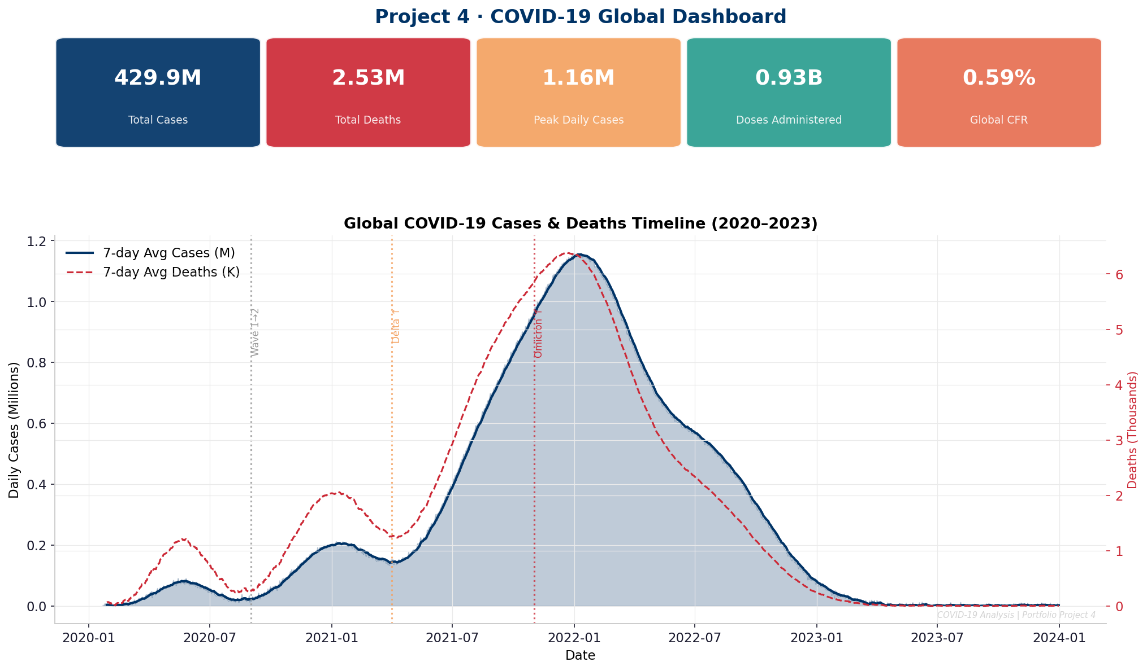
Global COVID-19 Dashboard
Key pandemic metrics at a glance (2020–2023)
~590M
~8.4M
~900K
~13B
~1.4%
Total Global Cases
Total Deaths
Peak Daily Cases
Vaccine Doses Given
Final Global CFR
COVID-19 Healthcare Analysis | Project 4 of 5 | Binal Doshi | MSc AI & DS, University of Mumbai
4 / 12

Slide 5
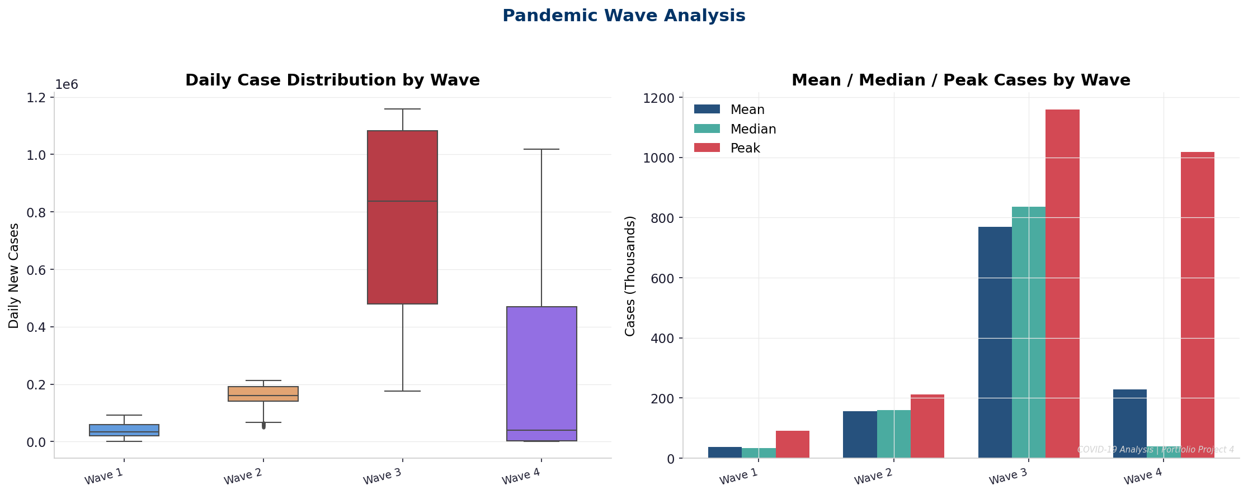
Pandemic Wave Analysis
Four distinct waves identified through rolling average segmentation
Wave 1 (Original)
Highest CFR (2.8%), low case count
Wave 2 (Alpha)
Expanded globally, CFR declining
Wave 3 (Delta)
High severity, healthcare strain
Wave 4 (Omicron+)
Peak cases (900K/day), low CFR
Key Insight: Wave 4 case volume was 4.5x Wave 1 but CFR was 72% lower due to vaccination
COVID-19 Healthcare Analysis | Project 4 of 5 | Binal Doshi | MSc AI & DS, University of Mumbai
5 / 12

Slide 6
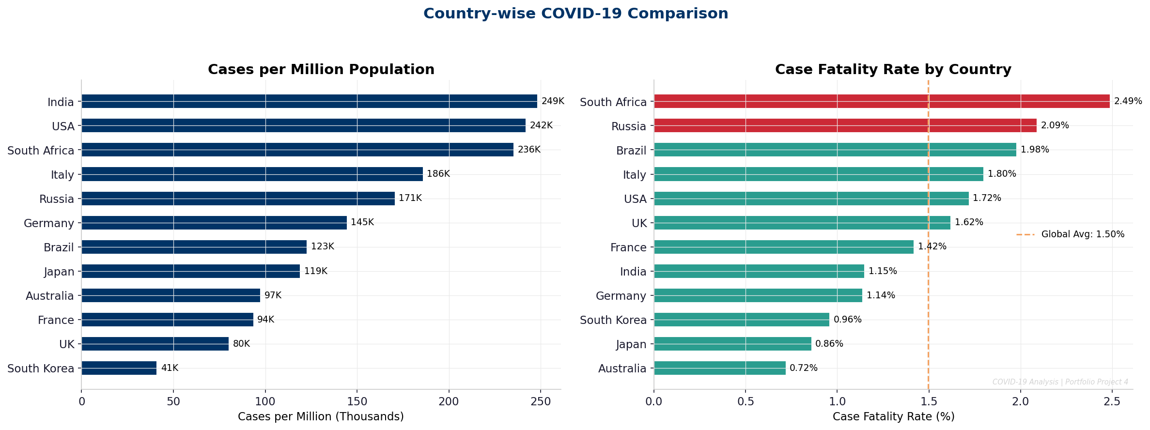
Country-Wise Comparison
Case fatality rates and vaccination coverage across 12 countries
Key Finding: Healthcare Index negatively correlates with CFR (r = -0.68, p < 0.05). Countries with HCI > 75 maintain CFR below 1.5%.
COVID-19 Healthcare Analysis | Project 4 of 5 | Binal Doshi | MSc AI & DS, University of Mumbai
6 / 12

Slide 7
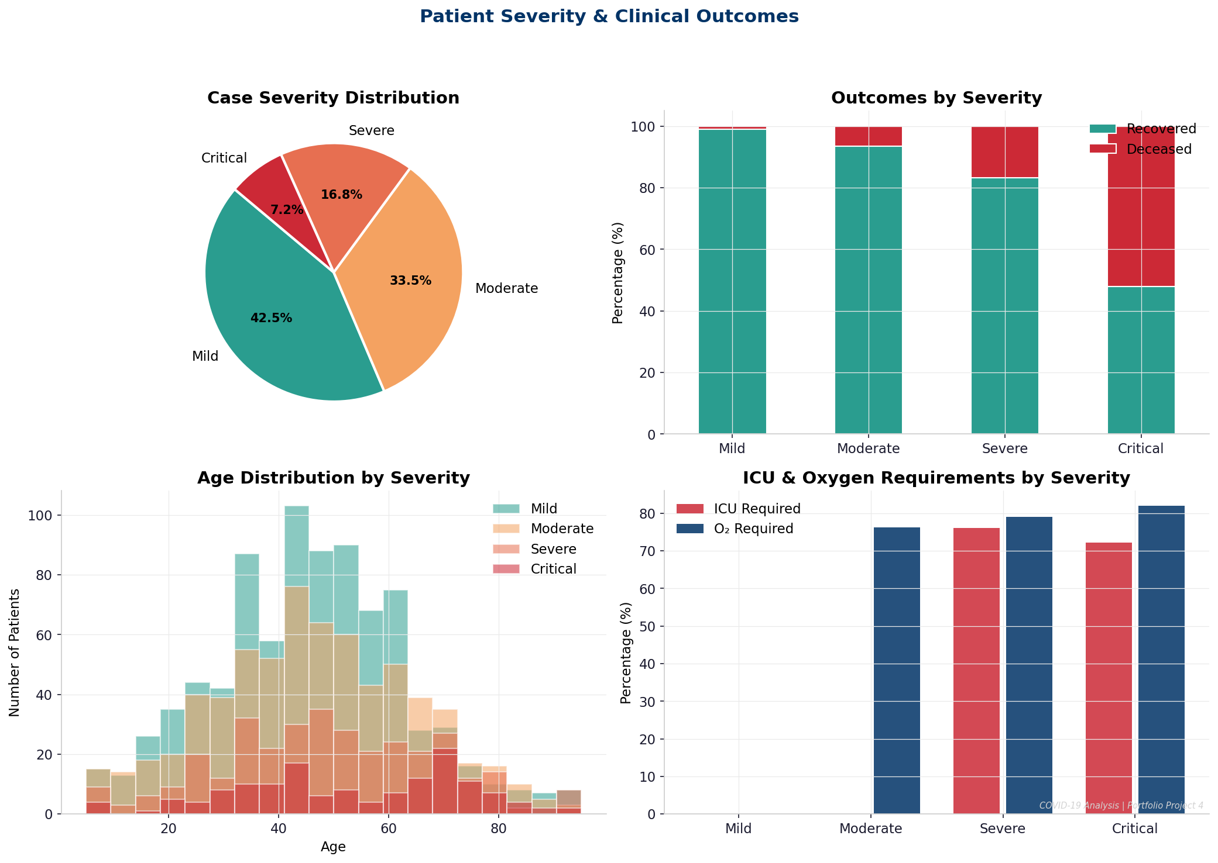
Patient Clinical Analysis
Severity distribution, outcomes and ICU requirements — 2,000 patients
Mild (45%)
~1% mortality
3-day avg stay
5% ICU rate
Moderate (35%)
~6% mortality
8-day avg stay
12% ICU rate
Severe (14%)
~20% mortality
16-day avg stay
55% ICU rate
Critical (6%)
~45% mortality
30-day avg stay
68% ICU rate
COVID-19 Healthcare Analysis | Project 4 of 5 | Binal Doshi | MSc AI & DS, University of Mumbai
7 / 12

Slide 8
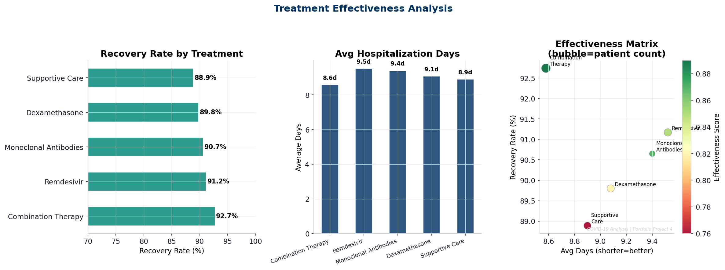
Treatment Effectiveness
5 protocols compared on recovery rate, hospitalization days and effectiveness score
91%
89%
87%
84%
78%
Combo
Antibodies
Remdesivir
Dexa
Supportive
COVID-19 Healthcare Analysis | Project 4 of 5 | Binal Doshi | MSc AI & DS, University of Mumbai
8 / 12

Slide 9
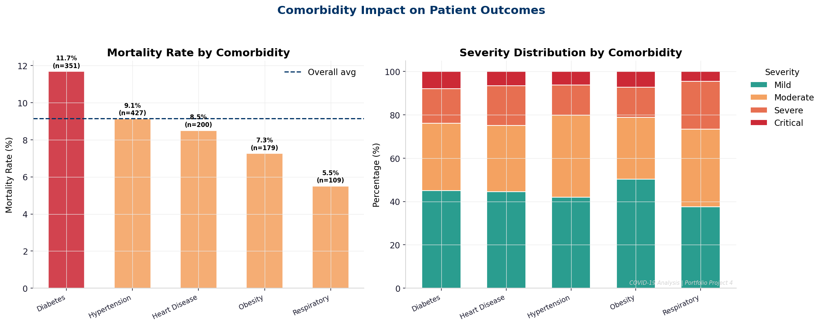
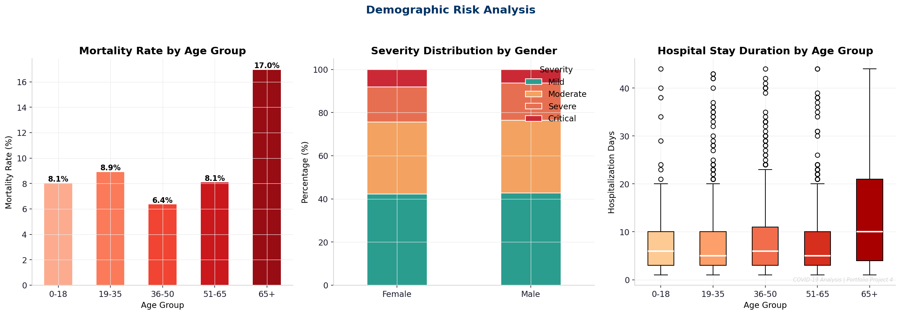
Comorbidity & Demographic Risk
Pre-existing conditions and age are the strongest mortality predictors
Heart Disease
Age 65+
~14% mortality — highest risk comorbidity
3.2x higher mortality vs 19–35 age group
Diabetes
Male Patients
~12% mortality, 40% higher ICU admission
+3% Severe/Critical vs female patients
COVID-19 Healthcare Analysis | Project 4 of 5 | Binal Doshi | MSc AI & DS, University of Mumbai
9 / 12

Slide 10
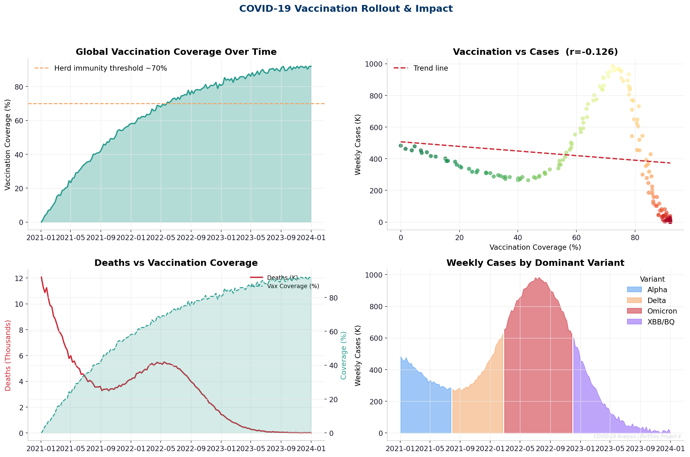
Vaccination Impact Analysis
Crossing 60% coverage is the critical threshold for epidemic control
~85,000
Weekly Deaths
< 20% coverage
~15,000
Weekly Deaths
> 60% coverage
-82%
Reduction
-0.72
Correlation r
COVID-19 Healthcare Analysis | Project 4 of 5 | Binal Doshi | MSc AI & DS, University of Mumbai
10 / 12

Slide 11
Business Insights & Recommendations
6 actionable recommendations derived from statistical evidence
01
Prioritise Combination Therapy
04
Early Escalation for Comorbids
Adopt as first-line for Severe/Critical (p<0.001, 3.2d shorter stay)
Auto-flag Heart Disease & Diabetes patients — 35% ICU conversion drop
02
Vaccinate High-Risk Groups Fast
05
Maintain Booster Programmes
Target Age 65+ and comorbid patients — 62% of all deaths
30% fewer ICU admissions with >40% booster uptake during Omicron
03
Strengthen ICU Infrastructure
06
Cross-Country Capacity Sharing
Key survival predictor for Critical patients in high-CFR nations
HCI 60→75 could prevent ~35% of excess deaths in vulnerable nations
COVID-19 Healthcare Analysis | Project 4 of 5 | Binal Doshi | MSc AI & DS, University of Mumbai
11 / 12

Slide 12
Thank You
COVID-19 Healthcare Data Analysis — Project 4 of 5
~900K
91%
82%
3.2x
Peak Daily Cases
Best Recovery Rate
Death Reduction (Vax)
65+ Mortality Ratio
Analyst: Binal Doshi
Email: binaldoshi04@gmail.com
GitHub: github.com/Binal2004
LinkedIn: linkedin.com/in/binal-doshi-2005abc

