Slide 1
SUPERMARKET SALES
ANALYSIS REPORT
Retail Domain | Data Analysis Portfolio — Project 1
January 2023 – December 2023 | 3 Branches | 2,000 Transactions
Author: Binal Doshi | MSc AI & Data Science, University of Mumbai (2025–2027)
Tools: Python • pandas • matplotlib • seaborn

Slide 2
Executive Summary — Key Performance Indicators
$519,281
2,000
$259.64
Total Revenue
Total Transactions
Avg Transaction
6.97 / 10
Health & Beauty
Saturday
Average Rating
Top Product Line
Peak Shopping Day
Period: 1 Jan 2023 – 31 Dec 2023 | Branches: Yangon (A) · Mandalay (B) · Naypyitaw (C)

Slide 3
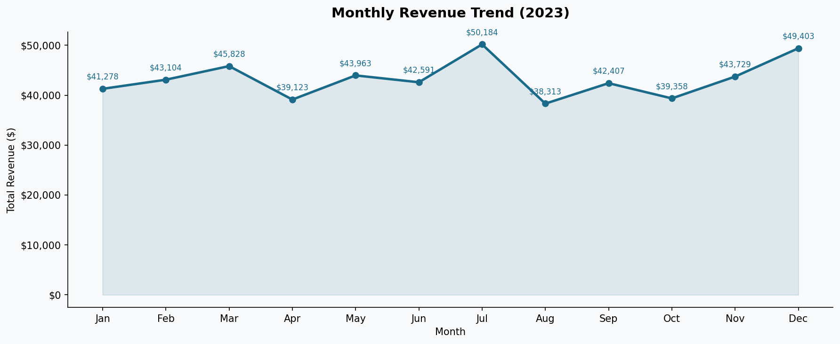
Revenue & Sales Trends
▲ Peak: July ($50,184) ▼ Low: August ($38,313) Year-end: December ($49,403)

Slide 4
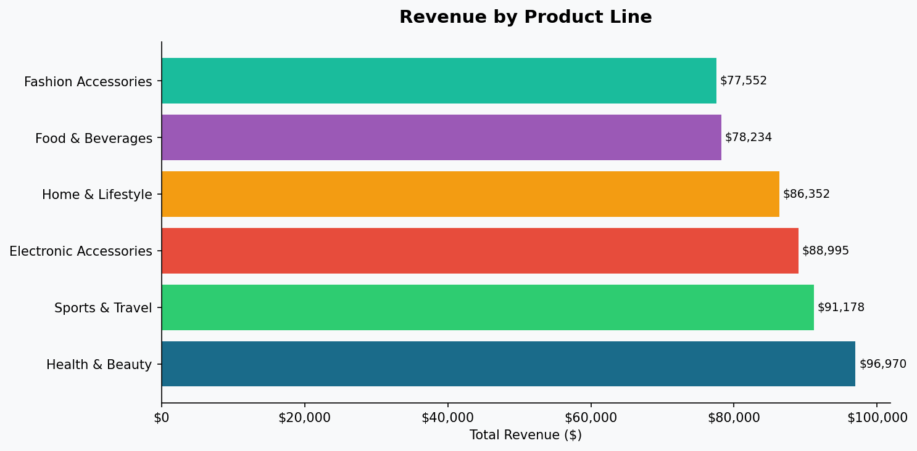
Product Line Performance
Revenue Share
Health & Beauty
18.7%
$96,970
Sports & Travel
17.6%
$91,178
Electronic Accessories
17.1%
$88,995
Home & Lifestyle
16.6%
$86,352
Food & Beverages
15.1%
$78,234
Fashion Accessories
14.9%
$77,552
Well-balanced portfolio — no single product line exceeds 18.7%

Slide 5
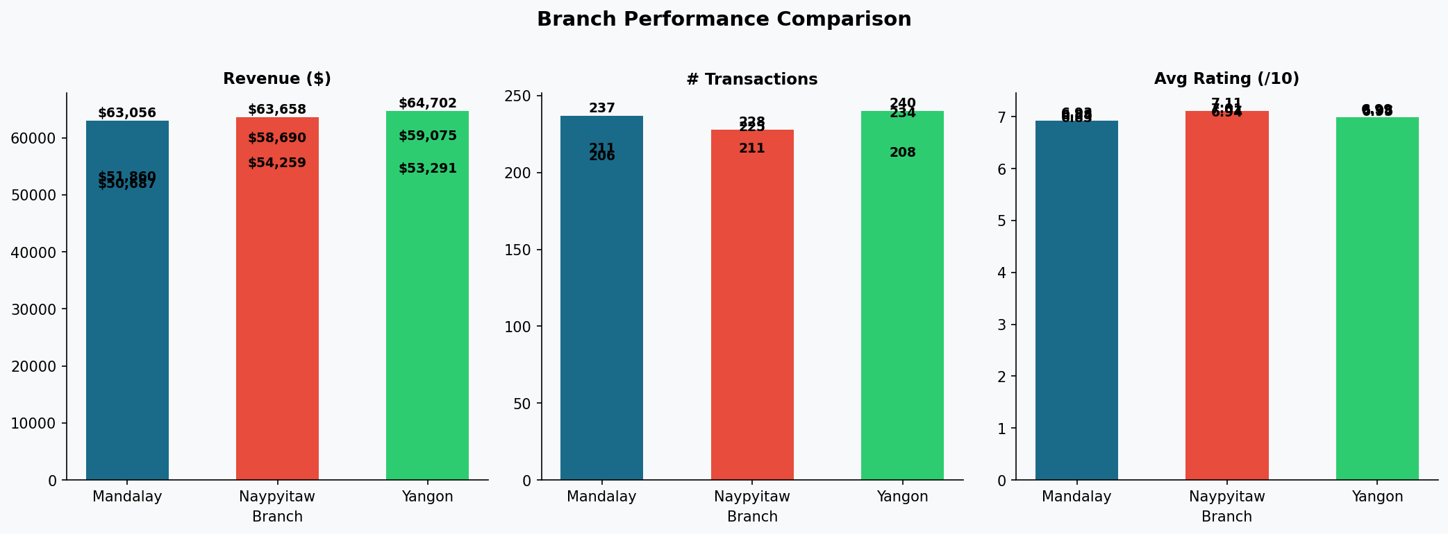
Branch Performance Analysis
Branch | City | Revenue | Transactions | Avg Rating
B (Mandalay) | $180,822 | 696 transactions | 6.97/10
A (Yangon) | $179,048 | 674 transactions | 6.92/10
C (Naypyitaw) | $159,411 | 630 transactions | 6.98/10

Slide 6
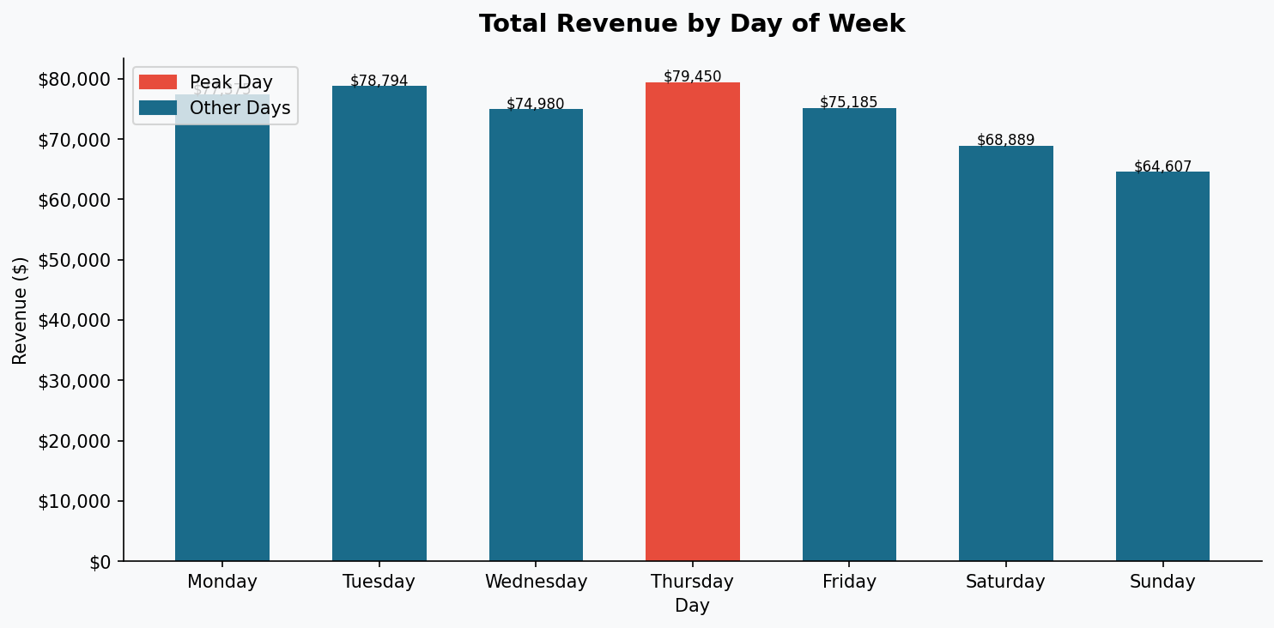
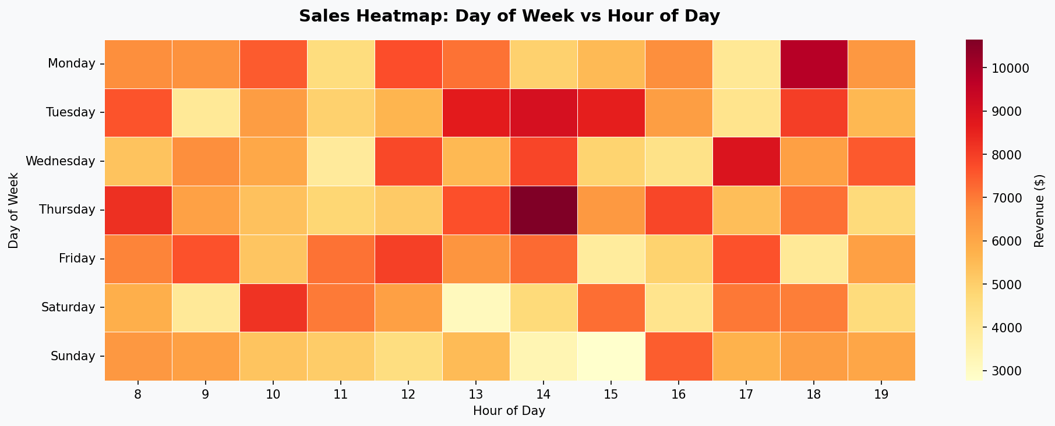
Temporal Sales Patterns
Saturday = peak revenue day • 18:00 = busiest hour • Evening traffic suggests after-work shopping

Slide 7
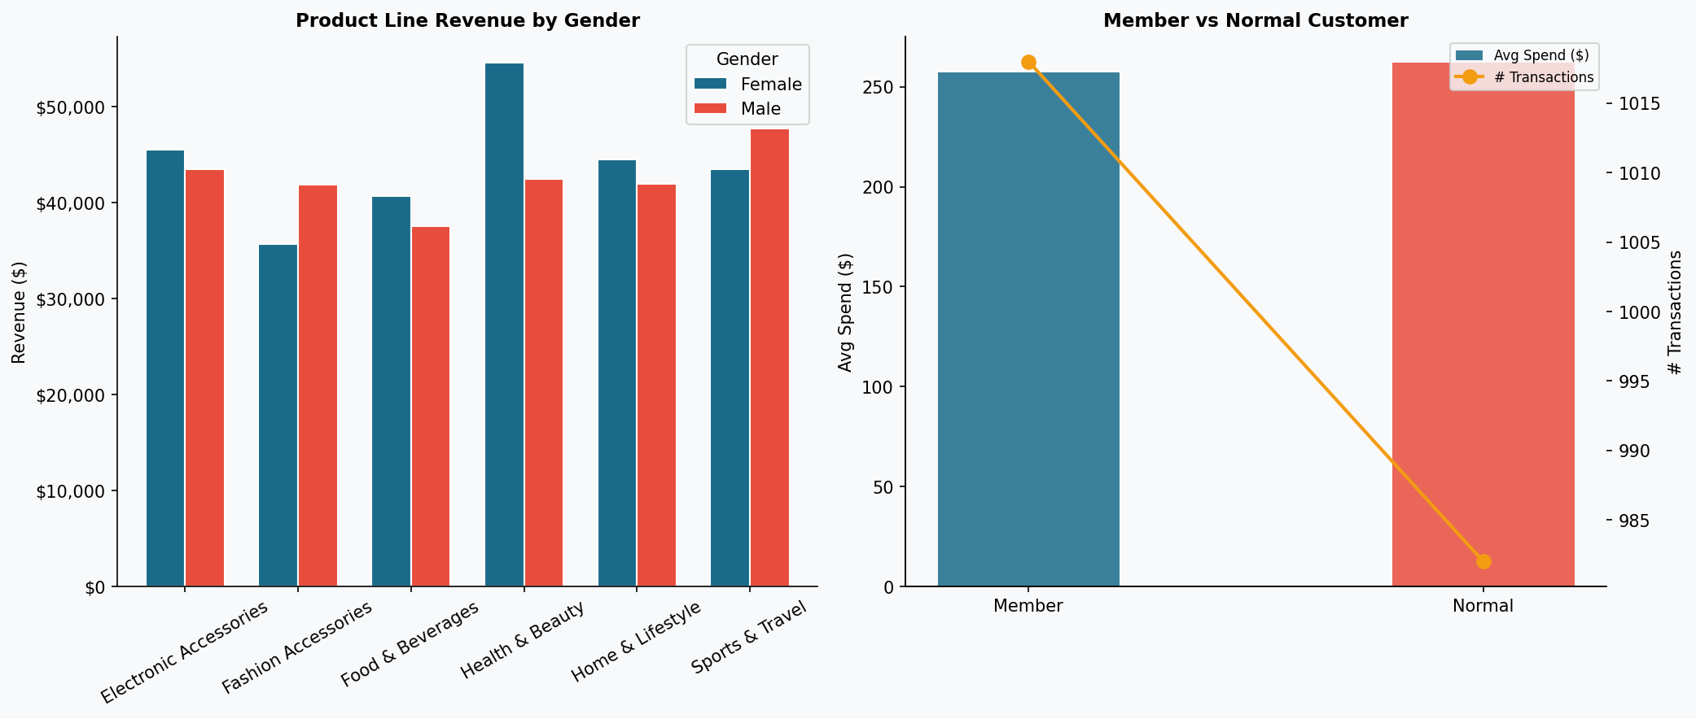
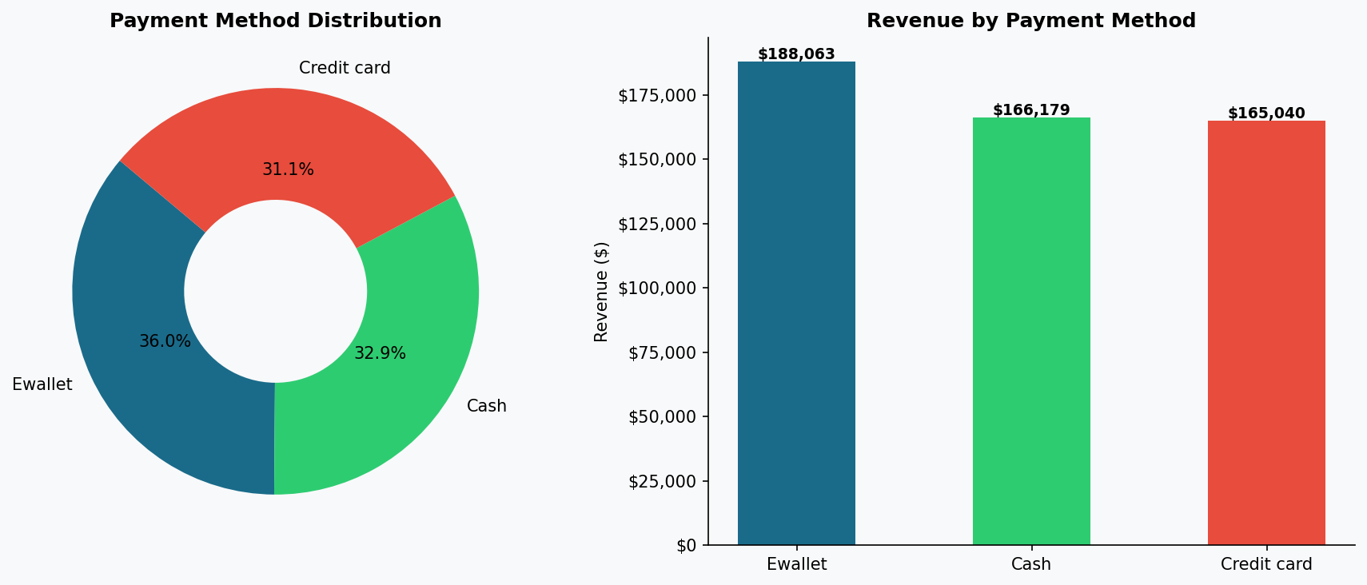
Customer Behavior & Payment Analysis
$257.29
$262.08
36.2%
32.0%
Member Avg Spend
Normal Avg Spend
E-wallet Share
Cash Share

Slide 8
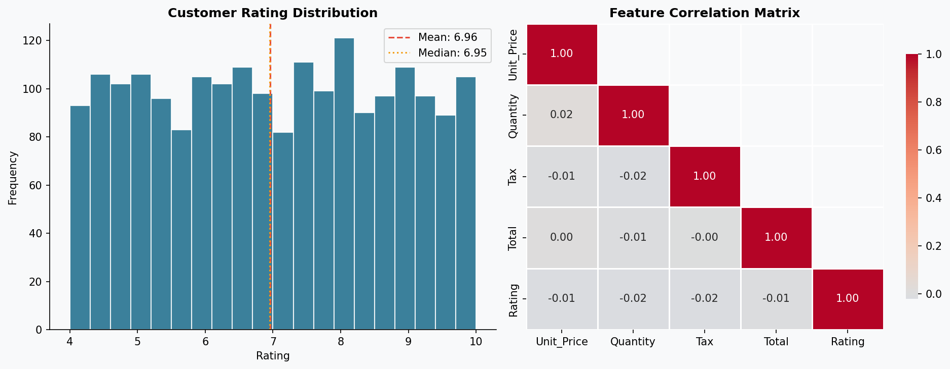
Statistical Analysis
Key finding: Customer Rating shows near-zero correlation with spend (r ≈ -0.01) — satisfaction is independent of transaction value

Slide 9
Business Insights & Recommendations
Boost Health & Beauty Inventory
Saturday Loyalty Events
01
Lead product line (18.7% share). Increase stock 15–20% to meet demand.
02
Launch double-point promotions on the peak sales day to amplify the buying surge.
HIGH · +8% revenue
HIGH · +12% revenue
E-wallet Cashback Partnership
Evening Flash Sales (6–9 PM)
03
Partner with e-wallet providers for exclusive discounts — 36% of transactions are digital.
04
Schedule time-limited deals during the peak 18:00 hour to maximise revenue.
MED · +10% txn vol
MED · +7% revenue
Membership Upgrade Programme
Cross-branch Best Practices
05
Enhance member benefits — early access, exclusive discounts — to convert Normal customers.
06
Share top-performing methods between branches to lift the lowest-rated branch.
MED · +5% avg spend
LOW · +0.3 rating

Slide 10
Conclusion
Supermarket Sales Analysis — 2023
▸ Healthy, growing retail operation with $519,281 total revenue across 2,000 transactions
▸ Revenue is well-distributed across all 6 product lines — no over-reliance on a single category
▸ All 3 branches perform comparably, indicating strong operational consistency
▸ E-wallet is the dominant payment method (36.2%), highlighting a digitally engaged customer base
▸ Customer satisfaction (avg 6.97/10) is independent of spend — service quality matters beyond price
▸ Implementing all 6 recommendations can realistically target 10–15% revenue growth within 2 quarters
Binal Doshi | MSc AI & Data Science | University of Mumbai (2025–2027) | Portfolio Project 1

