Slide 1
Salesforce Q2 FY27
Earnings
August 26, 2026

Slide 2

Introduction
Mark Murphy
Executive Vice President of Global Investor Relations

Slide 3

Safe Harbor & Non-GAAP Financial Measures
"Safe harbor" statement under the Private Securities Litigation Reform Act of 1995: This presentation contains forward-looking statements about the Company’s financial and operating results and guidance which include, but are not limited to, expected GAAP and non-GAAP financial and other operating and non-operating results. The achievement or success of the matters covered by such forward-looking statements involves risks, uncertainties and assumptions. If any such risks or uncertainties materialize or if any of the assumptions prove incorrect, results or outcomes could differ materially from those expressed or implied by these forward-looking statements. The risks and uncertainties referred to above include, but are not limited to: the effect of the acquisition of Informatica on our operating results, the market price of our common stock, and our ability to retain and hire key personnel; uncertainties regarding Al technologies and its integration into our product offerings; the effect of evolving domestic and foreign government regulations; regulatory developments and regulatory investigations involving us or affecting our industry; our ability to successfully introduce new services and product features, including related to AI and Agentforce; our ability to execute our business plans; our ability to meet our long-term revenue target and profitable growth framework; the pace of change and innovation in enterprise cloud computing services; our ability to maintain and enhance our brands; and expectations regarding closing contemplated acquisitions and contributions from acquired companies. Further information on these and other factors that could affect the Company’s actual results or outcomes is included in the reports on Forms 10-K, 10-Q and 8-K and in other filings it makes with the Securities and Exchange Commission from time to time. These documents are available on the SEC Filings section of the Financials section of the Company’s website at investor.salesforce.com/financials/. Salesforce, Inc. assumes no obligation and does not intend to revise or update publicly any forward-looking statements for any reason, except as required by law.
This presentation includes both GAAP and non-GAAP financial measures. An explanation of non-GAAP financial measures, why we believe these measures can be helpful, and a reconciliation of non-GAAP financial measures to the most comparable GAAP measures, when applicable, are included in the Appendix to this presentation and in our most recent earnings press release, which are available at investor.salesforce.com/financials/.

Slide 4

Q2 FY27 Highlights
Marc Benioff
Chair and CEO

Slide 5
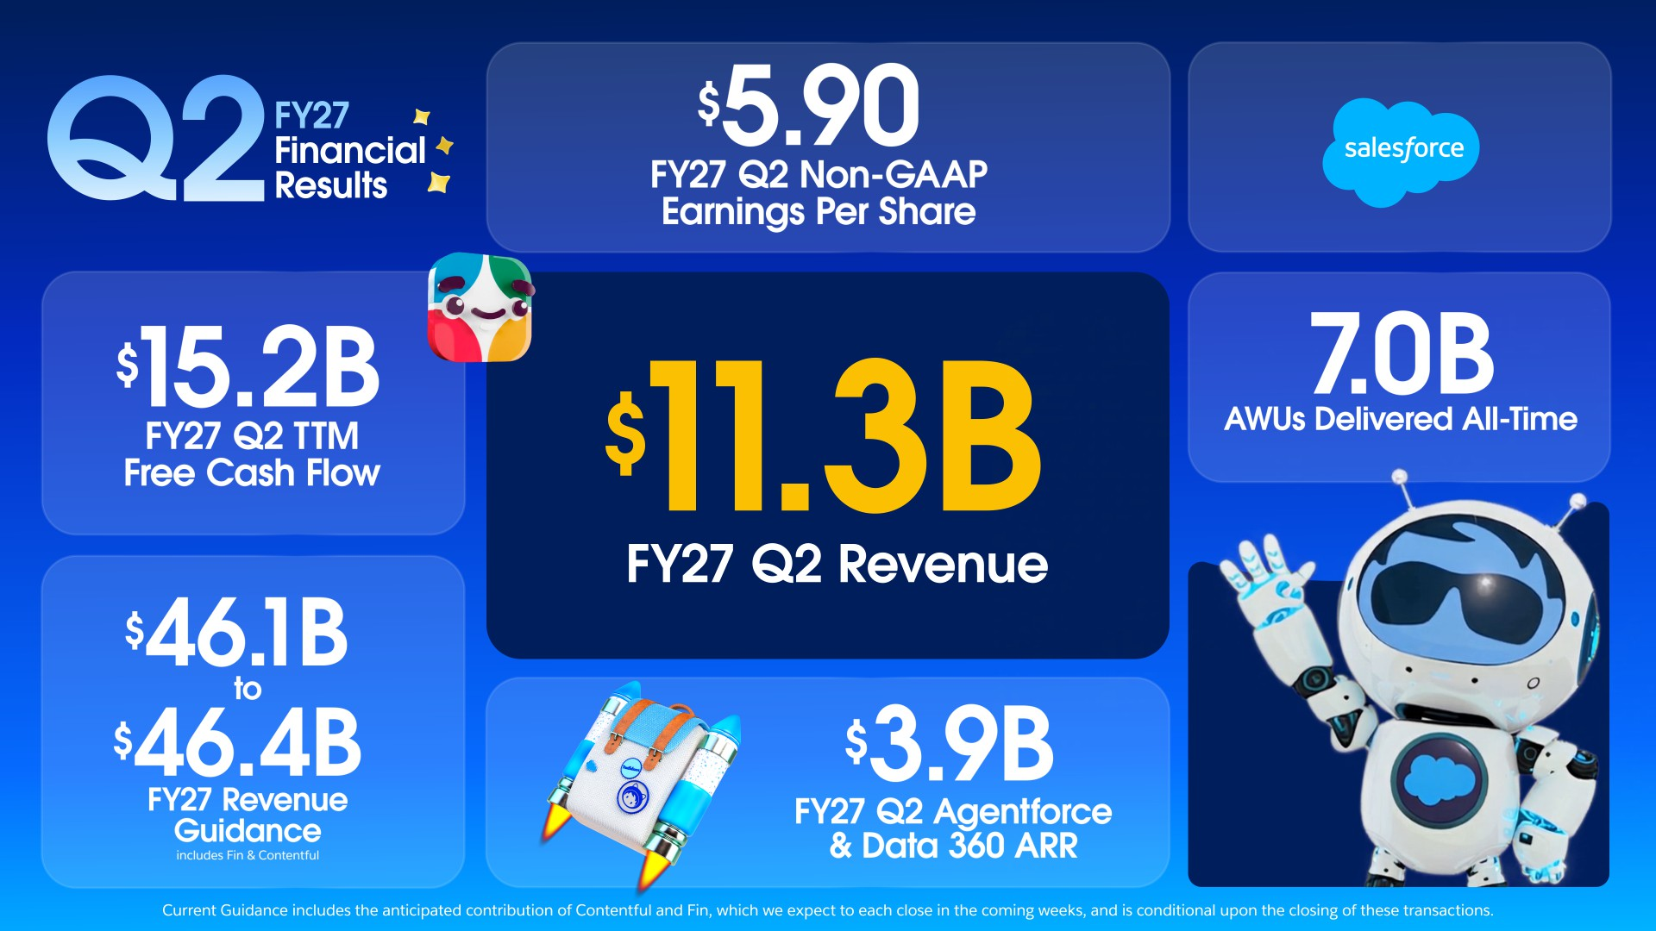

Slide 6
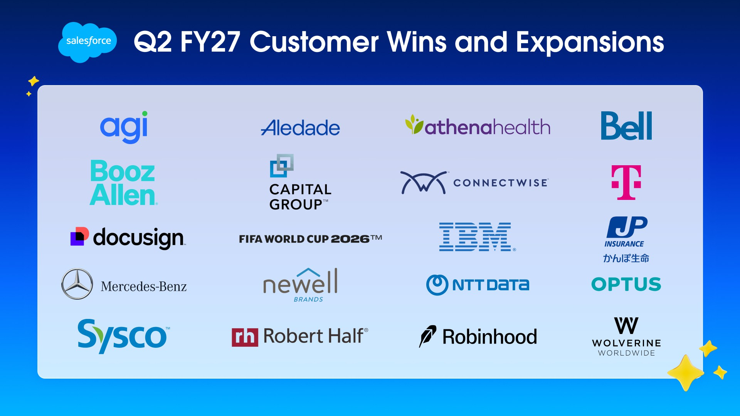

Slide 7
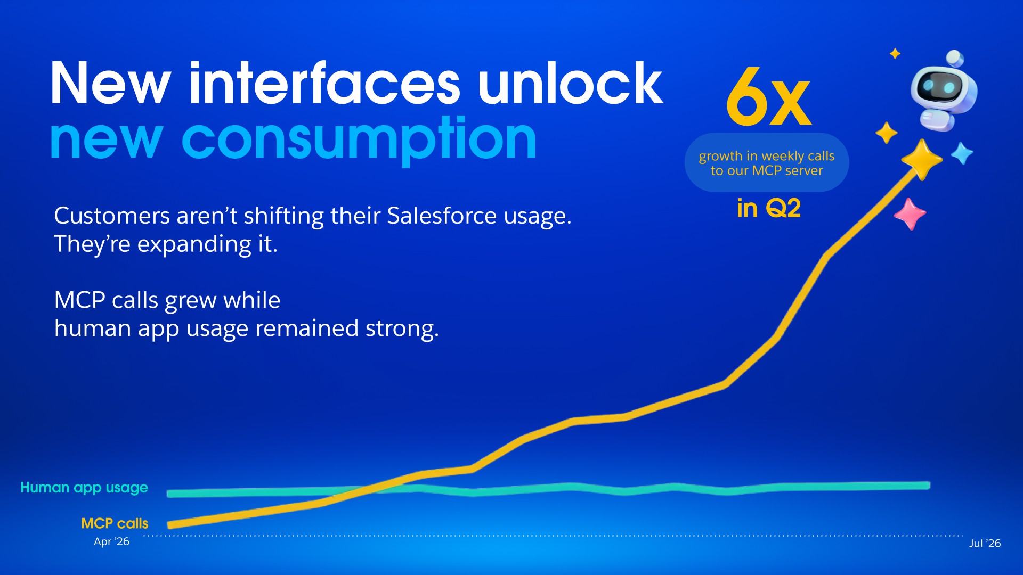

Slide 8

Q2 FY27 Highlights & Guidance
Robin Washington
President and Chief Operating and Financial Officer

Slide 9










Q2 FY27 Agentforce & Data 360 ARR reached nearly )3.9B, with Triple Digit Y/Y Growth
Gen AI & Agentforce
)1.5B
Agentforce ARR (Up over 240% Y/Y)
)3.9B
ARR
Agentforce & Data 360 ARR Incl. Informatica Cloud over 210% Y/Y
)2.4B
Data 36O ARR
(Up over 200% Y/Y)
Includes $1.1B Informatica Cloud ARR
Headless 360
Going forward, moving to milestone based reporting. Agentforce ARR includes Headless 360 and Slackbot effective Q2 FY27.
Informatica Cloud ARR includes Cloud business only, excluding On-Prem and ProServe ARR.
In Q3 FY26, the Company renamed its service offerings to reference Agentforce. There was no change to the allocation of Annual Recurring Revenue.
9

Slide 10
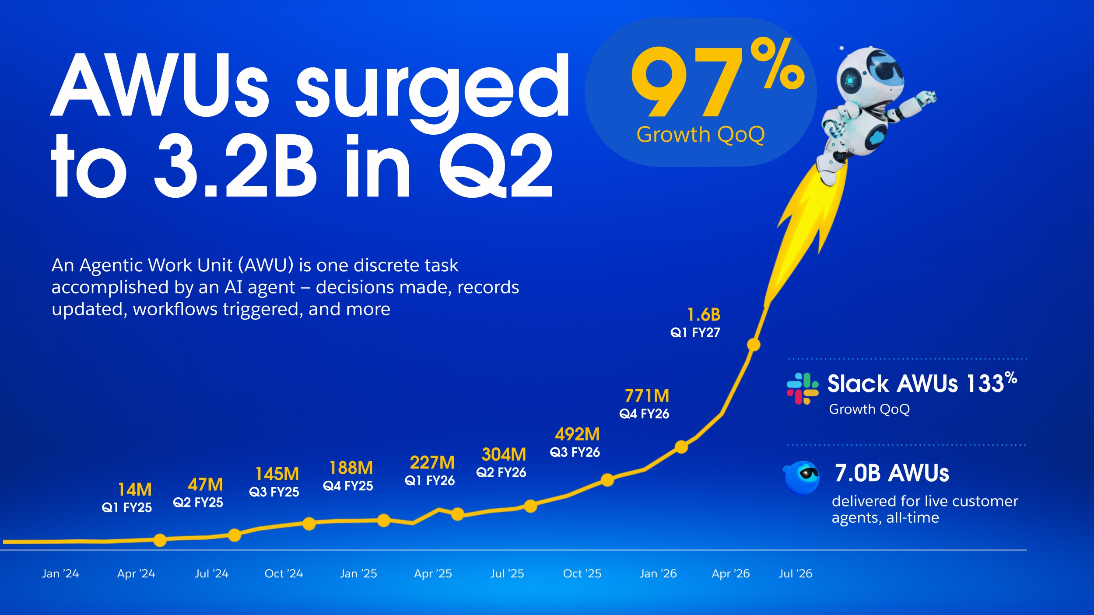

Slide 11












Q2 FY27 Financial Results
Top Line
Profit & Cash
GAAP Operating Margin
Non-GAAP
Operating Margin
Revenue
⁾11.3B
+11% Y/Y, +11% Y/Y CC
$9M Y/Y FX Impact
cRPO
⁾33.5B
+14% Y/Y, +14% Y/Y CC
$0 Y/Y FX Impact
RPO
⁾66.3B
+11% Y/Y
20.5%
34.1%
Operating Cash Flow
⁾1.3B
Free Cash Flow
⁾1.1B
Subscription & Support Revenue Disaggregation
Total Subscription & Support Revenue
⁾10.8B
+12% Y/Y, +11% Y/Y CC
$8M Y/Y FX Impact
Agentforce Apps
⁾7.2B
+8% Y/Y, +8% Y/Y CC
Data 360, Headless Platform, and Other
⁾3.6B
+ 20%Y/Y, +20% Y/Y CC
Capital Return
⁾0.4B
$364M Dividends Executed against $25B ASR
Revenue includes S456M Informatica contribution. Subscription & Support Revenue includes S440M Informatica contribution.

Slide 12
Full-Year FY27 Guidance Summary
Includes contribution from Contentful and Fin, expected to close in the coming weeks
 |  | Current Guidance | Prior Guidance
Revenue | ▲ | )46.1B - )46.4B | )45.9B - )46.2B
 |  | 11% - 12% Y/Y | 11% Y/Y
 |  | Approximately 11% Y/Y CC, $200M Y/Y FX | Approximately 10% - 11% Y/Y CC, $300M Y/Y FX
 |  | Informatica Contribution: Slightly Above 3pts | Informatica Contribution: Approximately 3pts
Subscription & Support Revenue Growth | ▲ | Slightly above 12% Y/Y Slightly under 12% Y/Y CC | Slightly under 12% Y/Y Approximately 11% Y/Y CC
GAAP Operating Margin | ▼ | 20.1% | 20.6%
Non-GAAP Operating Margin | HOLD | 34.3% | 34.3%
GAAP Diluted EPS | ▲ | )10.21 - )10.25 | )7.93 - )7.99
Non-GAAP Diluted EPS | ▲ | )16.67 - )16.71 | )14.06 - )14.12
Operating Cash Flow Growth | HOLD | Approximately 4% - 5% Y/Y | Approximately 4% - 5% Y/Y
Free Cash Flow Growth | HOLD | Approximately 4% - 5% Y/Y | Approximately 4% - 5% Y/Y
Capital Expenditures | HOLD | Approximately 1.5% of revenue | Approximately 1.5% of revenue
Current Guidance includes the anticipated contribution of Contentful and Fin, which we expect to each close in the coming weeks, and is conditional upon the closing of these transactions.

Slide 13
Q3 FY27 Guidance Summary
Includes contribution from Contentful and Fin, expected to close in the coming weeks
 | Current Guidance
Revenue | )11.42B - )11.5B 11% - 12% Y/Y 11% - 12% Y/Y CC, $0M Y/Y FX Informatica Contribution: Slightly Above 4pts
GAAP Diluted EPS | )1.81 - )1.83
Non-GAAP Diluted EPS | )3.42 - )3.44
cRPO Growth | Approximately 14% Y/Y Approximately 14% Y/Y CC, $100M Y/Y FX
Current Guidance includes the anticipated contribution of Contentful and Fin, which we expect to each close in the coming weeks, and is conditional upon the closing of these transactions.

Slide 14
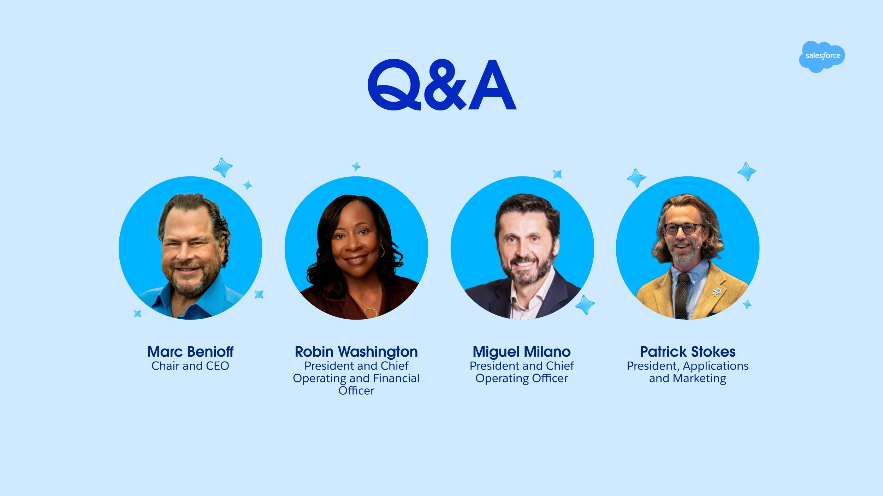
14

Slide 15







Thank
you

Slide 16
Appendix

Slide 17
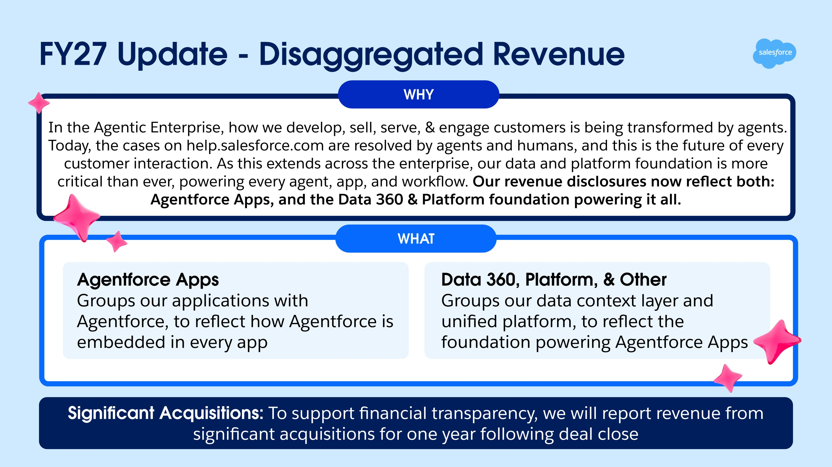

Slide 18
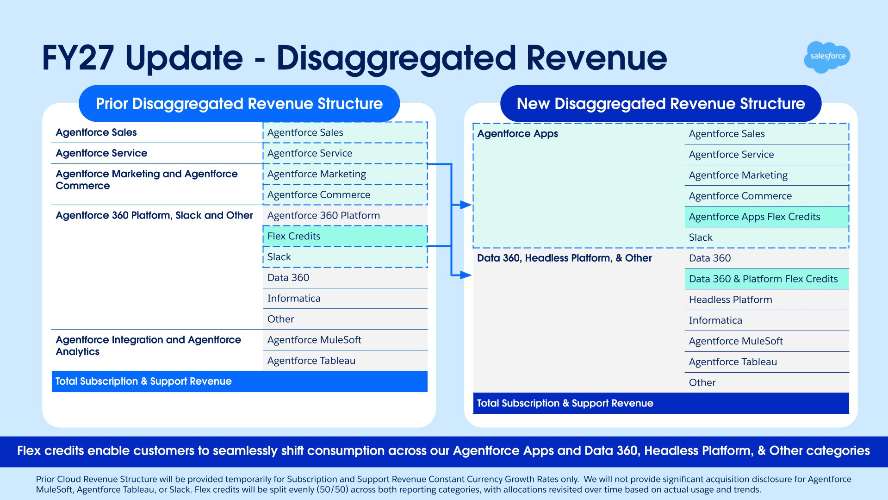

Slide 19

Revenue Growth Trends in Constant Currency
FY26 |  |  |  |  |  | FY27
Subscription & Support Revenue | Q1’ 26 | Q2’ 26 | Q3’ 26 | Q4’ 26 | FY' 26 | Q1’ 27 | Q2’ 27
Agentforce Apps | 7% | 7% | 7% | 6% | 7% | 7% | 8%
Data 360, Headless Platform, and Other | 13% | 14% | 13% | 21% | 15% | 23% | 20%
Total Subscription & Support Revenue | 9% | 9% | 9% | 11% | 10% | 12% | 11%
Total Revenue - Select Acquisitions
Informatica Total Revenue (SM)² | — | — | — | S399 | S399 | S444 | S456
Q2' 27 revenue attrition approximately 8%, in line with recent trends
Our speed of innovation is driving Agentforce Apps growth
¹Constant currency growth rates exclude the impacts of hedging gains.
²Informatica Total Revenue includes professional services revenue and subscription and support revenue. Q4 FY26 and FY26 results for Informatica represent a stub period reflecting revenue from the date of acquisition through the end of the fiscal year.
19

Slide 20

Revenue Growth Trends in Constant Currency Prior Disaggregated Revenue Structure
FY26 FY27
Subscription & Support Revenue | Q1’ 26 | Q2’ 26 | Q3’ 26 | Q4’ 26 | FY' 26 | Q1’ 27 | Q2’ 27
Agentforce Sales | 7% | 8% | 8% | 8% | 8% | 10% | 9%
Agentforce Service | 7% | 8% | 8% | 7% | 8% | 5% | 5%
Agentforce 360 Platform, Slack and Other | 14% | 16% | 19% | 37% | 22% | 43% | 43%
Agentforce Marketing and Agentforce Commerce | 4% | 3% | 1% | (1)% | 2% | (2)% | (1)%
Agentforce Integration and Agentforce Analytics | 10% | 12% | 6% | 3% | 7% | 1% | (6)%
Total Subscription & Support Revenue | 9% | 9% | 9% | 11% | 10% | 12% | 11%
Including Agentforce (reported in Agentforce 360 Platform, Slack and Other for the periods presented) would have added 2pts to Service Q2'27 revenue growth, offset by a reduction to Agentforce 360, Platform, Slack and Other.
To support transparency during the transition to our new disaggregated revenue structure, we will provide constant currency growth under the prior structure each quarter of FY27 and report solely under the new structure beginning in FY28
Flex Credits and Data 360 revenue are prospectively included in Agentforce 360 Platform, Slack and Other effective with deals closed in FY26.
¹Constant currency growth rates exclude the impacts of hedging gains.
20

Slide 21

















































































Q2 FY27 Revenue Growth by Region in
Constant Currency
EMEA
Americas
⁾2.8B
13%
⁾7.4B
10%
APAC
⁾1.2B
12%
Q1’ 26
Q2’ 26
Q3’ 26
Q4’ 26
FY'26
Q1’ 27
Q2’ 27
Americas
7%
9%
8%
9%
8%
11%
10%
EMEA
9%
7%
7%
13%
9%
12%
13%
APAC
11%
11%
11%
13%
12%
12%
12%
Q2 regional NNAOV growth anchored by strength in North America, Japan, and the UK
Revenues by geography are determined based on the region of the Company's contracting entity, which may be different than the region of the customer.
Revenue dollar figures are presented in nominal currency and growth rates are presented in constant currency. Constant currency growth rates exclude the impacts of hedging gains.
21

Slide 22
Q2 FY27 Key Balance Sheet and Cash Flow Metrics Growth Rate Trends
 | Q1’ 26 | Q2’ 26 | Q3’ 26 | Q4’ 26 | Q1’ 27 | Q2’ 27
Total RPO | 13% | 12% | 12% | 14% | 11% | 11%
cRPO | 12% | 11% | 11% | 16% | 14% | 14%
cRPO (in Constant Currency) | 11% | 10% | 11% | 13% | 13% | 14%
cRPO FX $M (Headwind) / Tailwind | $300M | $300M | $200M | $800M | $100M | $0
Operating Cash Flow | 4% | (17)% | 17% | 38% | 3% | 71%
Free Cash Flow | 4% | (20)% | 22% | 39% | 4% | 81%
Notes:
RPO growth rate change from Q4'26 to Q1'27 was primarily driven by FX.
cRPO to revenue relationship may change as we evolve our business model to incorporate more consumption revenue.
Strong Q2 results across RPO, cRPO, and cash flow, with cRPO CC growth up 1pt Q/Q

Slide 23
Returned )27.9B Capital Q2 FY27 YTD
Capital Return
Dividends
Share Repurchases
)59.3B
Cumulative Repurchases Since Inception, Including
$25B ASR
)27.5B
)3.9B
Cumulative Quarterly Dividend Payments Since Inception
(15)% Y/Y
Q2 FY27 Diluted Share Count Down (141M) Y/Y
Continued Focus on Reducing Share Count
)4.2B
)4.4B
)2.6B
)0.4B
Q2 FY26
Q3 FY26
Q4 FY26
Q1 FY27
Q2 FY27
Committed to robust capital return, )63.1B returned since inception including )25B ASR in Q1

Slide 24
Q2 & Full Year FY27 Non-GAAP Expense Profile
Non-GAAP % of Revenue
66%
FY27 Guidance GAAP
Operating Margin Stable Y/Y
65%
66%
65%
66%
19%
19%
19%
20%
20%
Cost of Revenues
Research & Development
Sales & Marketing
General & Administrative
12%
11%
12%
12%
12%
Includes impact of Contentful and Fin
 | 29% |  | 29% |  | 29% |  | 28% |  | 29%
 | 6% |  | 6% |  | 6% |  | 5% |  | 5%
Operating Margin | Q2 FY26 |  | Q3 FY26 |  | Q4 FY26 |  | Q1 FY27 |  | Q2 FY27
GAAP | 22.8% |  | 21.3% |  | 16.7% |  | 21.1% |  | 20.5%
Non-GAAP | 34.3% |  | 35.5% |  | 34.2% |  | 34.8% |  | 34.1%
FY27 Guidance
20bps
Non-GAAP Operating Margin
Expansion Y/Y
Operating as a lean, agentic enterprise, investing in growth, while driving efficiency and AI productivity
Current Guidance includes the anticipated contribution of Contentful and Fin, which we expect to each close in the coming weeks, and is conditional upon the closing of these transactions.
24

Slide 25
Non-GAAP Financial Measures
This presentation includes information about non-GAAP diluted earnings per share, non-GAAP income from operations, non-GAAP expenses, non-GAAP operating margin, free cash flow and free cash flow growth, constant currency revenue and revenue growth rates, and constant currency current remaining performance obligation growth rates (collectively the “non-GAAP financial measures”). These non-GAAP financial measures are measurements of financial performance that are not prepared in accordance with U.S. generally accepted accounting principles and computational methods may differ from those used by other companies. Non-GAAP financial measures are not meant to be considered in isolation or as a substitute for comparable GAAP measures and should be read only in conjunction with the Company’s condensed consolidated financial statements prepared in accordance with GAAP. Management uses both GAAP and non-GAAP financial measures when planning, monitoring and evaluating the Company’s performance.
The primary purpose of using non-GAAP financial measures is to provide supplemental information that may prove useful to investors and to enable investors to evaluate the Company’s results in the same way management does. Management believes that supplementing GAAP disclosure with non-GAAP disclosure provides investors with a more complete view of the Company’s operational performance and allows for meaningful period-to-period comparisons and analysis of trends in the Company’s business. Further, to the extent that other companies use similar methods in calculating non-GAAP financial measures, the provision of supplemental non-GAAP information can allow for a comparison of the Company’s relative performance against other companies that also report non-GAAP operating results.
Non-GAAP operating margin is the proportion of non-GAAP income from operations as a percentage of GAAP revenue. Non-GAAP income from operations excludes the impact of the following items: stock-based compensation expense, amortization of acquisition-related intangibles and charges related to restructuring initiatives and acquisition-related costs.
Non-GAAP diluted earnings per share excludes, to the extent applicable, the impact of the following items: stock-based compensation expense, amortization of purchased intangibles, charges related to restructuring initiatives and acquisition-related costs and income tax adjustments. These items are excluded because the decisions that give rise to them are not made to increase revenue in a particular period, but instead for the Company’s long-term benefit over multiple periods.
The Company defines the non-GAAP measure free cash flow as GAAP net cash provided by operating activities, less capital expenditures. Trailing twelve months free cash flow is calculated as GAAP net cash provided by operating activities for the aggregate four preceding fiscal quarters, less capital expenditures over that same period.
Constant currency information is provided as a framework for assessing how our underlying business performed excluding the effect of foreign currency rate fluctuations and the impact of hedging gains (losses). To present constant currency revenue, current and comparative prior period results for entities reporting in currencies other than United States dollars are converted into United States dollars at the weighted average exchange rate for the quarter being compared to for growth rate calculations presented, rather than the actual exchange rates in effect during that period. To present current remaining performance obligation on a constant currency basis, we convert the current remaining performance obligation balances in local currencies in previous comparable periods using the United States dollar currency exchange rate as of the most recent balance sheet date.
Other Metrics: The Company defines Agentforce and Data 360 annual recurring revenue ("ARR") as the annualized recurring value of active Data 360 and certain generative artificial intelligence ("AI") subscription agreements, including those for Agentforce, generative AI products and features, and Headless 360, that were executed at the end of the reporting period. The Company defines Informatica Cloud ARR as the annualized recurring value of active Informatica Cloud subscription agreements that were executed at the end of the reporting period. From time to time, we may update this metric to incorporate new products, feature offerings, or acquired technologies that meet its definition. Beginning in Q2 FY27, Agentforce ARR includes our latest AI offerings Slackbot and Headless 360.
The Company defines Net New Annual Order Value ("NNAOV") as the net change in the annual order value of our customer subscription agreements during a given period. NNAOV is calculated as the sum of: (i) the annualized contract value from new and existing customers who enter into subscription agreements during the period; less (ii) the reduction in annualized order value from customer cancellations, non-renewals, or downgrades during the period.
The Company defines an Agentic Work Unit ("AWU") as a measure of discrete tasks executed by AI agents in production across the Salesforce platform, including Agentforce and Slack. AWUs represent the conversion of generative AI capabilities into measurable business outputs, such as resolving customer cases, updating records or triggering automated workflows.
25

Slide 26
GAAP to Non-GAAP Financial Reconciliation
(in millions)
Three Months Ended July 31,
Non-GAAP income from operations |  |  | 2025 |  |  |  | 2026 |  | Non-GAAP operating margin |  | Full Year FY27 Guidance
GAAP income from operations Plus: Amortization of purchased intangibles |  | S |  | 2,332 380 |  | S |  | 2,331 522 | GAAP operating margin² Plus: Amortization of purchased intangibles⁴ |  | 20.1 % 4.4 %
Stock-based compensation expense⁵ |  |  |  | 793 |  |  |  | 904 | Stock-based compensation expense^{4,5} |  | 9.0 %
Restructuring and acquisition-related costs |  |  |  | 4 |  |  |  | 115 | Restructuring and acquisition-related costs^{4,5} |  | 0.8 %
Non-GAAP income from operations¹ |  | S |  | 3,509 |  | S |  | 3,872 | Non-GAAP operating margin² |  | 34.3 %
Revenue |  |  |  | 10,236 |  |  |  | 11,345
Non-GAAP operating margin² |  |  |  | 34.3 % |  |  |  | 34.1 %
(in millions)
Three Months Ended July 31,
Computations of free cash flow, a non-GAAP measure |  |  | 2025 |  |  |  | 2026
GAAP net cash provided by operating activities |  | S |  | 740 |  | S |  | 1,269
(Capital expenditures) |  |  |  | (135) |  |  |  | (171)
Free cash flow³ |  | S |  | 605 |  | S |  | 1,098
Three Months Ended July 31,
Non-GAAP diluted earnings per share |  |  | 2025 |  |  |  | 2026 |  | Q3 FY27 Guidance |  |  |  |  |  |  |  |  | Full Year FY27 Guidance
GAAP diluted earnings per share |  | S |  | 1.96 |  | S |  | 4.29 | S1.81 - S1.83 |  |  |  |  |  |  |  |  | S10.21 - S10.25
Plus:
Amortization of purchased intangibles |  |  |  | 0.40 |  |  |  | 0.64 | 0.57 |  |  |  |  |  |  |  |  | 2.45
Stock-based compensation expense⁵ |  |  |  | 0.82 |  |  |  | 1.10 | 1.29 |  |  |  |  |  |  |  |  | 4.96
Restructuring and acquisition-related costs |  |  |  | 0.00 |  |  |  | 0.14 | 0.12 |  |  |  |  |  |  |  |  | 0.42
(Income tax effects and adjustments) |  |  |  | (0.27) |  |  |  | (0.27) | (0.37) |  |  |  |  |  |  |  |  | (1.37)
Non-GAAP diluted earnings per share⁶ |  | S |  | 2.91 |  | S |  | 5.90 | S3.42 - S3.44 |  |  |  |  |  |  |  |  | S16.67 - S16.71
Shares used in computing non-GAAP diluted earnings per share (millions)⁷ |  |  |  | 962 |  |  |  | 821 | 827 |  |  |  |  |  |  |  |  | 838
Trailing Twelve (in millions) Months Ended Three Months Ended
Free Cash Flow |  |  | July 31, 2026 |  |  |  | October 31, 2025 |  |  |  | January 31, 2026 |  |  | April 30, 2026 |  |  | July 31, 2026
GAAP net cash provided by operating activities |  | S | 15,750 |  |  | S | 2,316 |  |  | S | 5,464 |  | S | 6,701 |  | S |  |  | 1,269
(Capital expenditures) |  |  | (596) |  |  |  | (139) |  |  | (141) |  |  | (145) |  |  | (171)
Free cash flow³ |  | S | 15,154 |  |  | S | 2,177 |  |  | S 5,323 |  |  | S 6,556 |  |  | S 1,098
¹Non-GAAP income from operations is used to calculate non-GAAP operating margin. It excludes the impact of the amortization of purchased intangibles, stock-based compensation expense and charges related to the Company's restructuring initiatives and acquisition-related costs.
²GAAP operating margin is the proportion of GAAP income from operations as a percentage of GAAP revenue. Non-GAAP operating margin is the proportion of non-GAAP income from operations as a percentage of GAAP revenue.
³Free cash flow ("FCF") is defined as GAAP net cash provided by operating activities, less capital expenditures. Trailing twelve months ("TTM") free cash flow is calculated as GAAP net cash provided by operating activities for the aggregate four preceding fiscal quarters, less capital expenditures over that same period.
⁴The percentages shown above have been calculated based on the midpoint of the low and high ends of the revenue guidance for full year FY27.
⁵The percentages shown in the restructuring and acquisition-related costs line have been calculated based on charges associated with the Company's restructuring initiatives and acquisition-related costs. Stock-based compensation expense excludes stock-based compensation expense related to the Company's restructuring initiatives, which is included in the restructuring and acquisition-related costs line.
⁶GAAP diluted earning per share ("EPS") is calculated by dividing GAAP net income by number of diluted shares. Non-GAAP diluted EPS is calculated by dividing non-GAAP net income by number of diluted shares. It excludes the impact of stock-based compensation expense, amortization of purchased intangibles, charges related to the restructuring initiatives and acquisition-related costs and income tax adjustments.
⁷The Company's shares used in computing GAAP net income per share guidance and non-GAAP net income per share guidance reflect the reduction to share count from the 103 million shares initially delivered under the ASR, but excludes any impact to share count from the final ASR settlement or potential Q3 - Q4 FY27 repurchase activity under our share repurchase program.
26

Slide 27
GAAP to Non-GAAP Financial Reconciliation
(in millions)
Period | Q2 FY26 | Q3 FY26 | Q4 FY26 | Q1 FY27 | Q2 FY27
Revenue | 10,236 | 10,259 | 11,201 | 11,133 | 11,345
GAAP Cost of Revenues | 2,242 | 2,255 | 2,508 | 2,570 | 2,649
Less:
Amortization of purchased intangibles | 150 | 156 | 224 | 244 | 234
Stock-based compensation expense¹ | 126 | 129 | 147 | 138 | 147
Acquisition-related costs | — | — | 2 | 1 | —
Non-GAAP Cost of Revenues | 1,966 | 1,970 | 2,135 | 2,187 | 2,268
Non-GAAP Cost of Revenues as a % of Revenue² | 19 % | 19 % | 19 % | 20 % | 20 %
GAAP Sales and Marketing Expense | 3,443 | 3,456 | 4,017 | 3,769 | 3,859
Less:
Amortization of purchased intangibles | 230 | 230 | 302 | 317 | 288
Stock-based compensation expense¹ | 293 | 296 | 413 | 320 | 345
Acquisition-related costs | — | — | 7 | 3 | 1
Non-GAAP Sales and Marketing Expense | 2,920 | 2,930 | 3,295 | 3,129 | 3,225
Non-GAAP Sales and Marketing Expense as a % of Revenue² | 29 % | 29 % | 29 % | 28 % | 29 %
GAAP Research and Development Expense Less: | 1,481 | 1,433 | 1,619 | 1,627 | 1,687
Stock-based compensation expense¹ | 280 | 271 | 336 | 310 | 301
Acquisition-related costs | — | — | 1 | 2 | 3
Non-GAAP Research and Development Expense | 1,201 | 1,162 | 1,282 | 1,315 | 1,383
Non-GAAP Research and Development Expense as a % of Revenue² | 12 % | 11 % | 12 % | 12 % | 12 %
GAAP General and Administrative Expense Less: | 734 | 667 | 902 | 740 | 725
Stock-based compensation expense¹ | 94 | 109 | 187 | 102 | 111
Acquisition-related costs | — | — | 62 | 10 | 17
Non-GAAP General and Administrative Expense | 640 | 558 | 653 | 628 | 597
Non-GAAP General and Administrative Expense as a % of Revenue² | 6 % | 6 % | 6 % | 5 % | 5 %
GAAP Operating Margin % | 22.8 % | 21.3 % | 16.7 % | 21.1 % | 20.5 %
Plus:
Amortization of purchased intangibles | 3.7 % | 3.8 % | 4.7 % | 5.0 % | 4.6 %
Stock-based compensation expense¹ | 7.8 % | 7.9 % | 9.6 % | 7.8 % | 8.0 %
Acquisition-related costs | — % | 2.5 % | 3.2 % | 0.9 % | 1.0 %
Non-GAAP Operating Margin %² | 34.3 % | 35.5 % | 34.2 % | 34.8 % | 34.1 %
¹Stock-based compensation expense included in the GAAP to non-GAAP reconciliation tables above excludes those expenses related to the Company's restructuring initiatives, which are included in the restructuring and acquisition-related costs line. For the three months ended July 31, 2026 and April 30, 2026, S2 million and S10 million of such expense is excluded, respectively. No other quarters presented in this slide incurred material stock-based compensation expense related to restructuring.
²Non-GAAP expense categories as a % of revenue and Non-GAAP Operating Margin are calculated using GAAP revenue.
27

