Slide 1
Arduino

Slide 2
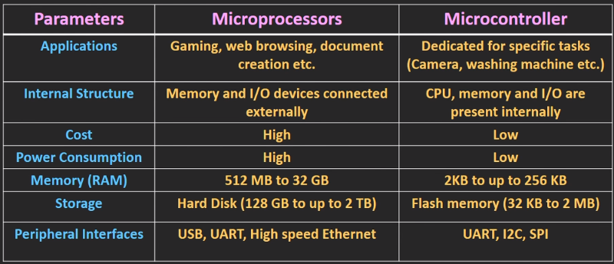
Micro Controllers vs Micro Processors

Slide 3
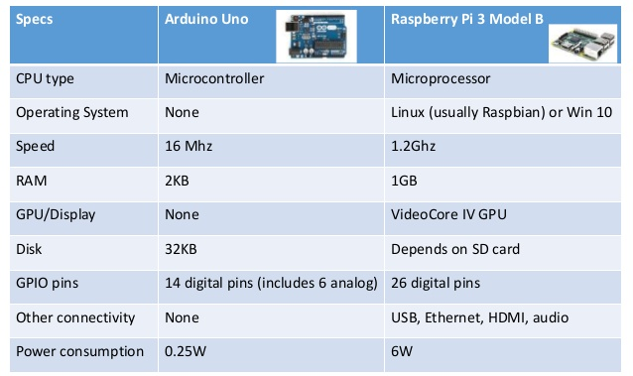
Arduino vs Raspberry Pie

Slide 4
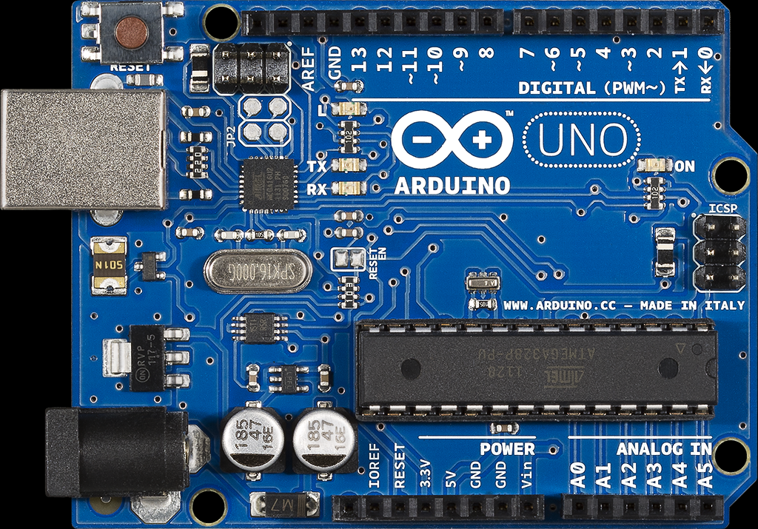
Arduino Uno
Micro Controller
  ATmega328
Operating voltage
  5V and 3.3V
Input Voltage
  7-12V
Digital I/O pins
  14 pins
Analog Input pins
  6 pins
Flash Memory
  32 KB
SRAM - 2 KB
EEPROM - 1 KB
Clock Speed - 16MHz

Slide 5
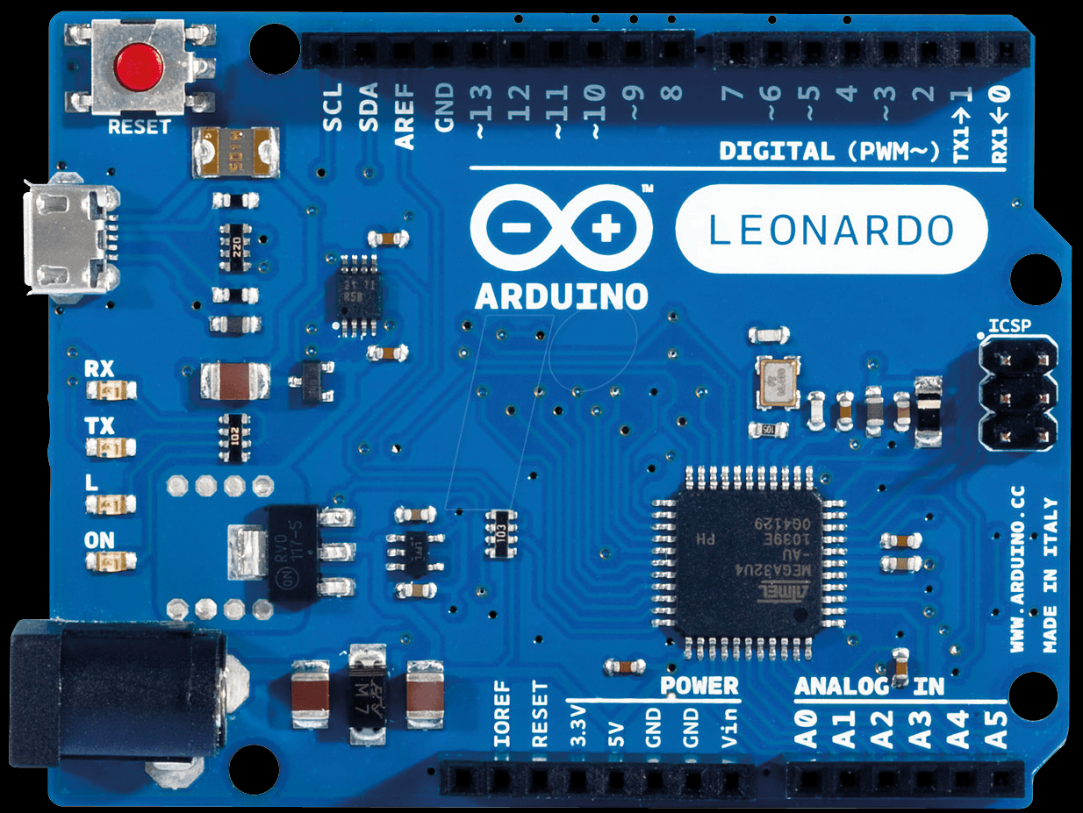
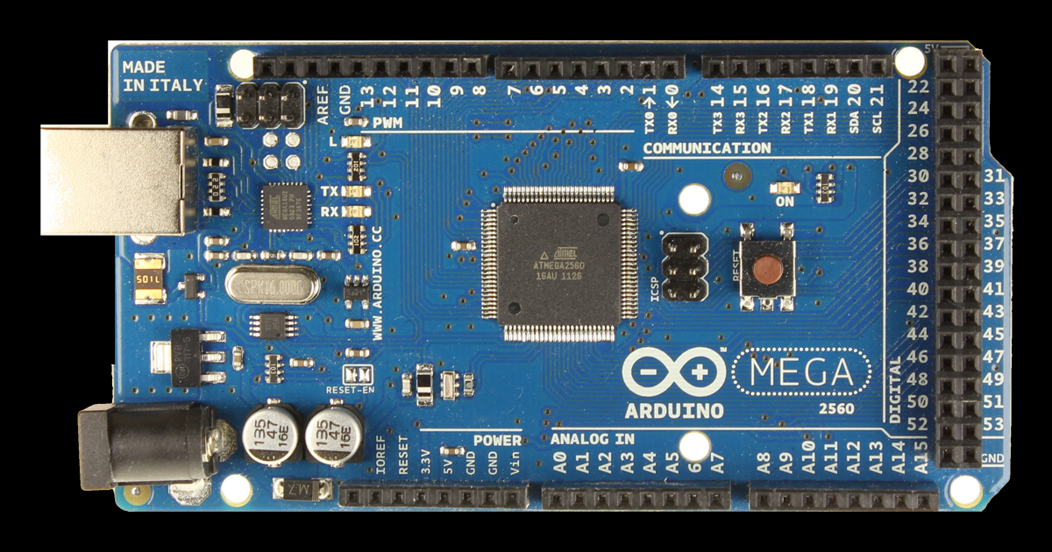
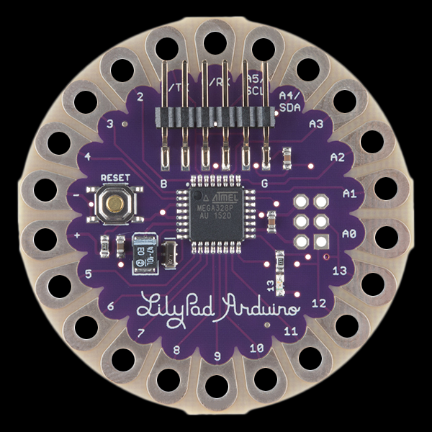
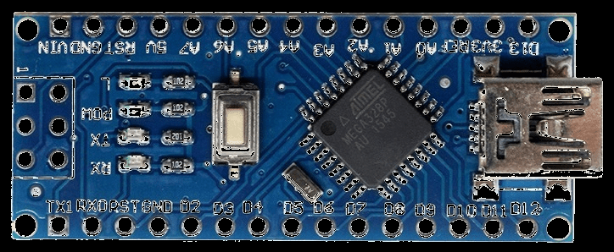
Common Arduino Boards

Slide 6


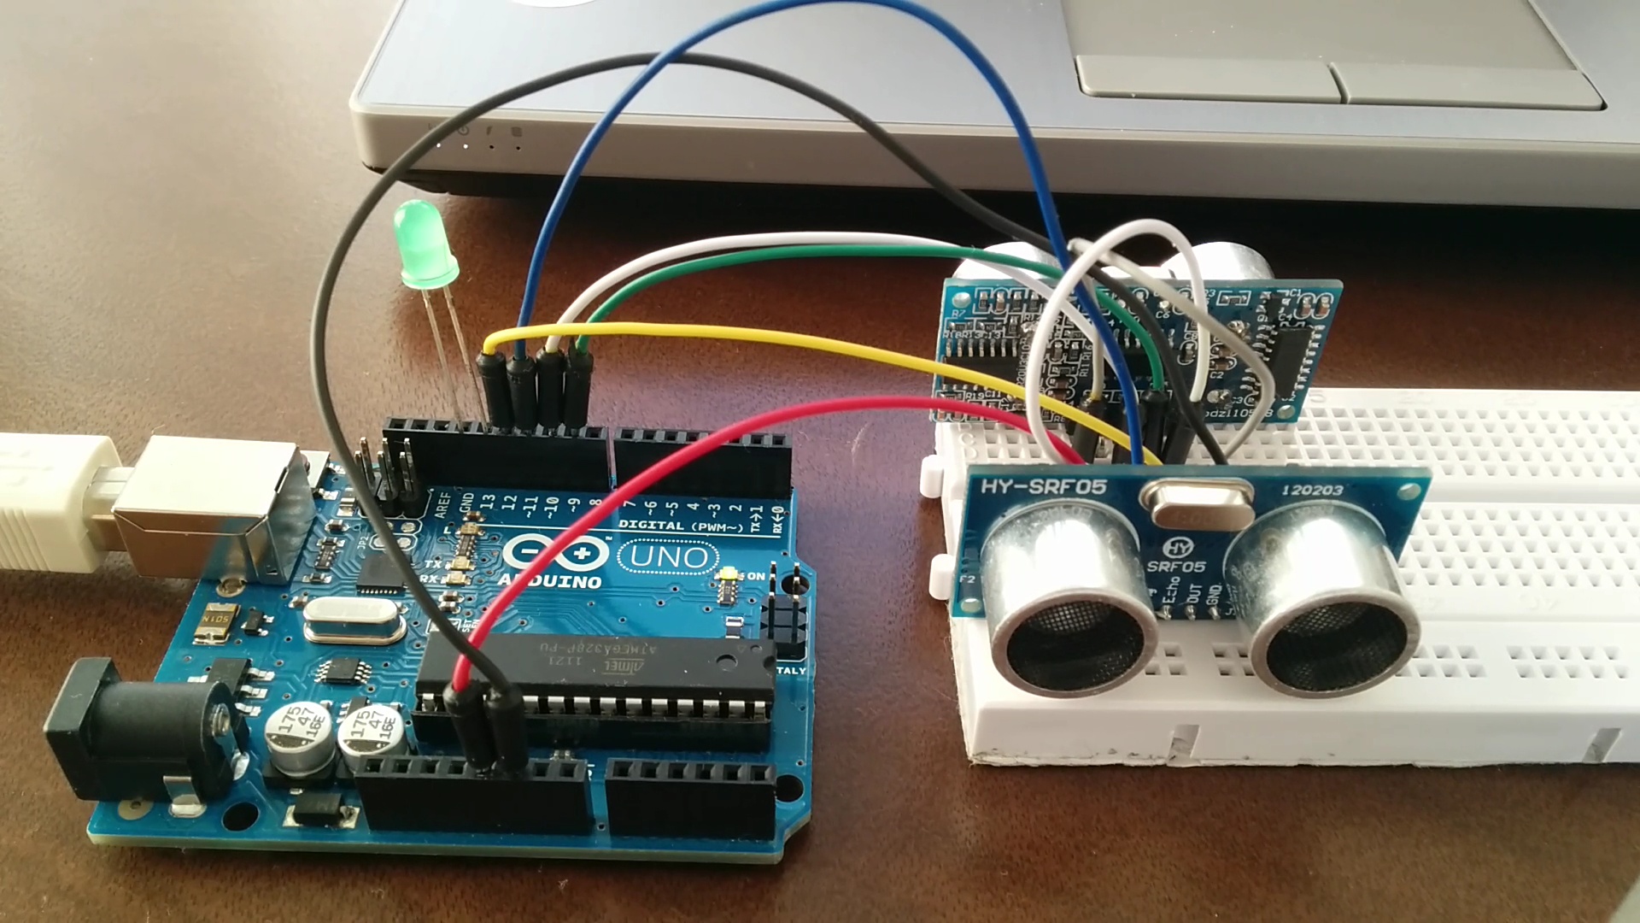
Applications of Arduino
Home automation
Sensor Prototyping
Robotics
ISP Programming
Easy WiFi, GSM, Ethernet, Bluetooth connectivity

Slide 7
Advantages of Arduino
Open Source
Simplified and user friendly
No additional programmer or burner required.
Portable
Low power consumption

Slide 8
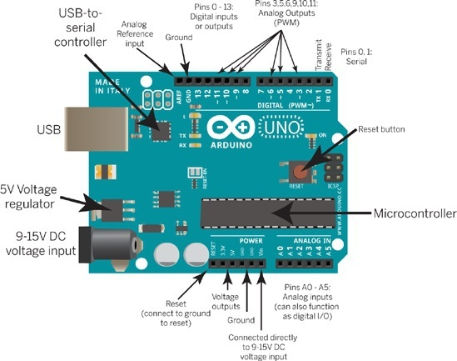
Arduino Uno

Slide 9
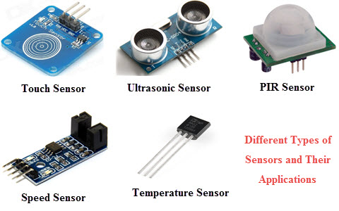
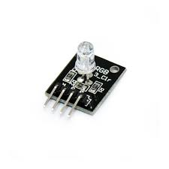
Sensors

Slide 10
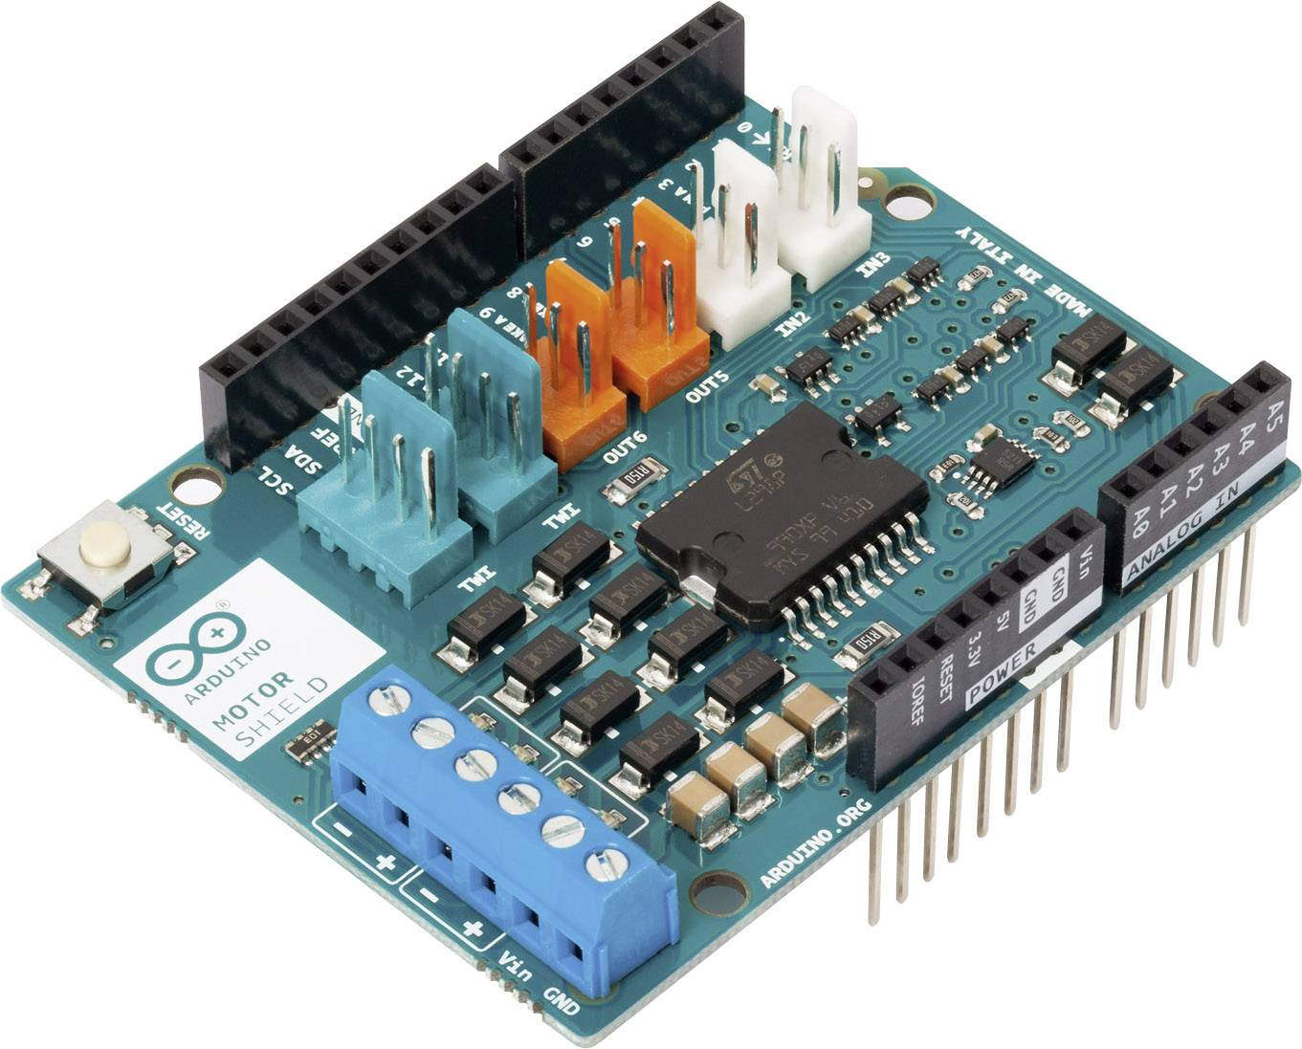
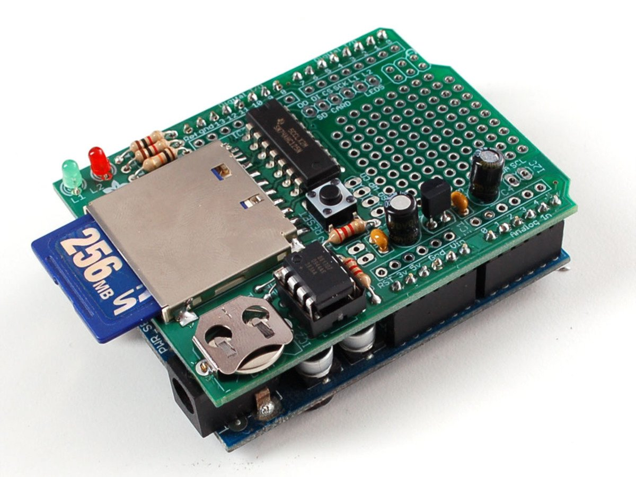
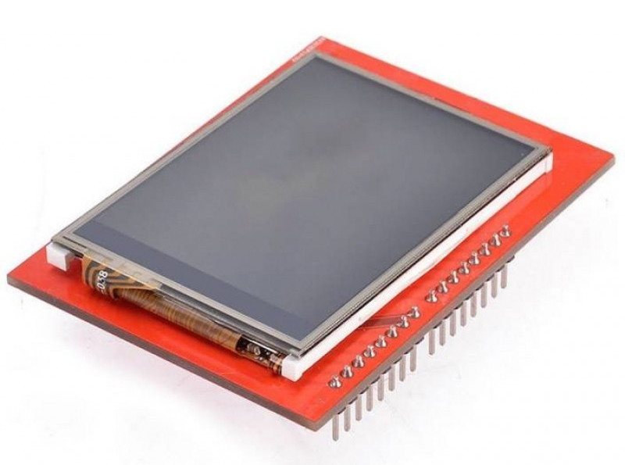
Arduino Shields

Slide 11
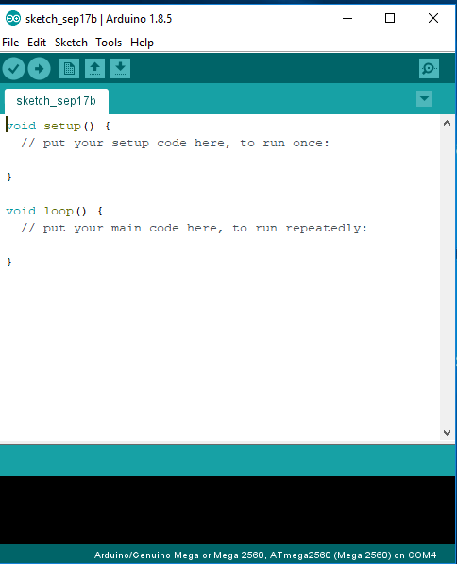
Arduino IDE
Setup
  It’s called only when arduino is powered on or reset. Used to initialize variables and pin modes.
Loop
  Loop function runs continuously till the device is powered off.

Slide 12
Pin Mode
pinMode function is used to set a pin in arduino as input or output.
  pinMode(13, Output); // Sets pin 13 as output pin
  pinMode(13, Input); // Sets pin 13 as input pin

Slide 13
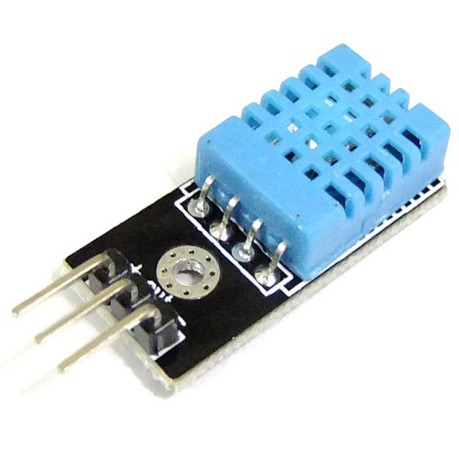
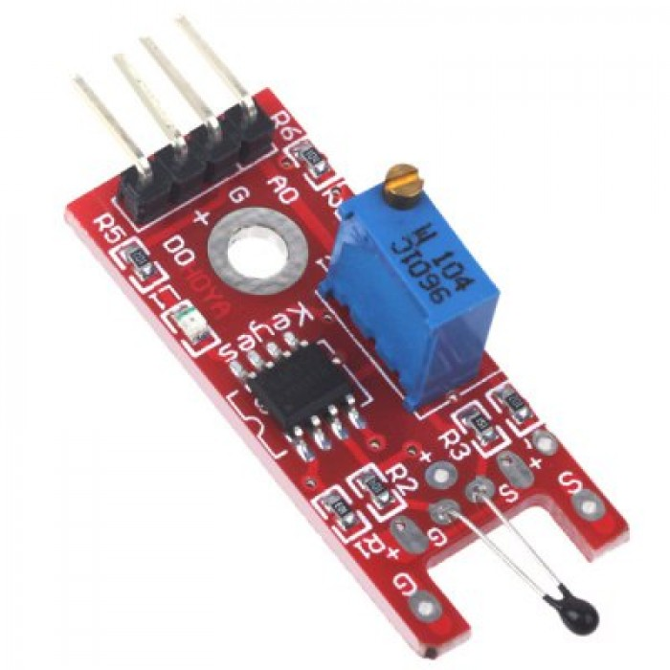
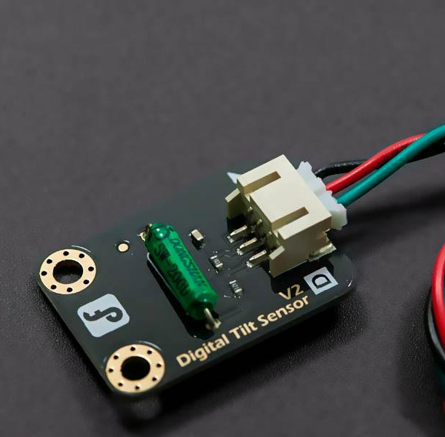
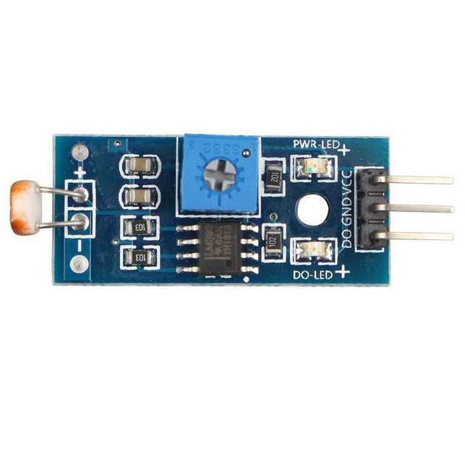
Reading / Writing digital values
digitalWrite(13, LOW);
  Makes the output voltage on pin 13, 0V
digitalWrite(13, HIGH);
  Makes the output voltage on pin 13, 5V
int buttonState = digitalRead(2);
  Reads the value of pin 2 in button state

Slide 14
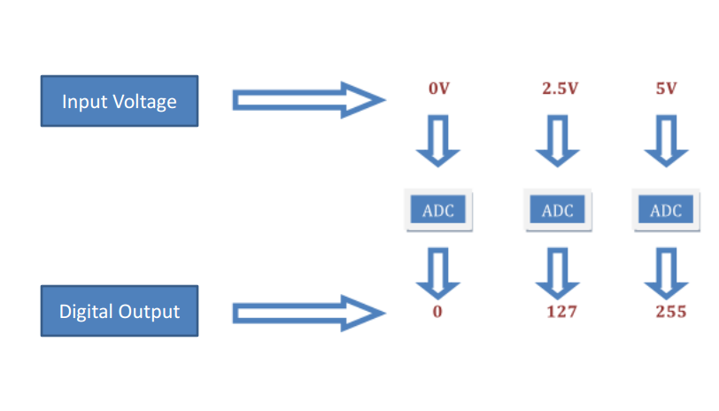
Converting Analog values to Digital

Slide 15
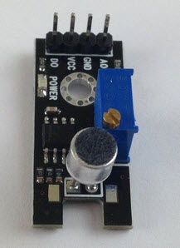
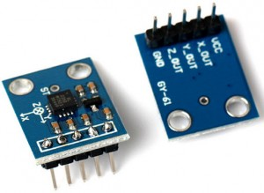

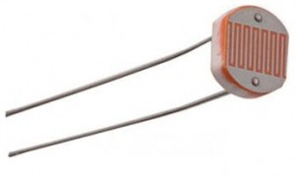
Reading / Writing analog values
analogRead(A0);
  Used to read the analog value from
  the pin A0
analogWrite(2, 128);
  Used to write the analog value of 128 to pin 2

Slide 16
Blinking inbuilt LED
// the setup function runs once when you press reset or power the board
void setup() {
// initialize digital pin LED_BUILTIN as an output.
pinMode(LED_BUILTIN, OUTPUT);
}
// the loop function runs over and over again forever
void loop() {
digitalWrite(LED_BUILTIN, HIGH); // turn the LED on (HIGH is the voltage
                level)
delay(1000); // wait for a second
digitalWrite(LED_BUILTIN, LOW); // turn the LED off by making the voltage
                LOW
delay(1000); // wait for a second
}

Slide 17
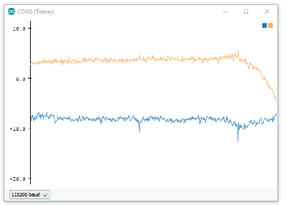
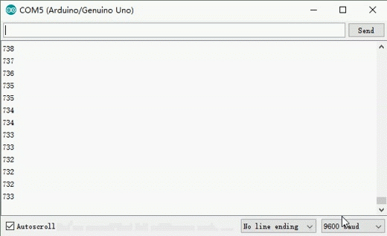
Serial Plotter
Serial Monitor

