Slide 1

Design of Machine Elements
ME20B052-Sneha M S
ME20B053-Chaitali Uday Karekar
ME20B051-Bigula Sandeep
Assignment-01
Finite element analysis
Group 22

Slide 2
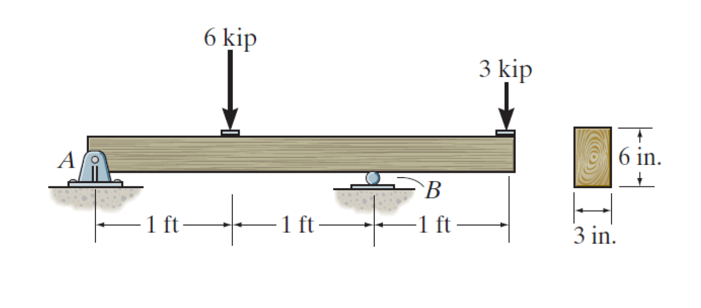
Given problem statement
To find and analyze:
Bending Moment and shear force diagrams
Maximum normal stress and stress profile
Transverse and longitudinal shear stress profiles along with maximum values
Deflection of beam at loading point
Comparing with FEA obtained results

Slide 3
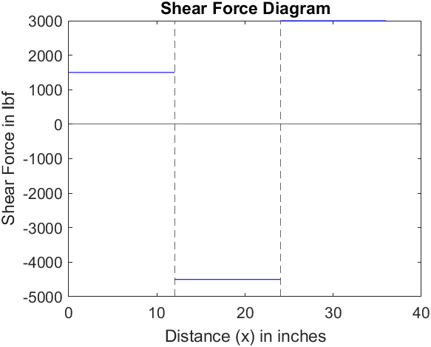
Analytical Results-Shear Force
The shear forces are calculated as follows:
V= 1.5 kips (0≤x<12 in)
V= -4.5 kips (12 ≤x<24 in)
V= 3.0 kips (24 ≤x<36 in)
x= 0 in
x= 12 in
x= 24 in
x= 36 in

Slide 4
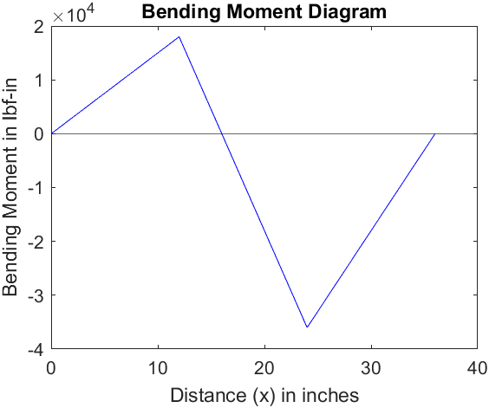
Analytical Results-Bending Moment
The bending moments are calculated as follows:
M= 1.5x kip-in (0≤x<12 in)
M= 72-4.5x kip-in (12 ≤x<24 in)
M= 3x-108 kip-in (24 ≤x<36 in)
Maximum bending moment of 36 kip-in occurs at x=24 in.
x= 0 in
x= 12 in
x= 24 in
x= 36 in

Slide 5
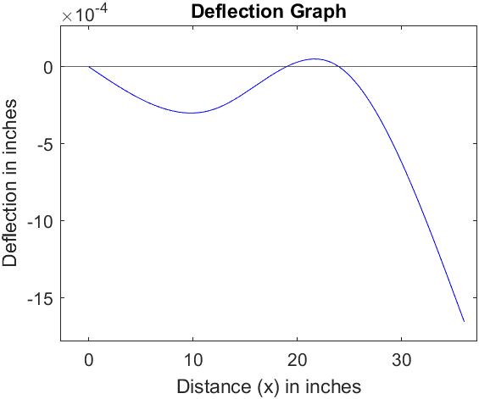
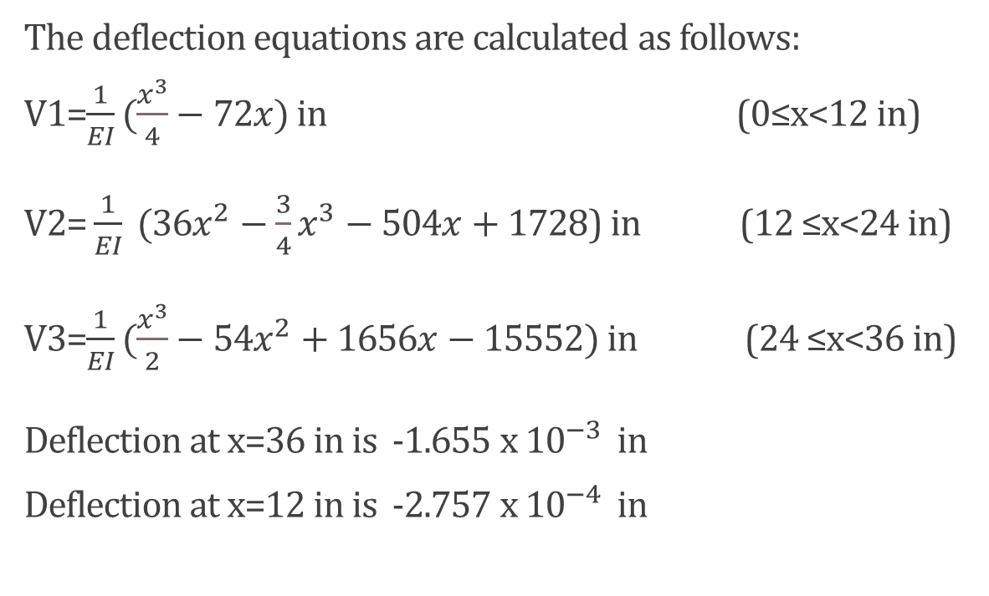
Analytical Results-Deflection
The deflection equations are calculated as follows:
V1=$\frac{1}{EI}(\frac{x^{3}}{4}−72x)$ in (0≤x<12 in)
V2= $\frac{1}{EI} (36x^{2}−\frac{3}{4}x^{3}−504x+1728$) in (12 ≤x<24 in)
V3=$\frac{1}{EI}(\frac{x^{3}}{2}−54x^{2}+1656x−15552)$ in (24 ≤x<36 in)
Deflection at x=36 in is -1.655 x ${10}^{−3}$ in
Deflection at x=12 in is -2.757 x ${10}^{−4}$ in
x= 0 in
x= 12 in
x= 24 in
x= 36 in

Slide 6
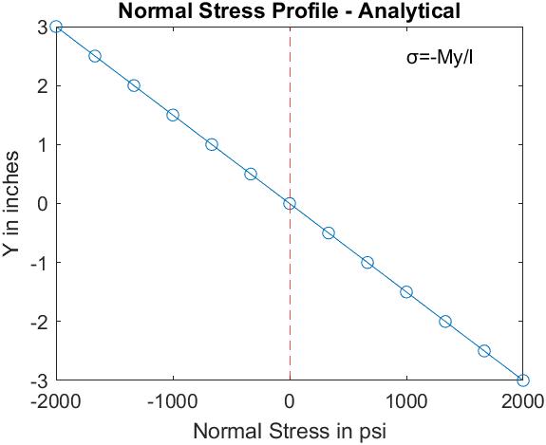
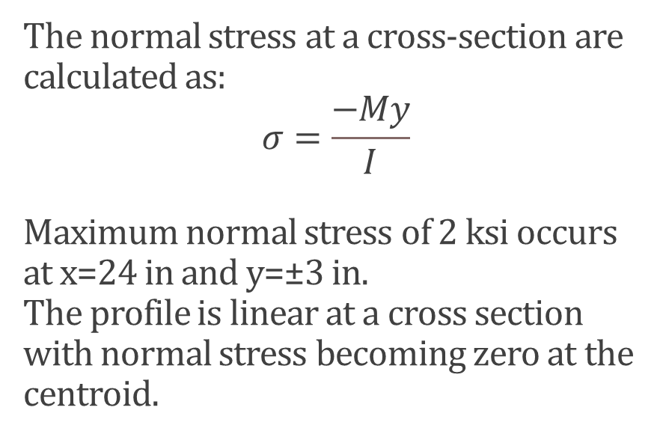
Analytical Results-Normal Stress
The normal stress at a cross-section are calculated as:
$$σ=\frac{−My}{I}$$
Maximum normal stress of 2 ksi occurs at x=24 in and y=±3 in.
The profile is linear at a cross section with normal stress becoming zero at the centroid.
y = 3 in
6 in
y = 0 in
y = - 3 in
3 in

Slide 7
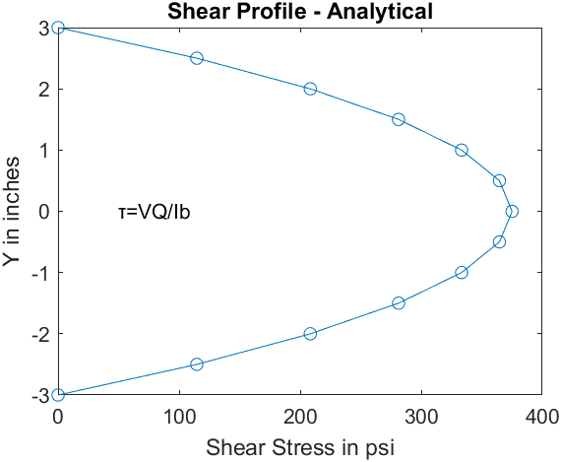
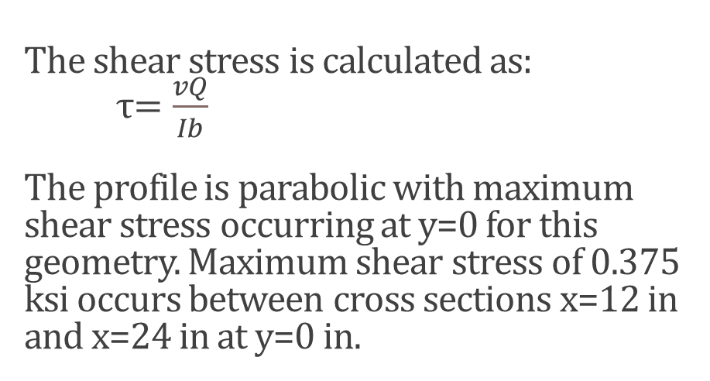
Analytical Results-Shear Stress
The shear stress is calculated as:
τ$=\frac{vQ}{Ib}$
The profile is parabolic with maximum shear stress occurring at y=0 for this geometry. Maximum shear stress of 0.375 ksi occurs between cross sections x=12 in and x=24 in at y=0 in.
y = 3 in
6 in
y = 0 in
y = - 3 in
3 in

Slide 8
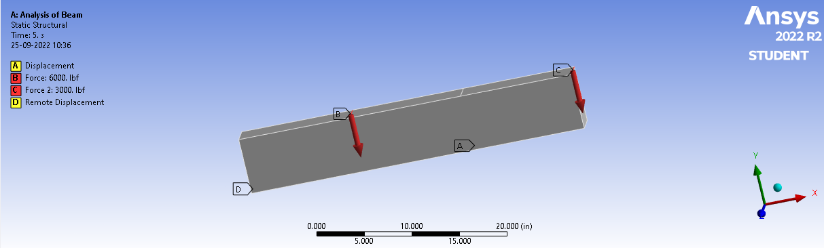
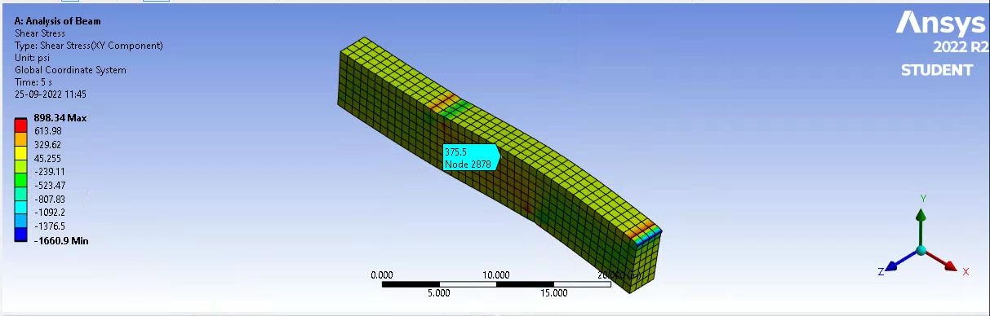
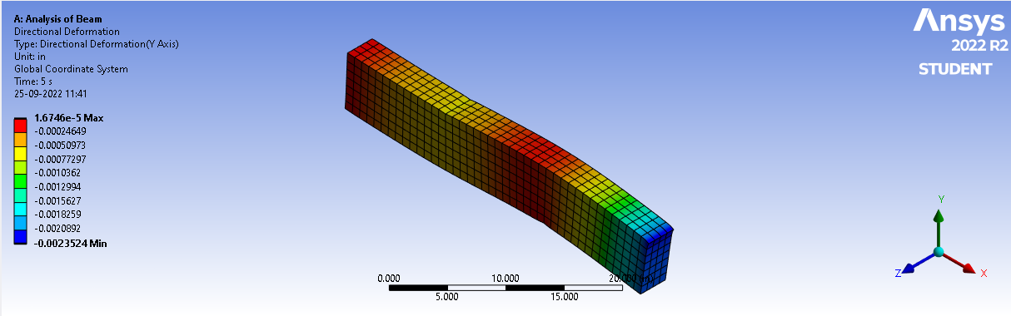
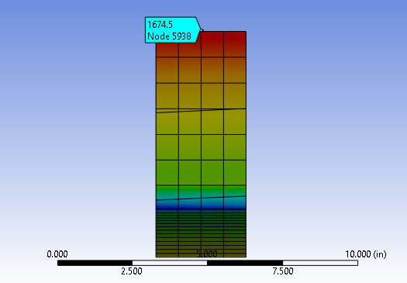
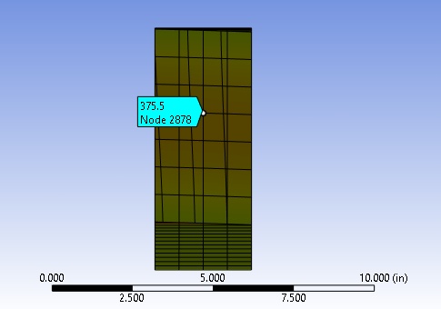
FEA Simulation
FBD of Beam
Shear Stress in Beam
Directional Deformation
Normal Stress at Section
Shear Stress at Section

Slide 9
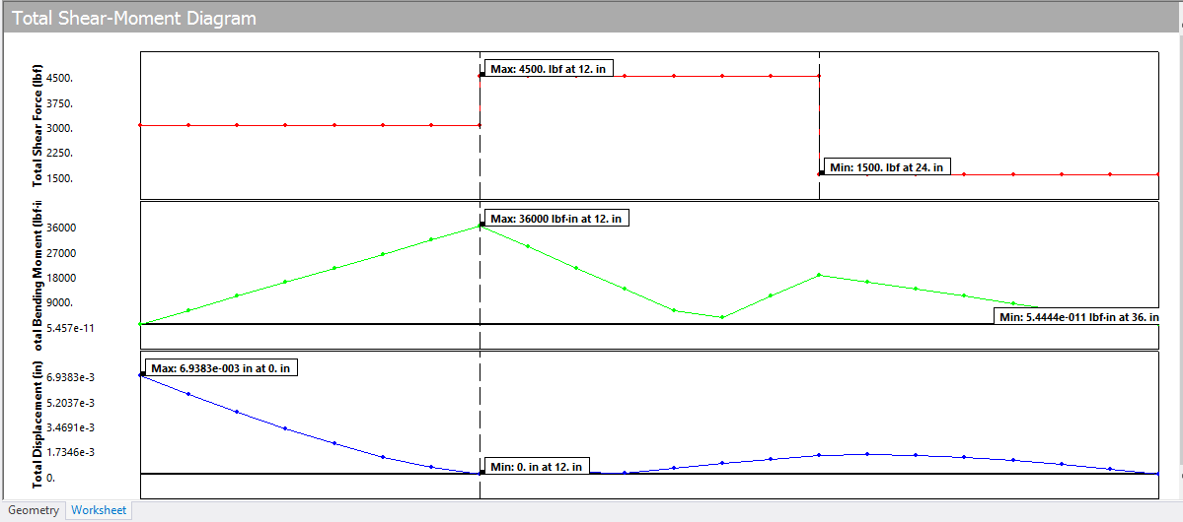
FEA Results-Shear Force
x=36 in
x=24 in
x=12 in
x=0 in
Maximum shear force of 4500 lbf acts between sections x=12 in and x=24 in.
Minimum shear force of 1500 lbf acts between sections x=0 in and x=12 in.
Sections between x=24 in and x=36 in experience shear force of 3000 lbf.

Slide 10
FEA Results-Bending Moment
Bending Moment in lbf-in
x=36 in
x=24 in
x=12 in
x=0 in
Maximum bending moment of 36000 lbf-in occurs at x=12 inches
Minimum bending moment (O lbf-in) occurs at x=36 inches
At x=18 inches, bending moment obtained is approximately 18000 lbf-in

Slide 11
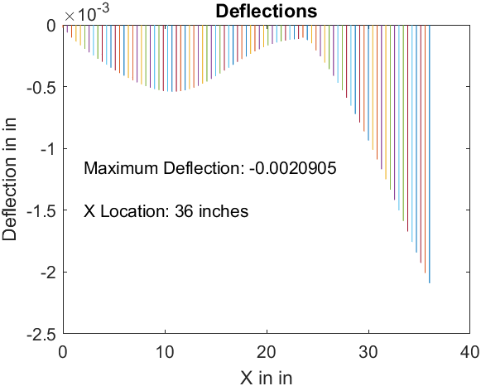
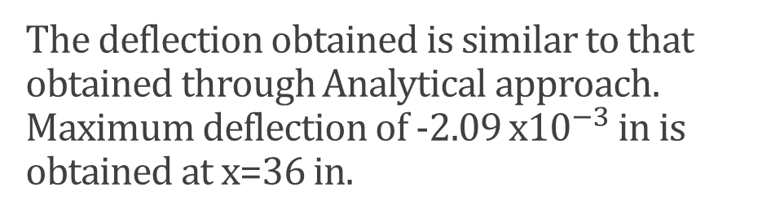
FEA Results-Deflection
The deflection obtained is similar to that obtained through Analytical approach. Maximum deflection of -2.09 x${10}^{−3}$ in is obtained at x=36 in.
x= 0 in
x= 12 in
x= 24 in
x= 36 in

Slide 12
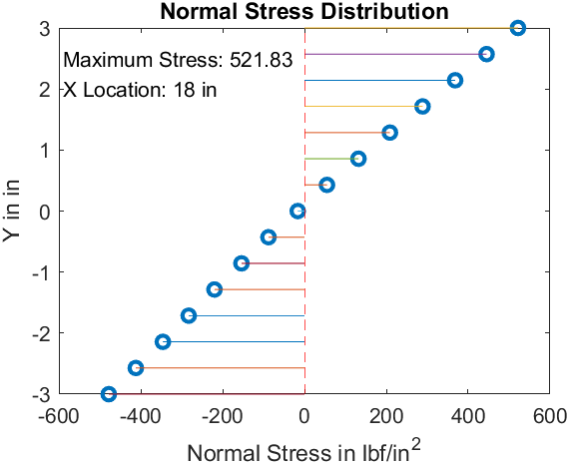
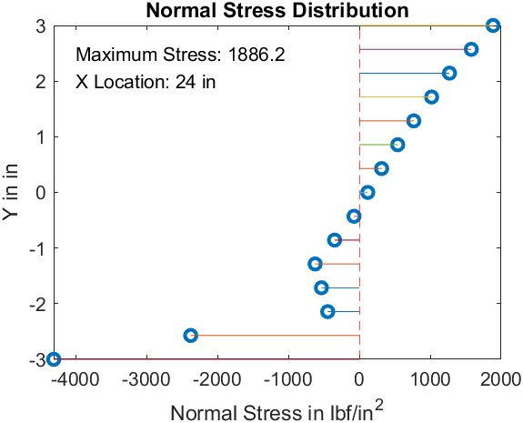
FEA Results-Normal Stress
The normal stress (bending stress) is the maximum at the ends of the beam while it becomes zero at the centroid of cross section. Due to the presence of a roller joint at x=12 in, the profile shows slight variations.
y = 3 in
6 in
y = 0 in
y = -3 in
At x=18 in
3 in
At x=24 in

Slide 13
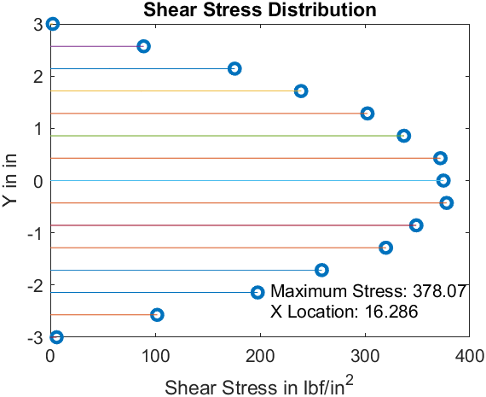
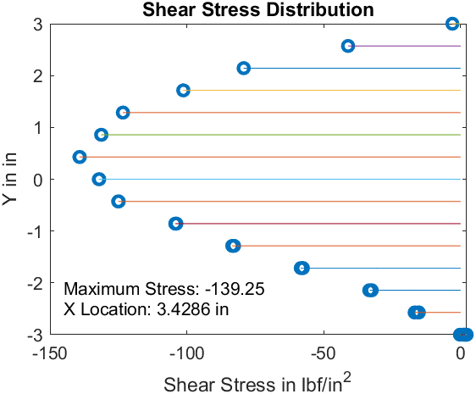
FEA Results-Shear Stress
The longitudinal shear stress profile exhibits a parabolic curve, maximum at the centroid and which becomes zero at the free surface. The transverse shear stress which equals this longitudinal shear stress also follows the same curve.
y = 3 in
6 in
y = 0 in
y = - 3 in
At x=16.286 in
3 in
At x=3.4286 in

Slide 14
THANK YOU!
Refer to this link for all models and calculations.
Refer to this link for analytical calculations.

