Slide 1

MedFriend
A privacy-first care-navigation agent
It does the paperwork of a medical procedure — and treats every document as untrusted.
Concierge Agents · Kaggle AI Agents Capstone
github.com/Binary-yev/MedFriend
Notes:
MedFriend is a privacy-first care-navigation agent. It does the administrative work of getting through a medical procedure — reading denials, appealing them, scheduling, checking email — while treating every document as untrusted and gating every real action behind the patient's approval. Built for the Concierge Agents track.

Slide 2







A major procedure is a second job
The surgery is only half of it. The rest is administrative — and it lands on the person least equipped to handle it: someone unwell, stressed, and not fluent in benefits jargon.
Get prior authorization
Decode denial letters written in insurance-speak
Find an in-network surgeon
Book the appointment
Appeal a wrongful denial — before a deadline
Escalate a complaint about a rehab facility
Chatbots explain these steps. The value is in doing them — safely.
Notes:
When someone is scheduled for a major procedure, the operation is only half the job. The other half is paperwork — prior auth, denial letters, finding an in-network surgeon, booking, appealing before a deadline — and it falls on someone who's unwell and overwhelmed. Existing chatbots can explain these steps. The real value is actually doing them — and doing them safely, because this involves real personal data and real actions.

Slide 3

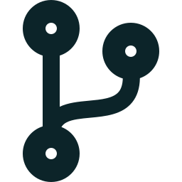
Why an agent — not a chatbot or a script
Messy, adversarial input
The next step depends on live state
The actions are real
A document arrives as text, a PDF, a photo, or a voicemail. The agent has to read it, classify it, and decide whether it can be trusted — a judgment, not a regex.
“Do I need prior auth?” is a lookup. “Has it been approved?” is a live decision. An appeal needs the evidence that satisfies the denial found first.
Sending email, placing phone calls, submitting appeals — that needs tool use, orchestration across sub-agents, and a human approval gate so nothing happens unilaterally.
Notes:
Why an agent and not a fixed script? Three reasons. One — the input is messy and adversarial: it could be pasted text, a scan, a photo, or a voicemail, and the agent has to judge whether it can even be trusted. Two — the next step depends on live state: some things are lookups, some are live decisions, and an appeal has to find the right supporting evidence first. Three — the actions are real: sending email, placing calls, submitting appeals, which needs orchestration and a human in the loop.

Slide 4
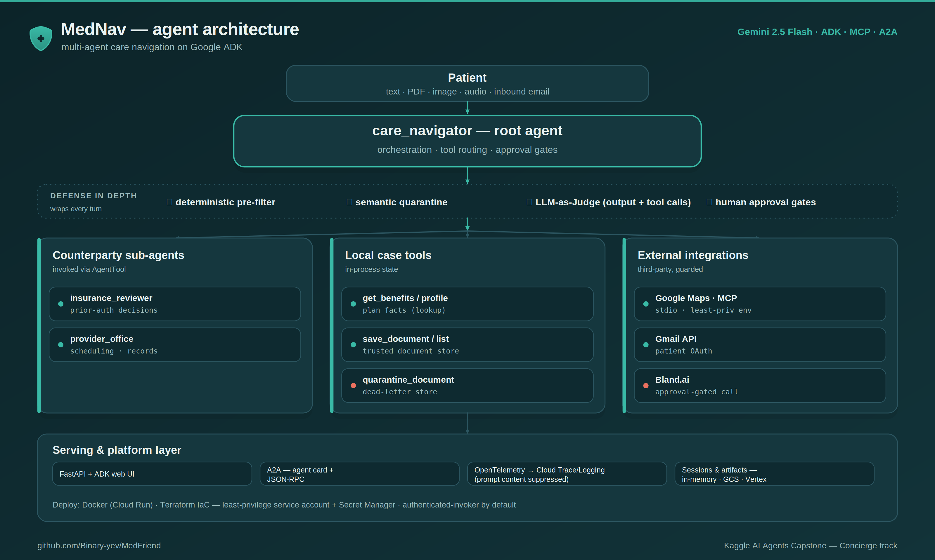
Architecture — multi-agent on Google ADK
How it flows
A root agent (Gemini 2.5 Flash) owns the conversation and routes each request.
Two sub-agents via AgentTool, plus local case tools and three external integrations.
Four security checkpoints wrap every turn.
Served behind FastAPI + A2A; deployable via Docker + Terraform.
Notes:
Architecturally it's a multi-agent system on Google's ADK. A single root agent owns the conversation and orchestrates two counterparty sub-agents — an insurance reviewer and a provider's office — using ADK's agent-as-a-tool pattern, so the root stays in control and everything shows up in one trace. It calls a real Google Maps MCP server, the Gmail API with the patient's own OAuth, and Bland.ai for approval-gated calls. Every turn is wrapped by four security checkpoints, and it's served behind FastAPI with A2A endpoints.

Slide 5





Security by design — four checkpoints
Every document — pasted, PDF, image, voicemail, or email — is untrusted.
1
2
3
4
Deterministic pre-filter
Semantic quarantine
LLM-as-a-Judge
Human approval gates
A regex/keyword screen that runs in code, before the model. Redacts PII and flags known injection strings.
The model classifies CLEAN vs TAMPERED; tampered content goes to a dead-letter store, invisible to all later reasoning.
A separate safety agent inspects the agent's output and every tool call, blocking unsafe ones before they take effect.
Every real action — email, phone call, appeal, booking — stops and waits for the patient's explicit “yes.”
Notes:
Security is the heart of this. Four independent checkpoints. One — a deterministic pre-filter runs in code before the model even sees the text; it redacts PII and flags known injection strings. Two — the model classifies each document clean or tampered, and tampered content goes to a quarantine store that's invisible to everything downstream. Three — a separate LLM-as-a-Judge inspects the agent's output and every tool call. Four — human approval gates on every real action. Even a missed injection can't cause an autonomous action.

Slide 6

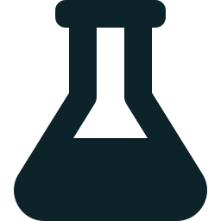

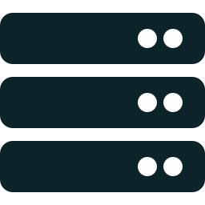
The build
Stack
Iteration loop
Google ADK + agents-cli, Gemini 2.5 Flash.
Built with an Antigravity / Gemini-CLI workflow (GEMINI.md).
ADK eval: a behavioral dataset, a second LLM grading response quality, and a deterministic tool-trajectory check — e.g. that the injection case actually fires quarantine_document.
Key decisions
Hardening & deploy
AgentTool, not sub_agents — root stays in control and shows in the trace.
Gmail via API + patient OAuth. Stateless counterparties make booking deterministic.
Hash-locked deps (uv.lock).
Docker (Cloud Run) + Terraform: least-priv SA, Secret Manager, auth-invoker default.
Bandit / CodeQL / Dependency-Review CI + STRIDE threat model.
Notes:
I built it with ADK and the agents-cli, developed with an Antigravity-assisted workflow configured in GEMINI.md. The iteration loop was ADK's eval harness — a behavioral dataset, a second LLM grading quality, and a deterministic trajectory check that verifies the injected denial actually gets quarantined. A few key decisions: AgentTool instead of sub_agents so the root stays in control; Gmail via the API with the patient's own OAuth; and stateless counterparties that make the booking negotiation deterministic. It's hardened with hash-locked dependencies, Terraform with least-privilege and Secret Manager, security scanning in CI, and a STRIDE threat model.

