Slide 1
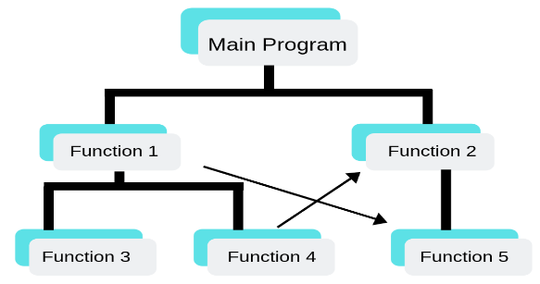
C Programming Language
C is a structured programming language.
It is considered a high-level language because it allows the programmer to concentrate on the problem at hand and not worry about the machine that the program will be using.
C is case-sensitive

Slide 2
Tokens in C
Keywords
  These are reserved words of the C language. For example int, float, double, char, if, else, for, while etc.
Identifiers
  An Identifier is a sequence of letters and digits, but must start with a letter. Underscore ( _ ) is treated as a letter. Identifiers are case sensitive. Identifiers are used to name variables, functions etc.
  Valid: Root, _getchar, __sin, x1, x2, x3, x_1, If
  Invalid: 324, short, price$, My Name

Slide 3
Tokens in C
String Literals
  A sequence of characters enclosed in double quotes as “…”. For example “13” is a string literal and not number 13. ‘a’ and “a” are different.
Operators
  Arithmetic operators like +, -, *, / ,% etc.
  Logical operators like ||, &&, ! etc. and so on.
White Spaces
  Spaces, new lines, tabs, comments ( A sequence of characters enclosed in /* and */ ) etc. These are used to separate the adjacent identifiers, keywords and constants.

Slide 4
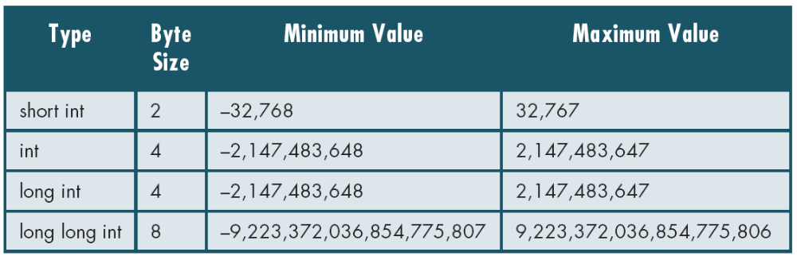
Basic Data Types
Integer Types
  Integers are stored in various sizes. They can be signed or unsigned.
Notes:
C is strongly typed. The variables and constants etc have a certain data types. All variables could have been double type, but then multiplying double numbers is very expensive. So the various data types have been provided for the reason of efficiency and ease of handling.

Slide 5
Basic Data Types
Integer Types
  short int Stored as 16 bits. Unsigned 0 to 65535.
  Signed -32768 to 32767.
  int Same as either short or long int.
  long int Stored as 32 bits. Unsigned 0 to 4294967295.
  Signed -2147483648 to 2147483647
Notes:
C guarantees only following:
Sizeof(short) <= sizeof(int) <= sizeof(long).

Slide 6
Basic Data Types
Character Types
  char Stored as 8 bits. Unsigned 0 to 255.
  Signed -128 to 127.

Slide 7
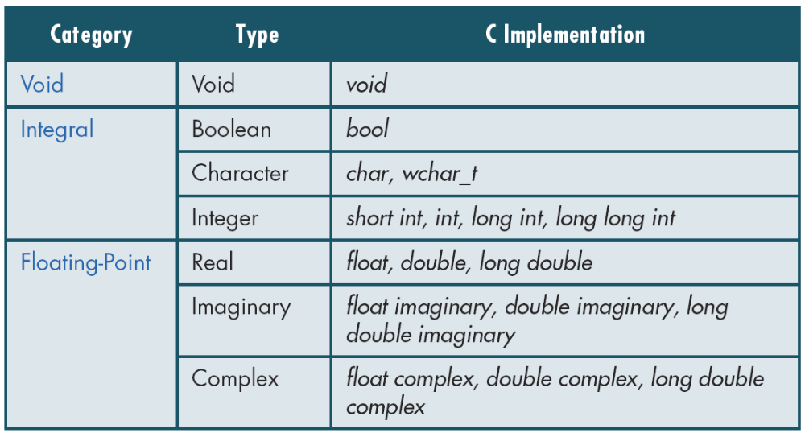
Data Types

Slide 8
Constants
Character and string constants
  ‘c’ , a single character in single quotes are stored as char.
  Some special character are represented as two characters in single quotes.
  ‘\n’ = newline, ‘\t’= tab, ‘\\’ = backlash, ‘\”’ = double quotes.
  Char constants also can be written in terms of their ASCII code.
  A sequence of characters enclosed in double quotes is called a string constant or string literal. For example
  “Charu”
  “A”
  “3/9”
  “x = 5”

Slide 9
Variables
Naming a Variable
  Must be a valid identifier.
  Must not be a keyword
  Names are case sensitive.
  Variables are identified by only first 32 characters.
  Naming Styles: Uppercase style and Underscore style
  lowerLimit lower_limit
  incomeTax income_tax
An identifier must start with a letter or underscore; it may not have a space or a hyphen.

Slide 10
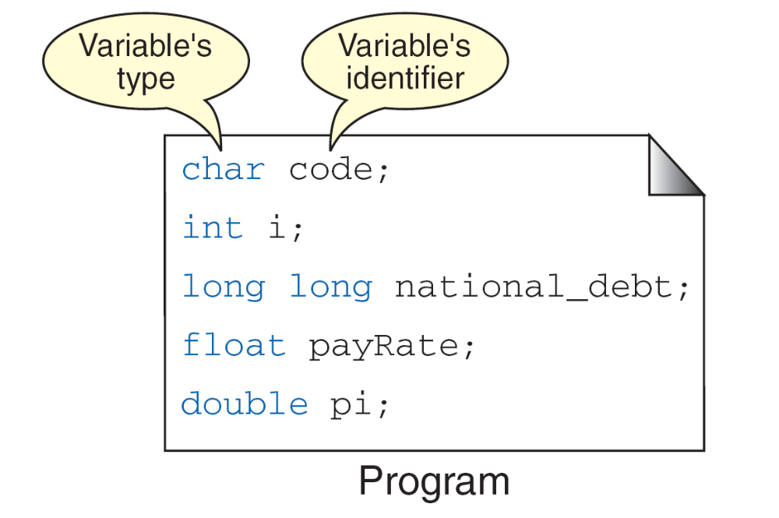
Declarations
Declaring a Variable

Slide 11
Declarations
Declaring a Variable
  Each variable used must be declared.
  A form of a declaration statement is
  data-type var1, var2,…;
  Declaration announces the data type of a variable and allocates appropriate memory location. No initial value (like 0 for integers) should be assumed.
  It is possible to assign an initial value to a variable in the declaration itself.
  data-type var = expression;
  Examples
  int sum = 0;
  char newLine = ‘\n’;

Slide 12
Global and Local Variables
Global Variables
  These variables are declared outside all functions.
  Life time of a global variable is the entire execution period of the program.
  Can be accessed by any function defined below the declaration, in a file.
/* Compute Area and Perimeter of a circle */
#include <stdio.h>
float pi = 3.14159; /* Global */
main() {
float rad; /* Local */
printf( “Enter the radius “ );
scanf(“%f” , &rad);
if ( rad > 0.0 ) {
float area = pi * rad * rad;
float peri = 2 * pi * rad;
printf( “Area = %f\n” , area );
printf( “Peri = %f\n” , peri );
}
else
printf( “Negative radius\n”);
printf( “Area = %f\n” , area );
}

Slide 13
Global and Local Variables
Local Variables
  These variables are declared inside some functions.
  Life time of a local variable is the entire execution period of the function in which it is defined.
  Cannot be accessed by any other function.
/* Compute Area and Perimeter of a circle */
#include <stdio.h>
float pi = 3.14159; /* Global */
main() {
float rad; /* Local */
printf( “Enter the radius “ );
scanf(“%f” , &rad);
if ( rad > 0.0 ) {
float area = pi * rad * rad;
float peri = 2 * pi * rad;
printf( “Area = %f\n” , area );
printf( “Peri = %f\n” , peri );
}
else
printf( “Negative radius\n”);
printf( “Area = %f\n” , area );
}

Slide 14
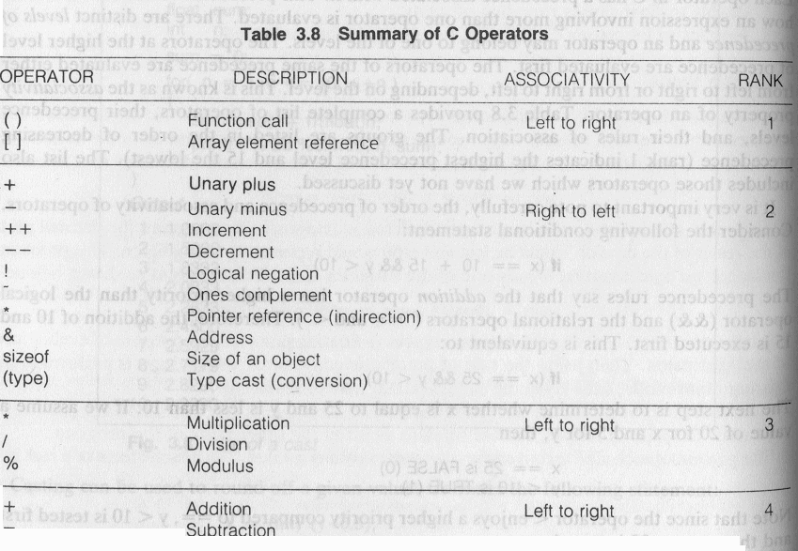
Precedence and Order of evaluation

Slide 15
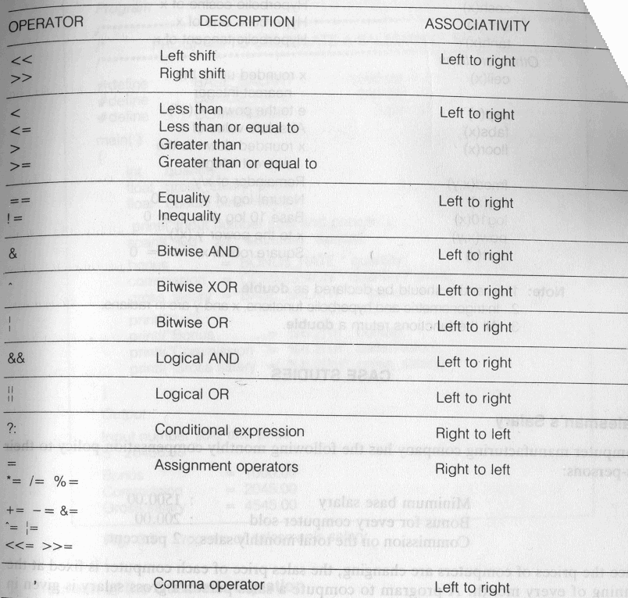
Precedence and Order of evaluation

Slide 16
Operators
Arithmetic Operators
  +, - , *, / and the modulus operator %.
  + and – have the same precedence and associate left to right.
  3 – 5 + 7 = ( 3 – 5 ) + 7 ≠ 3 – ( 5 + 7 )
  3 + 7 – 5 + 2 = ( ( 3 + 7 ) – 5 ) + 2
  *, /, % have the same precedence and associate left to right.
  The +, - group has lower precedence than the *, / % group.
  3 – 5 * 7 / 8 + 6 / 2
  3 – 35 / 8 + 6 / 2
  3 – 4.375 + 6 / 2
  3 – 4.375 + 3
  -1.375 + 3
  1.625

Slide 17
Operators
Arithmetic Operators
  % is a modulus operator. x % y results in the remainder when x is divided by y and is zero when x is divisible by y.
  Cannot be applied to float or double variables.
  Example
  if ( num % 2 == 0 )
    printf(“%d is an even number\n”, num)’;
  else
    printf(“%d is an odd number\n”, num);

Slide 18
Type Conversions
  The operands of a binary operator must have a the same type and the result is also of the same type.
  Integer division:
  c = (9 / 5)*(f - 32)
  The operands of the division are both int and hence the result also would be int. For correct results, one may write
  c = (9.0 / 5.0)*(f - 32)
  In case the two operands of a binary operator are different, but compatible, then they are converted to the same type by the compiler. The mechanism (set of rules) is called Automatic Type Casting.
  c = (9.0 / 5)*(f - 32)
  It is possible to force a conversion of an operand. This is called Explicit Type casting.
  c = ((float) 9 / 5)*(f - 32)

Slide 19
Automatic Type Casting
  char and short operands are converted to int
  Lower data types are converted to the higher data types and result is of higher type.
  The conversions between unsigned and signed types may not yield intuitive results.
  Example
  float f; double d; long l;
  int i; short s;
  d + f f will be converted to double
  i / s s will be converted to int
  l / i i is converted to long; long result
Hierarchy
Double
float
long
Int
Short and char

Slide 20
Explicit Type Casting
  The general form of a type casting operator is
  (type-name) expression
  It is generally a good practice to use explicit casts than to rely on automatic type conversions.
  Example
  C = (float)9 / 5 * ( f – 32 )
  float to int conversion causes truncation of fractional part
  double to float conversion causes rounding of digits
  long int to int causes dropping of the higher order bits.

Slide 21
Operators
Relational Operators
  <, <=, > >=, ==, != are the relational operators. The expression
  operand1 relational-operator operand2
  takes a value of 1(int) if the relationship is true and 0(int) if relationship is false.
  Example
  int a = 25, b = 30, c, d;
  c = a < b;
  d = a > b;
  value of c will be 1 and that of d will be 0.

Slide 22
Operators
Logical Operators
  &&, || and ! are the three logical operators.
  expr1 && expr2 has a value 1 if expr1 and expr2 both are nonzero.
  expr1 || expr2 has a value 1 if at least one of expr1 and expr2 is nonzero.
  !expr1 has a value 1 if expr1 is zero else 0.
  Example
  if ( marks >= 40 && attendance >= 75 ) grade = ‘P’
  If ( marks < 40 || attendance < 75 ) grade = ‘N’

Slide 23
Operators
Assignment operators
  The general form of an assignment operator is
  v op = exp
  Where v is a variable and op is a binary arithmetic operator. This statement is equivalent to
  v = v op (exp)
  a = a + b can be written as a += b
  a = a * b can be written as a *= b
  a = a / b can be written as a /= b
  a = a - b can be written as a -= b

Slide 24
Operators
Increment and Decrement Operators
  The operators ++ and –- are called increment and decrement operators.
  a++ and ++a are equivalent to a += 1.
  a-- and --a are equivalent to a -= 1.
  ++a op b is equivalent to a ++; a op b;
  a++ op b is equivalent to a op b; a++;
  Example
  Let b = 10 then
  (++b)+b+ b = ?
  b+(++b)+ b = ?
  b+b+(++b) = ?
  b+b*(++b) = ?

Slide 25
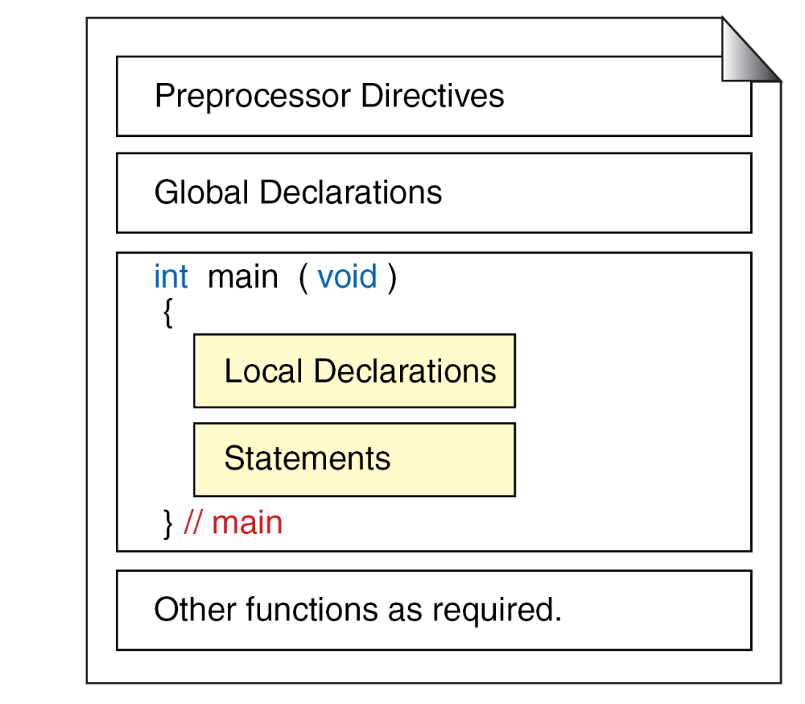
First C Program

Slide 26
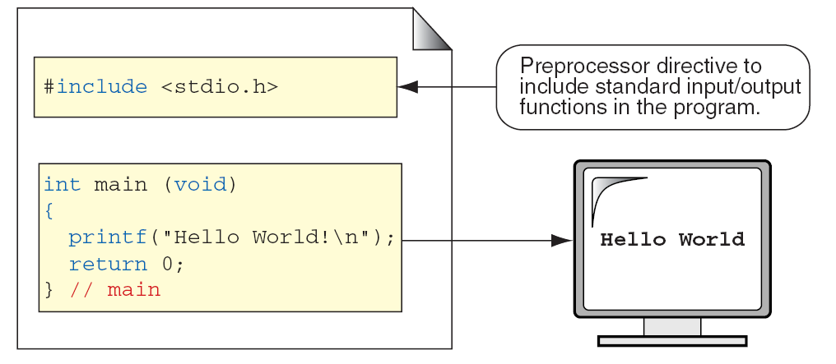
First C Program

Slide 27
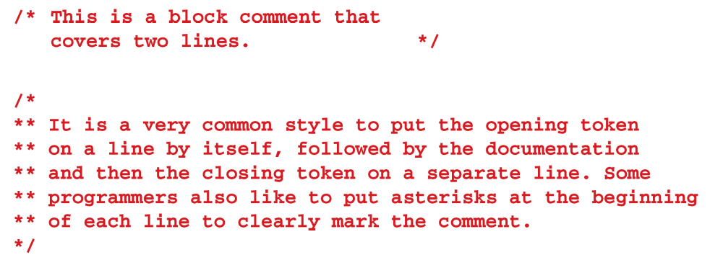
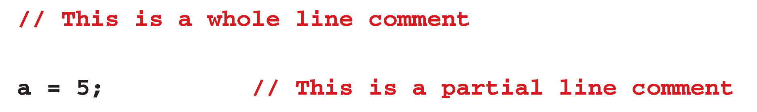
Comments

